Slide 1
The Reading Room
BOOK RECOMMENDER
Gabriela Cascione · Hina Haq
IronHack Data Analytics · June 2026

Slide 2
The Problem
Too Many Choices
Poor Recommendations
Wasted Time
Millions of books available — readers are overwhelmed and don't know where to start.
Generic suggestions don't reflect individual taste, mood, or reading history.
Readers spend more time searching than reading — and often give up on bad picks.

Slide 3
Our Solution
A personalised book recommender app that uses Machine Learning to suggest books based on genre, description similarity, and reading preferences.
2,004 books
K-Means (k=6)
TF-IDF + PCA
Streamlit App
1,004 GoodReads
1,000 Open Library
clustering algorithm
NLP & dimensionality
reduction
deployed recommender

Slide 4
The Data
2,004
1,004
1,000
14
Total Books
in the dataset
from GoodReads
web scraping
from Open Library
API
Features
per Book
After several iterations across different sources and scraping approaches, we settled on a combined dataset that gave us the richest and most complete data.
Fields collected per book:
Title · Author · Year Published · Genre · Description
Average Rating · Number of Ratings · Pages · ISBN
Cover Image URL · Language · Publisher · Series · Edition

Slide 5
Data Cleaning
Multi-language titles, authors & descriptions
Low-resolution cover images
Translated content from Arabic, Japanese, Greek, Persian and other scripts to English.
Detected small GoodReads thumbnails and replaced with larger, higher-quality versions.
Messy descriptions
Duplicate & noisy author data
Removed HTML tags, markdown links, line breaks, and irrelevant publisher metadata.
Cleaned repeated names and publisher info incorrectly listed in the author field.
Year & pages formatting
Genre standardisation
Extracted 4-digit years from free-text strings; standardised page counts to numeric.
Mapped 100s of genre variants to 66 clean categories using a custom mapping dictionary.

Slide 6
The ML Pipeline
1
2
3
4
5
TF-IDF
PCA
Genres
Numerics
K-Means
Book descriptions
5,000 features
Reduce to
50 components
MultiLabelBinarizer
66 categories
Rating, Pages
MinMaxScaler
k=6 clusters
Final model
Why k=6?
Silhouette Score: k=4 scored highest (0.179), k=6 scored second (0.166). We chose k=6 for richer, more diverse cluster themes — better for a book recommender experience.

Slide 7
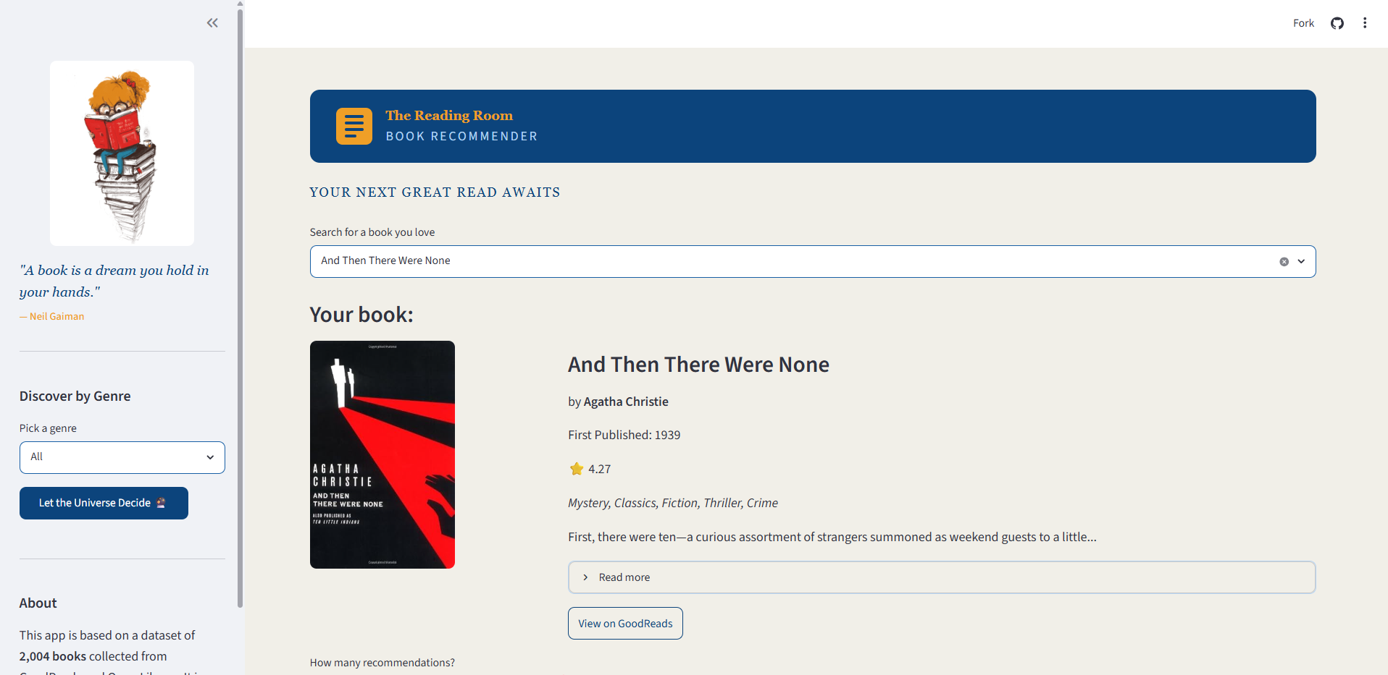
The App
Key Features
Smart Book Search: search from 2,004 books across GoodReads and Open Library
Discover by Genre: random book picker filtered by genre
[ INSERT APP SCREENSHOT HERE ]
Adjustable Results: slider to choose from 1 to 9 recommendations
Book Details: cover image, rating, year published, genres and expandable description
Direct Links: one click to view any book on GoodReads or Google Books
The Reading Room

Slide 8
Results & Challenges
What Worked
Challenges
• TF-IDF + PCA captured description similarity well
• Skoob blocked scraping — Next.js + Cloudflare 403
• Genre mapping standardised 100s of variants effectively
• Skeelo category pages rendered with JavaScript only
• K-Means k=6 produced diverse, meaningful clusters
• Barnes & Noble, LibraryThing, Bookshop.org also blocked
• GoodReads + Open Library data complemented each other
• Many books had non-English titles & author names
• Streamlit app is intuitive and fast
• Low-resolution cover images needed systematic fixing
• Genre data was highly inconsistent across sources

Slide 9
Next Steps
01
Larger Dataset
02
Recommendation Feedback
Scale to 10,000+ books for more diverse recommendations across genres and languages.
Allow users to rate whether they would read a suggestion — use feedback to improve future recommendations.
03
Agglomerative Clustering
04
Richer NLP
Test hierarchical clustering for more nuanced book groupings and compare against K-Means.
Incorporate word embeddings (Word2Vec, BERT) for deeper semantic similarity beyond TF-IDF.

Slide 10
Thank You!
Gabriela Cascione · Hina Haq
IronHack Berlin · June 2026
The Reading Room · Book Recommender

