Slide 1
M A S T E R O F S C I E N C E I N D A T A S C I E N C E
Surgical Process Discovery for
Scheduling Optimisation
Structural and Temporal Analysis of Perioperative Workflow
Hina Farheen
Student ID: 29402
Supervised by
Dr. Tariq Mahmood
Institute of Business Administration (IBA), Karachi | Fall 2025
Notes:
SCRIPT (0:00–0:30):
"Good morning, respected examiners, Dr. Mahmood, faculty members, and colleagues. My name is Hina Farheen, and today I will present my Master's thesis on Surgical Process Discovery for Scheduling Optimisation. This work applies process mining to real perioperative data from the Aga Khan University Hospital in Karachi, with the goal of improving surgical scheduling through data-driven workflow understanding. The presentation will take approximately 20 to 22 minutes, and I welcome your questions at the end."
TIME: 30 seconds.
POTENTIAL QUESTIONS:
Q: "Why this specific hospital?"
A: "AKUH is a major tertiary care institution in Karachi with digitized perioperative records spanning multiple years. Dr. Asad Latif, an anesthesiologist there, provided the dataset and clinical guidance from the earliest stages of this research."

Slide 2
📋 Agenda
1. MOTIVATION & CONTEXT
2. RESEARCH GAPS & QUESTIONS
The scheduling problem in surgical departments
Three critical gaps in current practice
3. PROPOSED METHODOLOGY
4. EXPERIMENTAL RESULTS
Bayesian Heuristic Miner — core contribution
Structural & temporal findings from 162K cases
5. RECOMMENDATIONS & IMPACT
6. CONCLUSIONS & FUTURE WORK
16 actionable scheduling improvements
Contributions, limitations, and next steps
Target: 20–25 minutes | Focus: Methodological novelty + operational impact
Notes:
SCRIPT (0:30–1:00):
"I'll begin by framing the operational problem — why surgical scheduling is so difficult and costly. Then the three research gaps this thesis addresses and our four research questions. I'll briefly position the work in the literature before diving into the core methodological contribution: the Bayesian Heuristic Miner. The results section covers both structural discovery and temporal analysis from 162,000 real surgical cases. Finally: recommendations, contributions, limitations, and future work."
TIME: 30 seconds. Trace the six cards left-to-right, top-to-bottom with your hand.

Slide 3
🔴 The Scheduling Problem
Surgeon A — Overrun
Operating Rooms are the most expensive resource in any hospital. OR costs represent 16–20% of total hospital budgets yet scheduling relies on fixed, procedure-based time estimates.
For the same procedure, duration varies enormously depending on who performs it: one surgeon 20 minutes, another 75 minutes. Same procedure, same hospital.
Planned 45 min
Overrun 30 min
Delays cascade through all subsequent cases
Surgeon B — Early Finish
Done 20 min
Idle 25 min
The Cost:
Every idle OR-minute = lost capacity. Every overrun = cascading delays. At high volume, small per-case inefficiencies compound into substantial lost theatre capacity.
OR sits empty — wasted capacity
Same 45-minute slot, two failure modes — the system cannot see surgeon-level variability
Notes:
SCRIPT (1:00–2:00):
"Let me make this concrete. Two surgeons at the same hospital, both scheduled for what the system treats as the same 45-minute procedure. Surgeon A consistently takes 75 minutes — every case pushes the whole day back. Surgeon B finishes in 20 — but the next patient isn't ready, so the OR sits empty for 25 minutes. Both situations waste the same scarce resource. This isn't hypothetical; it's daily reality in most tertiary hospitals, including AKUH where our data comes from. The OR represents 16 to 20 percent of total hospital budget, yet scheduling relies on fixed estimates that ignore this variability."
EMPHASIS: Pause after "both situations waste the same scarce resource." Gesture at the two timeline bars.
POTENTIAL QUESTIONS:
Q: "Is this problem specific to AKUH or universal?"
A: "The literature confirms it's universal. Van Veen-Berkx et al. (2015) documented utilisation problems across sixteen Dutch hospitals. Celik et al. (2025) confirm it remains a top-cited challenge in digitized surgical departments. AKUH faces the same structural pressures, typically with less slack than higher-resource settings."
CAUTION: If you quote the 16–20% budget figure with an author name, double-check the citation first — in the thesis text it appears next to one of the swapped Schwendimann/Martinez-Millana citations (see Defense Preparation Guide, Part 2). Safest phrasing: state the number without attributing it to a specific author.

Slide 4
🔍 Three Critical Research Gaps
📊
🔀
⏱️
GAP 1: No Data-Derived Baseline
GAP 2: No Statistical Separation of Signal vs. Noise
GAP 3: No Quantified Delay Picture
Hospitals document intended workflows, but no analysis exists of what the HIS actually recorded across hundreds of thousands of cases. Claims about “the surgical process” are anecdotal, not evidence-based.
Surgical logs contain both genuine rare clinical exceptions AND data-entry noise. Frequency counts alone cannot distinguish them. Staff must either ignore all deviations or treat all equally.
Staff hold informal beliefs about delays, rarely tested against timestamped records. A 5-minute delay in 130,000 cases costs more than one 10-day outlier but without quantification, we cannot know.
This Thesis: Bayesian-calibrated discovery, applied at scale, connecting structural and temporal findings
Notes:
SCRIPT (2:00–3:00):
"Beneath the scheduling symptom, I identified three deeper gaps. First, no data-derived baseline of the real surgical process — hospitals have the WHO Surgical Safety Checklist on paper, but nobody has analyzed what the hospital information system actually recorded across 162,000 cases. Second, no principled way to separate meaningful rare events from noise. Some rare transitions are genuine clinical exceptions — an emergency case bypassing elective preoperative steps. Others are data-entry inconsistencies. A frequency count cannot tell the difference. Third, no quantified picture of where delays concentrate. A five-minute delay recurring in a high-volume transition carries far larger cumulative cost than a dramatic but rare multi-hour delay."
EMPHASIS: Slow down on Gap 2 — it is the core motivation. Use hand gestures to separate the three gaps. Build to the banner at the bottom.
TIME: 1 minute.

Slide 5
❓ Research Questions
Baseline Discovery
1
How can process mining discover a reliable baseline model of real-world surgical workflow both for the institution and for subgroups (specialty, location, surgeon)?
Statistical Calibration
2
Can a statistically calibrated dependency measure (vs. purely frequency-based) more reliably distinguish genuine rare clinical pathways from noise, improving clinical interpretability?
Temporal Analysis
3
Where and for whom do surgical process delays concentrate temporally, and how do these relate to the structural pathways discovered?
Actionable Recommendations
4
What concrete, operationally realistic scheduling and process-improvement recommendations can be derived jointly from structural and temporal analyses?
Notes:
SCRIPT (3:00–4:00):
"These gaps translate into four research questions. RQ1: can process mining discover a reliable baseline model — not just hospital-wide, but broken down by thirteen specialties, four theatre locations, and individual high-volume surgeons? RQ2 is the methodological heart of this thesis: can a statistically calibrated dependency measure give us justified confidence in rare transitions? RQ3 connects structure to timing — where do delays concentrate, and for whom? RQ4 keeps this from being purely academic: what can the hospital's scheduling and quality teams actually do with the findings?"
EMPHASIS: Physically point to RQ2 when calling it "the methodological heart." Brief pause after each RQ.
TIME: 1 minute.

Slide 6
📚 Literature Review: Key Positioning
Systematic review following PRISMA methodology across 5 databases (Google Scholar, PubMed, IEEE Xplore, ScienceDirect, arXiv).
PUBLICATION TREND
Selection Pipeline:
167 records → 46 duplicates removed → 121 screened → 83 excluded → 38 full-text assessed → 25 excluded → 13 studies + 3 supplementary = 16 final studies
12
15
19
20
22
23
24
25
Three distinct waves — peaks in 2015, 2019, 2025 (schematic)
Key finding: Despite the Heuristic Miner being widely used in healthcare, no prior study modifies its pairwise dependency measure with Bayesian calibration during discovery itself.
Existing Bayesian treatments either replace the formalism (Moreira, 2015) or apply after discovery (Janssenswillen et al. 2020). Gap independently confirmed by the Santos et al. (2025) tertiary review.
Venue Distribution
Technical: 4 | Hybrid: 3 | Domain-Specific: 3
Recurring field weaknesses (2025 reviews):
small datasets, inconsistent metrics, reliance on public logs — all three addressed here
Notes:
SCRIPT (4:00–5:00):
"The literature review followed PRISMA across five databases. From 167 initial records we synthesized 16 final studies. The field shows distinct publication waves — peaks in 2015, 2019, and 2025 — rather than smooth growth. Venues split roughly evenly between technical and clinical, reflecting the genuinely interdisciplinary nature of the area. The critical finding: despite the Heuristic Miner being one of the most widely used discovery algorithms in clinical settings, no prior published work modifies its pairwise dependency calculation to account for sample size during discovery itself. Existing Bayesian treatments either replace the entire formalism with Bayesian Networks — Moreira 2015 — or add a probabilistic layer after discovery is complete — Janssenswillen 2020. Neither intervenes at the point where edges are first selected. That is the gap this thesis addresses."
EMPHASIS: Slow down on the key finding — this is the novelty claim. Make "during" vs "after" discovery unmistakable.
TIME: 1 minute.
POTENTIAL QUESTIONS:
Q: "Only 16 studies — enough to claim a gap?"
A: "The search deliberately targeted a narrow intersection: process mining in perioperative settings, statistical treatments of discovery uncertainty, and algorithm comparisons. That intersection is small by design; the 16 studies cover it comprehensively. The gap claim is precise and falsifiable — I verified it against each study individually, and the Santos et al. 2025 tertiary review independently confirms it."
Q: "What if a relevant paper appeared after your review?"
A: "An inherent limitation of any review. The most recent studies cited — Aversano et al. and Santos et al., both 2025 — were published during the review window and confirm the gap remained open. Anything published since submission would be incorporated in future work."

Slide 7
⚙️ Three-Stage Methodology Pipeline
1
2
3
Baseline Discovery
Bayesian Discovery
Temporal Analysis
Classical Heuristic Miner
Frequency-based
~17 edges
→
Bayesian Heuristic Miner
Posterior-calibrated
~32 edges
→
Performance DFG
Duration-based
Mean + Median
Dominant pathways
Core + exceptions
Delay location
↓ Integrated Findings → Structural Confidence + Delay Location → Recommendations
Same statistical concern applied to two aspects of the same data: how much confidence does a transition deserve, and how much time does it cost?
Notes:
SCRIPT (5:00–6:00):
"The methodology is three connected stages, not three independent analyses. Stage 1 establishes a frequency-based baseline with the classical Heuristic Miner — the dominant pathway, about seventeen edges, near-linear from Admission to Discharge. Stage 2 is the core contribution: we replace the classical dependency measure with a Bayesian posterior mean, which surfaces nearly double the edges — critically, structured into confirmed core, high-confidence exceptions, and review-class edges. Stage 3 annotates the structural backbone with durations, using both mean and median to avoid the misleading conclusions either statistic alone produces. The connecting logic: the same statistical concern applied to two aspects of the same data — how much confidence does a transition deserve, and how much time does it cost?"
EMPHASIS: Trace the pipeline left to right with your hand. Pause on Stage 2: "this is where the innovation lives." Say "connected stages, not independent analyses" explicitly.
TIME: 1 minute.

Slide 8
⚠️ Why the Classical Measure Fails on Clinical Data
Transition observed
dep(A,B) = [f(A→B) − f(B→A)] / [f(A→B) + f(B→A) + 1]
Can assign these two transitions numerically similar scores if their frequency ratios happen to be similar.
The +1 correction is fixed and ad hoc. It does not scale with evidence.
14 times
vs. transition observed
160,000+ times
No confidence
No domain knowledge
Binary outcome
Treats every frequency ratio as equally reliable, regardless of sample size
Cannot encode that some clinical sequences are near-deterministic by design
Rare transitions are either kept as noise or discarded as noise. No middle ground.
In a 162,286-case log, activity pairs differ in evidence by four orders of magnitude — the measure is blind to this
Notes:
SCRIPT (6:00–7:00):
"Before showing the fix, let me show the failure precisely. The classical dependency measure is a frequency ratio. It treats every pair of counts as equally reliable regardless of absolute scale: a transition observed fourteen times and one observed a hundred and sixty thousand times can receive numerically similar scores if their ratios are similar. Statistically, we should place far less confidence in fourteen observations. The +1 in the denominator is a fixed, ad-hoc correction that does not scale with evidence. And the measure has no way to encode clinical knowledge — that some sequences, like Prep Start to Incision, are near-deterministic by design. In our log, activity pairs differ in evidence by four orders of magnitude, and the measure is completely blind to that."
EMPHASIS: This slide sets up the contribution — let the 14 vs 160,000 contrast breathe.
TIME: 1 minute. [This intuition slide was in Claude's original deck; Kimi compressed it into bullets — restored here because it makes the next slide land.]

Slide 9
⭐ The Bayesian Heuristic Miner: Core Contribution
CLASSICAL (Problematic)
BAYESIAN (Proposed)
dep(A,B) = [f(A→B) − f(B→A)] / [f(A→B) + f(B→A) + 1]
p(A→B) ~ Beta(α, β)
E[p(A→B)] = [f(A→B) + α] / [f(A→B) + f(B→A) + α + β]
dep_bayes = (E_AB − E_BA) / (E_AB + E_BA)
• Treats 5 observations same as 5,000
• No statistical confidence in rare pairs
• Fixed +1 ad hoc correction
• Sample-size-aware shrinkage • Domain-informed priors
• Converges to classical for large N • Closed form: O(N + k²)
Prior Configuration (Domain-Knowledge Informed)
Activity Pair Category | α | β | Rationale
Near-deterministic clinical sequence | 5.0 | 1.0 | Strong prior: core pathway (Prep → Incision)
Cleaning sub-process | 3.0 | 1.0 | Moderate prior: commonly followed
Rare but clinically important | 2.0 | 1.0 | Mild prior: genuine but infrequent (Induction → Patient Ready)
All other pairs | 1.0 | 1.0 | Neutral: uniform (uninformative)
Key Property: When f(A→B) ≫ α, the posterior converges to the classical formula. Conservative by design — dominant pathways unchanged, only low-frequency treatment improved.
Notes:
SCRIPT (7:00–9:00) — SLOW DOWN, THIS IS THE TECHNICAL CORE:
"Our solution treats the true transition probability as an unknown quantity to be estimated with appropriate uncertainty. We model the observed forward count as a Binomial outcome and place a Beta prior over the unknown probability. Because Beta is conjugate to Binomial, the posterior is available in closed form — no simulation needed — and the whole computation stays at O(N plus k-squared); with fifteen activities, k-squared is just 225 pairs, negligible. The posterior mean becomes the new dependency score.
The priors are domain-informed: alpha five, beta one for near-deterministic sequences like Prep Start to Incision; three-one for the cleaning sub-process; two-one for rare-but-important transitions; and neutral one-one for everything else. When the observed count is large relative to the prior, the posterior converges to the classical formula — so the modification is conservative by design. It leaves the dominant backbone essentially unchanged and only improves how rare transitions are handled."
EMPHASIS: Point to each formula component. Land hard on "conservative by design." Explain why closed form matters (tractability at scale — vs MCMC).
TIME: 2 minutes.
POTENTIAL QUESTIONS:
Q: "Why Beta-Binomial, not another Bayesian model?"
A: "Conjugacy gives a closed-form posterior — MCMC across 225 activity pairs on 162,000 cases would be computationally prohibitive, and Janssenswillen et al. only afford it post-hoc. The posterior mean has a natural interpretation as a weighted average of prior belief and data. And both the Beta and the resulting score are naturally bounded, matching the classical measure's range."
Q: "Aren't the priors circular — you assumed the pathway you found?"
A: "Two answers. First, magnitude: core-pathway counts are in the tens of thousands to hundreds of thousands, so an alpha of five is numerically negligible there — the data completely dominates. Second, the interesting findings — the five exception patterns — emerged on transitions carrying NEUTRAL one-one priors. The priors did not put them there."
Q: "How sensitive are results to the prior values?"
A: HONEST ANSWER — do not claim a formal sensitivity analysis (none was run): "I did not run a formal sensitivity analysis, and I list that as a limitation with prior elicitation as future work. But the convergence property bounds the risk analytically: for any pair with substantial counts the prior contribution vanishes, and the review-class edges are explicitly flagged for clinical validation rather than asserted — so prior misspecification cannot silently create false core findings."

Slide 10
🧪 Experimental Design: Two Complementary Paths
📊 Depth-First Path
🔍 Breadth-First Path
Scope: Full dataset (162,286 cases)
Purpose: Directly answers RQ1–RQ3
1. Baseline Heuristic Miner
2. Bayesian Heuristic Miner
3. Performance DFG (Mean + Median)
Output: Institution-level structural model + delay map
Scope: 22 granular re-runs across subgroups
Purpose: Tests generalizability, supports RQ4
• 13 surgical specialties
• 4 theatre locations (Main OR, SDC, Endoscopy, ObGyn)
• 5 highest-volume surgeons
Output: Same pipeline, same parameters per subgroup → structural stability + temporal variation
Both paths converge on → Results → Recommendations
Notes:
SCRIPT (9:00–10:00):
"Two complementary paths. The depth-first path applies the full three-stage pipeline to all 162,286 cases — directly answering RQ1 through RQ3 at institution level. The breadth-first path repeats the identical pipeline across twenty-two subgroup re-runs: thirteen specialties, four theatre locations, and the five highest-volume surgeons — testing whether findings generalize beyond the aggregate and feeding RQ4. Both paths use identical tools and parameters, ensuring comparability, and converge on the results and recommendations."
TIME: 1 minute.
POTENTIAL QUESTIONS:
Q: "Why thresholds θ_dep = 0.5 and θ_freq = 10?"
A: "These are standard values in the Heuristic Miner literature, and 0.5 is also the pm4py library default — so the baseline is evaluated on its own home turf, not handicapped. Importantly, both models use the SAME thresholds, so the comparison isolates the effect of the dependency measure itself." (Do NOT claim a threshold sensitivity analysis was run — it wasn't; if pressed, acknowledge it as a reasonable robustness check for future work.)
Q: "Why no cross-validation?"
A: "Process discovery is unsupervised — there is no ground-truth model to hold out. The standard evaluation is to measure the discovered model against the log on fitness, precision, generalization, and simplicity, which is what we do."
Q: "Aren't the subgroup results overfitting?"
A: "Two safeguards: identical parameters across all 22 re-runs, and the observed result is stability — even the busiest single surgeon's model is nearly identical to the institution-wide backbone. Overfitting would show as divergent structures and collapsing metrics; we see neither."

Slide 11
📁 Dataset: Aga Khan University Hospital (AKUH)
Data Sources (5 systems)
• CCMS — Medical record numbers
• ADT — Admission records
• HIMS — Diagnosis & procedure coding
• PHA — Pharmacy • BB — Blood Bank
DATA CLEANING FUNNEL
Raw extract
445,897
Require incision timestamp
335,314
Fix chronology errors
183,611
Post-discharge fix
183,145
15 Perioperative Activities
Admission → Patient Sent → Patient Arrived → Cleaning Start → Cleaning End → Patient In → Induction Start → Patient Ready → Prep Start → Incision → Dressing → Timeout → Recovery In → Recovery Out → Discharge
Date filter (≥2009)
183,040
Final dataset
162,286
Note: 64% case loss, predominantly from chronologically inconsistent timestamps (default values in source system). Largest single removal step (151,703 cases). Acknowledged openly as a limitation.
Final composition: 13 specialties | 4 locations | top-5 surgeons | multi-year span
Notes:
SCRIPT (10:00–11:00):
"The data comes from AKUH's combined clinical systems — CCMS, ADT, HIMS, pharmacy, and blood bank — with fifteen timestamped perioperative milestones from Admission to Discharge. The raw extract had 445,897 cases. Cleaning was rigorous: we require a recorded incision timestamp; remove chronologically impossible timestamps — the largest single step, over 150,000 cases, indicating default or malformed values in the source system rather than anything surgical; fix post-discharge timestamps; apply a date filter; and reconstruct missing specialty labels by keyword matching on procedure descriptions. Final dataset: 162,286 cases. I want to be transparent: that is a 64 percent loss, and it is a real limitation — the representativeness of retained versus excluded cases cannot be fully verified."
EMPHASIS: Do not rush the 64% admission — volunteering it earns credibility before examiners raise it.
TIME: 1 minute.
POTENTIAL QUESTIONS:
Q: "With two-thirds of the data discarded, how can we trust the findings?"
A: "The majority of losses were chronologically impossible timestamps — perioperative events recorded before admission — which points to system defaults, not clinical selection. 162,286 cases still makes this one of the larger perioperative process mining studies in the literature. The core pathway is stable across all 22 subgroup re-runs, and the key temporal finding is independently corroborated in unrelated Turkish hospital data. Still, replication with cleaner source data would strengthen confidence, and fixing timestamp capture is literally our first governance recommendation."

Slide 12
📈 Results: Structural Discovery
Baseline Heuristic Miner
Bayesian Heuristic Miner
17
• Near-linear dominant pathway
• Case loss <1% after Patient In
• No confidence indication for rare transitions
32
• 10 core pathway edges (dep = 1.000)
• 5 high-confidence exceptions
• 17 review-class edges flagged (14–23 cases each)
edges retained
edges (nearly 2×)
Five Clinically Interpretable Exception Patterns
1. Admission → Patient In (1,410 cases, 0.999)
2. Patient In → Incision (1,392 cases, 0.999)
3. Dressing → Recovery In — skip Timeout (929 cases, 0.998)
4. Timeout → Discharge — skip recovery (1,239 cases, 0.998)
5. ⚠️ Incision → Timeout (1,003 cases, 0.948) — Checklist sequencing deviation
~83% of cases follow the canonical pathway | ~17% distributed across structured, named exceptions
Notes:
SCRIPT (11:00–13:00):
"The baseline produced seventeen edges — a clean near-linear pathway. The Bayesian model produced thirty-two, nearly double. But the critical difference is not the count, it's the STRUCTURE. Ten edges carry full confidence of one-point-zero — the confirmed core. Five more are high-confidence exceptions we can name and interpret: cases skipping from Admission directly to Patient In; skipping the Timeout before Recovery In; and most significantly, over one thousand cases where incision was recorded BEFORE the WHO Surgical Safety Checklist sign-out Timeout. The baseline cannot surface this because it has no mechanism for confidence in rare transitions. The remaining seventeen edges are low-frequency — fourteen to twenty-three cases each — and are explicitly flagged for clinical review rather than asserted as fact. That is the direct answer to RQ2: the Bayesian measure doesn't just change numbers, it changes what we can SAY about the data."
EMPHASIS: Pause on "thirty-two, nearly double." Slow right down on exception 5 — it is the most clinically significant finding of the thesis. Repeat "flagged for review, not asserted as fact."
TIME: 2 minutes.
POTENTIAL QUESTIONS:
Q: "32 edges vs 17 — isn't that just more complexity?"
A: "More edges, but more structured. The baseline's 17 are undifferentiated — you cannot tell which are reliable. The Bayesian 32 are categorized: 10 confirmed core, 5 interpreted exceptions, 17 flagged for review. And the F-measure rising from 0.854 to 0.896 confirms the net effect is more accurate, not merely more complex."
Q: "How do you explain Incision-before-Timeout?"
A: "Three possibilities: documentation lag — performed correctly, logged late; genuine protocol deviation; or a system artifact in what the timestamp field captures. The log alone cannot distinguish them — which is exactly why the recommendation is a targeted chart review, not a conclusion of wrongdoing. The finding is robust enough to warrant investigation; that is the honest claim."

Slide 13
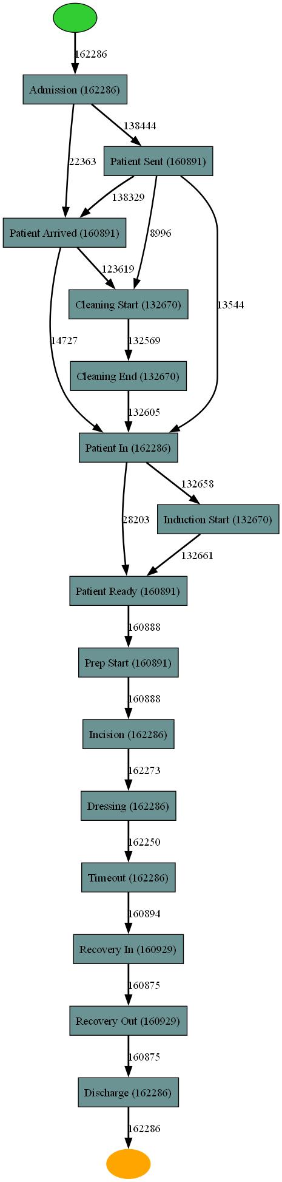
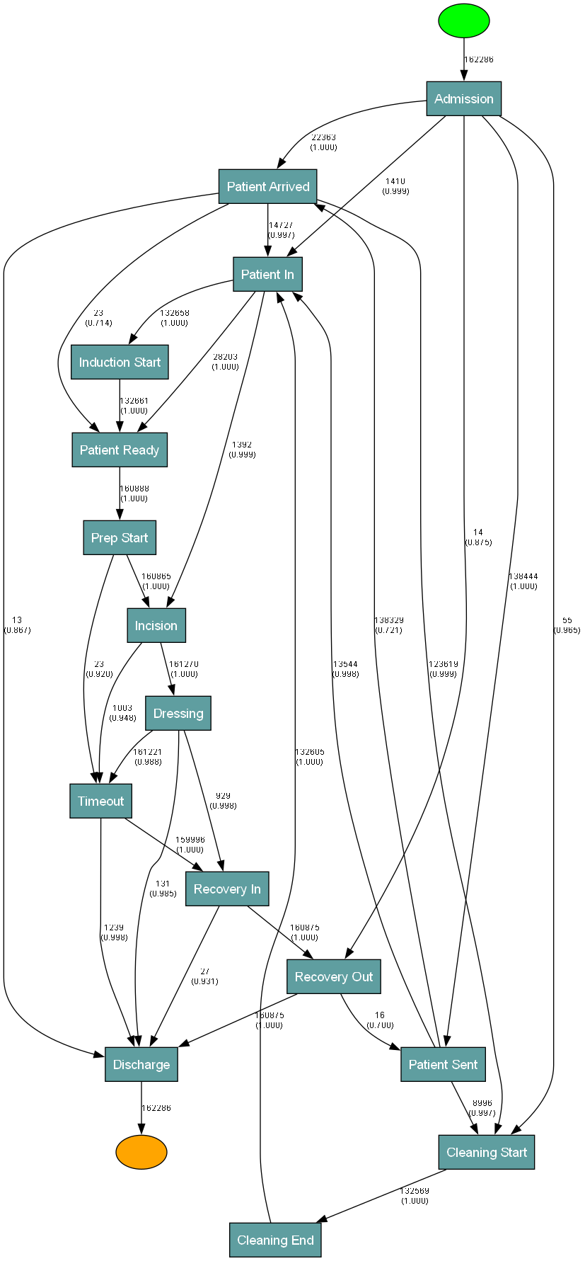
🗺️ The Discovered Process Maps
Baseline — 17 edges
Bayesian — 32 edges (core + exceptions + review-class)
Same log, same thresholds — the only change is the dependency measure
Notes:
SCRIPT (13:00–13:45):
"These are the actual discovered models from the thesis. On the left, the baseline: a clean spine. On the right, the Bayesian model: the same spine — deliberately preserved by the convergence property — plus the exception structure around it. Note that both were mined from the same log with the same thresholds; the only change is the dependency measure. Everything you see added on the right is what statistical calibration made visible."
EMPHASIS: Physically point at the identical backbone in both maps first, THEN at the additional edges — this visually proves "conservative by design."
TIME: 45 seconds. [Kimi's deck described these results but included no actual thesis figures — restored from Claude's deck: showing YOUR real outputs matters enormously in a viva.]

Slide 14
⏱️ Results: Temporal Analysis — The Mean-Median Divergence
Patient Sent → Discharge
Specialty-Level Delay Patterns
Cardiac Surgery: Incision→Dressing = 3 hours; Recovery In→Recovery Out = 36 min; Recovery Out→Discharge = 7 days
Ophthalmology: Most steps = minutes to under 1 hour. Only outlier: the shared ~7-day admission-side tail
Key insight: Intraoperative/recovery delay is specialty-specific; admission-side delay is institution-wide.
10
10
vs
days
min
MEAN
MEDIAN
Interpretation: The typical case completes in minutes. A few extreme outliers (likely administrative discharge delays) drag the mean to 10 days. Reporting mean alone is materially misleading.
Independent Corroboration: Özdağoğlu et al. (2025) — 373,008 events across 51,298 patients at a Turkish hospital, using Fuzzy Miner — reported the same phenomenon: noticeable mean–median gaps indicating transition times distributed over a wide range. Two hospitals, two countries, two algorithms — one pattern.
Notes:
SCRIPT (13:45–15:30):
"The temporal analysis reveals a finding both dramatic and operationally critical. For Patient Sent to Discharge, the MEAN is ten days — the MEDIAN is ten minutes. [PAUSE 2–3 SECONDS.] This is not a typo. The typical case completes in minutes; a small number of extreme cases — likely administrative discharge delays, not clinical ones — drag the mean to ten days. If the hospital reports only the mean, every scheduling decision built on that number is wrong.
The pattern differs by specialty. Cardiac surgery is genuinely long at almost every step — three hours incision to dressing, thirty-six minutes through recovery, seven days recovery to discharge. Ophthalmology's delays are confined almost entirely to the shared admission-side issue. So: intraoperative and recovery delay is specialty-specific; admission-side delay is institution-wide. And this is independently corroborated — Özdağoğlu and colleagues, different hospital, different country, different algorithm, same mean-median gap."
EMPHASIS: The 10-days/10-minutes contrast is your most memorable moment — deliver it slowly with a real pause. Point at each number.
TIME: ~1.75 minutes.
POTENTIAL QUESTIONS:
Q: "Couldn't the divergence be a data artifact?"
A: "Three lines of evidence say otherwise. Clinical plausibility — it appears on transitions with clear operational interpretations, not randomly. Internal consistency — the same pattern recurs across specialties and locations. And independent corroboration — Özdağoğlu et al. found the identical phenomenon in unrelated data with a different algorithm. Artifacts remain possible for individual values, which is why timestamp quality is our first recommendation."
Q: "Why 7 days recovery-to-discharge for cardiac?"
A: "It plausibly reflects genuine clinical reality — extended monitoring, step-down care, comorbid discharge planning. The point is not that seven days is surprising; it's that scheduling must account for it: booking a cardiac case without confirming downstream bed availability disrupts the schedule even when the OR itself runs perfectly."

Slide 15
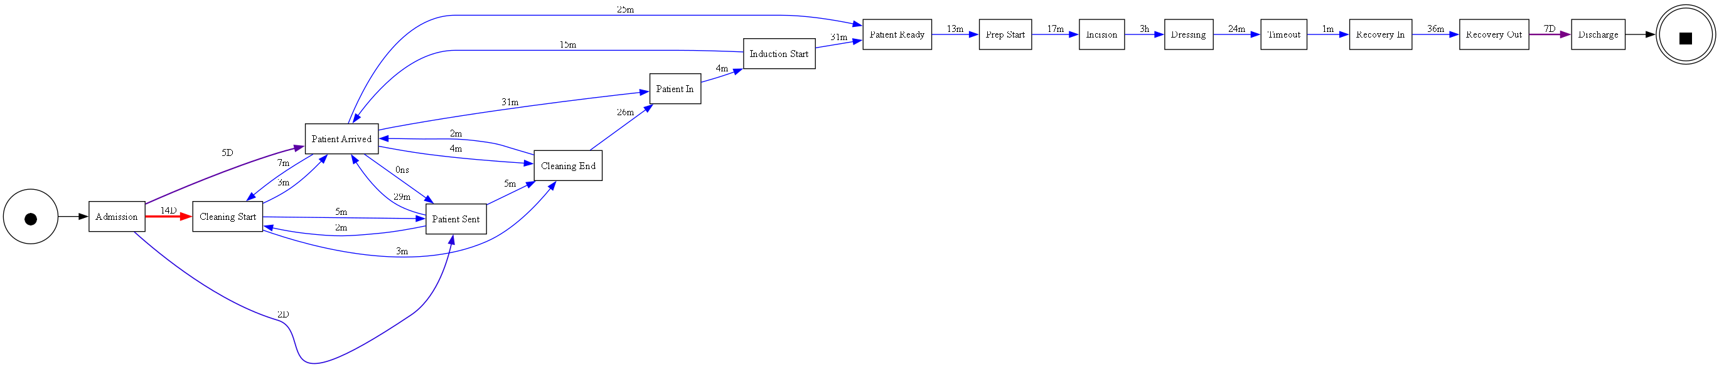
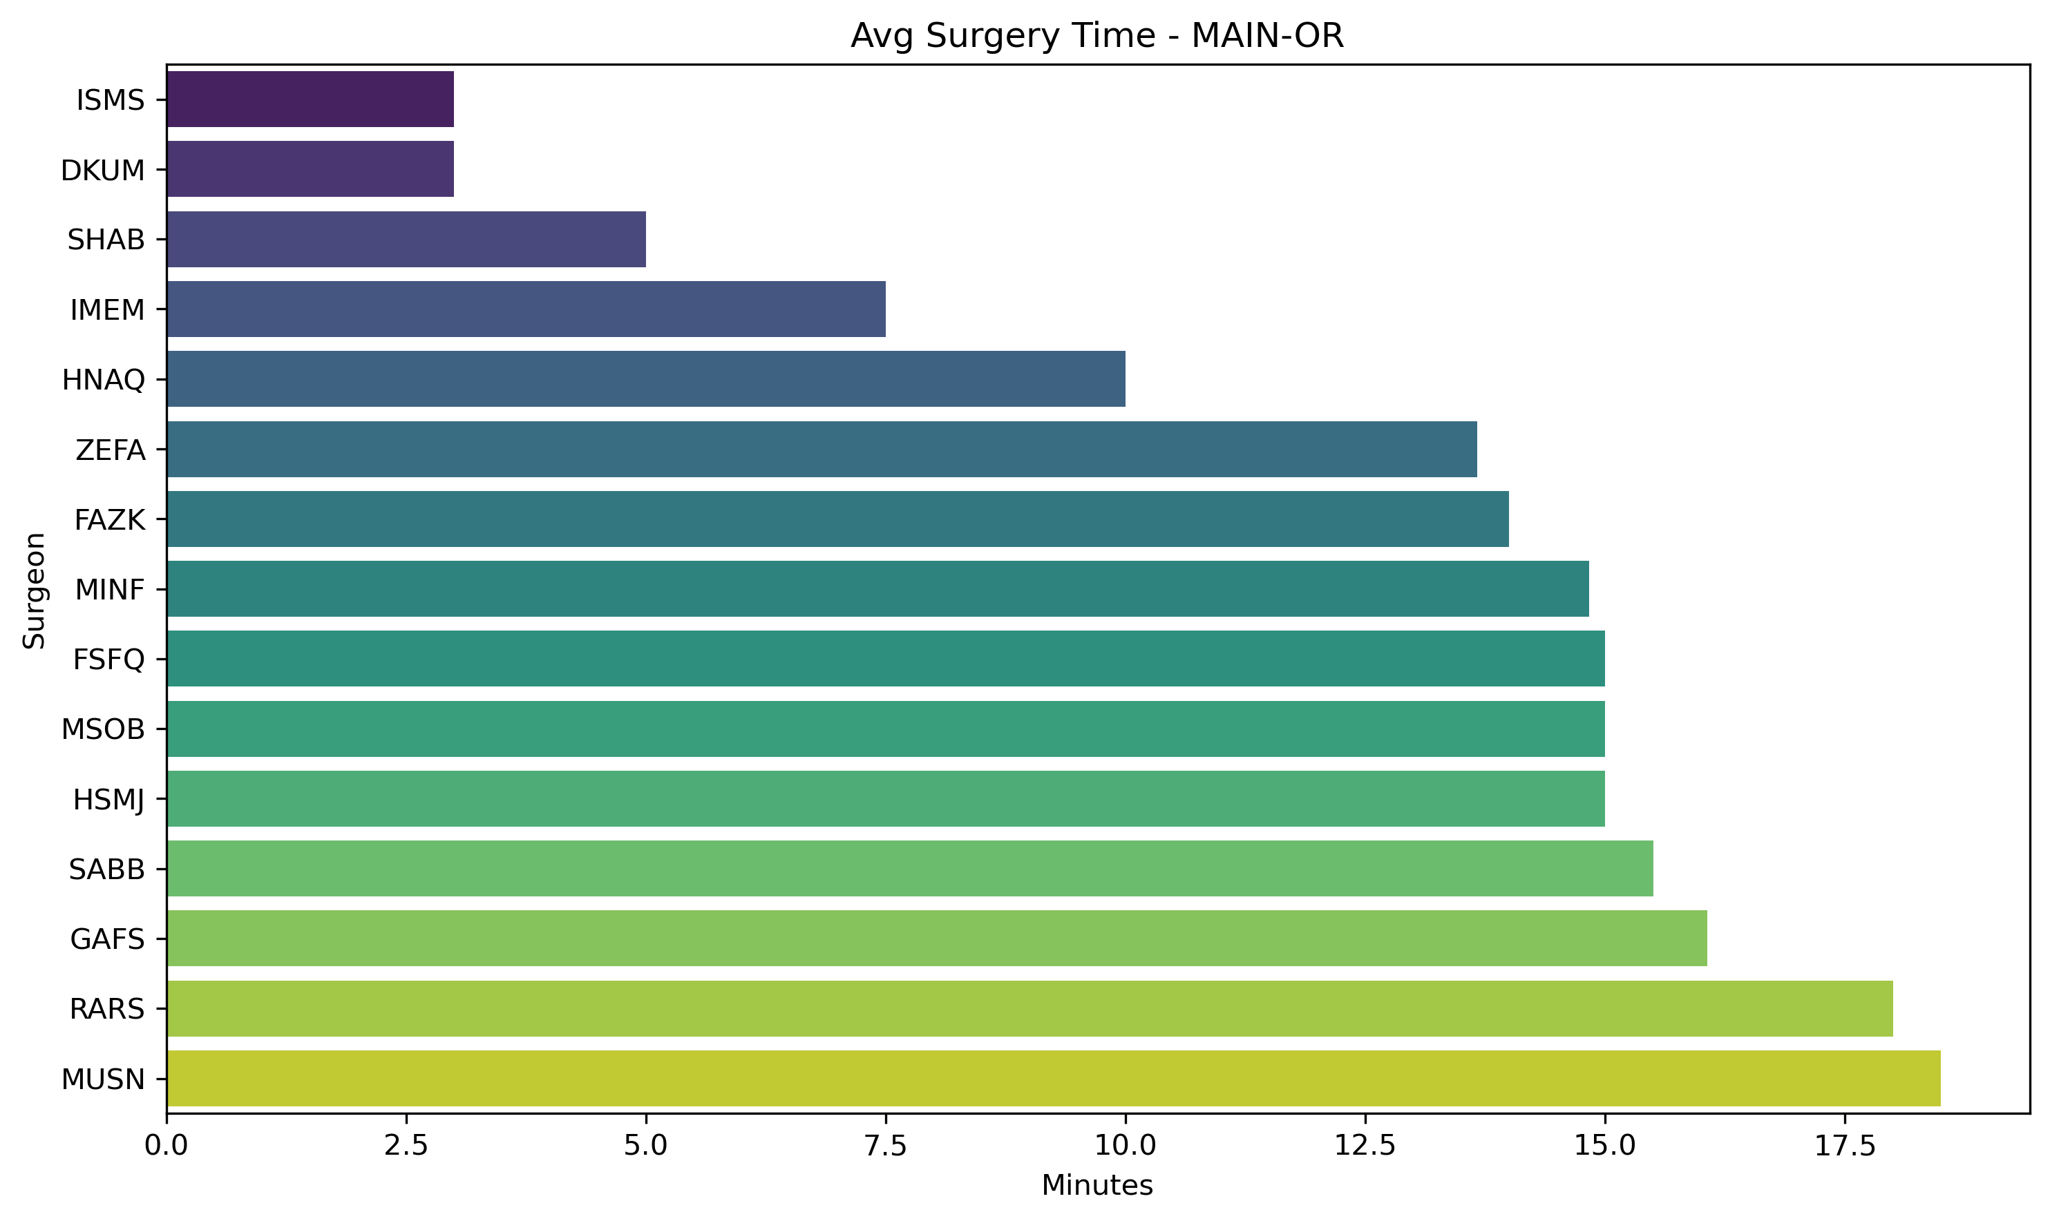
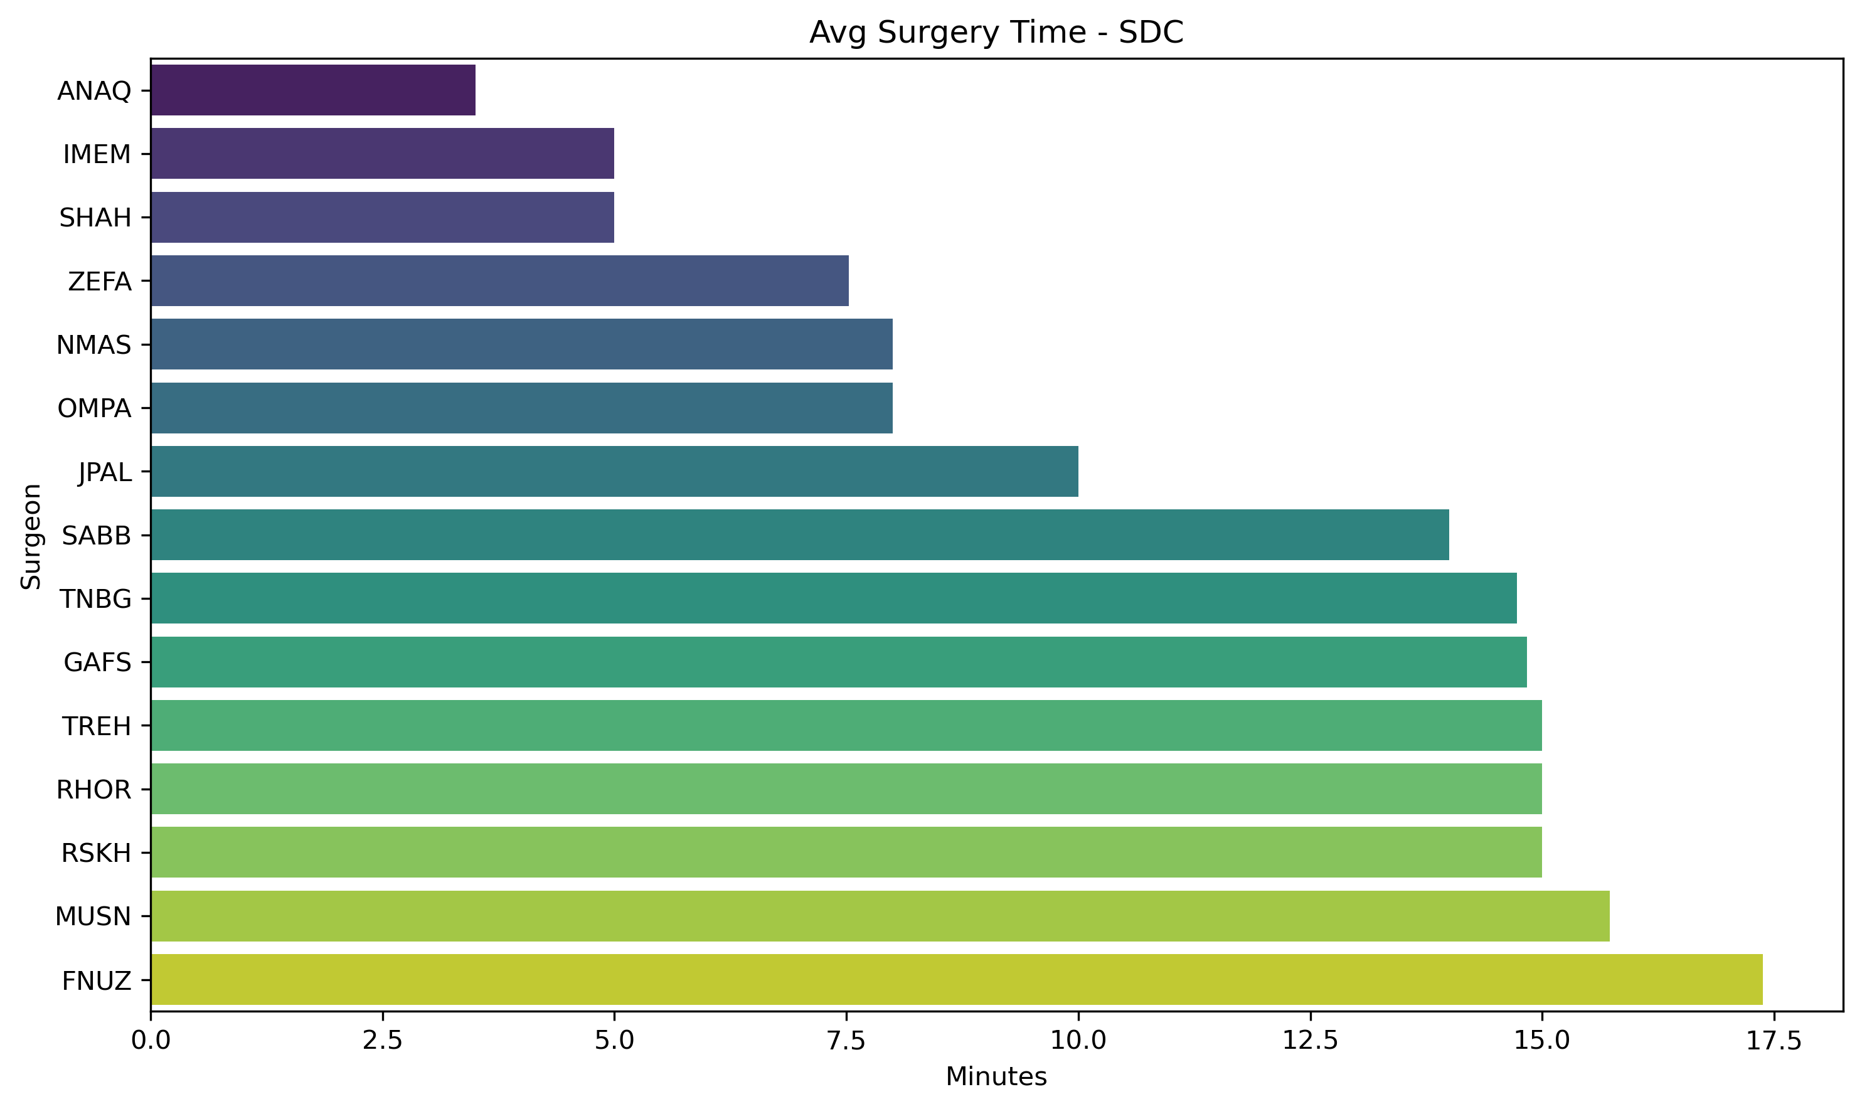
👥 Specialty & Surgeon-Level Variation (Breadth-First Results)
Cardiac — mean transition times
Ophthalmology — mean transition times
Avg surgery time by surgeon — Main OR
Avg surgery time by surgeon — Same Day Care
Surgeon duration rankings are NOT stable across locations — scheduling must model surgeon × location, not surgeon alone
Notes:
SCRIPT (15:30–16:15):
"The breadth-first runs confirm the structural backbone is stable across all subgroups — but timing is not. Top row: cardiac versus ophthalmology, the same fifteen activities on completely different clocks. Bottom row: average surgery time per surgeon at two locations. Notice the rankings are not stable — a surgeon who is relatively fast in the Main OR is not necessarily fast in Same Day Care. This matters for scheduling: surgeon identity alone is an incomplete predictor; it interacts with location and case mix. This aligns with Bartek et al. 2019, where surgeon identity contributed around thirteen percent of duration variability and surgeon-specific models cut overage substantially."
EMPHASIS: The instability of surgeon rankings across locations is the non-obvious insight — most people assume "fast surgeon is fast everywhere."
TIME: 45 seconds. [These are the thesis's own breadth-first figures — Kimi's deck had no slide for the surgeon×location results at all, despite them motivating the entire scheduling story.]
POTENTIAL QUESTIONS:
Q: "Why only 5 surgeons?"
A: "Volume constraints — discovery needs sufficient cases per subgroup for reliability. The top five collectively represent a substantial share of total volume; below that, per-surgeon logs get too thin for meaningful models. The scope is process discovery, not individual surgeon profiling."

Slide 16
⚖️ Comparative Analysis
Bayesian vs. Baseline — Evaluation Metrics
FITNESS
PRECISION
GENERALIZATION
SIMPLICITY
F-MEASURE
0.942
0.781
0.812
0.901
0.854
↓
↓
↓
↓
↓
0.967
0.834
0.846
0.847
0.896
▲ +2.7%
▲ +6.8%
▲ +4.2%
▼ −6.0%
▲ +4.9%
Simplicity decrease is a deliberate, acknowledged trade-off — the cost of retaining clinically interpretable exceptions
Notes:
SCRIPT (16:15–17:45):
"The Bayesian model outperforms the baseline on every metric except simplicity, where the decrease is a deliberate, acknowledged trade-off — we retain more edges to capture interpretable exceptions. Fitness improves because the model replays more real behavior. Precision improves — meaning the added edges reflect genuine transitions, not overgeneralization. Generalization improves — we are not overfitting. F-measure rises nearly five percent.
The comparison with my Thesis I work is instructive. Thesis I modified the Alpha Miner with HARD constraints on the public BPIC2011 log — if a transition violated a clinical rule it was discarded regardless of frequency. That proved over-restrictive: fitness and generalization dropped below baseline. This thesis takes the opposite approach — soft probabilistic calibration that discounts rather than discards — and improves across the board. I also ran classical Alpha on this log: it produced a model with 0.580 density and 0.273 determinism versus the Heuristic family's 0.104 and 0.818 — structurally unusable for clinical interpretation — confirming the Heuristic Miner as the right base algorithm."
EMPHASIS: "Discounts rather than discards" is the sentence that summarizes the methodological lesson between the two theses. Precision rising DESPITE more edges is the counterintuitive point — flag it.
TIME: 1.5 minutes.
POTENTIAL QUESTIONS:
Q: "How can precision rise when you add edges?"
A: "Precision penalizes behavior the model allows but the log doesn't contain. The added edges correspond to behavior that IS in the log — the exceptions — so allowing them reduces the mismatch. Extra edges lower precision only when they license unobserved behavior; these don't."
Q: "Why not Fuzzy Miner?"
A: "Fuzzy Miner filters by significance/correlation for visualization — related but different. It provides no sample-size-aware confidence per edge, so it cannot distinguish a confirmed rare pathway from noise. Özdağoğlu et al. used it and could describe the same temporal pattern, but not calibrate structural confidence. The approaches are complementary."

Slide 17
✅ 16 Operationally Realistic Recommendations
📐 STRUCTURAL (R1–R4)
📊 SPECIALTY-LEVEL (R9–R11)
R1. Make Bayesian-confirmed pathway the official reference
R2. Track 5 exception patterns by name, not as one category
R3. Chart review: 1,000+ cases with incision before Timeout ⚠️
R4. Clarify who logs “Patient Sent” vs “Patient Arrived”
R9. Different scheduling buffers per specialty
R10. Confirm recovery bed before booking cardiac cases
R11. Don't judge complex specialties by simple ones
⏱️ TEMPORAL (R5–R8)
🏛️ GOVERNANCE (R12–R15)
R5. Report median alongside mean for all durations ⚠️
R6. Auto-flag case-steps >24h as exceptions
R7. Prioritize by frequency × delay, not drama
R8. Create “Patient Ready to Incision” KPI
R12. Separate dashboard per specialty
R13. Fix timestamp quality → dashboard → alerts (in order)
R14. Track OR turnover with 3 specific numbers
R15. Attach specific alerts to specific failure points
Most require no new tooling — only changes to how existing data is reported, reviewed, and acted upon (+5 options considered and explicitly NOT adopted)
Notes:
SCRIPT (17:45–18:45):
"Sixteen recommendations in four categories. Structural: make the Bayesian-confirmed pathway the official reference, and — most important — a targeted chart review of the thousand-plus incision-before-Timeout cases, which has a direct patient-safety dimension. Temporal: report median alongside mean everywhere; prioritize improvement by frequency times delay, not by drama. Specialty-level: different buffers per specialty; confirm a recovery bed before booking cardiac cases. Governance: fix timestamp quality FIRST, then dashboards, then alerts — alerts built on unreliable data generate false alarms and destroy clinical trust. Critically, most of these need no new capital or tooling — only changes to how data the hospital already collects is reported, reviewed, and acted upon. The thesis also documents five options that were considered and deliberately NOT adopted, with reasons."
EMPHASIS: Highlight R3 (safety) and R5 (mean-median). "No new tooling" is the operational-realism claim — say it plainly.
TIME: 1 minute.
POTENTIAL QUESTIONS:
Q: "What resistance would you expect from clinical staff?"
A: "Three kinds. 'We already know this' — data-derived confirmation is what converts anecdote into resource decisions. 'The data is wrong' — a fair concern, which is why data quality is recommendation one. 'This is surveillance' — the analysis is at process level, not individual blame, and the framing is system improvement."
Q: "How would implementation actually proceed?"
A: "Phased, per R13: data quality first with IT, then specialty dashboards, then alerts with named owners. Even the smallest step — reporting median alongside mean — could be adopted almost immediately and would already prevent materially misleading numbers." (If asked for exact timelines, give ranges as opinion, not thesis content — the thesis does not specify implementation durations.)

Slide 18
🎯 Contributions & Limitations
✅ Four Key Contributions
⚠️ Key Limitations
1. Bayesian extension to Heuristic Miner's dependency measure — first to embed calibration during discovery, not after
Hand-set priors: α, β analyst-assumed, not formally elicited from clinicians — the most important theoretical limitation
64% case loss: Representativeness of retained vs. excluded cases cannot be fully verified
2. Large-scale real-world application — 162,286 cases, first log-derived characterization at this institution
Single institution: Generalizability to other hospitals untested
3. Connected structural–temporal framework — same statistical reasoning for both frequency and duration confidence
No outcome linkage: Process timing only — no patient outcomes or severity control
4. Sixteen filtered, operationally realistic recommendations for direct use by scheduling & quality teams
No standard benchmark: Inconsistent metrics across studies limit external comparability
Notes:
SCRIPT (18:45–20:00):
"Four contributions. First, the Bayesian extension to the Heuristic Miner's dependency measure — to our knowledge the first to embed calibration during discovery itself. Second, scale: 162,000 real cases, the first log-derived characterization of surgical process behavior at this institution. Third, the connected structural-temporal framework — the same statistical reasoning underlying both frequency confidence and duration confidence. Fourth, sixteen operationally realistic recommendations the hospital can act on directly.
And equally clearly, the limitations. The priors are analyst-assumed, not formally elicited — the most important theoretical limitation. We lost 64 percent of the raw data in cleaning and cannot fully verify representativeness. It is a single-institution study. We analyze process timing only, with no linkage to outcomes or severity. And there is no standardized benchmark for calibrated dependency measures, limiting external comparability."
EMPHASIS: Confident on contributions, humble on limitations. Do NOT rush the limitations — examiners reward honesty here. Note the thesis text says "four contributions" but §6.4 lists three — know your four cleanly (this list) in case an examiner counts.
TIME: 1.25 minutes.
POTENTIAL QUESTIONS:
Q: "Is this sufficient for a Master's thesis?"
A: "The contribution spans three levels — methodological (a novel algorithmic extension with derivation, complexity analysis, and implementation), empirical (one of the larger real-world perioperative logs in the literature), and practical (sixteen usable recommendations). The methodological layer alone would qualify; the other two add value."
Q: "What would it take to publish?"
A: "Two additions: formal prior elicitation with clinicians, and validation on at least one more institution. Then it would suit a venue like the Journal of Biomedical Informatics or the International Conference on Process Mining."

Slide 19
🚀 Future Work
Formal Prior Elicitation ⭐ Structured interviews with surgical & anesthetic staff to set α, β from clinical expertise — directly answers the main limitation
1
Hierarchical Bayesian Model Learn priors from the data's own structure instead of hand-specified defaults
2
Checklist-Sequencing Chart Review Clinical review of the 1,000+ Incision-before-Timeout cases: documentation lag vs. genuine protocol deviation
3
Multi-Institutional Validation Apply the Bayesian Heuristic Miner to other tertiary hospitals' perioperative logs
4
Deployed Scheduling Dashboard Live specialty-specific dashboard, phased: data quality → dashboard → alerts
5
Notes:
SCRIPT (20:00–21:00):
"Five directions, each following from a limitation. First and most important: formal prior elicitation — asking surgical and anesthetic staff what proportions they expect before seeing data, replacing my analyst defaults with genuine clinical expertise. Second, a hierarchical Bayesian model that learns priors from the data's own structure. Third, the dedicated chart review of the checklist-sequencing cases — the log alone cannot distinguish documentation lag from real deviation. Fourth, multi-institutional validation. Fifth, deploying the dashboard on the live feed in the phased order: data quality, then dashboard, then alerts."
EMPHASIS: Item 1 connects to the main limitation — make that link explicit. Item 3 connects to the headline finding.
TIME: 1 minute.

Slide 20
🏁 Conclusion: Three Takeaways
Surgical scheduling can be grounded in data, not guesswork
1
162,286 real cases → 83% canonical pathway + 17% structured exceptions; surgeon-level variation is measurable and actionable
Statistical calibration during discovery changes what we can say about rare events
2
Confirmed exceptions vs. noise — surfacing a checklist-sequencing deviation the frequency-only baseline missed entirely
Mean and median together prevent materially misleading conclusions
3
10-day mean vs. 10-minute median on the same transition — independently corroborated in unrelated hospital data
“A well-targeted statistical correction to an existing, trusted discovery algorithm, applied to data a hospital already collects, can surface specific, actionable findings that neither informal clinical experience nor an uncorrected frequency count could reveal.”
Notes:
SCRIPT (21:00–22:00):
"To conclude, three takeaways. One: surgical scheduling can be grounded in data rather than guesswork — 162,000 cases resolve into an 83 percent canonical pathway and five named, interpretable exception categories, not undifferentiated noise. Two: statistical calibration during discovery changes what we can say about rare events — it surfaced a checklist-sequencing deviation the frequency-only baseline completely missed. Three: mean and median together prevent materially misleading conclusions — a ten-day mean versus a ten-minute median is not a statistical curiosity, it is an operational disaster if only the mean is reported.
[SLOWLY:] A well-targeted statistical correction to an existing, trusted discovery algorithm, applied to data a hospital already collects, can surface specific, actionable findings that neither informal clinical experience nor an uncorrected frequency count could reveal.
Thank you. I'm happy to take your questions."
EMPHASIS: Deliver the closing line slowly. Eye contact with each examiner. "Thank you" confident, not apologetic. Open posture for Q&A.
TIME: 1 minute.

Slide 21
Thank You
Questions & Discussion
162,286
17 → 32
83%
10d vs 10min
16
cases analyzed
edges discovered
canonical pathway
mean vs median
recommendations
Hina Farheen | Supervised by Dr. Tariq Mahmood | IBA Karachi | Fall 2025
Notes:
Q&A STANCE:
- Listen fully; repeat the question back ("So your question is whether…") to buy thinking time.
- Structure answers: "Three points. First… Second… Third…"
- If unsure: "I don't have a confident answer, but my reasoning is…" — never bluff.
- Plain-language fallback for the method (for a skeptical clinician): "The prior is a clinical hunch; the data is what actually happened; the posterior is the updated belief. With lots of data the hunch stops mattering."
TOP 5 QUESTIONS TO EXPECT:
1. Defend the 64% case loss → system-default timestamps, stability across 22 re-runs, external corroboration, R13.
2. Why Beta-Binomial specifically → conjugacy/closed form at scale, interpretability, bounded.
3. What is genuinely novel → intervention point: DURING discovery (vs Moreira: replaces formalism; Janssenswillen: after discovery).
4. Prior circularity → α=5 vs counts of 10,000+; exceptions emerged on NEUTRAL priors.
5. Why no clinical outcome linkage → scope separation is deliberate and literature-endorsed (Celik et al. 2025); outcomes = future work.
KEY NUMBERS CARD: 162,286 final | 445,897 raw (64% loss) | 17→32 edges | 10 core = 1.000 | 5 exceptions | 1,003 Incision-before-Timeout (0.948) | 83/17 split | 10d vs 10min | F: 0.854→0.896 | precision 0.781→0.834 | 13 specialties, 4 locations, 5 surgeons, 22 re-runs | θdep=0.5, θfreq=10 | k=15, k²=225 | priors 5/1, 3/1, 2/1, 1/1.

