Slide 1
Elastic Stack

Slide 2
History
Apache Lucene(full-text search)
ElasticSearch
ELK(Elasticsearch + Logstash + Kibana)
Elastic Stack

Slide 3
Beats
Data Collection
Lightweight shippers --> Logstash & Elasticsearch
Filebeat : ships log files from your servers
Metricbeat : periodically collects metrics from the operating systems and services running on your servers
Packetbeat
Winlogbeat
Heartbeat

Slide 4
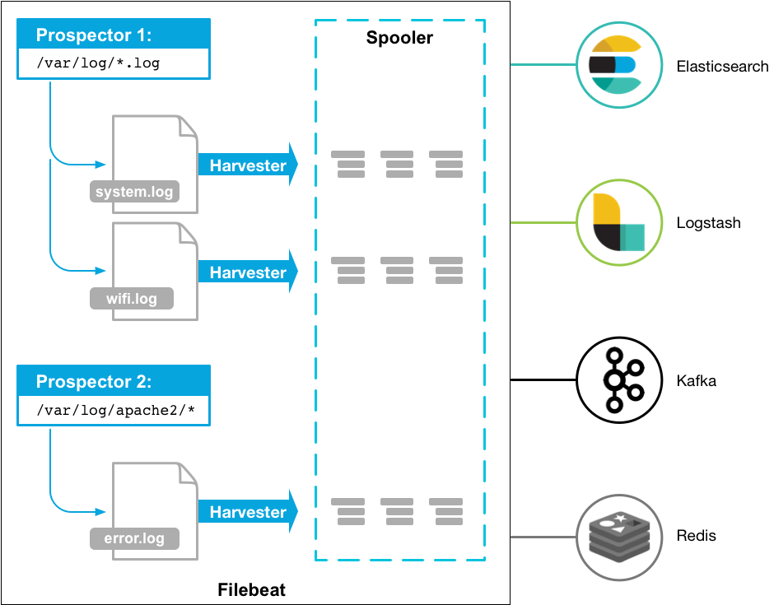
Filebeat

Slide 5
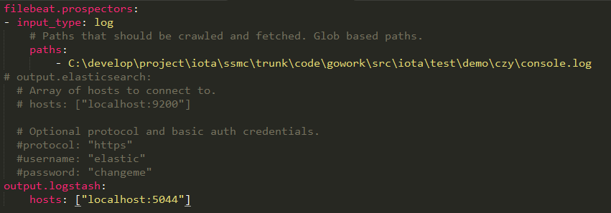
filebeat.yml

Slide 6
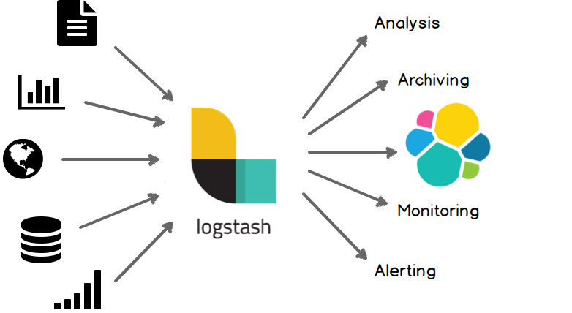
Logstash
Data collection
Transform
Parse

Slide 7
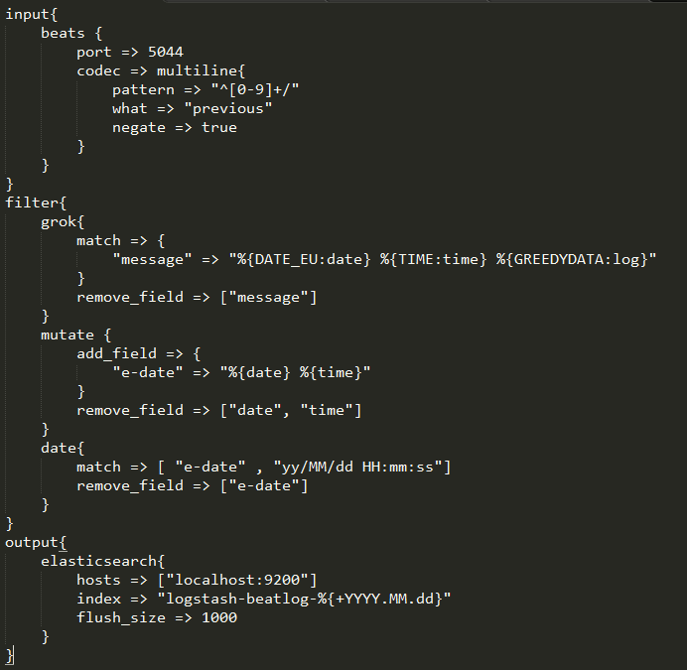
conf
Input
Output
Filter
Codec

Slide 8
ElasticSearch
Search
Analyze
Store

Slide 9
Kibana
Visualize

Slide 10
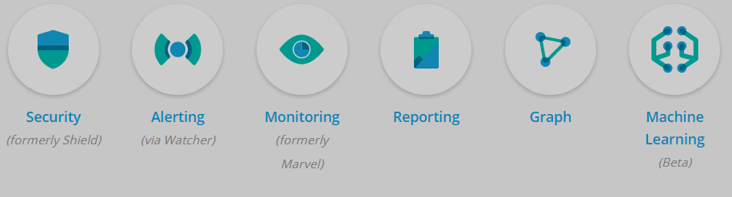
X-Pack

