Slide 1
Age Detection from facial images
Done by:
Eman Alshehri – Hind Alamri

Slide 2
Content
GOAL
TOOLS
MODEL
1
3
5
2
4
6
DATASET
EDA
Gender Age Prediction from Camera.

Slide 3
1. Goal
The main objective of this project is to use deep-learning algorithms in order to estimate the age from facial image.

Slide 4
2. Dataset
The UTKFace dataset consists of over 20,000 face images with age and gender.
Age is an integer from 0 to 116.
Gender is either 0 (male) or 1 (female).
Race is an integer from 0 to 4 denoting White, Black, Asian, Indian, and Others.
Date and time is in the format of yyyymmddHHMMSSFFF, showing the date and time an image was collected to UTKFace..

Slide 5






3.Tools

Slide 6
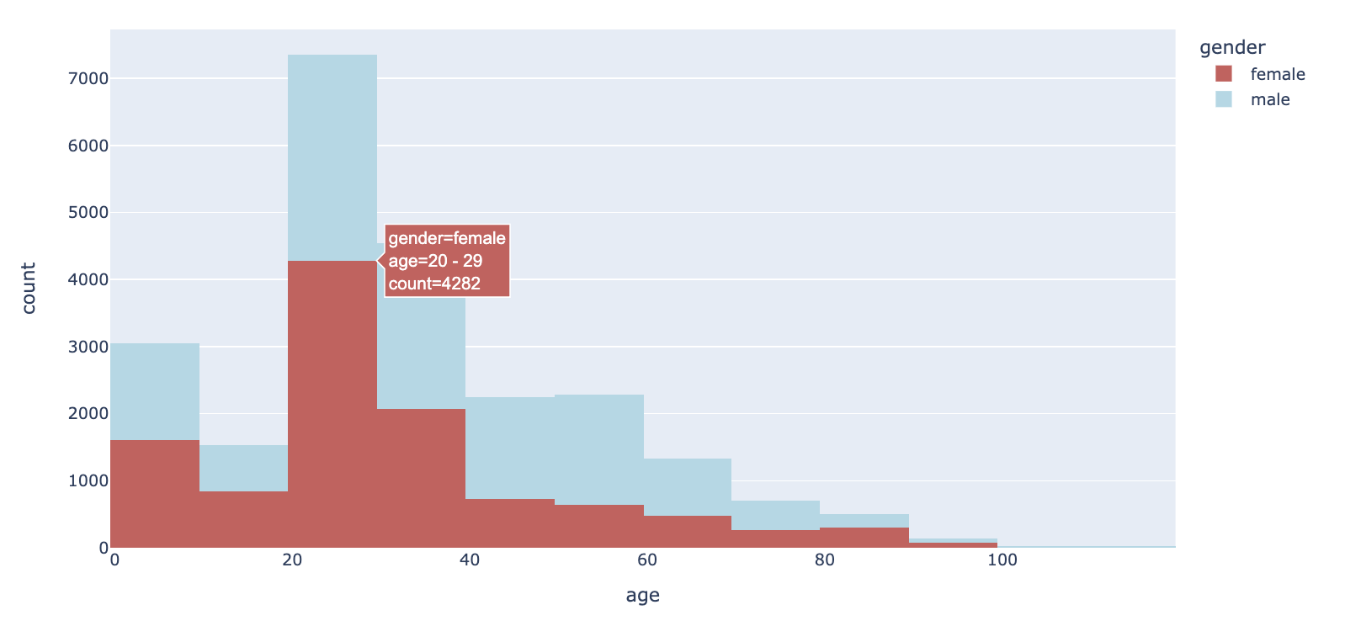
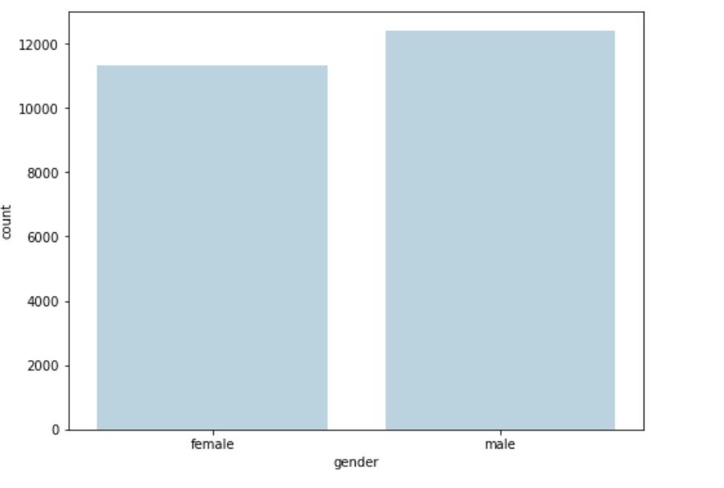
2. EDA

Slide 7
5.Model
Logistic Regression
Simple Nurture Network
Convolutional Neural Network
Convolutional Neural Network (2)
Transfer
Learning

Slide 8
Logistic Regression model (Baseline)
Logistic Model
Train accuracy:
0.687
Validation accuracy:
0.479
Logistic Regression Metric
Accuracy classification score.

Slide 9
Simple Neural Network model (NN) for Age
Hidden Layers: 4
Units:388
Epochs = 30
Callbacks : early stopping
Train accuracy:
0.32305
Validation accuracy:
0.3040

Slide 10
Convolutional Neural Networks (First attempt) for Age
Hidden Layers: 8
Units:316
Epochs = 30
Callbacks : early stopping
Droup out :20%
Train accuracy:
0.3230
Validation accuracy: 0.3040

Slide 11
Convolutional Neural Networks (Second attempt) for Age
Hidden Layers: 12
Units:306
Epochs = 30
Callbacks : early stopping
Droup out :20%
Train accuracy:
0.5358
Validation accuracy:
0.4611
Test accuracy:0.365

Slide 12
Transfer Learning(VGG16) for Age
Hidden Layers: 7
Units:907
Droup out :50%
Train accuracy:
0.414
Validation accuracy:
0.4045

Slide 13
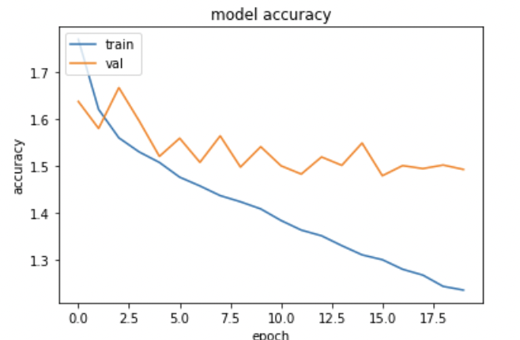
Transfer Learning(mobilenet_v2) for Age
Train accuracy:
0.587
Validation accuracy:
0.4355
Hidden Layers:5
Units:496
Droup out :50%

Slide 14
Transfer Learning(EfficientNetB0) for Age
Hidden Layers: 5
Units:600
Train accuracy:
0.99657
Validation accuracy:
0.5275

Slide 15
Gender Modeling
Hidden Layers: 11
Units:576
Epochs = 30
Callbacks : early stopping
Droup out :50%, 30% ,30%
Train accuracy:
0.913
Validation accuracy:
0.8658

Slide 16
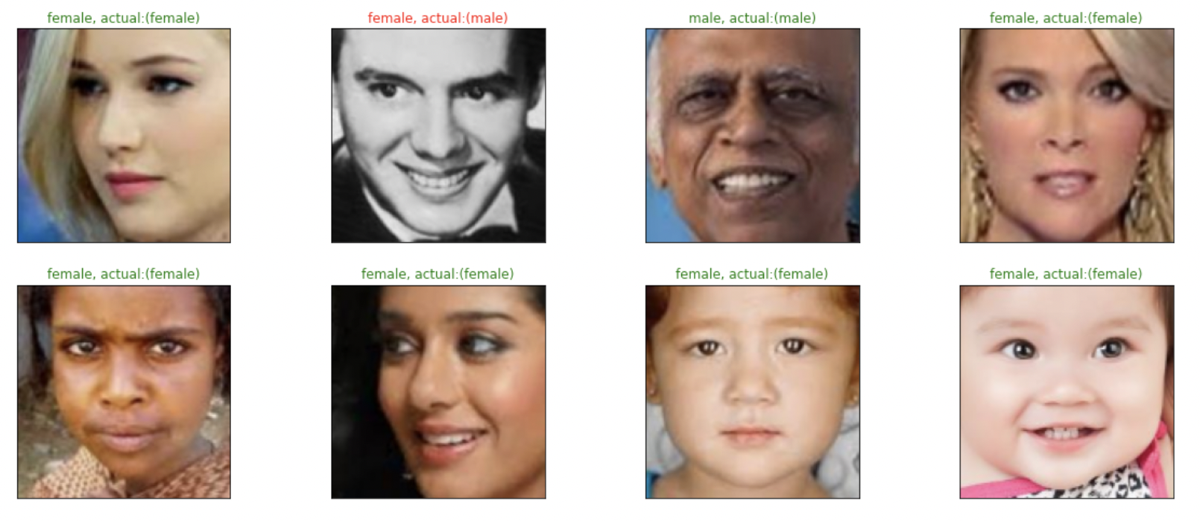
Testing Gender Model

Slide 17
Gender Age Prediction from Camera.

Slide 18
Thanks ..

