Slide 1

Farming advisor

Slide 2

GARDEN ELEMENTS
Seeds
Plants
Weather

Slide 3
Datasets Used
Plant Disease Prediction:
Crop Recommendation:
https://www.kaggle.com/datasets/atharvaingle/crop-recommendation-dataset/data
Fertilizer Recommendation:
https://www.kaggle.com/datasets/nishchalchandel/fertilizer-recommendation
Irrigation Planning:

Slide 4

PEAK PLANTING SEASON

Slide 5
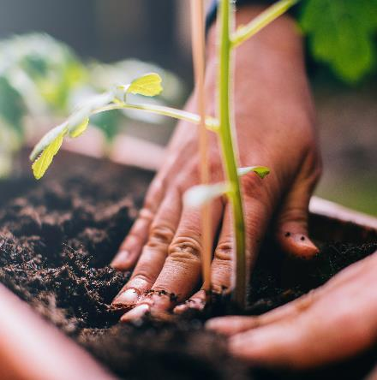
THE PLANTING CYCLE
PLANTING
FEEDING
WATERING
HARVESTING

Slide 6
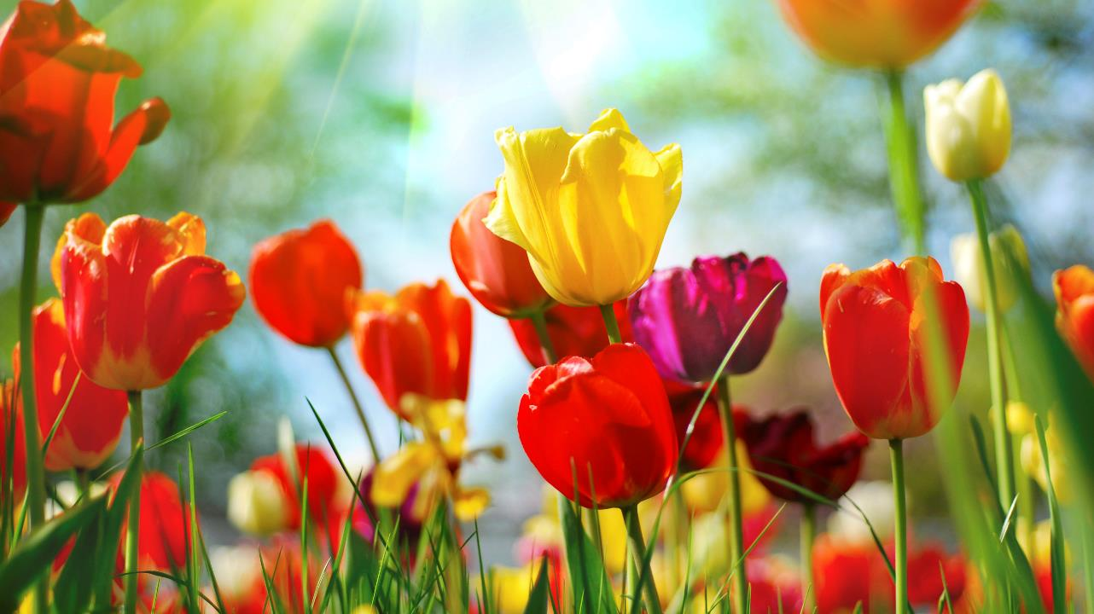
Thank you

