Slide 1

External Project Presentation of Computer Networking(CSE 3034) on Voice Over WiFi (Vo-WiFi) System
Supervisor
Arabinda Sahoo
Professor, ITER
Presented by
Sarthak Das (2141004005)
Piyush Tarai (2141020005)
Hindu Mohanty(2141013185)
Agnee Mohanty(2141013186)
Subhankar Sarkar(2141019215)
Department of Computer Science and Engineering
Institute of Technical Education & Research (ITER)
Siksha ‘O’ Anusandhan Deemed to be University, Bhubaneswar
Jan, 2024

Slide 2
Contents
Introduction
Problem statement
Methodology
Implementation
Result and Interpretation
Conclusion

Slide 3
Introduction
In the ever-evolving landscape of communication technologies, the integration of Voice over WiFi (VoWiFi) has emerged as a groundbreaking solution that enhances the flexibility and accessibility of voice communication. We aim to delve into the intricacies of VoWiFi systems, exploring their architecture, functionality, and the underlying technologies that make seamless voice communication over WiFi networks possible.
As the demand for mobile communication continues to surge, traditional cellular networks often face challenges in providing consistent coverage and capacity. VoWiFi presents itself as an alternative, allowing users to make voice calls over a WiFi network, leveraging the ubiquity of WiFi hotspots in homes, offices, and public spaces. This project endeavors to investigate the various facets of VoWiFi, providing insights into its design, implementation, and the potential it holds for revolutionizing the way we communicate.

Slide 4
Problem Statement
To implement a basic Voice over Wi-Fi (VoWi-Fi) system within a single access point using socket programming. Demonstrates how to capture audio from a microphone on the client side, transmit it over a local network using sockets, and play it back on the server side. (use Java Programming)

Slide 5
Methodology
We need to have two devices (Client & Server Side) connected to the same WiFi.
We designed two codes for both sides where the Server side listens for a client connection & then receives data & plays it using Java Sound API , and the Client Side captures audio from microphone, transmits it to server device at specified IP address and port, using Java Sound API and network sockets.
We need to determine the IP Address of the WiFi Device & port available on Server Device before executing the codes.

Slide 6
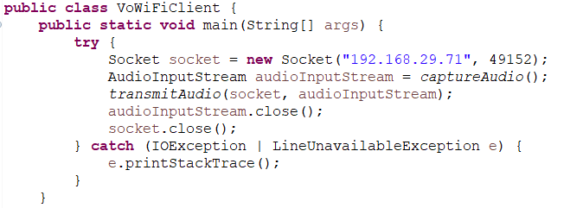
Implementation
Client Code:

Slide 7
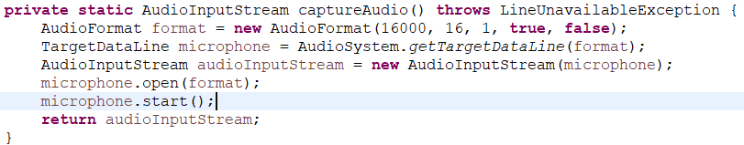
Implementation
Audio Input Function (Client Code):

Slide 8
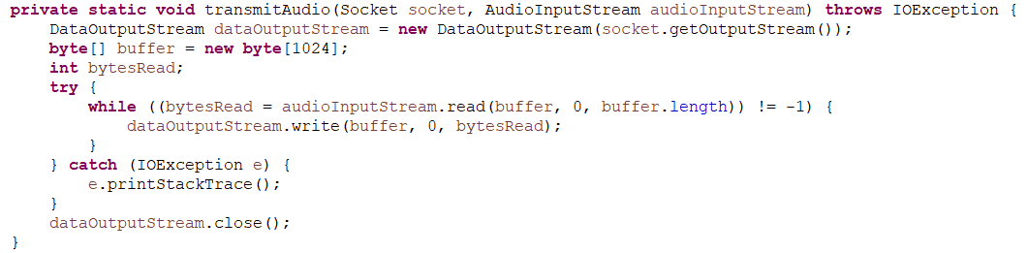
Implementation
Audio Transmit Function (Client Code):

Slide 9
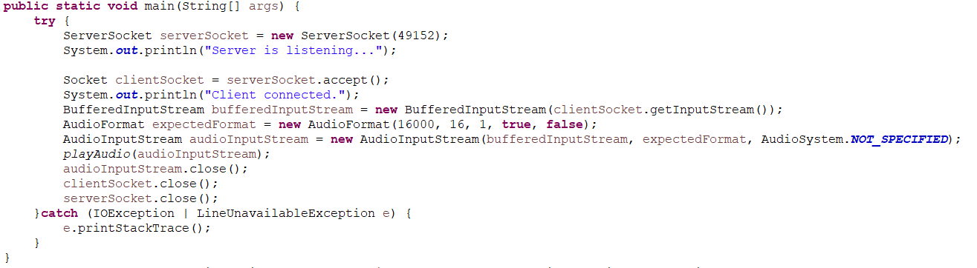
Implementation
Server Code:

Slide 10
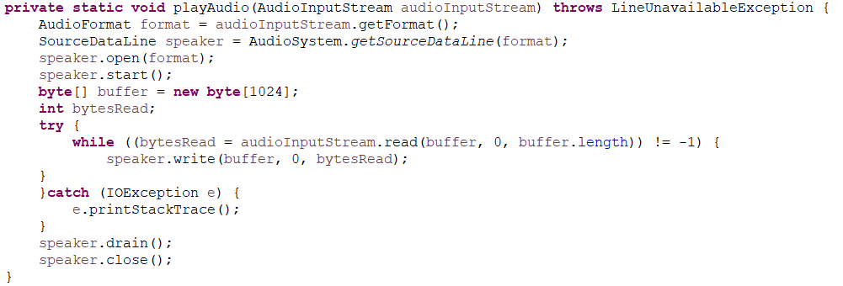
Implementation
Audio Playing Function (Server Code):

Slide 11
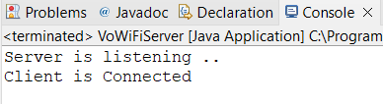
Result and Interpretation
On Server Side:
After the Client is connected we will see/hear that the audio input we provided on Client Side is transmitted over WiFi to Server Side in almost real time.

Slide 12
Conclusion
The above VoWiFi project serves as a foundation for further research and development in the realm of computer networking and communication technologies. By addressing various aspects of VoWiFi, from technical protocols to real-world applications, the project offers a holistic perspective on the capabilities, challenges, and future potential of Voice over WiFi systems.
The whole team behind this truly appreciate the guidance provided by our supervising professor to introduce this system to us.

Slide 13
References
Computer Networks, Andrew S. Tannenbaum, Pearson India
Java Network Programming by Harold, O’Reilly (Shroff Publishers).
www.google.com
www.geekforgeeks.com
www.github.com
Other relevant articles published on web

Slide 14

Feel Free But We Won’t Appreciate! ☺

Slide 15


