Slide 1
Hinduja.J
Final Project
3/21/2024 Annual Review

Slide 2
PROJECT TITLE
Sleep-Apnea-Cases
3/21/2024 Annual Review

Slide 3


AGENDA
Problem Statement
Project Overview
Who are the end users?
Solutions and value of propositions
WOW factor in the solution
Modelling
Results
3/21/2024 Annual Review

Slide 4

PROBLEM STATEMENT
Sleep apnea, a prevalent sleep disorder characterized by interrupted breathing during sleep, poses significant health risks and is increasingly becoming a concern globally. Despite advancements in diagnosis and treatment, the number of reported cases continues to rise. The challenge lies in accurately detecting and managing sleep apnea cases to mitigate associated health complications and improve overall well-being.
This project aims to address the following key issues:
Diagnostic Accuracy: Enhancing the accuracy of sleep apnea diagnosis is crucial for timely intervention and effective management.
Treatment Efficacy: Assessing the effectiveness of existing treatments for sleep apnea is essential for optimizing patient outcomes.
Public Awareness and Education: Increasing public awareness about the risks and symptoms of sleep apnea is vital for early detection and prevention
4/5/2024 Annual Review

Slide 5

PROJECT OVERVIEW
My project aims to highlight the objectives of our endeavor. Sleep apnea, characterized by interrupted breathing during sleep, is increasingly prevalent worldwide, posing significant health risks. Accurate diagnosis and effective treatment remain challenging, with traditional methods often lacking precision, leading to underdiagnosis or mismanagement. Evaluating treatment efficacy and raising public awareness about sleep apnea are essential for improving outcomes and reducing associated health risks. Our project aims to leverage data-driven approaches and innovative technologies to enhance diagnostic precision, evaluate treatment efficacy, and raise public awareness. By addressing these key areas, our project seeks to mitigate the burden of sleep apnea, improve patient outcomes, and enhance overall sleep health.
4/5/2024 Annual Review

Slide 6

WHO ARE THE END USERS?
The end users of this project encompass healthcare professionals, patients, the general public, and researchers. Healthcare professionals, including physicians and sleep specialists, stand to benefit from improved diagnostic tools and treatment options for sleep apnea, enhancing their ability to provide accurate diagnosis and effective care. Patients, particularly those affected by sleep apnea or at risk of developing it, would benefit from increased awareness and access to reliable information about the disorder and its management. The general public would also benefit from enhanced awareness campaigns, empowering individuals to recognize symptoms, understand risk factors, and prioritize sleep health. Additionally, researchers and academia would find value in the project's contributions to advancing knowledge and technology in sleep medicine, supporting ongoing efforts to improve diagnosis, treatment, and public health outcomes related to sleep apnea.
4/5/2024 Annual Review

Slide 7

YOUR SOLUTION AND ITS VALUE PROPOSITION
Our project proposes a comprehensive approach to addressing the challenges surrounding sleep apnea diagnosis, treatment, and public awareness. By leveraging advanced data-driven techniques and innovative technologies, such as machine learning algorithms and educational initiatives, we aim to enhance diagnostic precision, evaluate treatment efficacy, and raise public awareness about sleep apnea.
The value proposition of our solution lies in its ability to:
Enhance Diagnostic Precision: By developing robust algorithms and diagnostic tools, we seek to improve the accuracy and efficiency of sleep apnea diagnosis, enabling healthcare professionals to identify and treat cases more effectively.
Evaluate Treatment Efficacy: Through the utilization of machine learning models and data analysis techniques, we aim to assess the effectiveness of existing treatments for sleep apnea, providing insights into optimal therapeutic approaches and patient outcomes.
Raise Public Awareness: By launching targeted educational campaigns and initiatives, we strive to increase public awareness about the signs, symptoms, and health risks associated with sleep apnea, empowering individuals to seek timely diagnosis and appropriate treatment.
4/5/2024 Annual Review

Slide 8

THE WOW IN YOUR SOLUTION
The "wow" factor in our solution lies in its integration of cutting-edge technology with a holistic approach to addressing the complexities of sleep apnea. By harnessing the power of advanced data analytics and machine learning algorithms, we're able to offer personalized and precise diagnostic tools, tailor-made treatment plans, and targeted public awareness campaigns. This not only revolutionizes the way sleep apnea is diagnosed and managed but also empowers individuals to take control of their sleep health like never before. Our solution doesn't just stop at improving outcomes for patients and healthcare providers—it aims to spark a fundamental shift in how society perceives and addresses sleep disorders, ultimately leading to a healthier and more informed population.
4/5/2024 Annual Review

Slide 9
MODELLING
Our project follows a systematic approach, starting with data collection and preprocessing, followed by model development, training, evaluation, and prediction.
Data Collection and Preprocessing: We gather sleep data from various sources, including CSV files and text files containing labels. The data is then preprocessed to ensure quality and consistency, converting time data into numerical representations and organizing it into sequences suitable for modeling.
Model Development and Training: We employ a Recurrent Neural Network (RNN) model using TensorFlow, specifically a SimpleRNN architecture chosen for its ability to capture temporal dependencies. The model is trained on preprocessed data, with optimized hyperparameters such as sequence length and batch size.
Model Evaluation: After training, the model is evaluated using validation data to assess performance, calculating metrics like mean squared error and R-squared to measure accuracy and predictive capability.
Data Prediction: Upon training and evaluation, predictions are made on unseen validation data to generate insights into sleep apnea patterns. Predicted values are compared with actual values, and residuals are analyzed to understand model performance further.
Tools and Requirements: Our project utilizes Python libraries like pandas, NumPy, matplotlib, scipy, scikit-learn, and TensorFlow. Google Colab provides cloud-based computing resources for efficient model development and training.
4/5/2024 Annual Review

Slide 10
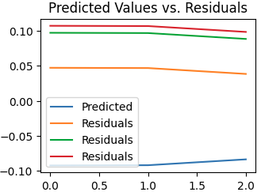
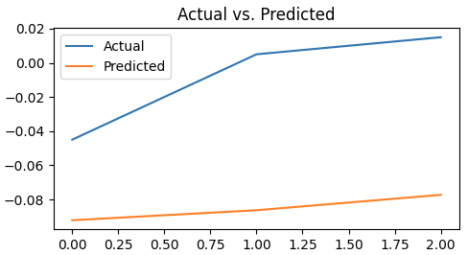
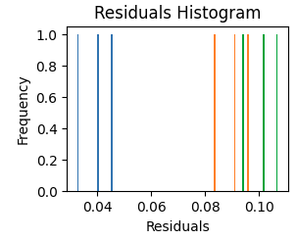
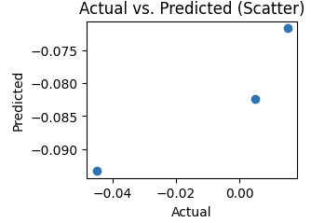
RESULTS
4/5/2024 Annual Review

