Slide 1
Claude Code in VS Code
The tricks I use every day
A practical tour for friends: start, configure, plan, drive
Notes:
Welcome. This is a hands-on tour of how I actually work with Claude Code inside VS Code. No theory: every slide is something you can try today.

Slide 2
Four blocks: start, configure, plan, then drive daily
1
2
3
4
Start
Configure
Plan
Drive
Claude's tools, extension vs CLI, opening a project
.claude/ folder, CLAUDE.md, skills, agents, hooks
Problem, decisions, phases, exit gates, "next phase"
Context tricks, terminal flags, MCP, review commands
Slides 3-6
Slides 7-12
Slides 13-14
Slides 15-20
Notes:
The talk has four parts. First how to start. Then the files that configure Claude. Then the planning process I follow. Finally the commands and flags I reach for every day.

Slide 3
Claude works through tools: read, search, edit, run
Read
Grep
Glob
Edit
Opens files (code, images, PDFs)
Searches inside files for text or patterns
Finds files by name pattern
Changes an exact piece of an existing file
Write
Bash
AskUserQuestion
Agent
Creates or fully replaces a file
Runs terminal commands: tests, git, uv
Asks you to choose between options
Hands a task to a sub-agent
Also: WebSearch, WebFetch, Skill... You decide which tools may run without asking (permissions).
Notes:
Everything Claude does goes through tools. Read, Grep and Glob look at your project. Edit and Write change files. Bash runs commands such as tests and git. AskUserQuestion is how it asks you to pick between options. Agent delegates to a sub-agent. You see each tool call in the chat, and permission settings control which ones ask first.

Slide 4
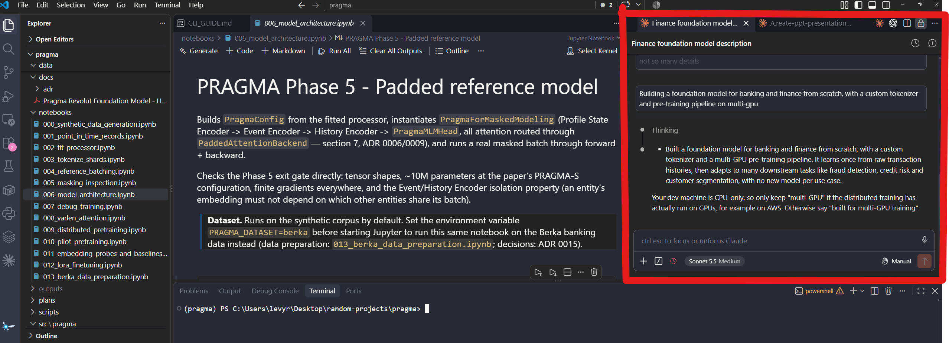
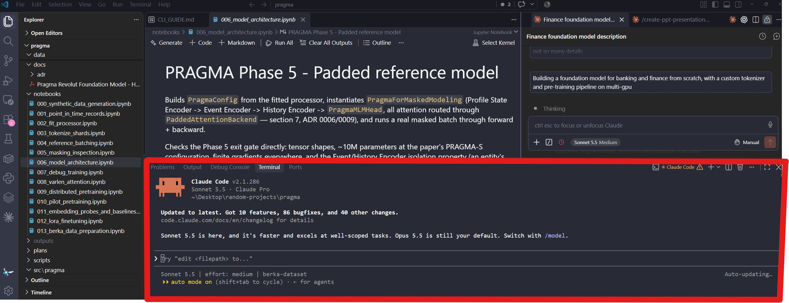
Two front doors, same Claude: extension and CLI
VS Code extension
CLI in a terminal
Chat panel on the right side, inline diffs, @-mention files
Run `claude` in any terminal, including the one inside VS Code
SCREENSHOT
Screenshot: Claude Code panel in VS Code (right side)
SCREENSHOT
Screenshot: terminal with `claude` running
My split: extension for chat day-to-day, CLI for flags, agents and automation
Notes:
The extension gives you a chat panel inside VS Code with diffs you can click through. The CLI is the same engine in a terminal, with more flags and automation. Slash commands work in both. My split: extension for everyday chat, CLI for flags, agents, worktrees and scripting.

Slide 5
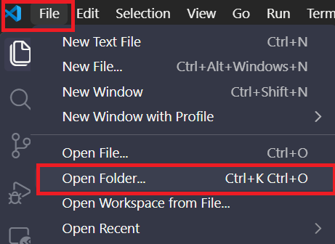
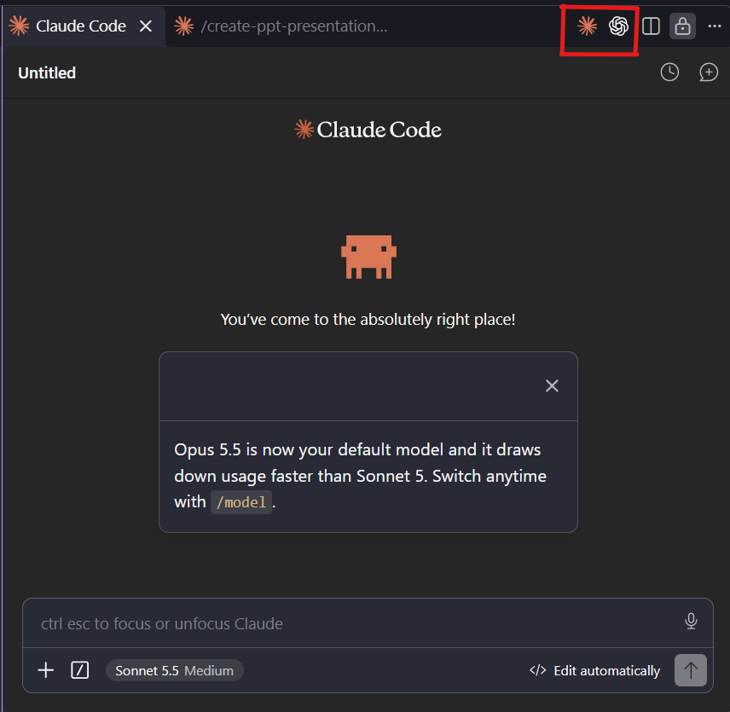
Start in VS Code: open a folder, open the Claude panel
Step 1
SCREENSHOT
VS Code: File > Open Folder...
File > Open Folder...
Claude only sees what is inside the folder.
Step 2
Open the Claude panel
SCREENSHOT
Claude Code panel, side menu
Claude icon in the side menu (right side).
Step 3
Describe a task
Review diffs, then accept or push back.
Notes:
Claude works inside the folder you open, so always start with File, Open Folder. Then open the Claude Code panel from the side menu and describe a task. Edits show up as diffs you approve.

Slide 6
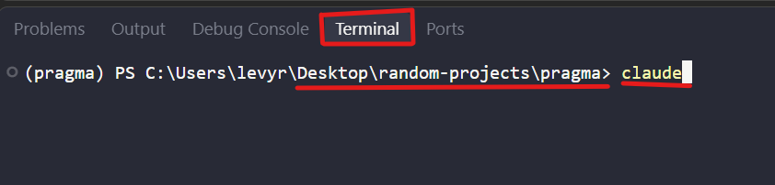
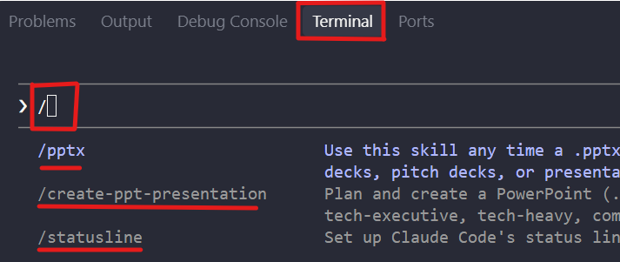
Start the CLI: one word in any terminal
SCREENSHOT
Terminal with `claude` started in a project folder
Three moves
Open a terminal (VS Code: Ctrl+`)
  Or go to ‘Terminal’→ ‘New Terminal’
Open folder
  Or cd into your project folder
Type claude and press Enter
Type / to see every slash command
Notes:
You can use the terminal built into VS Code (Ctrl+backtick) or any external terminal. cd into the project, type claude. That's it. Everything else in this talk works the same.

Slide 7
The .claude/ folder is where you shape Claude's behavior
.claude/
settings.json
settings.local.json
agents/
summarizer.md
skills/
my-skill/SKILL.md
rules/
style.md
commands/
CLAUDE.md (project root)
settings.json
Permissions, hooks, env. Shared via git
settings.local.json
Your personal overrides, not committed
agents/
Sub-agents, one markdown file each
skills/
Repeatable playbooks, one folder each
rules/
Small focused instruction files
commands/
Your own slash commands
Same layout in ~/.claude/ applies to all your projects
Notes:
Everything that customizes Claude lives in a .claude folder. The project one is shared through git. The one in your home directory applies to all your projects. You rarely write these files by hand: ask Claude to create or edit them.

Slide 8
CLAUDE.md: Claude's briefing note for your project
What goes in it
Why it's worth having
What the project is and its layout
Commands: how to run, test, lint
Conventions and style preferences
Where the plans and decisions live
Do's and don'ts (e.g. never commit unasked)
Loaded every session: no re-explaining
Shared with the team through git
Fewer wrong guesses, fewer corrections
A global one in ~/.claude/ holds personal habits
> Create a CLAUDE.md for this project: what it is, how to run and test it,
and the conventions you see in the code. (or just type /init)
Notes:
CLAUDE.md is read at the start of every session, so Claude never starts from zero. I don't write mine by hand: I ask Claude to draft it (the /init command does this), then I refine it. Keep it short and concrete.

Slide 9
Skills, rules, hooks, agents: pick the right block
Repeatable behavior
Isolated behavior
Mandatory behavior
Delegated work
Skills
Rules
Hooks
Agents
A playbook Claude loads when the task matches, or when you type /name.
Small focused instruction files, optionally scoped to certain files.
Commands that run automatically on events. Guaranteed, not suggested.
Specialist helpers with their own context, tools and model.
CLAUDE.md = always-on context. These four = on-demand or automatic behavior.
Notes:
A quick mental model. Skills are playbooks for things you repeat. Rules are small isolated instructions. Hooks are mandatory: they run automatically, Claude cannot forget them. Agents are separate workers with their own context.

Slide 10
Example of my skills: Claude wrote them, and I keep asking it to edit them
Skill | What it does
create-new-project | Scaffolds a Python uv project with plans/, notebooks/, src/
create-notebook | Builds local or Kaggle Jupyter notebooks
create-tests / run-tests | Writes tests; runs pytest + ruff + mypy like CI
create-cli | Adds a small CLI plus a CLI.md on how to run it
create-ppt-presentation | Plans and builds a .pptx deck (like this one)
create-video | Narrated explainer video from a script (MP4)
git-flows | Checks GitHub identity, branch and commit conventions
Ask: "Create a skill that does X every time I ask for Y". Later: "Edit that skill so it also Z".
Notes:
These are the skills I use across projects. Every one was produced by asking Claude, and I often ask it to tweak them when I notice something I'd change. Skills live in ~/.claude/skills/.

Slide 11
Agents: a markdown file in .claude/agents/
---
name: summarizer
description: Summarize files in 5 bullets
tools: Read, Grep, Glob
model: haiku
---
You read the given files and
return a 5-bullet summary.
Built-in agents
Explore: fast read-only search
Plan: designs an approach
General-purpose: multi-step work
How to call them
Ask Claude to write it, or use /agents
@agent-summarizer in the chat
claude --agent coordinator for the whole session
Or just ask: Claude delegates by itself
Notes:
An agent is a markdown file: frontmatter with name, description, tools and model, then instructions. Claude can delegate to it automatically, or you call it with @agent-name. Built-in agents like Explore and Plan already exist. You can also run an entire session as an agent with claude --agent.

Slide 12
Hooks and settings: get a push notification when Claude finishes
{
"hooks": {
"Stop": [{
"hooks": [{
"type": "command",
"command": "<your notify script>"
}]
}]
}
}
Settings levels
~/.claude/settings.json: all projects
.claude/settings.json: this project, shared
.claude/settings.local.json: just you
Easiest way
Ask: "Add a hook that notifies me when you finish"
Use /hooks to see what's active
Events: Stop, Notification, PreToolUse...
Notes:
Hooks are configured in settings.json and run a command on an event, for example when Claude stops and waits for you. I use one to get a push notification so I can leave a long task running. You can ask Claude to set it up for you.

Slide 13
Plan first, then build in phases: my process
1
2
3
4
5
Problem
Decisions
Detailed plan
Tests + criteria
Phases + gates
What am I solving, for whom?
Settle open choices before coding
Written to plans/001-plan-name.md
Acceptance criteria, test plan
Exit gate to pass before the next
Exit gate example: "tests pass, ruff and mypy clean, debug run works"
A written plan survives context resets. Claude re-reads it, so nothing is lost.
Notes:
This is the flow from my create-new-project skill. I start with the problem, settle the open decisions with Claude, then ask for a detailed written plan with tests, acceptance criteria and exit gates per phase. Only then do we write code.

Slide 14
Then the loop is one sentence: next phase
plans/
001-plan-main.md
Phase 1: build, tests
Exit gate: tests pass
Phase 2: ...
progress.md
Status: phase 2 done
Done / In progress / Next
Gate evidence
1
Claude builds the phase
2
Runs tests and the exit gate
3
Updates progress.md with evidence
4
I review, then say: next phase
Notes:
Once the plan and progress file exist, driving the project is trivial. Claude builds the phase, runs the exit gate, updates progress.md, and I read the evidence. If it is good, I type: next phase.

Slide 15
/clear early, /clear often: keep the context lean
/context
/clear
/rewind
/memory
See what fills the context window
Fresh start between unrelated tasks
Roll the conversation back to an earlier point
View and edit what Claude remembers
Works in the extension chat and in the CLI
/btw
/rename
/goal
Side question that doesn't clutter the chat
Name a session so you can resume it later
Set a goal Claude keeps working toward
Notes:
Claude's context window fills up, and quality drops when it is cluttered. These chat commands keep it tidy. /context shows what is using space. /clear starts fresh between tasks. /rewind undoes a wrong turn. /btw asks a side question without polluting the context.

Slide 16
Terminal flags: resume, fork, script, and run in parallel
claude -c
claude --resume
--fork-session
Continue the most recent conversation
Pick an earlier session to resume
Branch off a session, keep the original
claude -p "..."
claude --agent coordinator
claude --worktree add-billing
One prompt, plain output, for scripts
Run the whole session as that agent
Isolated git worktree for parallel work
Notes:
These are the CLI flags I use most. -c continues the last conversation. --resume lets you pick one. --fork-session branches off instead of continuing. -p runs one prompt non-interactively, great for scripts. --agent runs as a specific agent. --worktree gives Claude an isolated copy of the repo for parallel work.

Slide 17
MCP: plug outside tools into Claude
What it is
# list configured servers
claude mcp list
# add a remote (HTTP) server
claude mcp add --transport http <name> <url>
A standard way to connect Claude to external tools and data
Add it once, Claude can then use it in any chat
In chat, /mcp shows connected servers
Only add servers you trust
Add --scope user to make it available in all projects
Notes:
MCP servers give Claude new tools, such as GitHub, docs or databases. You manage them from the terminal. Only add servers you trust, because they can act on your behalf.

Slide 18
Check and ship with the built-in commands
/run
/verify
/code-review
Launch the app and see the change working
Check that the work actually does what was asked
Review the diff for bugs; "ultra" runs a deep cloud review
/security-review
/simplify
/install-github-app
Security check of the pending changes
Clean up changed code for reuse and clarity
Connect Claude to your GitHub repo and PRs
Notes:
These built-in commands cover the quality loop. /run launches the app to prove a change works. /code-review looks for bugs. ultra is a deeper cloud review that you trigger yourself and is billed. /security-review checks the branch for vulnerabilities. /simplify cleans up code. /install-github-app lets Claude work on your GitHub PRs.

Slide 19
Take it with you, and keep learning inside the tool
Anywhere
Learn
/remote-control
/powerup
Continue a running session from another device. Start a long task, then check on it from your phone.
Interactive in-product lessons for features you haven't tried yet. A good way to find new tricks.
Notes:
/remote-control lets you continue a running session from another device, like your phone, so you can leave a long task and check on it. /powerup is built-in interactive lessons that teach you features you haven't tried yet.

Slide 20
Eight habits to take home
1
2
3
4
Open a folder
CLAUDE.md
Plan before code
Phases
File > Open Folder..., then start Claude
Ask Claude to write it
Plans, tests, exit gates
Say "next phase"
5
6
7
8
Keep context lean
Config via Claude
Review
Parallelize
/clear, /context, /rewind
Skills, agents, hooks
/code-review, /security-review
--worktree, agents
Notes:
If you only remember eight things, remember these. Start from a folder and a CLAUDE.md, plan before code, build in phases, keep the context clean, let Claude write its own config, and review with the built-in commands. Thanks, and happy to demo any of it.

