Slide 1

University of Puthisastra
Website Project
Topic: Promotion Ads
By Group I
Mr. Hing Kosal (Leader)
Mr. Chhorn SokTheng (Deputy)
Ms. Kong Sreya
Mr. Koiy Bottra
Mr. Soy Trikea
Mr. Ly Visal
Mr. Smai Phouchhet
Lecturer : Lypengleang Seang
Course : Dynamic Web App
Years : III
Semester : II
Academic Year: 2019 – 2020

Slide 2
Contents
I. Introduction
II. Problem & Solution
III. Features
IV. Conclusion and Future Plan
V. Project Developing tool and prototype

Slide 3
II. Project Objective
I. Introduction
We advertise product promotions for companies and seller to customers through our website. Seller easy to promotion their product and buyer easy to find standard product with good price and quality.

Slide 4

II. Project Objective
II. Problem and Solution
a. Problem
- People hard to find promotion product
- Spend a lot of time to find promotion product
- Some time get not standard product
- For seller hard to find the place where they can promote their product

Slide 5

II. Problem and Solution
b. Solution
Building a dynamic web application for all information management about promotion products from different company to the world.

Slide 6
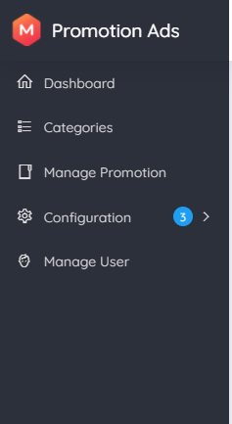
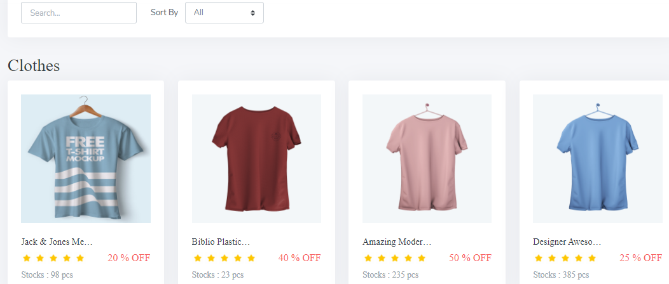
III. Features
Backend
Backend store data of company and information about ads
On our right size is Left size bar which control over
Frontend
Frontend to view all promotion post by selecting from the backend

Slide 7
V. Conclusion and Future Plan
a. Future Plan
So, our website is to make sure companies and sellers can advertise their products through our website with the high rate of viewers or consumers.
In the next future, we will develop more in order to make it broad market, broad view, high rate of purchasing

Slide 8


VI. Project Developing tool and prototype
a. Project developing tools
Programming Language : Laravel
IDE : VScode
SQL Database : MySQL

Slide 9
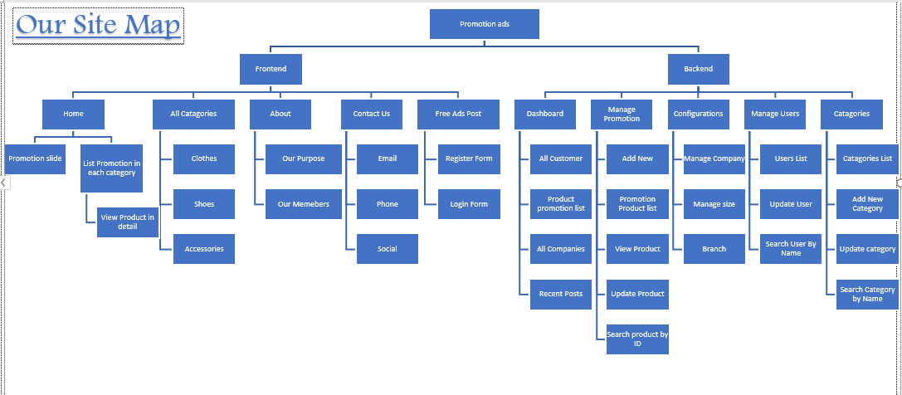
Promotion Ads Site Map

Slide 10
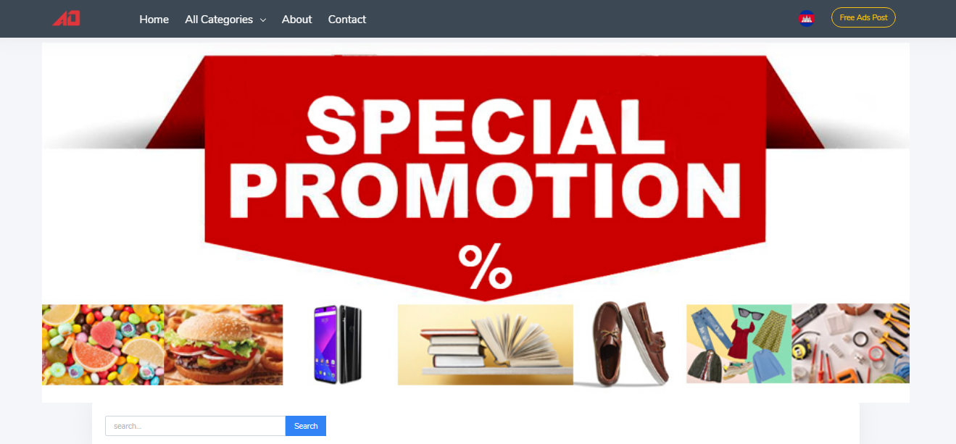
VI. Project Developing tool and prototype
b. Prototype (Frontend)
Home Page
Home Page: see all promotion product by category.

Slide 11
VI. Project Developing tool and prototype
b. Prototype (Frontend)
Home Page
Home Page: see all promotion product by category.

Slide 12
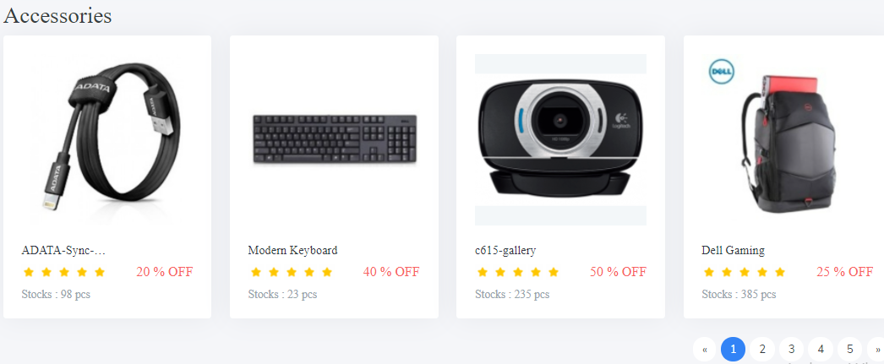
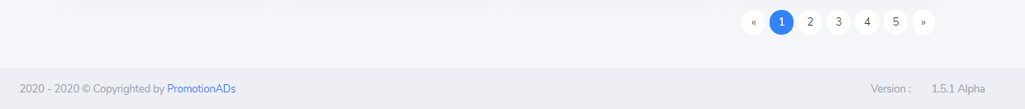
VI. Project Developing tool and prototype
b. Prototype (Frontend)
Home Page
Home Page: see all promotion product by category.

Slide 13
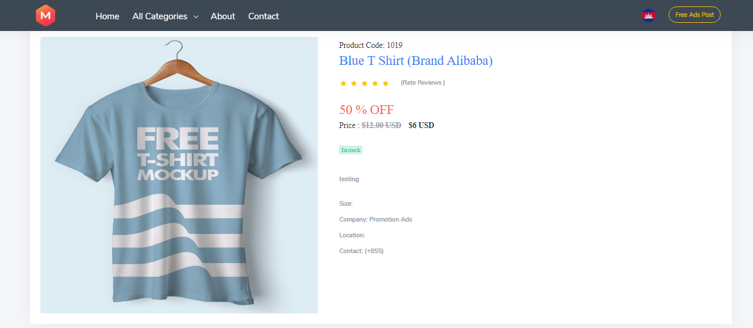
VI. Project Developing tool and prototype
b. Prototype (Frontend)
Product Detail

Slide 14
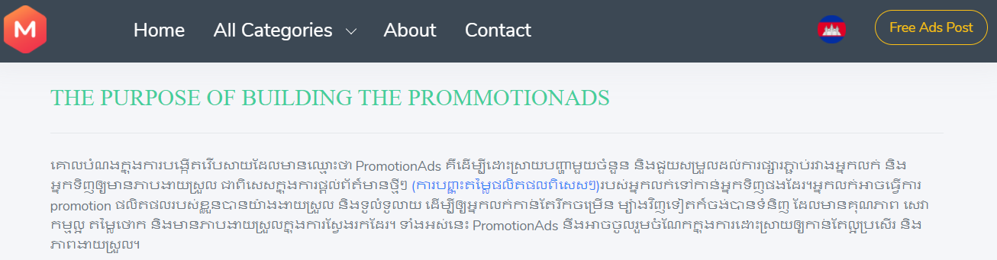
VI. Project Developing tool and prototype
b. Prototype (Frontend)
About
About is you will see our future goal and our team members.

Slide 15
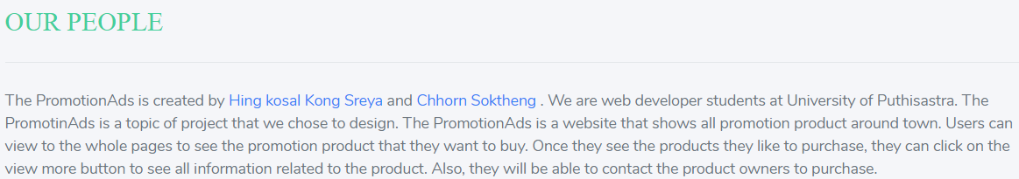
VI. Project Developing tool and prototype
b. Prototype (Frontend)
About

Slide 16
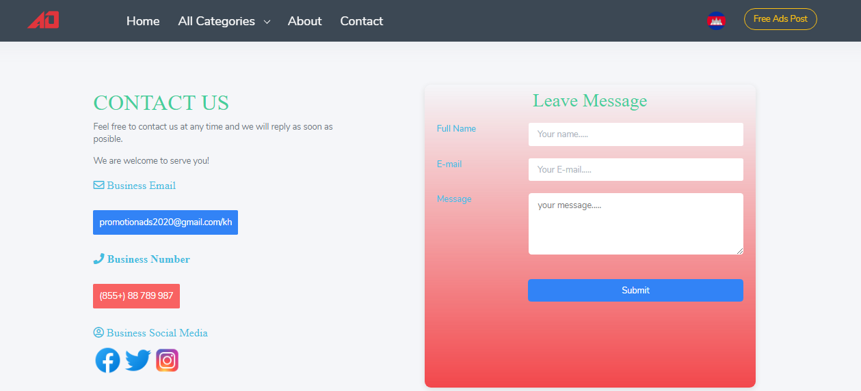
VI. Project Developing tool and prototype
b. Prototype (Frontend)
Contact Us
Contact Us is where you can send us message and contact us over the social media and Phone

Slide 17
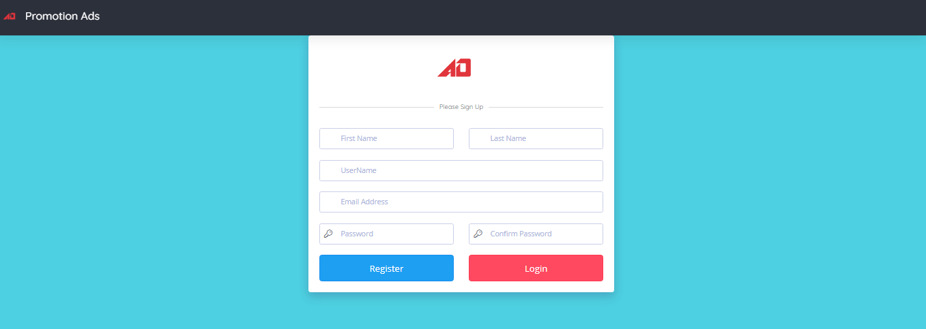
VI. Project Developing tool and prototype
b. Prototype (Frontend)
Register Form
Register Form: Register new account to login.

Slide 18

VI. Project Developing tool and prototype
b. Prototype (Frontend)
Login Form
Login Form: You need to have Email and password by register to login to backend then you can post your promotion ads.

Slide 19
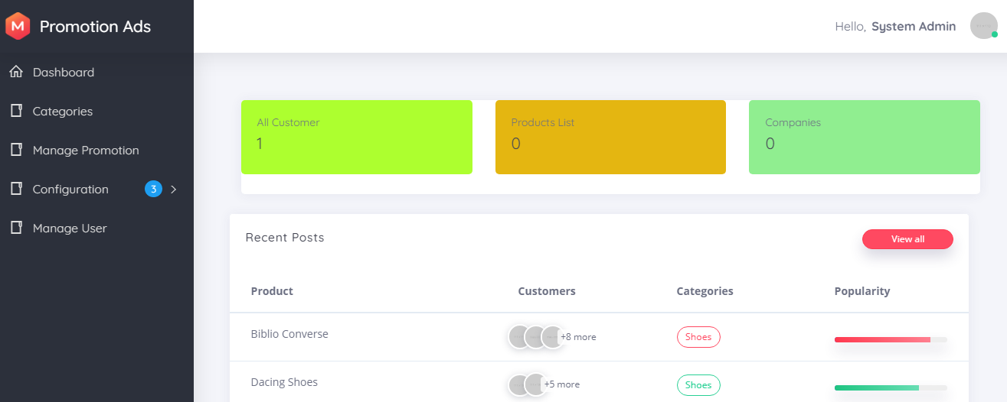
VI. Project Developing tool and prototype
b. Prototype (Backend)
Dashboard

Slide 20
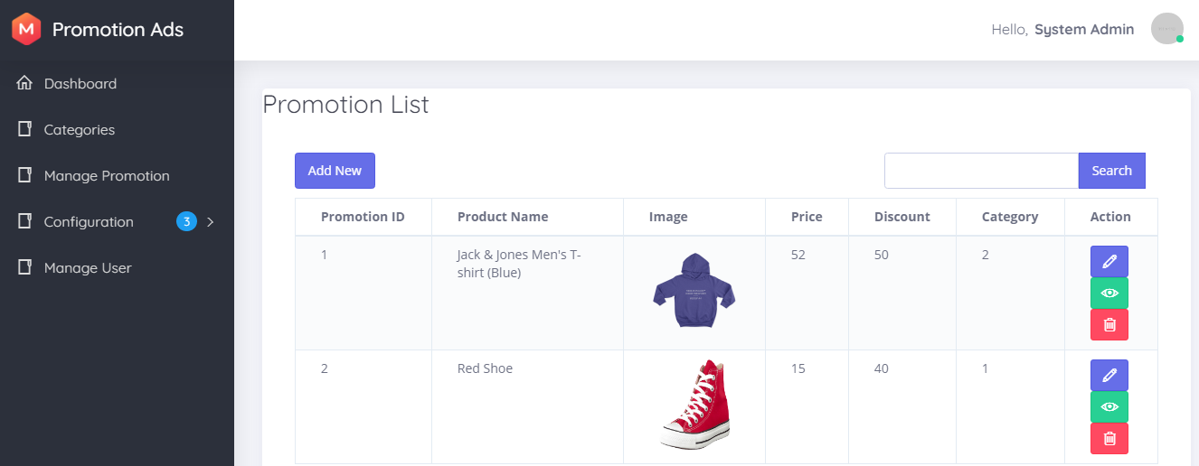
VI. Project Developing tool and prototype
b. Prototype (Backend)
View Lists Promotion Products
Promotion Product is where we can see all promotion post.
- We can add, update, delete,view and search

Slide 21
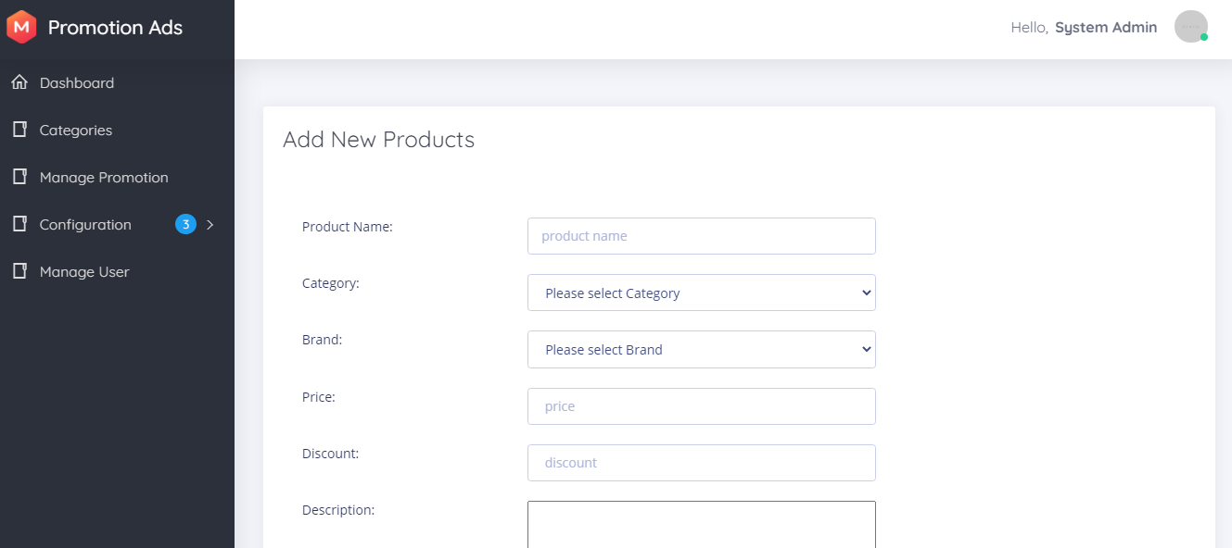
VI. Project Developing tool and prototype
b. Prototype (Backend)
Add Promotion Products

Slide 22
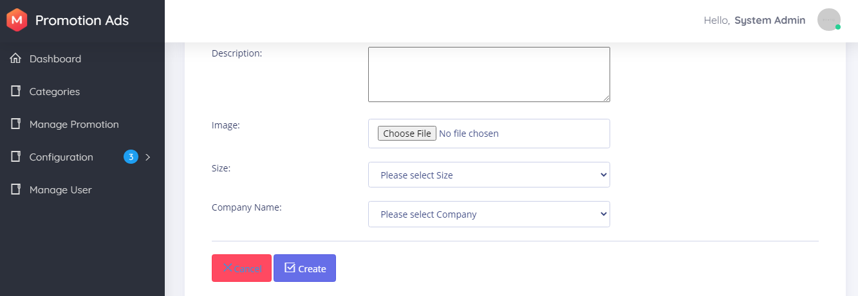
VI. Project Developing tool and prototype
b. Prototype (Backend)
Add Promotion Products

Slide 23
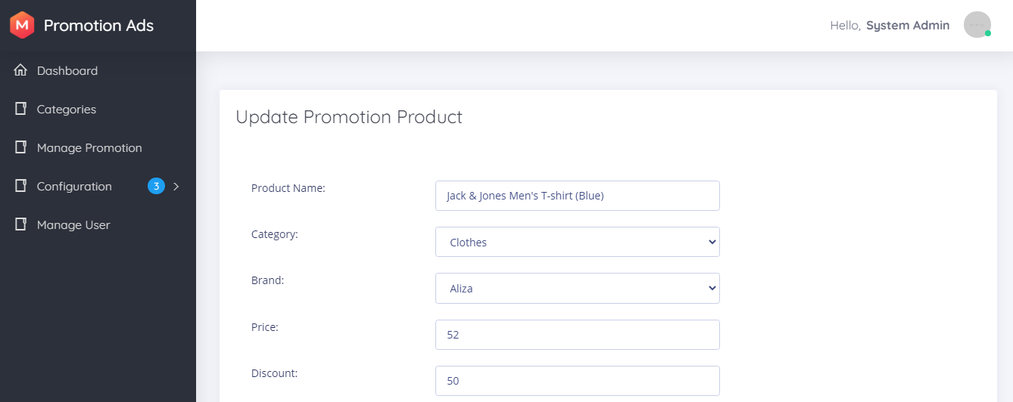
VI. Project Developing tool and prototype
b. Prototype (Backend)
Update Promotion Products

Slide 24
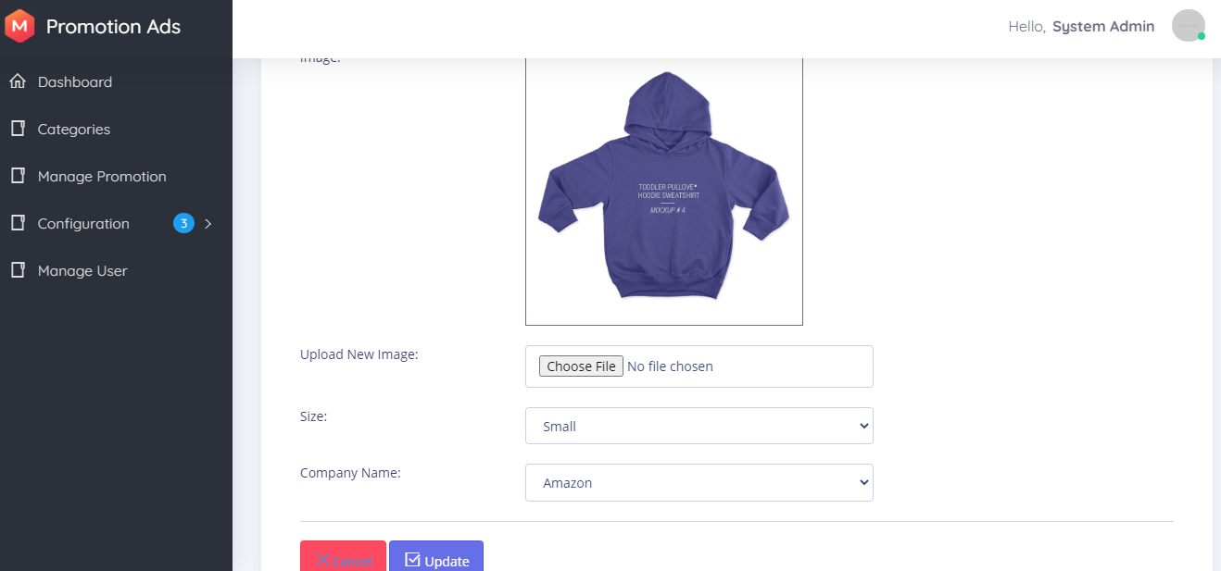
VI. Project Developing tool and prototype
b. Prototype (Backend)
Update Promotion Products

Slide 25
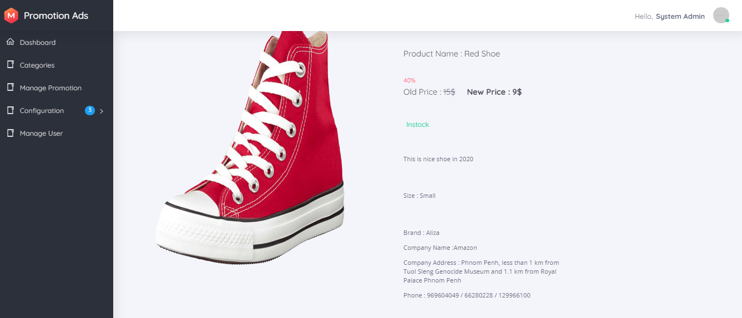
VI. Project Developing tool and prototype
b. Prototype (Backend)
View a Promotion Product
We can view in specific promotion product.

Slide 26
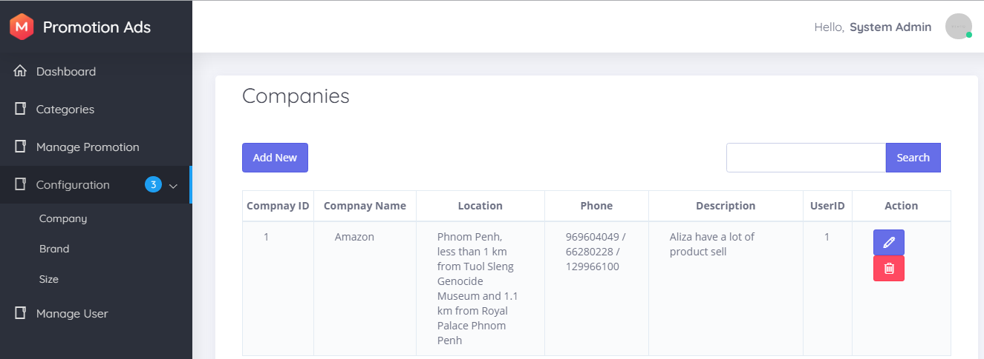
VI. Project Developing tool and prototype
b. Prototype (Backend)
View lists Company
Company of product before post promotion ads all product need to have company.
- View lists: view all Company.
- We can add, update and delete and search

Slide 27
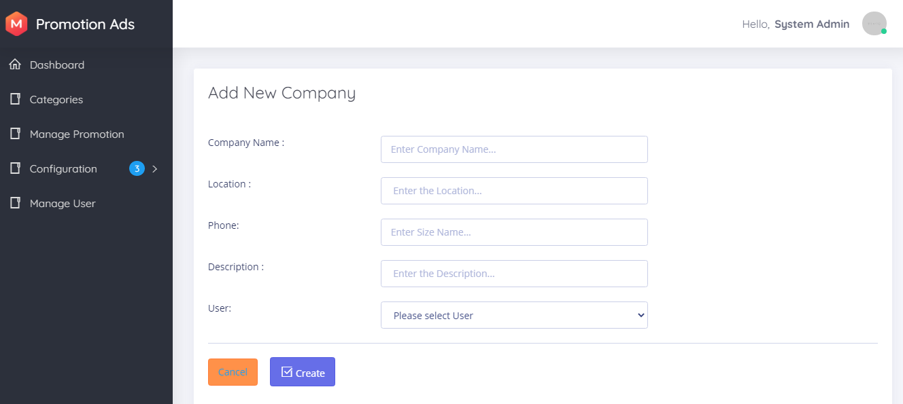
VI. Project Developing tool and prototype
b. Prototype (Backend)
Add Company

Slide 28
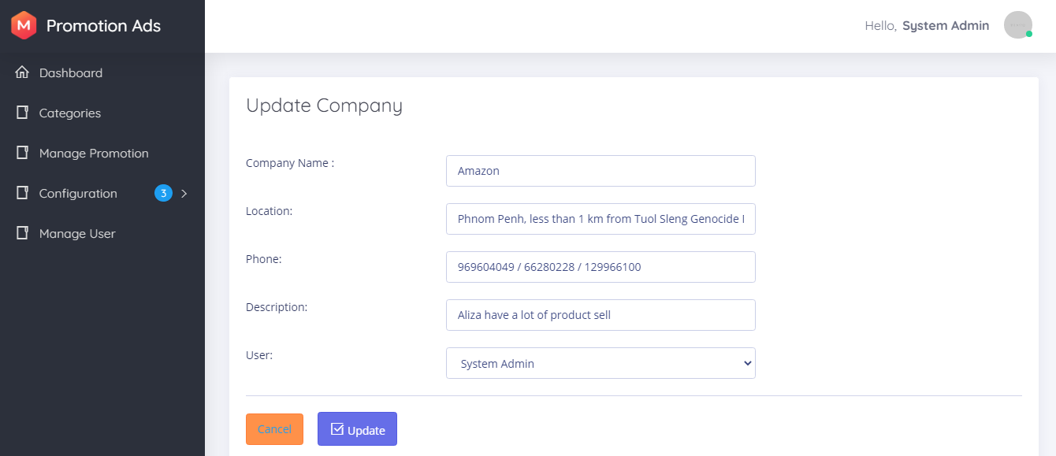
VI. Project Developing tool and prototype
b. Prototype (Backend)
Update Company

Slide 29
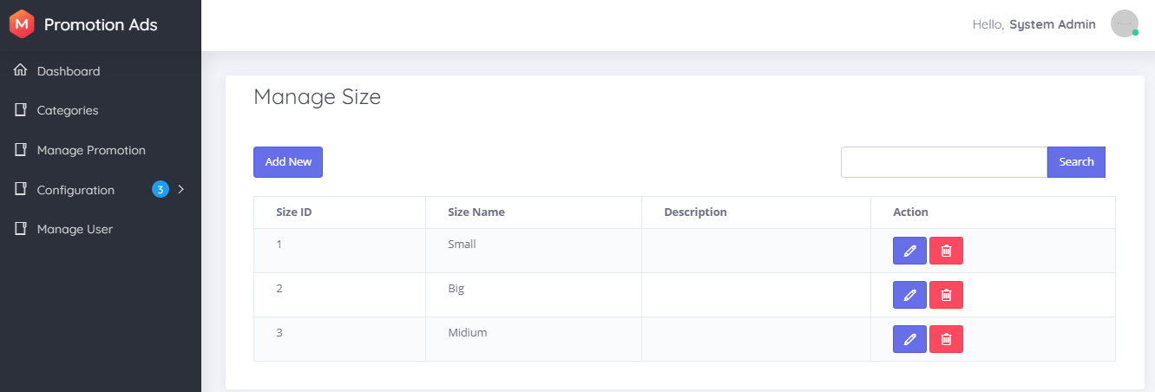
VI. Project Developing tool and prototype
b. Prototype (Backend)
View lists Size
Size is about product size like clothes or shoes...
- View lists: view all size.
- We can add, update and delete

Slide 30
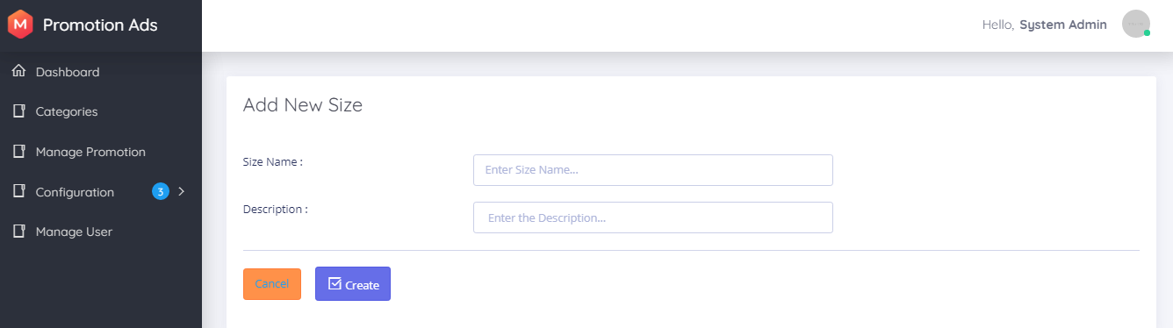
VI. Project Developing tool and prototype
b. Prototype (Backend)
Add Size

Slide 31
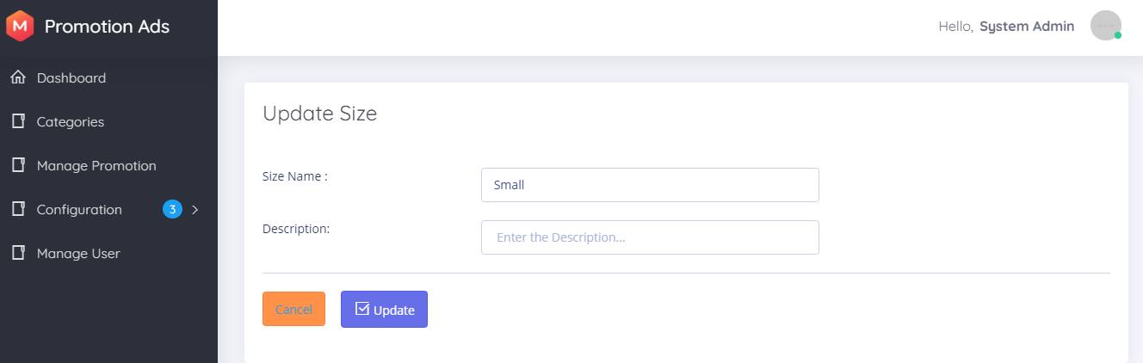
VI. Project Developing tool and prototype
b. Prototype (Backend)
Update Size

Slide 32
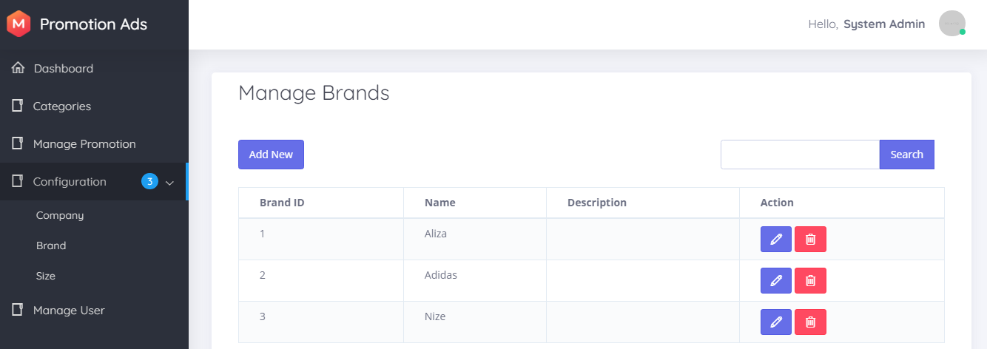
VI. Project Developing tool and prototype
b. Prototype (Backend)
View lists Brand
Brand is focus on product brand.
- View lists: view all product brand in the system.
- We can add, update and delete

Slide 33
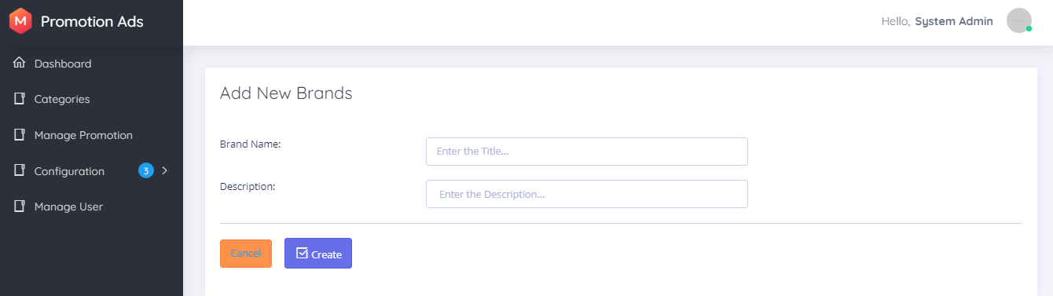
VI. Project Developing tool and prototype
b. Prototype (Backend)
Add Brand

Slide 34
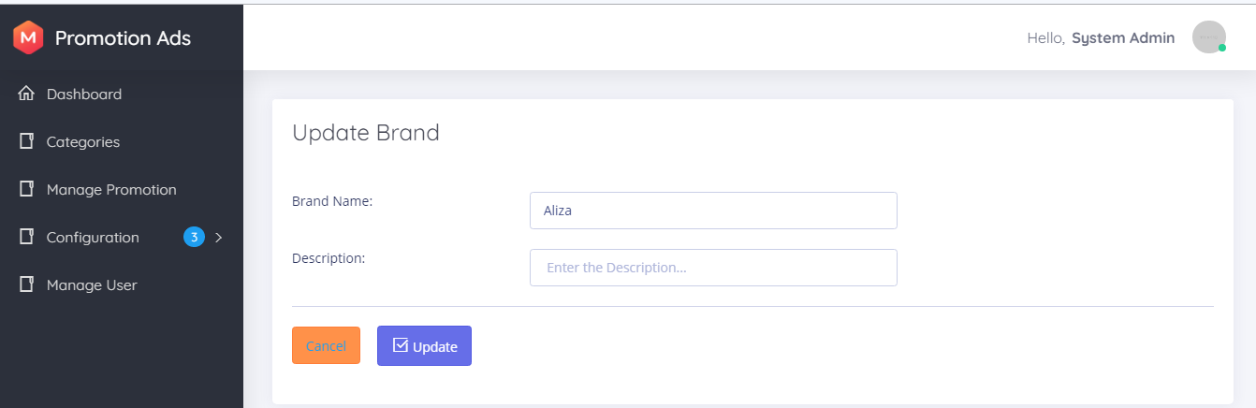
VI. Project Developing tool and prototype
b. Prototype (Backend)
Update Brand

Slide 35
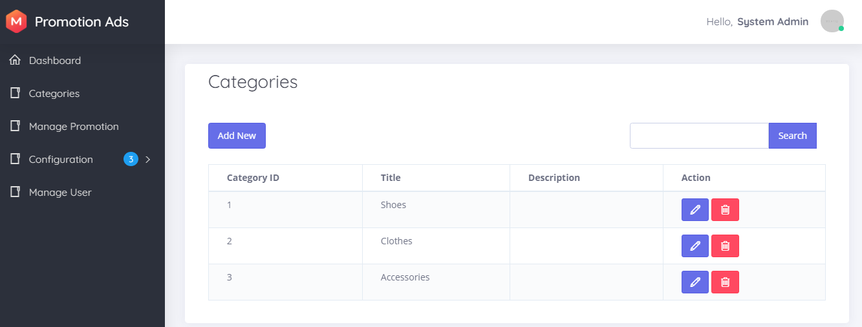
VI. Project Developing tool and prototype
b. Prototype (Backend)
View lists Category
Category is different kinds of products.
- View lists: view all category system have.
- We can add, update and delete

Slide 36
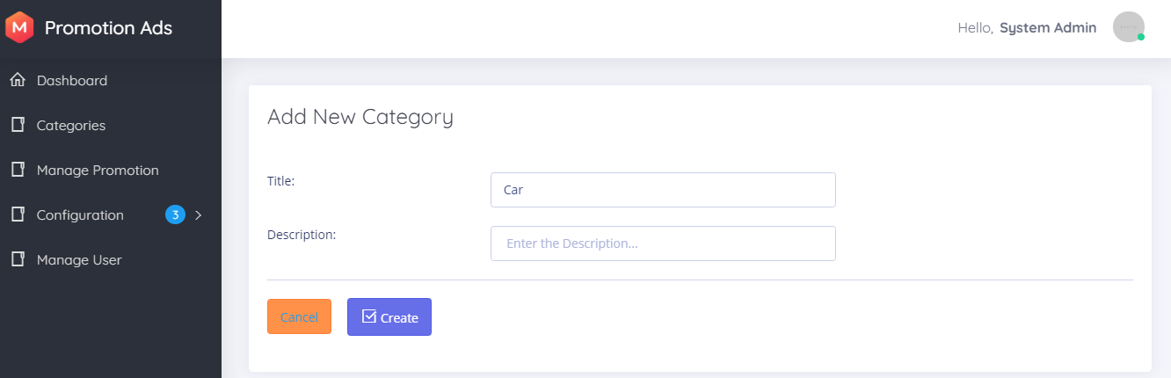
VI. Project Developing tool and prototype
b. Prototype (Backend)
Add Category

Slide 37
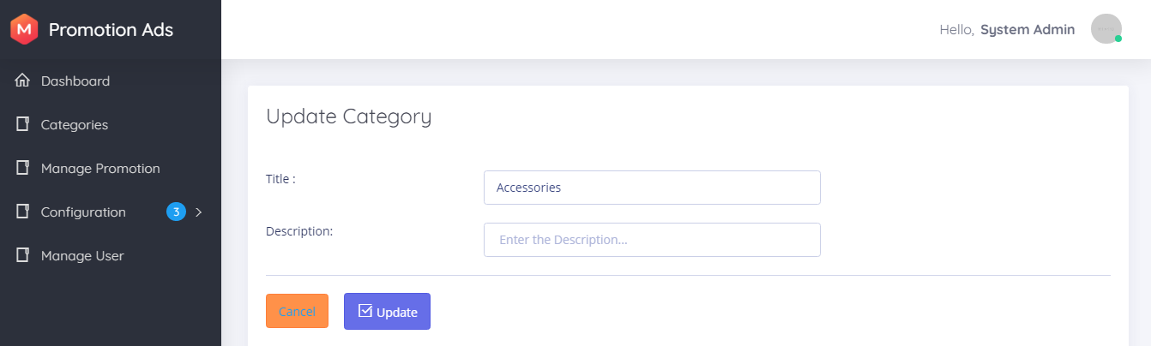
VI. Project Developing tool and prototype
b. Prototype (Backend)
Update Category

Slide 38
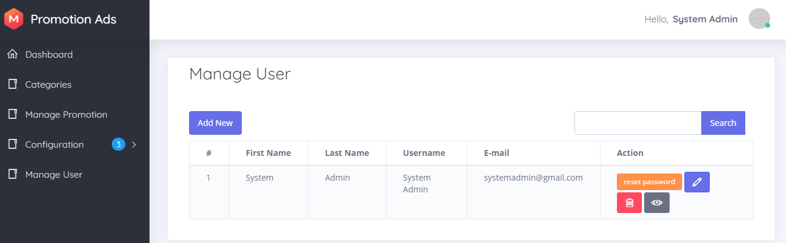
VI. Project Developing tool and prototype
b. Prototype (Backend)
View lists User
User use to login the backend of the system and can post new promotion ads.
- We can reset password , edit, delete and view list of users and search

Slide 39
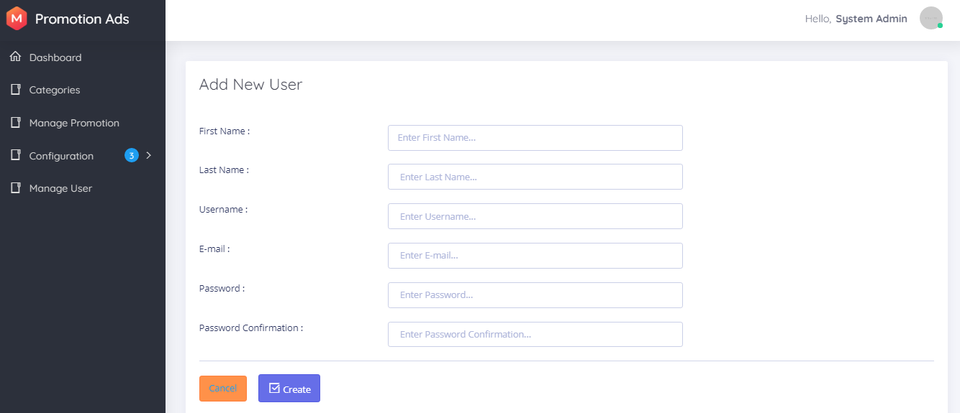
VI. Project Developing tool and prototype
b. Prototype (Backend)
Add User

Slide 40
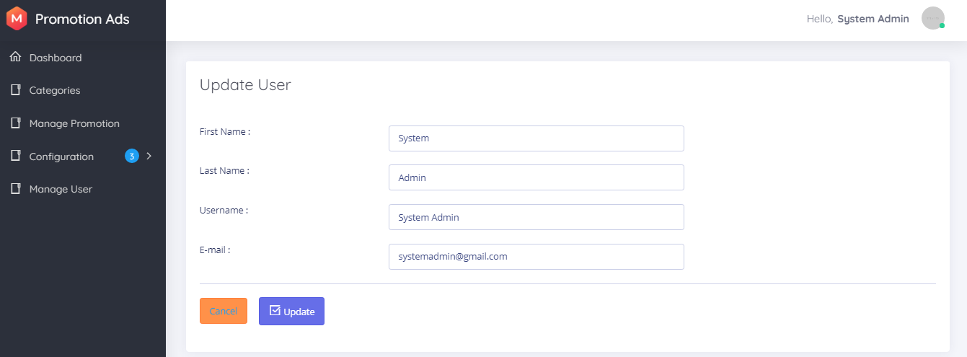
VI. Project Developing tool and prototype
b. Prototype (Backend)
Update User

Slide 41
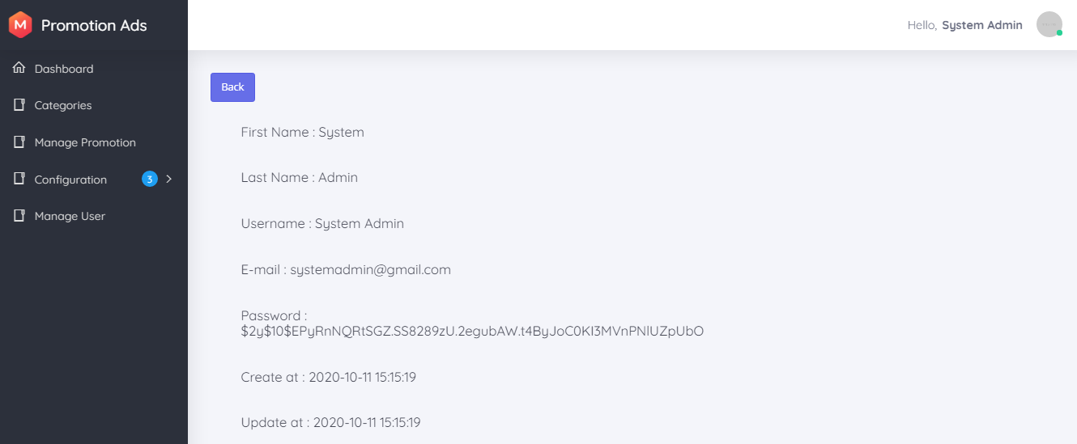
VI. Project Developing tool and prototype
b. Prototype (Backend)
View User

Slide 42

VI. Project Developing tool and prototype
b. Prototype (Backend)
Reset Password

Slide 43
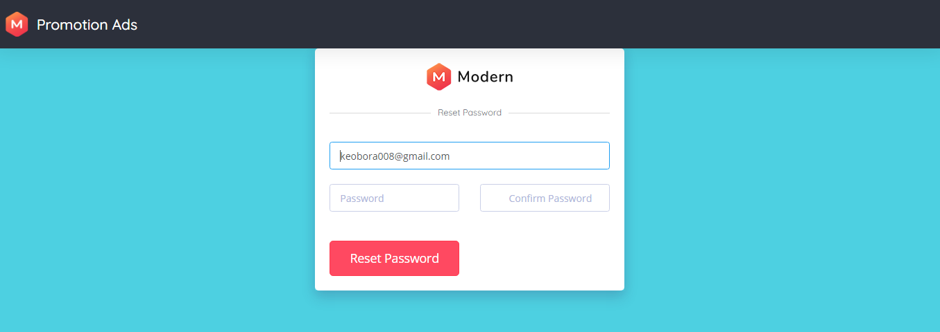
VI. Project Developing tool and prototype
b. Prototype (Backend)
Reset Password

Slide 44


Reference
Frontend Template
https://coderthemes.com/ubold/layouts/creative/dashboard-2.html
Backend Template
https://pixinvent.com/modern-admin-clean-bootstrap-4-dashboard-html-template/html/ltr/vertical-modern-menu-template/index.html
Laravel Tutorial
https://laravel.com
https://www.youtube.com/watch?v=EU7PRmCpx-0&list=PLillGF-RfqbYhQsN5WMXy6VsDMKGadrJ-
https://www.tutorialspoint.com/laravel/

Slide 45
Thanks!!!!!!!!!

