Slide 1

University of Puthisastra
Website Project
Topic: Promotion Ads
Lecturer : Lypengleang Seang
Course : Dynamic Web App
Years : III
Semester : II
Academic Year: 2019 – 2020
By Group I
Mr. Hing Kosal
Ms. Kong Sreya
Mr. Chhorn SokTheng

Slide 2
Contents
I. Introduction
II. Problem & Solution
III. Features
IV. Conclusion and Future Plan
V. Project Developing tool and prototype

Slide 3
II. Project Objective
I. Introduction
We advertise product promotions for companies and seller to customers through our website. Seller easy to promotion their product and buyer easy to find standard product with good price and quality.

Slide 4

II. Project Objective
II. Problem and Solution
a. Problem
- People hard to find promotion product
- Spend a lot of time to find promotion product
- Some time get not standard product
- For seller hard to find the place where they can promote their product

Slide 5

II. Problem and Solution
b. Solution
Building a dynamic web application for all information management about promotion products from different company to the world.

Slide 6
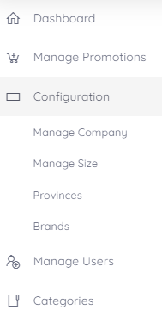
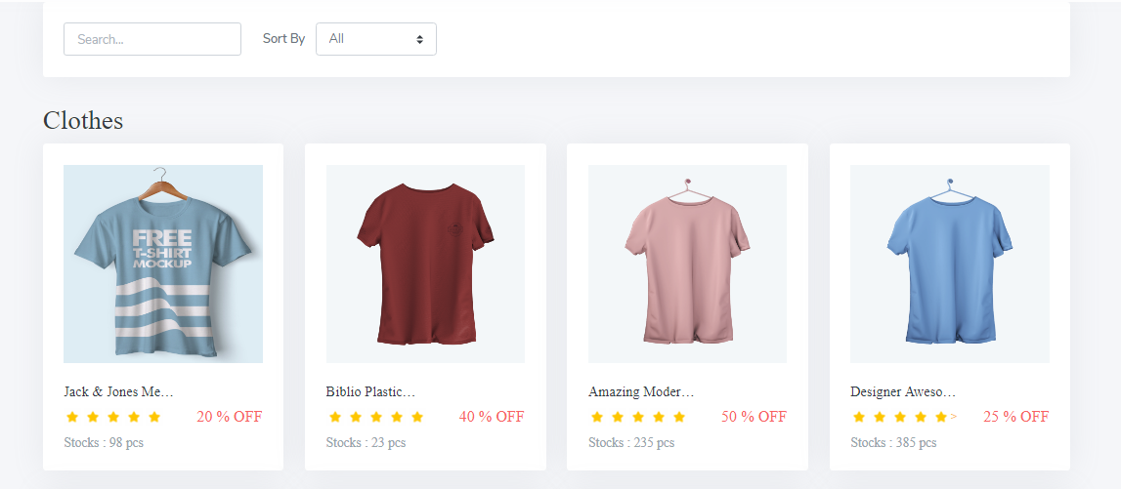
III. Features
Backend
Backend store data of company and information about ads
On our right size is Left size bar which control over
Frontend
Frontend to view all promotion post by selecting from the backend

Slide 7
V. Conclusion and Future Plan
a. Future Plan
So, our website is to make sure companies and sellers can advertise their products through our website with the high rate of viewers or consumers.
In the next future, we will develop more in order to make it broad market, broad view, high rate of purchasing

Slide 8


VI. Project Developing tool and prototype
a. Project developing tools
Programming Language : PHP, html, css, Bootstrap,JavaScript
IDE : PhpStorm,VScode
SQL Database : MySQL

Slide 9
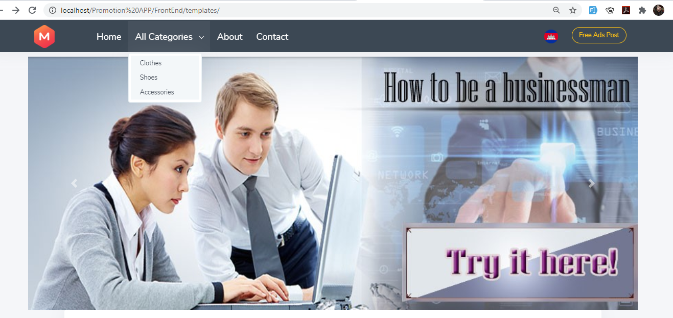
VI. Project Developing tool and prototype
b. Prototype (Frontend)
Home Page
Home Page: see all promotion product by category.

Slide 10
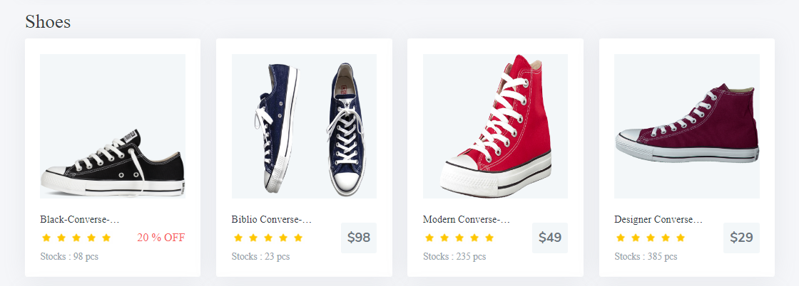
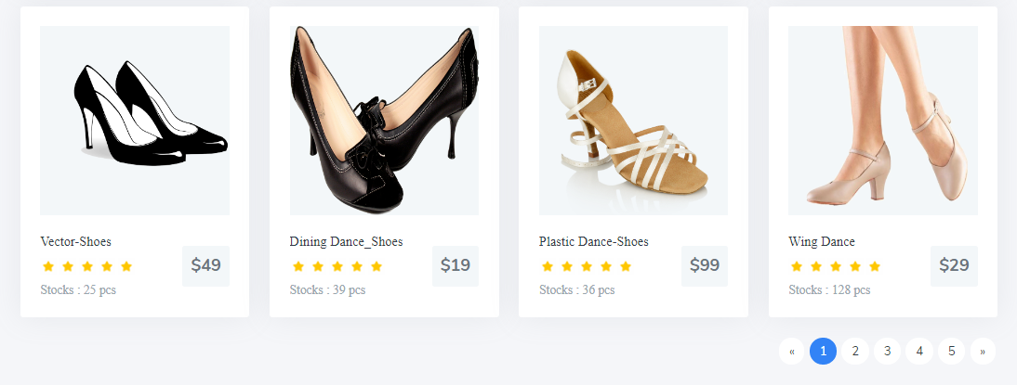
VI. Project Developing tool and prototype
b. Prototype (Frontend)
Home Page

Slide 11
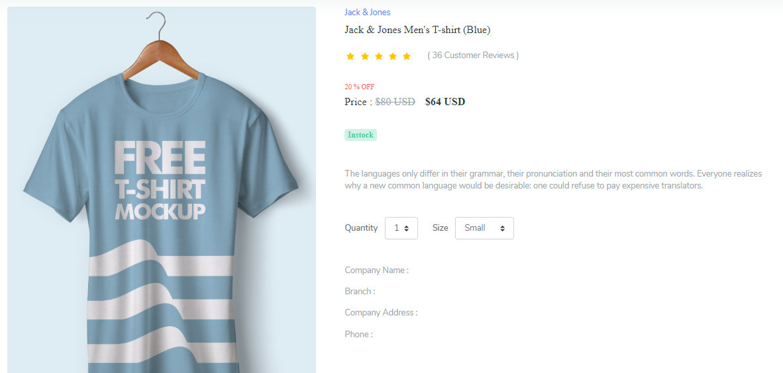
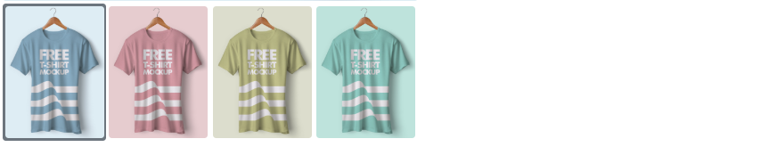
VI. Project Developing tool and prototype
b. Prototype (Frontend)
Product Detail

Slide 12
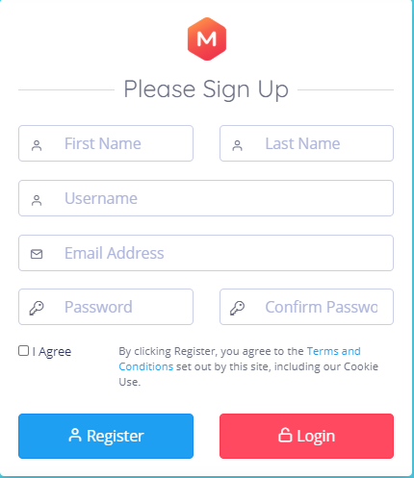
VI. Project Developing tool and prototype
b. Prototype (Frontend)
Register Form
Register Form: Register new account to login.

Slide 13
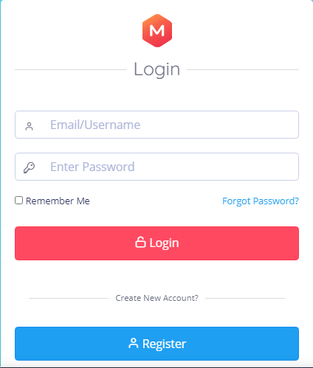
VI. Project Developing tool and prototype
b. Prototype (Frontend)
Login Form
Login Form: You need to have Email and password by register to login to backend then you can post your promotion ads.

Slide 14
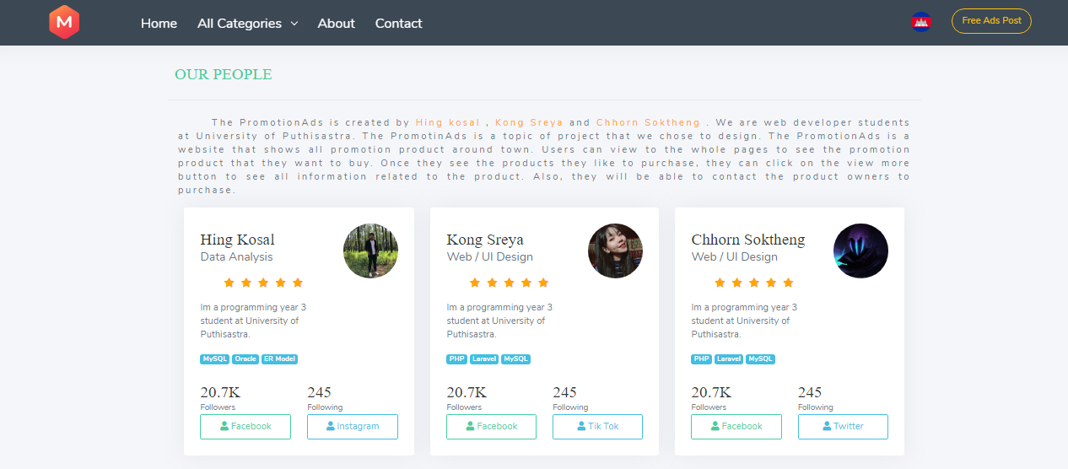
VI. Project Developing tool and prototype
b. Prototype (Frontend)
About Us
About is you will see our future goal and our team members.

Slide 15
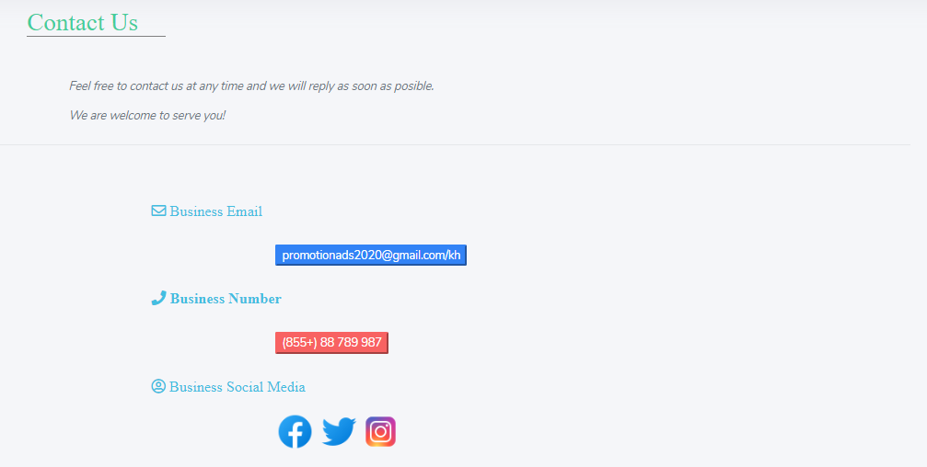
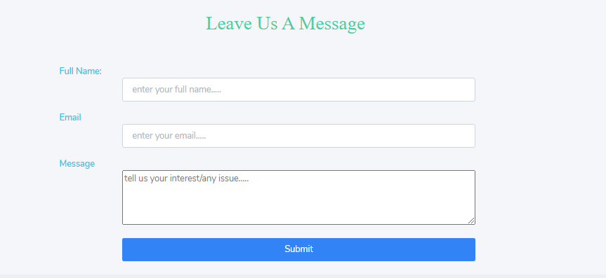
VI. Project Developing tool and prototype
b. Prototype (Frontend)
Contact Us
Contact Us is where you can send us message and contact us over the social media and Phone

Slide 16
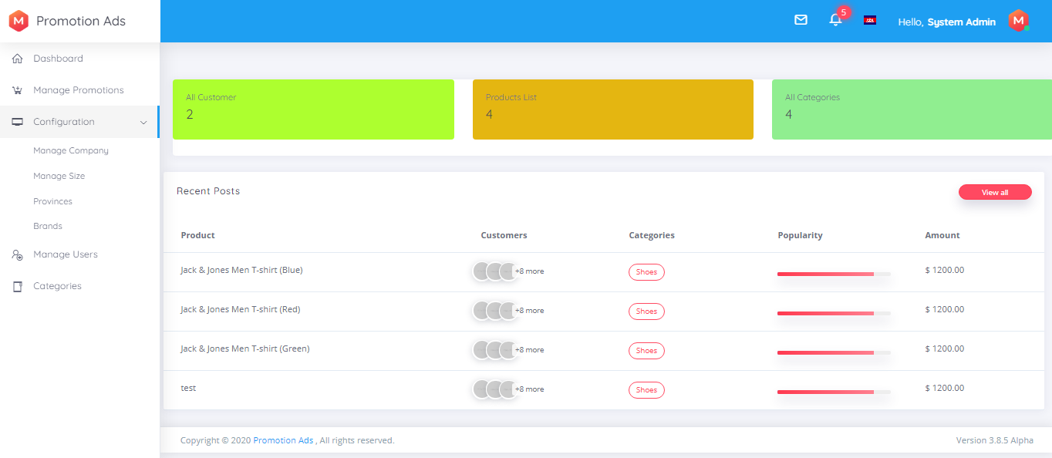
VI. Project Developing tool and prototype
b. Prototype (Backend)
Dashboard

Slide 17
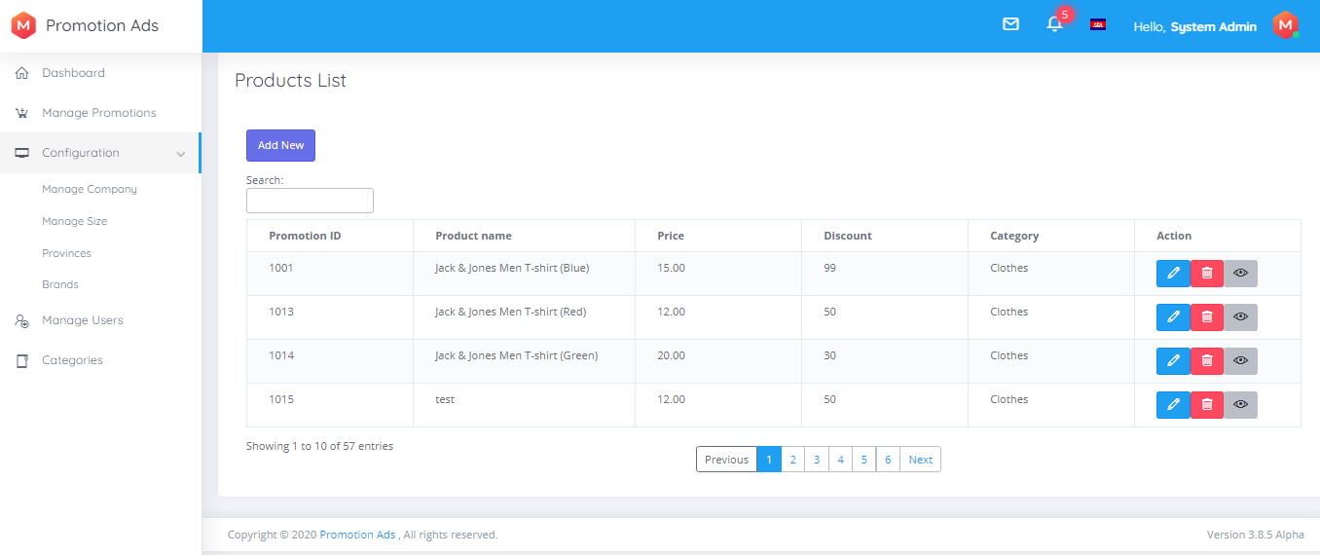
VI. Project Developing tool and prototype
b. Prototype (Backend)
View Lists Promotion Products
Promotion Product is where we can see all promotion post.
- We can add, update, delete, and view

Slide 18
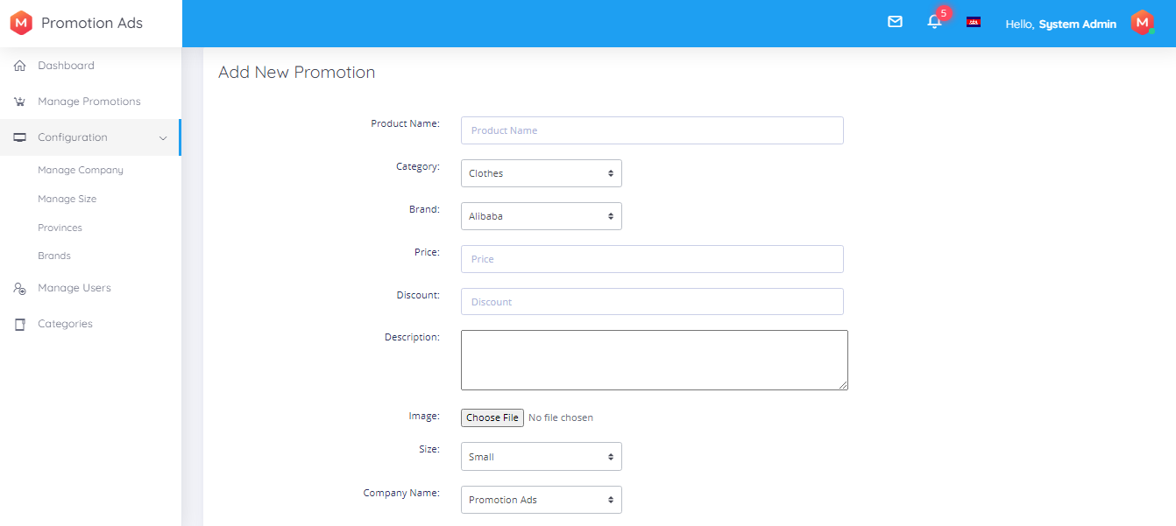
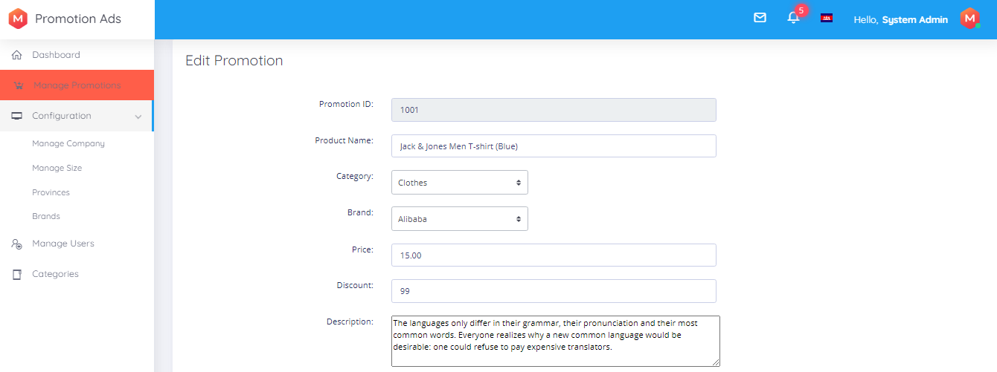
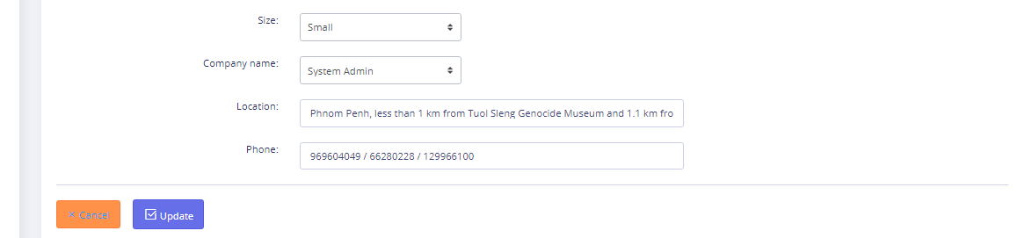
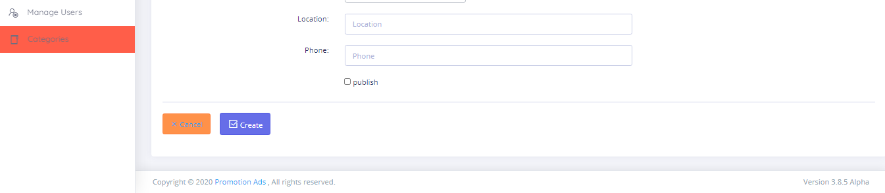
VI. Project Developing tool and prototype
b. Prototype (Backend)
Add, and Update Promotion Products

Slide 19
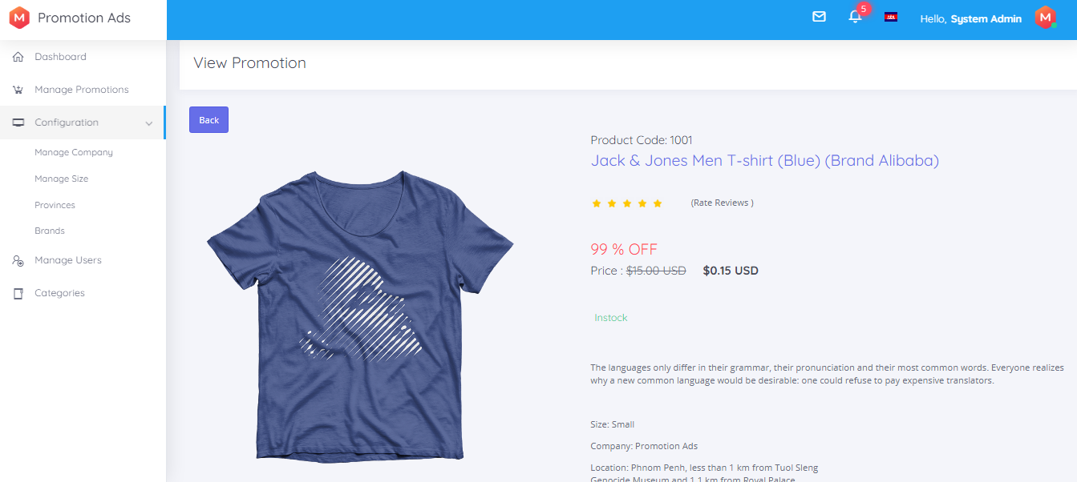
VI. Project Developing tool and prototype
b. Prototype (Backend)
View a Promotion Product
We can view in specific promotion product.

Slide 20
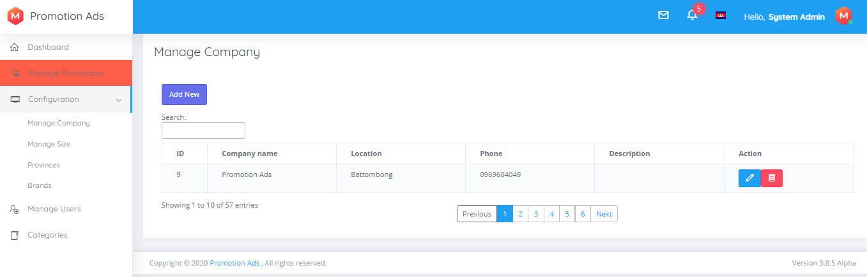
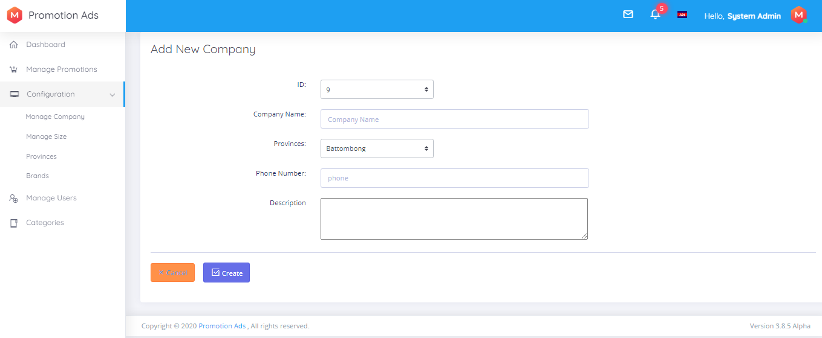

VI. Project Developing tool and prototype
b. Prototype (Backend)
View lists, Add, and Update Company
Company of product before post promotion ads all product need to have company.
- View lists: view all Company.
- We can add, update and delete

Slide 21
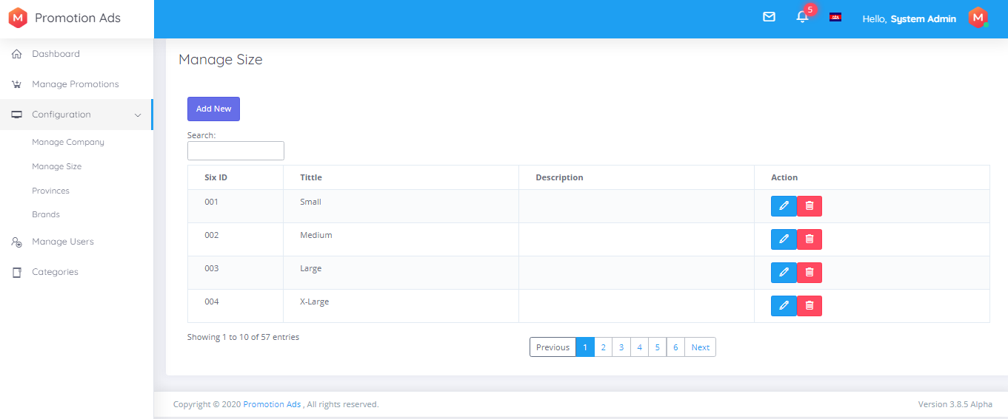
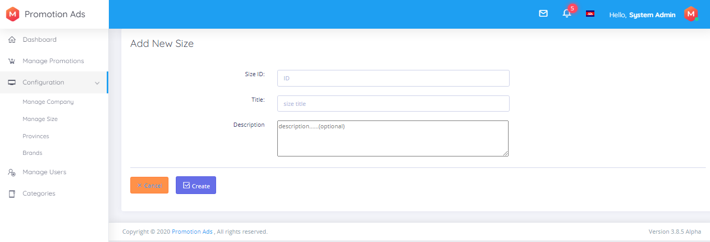
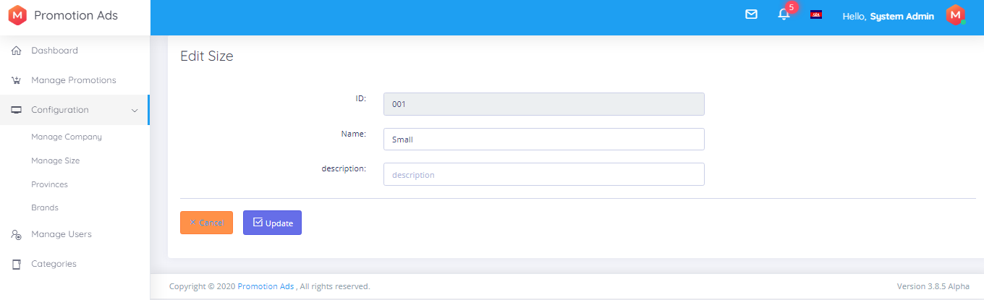
VI. Project Developing tool and prototype
b. Prototype (Backend)
View lists, Add, and Update Size
Size is about product size like clothes or shoes...
- View lists: view all size.
- We can add, update and delete

Slide 22
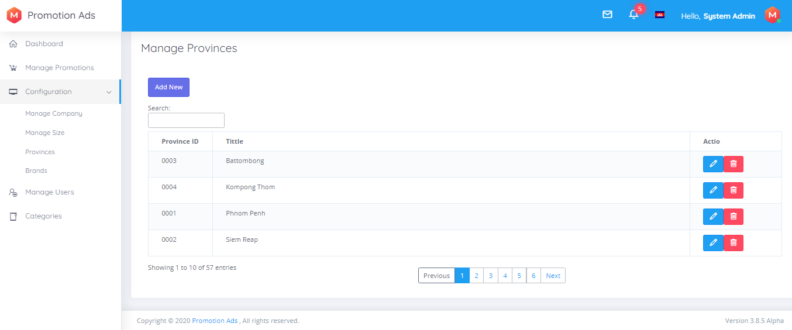
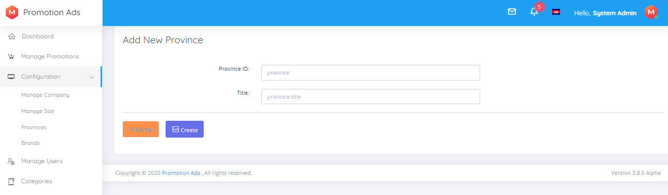
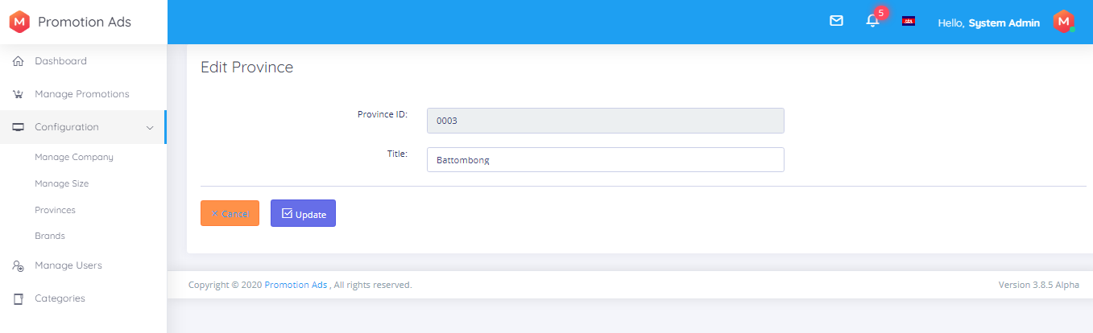
VI. Project Developing tool and prototype
b. Prototype (Backend)
View lists, Add, and Update Province
Province is about location of company.
- View lists: view all province.
- We can add, update and delete

Slide 23
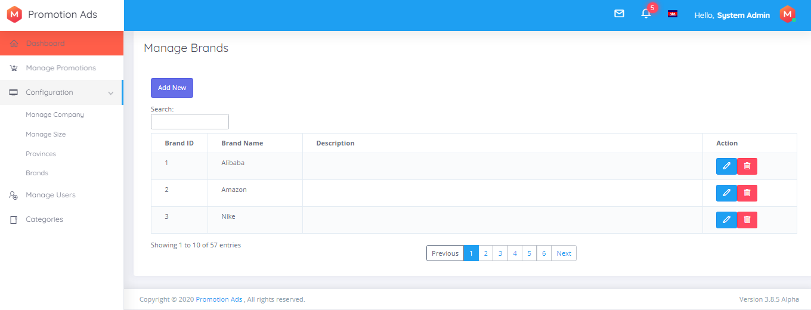


VI. Project Developing tool and prototype
b. Prototype (Backend)
View lists, Add, and Update Brand
Brand is focus on product brand.
- View lists: view all product brand in the system.
- We can add, update and delete

Slide 24
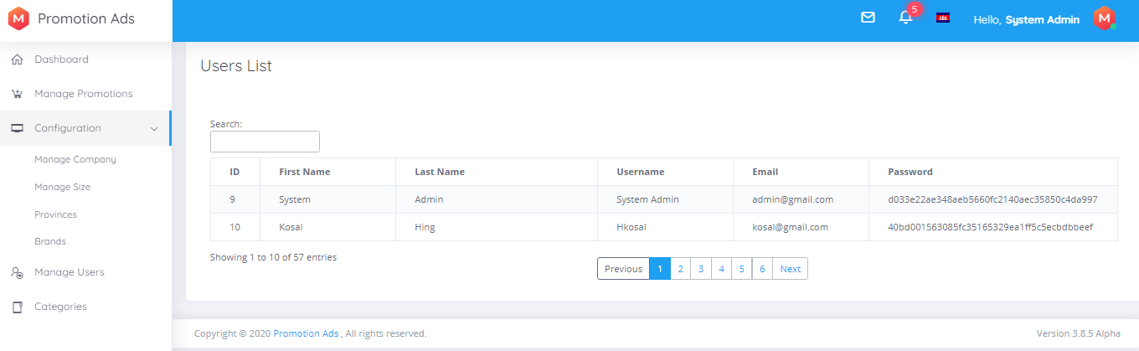
VI. Project Developing tool and prototype
b. Prototype (Backend)
View lists User
User use to login the backend of the system and can post new promotion ads.
- We can only view list of users

Slide 25
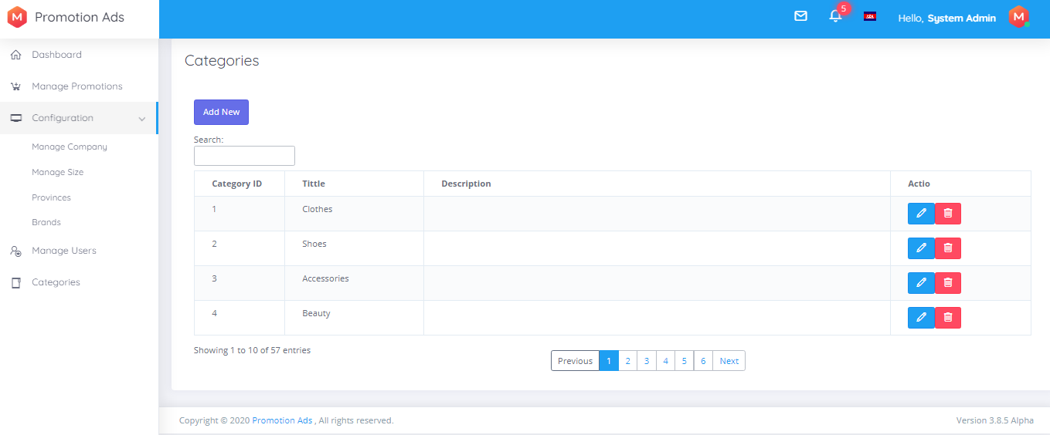

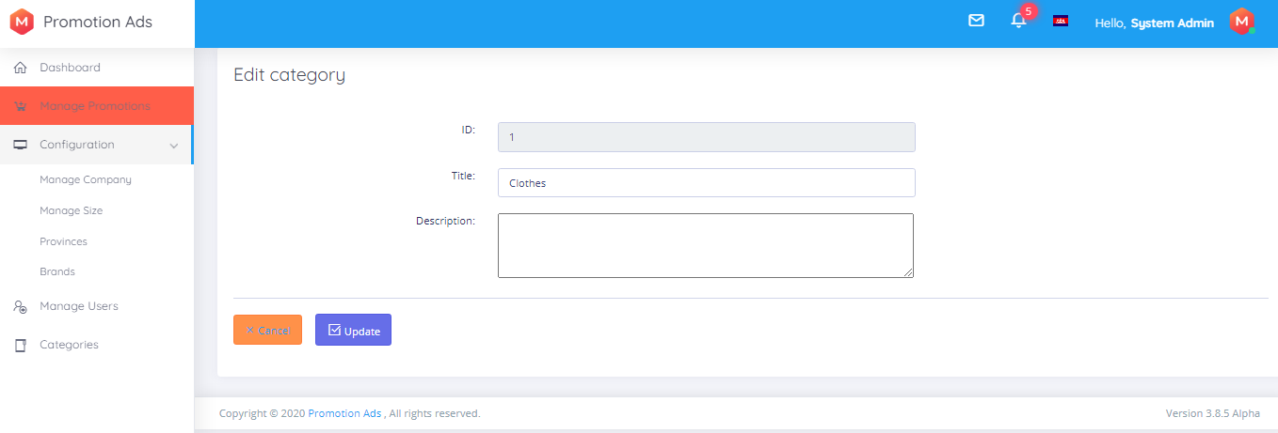
VI. Project Developing tool and prototype
b. Prototype (Backend)
View lists, Add, and Update Category
Category is different kinds of products.
- View lists: view all category system have.
- We can add, update and delete

Slide 26
Thanks!!!!!!!!!

