Slide 1
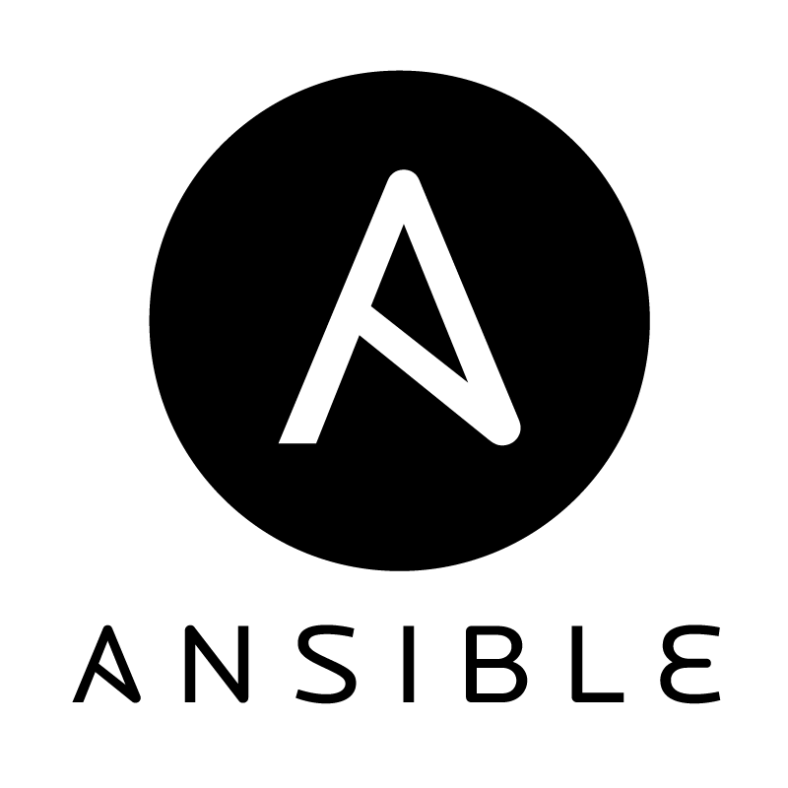
Automation with Ansible & EC2

Slide 2
Agenda
Recap: Cloud Computing
Infrastructure Automation
Ansible
Examples with Ansible
Outlook

Slide 3
Recap: Cloud Computing

Slide 4
Recap: Cloud Computing Definition
Cloud computing is a model for enabling ubiquitous, convenient, on-demand network access to a shared pool of configurable computing resources (e.g., networks, servers, storage, applications, and services) that can be rapidly provisioned and released with minimal management effort or service provider interaction.
Source: National Institute for Standards & Technology (NIST) http://csrc.nist.gov/publications/nistpubs/800-145/SP800-145.pdf

Slide 5

Recap: Cloud Computing Characteristics
On-demand Self-service
Broad Network Access
Measured Service
Resource Pooling
Rapid Elasticity
Supermarket
Scalability
Performance
Multi-Tenancy
Business Model
Relevant to this talk

Slide 6
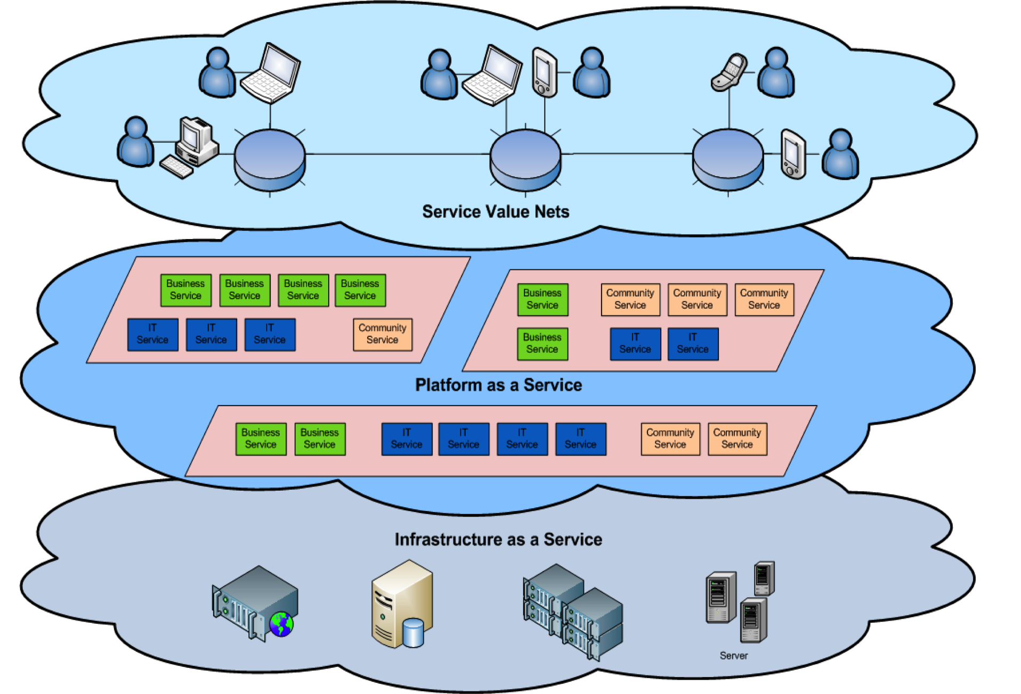
Recap: Cloud Service Delivery Models
SaaS
Web Applications like
Google Apps, Salesforce etc.
Software as a Service
PaaS
Development or execution
environments like
Google App Engine, Windows Azure
IaaS
Offerings like Google Storage,
Amazon Web Services etc.
Focus of this talk

Slide 7
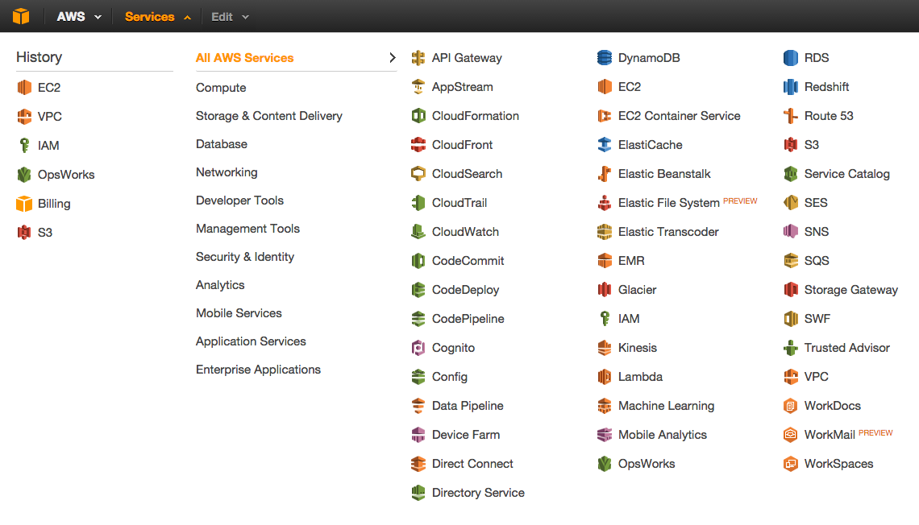
Recap: Amazon Web Services
EC2 is the elastic compute cloud of AWS offering “computers” as a service.

Slide 8
Recap: EC2 Core Concepts
Amazon Machine Image (AMI): an encrypted file stored in Amazon storage, containing all the information necessary to boot instances of a customer’s software
An AMI is like a bootable root disk, which can be pre-defined or user-built.
Public AMIs: Pre-configured, template AMIs
Private AMIs: User-built AMI containing private applications, libraries, data and associated configuration settings
There is a community of AMI creators, e.g. bitnami.com, thecloudmarket.com, aws.amazon.com/marketplace.
Instance: The running system based on an AMI
All instances based on the same AMI begin executing identically. An instance can be launched in a few minutes.
Any information on them is lost when the instances are terminated or if they fail.
Data can be made persistent by use of the Amazon storage services

Slide 9
Infrastructure Automation

Slide 10
Infrastructure Automation Approaches

Slide 11
Opscode Chef

Slide 12
PuppetLabs Puppet

Slide 13
Ansible

Slide 14
What is Ansible?
A YAML-based, descriptive language for automation of infrastructure setups
Owns concepts to structure definition files:
Variables (vars)
Tasks
Profiles
Handlers
Templates (jinja2)
Provides reusable modules to run tasks
Can manage known hosts & cloud services
YAML: true Fruits:
- name: Apple
price: .50
- name: Banana price: .80

Slide 15
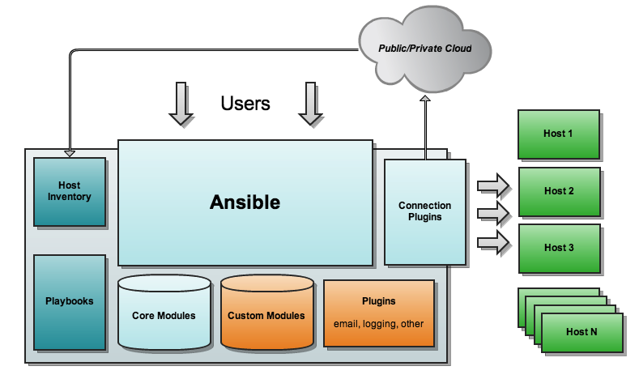
Ansible Setup
Any PC to remote machine

Slide 16
Ansible Galaxy
Ansible repo with many modules available
Many integrations with clouds, vagrant, etc.

Slide 17
With Ansible it’s like…
Defining and documenting your infrastructure
Thinking about a final state (idempotence)
Modules pave the way to simple setups
Iteration works in descriptive files, too!
No more (or less) scripting, but still thinking!
Support for continuous delivery and rolling upgrades
Problems with Python may occur

Slide 18
Examples with Ansible

Slide 19
Architecture of Example 1

