Slide 1


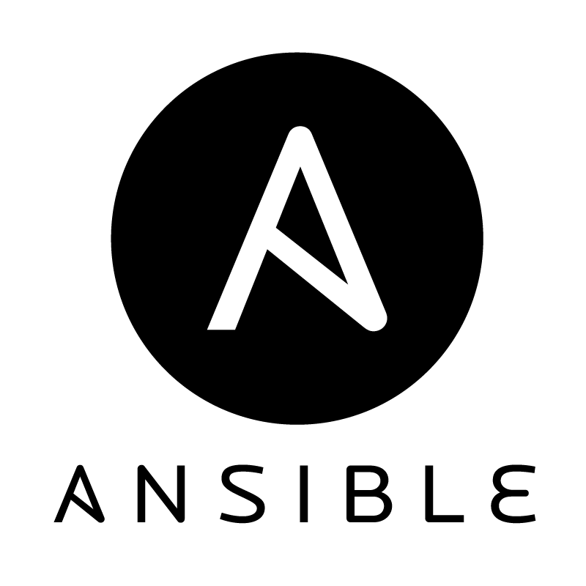

Automation with Ansible and EC2
Michael Menzel
Vineet Hingorani
September 02, 2015

Slide 2
Agenda
Recap: Cloud Computing & Compute Clouds
Definition, Characteristics, Delivery Models, Core Concepts
Infrastructure Automation with OSCM
Concept of OSCM, Opscode Chef, Saltstack Salt
Ansible
Explain the Ansible Approach, Share our Experiences
Examples with Ansible
Start Example App on multiple Instances with Load Balancer, Start MetricStorageService and use Auto-Scaling
Outlook
Ansible Tower, Discussion on how to leverage

Slide 3


Recap: Cloud Computing

Slide 4
Cloud Computing Definition
Cloud computing is a model for enabling ubiquitous, convenient, on-demand network access to a shared pool of configurable computing resources (e.g., networks, servers, storage, applications, and services) that can be rapidly provisioned and released with minimal management effort or service provider interaction.
Source: National Institute for Standards & Technology (NIST) http://csrc.nist.gov/publications/nistpubs/800-145/SP800-145.pdf

Slide 5

Cloud Computing Characteristics
On-demand Self-service
Broad Network Access
Measured Service
Resource Pooling
Rapid Elasticity
Supermarket
Scalability
Performance
Multi-Tenancy
Business Model
Relevant to this talk

Slide 6
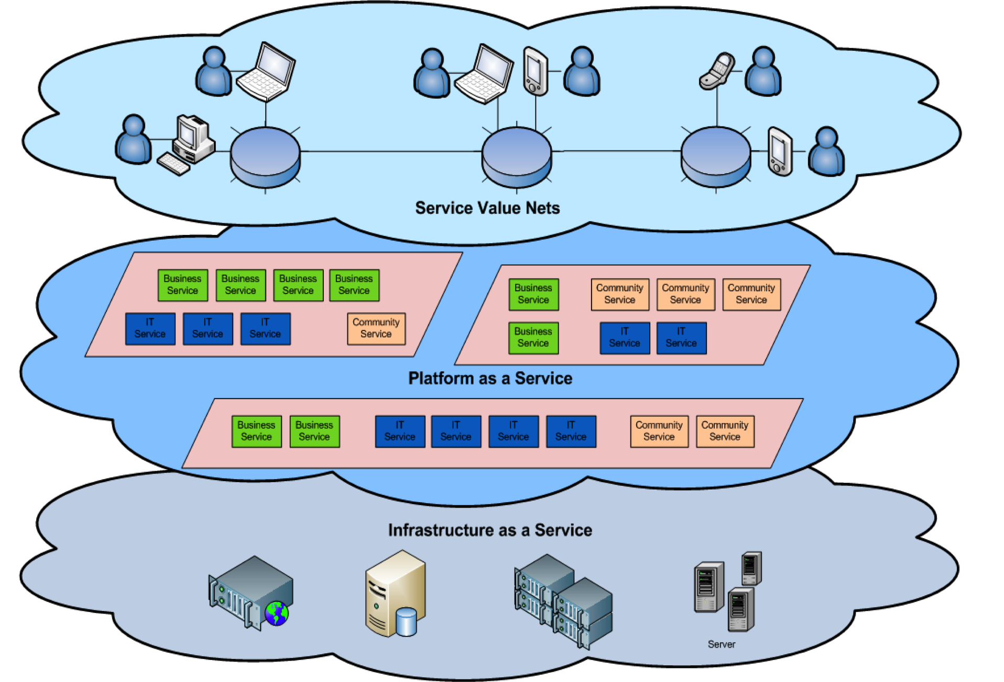
Cloud Delivery Models
Software as a Service
SaaS
Web Applications like
Google Apps, Salesforce etc.
PaaS
Development or execution
environments like
Google App Engine, Windows Azure
IaaS
Offerings like Google Storage,
Amazon Web Services etc.
Focus of this talk

Slide 7
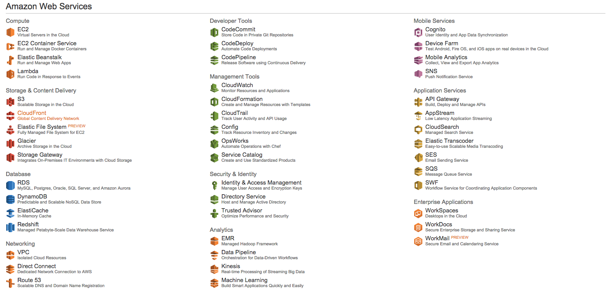
Amazon Web Services
EC2 is the elastic compute cloud of AWS offering “computers” as a service.

Slide 8
EC2 Core Concepts
Amazon Machine Image (AMI)
An encrypted file stored in Amazon storage, containing all the information necessary to boot instances of a customer’s software
An AMI is like a bootable root disk, which can be pre-defined or user-built.
Public AMIs: Pre-configured, template AMIs. Eg. Ubuntu 14.04, Red Hat Enterprise 7
Private AMIs: User-built AMI containing private applications, libraries, data and associated configuration settings. Eg. Ubuntu 14.04 image with HANA as a software.
There is a community of AMI creators, e.g. bitnami.com, thecloudmarket.com, aws.amazon.com/marketplace
Instance
The running system based on an AMI
All instances based on the same AMI begin executing identically. An instance can be launched in a few minutes.
Any information on them is lost when the instances are terminated or if they fail.
Data can be made persistent by use of Amazon storage services.

Slide 9
Infrastructure Automation

Slide 10
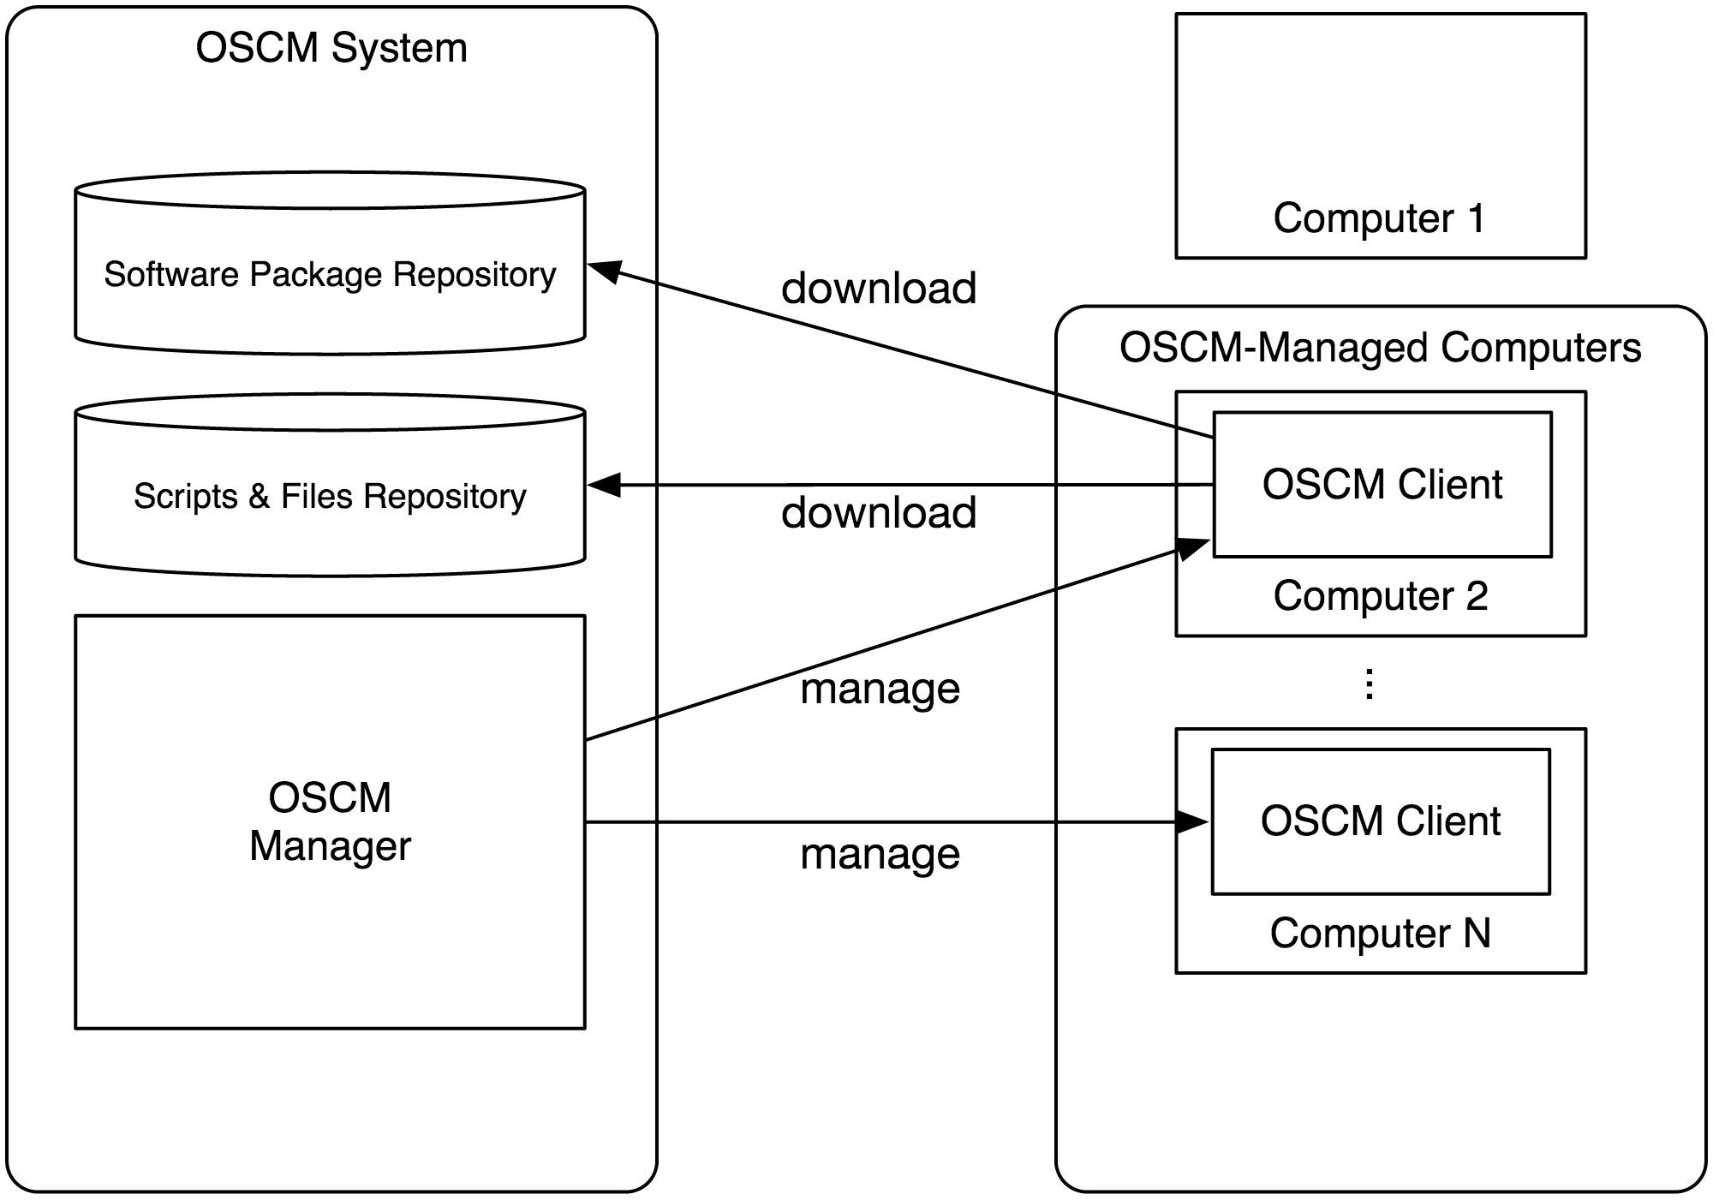
Infrastructure Automation Approaches
Scripting Environments
Applying configuration to nodes (single or hundreds)
Includes automating everything
Installing OS
Configuring servers on instances
Configuring how different softwares communicate with each other
Setting up and replicating environments in less error-prone manner
Automated testing
Documentation
Versioning of infrastructure setup

Slide 11

OpsCode Chef
Configuration Management Tool
Uses Ruby based Domain Specific Language for writing recipes
Can integrate with cloud-based platform but not originally built for that
The API is written both in Ruby and Erlang
Supports multiple platforms for clients Solaris, FreeBSD, OS X, Ubuntu, Debian, Fedora, Microsoft Windows
Server is supported on Oracle Linux/CentOS and Ubuntu

Slide 12
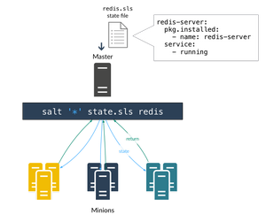
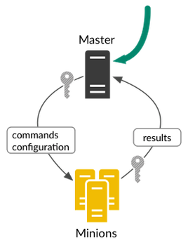
SaltStack Salt
Another Management Software for CloudOps, ITOps, DevOps
Written in Python
Configuration files written in YAML or PyDSL
Master-Client architecture and needs a Master always running

Slide 13
Ansible

Slide 14
What is Ansible?
YAML based language
Descriptive language for automation of infrastructure setups
Concepts
Owns concepts to structure and reuse definition files:
Variables (vars)
Tasks
Profiles
Handlers
Templates (jinja2)
Provides reusable modules to run tasks
Can manage known hosts and cloud services
YAML: true Fruits:
- name: Apple
price: .50
- name: Banana price: .80

Slide 15
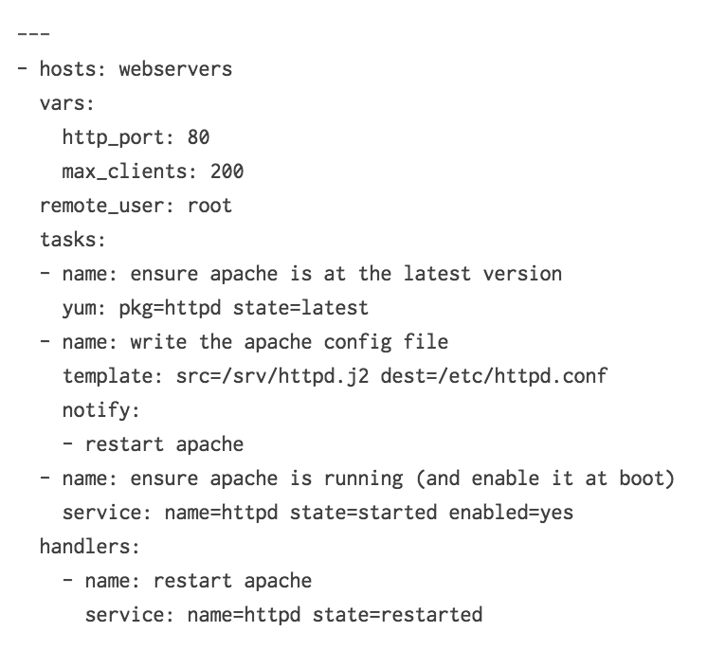
Basics
Playbooks
Ansible’s configuration, deployment and orchestration language.
The design plan. The set of steps. The work process.
Modules
The tasks that are actually executed in the playbooks.
They do the actual work.
Core Modules
Maintained by the Ansible team shipped with Ansible itself.
Extra Modules
Maintained by the community and may not ship with Ansible in future.
Module yum

Slide 16
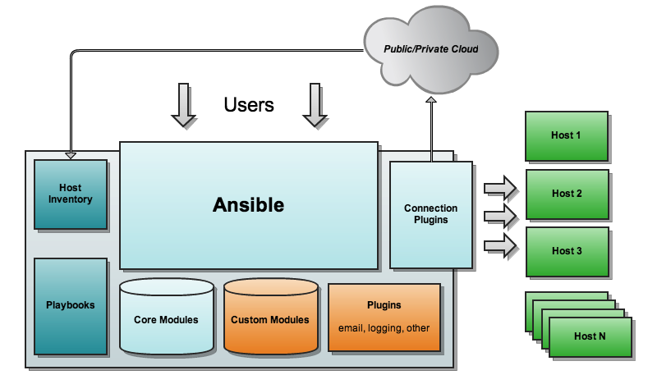
Ansible Setup

Slide 17
Examples with Ansible

Slide 18
Ansible Example 1: Target Architecture

Slide 19
Ansible Example 2: Target Architecture

Slide 20
Outlook

Slide 21
Imagine more complex architectures

Slide 22
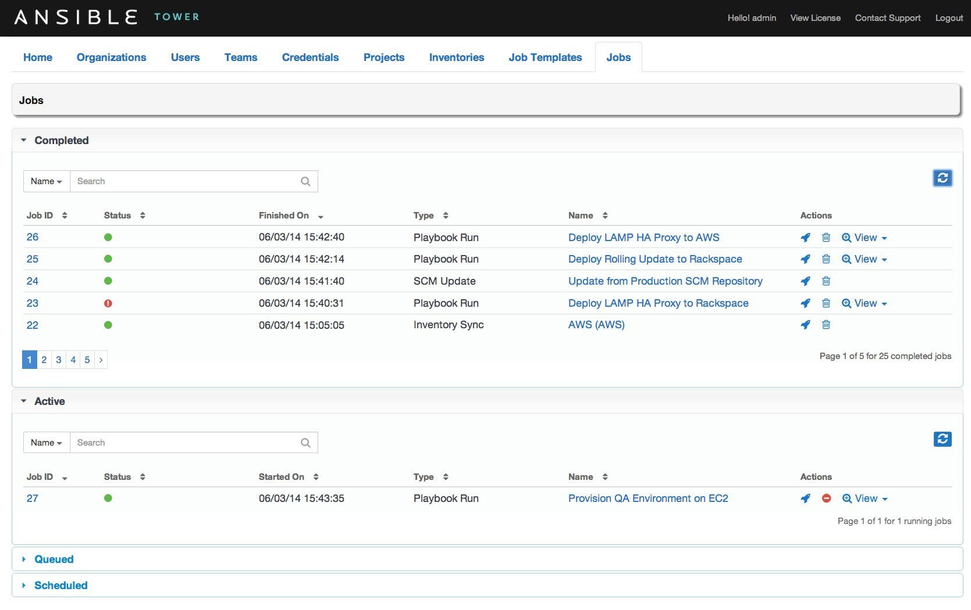
Ansible Tower
Provides a comprehensive management GUI
Costs scale with number of managed machines (good & bad)
Adds features such as:
Scheduling of ansible tasks
Direct machine access
Logging of user actions

Slide 23
How can we leverage
Questions?
How can we use this technology?

Slide 24
Thank you
Contact information:
Michael Menzel
Vineet Hingorani
C3.05

Slide 27
The Grid
Headline area
White space
Drawing area

