Slide 1

Testing Adaptive Step-Size Algorithms for an Implicit Euler Solver Using the Newton-Raphson Method
Final Project for: | 3301 Numerical Methods of Simulation
Submitted by: | Sophia Döring (31519) & Aaron Hinkle (22113)
March 1, 2023
Notes:
Title slide - Include the project title, presenter name(s), and date.

Slide 2
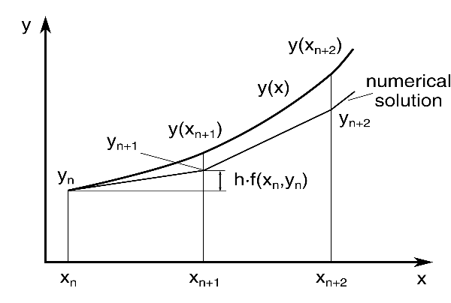
Introduction
Implicit Euler Method:
Source: https://www.freecodecamp.org
Notes:
Graphically, the idea of the Euler scheme is to take the current value of a target function and its derivative at the current time, and to assume that it is approximately linear for some small change in time h. In other words, drawing a secant line from f(t) at a slope of f’(t). The implicit Euler scheme simply uses the slope at the end of the line approximation, instead of at the beginning of it like the explicit version of the method. When the function f(u, t) is non-linear, then the implicit Euler method results in a set of non-linear equations that need to be solved for each time step. The Newton-Raphson method can be used for this purpose.

Slide 3

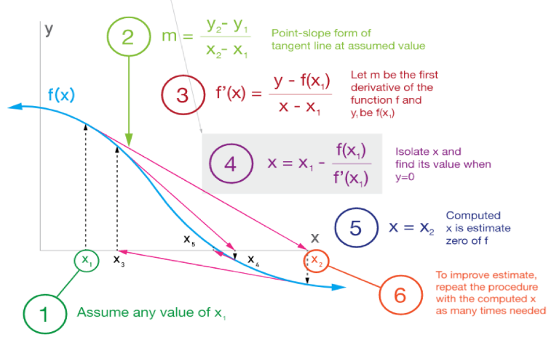
Introduction
Newton-Raphson method:
Source: https://wethestudy.com
Notes:
The Newton-Raphson method is a well-known technique for solving for roots by successive approximation. An initial guess x1 is chosen such that F(x1) is reasonably close to 0. The x-intercept of the tangent line evaluated at that point is then used as the guess for the next iteration of the algorithm, which is repeated until some suitable level of tolerance is reached.

Slide 4
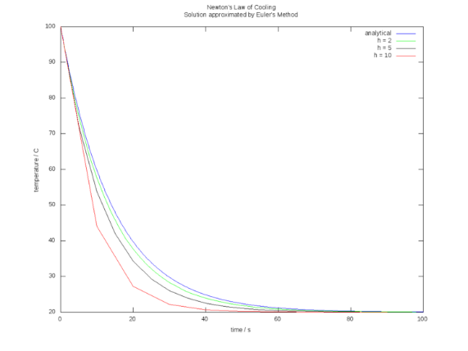
Introduction
Problem:
Step size affects stability and efficiency.
Stability isn’t guaranteed for all step sizes, but what step size to choose?
Fixed step size is inefficient for functions with rapid variation in the domain.
Solution:
Adaptive step size methods automatically adjust the step size based on the accuracy of the solution, resulting in fewer steps and reduced computation time.
Source: https://rosettacode.org
Notes:
The stability of the method is not guaranteed for all step sizes. It depends on the ODE being considered. If the solution varies rapidly over a portion of the time interval and slowly over the remaining time, then using a fixed time step is inefficient. Using a variable step sizeis particularly important when there is large variation in the magnitude of the derivative of the function, but if it is implemented efficiently, then it can also serve to reduce computation time since fewer time steps are required for relatively “smooth” functions.
Adaptive step automatically adjust the step size based on the accuracy of the solution. This can improve the efficiency of the integration, since the step size can be increased when the solution is accurate and decreased when the solution is less accurate. This can reduce the total number of steps required to reach the desired tolerance, which can result in a significant reduction in computation time.

Slide 5
Objectives
The project aimed to implement and compare the efficiency and accuracy of three different numerical methods for solving initial value problems.
Constant step size implicit Euler solver using the Newton-Raphson method
Adaptive step size algorithm based on the ratio between the first and second derivative
Adaptive step size algorithm based on minimizing the mean square error (MSE)
Notes:
The analysis compared three novel algorithms that were developed for this project (read them). To evaluate the performance of the algorithms, a set of test problems with known analytical solutions were used (we will see those in a minute). This allowed for comparison between the computed solutions and the true solutions in order to measure the accuracy and efficiency of the new algorithms.

Slide 6
Methodology
Second Derivative:
When the second derivative is large, it indicates that the function is changing rapidly, so a smaller step size may be needed to accurately capture the behavior of the function.
On the other hand, when the second derivative is small, it indicates that the function is changing slowly, so a larger step size can be used without compromising the accuracy of the solution.
Mean Square Error:
MSE can be used to measure the difference between the numerical solution and the true solution to the IVP. If the MSE is above a certain threshold, then the approximate solution is not accurate enough, and the step size needs to be reduced in order to improve the accuracy of the solution.
On the other hand, if the MSE is below the threshold, then the approximate solution is accurate enough, and h can be increased in order to reduce the computational cost of the algorithm. The idea is to adjust h so that the RMSE is minimized, while still maintaining an acceptable level of accuracy.
Notes:
When the second derivative is large, it indicates that the function is changing rapidly, so a smaller step size may be needed to accurately capture the behavior of the function. On the other hand, when the second derivative is small, it indicates that the function is changing slowly, so a larger step size can be used without compromising the accuracy of the solution.
MSE is used to measure the difference between the numerical solution and the true solution. If it’s above a certain threshold, then the approximate solution is not accurate enough, and the step size needs to be reduced in order to improve the accuracy of the solution. On the other hand, if it’s is below the threshold, then the approximate solution is accurate enough, and h can be increased in order to reduce the computational cost of the algorithm. The idea is to adjust the step size so that the RMSE is minimized, while still maintaining an acceptable level of accuracy.

Slide 7
Methodology
Base Algorithm with Constant h:
% PUT IN INITIAL VALUES AND BOUNDARIES
x_start = 5;
t_start = 0;
t_end = 5;
const_h = 0.1;
step_newt = 10000;
%--------------------------------------------------------------------------
% START SOLVING WITH CONSTANT H
t_array = t_start:const_h:t_end; %setting the whole time array
n = numel(t_array); %finding the number for the loop for finding x values
for i=1:n-1 %LOOP FOR EULER STEPS
x_sol(1) = x_start; %solution of x with the newton method
x_guess(1)= x_sol(1)+const_h;%guess of x for the newton method
x_sol(i+1) = newton(@dx_dt,x_sol(i),x_guess(i),t_array(i)+const_h,const_h,step_newt);%solution of x with the newton method
x_guess(i+1) = x_sol(i+1)+(x_sol(i+1)-x_sol(i));%guess of x for the newton method
end %LOOP FOR EULER STEPS
%--------------------------------------------------------------------------
% REAL VALUES OF X AND MSE
for i=1:n-1 %LOOP FOR REAL VALUES
x_true(1) = x_start; %solution of x with the newton method
mse_value(1) = 0;
x_true(i+1) = dx_dt_sol(t_array(i+1),x_start);
mse_value(i+1) = MSE(x_sol(i+1),x_true(i+1));
end %LOOP FOR REAL VALUE
mse_sum = sum(mse_value);
%==========================================================================
% FUNCTIONS
%==========================================================================
% FUNCTION TO SOLVE AND FUNCTION FOR REAL SOLUTION
function func = dx_dt(t,x)
func = 2*x;
end
function f_solution = dx_dt_sol(t,x_0)
f_solution = x_0*exp(2*t);
end
%--------------------------------------------------------------------------
% FUNCTION FOR NEWTON METHOD
function x_newt = newton(dx_dt,x_i, x_guess, t, h,step_newt)
prime_factor = 0.00000001; %For getting the drivative
error = 0.0001; %Tolerance for finding the root
%First newton step
x_search(1) = x_guess;
funct = dx_dt(t,x_guess);
newton = x_i + h * funct - x_guess;
primestep = (x_i + h * dx_dt(t,x_guess+prime_factor) - (x_guess+prime_factor));
prime = (primestep-(newton))/prime_factor;
j = 2;
x_search(j) = x_search(1)-newton/prime;
while (abs(x_search(j)-x_search(j-1))>error) & j < step_newt %LOOP FOR NEWTON STEPS
funct = dx_dt(t,x_search(j));
newton = x_search(j) + h * funct - x_search(j);
prime = ((x_i + h * dx_dt(t,x_search(j)+prime_factor) - (x_search(j)+prime_factor))-(newton))/prime_factor;
x_search(j+1)=x_search(j)-newton/prime;
j=j+1;
end%LOOP FOR NEWTON STEPS
if abs(x_search(j)-x_search(j-1))>error%IF STATEMENT FOR NEWTONSTEPS (if not successful)
x_newt = 0;
end%IF STATEMENT FOR NEWTONSTEPS
x_newt = x_search(j);
end
%--------------------------------------------------------------------------
% FUNCTION FOR MEAN SQUARE ERROR
function MSE = MSE(x_estimate,x_true)
MSE = (x_estimate-x_true)^2;
end
Notes:
The base script implements an implicit Euler numerical solver that discretizes the time domain using a constant step size const_h to approximate the solution to a differential equation defined by the function dx_dt. The code also calculates the MSE between the approximate solution obtained with the Euler solver and the actual solution of the differential equation. The code first sets up the initial values for the time domain t_start and t_end, the step size const_h, and the initial condition for the solution x_start. The code also defines the number of iterations for the Newton method step_newt. In the next step, the code sets up a loop that uses the Euler method to calculate the approximate solution of the differential equation. The loop iterates over the time domain and for each iteration, it uses the Newton method to solve the implicit equation obtained during the Euler step by repeatedly updating the value of xi until the absolute value of f’(xi) is less than the tolerance level tol. The guess for the Newton method is set as the previous solution plus const_h, and the solution for the Newton method is used as the new approximation of the solution. The code then calculates the actual solution of the differential equation and the MSE between the approximate solution and the actual solution. Finally, the code visualizes the results by plotting the approximate and actual solutions and the MSE. The code also includes three helper functions. The dx_dt function defines the differential equation that needs to be solved. The dx_dt_sol function calculates the actual solution of the differential equation. The newton function implements the Newton method for finding the roots of the implicit equation obtained by the implicit Euler method. The MSE function calculates the Mean Square Error between the values.

Slide 8
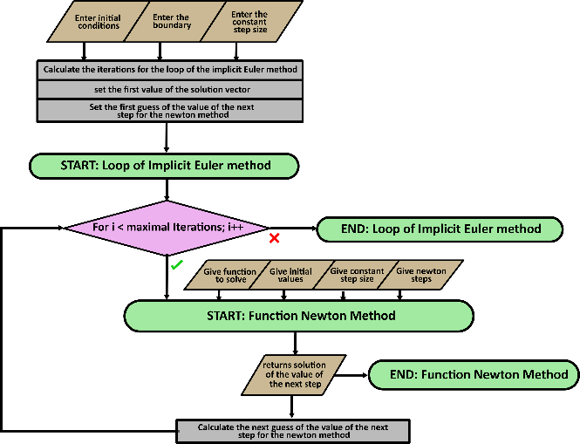
Methodology
Structure of Code of IEM with Constant h:
Notes:
The base script implements an implicit Euler numerical solver that discretizes the time domain using a constant step size const_h to approximate the solution to a differential equation defined by the function dx_dt. The code also calculates the MSE between the approximate solution obtained with the Euler solver and the actual solution of the differential equation. The code first sets up the initial values for the time domain t_start and t_end, the step size const_h, and the initial condition for the solution x_start. The code also defines the number of iterations for the Newton method step_newt. In the next step, the code sets up a loop that uses the Euler method to calculate the approximate solution of the differential equation. The loop iterates over the time domain and for each iteration, it uses the Newton method to solve the implicit equation obtained during the Euler step by repeatedly updating the value of xi until the absolute value of f’(xi) is less than the tolerance level tol. The guess for the Newton method is set as the previous solution plus const_h, and the solution for the Newton method is used as the new approximation of the solution. The code then calculates the actual solution of the differential equation and the MSE between the approximate solution and the actual solution. Finally, the code visualizes the results by plotting the approximate and actual solutions and the MSE. The code also includes three helper functions. The dx_dt function defines the differential equation that needs to be solved. The dx_dt_sol function calculates the actual solution of the differential equation. The newton function implements the Newton method for finding the roots of the implicit equation obtained by the implicit Euler method. The MSE function calculates the Mean Square Error between the values.

Slide 9
Methodology
Adapting Step Size Based on 2nd Derivative:
while t_array(i)<=t_end %LOOP FOR EULER STEPS
x_sol(1) = x_start;
f_prime = dx_dt_prime(@dx_dt,t_array(i),x_sol(i));
f1(i)=f_prime;
f_2prime = (dx_dt_prime(@dx_dt,t_array(i),x_sol(i)+0.1)-dx_dt_prime(@dx_dt,t_array(i),x_sol(i)))/0.1;
f2(i)=f_2prime;
if f_2prime==0
der2_h=h_max;
end
der2_h = abs(f_prime/f_2prime)*0.001;
if der2_h > h_max || der2_h == 0
der2_h=h_max;
end
der(i)=der2_h;
x_guess(1)= x_sol(1)+der2_h;%guess of x for the newton method
x_sol(i+1) = newton(@dx_dt,x_sol(i),x_guess(i),t_array(i)+der2_h,der2_h,step_newt);
t_array(i+1)=t_array(i)+der2_h;
x_guess(i+1) = x_sol(i+1)+(x_sol(i+1)-x_sol(i));%guess of x for the newton method
i = i+1;
end %LOOP FOR EULER STEPS
% FUNCTION FOR GETTING DERIVATIVE NUMERICALLY
%--------------------------------------------------------------------------
function func_prime = dx_dt_prime(funct,t,x)
prime_step = 0.0001;
func_prime = (funct(t,x+prime_step)- funct(t,x))+prime_step;
end
Notes:
The second script utilizes the same implementation of the Implicit Euler method, but this time the step size is adaptive based on the second derivative. It solves the differential equation initially with a constant step size h using a while loop. Inside the loop, it calculates the first and second derivatives and adjusts h accordingly. Finally, it calculates the real values of x and the MSE and visualizes the solution.

Slide 10
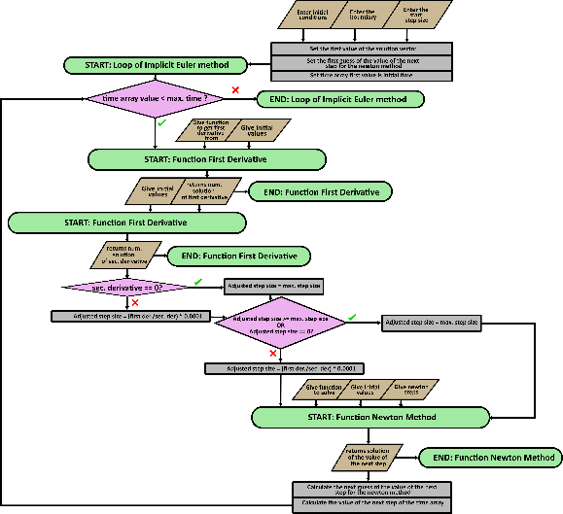
Methodology
Structure of Code of 2nd Derivative:
Notes:
The second script utilizes the same implementation of the Implicit Euler method, but this time the step size is adaptive based on the second derivative. It solves the differential equation initially with a constant step size h using a while loop. Inside the loop, it calculates the first and second derivatives and adjusts h accordingly. Finally, it calculates the real values of x and the MSE and visualizes the solution.

Slide 11
Methodology
Adapting Step Size Based on Minimizing MSE:
% START SOLVING WITH ADJUSTMENT BY MINIMIZING MSE
t_array(1) = t_start;
i = 1;
h(1) = h_start;
while t_array(i)<=t_end %LOOP FOR EULER STEPS
x_sol(1) = x_start;
h_new = gradient_descent(@MSE,h_start,x_sol(i),t_array(i),@dx_dt_sol,x_start,step_newt);
h(i+1)=h_new;
x_sol(i+1)=newton(@dx_dt,x_sol(i),x_sol(i)+0.001,t_array(i)+h_new,h_new,step_newt);
t_array(i+1)=t_array(i)+h_new;
i = i+1;
end %LOOP FOR EULER STEPS
%--------------------------------------------------------------------------
% FUNCTION FOR GRADIENT DESCENT
function h_right = gradient_descent(funct,h_start,x_sol,t,x_true,x_start,step_newt)
min(1)= h_start;
k = 2;
alpha = 0.01;
f_prime = (funct(newton(@dx_dt,x_sol,x_sol+0.001,t+min(1)+0.00001,min(1)+0.00001,step_newt),x_true(t+min(1),x_start))-funct(newton(@dx_dt,x_sol,x_sol+0.001,t+min(1),min(1),step_newt),x_true(t+min(1),x_start)))/0.00001;
min(k) = min(1) - alpha * f_prime;
while abs(min(k-1)-min(k))>0.1 & k < 10000
f_prime = (funct(newton(@dx_dt,x_sol,x_sol+0.001,t+min(k)+0.00001,min(k)+0.00001,step_newt),x_true(t+min(k),x_start))-funct(newton(@dx_dt,x_sol,x_sol+0.001,t+min(k),min(k),step_newt),x_true(t+min(k),x_start)))/0.00001;
min(k+1) = min(k) - alpha * f_prime;
k=k+1;
end
if min(k)>0 & abs(min(k-1)-min(k))<0.1
h_right=min(k);
else
h_right=0.001;
end
end
%--------------------------------------------------------------------------
% FUNCTION FOR NEWTON METHOD
function x_newt = newton(dx_dt,x_i, x_guess, t, h,step_newt)
prime_factor = 0.00000001; %For getting the drivative
error = 0.0001; %Tolerance for finding the root
%First newton step
x_search(1) = x_guess;
funct = dx_dt(t,x_guess);
newton = x_i + h * funct - x_guess;
primestep = (x_i + h * dx_dt(t,x_guess+prime_factor) - (x_guess+prime_factor));
prime = (primestep-(newton))/prime_factor;
j = 2;
x_search(j) = x_search(1)-newton/prime;
while (abs(x_search(j)-x_search(j-1))>error) & j < step_newt %LOOP FOR NEWTON STEPS
funct = dx_dt(t,x_search(j));
newton = x_search(j) + h * funct - x_search(j);
prime = ((x_i + h * dx_dt(t,x_search(j)+prime_factor) - (x_search(j)+prime_factor))-(newton))/prime_factor;
x_search(j+1)=x_search(j)-newton/prime;
j=j+1;
end%LOOP FOR NEWTON STEPS
if abs(x_search(j)-x_search(j-1))>error%IF STATEMENT FOR NEWTONSTEPS (if not successful)
x_newt = 0;
end%IF STATEMENT FOR NEWTONSTEPS
x_newt = x_search(j);
end
Notes:
Once again, the implicit Euler method is implemented using the Newton method at each time step, but this time, the goal is to adjust the step size h in a such a way as to minimize the MSE by using gradient descent. Gradient descent is a widely used optimization algorithm that can be used to minimize a function by iteratively updating its parameters in the direction of the negative gradient of the function, which corresponds to the steepest descent direction of the function. In the first part of the code, some initial values are set for x, t, h, and the step size for Newton’s method, which is used in the gradient descent function. The error is also set to a small value. Then, the while loop starts for the Euler method. Within the while loop, the gradient descent function is called to find the value of h that minimizes the MSE. The MSE is then minimized using gradient descent by adjusting the value of h, and the adjusted value of h is stored in the h-array and is used to calculate the next value of x using Newton’s method. The new value of t is then calculated using the adjusted value of h and the loop continues until t_array(i) is greater than t_end, at which point the loop stops.

Slide 12
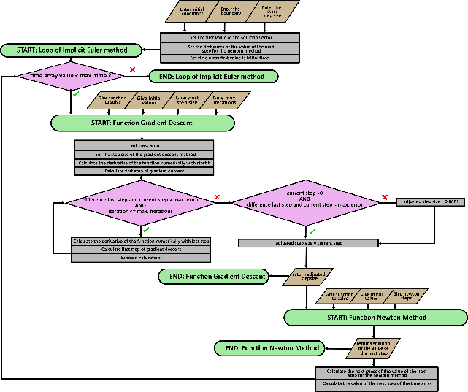
Methodology
Structure of Code of Minimizing MSE:
Notes:
Once again, the implicit Euler method is implemented using the Newton method at each time step, but this time, the goal is to adjust the step size h in a such a way as to minimize the MSE by using gradient descent. Gradient descent is a widely used optimization algorithm that can be used to minimize a function by iteratively updating its parameters in the direction of the negative gradient of the function, which corresponds to the steepest descent direction of the function. In the first part of the code, some initial values are set for x, t, h, and the step size for Newton’s method, which is used in the gradient descent function. The error is also set to a small value. Then, the while loop starts for the Euler method. Within the while loop, the gradient descent function is called to find the value of h that minimizes the MSE. The MSE is then minimized using gradient descent by adjusting the value of h, and the adjusted value of h is stored in the h-array and is used to calculate the next value of x using Newton’s method. The new value of t is then calculated using the adjusted value of h and the loop continues until t_array(i) is greater than t_end, at which point the loop stops.

Slide 13
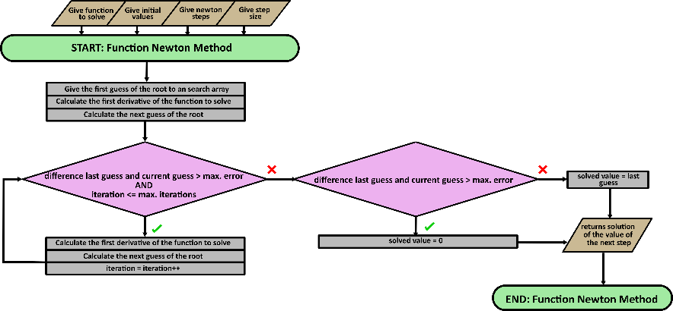
Methodology
General Structure of code of Newton-Raphson Method:
Notes:
Once again, the implicit Euler method is implemented using the Newton method at each time step, but this time, the goal is to adjust the step size h in a such a way as to minimize the MSE by using gradient descent. Gradient descent is a widely used optimization algorithm that can be used to minimize a function by iteratively updating its parameters in the direction of the negative gradient of the function, which corresponds to the steepest descent direction of the function. In the first part of the code, some initial values are set for x, t, h, and the step size for Newton’s method, which is used in the gradient descent function. The error is also set to a small value. Then, the while loop starts for the Euler method. Within the while loop, the gradient descent function is called to find the value of h that minimizes the MSE. The MSE is then minimized using gradient descent by adjusting the value of h, and the adjusted value of h is stored in the h-array and is used to calculate the next value of x using Newton’s method. The new value of t is then calculated using the adjusted value of h and the loop continues until t_array(i) is greater than t_end, at which point the loop stops.

Slide 14
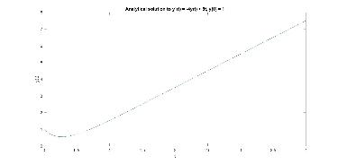
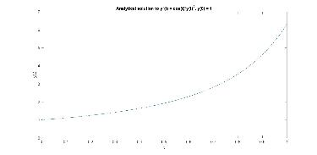
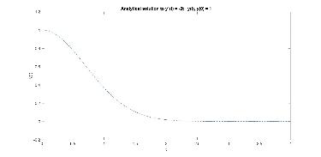
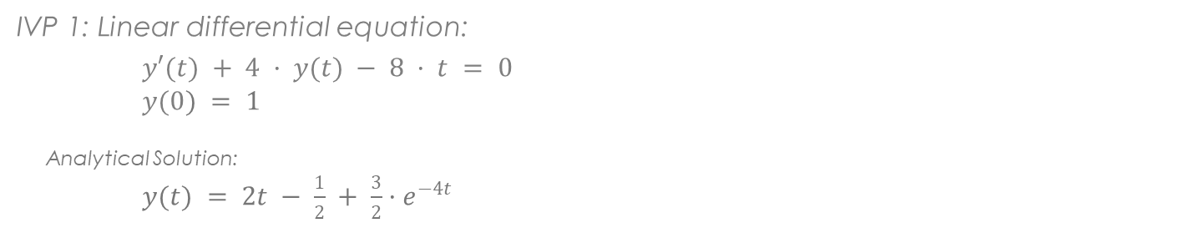
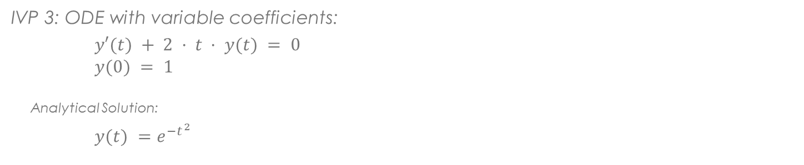
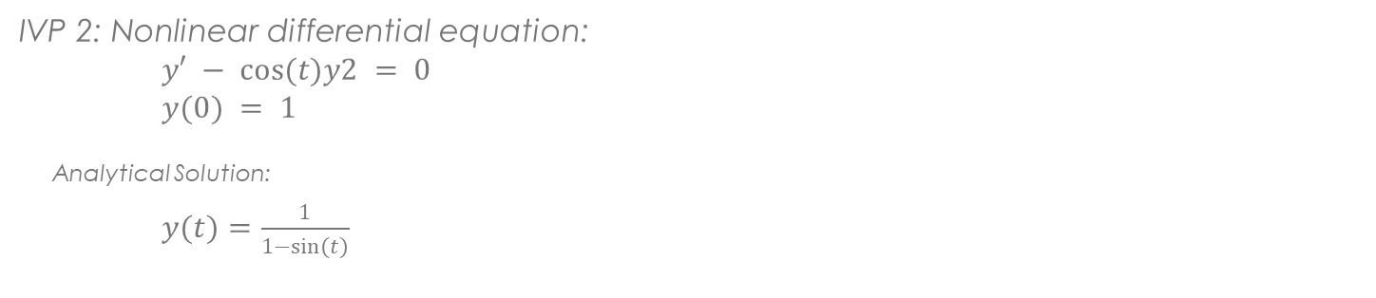
Methodology
Test IVPs:
IVP 1: Linear differential equation:
$y′(t) + 4 · y(t) − 8 · t = 0$ $y(0) = 1$
Analytical Solution:
$y(t) = 2t − \frac{1}{2} + \frac{3}{2}·e^{−4t}$
IVP 2: Nonlinear differential equation: $y′ − cos(t)y2 = 0$ $y(0) = 1$
Analytical Solution:
$y(t)=\frac{1}{1−sin(t)}$
IVP 3: ODE with variable coefficients:
$y′(t) + 2 · t · y(t) = 0$ $y(0) = 1$
Analytical Solution:
$y(t) =e^{{−t}^{2}}$
Notes:
These IVP’s were chosen because they have analytical solutions and for their different properties (e.g. linear vs nonlinear, variable coefficients), which can affect the performance of the numerical solvers. These examples were used to compare the behavior of the different algorithms and to see which ones perform the best for each problem.

Slide 15
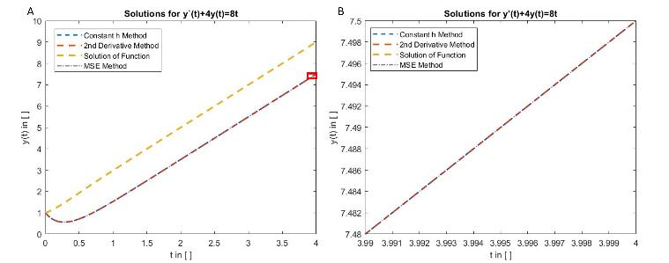
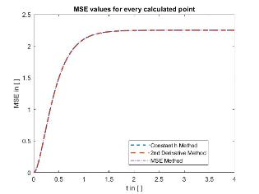
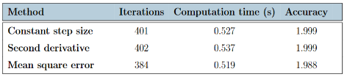
Results
IVP 1:
Graph A shows the results of the methods and the real solution over t ([0,4]). Graph B is a close-up of the red rectangle to see the difference between the methods.

Slide 16
Analysis
IVP 1:
Constant step size and second derivative methods had almost identical results except for computation time
MSE method showed higher accuracy and lower computation time due to smaller number of iterations and adaptation of step size to MSE
MSE method had larger step sizes than constant step size in linear ODE section, requiring fewer iterations
MSE values for each step showed initial error increase, followed by similar course as analytical solution
Error propagation led to high but stable error in linear ODE section
Notes:
The results of the constant step size and the second the derivative for the first test IVP are almost identical except for the computation time. This is because the second derivative method uses a constant, maximal step size if the second derivative, which is calculated numerically, is 0. This is the case for this IVP. The number of iterations and accuracy are the almost the same since the maximal step size is the same as the constant step size. Because of a rounding error of the step size of the second derivative, the program additionally does one extra step. The additional computation time is a result of the additional computation of the first and second derivative. The MSE method shows a higher accuracy as the average MSE is smaller. Additionally, the computation time is lower because of the smaller number of iterations. The reason for the lower number of iteration and higher accuracy is, that in the beginning the adaptation of h to the MSE leads to the almost same step sizes as the constant step size, the step size seems close enough to a minimal error. In the section of the IVP where the ODE shows approximately linear behavior, the MSE method shows larger step sizes than the constant step size, because they do not lead to a significant increase of the error. Therefore, fewer iterations are needed. The program is not sensitive to the propagation of the error. Therefore an optimal h is found that does not significantly increase the error and does not consider the overall error from the previous steps. The MSE values for show that in the beginning, when all methods seem to undershoot the real values, the error increases. After this overshoot the graph of the analytical solution and the graphs of all methods show a very similar course. Because of the error propagation the value of the error for every point in that section is high, but hardly increases.

Slide 17
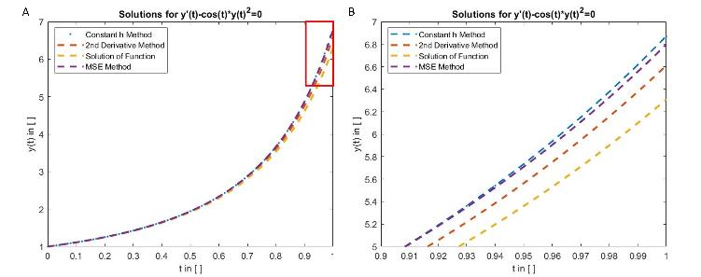
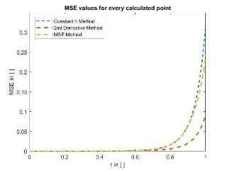
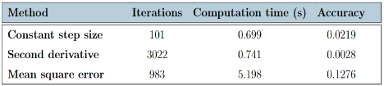
Results
IVP 2:
Graph A shows the results of the methods and the real solution over t ([0,4]). Graph B is a close-up of the red rectangle to see the difference between the methods.

Slide 18
Analysis
IVP 2:
Constant step size was faster and required fewer iterations, but had lower accuracy than second derivative method
MSE method had higher computation time and lower accuracy than constant step size, due to error propagation and small step size leading to increased average error
Second derivative method showed smaller error propagation and higher accuracy than other methods
MSE values at last section show lower MSE but higher average MSE due to more steps taken
Notes:
The constant step size algorithm was 6 % faster than the second derivative method and it required only 3 % as many iterations. However, the accuracy of the second derivative method was seven times higher. The reason why the accuracy is higher is due to the high number of iterations in the sections of domain where the error of the other two methods increases dramatically, which also leads to a higher propagation of error in the end. In contrast, the MSE method, even though it shows a higher number of iterations, exhibited a lower accuracy than the constant step size method. Additionally, the computation time is seven times higher. This is because, in the beginning of the calculation, the step size leading to a minimal MSE is close in value to the constant step size. Early in the domain, error propagation leads to the situation that no h can be found which leads to the minimal MSE later in the domain. Thus, after running the loop for searching the minimum, the program is using a very small h. By using a small step size, especially in the end of the domain where large error occurs, the overall average error increases tremendously leading to less accurate results. This problem of the MSE method can also be observed in the MSE values of the MSE method at the last section of graph. They show a lower MSE than the values of the constant step size. But there are more steps taken by the MSE value in this section the average MSE increases dramatically. The second derivative method shows a smaller error propagation than the other two methods.

Slide 19
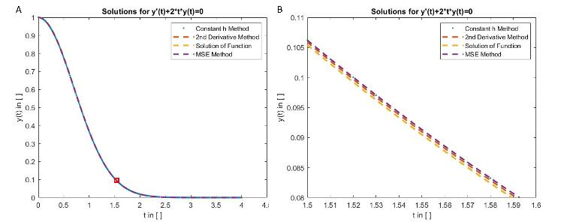
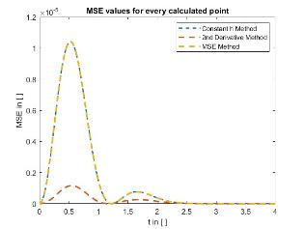
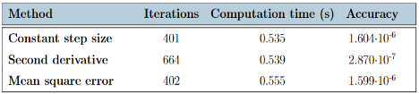
Results
IVP 3:
Graph A shows the results of the methods and the real solution over t ([0,4]). Graph B is a close-up of the red rectangle to see the difference between the methods.

Slide 20
Analysis
IVP 3:
All methods showed higher accuracy than IVP 1
Constant step size and MSE methods had similar solutions, but MSE had one extra step for slightly higher accuracy
Second derivative method had highest accuracy but took more iterations and less computation time than MSE
Figure 3.6 showed no error propagation due to function curvature
Second derivative method adjusts step size as second derivative increases for higher accuracy
Notes:
The constant step size and the MSE methods show very similar solutions. The MSE has one step size more which leads to a slightly higher accuracy than the constant step size. This is because the initial step size for finding the optimal step size with a minimal MSE for the MSE method, is the same as the constant step size. Because the MSE is so small anyway, the step size is adjusted only once to see if the maximal tolerance of the error is satisfied and the calculated step size for comparing with the maximal tolerance is taken, which in this case is slightly smaller than the constant step size. Therefore one step more is needed to get to the boundary. The higher computation time is a result of the additional calculation of the minimal MSE with the gradient descent. Once again, The second derivative method showed higher accuracy and took a larger number of iterations, especially in the beginning and when the curve of the graph flattens. The step size of the method adjusts as the second derivative increases. This has a significant impact on the accuracy as these sections are highly sensitive to error in the Implicit Euler Method. The computation time is also lower than with the MSE method, which leads to the assumption that the additional calculations needed for the MSE method need more time than of the second derivative method. Even though the second derivative method is more than five times more accurate for this IVP, the question remains if it is necessary if the error in general is very small for all methods. This probably depends on the application. There is no error propagation. The error peaks but flattens in the end. This is due to the characteristics of the function. The graph shows a change curvature with one turning point. The Implicit Euler shows the systematic error of undershooting the real curvature. A change of curvature within the course of the graph can lead to a decrease of the error propagation, which is the case for the third IVP.

Slide 21
Conclusion
Adaptive step size algorithms can significantly improve the accuracy of numerical solutions for certain types of IVPs while maintaining reasonable computation times.
The choice of adaptive step size algorithm depends on the characteristics of the problem being solved.
The Newton-Raphson method can be a common procedure but can lead to problems, especially when the ODE is not homogeneous or not differentiable.
The MSE algorithm can be effective when solving discrete systems, especially for solving some types of inverse problems, but can be limited by the need for an actual solution for comparison.
The second derivative algorithm can be a more precise solver for test IVPs, especially for functions with a change of curvature, but is only applicable to homogeneous, first-order systems with a non-zero second derivative.
Notes:
Overall, these findings suggest that the use of adaptive step size algorithms, such as the Newton-Raphson, MSE, and second derivative algorithms, can improve the accuracy of numerical solutions for certain types of IVPs. However, the choice of method may depend on the particular characteristics of the problem being solved, and the limitations and challenges associated with each method should be carefully considered.

Slide 22
Thank You!
Notes:
Overall, these findings suggest that the use of adaptive step size algorithms, such as the Newton-Raphson, MSE, and second derivative algorithms, can improve the accuracy of numerical solutions for certain types of IVPs. However, the choice of method may depend on the particular characteristics of the problem being solved, and the limitations and challenges associated with each method should be carefully considered.

Slide 23
References
Report References: | Presentation References:
Chapra, S. C. and Canale, R. P. (2015). Numerical Methods for Engineers. McGraw-Hill Education, 2 Penn Plaza, New York, NY 10121, 7 edition. | https://www.freecodecamp.org/news/eulers-method-explained-with-examples/
Feldman, J. (1999). Variable Step Size Methods. https://personal.math.ubc.ca/ CLP/. Retrieved from https://personal.math.ubc.ca/∼feldman/math/vble.pdf. | https://wethestudy.com/mathematics/newton-raphson-method-how-calculators-work/
Gardner, W. A. (1984). Learning characteristics of stochastic-gradient-descent algorithms: A general study, analysis, and critique. Signal Processing, 2(6). doi:10.1016/0165-1684(84) 90013-6 | https://rosettacode.org/wiki/Euler_method
Mustapha, A., Mohamed, L., and Ali, K. (2020). An overview of gradient descent algorithm optimization in machine learning: Application in the ophthalmology field. In Communications in Computer and Information Science, pages 349–359.
Peterson, J. (2017). Numerical Methods for Differential Equations. Department of Scientific Computing, Florida State University, Tallahassee, FL 32304, USA
Skouras, K., Goutis, C., and Bramson, M. J. (1994). Estimation in linear models using gradient descent with early stopping. Statistics and Computing, 4(4):271–278. doi:10.1007/bf00156 750
Turin, A. (2020). Gradient descent from scratch.
Zhang, L., Zhang, C., and Liu, M. (2020). Variable-step-size second-order-derivative multistep method for solving first-order ordinary differential equations in system simulation. Advances in Complex Systems. A Multidisciplinary Journal, 11(01). doi:10.1142/s1793962320500014

