Slide 1
Block-Image Game Engine
Architecture & External Communication
How hardware, the storage engine, and external sources like game studios interact
Storage IS the World
Direct Byte Offsets
Dual-Array Design
Quorum Safety
Notes:
This presentation covers the Block-Image Game Engine — a novel architecture where the game world is stored as a flat block image on NVMe storage. Player position maps directly to a byte offset. There is no streaming middleware, no game database, no world cache.

Slide 2
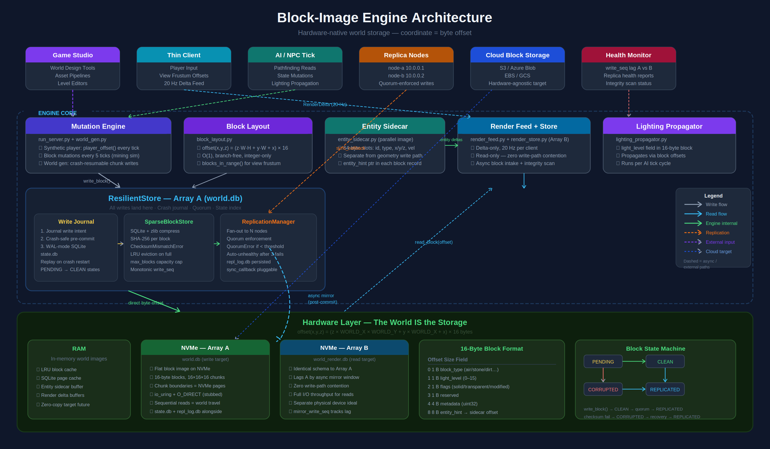
Full Architecture Overview
Notes:
This diagram shows all major components: external sources at the top (game studio, thin client, AI tick, replica nodes, cloud storage, health monitor), the engine core in the middle (mutation engine, block layout, entity sidecar, render feed, lighting propagator, and the ResilientStore with its journal/SparseBlockStore/ReplicationManager sub-components), and the hardware layer at the bottom (RAM, NVMe Array A for writes, NVMe Array B for reads, block format, and the block state machine).

Slide 3
Write Path: Studio → Engine → NVMe
1
Game Studio / AI Tick
4
ReplicationManager
Sends write_block(offset, data)
via Mutation Engine or run_server.py
Coordinate → offset arithmetic (O1)
Fan-out to N replica nodes
QuorumError if < required_replicas
Auto-marks failing nodes unhealthy
2
Write Journal
5
Async Mirror → Array B
Crash-safe pre-commit to state.db
PENDING state recorded in WAL
Survives power loss — replays on restart
Post-commit, post-quorum forward
world_render.db updated async
Never adds latency to write path
3
SparseBlockStore
6
Block State: REPLICATED
zlib compress + SHA-256 checksum
Written to world.db (Array A, NVMe)
CapacityError on address overflow
State index updated in state.db
Write sequence number incremented
Array B lag tracked via write_seq
Notes:
Write path: The studio or AI tick triggers a write through the Mutation Engine. This journals the intent (crash-safe), writes to SparseBlockStore on Array A (NVMe), fans out to replica nodes for quorum, then asynchronously mirrors to Array B for the render feed. Block state transitions from PENDING → CLEAN → REPLICATED.

Slide 4
Read Path & Hardware Design
Thin Client Request
16-byte block alignment
Player position → player_offset(px,py,pz)
blocks_in_range() for view frustum set
Every offset is a power-of-2 multiple. NVMe page boundaries = chunk boundaries for 16×16×16 reads.
RenderFeed (20 Hz)
O(1) coordinate lookup
Delta-only feed — only changed blocks sent
Reads exclusively from Array B (world_render.db)
offset(x,y,z) = (z·W·H + y·W + x) × 16. No hash, no index, no cache miss at engine layer.
RenderStore (Array B)
Dual-array isolation
read_block(offset) → verify SHA-256
Corrupt block → recover from replica
Array A absorbs all writes. Array B has zero write-path contention — full NVMe throughput for reads.
Entity Deltas
Hardware-agnostic core
EntitySidecar runs in parallel
64-byte slots, entity_hint ptr in block record
Same logic runs over RAM, NVMe, or cloud block storage. io_uring + O_DIRECT stubbed for future.
Notes:
Read path: The thin client converts player position to a byte offset, the RenderFeed delivers only changed blocks at 20 Hz from Array B (never touching Array A), SHA-256 is verified on every read, and corrupt blocks recover from replicas. The right side shows key hardware design principles: 16-byte alignment, O(1) offset formula, dual-array write/read separation, and hardware-agnostic storage layer.

Slide 5
External Sources & Integration Points
Game Studio
Game Clients / Players
World design & asset pipelines
20 Hz real-time delta feed
Calls world_gen.py with --seed, --size, --out flags. All terrain writes go through ResilientStore — journal, quorum, and mirror forward included. Generation is crash-resumable at any chunk boundary.
Client subscribes to RenderFeed. Engine delivers delta-only block and entity changes at 20 Hz. Client converts player position to offset via player_offset() every tick. No direct storage access.
python world_gen.py --size 64 --seed 42 --out world.db
python client.py → RenderDelta(block_deltas, entity_deltas)
AI / NPC Systems
Replica Nodes
Pathfinding & state mutations
Quorum-enforced durability
AI tick reads block offsets for spatial queries (entities_near is linear scan; replace with R-tree for >1000 entities). Lighting propagator runs per tick via the same write path. Mutations fire every 5 ticks.
Supply a sync_callback and recovery_callback to ReplicationManager. The engine fans writes to all healthy nodes, enforces required_replicas quorum, auto-marks nodes unhealthy after 3 failures. No network I/O built-in — wire in your own transport.
run_server.py → ai_tick() → write_block(offset, data)
ReplicationManager(sync_callback=my_sync, required_replicas=2)
Cloud Block Storage
Health Monitor
Hardware-agnostic target
Observability & integrity
The storage layer has no opinion on the underlying device. Point world.db and world_render.db at cloud-backed block volumes (EBS, GCS, Azure Disk). Same flat image semantics. Placing A and B on separate physical volumes is the intended production config.
health_report() returns per-node and aggregate snapshots. verify_integrity() is a generator-based paginated scan using a dedicated read-only connection — never blocks live I/O. Array A vs B write_seq lag printed every 2 seconds.
SparseBlockStore('s3-backed-volume/world.db', max_blocks=…)
rm.health_report() / store.verify_integrity()
Notes:
Six external integration points: Game Studio uses world_gen.py CLI. Clients subscribe to a 20 Hz delta feed. AI/NPC systems call write_block and run the lighting propagator each tick. Replica nodes plug in via a sync_callback — the engine handles quorum and auto-healthchecks. Cloud block storage just needs a volume mounted; the flat image model is hardware-agnostic. The health monitor exposes write_seq lag and integrity scan results.

