Slide 1
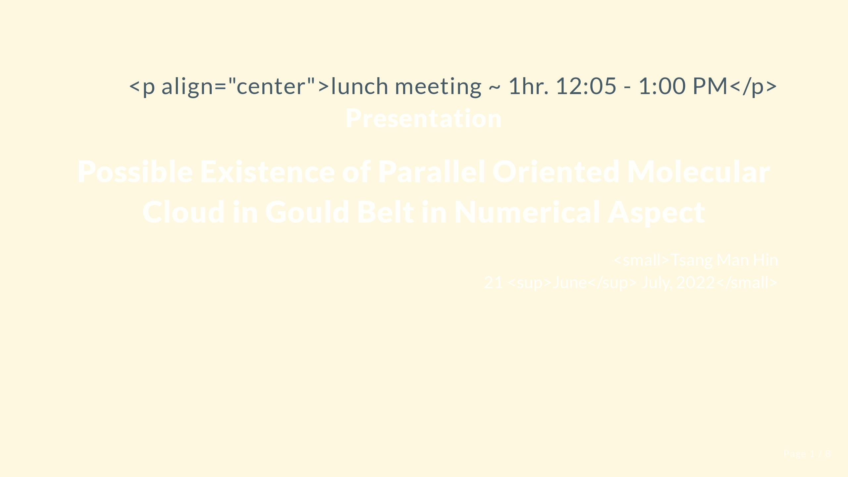

Slide 2


Slide 3
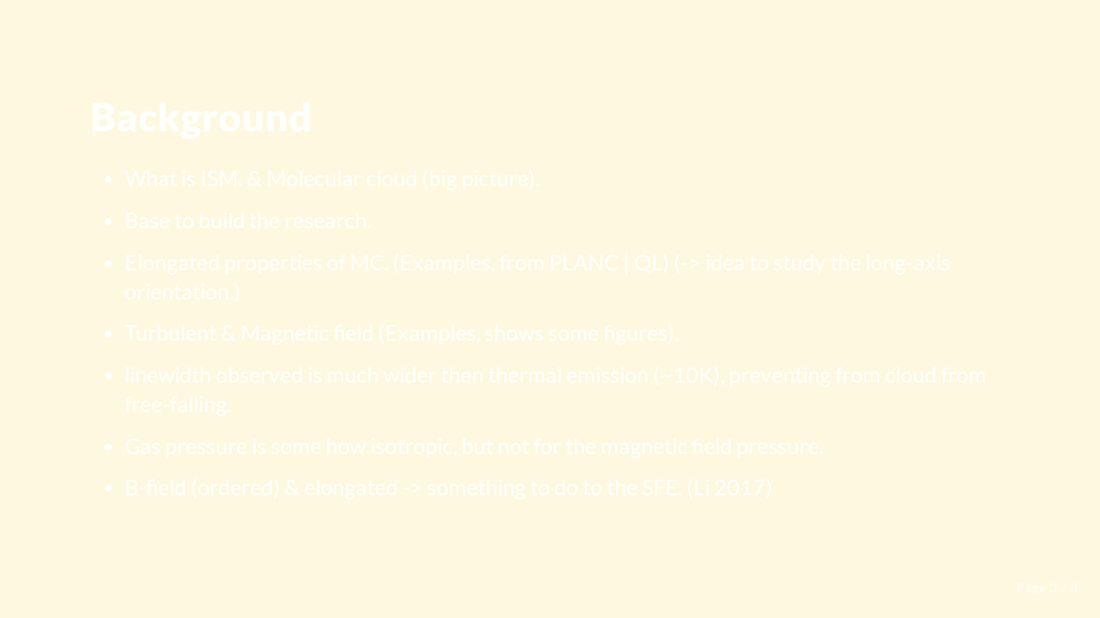
Notes:
Too Basic

Slide 4


Slide 5

Notes:
Logic flow

Slide 6


Slide 7


Slide 8
