Slide 1


Single Cycle Processor & Compiler

Slide 2
Requirments
Proiect : MicroArhitecturi
MIPS(Microprocessor without Interlocked Pipelined Stages)
Extension: Compilator (scripting)

Slide 3
Single Cycle Processor

Slide 4
Data input
8c // lw $t1, 4($zero)
09
00
04
8c // lw $t0, 0($zero)
08
00
00
01 // slt $t8 ,$t1 , $t2
2a
c0
2a
01 // add $t2, $t1, $t0
28
50
20
11 // beq $t2, $t2 , 2
4a
00
02
01 // sub $t3 $t1 $t0
28
58
22
01 // and $t4 $t1 $t0
28
60
24
01 // or $t5 $t1 $t0
28
68
25
ac // sw $t3, 16($zero)
0b
00
10
ac // sw $t2, 24($zero)
0a
00
18
8c // lw $t6, 16($zero)
0e
00
10
8c // lw $t7, 24($zero)
0f
00
18
08 // j 12($zero) 12 -> jump addr
00
00
0c
3
Single Cycle Processor

Slide 5
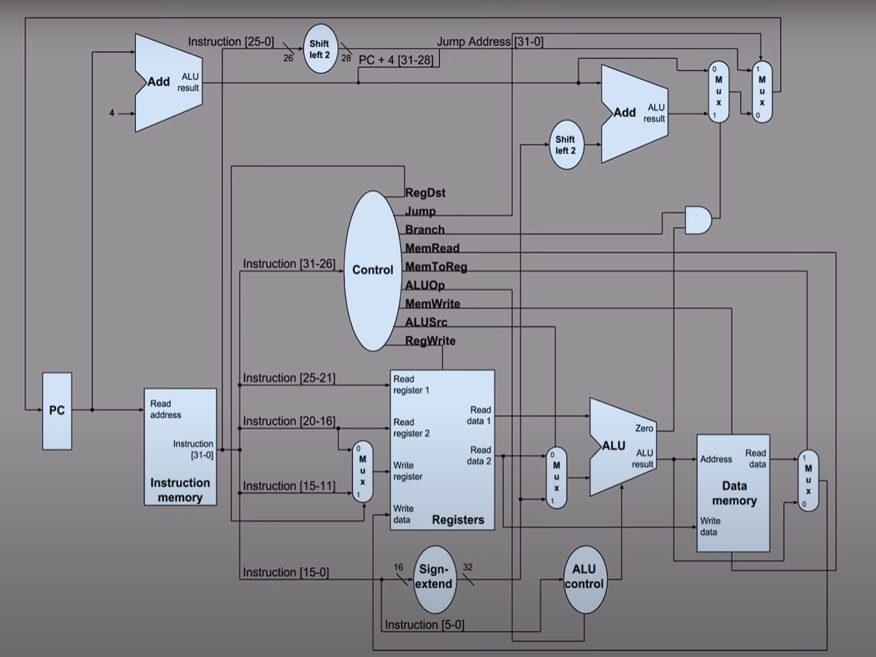
Compiler
Data input
Data output

Slide 6
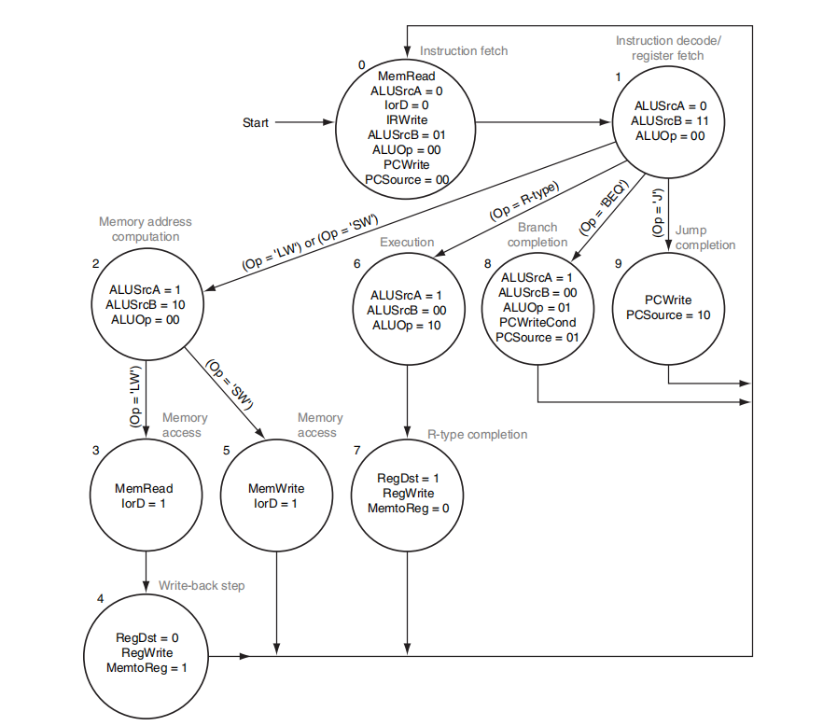
3
Single Cycle Processor

Slide 7
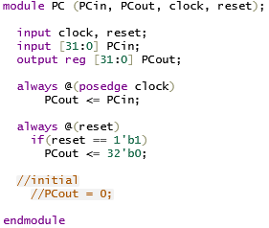
PC
3
Single Cycle Processor
Waveform

Slide 8
PC Waveform
3
Single Cycle Processor
PC Back

Slide 9
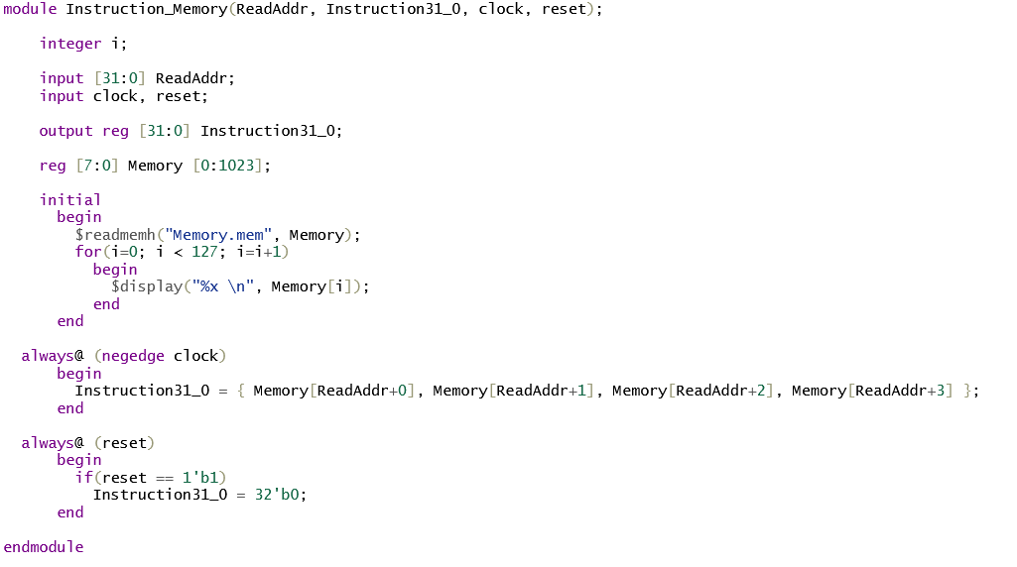
Instruction Memory
3
Single Cycle Processor
Waveform

Slide 10
Instruction Memory
Waveform
3
Single Cycle Processor
Instruction Memory Back

Slide 11
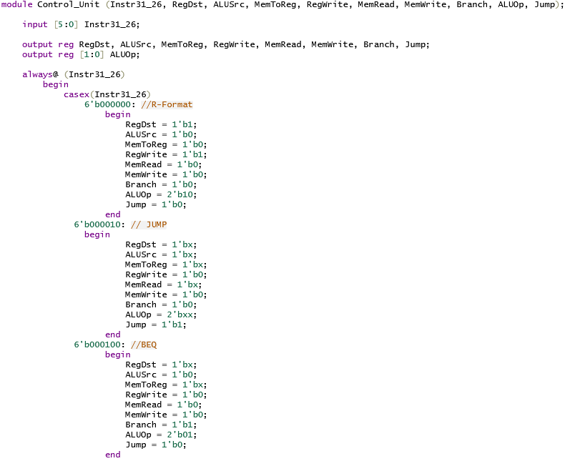
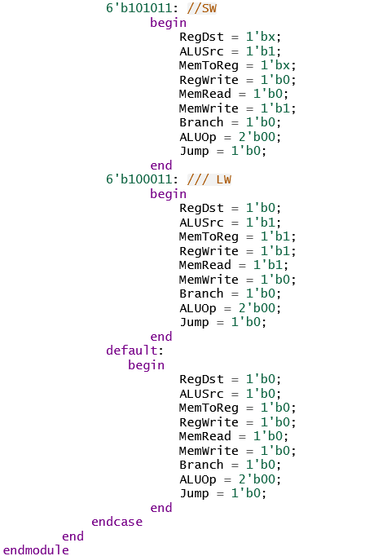
Control Unit
3
Single Cycle Processor
Waveform

Slide 12
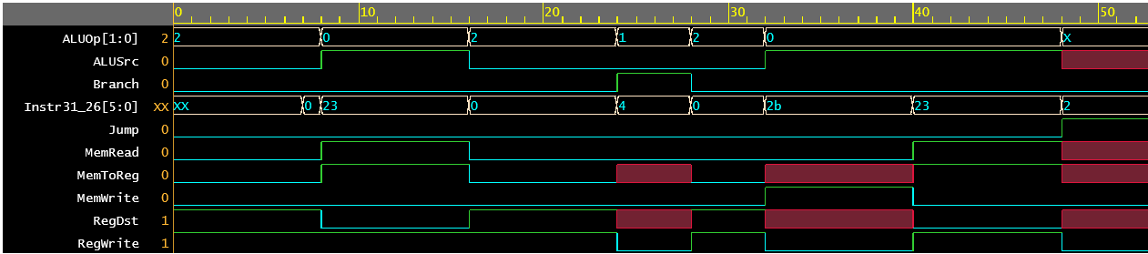
Control Unit Waveform
3
Single Cycle Processor
Control Unit Back

Slide 13
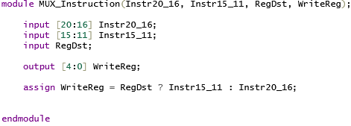
MUX Instruction
3
Single Cycle Processor
Waveform

Slide 14
MUX Instruction
Waveform
3
Single Cycle Processor
MUX Instruction Back

Slide 15
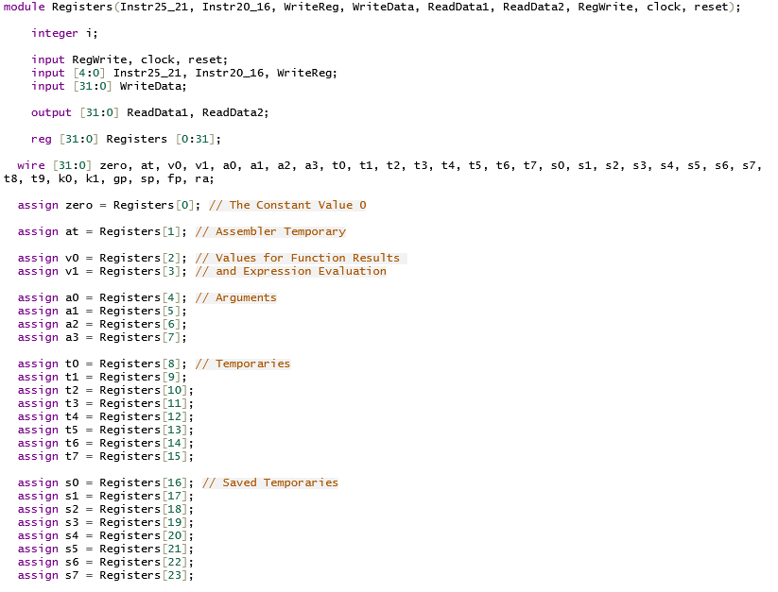
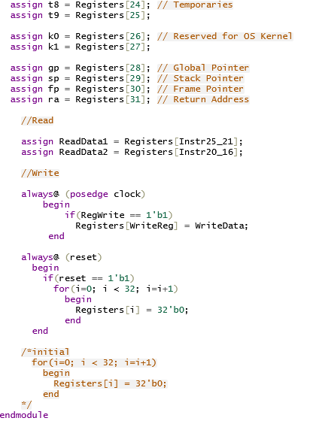
Registers
3
Single Cycle Processor
Waveform

Slide 16
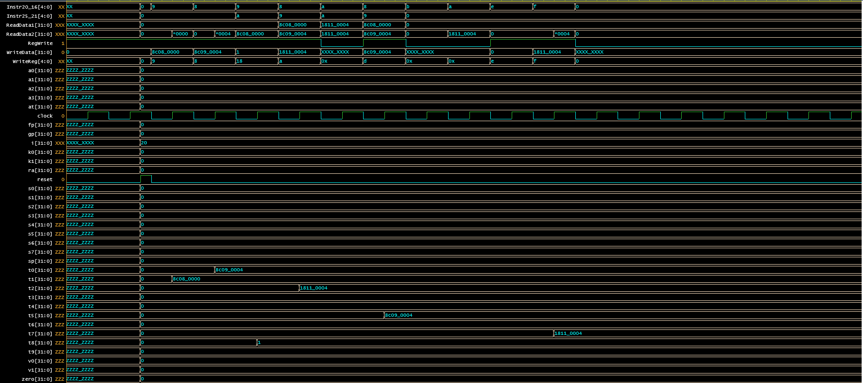
Registers Waveform
3
Single Cycle Processor
Registers Back

Slide 17
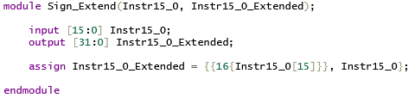
Sign-extend
3
Single Cycle Processor
Waveform

Slide 18
Sign-extend
Waveform
3
Single Cycle Processor
Sign-extend Back

Slide 19
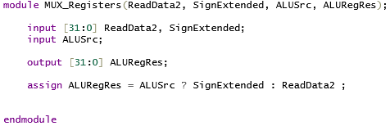
MUX Registers
3
Single Cycle Processor
Waveform

Slide 20
MUX Registers
Waveform
3
Single Cycle Processor
MUX Registers Back

Slide 21
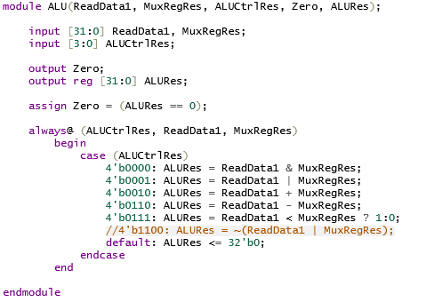
ALU
3
Single Cycle Processor
Waveform

Slide 22
ALU Waveform
3
Single Cycle Processor
ALU Back

Slide 23
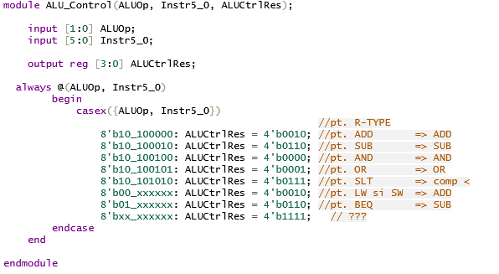
ALU Control
3
Single Cycle Processor
Waveform

Slide 24
ALU Control
Waveform
3
Single Cycle Processor
ALU Control Back

Slide 25
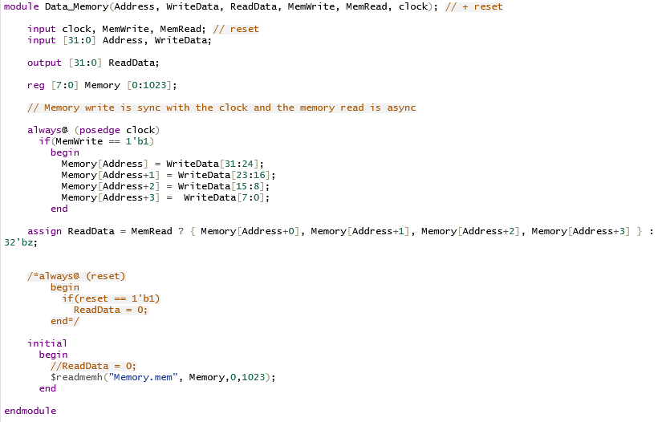
Data Memory
3
Single Cycle Processor
Waveform

Slide 26
Data Memory
Waveform
3
Single Cycle Processor
Data Memory Back

Slide 27
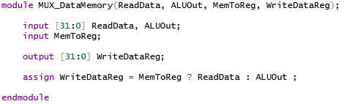
MUX Data Memory
3
Single Cycle Processor
Waveform

Slide 28
MUX Data Memory
Waveform
3
Single Cycle Processor
MUX Data Memory Back

Slide 29
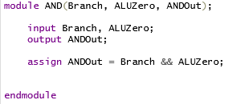
AND Gate
3
Single Cycle Processor
Waveform

Slide 30
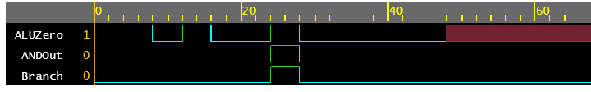
AND Gate
Waveform
3
Single Cycle Processor
AND Gate Back

Slide 31
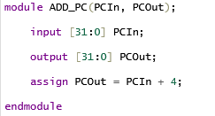
ADD PC
3
Single Cycle Processor
Waveform

Slide 32
ADD PC Waveform
3
Single Cycle Processor
ADD PC Back

Slide 33
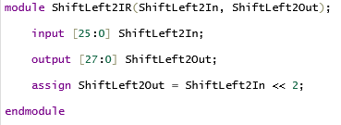
Shift Left 2 IR
3
Single Cycle Processor
Waveform

Slide 34
Shift Left 2 IR
Waveform
3
Single Cycle Processor
Shift Left 2 IR Back

Slide 35
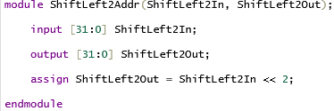
Shift Left 2 Addr
3
Single Cycle Processor
Waveform

Slide 36
Shift Left 2 Addr
Waveform
3
Single Cycle Processor
Shift Left 2 Addr Back

Slide 37
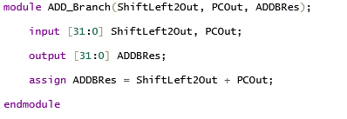
ADD Branch
3
Single Cycle Processor
Waveform

Slide 38
ADD Branch
Waveform
3
Single Cycle Processor
ADD Branch Back

Slide 39
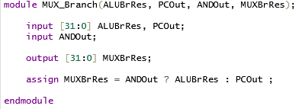
MUX Branch
3
Single Cycle Processor
Waveform

Slide 40
MUX Branch
Waveform
3
Single Cycle Processor
MUX Branch Back

Slide 41
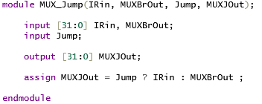
MUX Jump
3
Single Cycle Processor
Waveform

Slide 42
MUX Jump
Waveform
3
Single Cycle Processor
MUX Jump Back

Slide 43
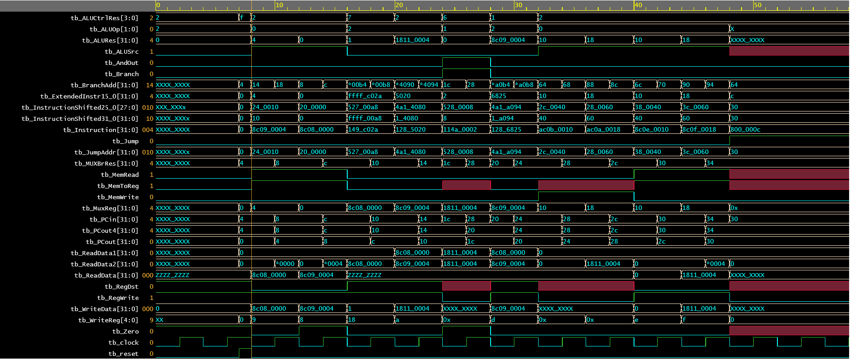
Data output
3
Single Cycle Processor
Data input

Slide 44
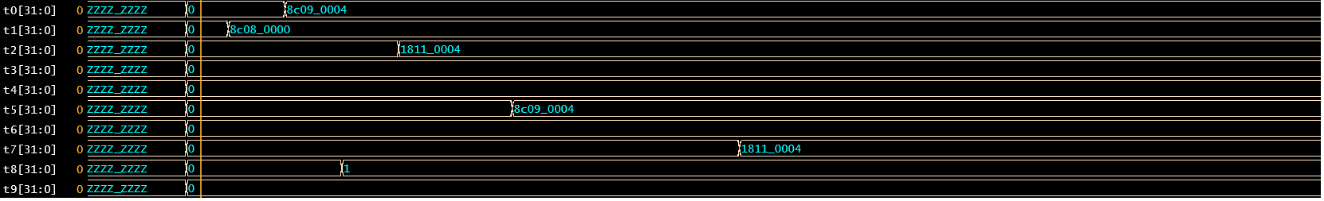
Data output
3
Single Cycle Processor
Data output

Slide 45
Compiler
Single Cycle Processor

Slide 46
Data input/output
Input:
lw $t1, 4($zero)
lw $t0, 0($zero)
slt $t8 ,$t1, $t2
add $t2, $t1, $t0
beq $t2, $t2, 2
sub $t3, $t1, $t0
and $t4, $t1, $t0
or $t5, $t1, $t0
sw $t3, 16($zero)
sw $t2, 24($zero)
lw $t6, 16($zero)
lw $t7, 24($zero)
j 12($zero)
Output:
8c
09
00
04
8c
08
00
00
01
2a
c0
2a
01
28
50
20
11
4a
00
02
01
28
58
22
01
28
60
24
01
28
68
25
ac
0b
00
10
ac
0a
00
18
8c
0e
00
10
8c
0f
00
18
08
00
00
0c
3
Compiler

Slide 47
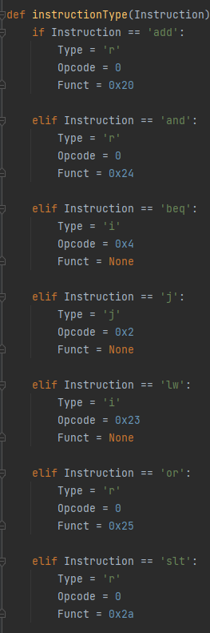
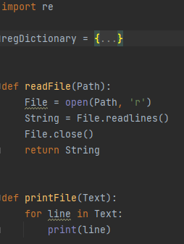
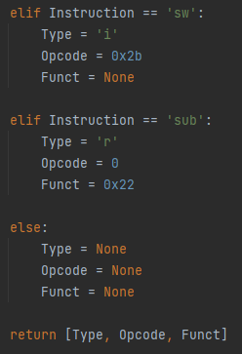
3
Compiler

Slide 48
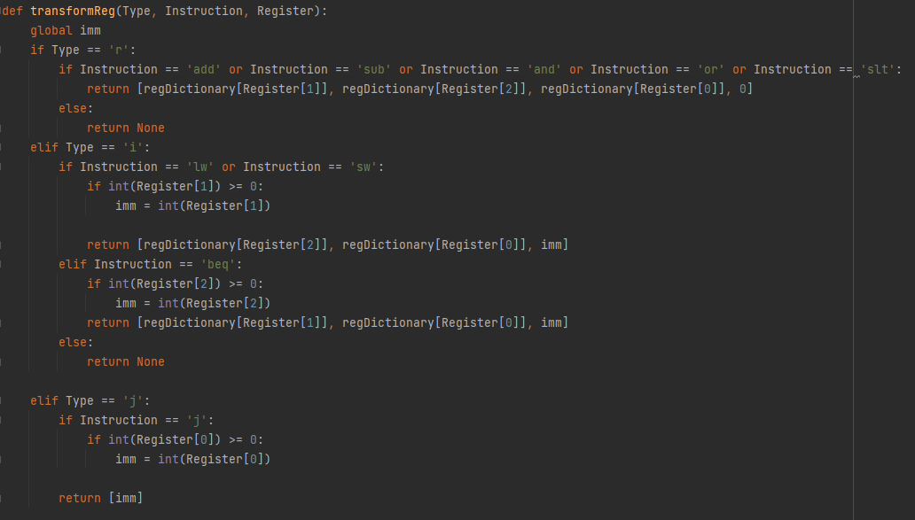
3
Compiler

Slide 49
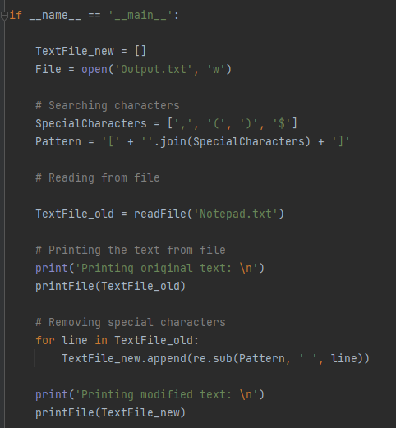
3
Compiler

Slide 50
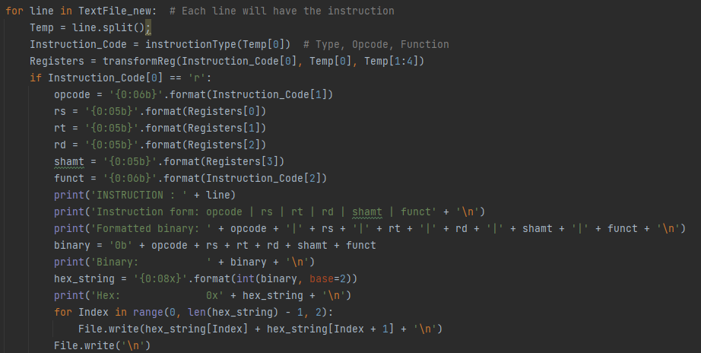
3
Compiler

Slide 51
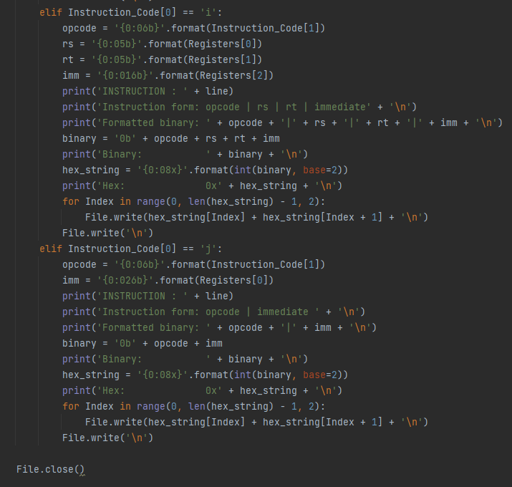
3
Compiler

Slide 52
Thank you
Project by
Arhip C-tin Alexandru
Single Cycle Processor
Compiler

