Slide 1
Uncertainties inherent for the wind turbine design process (modelling chain)
A. Cousin, M. Guiton (IFP Energies Nouvelles)

Slide 2
Summary
Reminders on aero-servo-hydro-elastic (ASHE) simulations used in design of an Offshore Wind Turbine (OWT)
Overview of the modeling chain in operational and parked conditions
Long-term and short-term wind speed and wave elevation processes
Review of uncertainty sources in the modeling chain
Joint probability on LT parameters for a site
Aerodynamics including turbulence box setting
Blade pitch and generator torque controller
Hydrodynamics (fixed and floating foundations)
Post-treatment uncertainty for ULS and FLS
Extension to the design of a wind farm
Wake analysis
Annual Energy Production (AEP) and fatigue contraints
Clustering of wind conditions and turbine settings

Slide 3
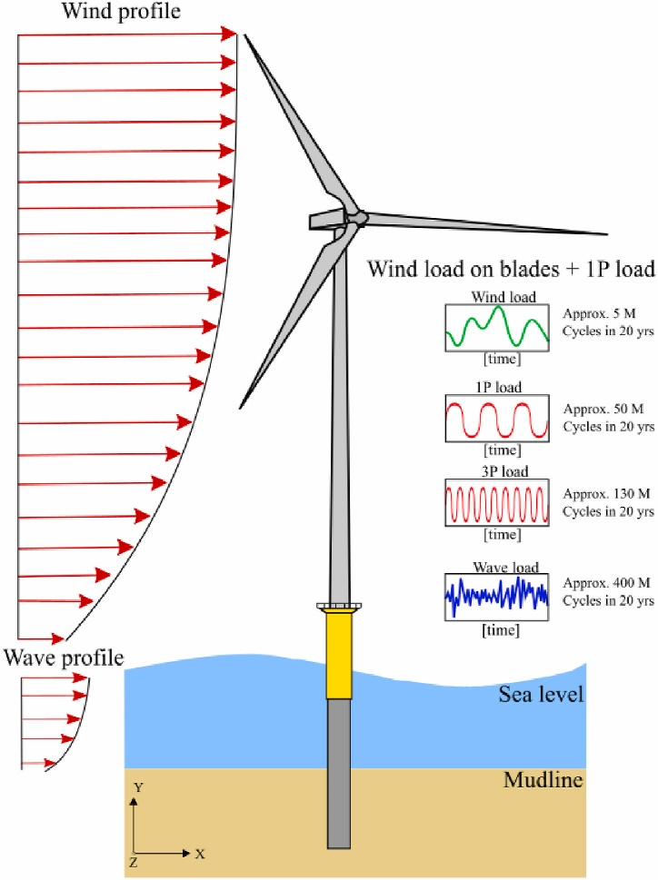
Overview of the modeling chain in operational and parked conditions
Aerodynamics : turbulent wind loads on blade and tower
3D turbulence wind box generator
Blade Element Momentum (BEM) for induction and loads on rotor
Control on blade pitch and generator torque to optimize production and ensure integrity for operational turbine conditions
Hydrodynamics : wave and current loads on immersed foundation components
Large body (D>wavelength) : transfer functions for linear potential approach (statics + radiation + diffraction)
Small body (D<wavelength) : Morison equation with inertia and drag terms. Drag proportional to solid – fluid velocity to the square.
Aleem et al, Ocean Engineering, vol. 248, 2022

Slide 4
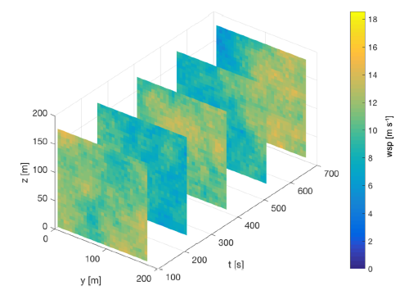
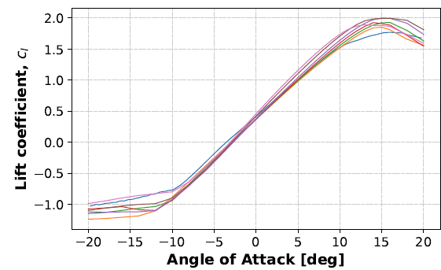
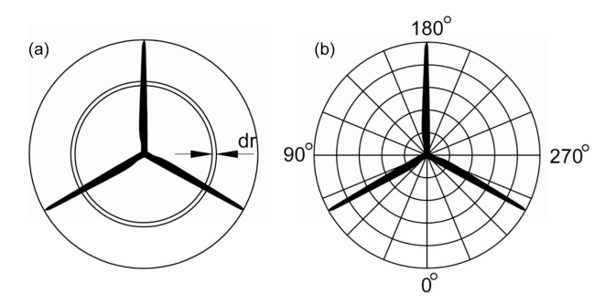
Overview of the modeling chain in operational and parked conditions
Aerodynamics
Turbulence box statistical generator (e.g. TurbSim of NREL, HIPERSIM of DTU)
Assumptions : Frozen turbulence, Gaussian process, spectrum, time and space increments
Blade Element Momentum
Induced velocities at rotor disk from momentum theory (decrease of wind speed, stationary flow)
Blade sectional forces from 2-D airfoil characteristics (lift and drag polars)
Empirical corrections needed for 3D and transient flow patterns
Hannesdotir et al, Wind Energ. Sci., 4, 325–342, 2019
Madsen et al, Wind Energ. Sci., 5, 1–27, 2020
IEA 15-MW, NREL/TP-5000-75698 report

Slide 5
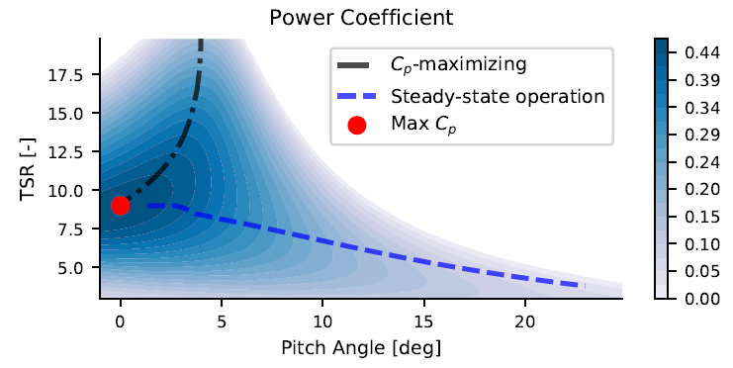
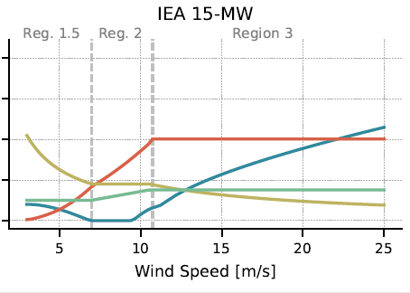
Overview of the modeling chain in operational and parked conditions
Controller on blade pitch and generator torque (tuning of gains required)
region 1.5 : torque control to regulate minimum rotor speed, pitch control to optimize power (black curve)
region 2: fixed blade pitch, torque control to optimize power (red point, optimal TSR)
region 2.5 : rated rotor speed but need to increase torque to reach nominal power
region 3: fixed torque, pitch control to regulate rotor speed (blue curve)
Abbas et al, vol. 7, 1, WES, 7, 53–73, 2022

Slide 6
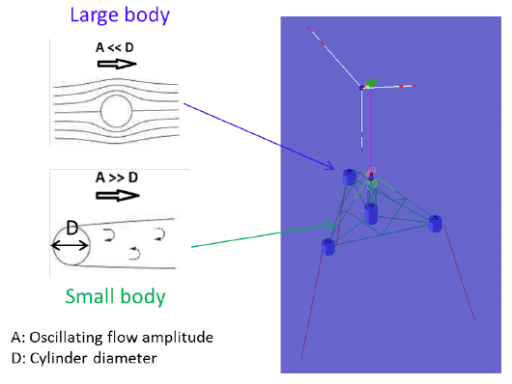
Overview of the modeling chain in operational and parked conditions
Hydrodynamics
Small body : the oscillating flow detaches from the body surfaces. Large uncertainty in the fitting of drag coef. from basin tests or CFD
Large body : assumption of linear superposition of contributions
For monopile, Mac Camy & Fuchs (MCF) analytical extension of Morison drag force for large diameter approximations :
Radius change
Non-linear wave and wave loading order
C. Clément, PhD Normandie Université, 2021

Slide 7
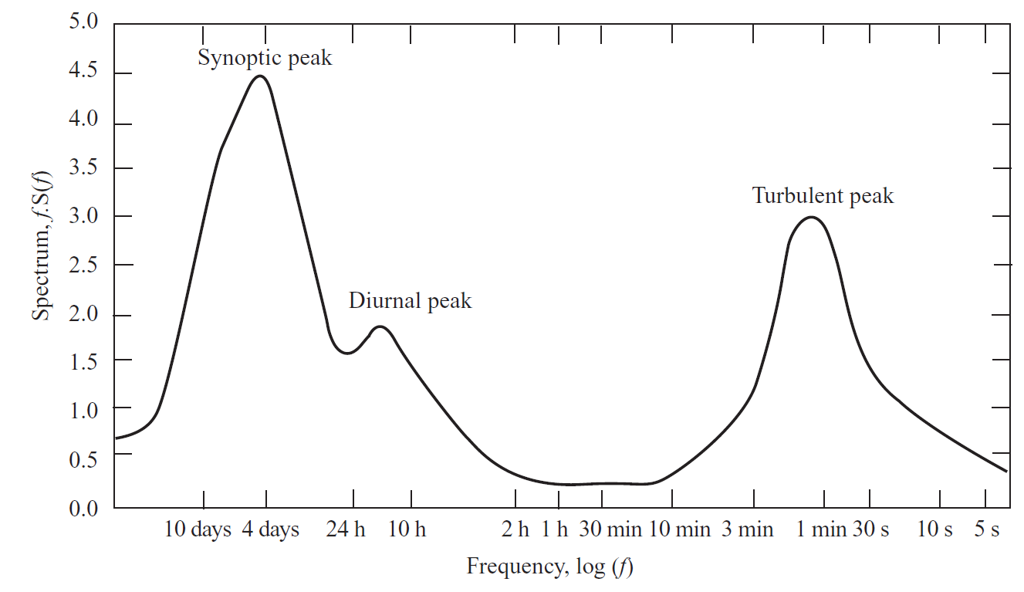
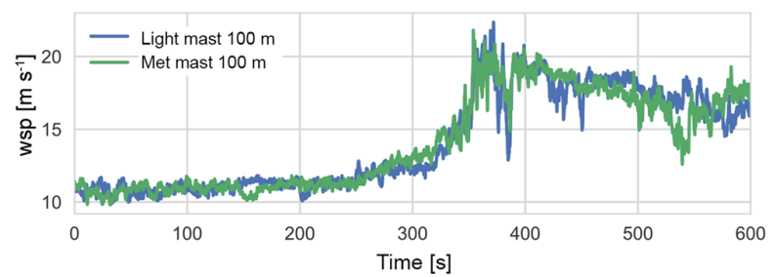
Long-term and short-term wind speed and wave elevation processes
Wind speed and wave elevation described by Gaussian Processes with and without mean bias
non-Gaussian process can be simulated for extreme events with constraining method embedding monitored gusts like in HIPERSIM DTU turbulence box software.
Time scale separation in PSD : long-term (10 min for wind, 1 to 3h for waves) pluriannual statistics, short term variation with stochastic replications
Wind speed spectrum fluctuation
Vohrpahl et al, WIREs Energy Environ 2013
Hannesdotir et al, Wind Energ. Sci., 4, 325–342, 2019

Slide 8
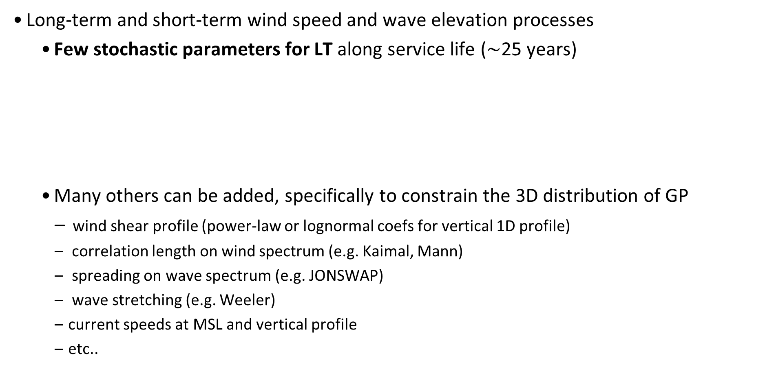
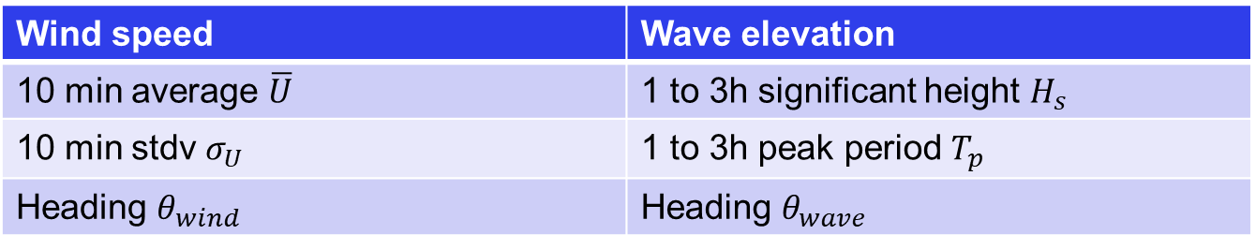
Reminders on aero-servo-hydro-elastic simulations used in design of an Offshore Wind Turbine (OWT)
Long-term and short-term wind speed and wave elevation processes
Few stochastic parameters for LT along service life ($\sim$25 years)
Many others can be added, specifically to constrain the 3D distribution of GP
wind shear profile (power-law or lognormal coefs for vertical 1D profile)
correlation length on wind spectrum (e.g. Kaimal, Mann)
spreading on wave spectrum (e.g. JONSWAP)
wave stretching (e.g. Weeler)
current speeds at MSL and vertical profile
etc..
Wind speed | Wave elevation
10 min average $\overline{U}$ | 1 to 3h significant height $H_{s}$
10 min stdv $σ_{U}$ | 1 to 3h peak period $T_{p}$
Heading $θ_{wind}$ | Heading $θ_{wave}$

Slide 9
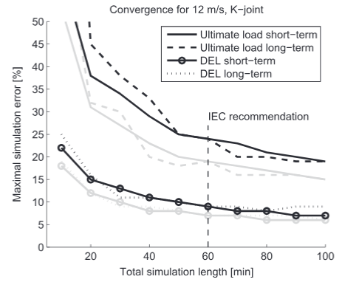
Long-term and short-term wind speed and wave elevation processes
IEC simulations guidelines recommends 6 replications of 10 min only for ST wind and wave (stochastic seed for instance on phase angle of Fourier components for irregular time series)
Residual variance on Fatigue output
Not enough for Ultimate ouput
Increases the replications (IEC rule is actually 36 for ULS DLC)
Fit extreme GEV distribution on max before extrapolation at 50 year returning period
Larger time is required for floating as wave spectrum shift to lower frequency (peak around 0.1Hz)
Zwick & Muskulus, Wind Energ., 18, 2015

Slide 10
Summary
Reminders on aero-servo-hydro-elastic (ASHE) simulations used in design of an Offshore Wind Turbine (OWT)
Overview of the modeling chain in operational and parked conditions
Long-term and short-term wind speed and wave elevation processes
Review of uncertainty sources in the modeling chain
Joint probability on LT parameters for a site
Aerodynamics including turbulence box setting
Blade pitch and generator torque controller
Hydrodynamics (fixed and floating foundations)
Post-treatment uncertainty for ULS and FLS
Extension to the design of a wind farm
Wake analysis
Annual Energy Production (AEP) and fatigue contraints
Clustering of wind conditions and turbine settings

Slide 11
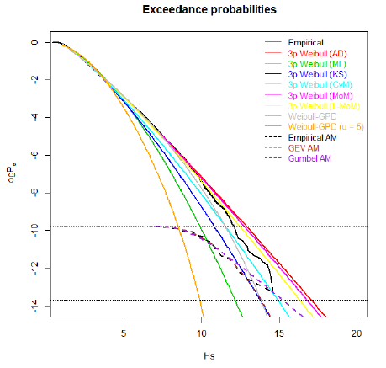
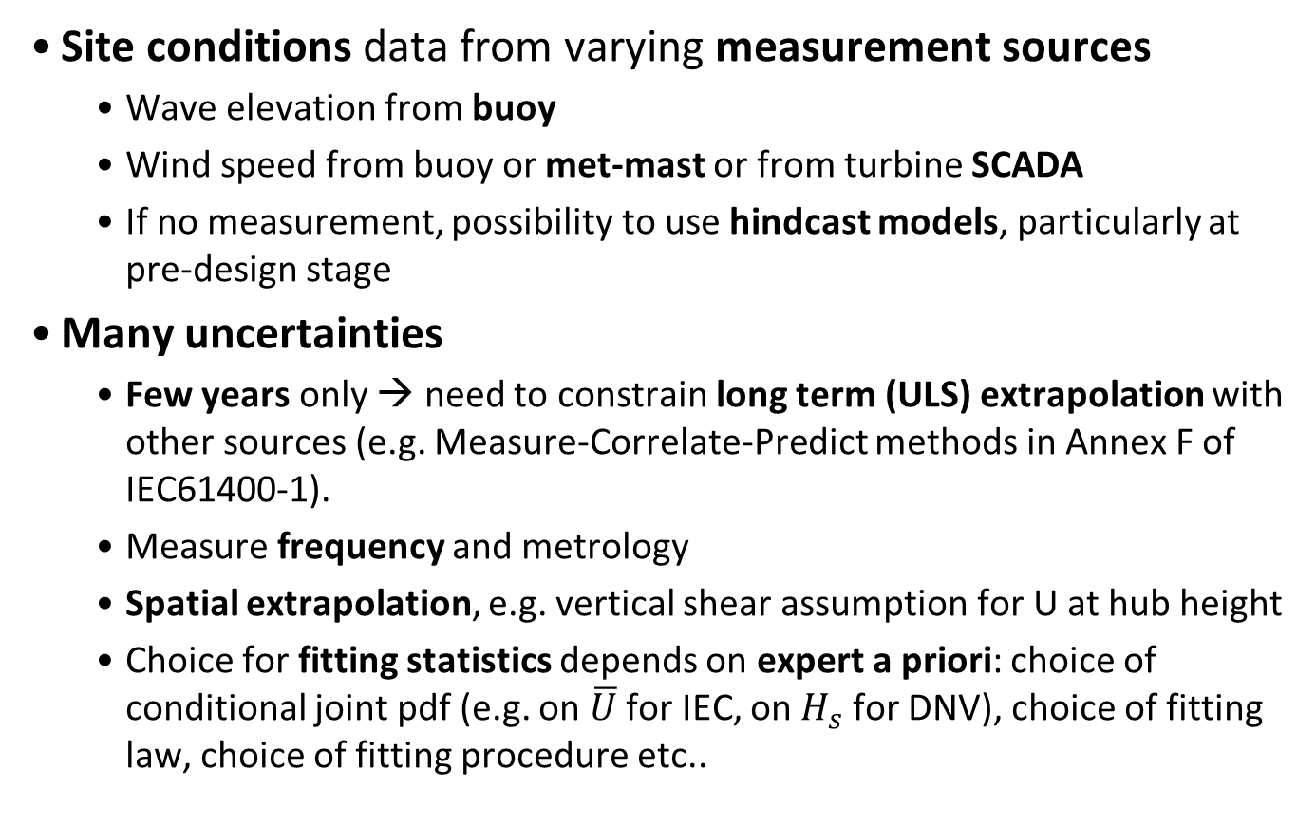
Joint probability on LT parameters for a site
Site conditions data from varying measurement sources
Wave elevation from buoy
Wind speed from buoy or met-mast or from turbine SCADA
If no measurement, possibility to use hindcast models, particularly at pre-design stage
Many uncertainties
Few years only → need to constrain long term (ULS) extrapolation with other sources (e.g. Measure-Correlate-Predict methods in Annex F of IEC61400-1).
Measure frequency and metrology
Spatial extrapolation, e.g. vertical shear assumption for U at hub height
Choice for fitting statistics depends on expert a priori: choice of conditional joint pdf (e.g. on $\overline{U}$ for IEC, on $H_{s}$ for DNV), choice of fitting law, choice of fitting procedure etc..
Vanem et al, OMAE2023-101961, 2023

Slide 12
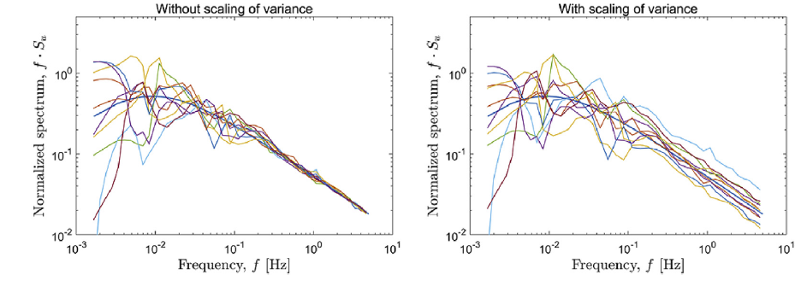
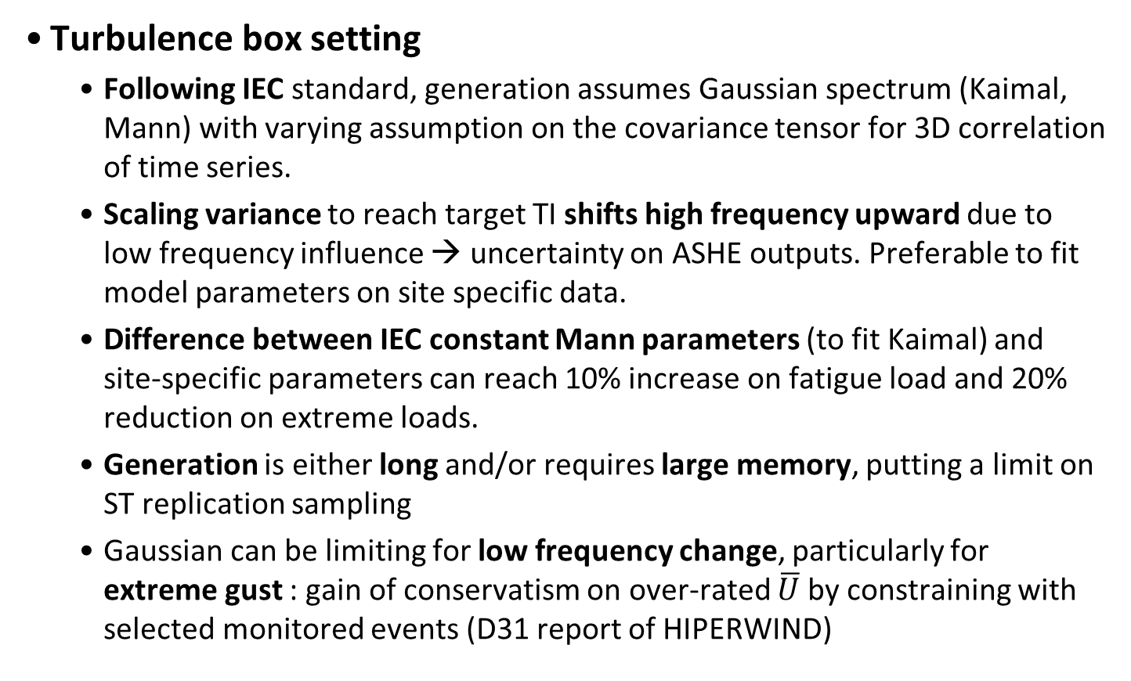
Aerodynamics including turbulence box setting
Turbulence box setting
Following IEC standard, generation assumes Gaussian spectrum (Kaimal, Mann) with varying assumption on the covariance tensor for 3D correlation of time series.
Scaling variance to reach target TI shifts high frequency upward due to low frequency influence → uncertainty on ASHE outputs. Preferable to fit model parameters on site specific data.
Difference between IEC constant Mann parameters (to fit Kaimal) and site-specific parameters can reach 10% increase on fatigue load and 20% reduction on extreme loads.
Generation is either long and/or requires large memory, putting a limit on ST replication sampling
Gaussian can be limiting for low frequency change, particularly for extreme gust : gain of conservatism on over-rated $\overline{U}$ by constraining with selected monitored events (D31 report of HIPERWIND)
Dimitrov et al, Renewable Energy, 101, 2017

Slide 13
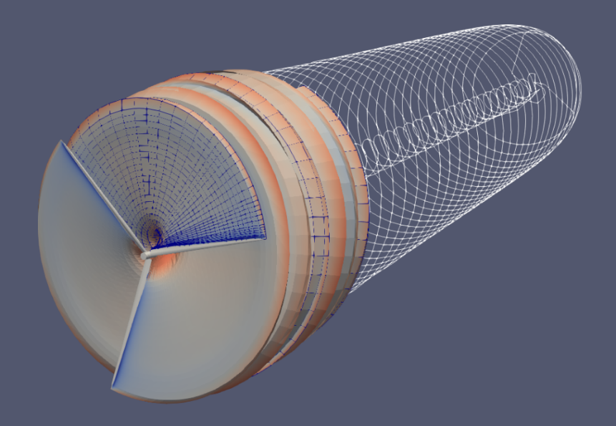
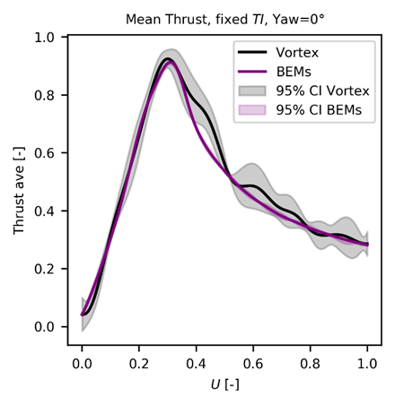
Aerodynamics including turbulence box setting
Generally missing data from turbine manufacturer
Ongoing research to fit aerodynamic polars from measurement
BEM vs Vortex model uncertainty
Empirical corrections on BEM for 3D and transient flows patterns:
Tip loss, Dynamic stall, Yaw misalignement
Vortex methods can simulate these with higher fidelity but still reasonable computational cost
Lifting line approximation (infinite lines for blades)
Inviscid and incompressible Vortex filaments with optimization (filament merging and transition to tip lines in the far downwind domain)
Comparison for a PLEX sampling env. conditions with adaptive kriging to compute points where the uncertainty is largest
→ For a monopile case, small differences on power (<2.3%), thrust (<4.2%) and blade flapwise DEL (<0.2%)
HIPERWIND D32 report

Slide 14
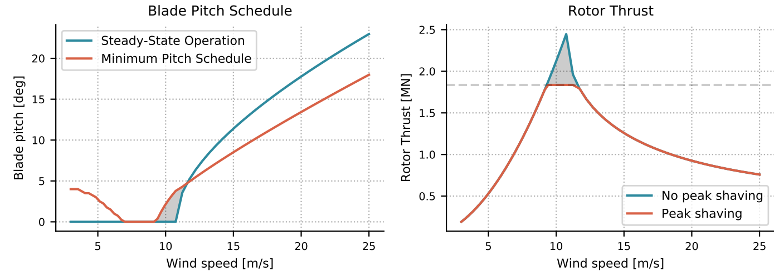
Blade pitch and generator torque controller
Generally missing data from turbine manufacturer → tuning generic open-source controller
Generate steady power and thrust coefficient surfaces with BEM
Tuning of torque and pitch (different regions) gains to get target production
Tuning of damping and frequency of closed loop
Reduce thrust by peak shaving with minimum blade pitch
Differences will remain between tuned generic and industrial controller
Can be quantified if industrial one is shared as library (DLL)
If not, ongoing research to optimize the generic controller with SCADA and if available high frequency monitoring
Abbas et al, vol. 7, 1, WES, 7, 53–73, 2022

Slide 15
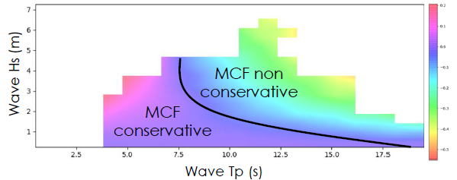
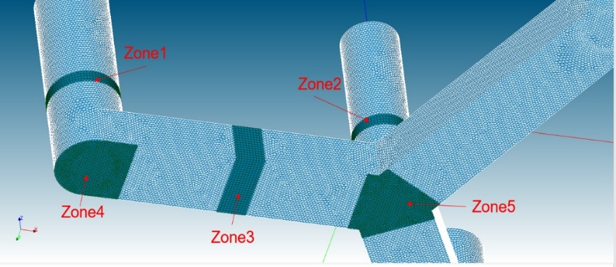
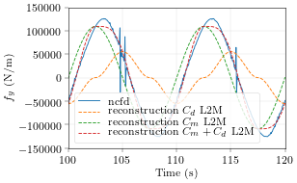
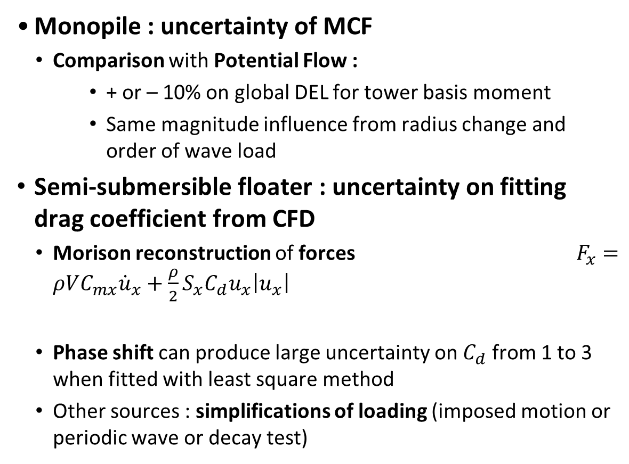
Hydrodynamics (fixed and floating foundations)
Monopile : uncertainty of MCF
Comparison with Potential Flow :
+ or – 10% on global DEL for tower basis moment
Same magnitude influence from radius change and order of wave load
Semi-submersible floater : uncertainty on fitting drag coefficient from CFD
Morison reconstruction of forces $F_{x}=ρVC_{mx}{\dot{u}}_{x}+\frac{ρ}{2}S_{x}C_{d}u_{x}\left|u_{x}\right|$
Phase shift can produce large uncertainty on $C_{d}$ from 1 to 3 when fitted with least square method
Other sources : simplifications of loading (imposed motion or periodic wave or decay test)
Difference (%) on tower basis DEL with 2nd order wave load
HIPERWIND D33 report

Slide 16
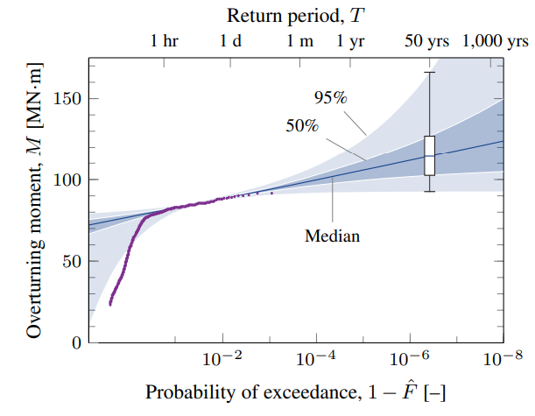
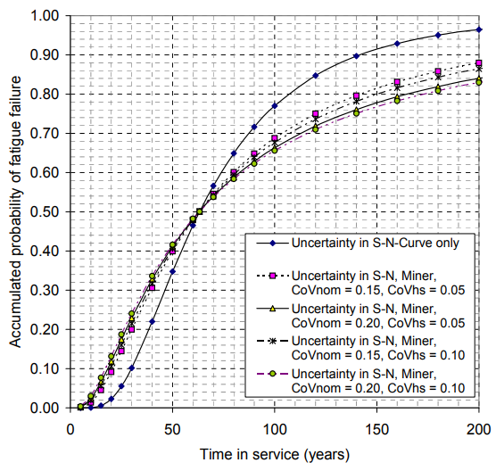
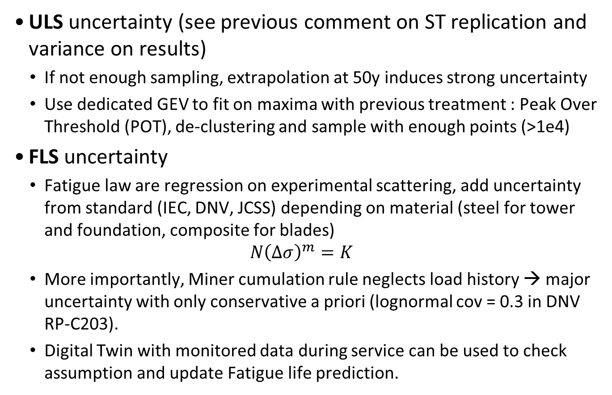
Post-treatment uncertainty for ULS and FLS
ULS uncertainty (see previous comment on ST replication and variance on results)
If not enough sampling, extrapolation at 50y induces strong uncertainty
Use dedicated GEV to fit on maxima with previous treatment : Peak Over Threshold (POT), de-clustering and sample with enough points (>1e4)
FLS uncertainty
Fatigue law are regression on experimental scattering, add uncertainty from standard (IEC, DNV, JCSS) depending on material (steel for tower and foundation, composite for blades)
$$N{\left(Δσ\right)}^{m}=K$$
More importantly, Miner cumulation rule neglects load history → major uncertainty with only conservative a priori (lognormal cov = 0.3 in DNV RP-C203).
Digital Twin with monitored data during service can be used to check assumption and update Fatigue life prediction.
Van Eijk et al, Wind Energy Science, 2017
DNV RPC-203

Slide 17
Other sources
Physical damping and numerical damping
Geometrical and material (elastic and ultimate limit) manufacturing
Soil structure interface stiffness
Etc..
Results for a monopile in Njomo‐Wandji et al, Wind Energy. 2019

Slide 18
Summary
Reminders on aero-servo-hydro-elastic (ASHE) simulations used in design of an Offshore Wind Turbine (OWT)
Overview of the modeling chain in operational and parked conditions
Long-term and short-term wind speed and wave elevation processes
Review of uncertainty sources in the modeling chain
Joint probability on LT parameters for a site
Aerodynamics including turbulence box setting
Blade pitch and generator torque controller
Hydrodynamics (fixed and floating foundations)
Post-treatment uncertainty for ULS and FLS
Extension to the design of a wind farm
Wake analysis
Annual Energy Production (AEP) and fatigue contraints
c

Slide 19
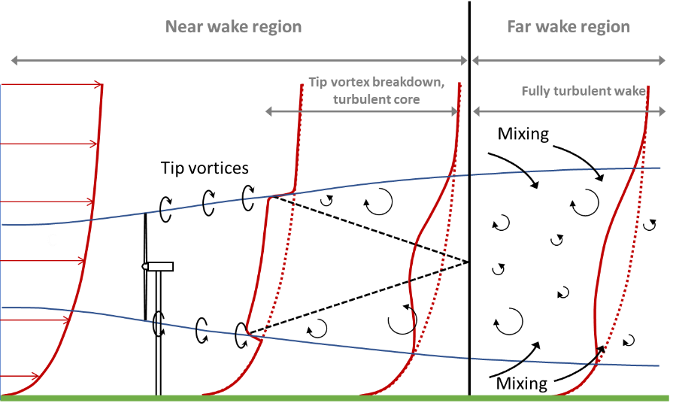
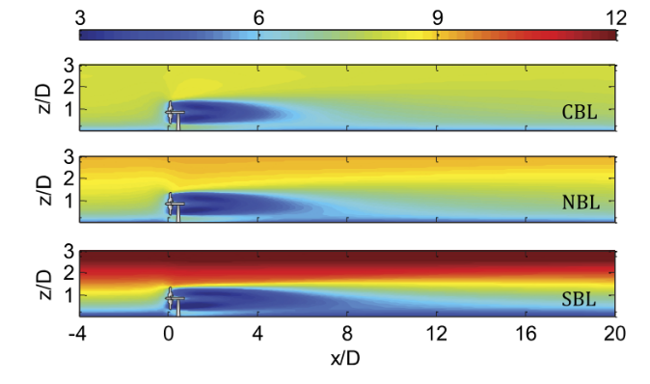
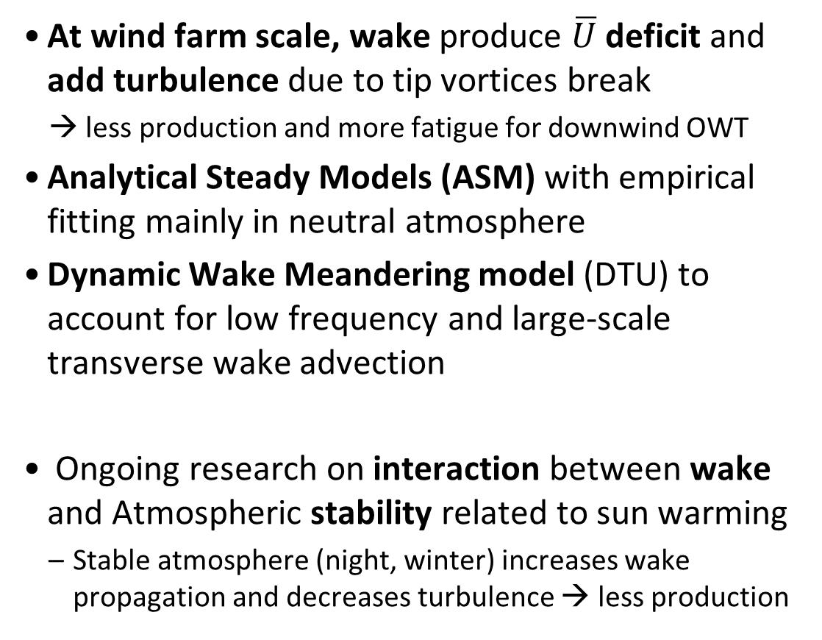
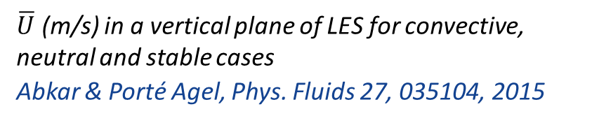
Wake analysis
At wind farm scale, wake produce $\overline{U}$deficit and add turbulence due to tip vortices break
→ less production and more fatigue for downwind OWT
Analytical Steady Models (ASM) with empirical fitting mainly in neutral atmosphere
Dynamic Wake Meandering model (DTU) to account for low frequency and large-scale transverse wake advection
Ongoing research on interaction between wake and Atmospheric stability related to sun warming
Stable atmosphere (night, winter) increases wake propagation and decreases turbulence → less production
Uchida, Energies, 13(14), 3745, 2020
$\overline{U}$ (m/s) in a vertical plane of LES for convective, neutral and stable cases
Abkar & Porté Agel, Phys. Fluids 27, 035104, 2015

Slide 20
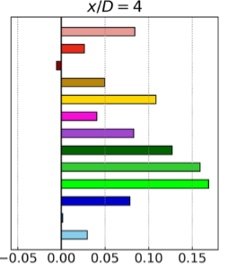
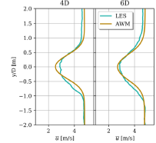
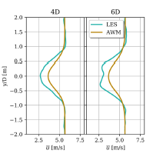
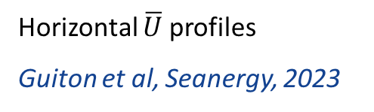
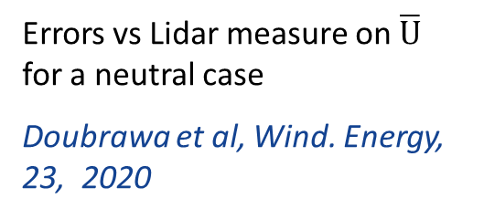
Wake analysis
Uncertainty depending on ASM assumptions, still to be validated for multiple wake interactions
ASM well fitted for neutral atmosphere but underprediction for stable vs LES (HIPERWIND D32)
→ ongoing research to reduce this gap but uncertainty to include by meantime
Neutral ABL
Stable ABL
Errors vs Lidar measure on $\overline{U}$ for a neutral case
Doubrawa et al, Wind. Energy, 23, 2020
Horizontal $\overline{U}$profiles
Guiton et al, Seanergy, 2023

Slide 21
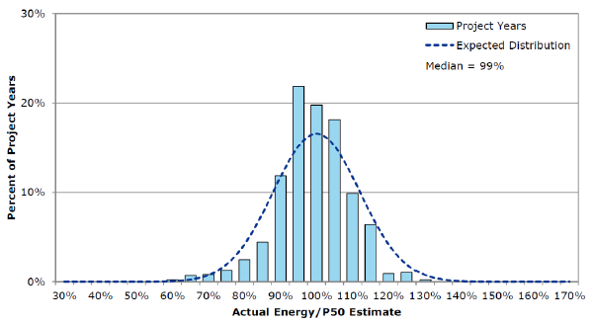
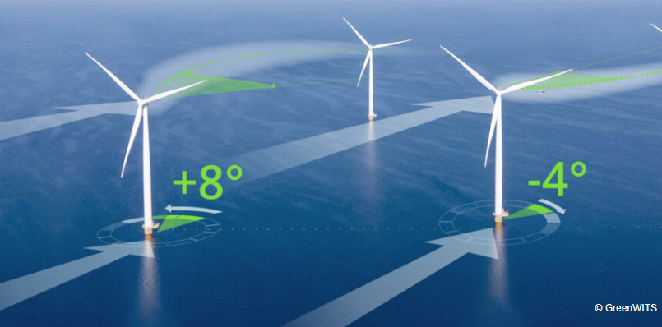
Annual Energy Production (AEP) and fatigue contraints
AEP is the leading Key Point of Interest (KOI) for wind farm evaluation
Analytical steady wake models are fast enough to compute AEP (mean expectation over LT wind and wave parameters)
Fatigue constraint require surrogate models to replace costly ASHE (D31 report of HIPERWIND)
Influence of floater motion for FOWT : rotor inclination and upward deflection of wake
Few percent gains on AEP are of major importance
Ongoing research to improve wind farm performance
Embed in a layout optimization accounting for sitting (space) constraints (benchmark in Thomas et al, Wind Energ. Sci., 8, 865–891, 2023)
Wind farm control by wake steering
Underperfomance for 249 wind farms
Damiani, NREL/TP-5000-67499, 2018
https://www.greenwits.com

Slide 22
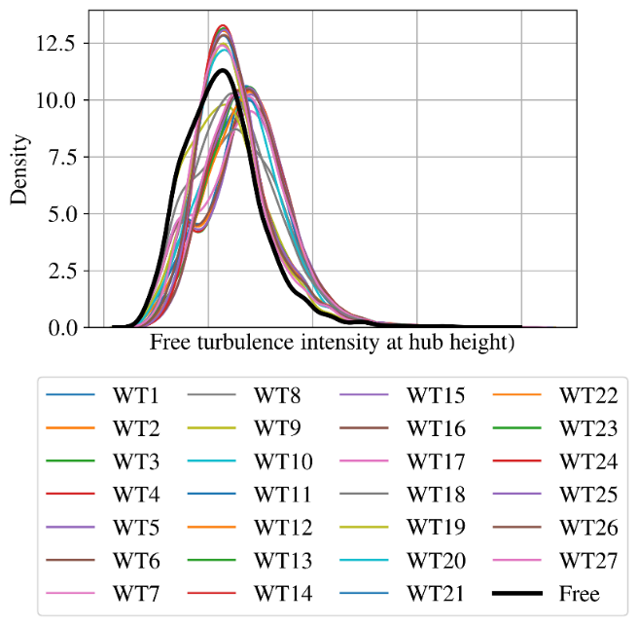
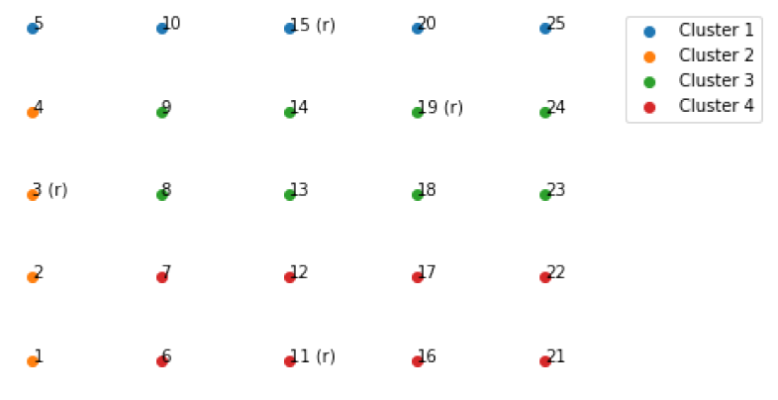
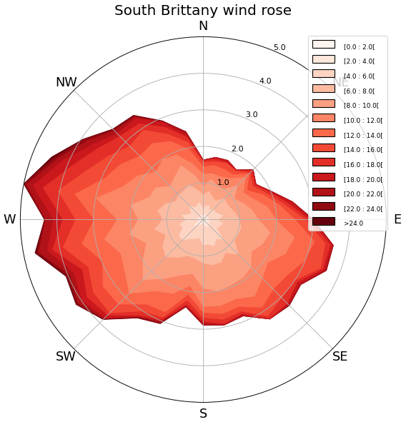
Clustering of wind conditions and turbine settings
free wind
Wake analysis produces heterogeneous maps of wind conditions in the wind farm
RBD ULS & FLS high cost requires to reduce number of OWT cases
Clustering to compute few groups with representative OWT
Maximum Mean Discrepancy metrics between pdf
Know methods (e.g. k-medoids) converge to 4 to 5 clusters for a 3 x 9 farm
Gain in computation introduces uncertainty from differences between OWT and cluster representant
OWT conditions can also vary (turbine, foundation, water depth, soil stiffness etc..) which add constraint on the clustering
Lovera et al, Wake 2023

Slide 23
Conclusions and recommendations
Design of Offshore Wind Turbines involves a complex 2-scales (wind farm and turbine) and multiphysics model chain.
For each stage of the model chain, multiples sources of uncertainty may be considered both on input data and for the modeling simulator.
Limitations on the number of uncertainty sources due to the huge number of calls to simulator in reliability with low target annual failure probabilities (1E-4 to 1E-5 depending on OWT component)
Choose the most important sources (from sensitivity analysis, as it depends on site and OWT case)
Quantify them to replace as possible a priori (e.g. WP3 results in D32 report with comparison of low fidelity to high fidelity models and adaptive Kriging for PLEX refinement).

Slide 24







Partners

Slide 25


Funding scheme
This project has received funding from the European Union’s Horizon 2020 Research and Innovation Programme under Grant Agreement No. 101006689
Project Coordinator
Nikolay Krasimirov Dimitrov
DTU Wind and Energy Systems
nkdi@dtu.dk

