Slide 1
Introduction to the Project (Version 1)
Nikolay Dimitrov, Michael McWilliam, Pablo Morato

Slide 2
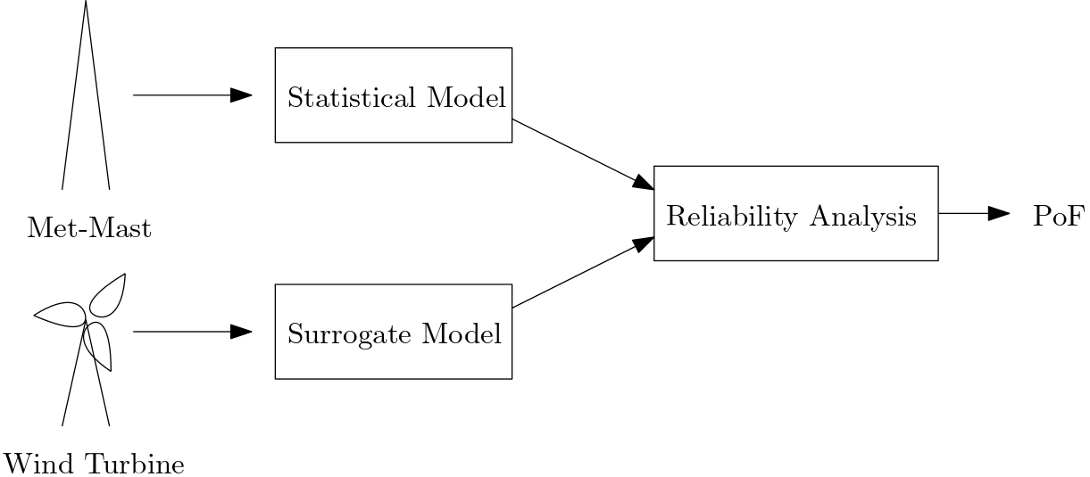
We want to install the IEA 15MW wind turbine at a given site.
We need to determine the probability of failure for safety
We have some meteorological measurement data for the site
We have fatigue load data for the turbine
Can you calculate the probability of failure?

Slide 3
Data Description
Met Data:
Wind Direction [deg]
Wave Direction [deg]
Wave Period [s]
Wave Height [m]
Standard deviation of stream-wise wind [m/s]
Wind Speed [m/s]

Slide 4
Data Description
Environmental Conditions for Turbine Data:
Wind Direction [deg]
Yaw Error [deg]
Wave Direction [deg]
Wave Period [s]
Wave Height [m]
Standard deviation of stream-wise wind [m/s]
Wind Speed [m/s]
Wind Shear Exponent [-]
Air Density [kg/m3]
There is not a perfect correspondence between Met-Data and Turbine data

Slide 5
Data Description
Turbine Load Data:
Damage Equivalent Bending Moment Load for:
Tower Base
Mx is For-Aft Bending
My is Side-Side Bending
Mz is Torsion
Tower Top (same coordinate system as tower base)
Blade Root
Mx is Flapwise bending
My is Edgewise bending
Mz is Torsional bending

Slide 6

What is Damage Equivalent Load?
n_{i} S_{i} are taken from the cycle matrix counts from standard rainflow counting (i.e. sum in the numerator is damage)
N_{ref} was taken as 1 (easy to factor out the damage)
m is the slope in the S-N curve:
3 for steel
10 for composites
Each DEL gives the damage accumulated over 10 minutes under given conditions
DEL are given as moments… but material failure models are based on stress?
Design geometry is needed to convert moments to stress

Slide 7


What is Fatigue Failure?
Failure when D exceeds the limit for the material
The total damage is sum of damage accumulated over all conditions
N is the number of times a given condition is seen (environmental data)
D is the damage accumulated in those conditions (turbine load surrogate)
X is the stochastic space for the damage calculation (see data description above)

Slide 8

What is Probability of Failure?
A singe evaluation of D-total and D-limit is either failure or no-failure.
To calculate PoF with fatigue, we need to consider additional stochastic variables (i.e. Y) outside of X. So then D-total has dependency on Y. Examples of Y are as follows:
Errors in your statistical model
Long-term weather variation
Errors in your surrogate
Uncertainty in material properties
Variation in the failure limits
Uncertainty in other unknown quantities
Shear statistics
Then the we consider reliability in the stochastic space of Y
For every realization of Y, we calculate both D-limit and D-total and can assess failure
So PoF is basically the frequency of Y where failure occurs

Slide 9
Day 2) Building a Statistical Model
Choose your stochastic space
Choose your distribution function and any conditional dependencies
Choose at least 1 bivariate distribution (i.e. greatest dependency)
Assume independence otherwise
Assess a couple candidate distributions for the data (QQ plots)
Fit your distribution
Justify your method (i.e. Show some goodness of fit measures)

Slide 10
Day 3) Load Surrogate Model
Choose your surrogate model
Describe the basic theory and properties of your chosen surrogate model
Discuss the properties relative to other surrogate methods. Alternatives include:
Neural networks
Polynomial curve fits
Fit your model
Describe the method that was used to fit the model
Assess the quality of fit
Measures of uncertainty (if available)
R-squared (if relevant)
Cross validation

Slide 11
Day 4) Reliability Analysis
Choose your stochastic space for reliability (Y)
Choose your limit state equation (OK if g(Y)>0)
Choose your Reliability Analysis Method
Evaluate the reliability

Slide 12
Afterwards
Refining the analysis as needed
Writing the report considering the following discussion topics:
How robust is your estimate? Sources of error? How could you verify?
How could your analysis be improved?
How could extract value (cost savings, risk minimization) from this reliability analysis?

Slide 13
Reporting Requirements
Document your work in a 10 page report
A proper latex report is preferred
We can accept a PDF of your Python Notebook only if it is very well formatted and readable like a report
Submit a report end of day Friday September 15th 2023 (nkdi@dtu.dk)
Evaluated as a Pass/Fail

