Slide 1
MySQL - Database
Restaurant Management System
Presented By
Mostafijul Islam
ID: 242034012, Dept. SWE,
Green University Of Bangladesh.

Slide 2
Table of contents
01
02
03
Introduction
Project Goal
ER-Diagram
Introduce you to the whole idea of this project.
What was the initial goal behind the project.
Look at the ER-Diagram of what we’ll be working with.
04
05
06
Infrastructure
Output/Result
Future Vision & Conclusion
Understand the utilities and the infrastructure of the project.
Hopefully, we will get to see a demo of the project.
Some finishing thoughts about the whole journey.

Slide 3
Introduction
The Idea
This project is built as way to learn how Database Management Systems work.
And it’s a demonstration of how you can solve real-life problems using digital products, in this case a fully functioning database. And it can make life easier.
What we will need
XAMPP
MySQL Server
Apache Web Server
Knowledge of SQL (aka. Structured Query Language)
And with all that, we are ready to begin our journey into the database world!

Slide 4
Project Goals
Utilize
Learn
Utilizing the theory and MySQL knowledge to design, develop, and test ideas.
Learning DBMS and MySQL through a fun and engaging real-world project task.
Explore
Output
Exploring fundamentals of MySQL in simple practical scenario and utilize it to solve real-world problems .
Producing clear results that showcase how to design, build and finally utilize a Database.

Slide 5
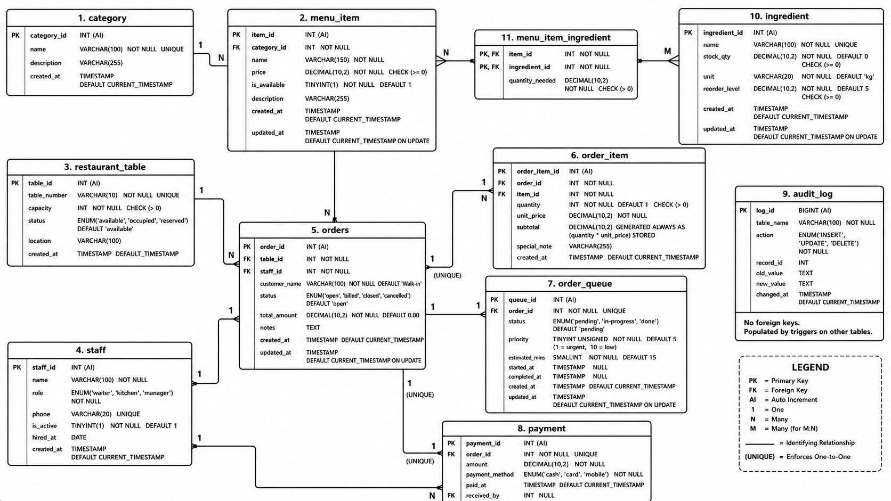
ER-Diagram Of the System

Slide 6
Infrastructure Of The System
Tables
Ingredient
Menu Item
Menu Item Ingredient
Orders
Order Item
Category
Audit Log
Order Queue
Payment
Restaurant Table
Staff

Slide 7
Infrastructure Of The System
Views
There are total 6 view, that help the manager see the Full menu, Table Status, Active Orders, Daily revenue and etc.
Triggers
There are total 9 triggers, that help to maintain consistency while managing new orders and updating order payment, time, etc.
Procedures
There are total 10 procedures, including one that uses Cursor and they help with minimizing the lengthy work like updating queue status, creating new order, etc.
Functions
There are total 5 individual functions, that shortens writing long .

Slide 8
Now let’s cook the program
Run XAMPP application.
Start MySQL and Apache Server.
Open http://localhost/phpmyadmin/index.php.
Run the restaurant-management-system.sql as raw SQL query.

Slide 9
Future Vision & Conclusion
Improvements We can Make
Add a Admin management system.
Add access security and permission management.
Introduce Algorithms for popular dishes.
Add Authentication and Billing system.
Conclusion
This Database delivers a Normalized and scalable foundation for restaurant operations. By defining relationship Cardinality—from one-to-many order flows to many-to-many ingredient recipes. We ensure strict data integrity and eliminate redundancy. Coupled with safeguards like price snapshotting and an immutable audit log, this design perfectly balances daily operational performance with accurate historical tracking.

Slide 10
Thank You! 💙✨

