Slide 1


BEATSaudio
A MUSIC PLAYER

Slide 2


DEVELOPED BY
HIRA AMIR
AMBER ARAIN
20SW014(SEC 1)
20SW019(SEC 1)

Slide 3

BEATSaudio
BEATSaudio is a GUI based JAVA application, Its functionalities includes
Allows user to select music from their PC
Allows user to play and pause music
Allows user to go previous or next music

Slide 4
Classes used in our application

Slide 5

1-Animation
In this Animation class we have made starting frame and made it sleep for 20000 milli seconds using Multithreading concept

Slide 6
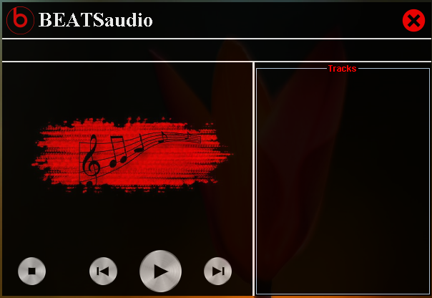
2-BEAT
IN this BEAT class we have made a header that includes icon image, our app label(BEATSaudio) and an exit button.
Furthur more we have created 2 pannels 1 for the current track and other pannel contains play and pause buttons .

Slide 7
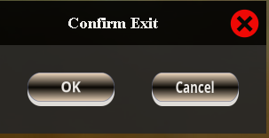
3- EXITFRAME
This EXITFRAME class allows the user to exit from Musice player application

Slide 8





4-INFORMATION
This INFORMATION class contains all the settings of buttons and frames like frame size,layout etc and added action listeners on buttons

Slide 9

5-MARQUEELABEL
We have used Marquee label class that is used to scroll a text "Hit The Play Buttton"message across the screen

Slide 10
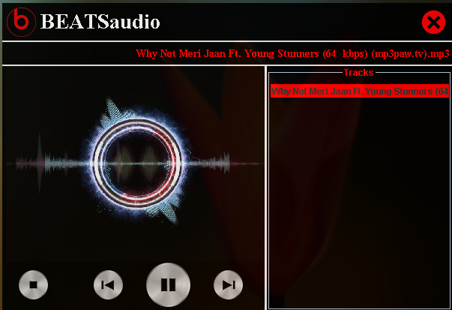
6-LAUNCHER
in this LAUNCHER class we have made an object of our ANIMATION class that launches our app

Slide 11

LET'S LOOK AT THE CODE!

