Slide 1
MITM Attack &
Defense Simulation
Man-in-the-Middle Attack | Kali Linux + Ubuntu
Submitted by: Hira Islam | Information Security | April 2026

Slide 2
What is a MITM Attack?
Definition
Attack Flow
A MITM attack occurs when an attacker secretly intercepts communication between two parties.
The attacker positions himself BETWEEN the victim and the gateway, capturing all traffic.
Used to steal credentials, banking info, and sensitive data.
01
Attacker joins same network
02
Scans for victim IP/MAC
03
Sends fake ARP replies
04
All traffic flows through Kali
Normal vs MITM:
Normal: Alice ←————————→ Bank
05
Credentials captured!
MITM: Alice ←→ Attacker ←→ Bank
Victim has NO IDEA!

Slide 3
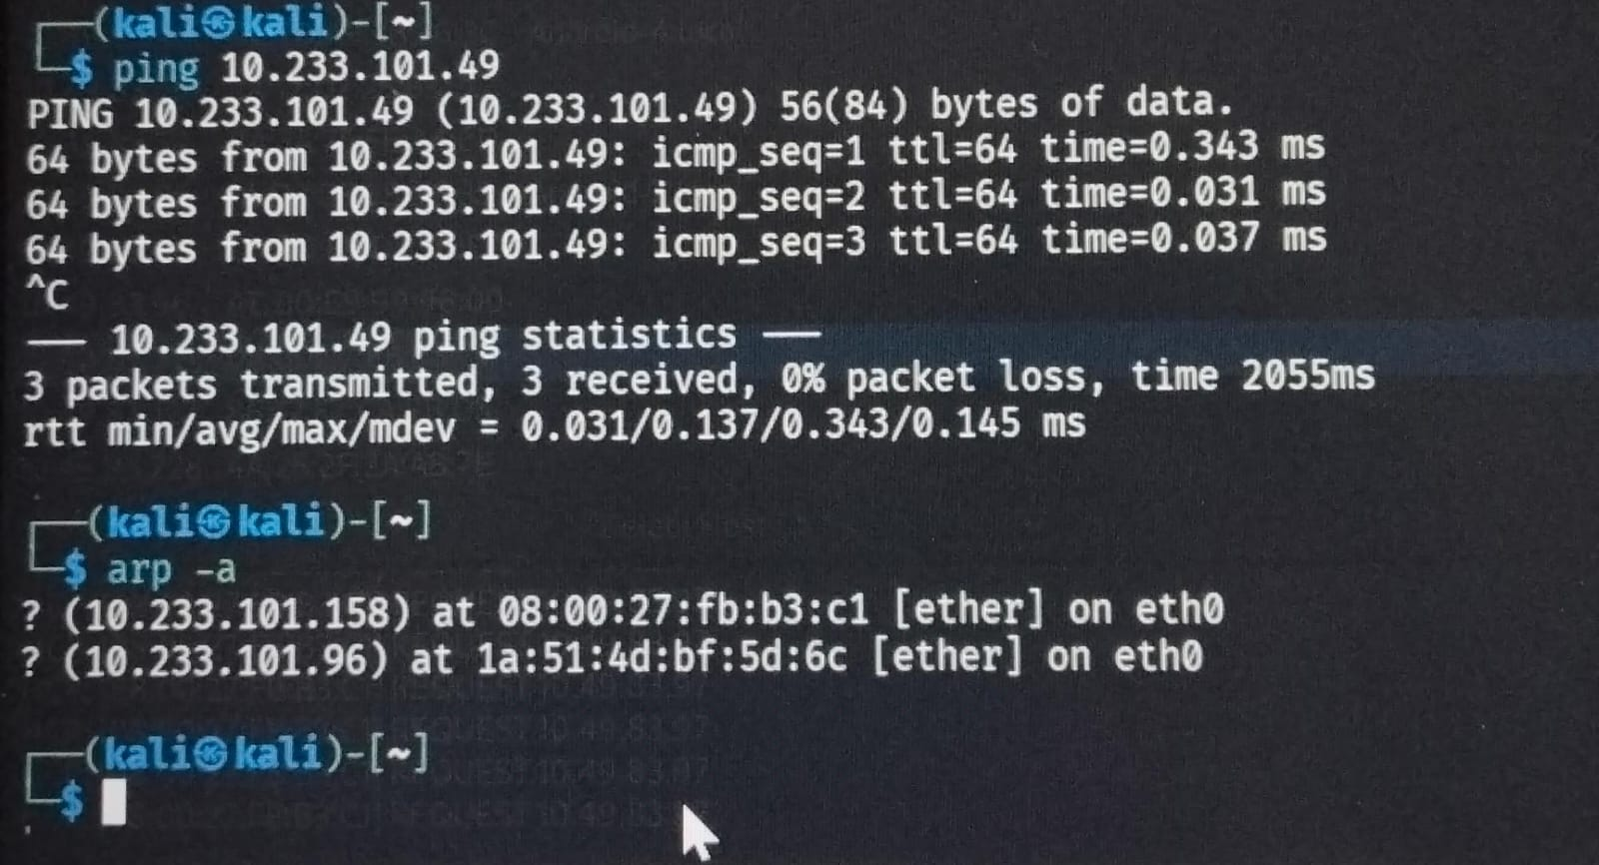
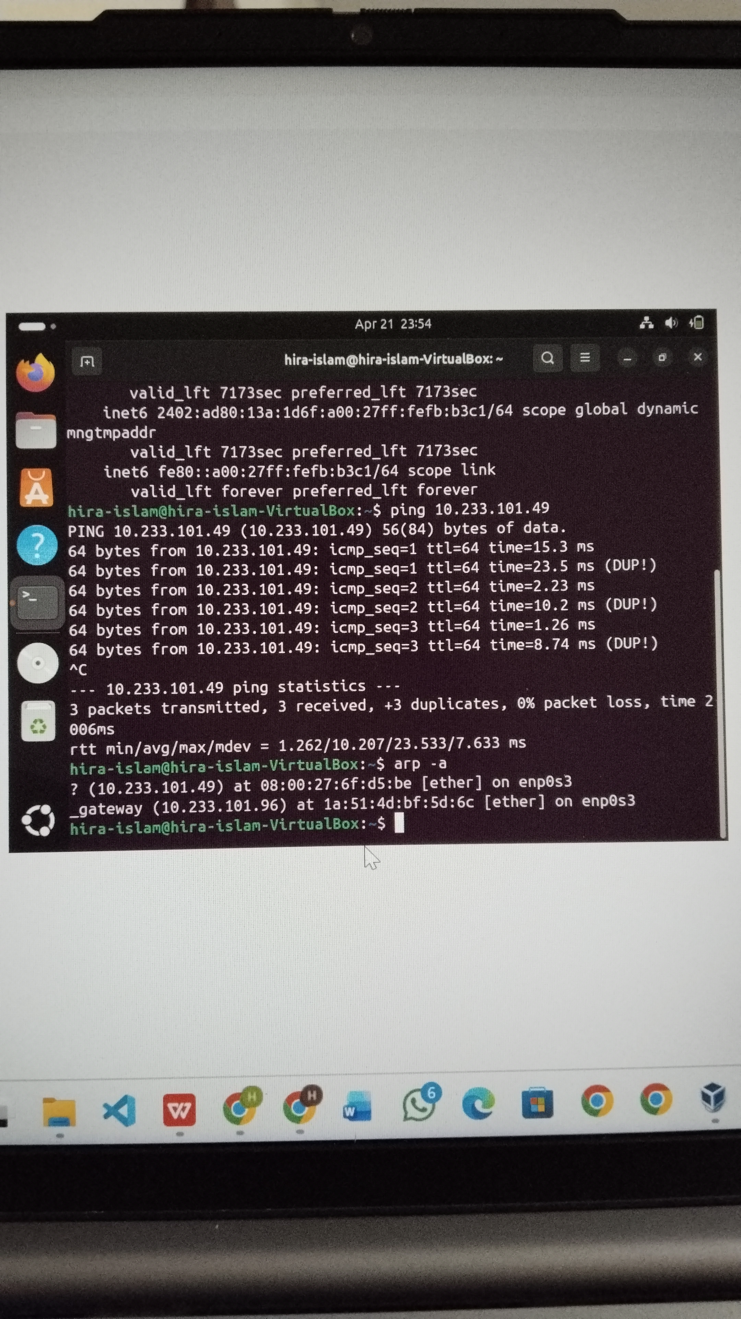
Lab Setup & Network Topology
ATTACKER
VICTIM
GATEWAY
Kali Linux
Ubuntu
Router
10.233.101.49
ARP Spoof
10.49.83.97
ARP Spoof
10.49.80.1
eth0
enp0s3
Default GW
Ubuntu → Kali Ping (Connected!)
Kali → Ubuntu Ping (Connected!)

Slide 4
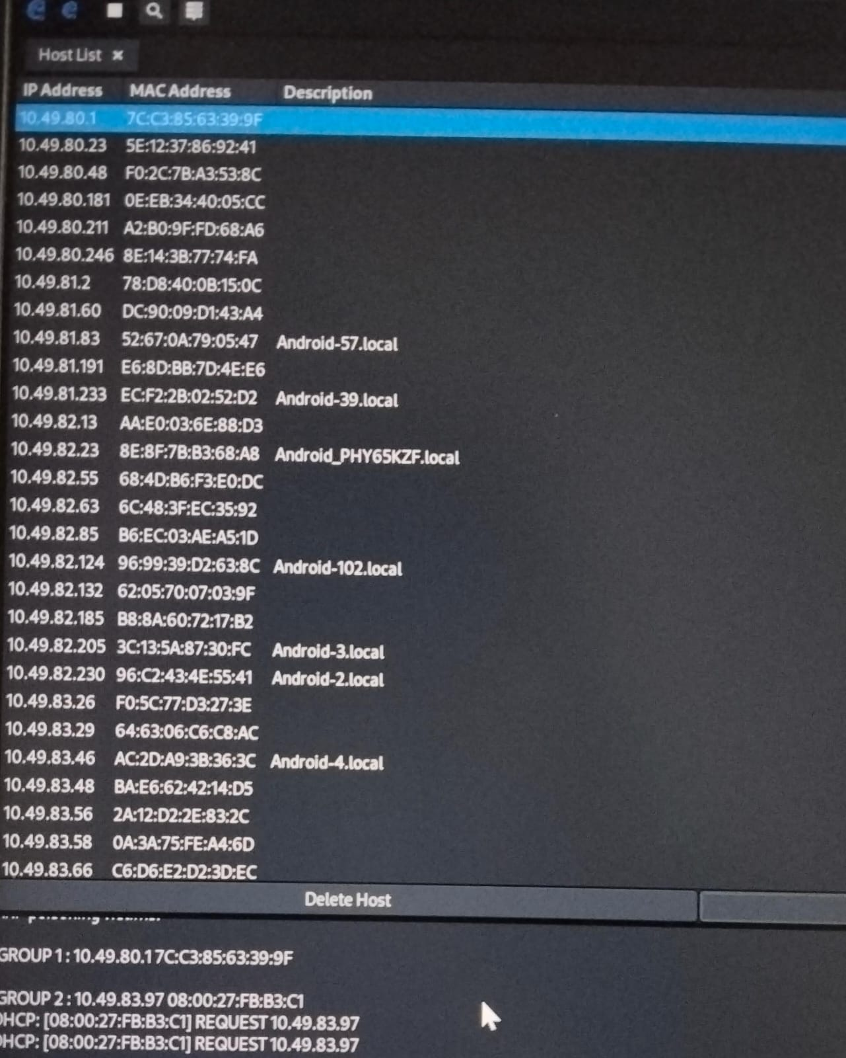
Attack Demo — Ettercap Host Discovery
[ RED TEAM PHASE ]
Ettercap Host List — Real Scan
Steps Performed:
1. sudo ettercap -G
2. Hosts > Scan for Hosts
3. 30+ devices found!
4. Ubuntu selected Target 1
5. Gateway selected Target 2
6. Mitm > ARP Poisoning
7. Start > Start Sniffing

Slide 5
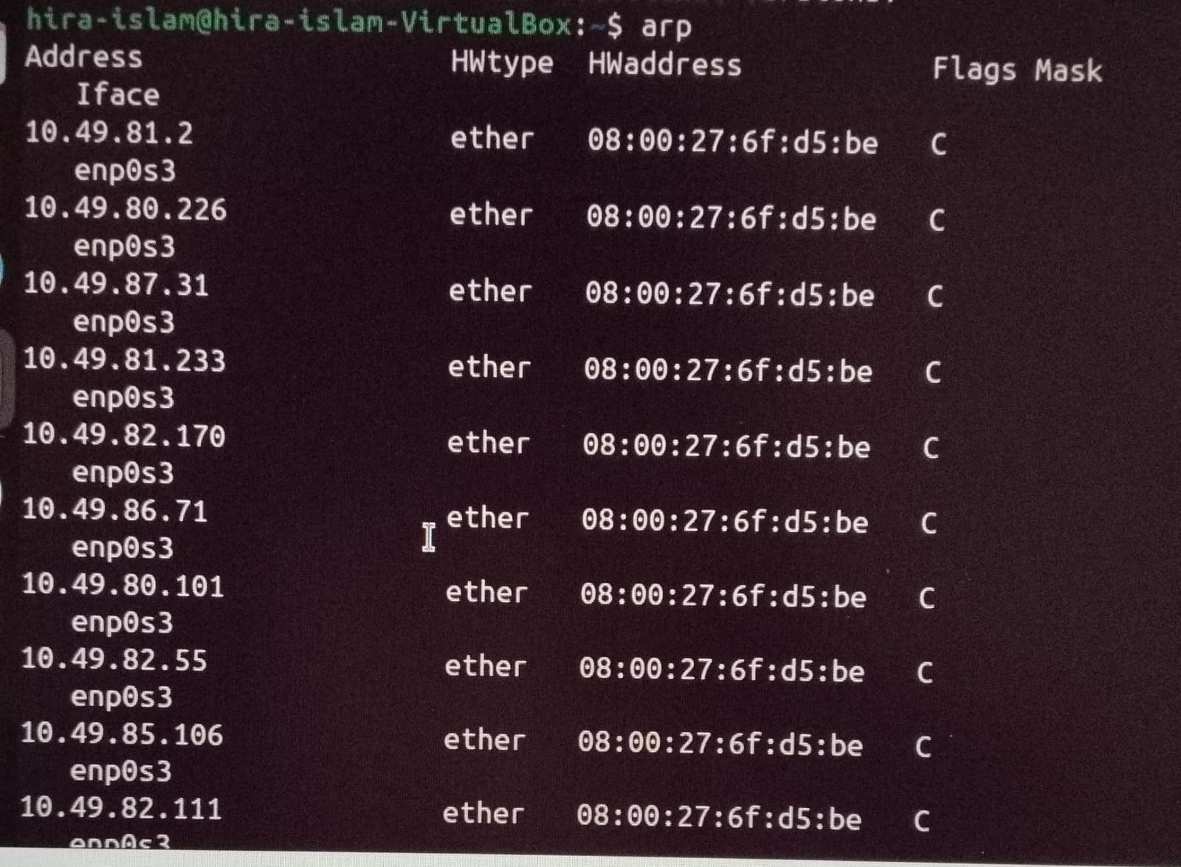
ARP Poisoning — Proof!
[ ARP CACHE POISONED ]
Ubuntu ARP Table — POISONED!
What This Proves:
All IPs same MAC!
MAC = 08:00:27:6f:d5:be
This is KALI's MAC!
Ubuntu thinks Kali
is the Gateway!
All traffic now
flows through Kali!

Slide 6
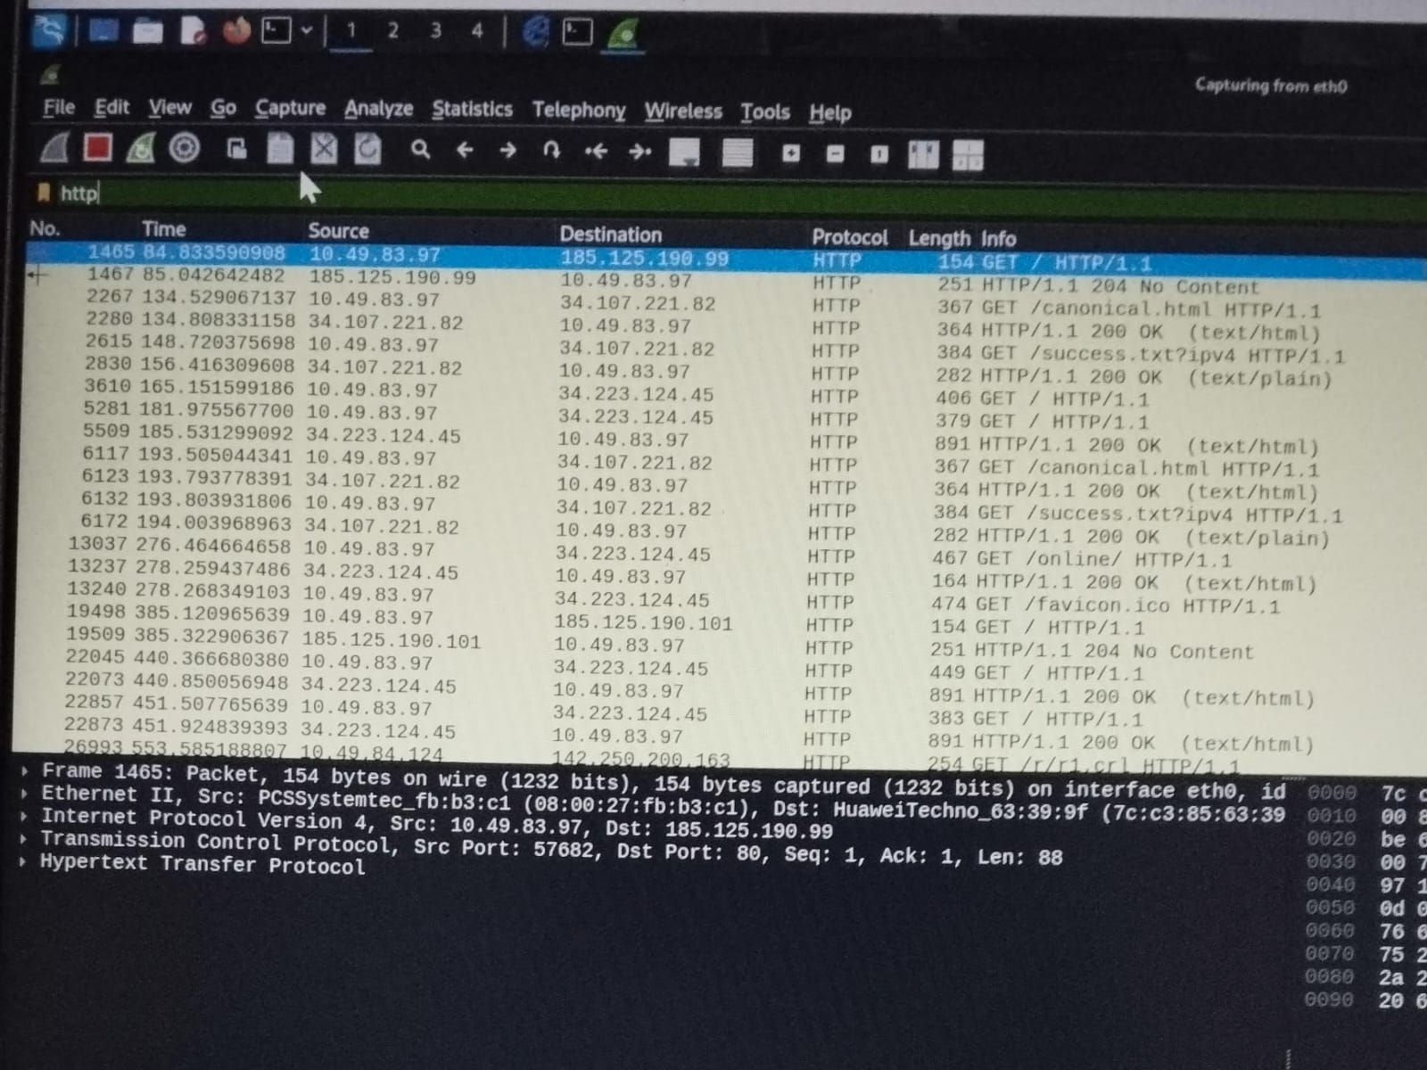
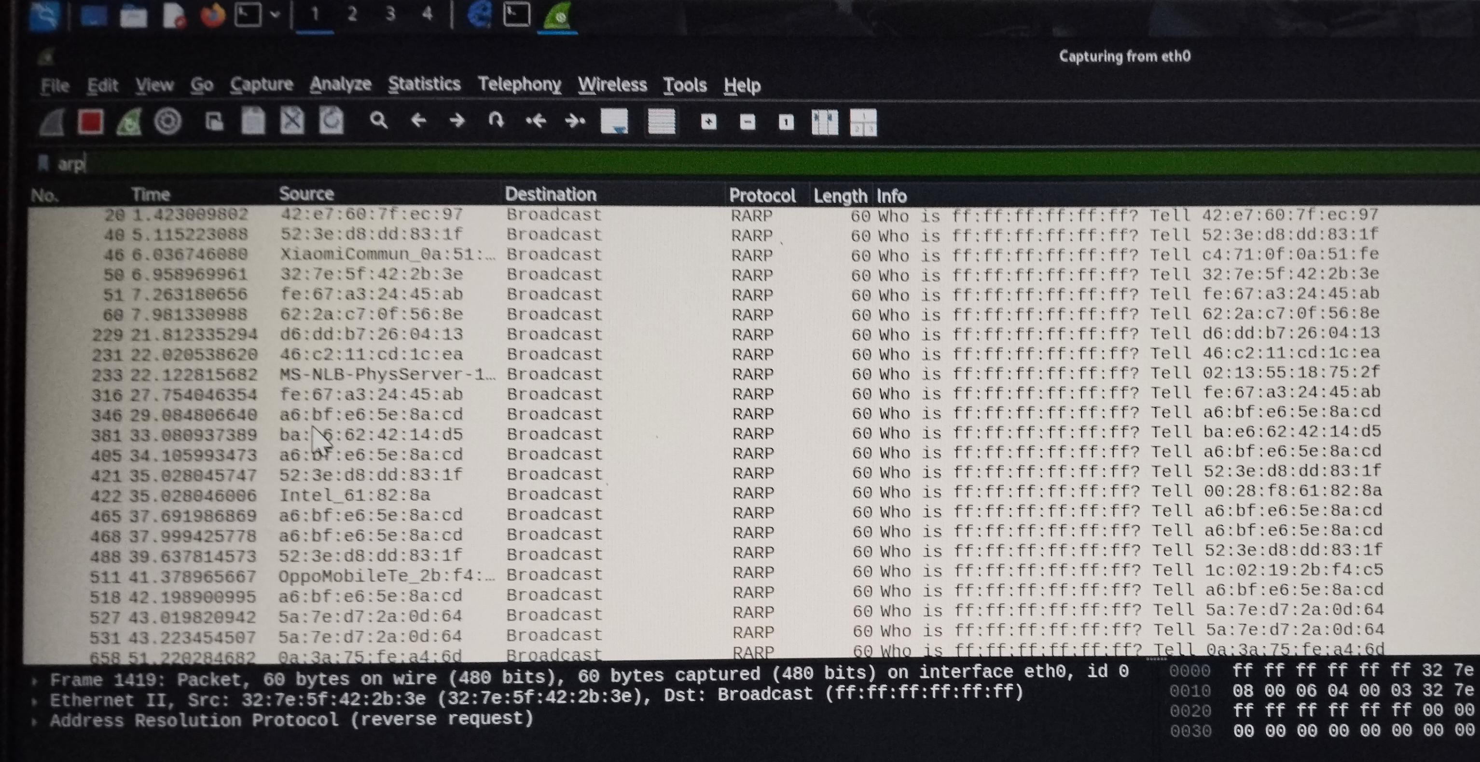
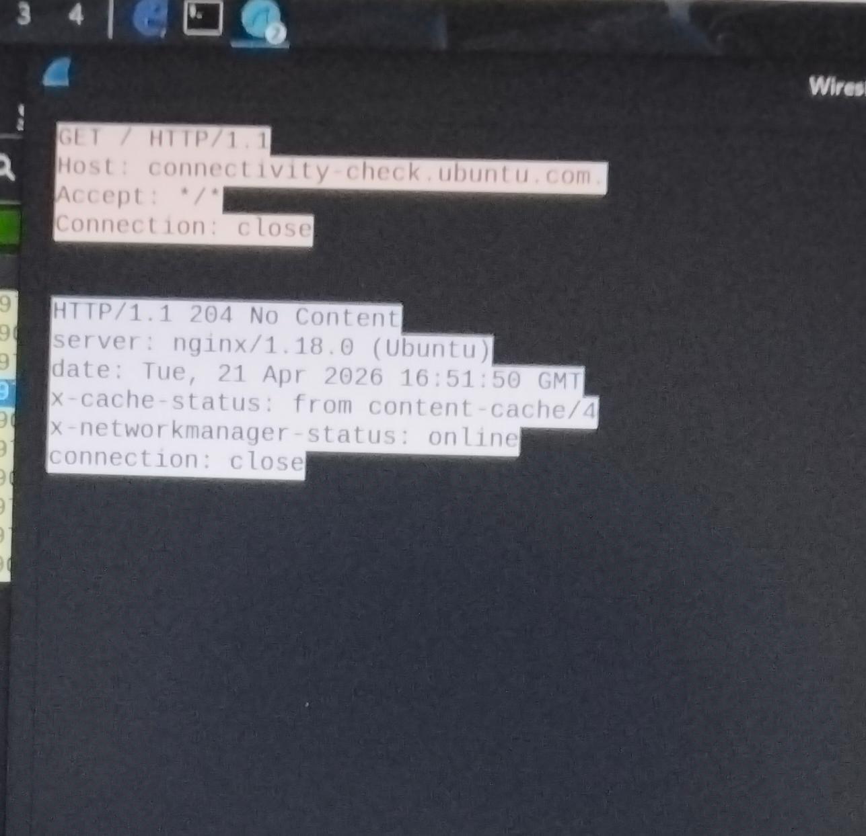
Wireshark — Traffic Captured!
[ INTERCEPTED TRAFFIC ]
HTTP Traffic Captured — Filter: http
ARP Filter — Poison Packets!
HTTP Packet Details — Visible Headers!

Slide 7
Defense & Detection
[ BLUE TEAM PHASE ]
arp_detect.py
Countermeasures
Python + Scapy Detection:
• Monitors all ARP packets
• Checks MAC vs known table
• Alerts on MAC mismatch
• Saves log to file
sudo python3 arp_detect.py
OUTPUT:
[ALERT] ARP SPOOFING
DETECTED!
VPN
Encrypt all traffic
HTTPS
SSL/TLS only
Static ARP
Fix MAC entries
2FA
Account protection
DAI
Switch-level defense
Monitor
ARP anomaly alerts

Slide 8
Results & Conclusion
Test / Achievement
Result
Status
Network Connected (Kali + Ubuntu)
ping 0% loss
PASS ✓
Ettercap Host Discovery
30+ hosts found
PASS ✓
ARP Poisoning Attack
ARP table poisoned!
PASS ✓
HTTP Traffic Intercepted
Packets captured
PASS ✓
Wireshark ARP Filter
Fake ARP visible
PASS ✓
Python Scripts Written
3 scripts ready
PASS ✓
Conclusion
This project successfully demonstrated a complete MITM attack lifecycle using Kali Linux and Ubuntu. ARP Spoofing via Ettercap poisoned the victim's ARP cache, enabling full traffic interception via Wireshark. Python scripts were developed for both attack automation and defense detection. Project covers Attack, Detect, and Defend — complete security cycle!

