Slide 1
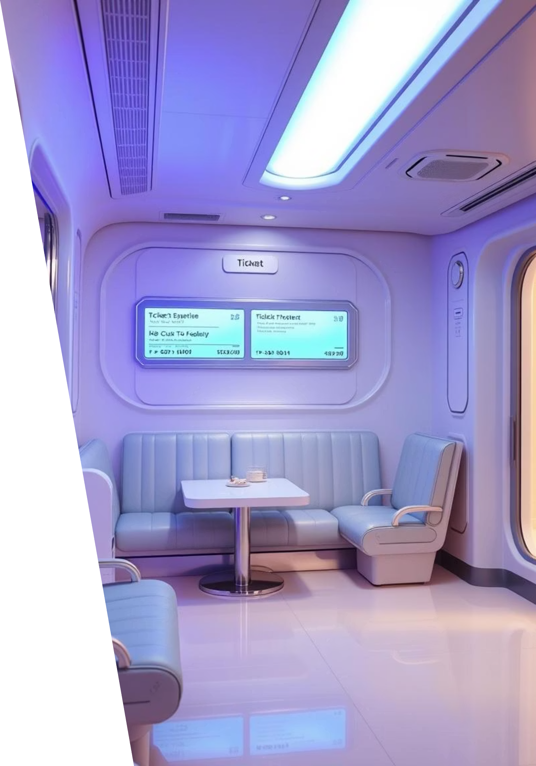
Dynamic Ticket Reservation and Cancellation System
This presentation outlines the architecture and implementation of a robust dynamic ticket reservation and cancellation system. Developed in Java, this system addresses the complexities of real-time seat management, ensuring high performance and data integrity. We will delve into the core data structures and algorithms that power its efficiency and user experience.
Project by: Hira Khan, Momina Kamal, Aiman, Fatima Akram

Slide 2




Problem Description and Challenges
The system simulates a real-world ticket booking environment where performance, data integrity, and usability are paramount. We faced several critical challenges that necessitated the adoption of advanced data structures and algorithms.
Efficient Conflict Handling
Preventing double bookings and managing concurrent requests for the same seat.
Scalable Seat Management
Ensuring the system can handle a large number of seats and booking requests without performance degradation.
Real-time Expiry & Undo
Implementing mechanisms for automatic booking expiry and supporting undo operations for user actions.
Addressing these challenges required careful consideration of data structure choices and algorithmic design to achieve optimal system performance and reliability.

Slide 3
System Design Overview
Core Components
Technology Stack
Seat, CategoryNode, TicketSystem for modularity.
Java Swing for GUI development.
Seat: Represents individual seats with status.
CSV files for persistent data storage.
CategoryNode: Manages seat availability per category.
Combination of AVL Tree, HashMap, and Stack for data handling.
TicketSystem: Orchestrates all operations.

Slide 4

Key Functionalities:
Seat Management
Book and cancel by category: VIP, Premium, Economy.
Booking Expiry
Automated tracking and release of expired bookings.
User Interface
Intuitive GUI for seamless interaction.
Data Persistence
Reliable saving and loading of seat data.

Slide 5

Introduction to the System
Our system is a desktop-based Java application designed for dynamic booking and cancellation of seats across VIP, Premium, and Economy categories. It provides a comprehensive solution for managing ticket inventories with advanced features tailored for efficiency and user convenience.
GUI-Based Interface
Intuitive graphical user interface for seamless interaction.
Auto-Expiry for Bookings
Automated release of unconfirmed or timed-out bookings.
Persistent Data Storage
Reliable data saving and loading using CSV files, ensuring data integrity across sessions.
Optimized Performance
Leveraging AVL Tree, HashMap, and Stack for high-speed operations.

Slide 6





Data Structures Utilized
HashMap for Seats
AVL Tree for Categories
O(1) access for direct seat lookups.
Balanced search and insertion of categories.
Stack for Undo
HashMap for Expiry
Future enhancement for operation reversal.
Efficient tracking of booking expiry times.

Slide 7

Data Structures Details:
The efficiency and responsiveness of our system are primarily attributable to the strategic integration of several key data structures. Each structure serves a specific purpose, contributing to the overall robustness and speed of operations.
AVL Tree
Used to store and manage seat categories (VIP, Premium, Economy), ensuring balanced search and insertion operations with O(log N) time complexity. This structure maintains sorted categories and rapid access.
HashMap for Seats
Maps unique seat numbers to their corresponding Seat objects, enabling O(1) average-time complexity for direct seat access and status updates. Essential for rapid lookups during booking and cancellation.
Stack for History
Maintains a chronological record of booking and cancellation operations, facilitating undo functionality. This LIFO structure allows for easy retrieval of the last performed action.
HashMap for Expiry
Tracks the timestamp of each booking, allowing for efficient identification and automatic cancellation of expired reservations. This provides a fast lookup for time-sensitive bookings.

Slide 8



Flowcharts & Algorithms
The system's logic is underpinned by carefully designed algorithms that leverage our chosen data structures to ensure optimal performance and reliability. Here's a breakdown of the key processes:
AVL Tree Insertion Logic
Booking Algorithm
Expiry Algorithm
When a new category or a seat within a category is added, the AVL tree ensures it remains balanced through rotations, maintaining logarithmic time complexity for all tree operations. This guarantees efficient access to category data.
First, the system verifies if the requested seat exists and is not already booked. Upon confirmation, the seat status is updated, the category is adjusted, and a timestamp is logged for expiry tracking.
A background process periodically checks the booking timestamps via the dedicated HashMap. Any booking that has exceeded its allowed reservation time is automatically cancelled and released, maintaining seat availability.

Slide 9
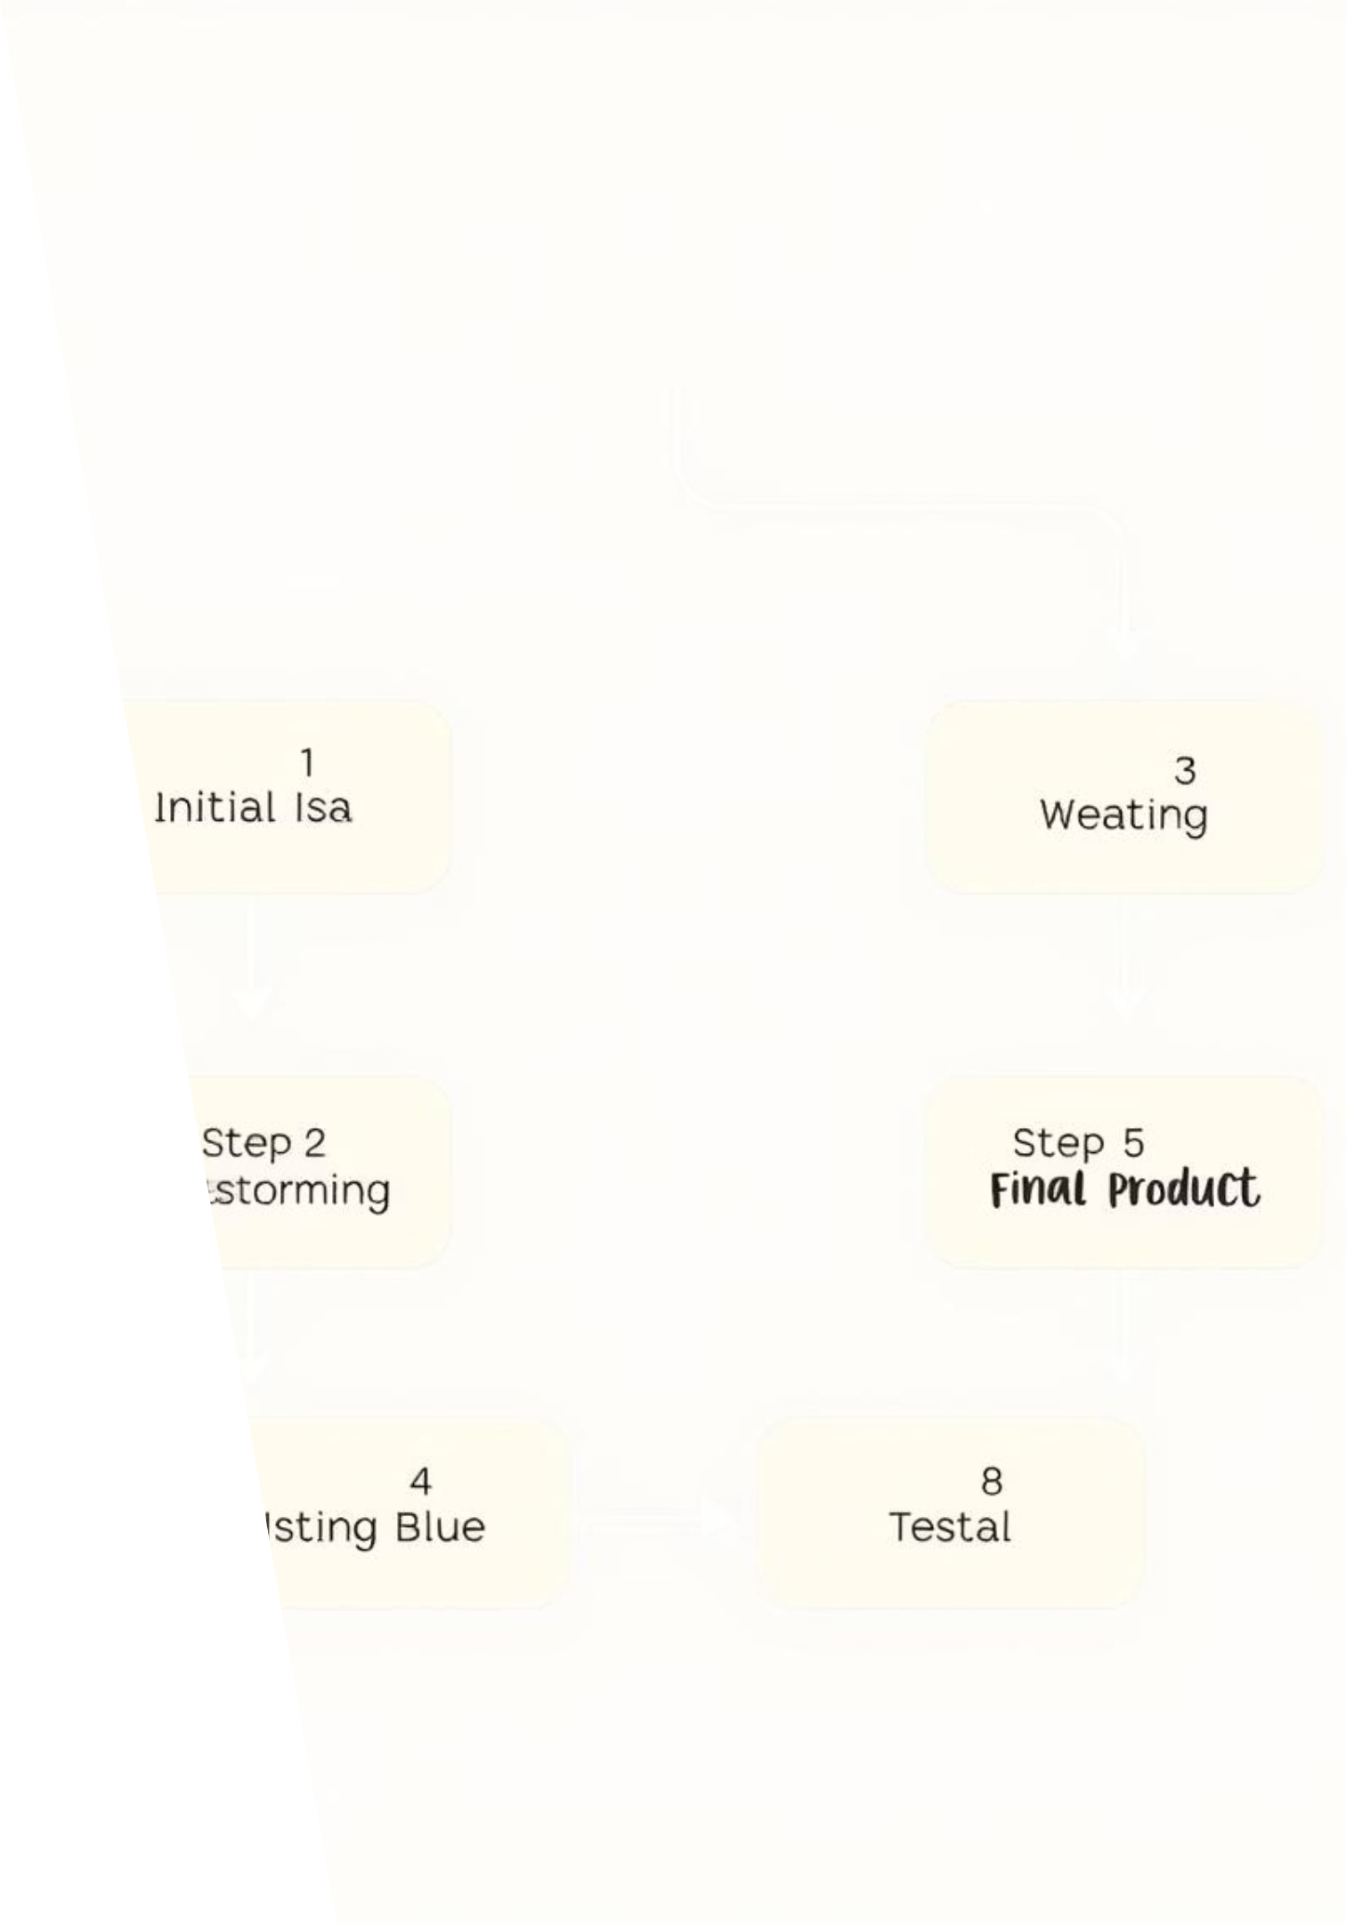


Booking & Cancellation Flow
Booking Process
Check availability.
Book the seat.
Update category status.
Initiate expiry tracking.
Cancellation Process
Verify booking details.
Cancel the seat.
Update category status.
Remove from expiry tracking.

Slide 10

Load & Save Operations
Load on Startup
Save on Exit
Reads all seat data from CSV.
Writes current seat data to CSV.
Initializes system state.
Ensures sorted, consistent output.
Error Handling
Gracefully manages malformed data.
Identifies and reports CSV errors.

Slide 11
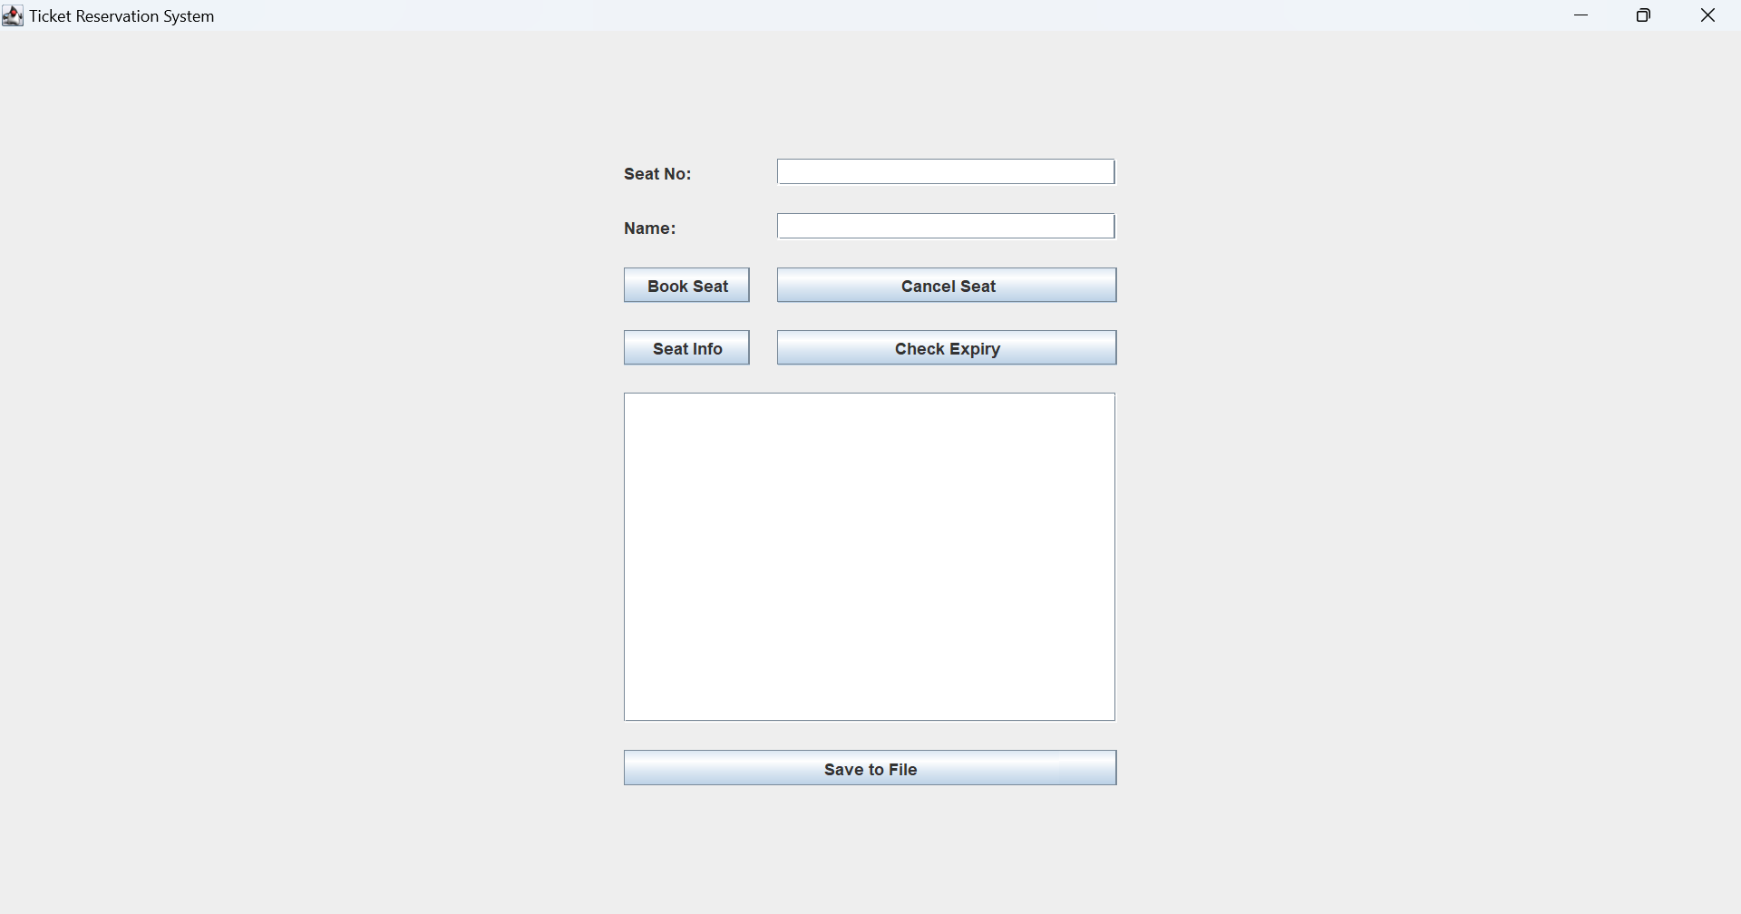
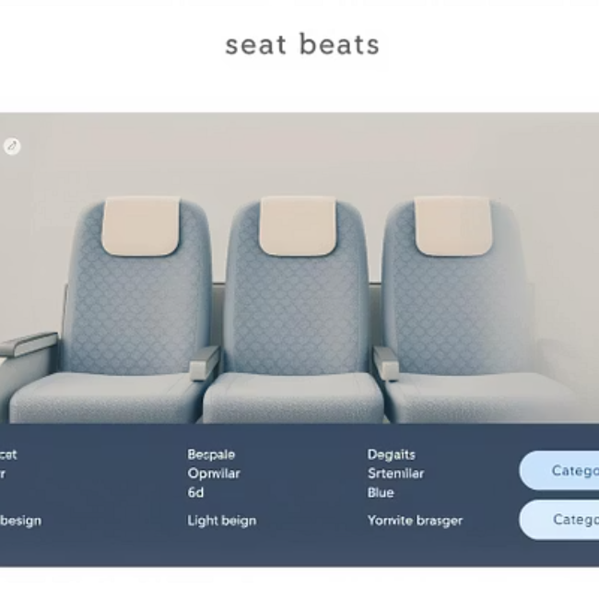

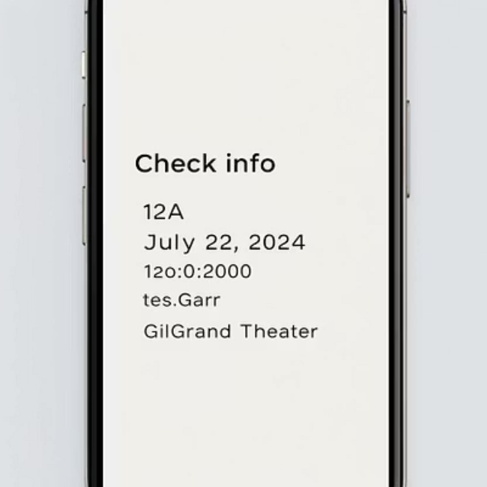
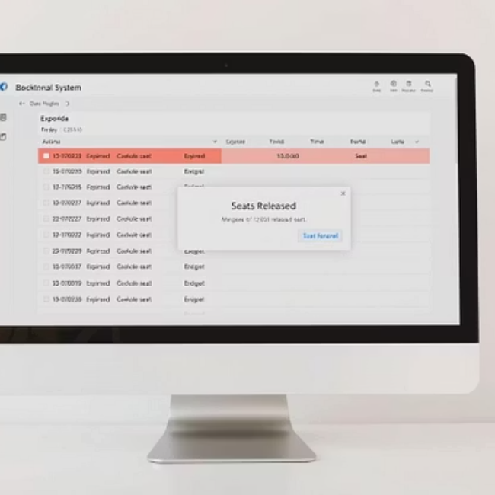
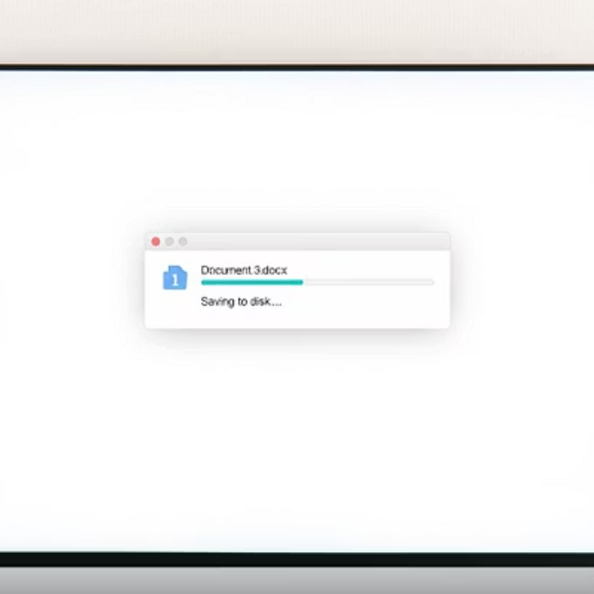
System Demonstration Screens
Basic Interface:

Slide 12
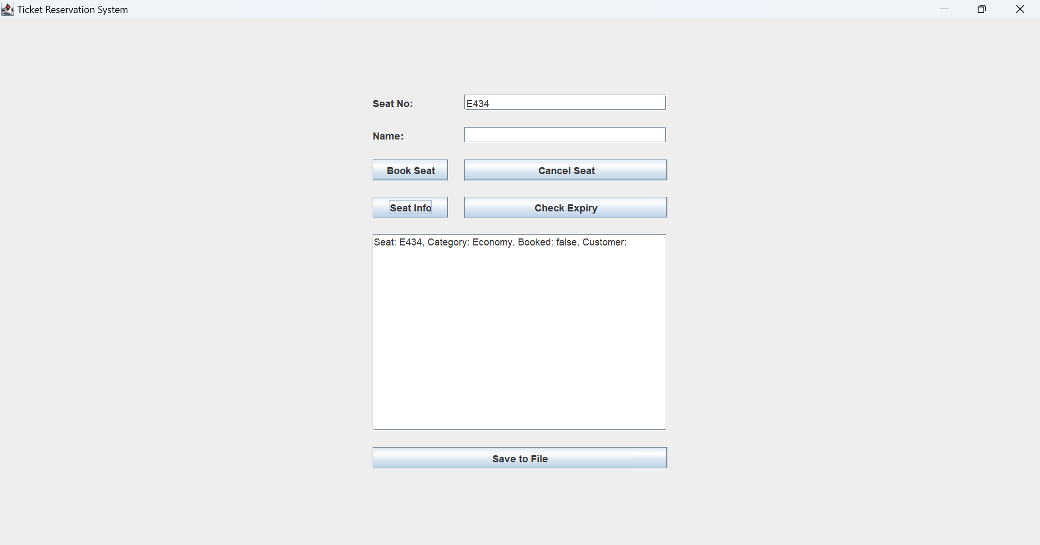
System Demonstration Screens
Checking Seat Information:

Slide 13
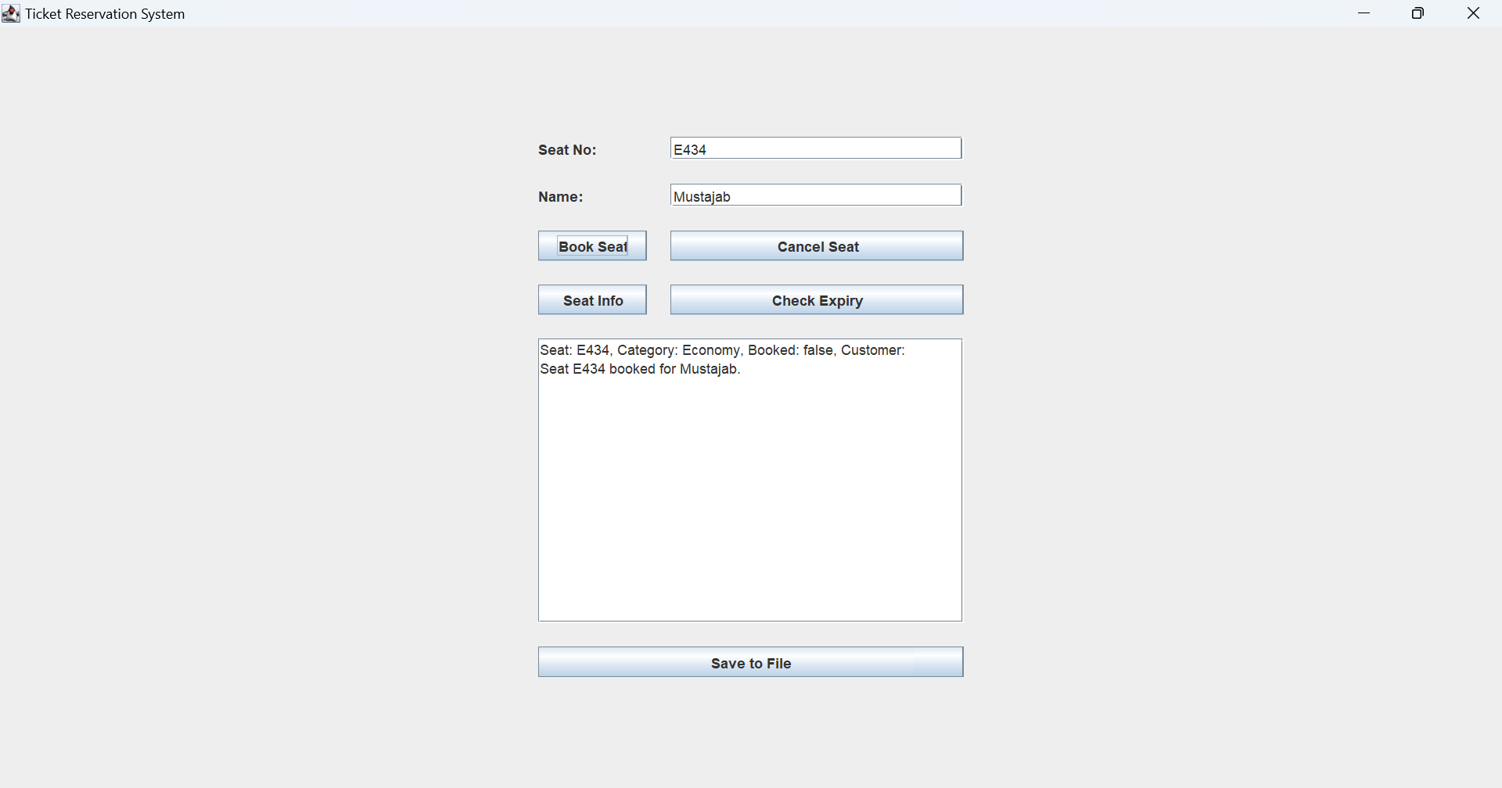
System Demonstration Screens
Booking a Seat:

Slide 14
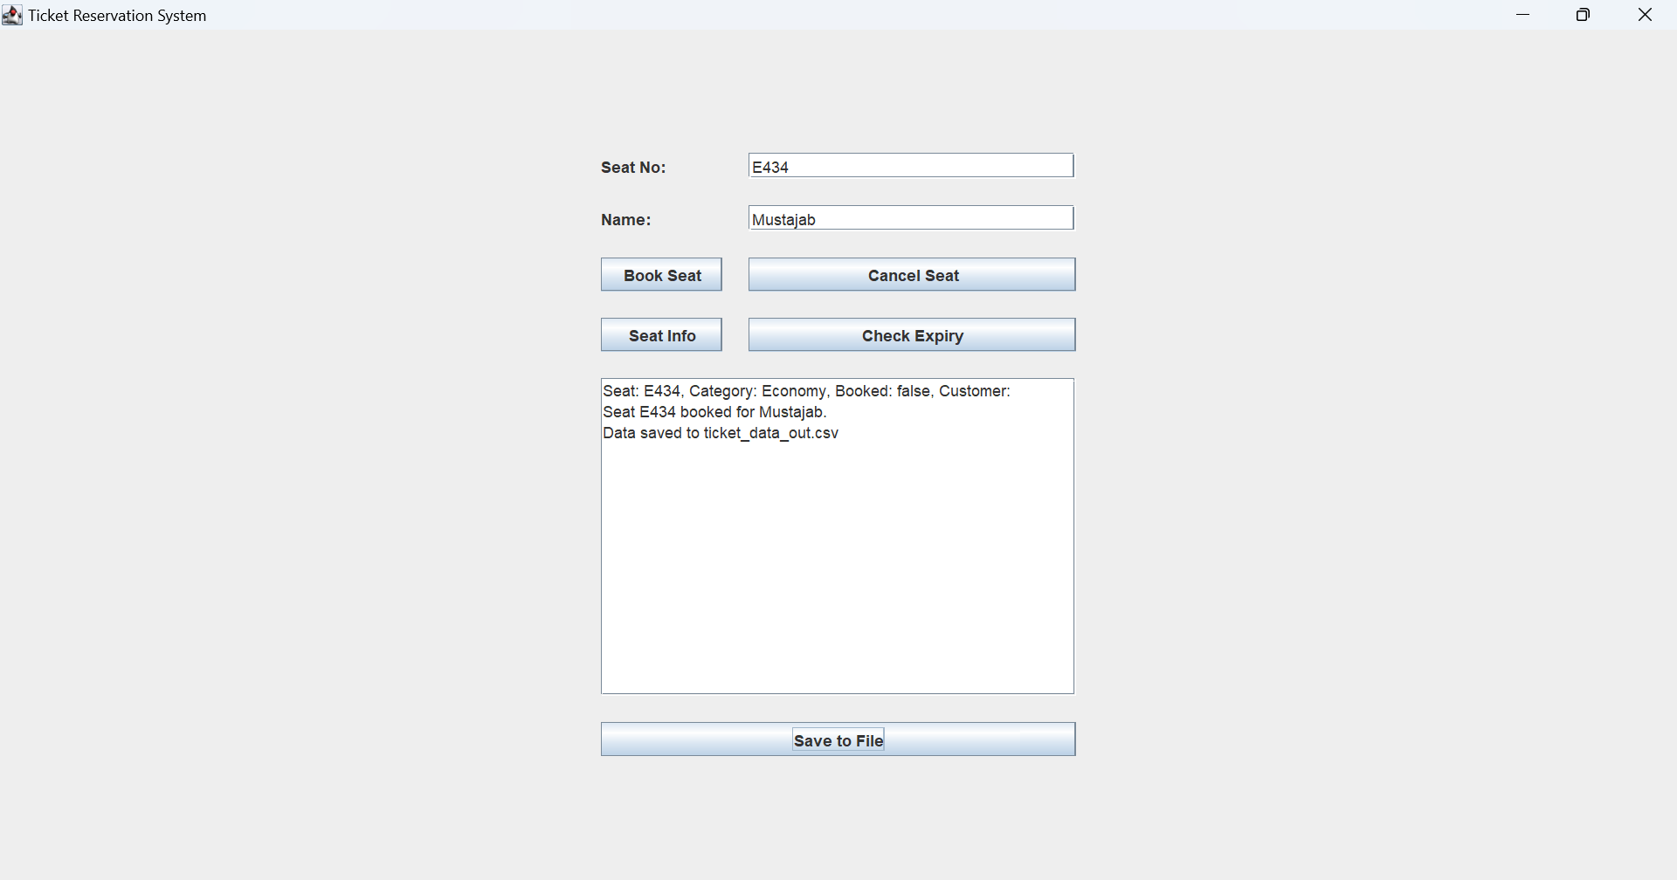
System Demonstration Screens
Saving data in file:

Slide 15
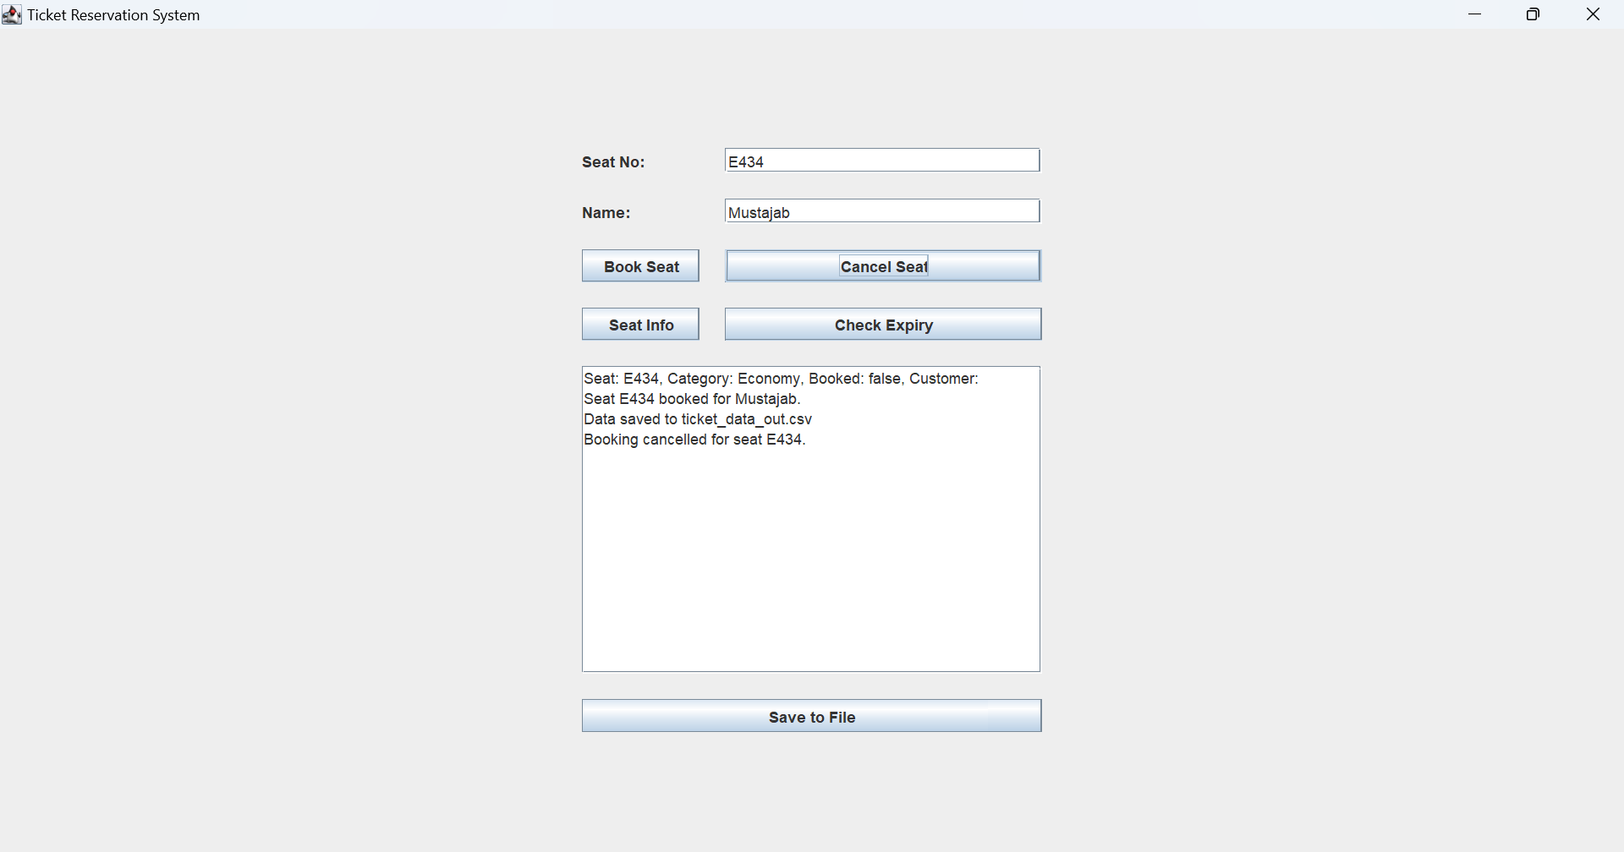
System Demonstration Screens
Cancelling Seat:

Slide 16
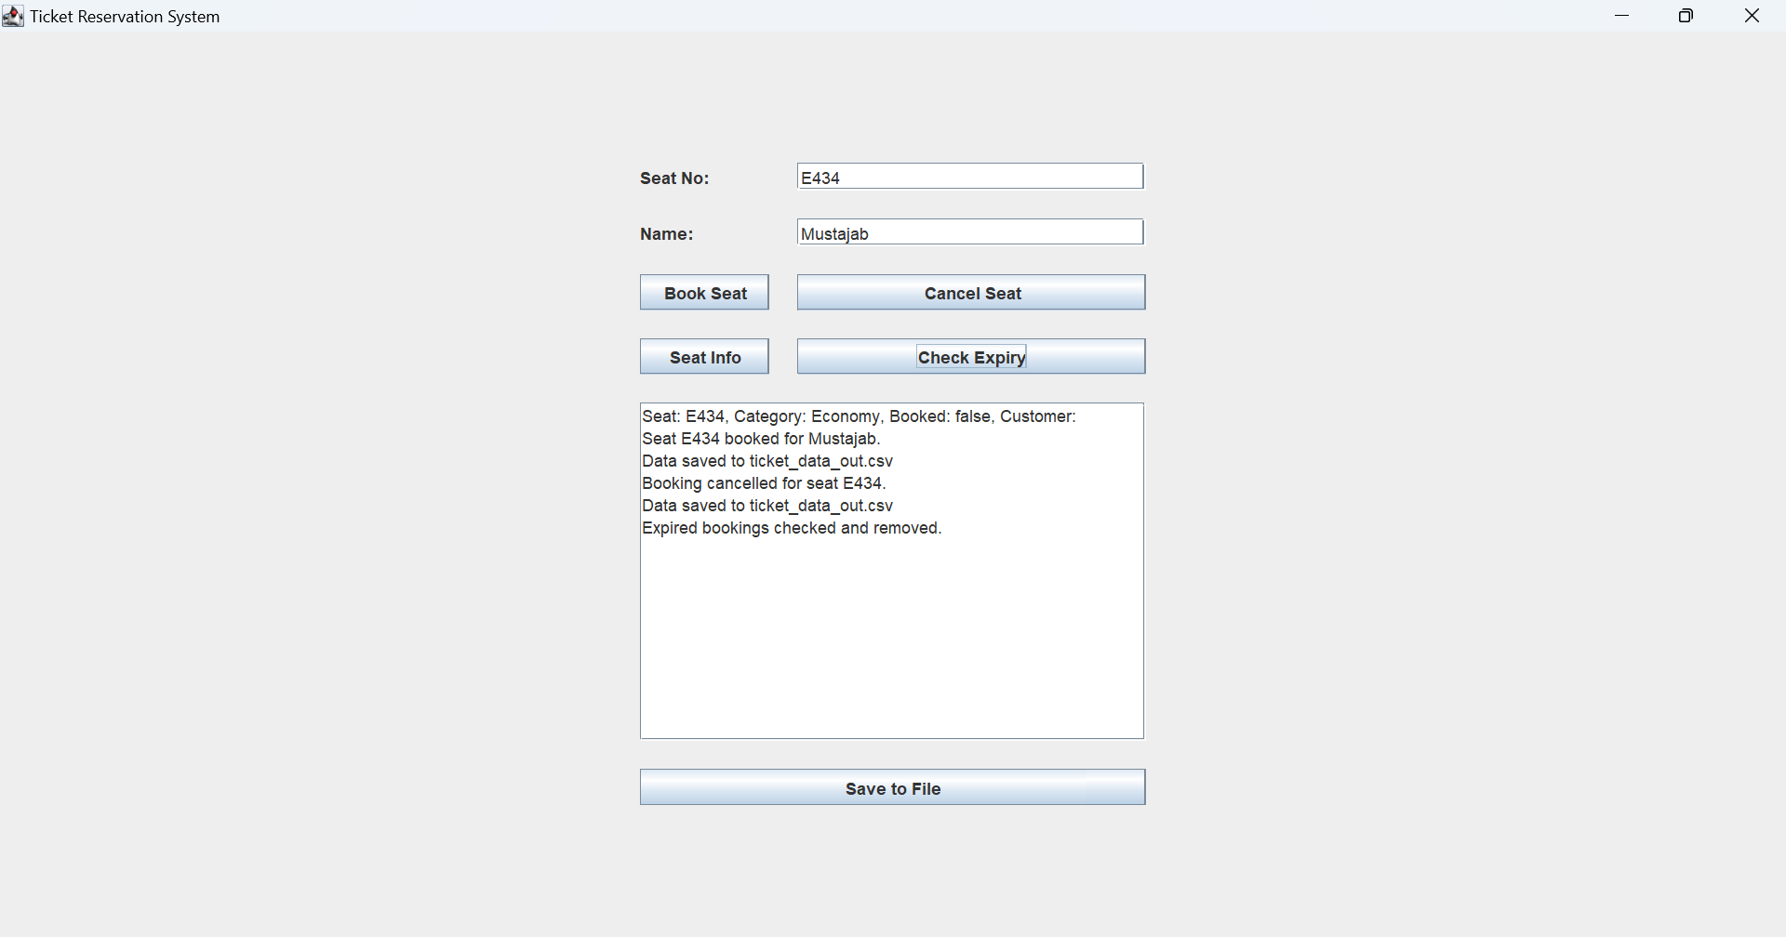
System Demonstration Screens
Checking the expiry:

Slide 17
Performance Results & Edge Case Handling
The system has been rigorously tested to ensure high performance and robust handling of various edge cases, crucial for a real-world ticketing application.
Performance Metrics
Edge Cases Handled
1ms
10ms
Invalid CSV Lines
The system gracefully handles and logs malformed or corrupted entries during data import from CSV, preventing crashes.
Booking Time
Expiry Check (500+ entries)
Average time for a single seat booking operation, ensuring rapid transaction processing.
Time taken to scan and process over 500 booking entries for expiry, demonstrating efficiency under load.
Non-existent Seats
Proper error handling for attempts to book or query seats that do not exist within the system's inventory.
Duplicate Bookings
Robust checks prevent a single seat from being booked more than once, ensuring data integrity.
Cancellation of Unbooked Seats
Prevents errors when a user attempts to cancel a seat that is not currently reserved.

Slide 18

Test Results & Edge Case Handling
Functionality Tests
Validated valid and invalid bookings.
Confirmed accurate cancellations.
Expiry Mechanisms
Bookings correctly expire after 5 minutes.
Seats become available post-expiry.
Input Validation
Handles invalid seat inputs.
Detects duplicate seat attempts.
CSV Robustness
System tolerates wrong CSV formats.
Performance remains efficient with large datasets.

Slide 19

Conclusion & Future Scope
Efficient & User-Friendly
Delivers a seamless ticketing experience.
Highly Scalable
Leverages AVL and HashMap for performance.
Future Enhancements
Online synchronization for real-time updates.
Dedicated Admin panel for management.
Full Undo/Redo feature for all operations.

