Slide 1
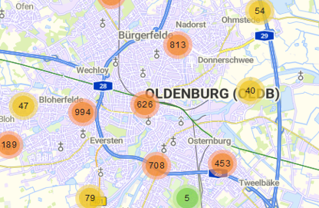
Innovating City Issue Reporting: Progress Update
Human-Computer Interaction
Michael Krah, Minu Lee, Marten Seegers
2025.05.09

Slide 2
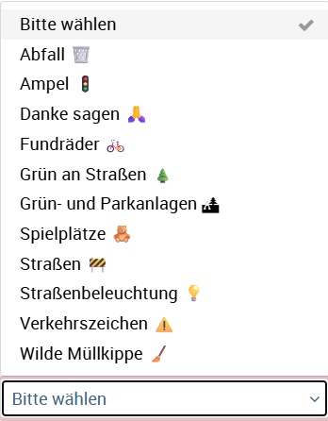
Introduction
Goal: Make reporting city issues smarter and more user-friendly.
Current Issues:
Unclear categorization
Accessibility barriers
https://gemeinsam.oldenburg.de/oldenburg/de/flawRep/54305/create?6

Slide 3
Gathering Insights, Design Thinking
Stakeholders: Who is actually acting on the reported issues? → some more investigation planned
Design Thinking
User: People spotting issues in Oldenburg
Need: stressful lives, need to have an easy way to communicate issues
Insight: everybody has a smartphone in their pocket, categorization is confusing
People spotting issues in Oldenburg need an easy way to communicate that issue in a way that is quick and easy.
How might we make Mängelmelder quicker and easier to use?

Slide 4
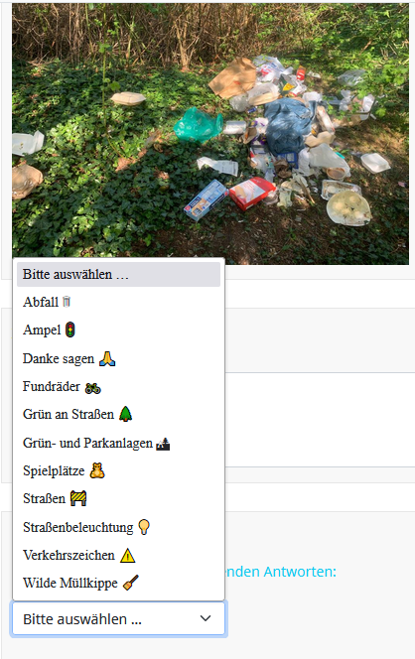
Research Plans
Planned Insights:
Conduct an online survey to assess participant agreement on categorization
Assess system usability (e.g., System Usability Scale)
Gather additional qualitative data (e.g., think aloud method or open-ended survey question)
Expected Findings:
Users struggle with category selection
The current system scores bad in term of usability

Slide 5
Design Plans
Intended UI Improvements:
Simplified category selection with icons
Option for anonymous reporting
Planned Design Decisions:
Use icons for intuitive category recognition

Slide 6
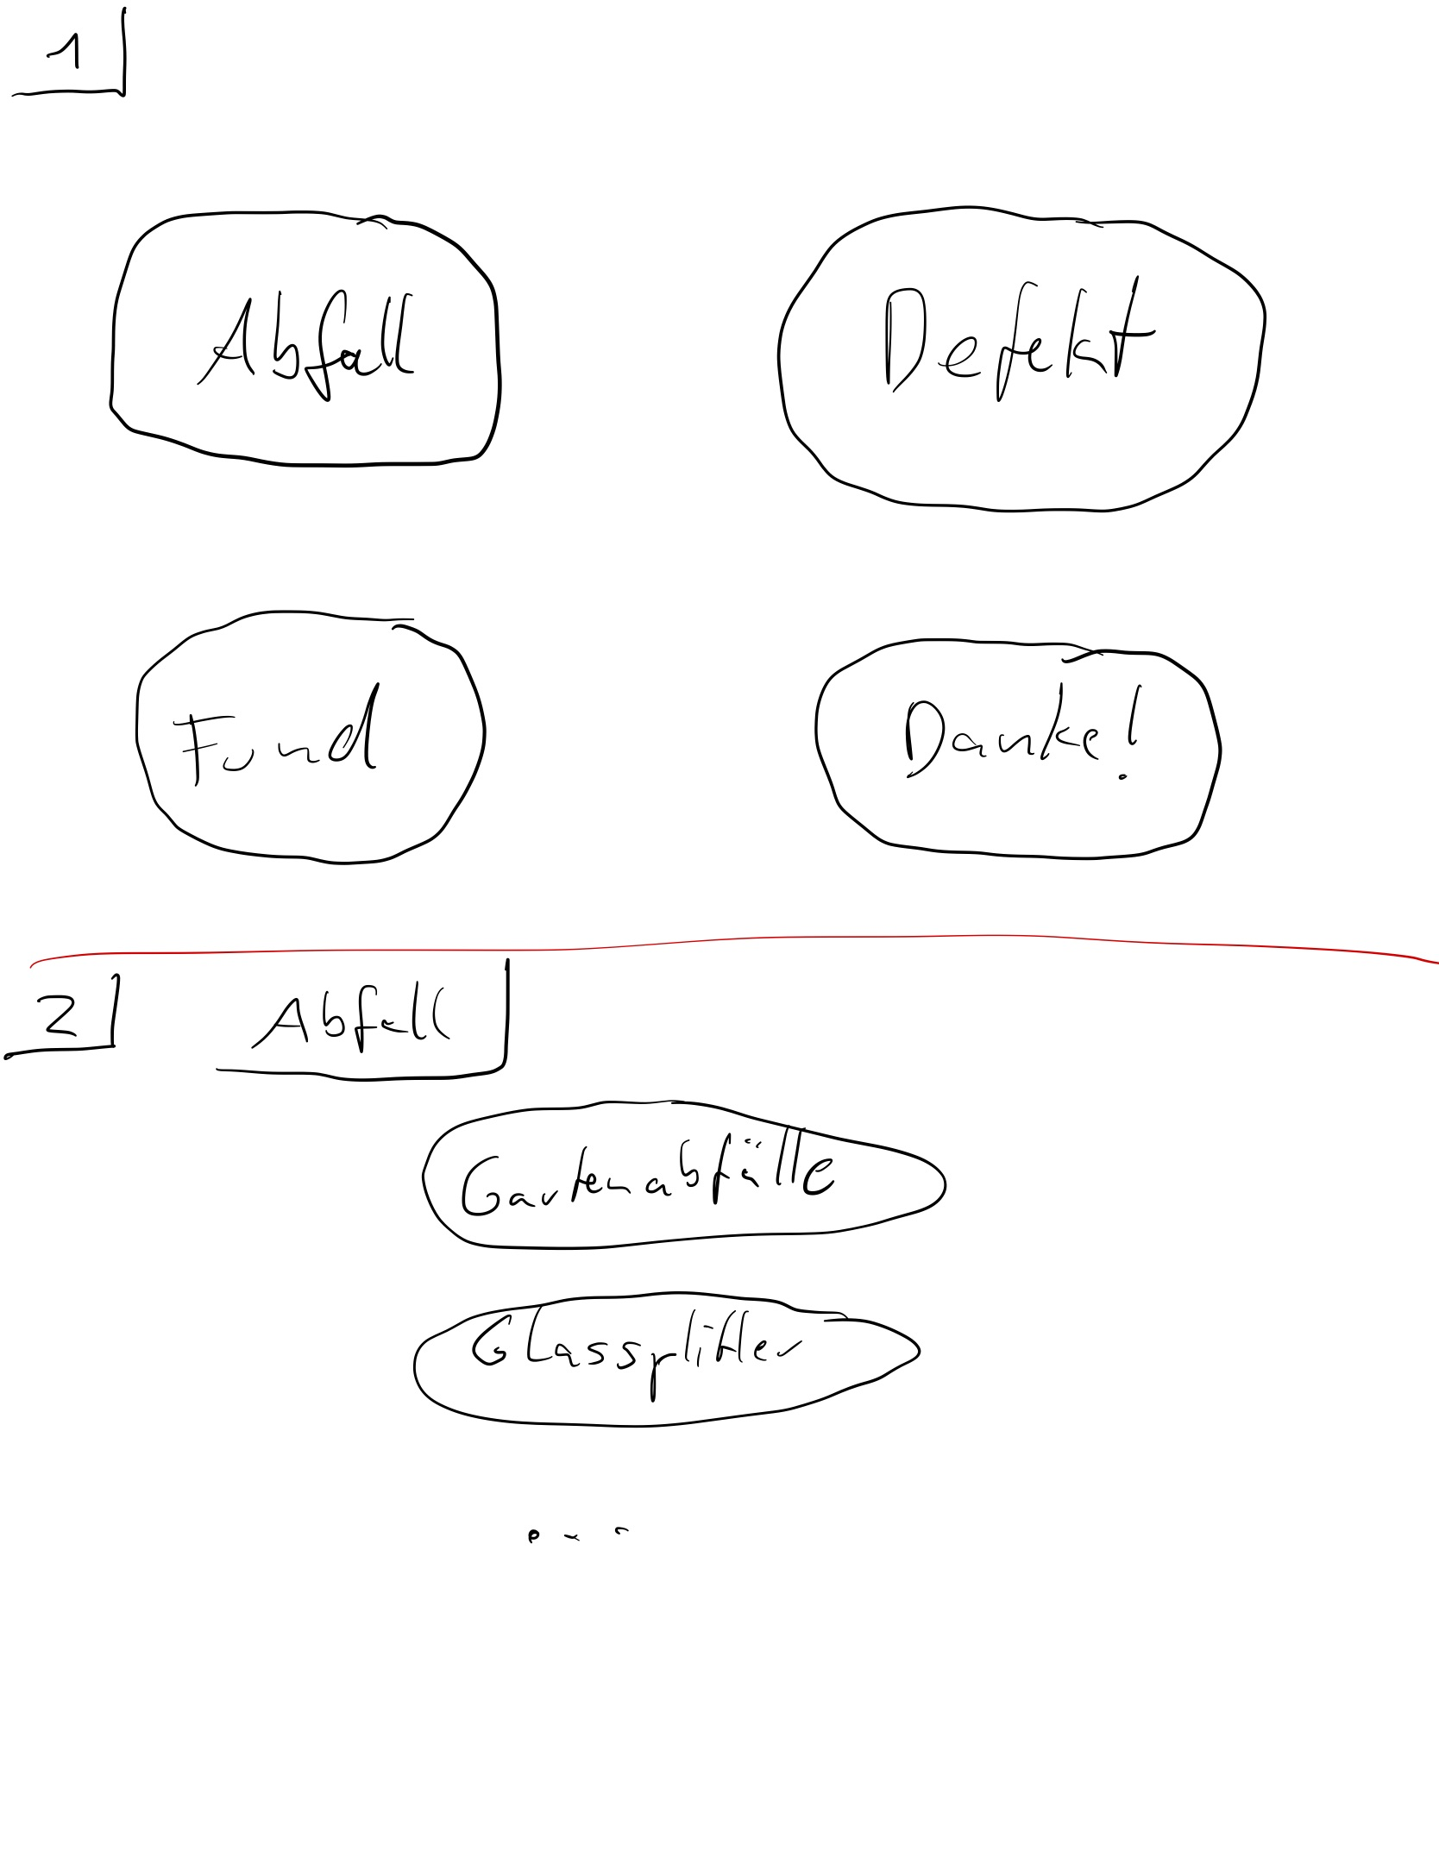
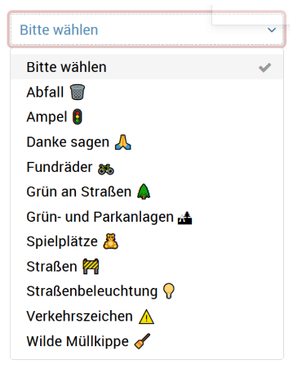
Rough UI Prototype
https://gemeinsam.oldenburg.de/oldenburg/de/flawRep/54305/create?6

Slide 7
Evaluation Plan
Planned Methods:
Experimental survey design: Current website vs. future mockups
Why Suitable:
Able to evaluate our prototype against the current website in a controlled environment
Expected Outcomes:
Higher categorization agreement among participants
Higher system usability

Slide 8
Next Steps
Immediate Actions:
Finalize the survey
Derive a new categorization scheme (e.g., based on survey feedback or clustering methods)
Begin initial design sketches for mockups
Plan the evaluation process for future mockups

