Slide 1
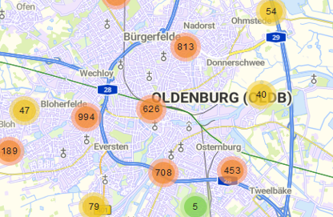
Innovating City Issue Reporting: Progress Update
Human-Computer Interaction
Michael Krah, Minu Lee, Marten Seegers
2025.05.09

Slide 2
Introduction
Goal: Make reporting city issues smarter and more user-friendly.
Current Issues:
Unclear categorization
Privacy concerns
Accessibility barriers

Slide 3
Research Plans
Planned Insights:
Plan to analyze user feedback from various sources
Plan to conduct interviews with up to 5 users
Expected Findings:
Users may struggle with category selection
Privacy concerns could lead to hesitation

Slide 4
Design Plans
Intended UI Improvements:
Simplified category selection with icons
Option for anonymous reporting
Planned Design Decisions:
Use icons for intuitive category recognition
Include an anonymous option to address privacy concerns

Slide 5
Evaluation Plan
Planned Methods:
A/B testing: Current website vs. future mockups
Usability tests with 10 participants
Why Suitable:
A/B testing to measure user satisfaction and task completion time
Usability tests for qualitative feedback
Expected Outcomes:
Higher user satisfaction
Reduced task completion time

Slide 6
Next Steps
Immediate Actions:
Finalize research methods and prepare for user interviews
Begin initial design sketches for mockups
Plan the evaluation process for future mockups

