Slide 1
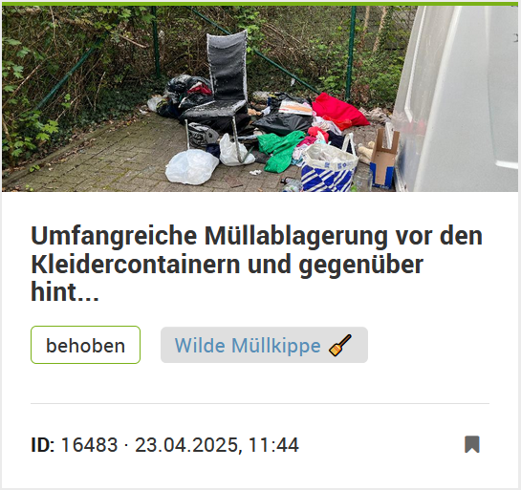
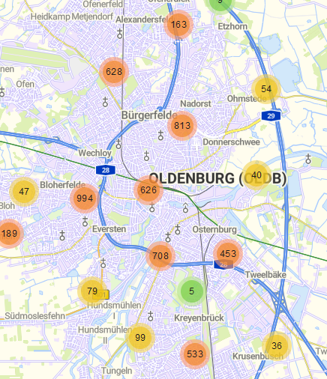
Innovating how we report city issues

Slide 2
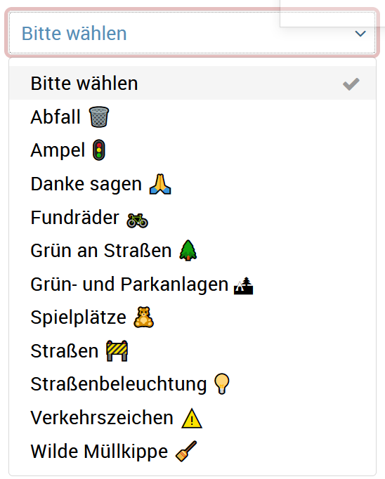
City issues
Citizens can report issues, but face several problems in doing so (e.g., unclear categorization, no mobile version)
Objective: Make reporting city issues smarter and more user-friendly

Slide 3
HCI design cycle
Gather insights and compile requirements
Rely on existing knowledge (supervisor)
Scrape and analyze app store reviews or complaints
Design and prototype
Design UI mockups
Evaluate
A/B testing: current website vs.mockups
Conjoint experiment, factorial survey design

