Slide 1
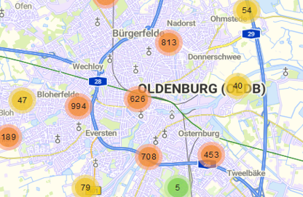
Innovating City Issue Reporting: Progress Update
Human-Computer Interaction
Michael Krah, Minu Lee, Marten Seegers
2025.05.27

Slide 2
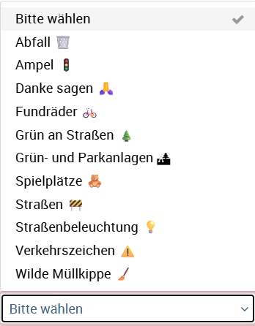
Introduction
Goal: Make reporting city issues smarter and more user-friendly.
Current Issues:
Unclear categorization
Accessibility barriers
https://gemeinsam.oldenburg.de/oldenburg/de/flawRep/54305/create?6

Slide 3
Research Progress
Current Status:
Conducted initial Think-Aloud and NASA-TLX sessions.
Focused on identifying usability issues in the Mängelmelder system.
Planned Evaluation: Detailed analysis and testing to follow.

Slide 4
Open Issues
Think-Aloud has revealed multiple issues, which one to select?
How many interviewees for Think Aloud are needed?
How thorough should we conduct the Think Aloud analysis? (e.g. coding)

Slide 5
Next Steps
Collect and transcribe Think-Aloud and NASA-TLX data.
Collect and analyze dataset (scrape data or ask Dennis)
Develop prototype (Figma)
Evaluation (survey experiment)

