Slide 1
BRAINY-BOT
AI-CHATBOT

Slide 2
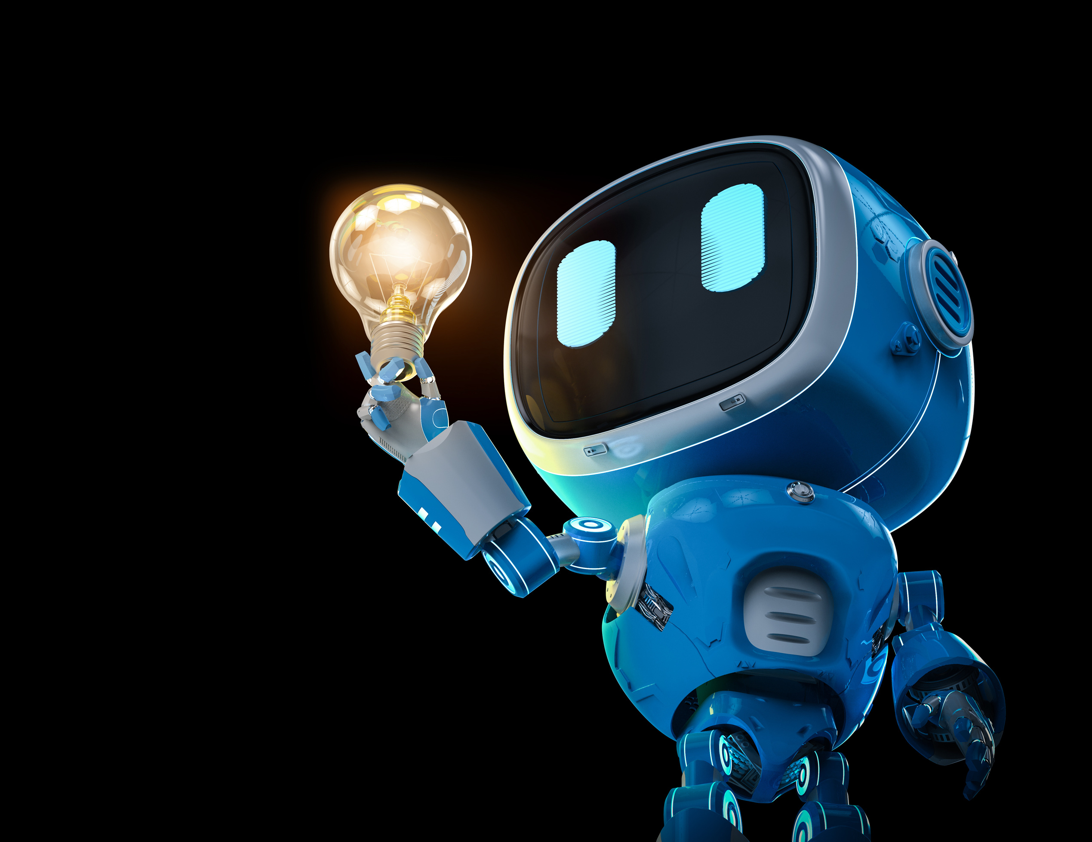

CHALLENGES IN EDUCATION IN NEPAL
Geographical Barriers: Remote areas and hilly terrain make it difficult for children to reach schools.
Untrained Teachers: Many teachers lack professional training and use outdated teaching methods.
Insufficient Infrastructure: Lack of adequate classrooms, furniture, and facilities like libraries or laboratories.

Slide 3
OUR SOLUTION: AI BOTS FOR EDUCATION
AI-powered bots to assist teachers and students.
Facilitates personalized learning experiences.
Bridges the gap between student and Techonology
Enables teachers to focus on impactful teaching by automating routine tasks.

Slide 4
ACCESSIBILITY FOR DIVERSE LEARNERS & PERSONALIZATION OF LEARNING
Inclusive Education: Helps Students with disabilities(e.g., visual or hearing impairments) through speech-to-text, text-to-speech.
Language Support: NLP can provide translations, grammar
corrections, and support for multiple languages.
24/7 Availability: The chatbot is always accessible ,offering round-the-clock assistance to students.
Adaptive Learning: NLP can assess a student’s level of understanding and adjust explanations, questions, or resources accordingly.
Customized Responses: Tailors answers based on the student’s specific needs and context.

Slide 5
IMPACT OF AI BOTS IN NEPAL
Language Support: Bots with multilingual capabilities can help bridge language barriers, supporting Nepali and regional languages.
Access to Resources: Students in remote areas can access educational materials through mobile-friendly AI bots,
overcoming geographical limitations
Teacher Support: AI bots can assist educators with lesson planning, grading, and administrative tasks, reducing their workload.

Slide 6
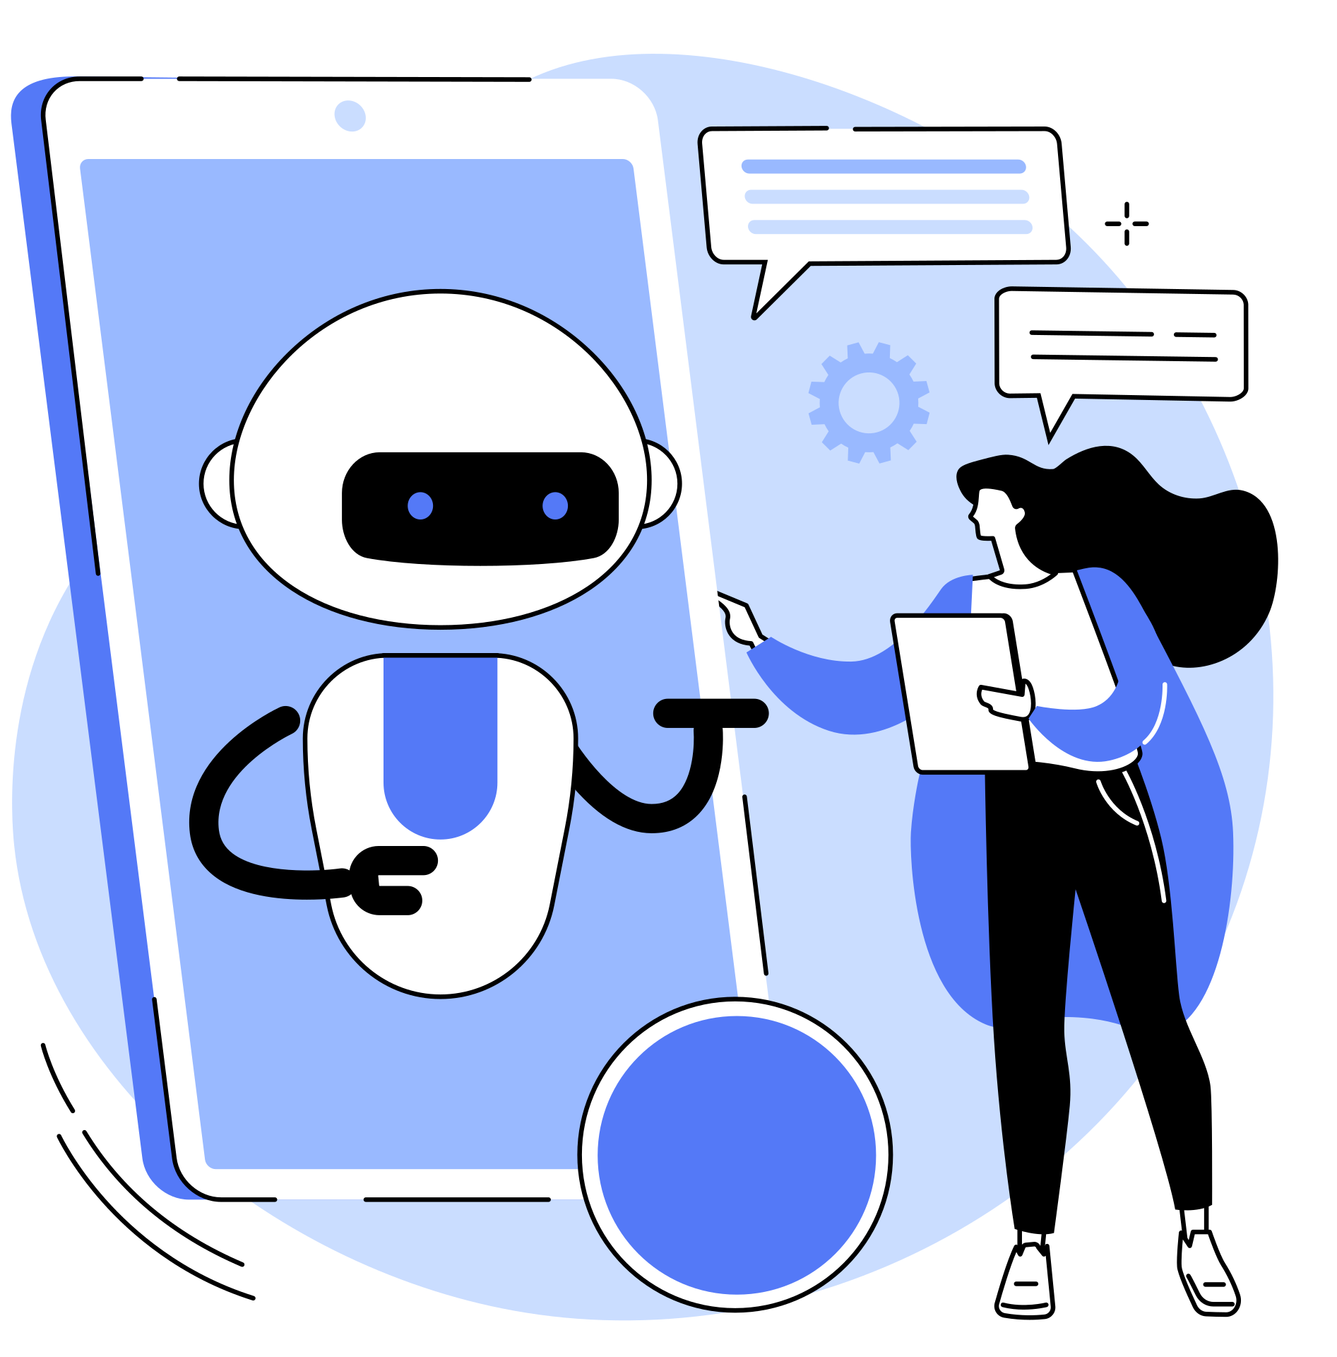
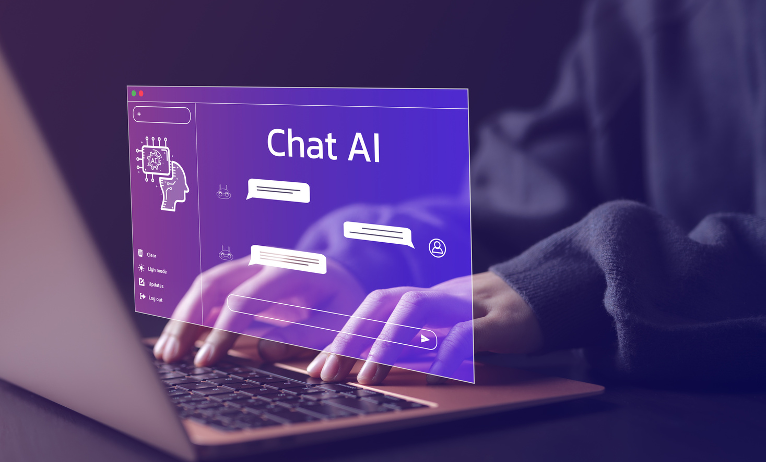
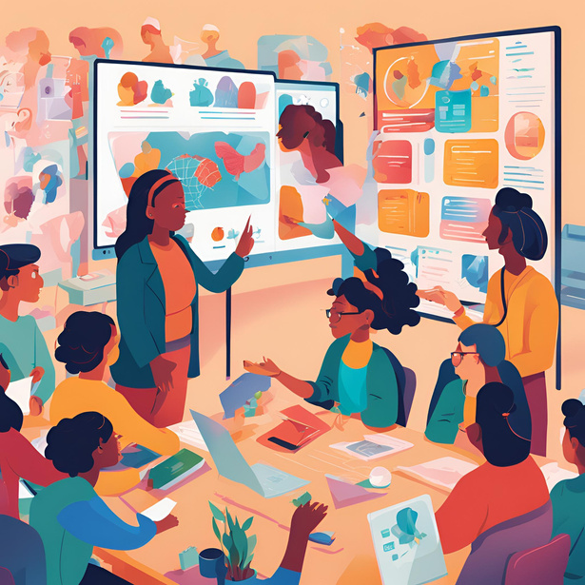

OUR FEATURES
Efficient Resource Management (ORMEngagement and Interactivity & Scalability Integration) & Cost-Effectiveness
Language Support
Chat Bot
Adaptive Learning
Customized Responses

Slide 7
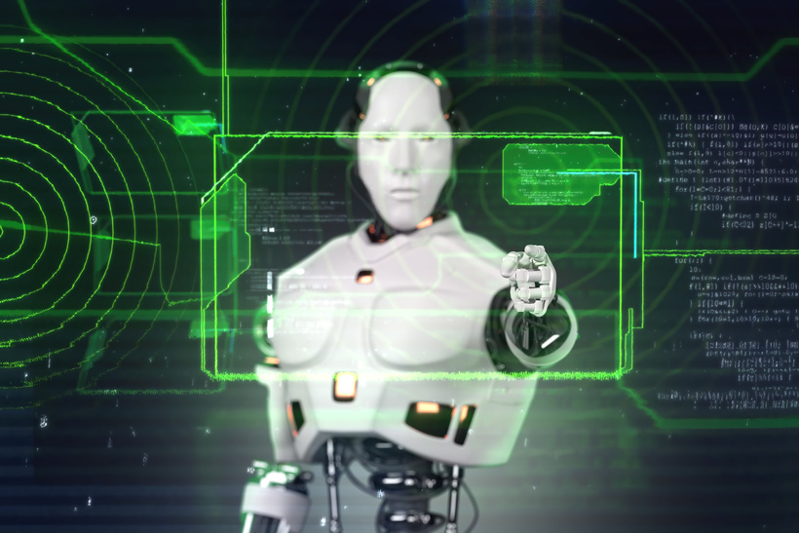

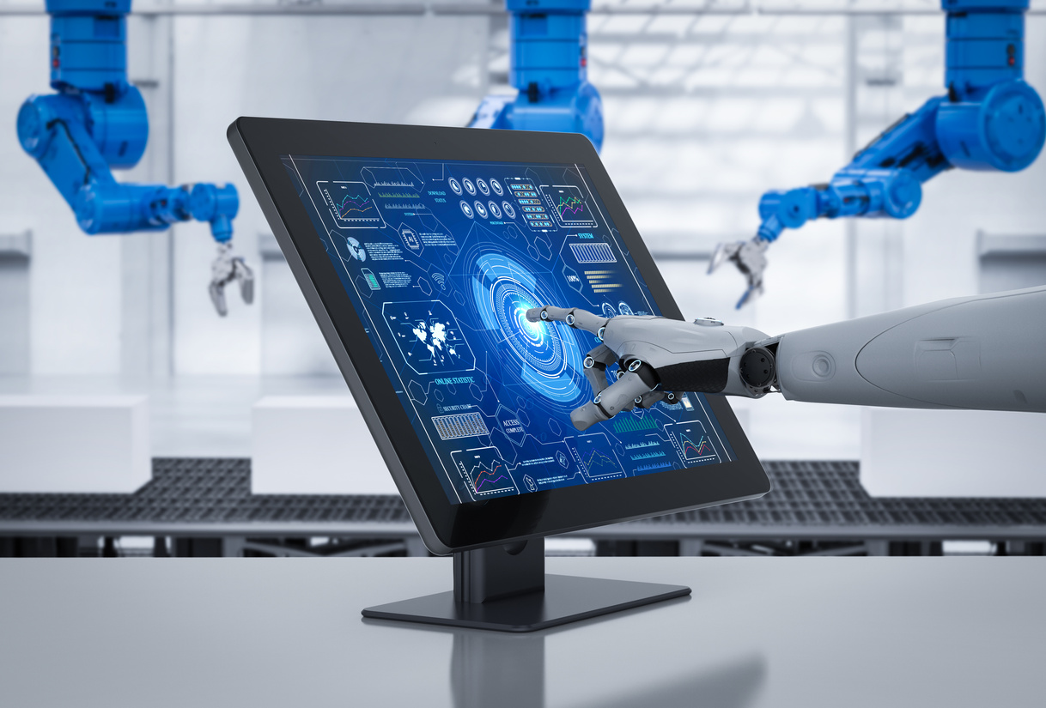

AI-Powered Insights
Recommends educational or vocational resources based on user interests and market trends.
OUR SERVICE
Affordable Education
Students in remote or underprivileged areas can access quality resources without needing physical infrastructure.
Brainy Bot offers AI-powered educational assistance tailored for both students and teachers.
Our services include step-by-step explanations, and personalized learning.
Progress Tracking
Identifies areas where students with disabilities struggle and adapts to support their learning needs.
Skill Development
Offers courses and real-world scenarios to develop critical thinking, decision-making, and technical skills.

Slide 8
FUTURE VISION
Advanced topics (STEM subjects, competitive exam preparation).
Partnerships with NGOs, schools, and the government.
Expand to other regions facing similar challenges.
Integration of voice-based interaction for users with low literacy levels.

Slide 9
THANK YOU

