Slide 1
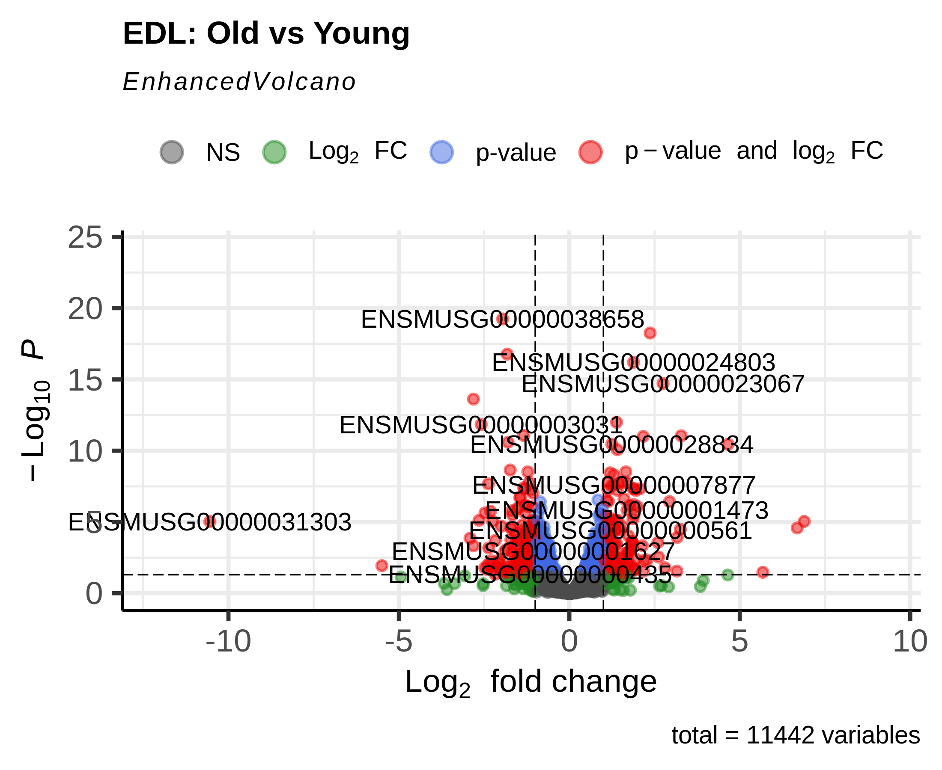
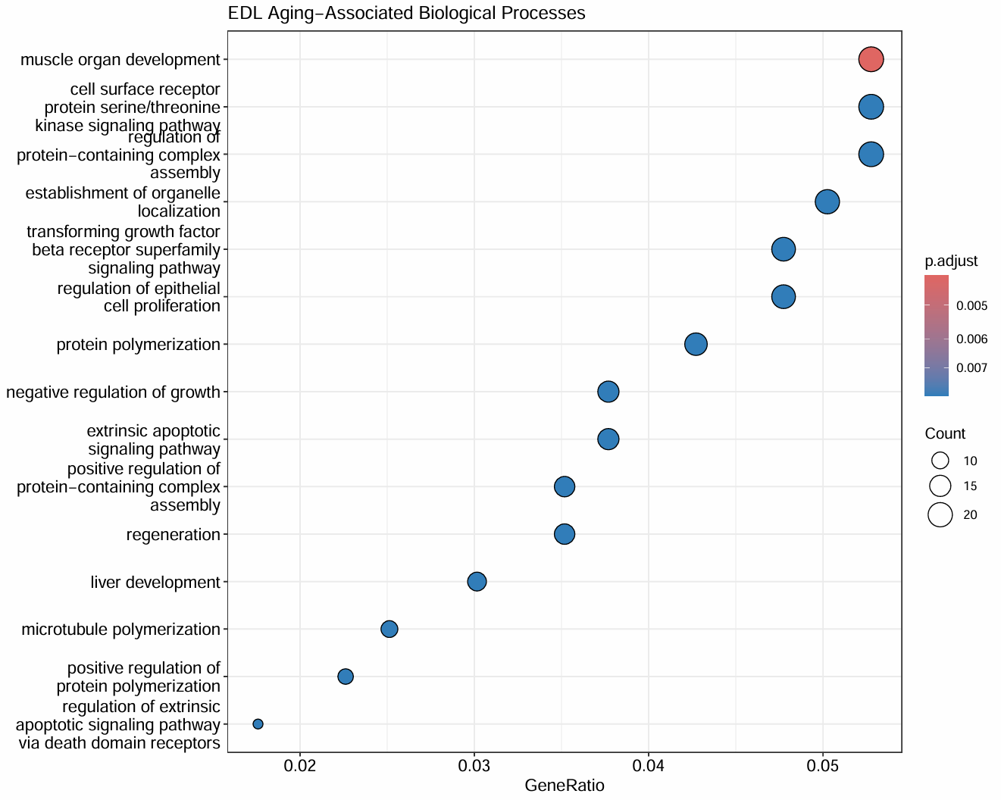
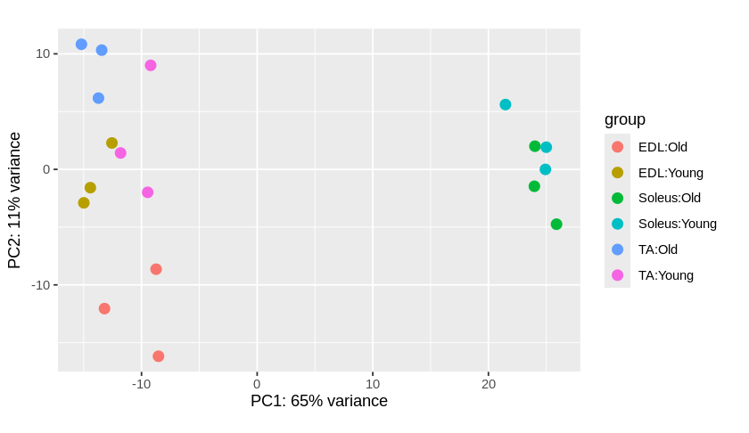
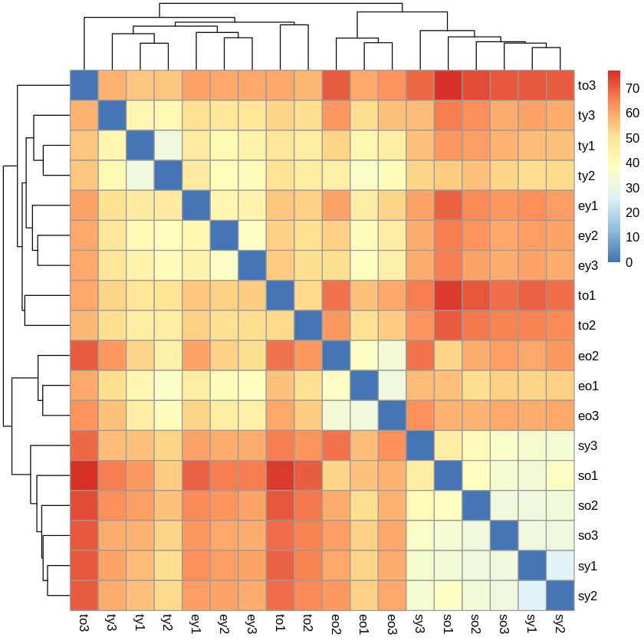
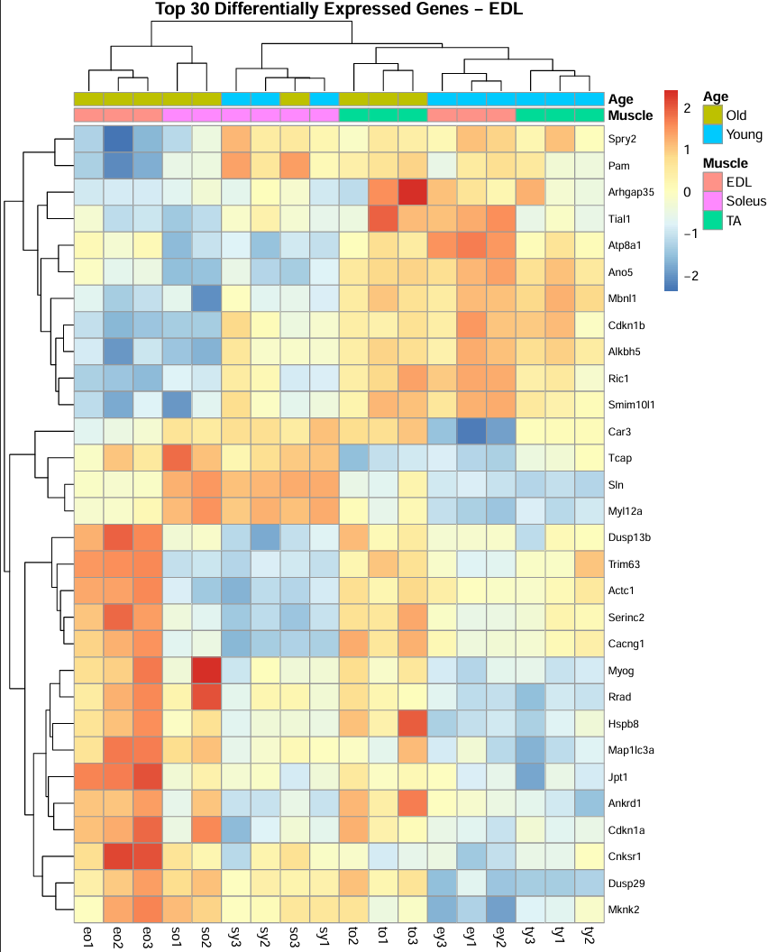
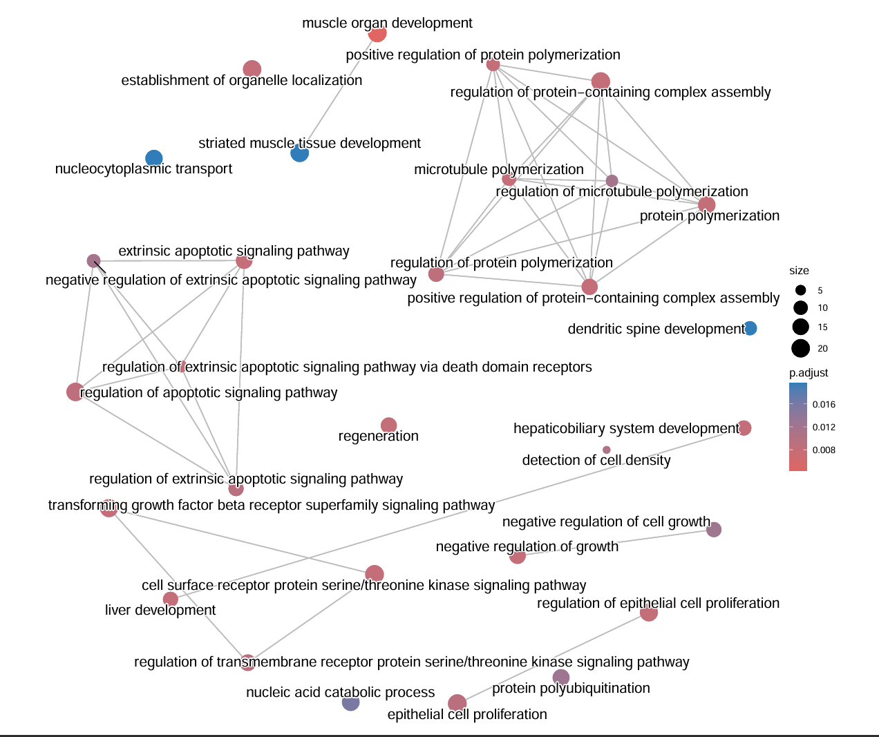
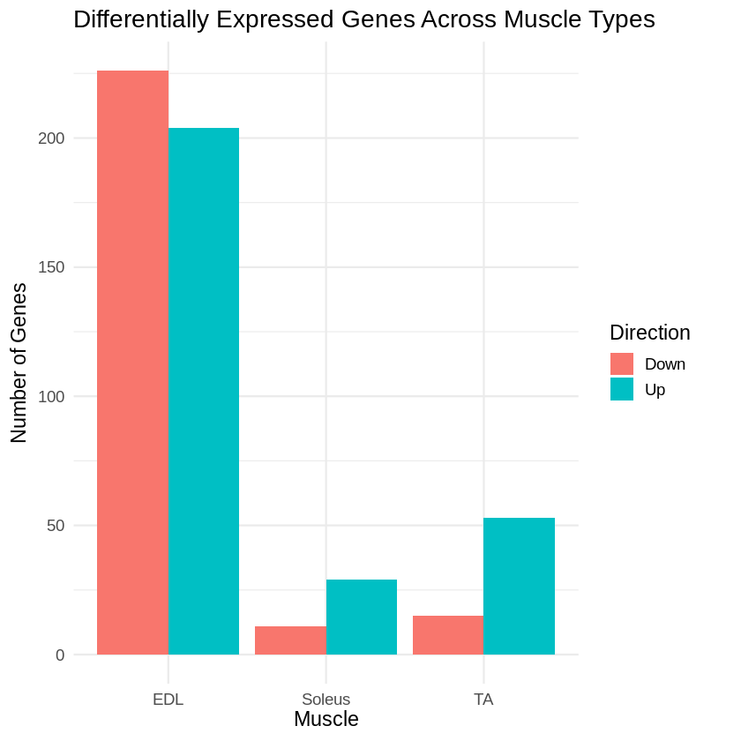
Comparative Transcriptomic Analysis of Skeletal Muscle Aging in Mice A Multi-Muscle RNA-seq Case Study Using DESeq2, Biomarker Discovery and Functional Enrichment Analysis Akshat Jaiswal Indian Institute of Technology Ropar
BACKGROUND
Sarcopenia is an age-associated decline in skeletal muscle mass and function. Different muscle types exhibit distinct susceptibility to aging; however, the molecular basis of these differences remains incompletely understood.
This study compares transcriptomic changes across three skeletal muscle types to identify aging-associated genes and pathways.
EDL Volcano Plot
EDL GO Enrichment
DATASET
GEO Accession: GSE287832
Organism: Mus musculus
Samples: 18 RNA-seq samples
Muscles: • EDL • Soleus • TA
Conditions: • Young • Old
Replicates: 3 biological replicates per group
PCA Analysis
Samples cluster according to muscle type and age, indicating robust biological separation.
Aging induces extensive transcriptional remodeling in EDL muscle.
RNA-seq Data
↓
Quality Control
↓
DESeq2
↓
Differential Expression
↓
Biomarker Discovery
↓
GO Enrichment
↓
Biological Interpretation
Top EDL Biomarkers
Functional enrichment reveals aging-associated pathways related to muscle development, growth regulation and cellular remodeling.
EDL Pathway Network
Sample Distance Heatmap
Biological replicates exhibit strong within-group similarity and no major outliers.
Differential Expression Summary
EDL exhibited the strongest aging-associated transcriptional response.
Pathway network analysis highlights interconnected biological processes altered during aging.
Top biomarkers clearly distinguish young and aged EDL samples.
KEY FINDINGS
• EDL displayed 1129 significant genes.
• Soleus displayed only 44 significant genes.
• TA displayed 105 significant genes.
• EDL showed strong enrichment of growth regulation,
apoptosis and developmental pathways.
• Soleus exhibited vascular and extracellular matrix
adaptation pathways.
• TA maintained muscle-specific adaptive programs.
• Aging affects skeletal muscles in a muscle-type-specific
manner.
CONCLUSIONS
1. Aging responses differ substantially across muscle types.
2. EDL is highly susceptible to transcriptomic remodeling.
3. Soleus exhibits relative resilience.
4. TA demonstrates an intermediate phenotype.
5. Distinct biological pathways underlie muscle-specific aging.
SKILLS DEMONSTRATED
✓ RNA-seq Analysis
✓ Differential Expression (DESeq2)
✓ Biomarker Discovery
✓ Data Visualization
✓ Functional Enrichment
✓ Scientific Reporting
✓ Biological Interpretation
✓ Research Communication

