Slide 1
Credit Risk Assessing Using Data mining techniques
han tang

Slide 2

Data mining lifecycle: crisp-dm
Text

Slide 3
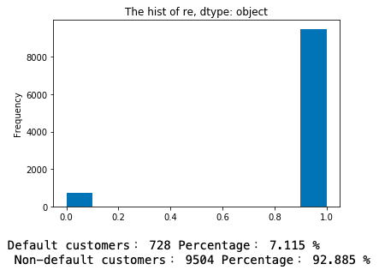
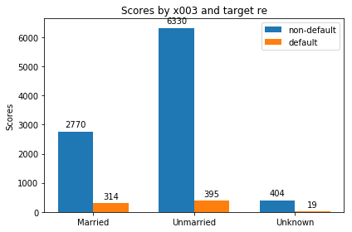
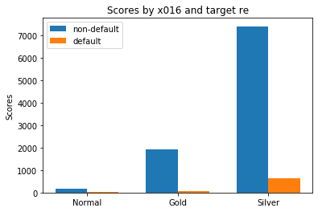
Business understanding & data understanding
Text
Inspect the distribution of dataset, by features.
The data is imbalanced. Model could bias to non-default customers.
Other findings from basic data understandings:
Unmarried customers have lower defaulting rate.
Customers hold gold card have lower defaulting rate.

Slide 4
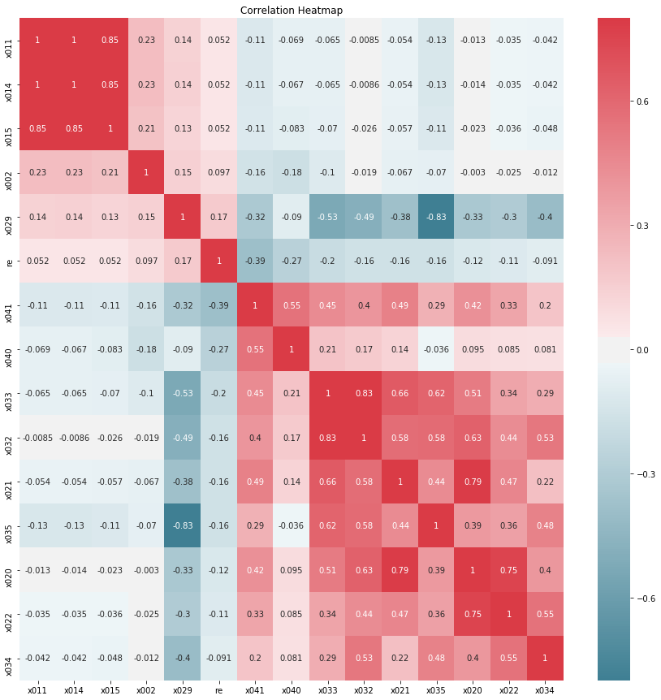
data preparation
Text
Analyse categorical features and continuous features separately.
One-hot encode the categorical features.
Inspect the correlation matrix between features, to filter collinear features and find features highly correlate to the target feature (features x014,x015,x035,x032 are removed).
Polynomial features do not have significantly higher correlation.
Choose the features with the 10 highest correlations for analysing.

Slide 5
Data preparation
Text
Use Variance Inflation Factor (VIF) to inspect and remove multi-collinear features.
The train - test partition rate is set to 67%:33%.
Apply SMOTE (Synthetic Minority Oversampling TEchnique) to oversample the minority class data (default customers) and Tomek’s links technique to reduce the noises.

Slide 6
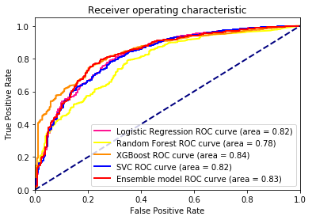
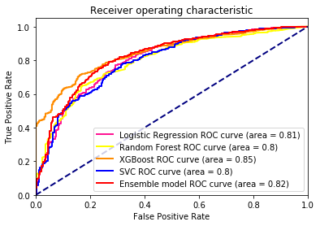
modelling & evaluation
Text
Algorithms applied: Logistic Regression, Random Forest (Number of trees: 50, 100), XGBoost, Support Vector Machine, an ensemble model of them.
XGBoost trained from polynomial features with VIF threshold of 10, and original features with VIF threshold of 2.5, reach the highest AUC value (0.85 and 0.84)
Original features, VIF<2.5
Polynomial features, VIF<10

Slide 7
THANK you
Q & a

