Slide 1
Predictive Analysis for classifying bird species from their songs
Signal & Audio Processing project
Programme: DT228A DA
Student No.: D16129273
Student Name: Han Tang

Slide 2
Build a CNN predictive model for bird species classifying from bird songs data.
Dataset
Preprocessing
Build the model
Evaluation & Testing

Slide 3

Dataset:
This dataset contains 687 instances of training data and 1000 instances of testing data.
There are 87 kinds of labels within this dataset.
nips4b_birds_trainfile007.wav

Slide 4
Preprocessing
Generate MFCC spectrum graphs from audio files
Resize the spectrum graphs to at the same size for CNN training
Label the training image data.

Slide 5
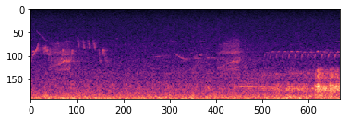
MFCC generating & graph resizing
Generate MFCC spectrum graphs from each signals.
nips4b_birds_trainfile007.wav

Slide 6
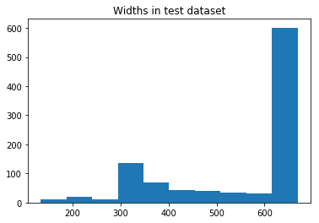
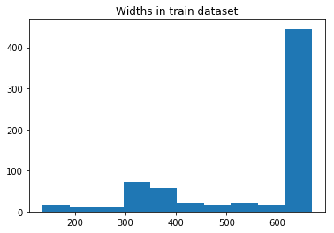
MFCC generating & graph resizing
The width histograms for test data and train data

Slide 7
MFCC generating & graph resizing
Resize all the graphs to size (669, 193).
No resizing operation for those graphs of the width 669.
For those of width smaller than 669px. Same part would be repeated until its width reaches 669px.

Slide 8
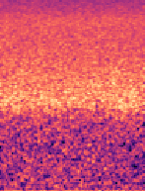
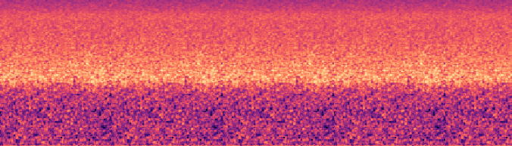
MFCC generating & graph resizing
An instance of resizing
Before resizing
After resizing

Slide 9
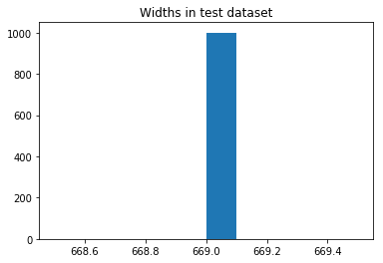
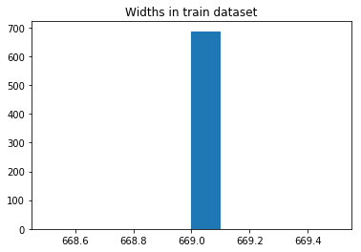
MFCC generating & graph resizing
It can be found from the histograms that the resized images are of the same size (669, 193)

Slide 10
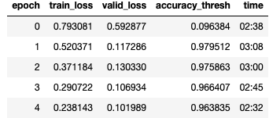
Modelling & Evaluation
The CNN architecture applied for training: resnet50 from library fastai.
20% of data used for building the model and the rest 80% for validation.
The validation accuracy reaches a good performance for the last epoch (96.38%).

Slide 11
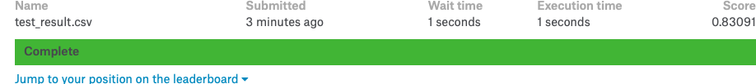
Result
The generated prediction was uploaded to Kaggle and received a predicting accuracy of 83%

