Slide 1
Single-sequence protein structure prediction using language models from deep learning

Slide 2
Motivations
Results
Methods
Discussion

Slide 3
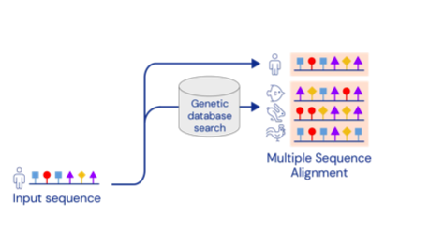
Motivations
Challenges remain after AlphaFold2 comes out for the protein structure prediction problem
AlphaFold2 and related systems use deep learning to predict protein structure from co-evolutionary relationships encoded in multiple sequence alignments (MSAs).

Slide 4
Motivations
Challenges remain after AlphaFold2 comes out for the protein structure prediction problem
An MSA cannot be generated from orphan and rapidly evolving proteins, making prediction inaccurate.
Rapid exploration of designed structures remains a challenge.
Predicting structures from MSAs cannot help us understand the rules governing spontaneous polypeptide folding.

Slide 5
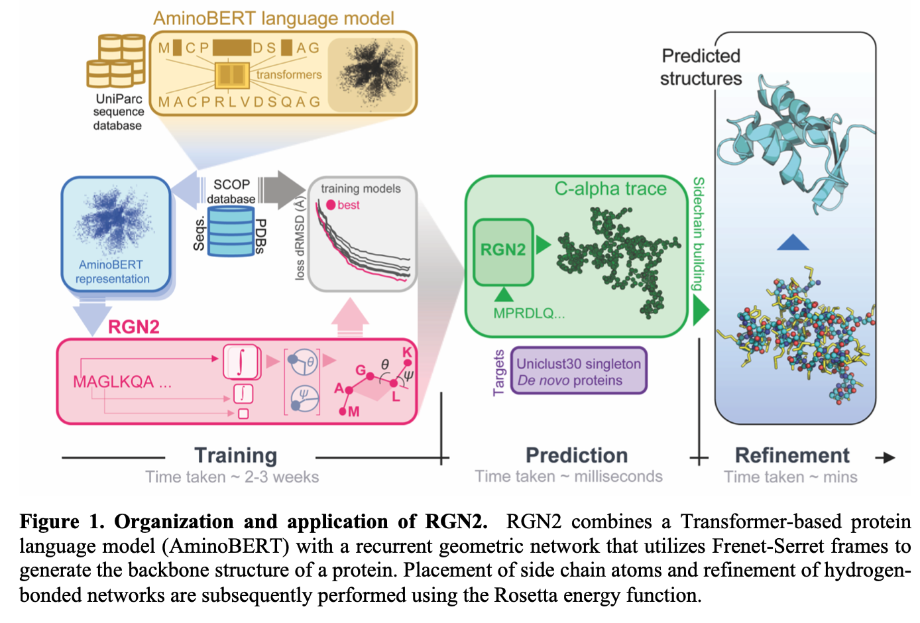
An end-to-end differentiable recurrent geometric network (RGN2)
A protein language model (AminoBERT): a Transformer to learn latent structural information from millions of unaligned proteins.
A geometric module that compactly represents $C_{α}$ backbone geometry.

Slide 6
Results
Predicting structures of proteins with no homologs (Orphan proteins)
Predicting the structures of de novo (designed) proteins
RGN2 prediction speed

Slide 7
Results
Predicting structures of proteins with no homologs (Orphan proteins)
SOTA models: AlphaFold2 (AF2), RoseTTAFold (RF), trRosetta
Test set: 222 orphan proteins (Uniclust 30 dataset), 196 of which have structures available in the Protein Databank (PDB).
Measuring Matrices: dRMSD (distance-based root mean squared deviation) and GDT_TS (the global distance test - Total Score)
“RMSD uses the actual distances between alpha carbons, where GDT works with the percentage of alpha carbons that are found within certain cutoff distances of each other” - (GDT, Foldit Wiki, Foldit)
GDT_TS uses cutoff distances of 1, 2, 4, and 8 angstroms. The percentage of alpha carbons falling within each of these distances is determined, then added up and divided by four. This measurement is used as major assessment criteria in the production of results from the CASP.
GDT_TS = (GDT_P1 + GDT_P2 + GDT_P4 + GDT_P8) / 4

Slide 8
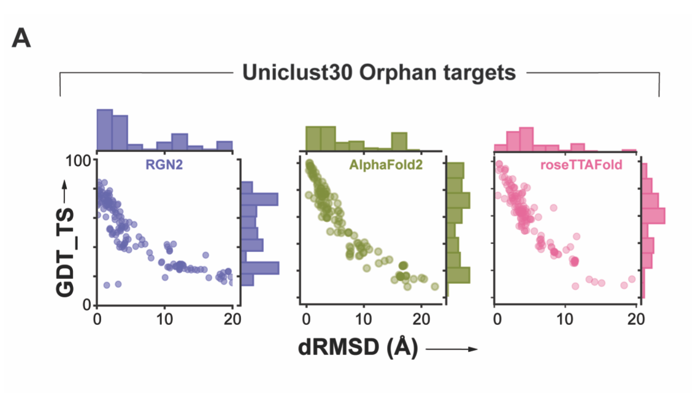
Results
Predicting structures of proteins with no homologs (Orphan proteins)
Absolute performance metric for RGN2 (purple), AF2(green), and RF (pink) across 196 orphan proteins lacking known homologs. Outliers in RGN2 plot correspond to short targets where a few poorly predicted residues substantially lower GDT_TS

Slide 9
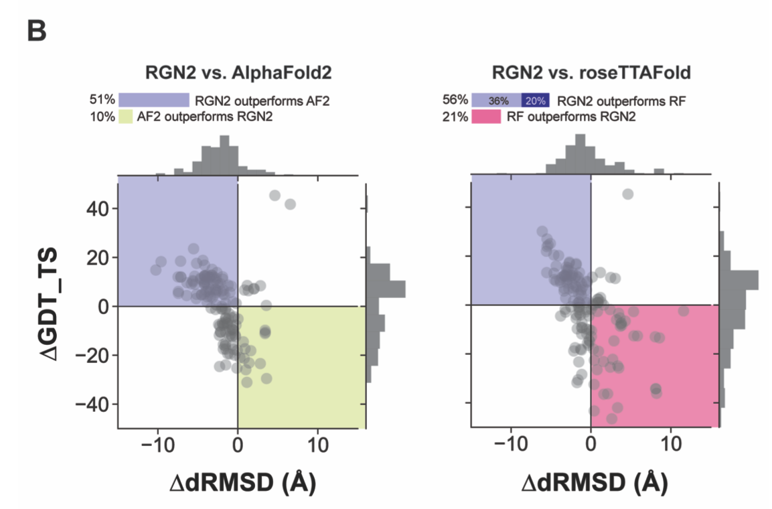
Results
Predicting structures of proteins with no homologs (Orphan proteins)
Differences in prediction accuracy between RGN2 and AF2 / RF are shown for the 196 orphan proteins, using dRMSD and GDT_TS as metric. RF failed to converge for 40 targets, yielding no predictions.

Slide 10
Results
Predicting structures of proteins with no homologs (Orphan proteins)
Determined the fraction of each secondary structure element (alpha-helix, beta-strand, hydrogen-bonded turn, 3/10-helix, bend, beta-bridge, and 5-helix) to investigate the basis for these differences in performance.
We also examined performance as a function of protein length.

Slide 11
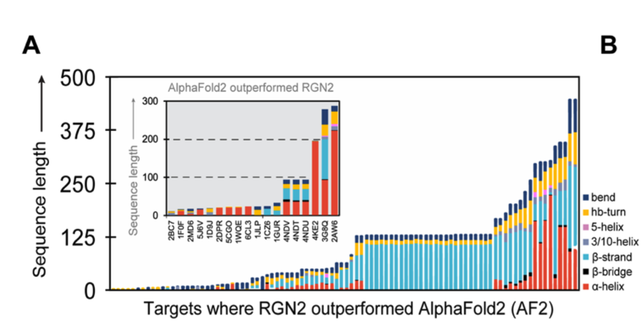
Results
Predicting structures of proteins with no homologs (Orphan proteins)
RGN2 performs better on proteins rich in bends and on hydrogen-bonded turns interspersing helices, while others (AlphaFold2) better in targets with high fractions of beta-strand and beta-bridges.
RGN2 generally outperformed AF2 on longer proteins.

Slide 12
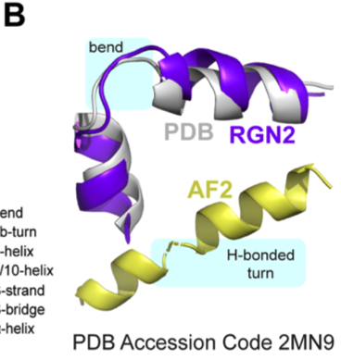
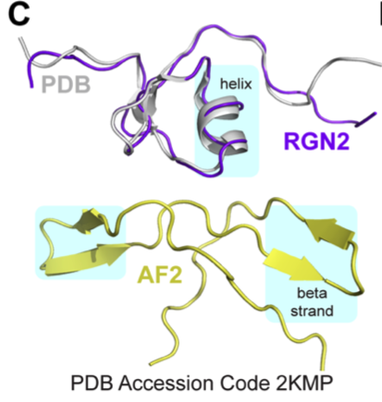
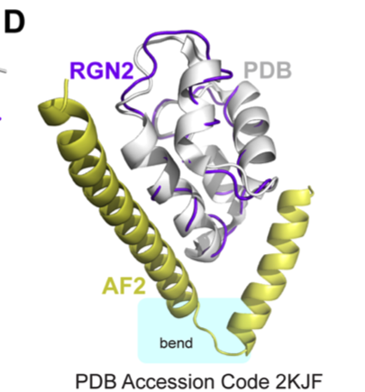
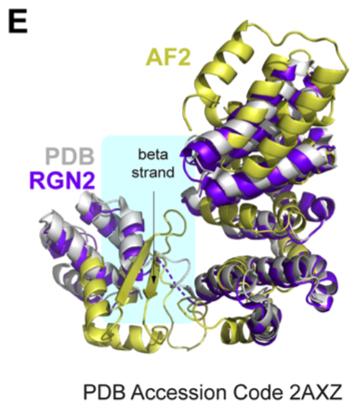
Results
Predicting structures of proteins with no homologs (Orphan proteins)
RGN2 performs better for alpha helical targets with bends or turns between helical domains, while AlphaFold2 often predicts them as spurious beta strands.

Slide 13
Results
Predicting the structures of de novo (designed) proteins
We used a set of 35 proteins generated de novo using the Rosetta energy function

Slide 14
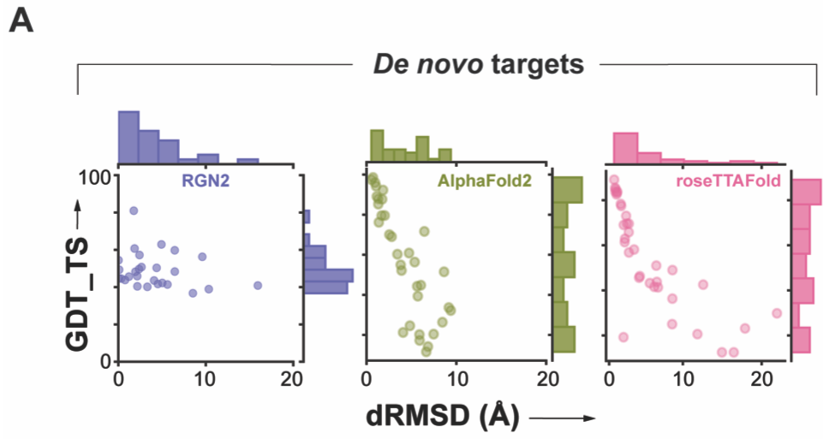
Results
Predicting the structures of de novo (designed) proteins
Absolute performance metrics for RGN2 (purple), AF2 (green), and RF (pink) across 35 de novo designed proteins with no known homologs

Slide 15
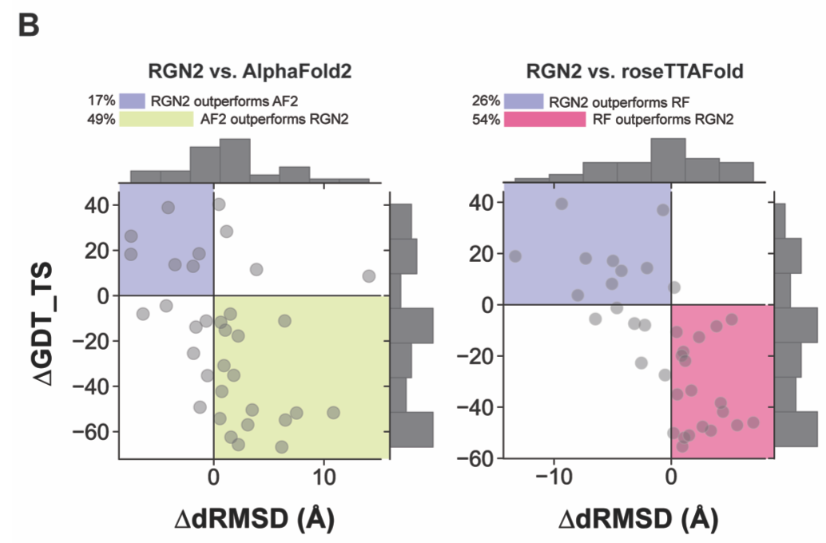
Results
Predicting the structures of de novo (designed) proteins
Differences in prediction accuracy between RGN2 and AF2/RF are shown for these 35 proteins

Slide 16
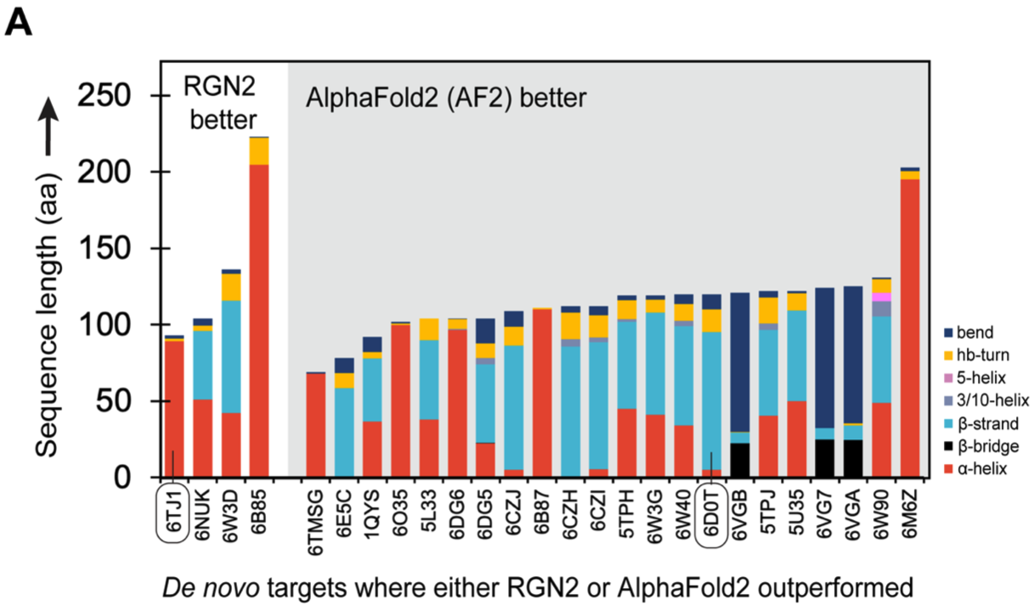
Results
Predicting the structures of de novo (designed) proteins
Stacked bar chart shows the relative fractions of secondary structure elements in 35 de novo proteins. AF2 outperforms RGN2 on proteins with high beta-sheet content.

Slide 17
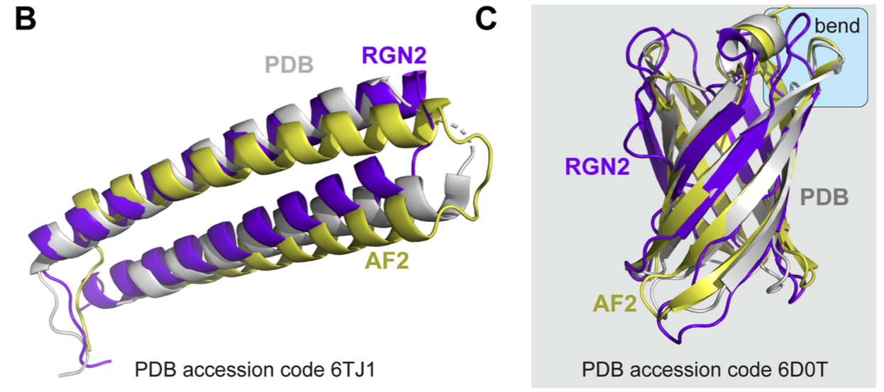
Results
Predicting the structures of de novo (designed) proteins
87% of 6D0T is a beta sheet arranged in a radially symmetric manner, where AF2 outperforms RGN2.
RGN2 outperforms AF2 on 6TJ1 which comprises alpha helices held in place by hydrogen-bonded turns.
The author suggests a hybrid model may render better results.

Slide 18
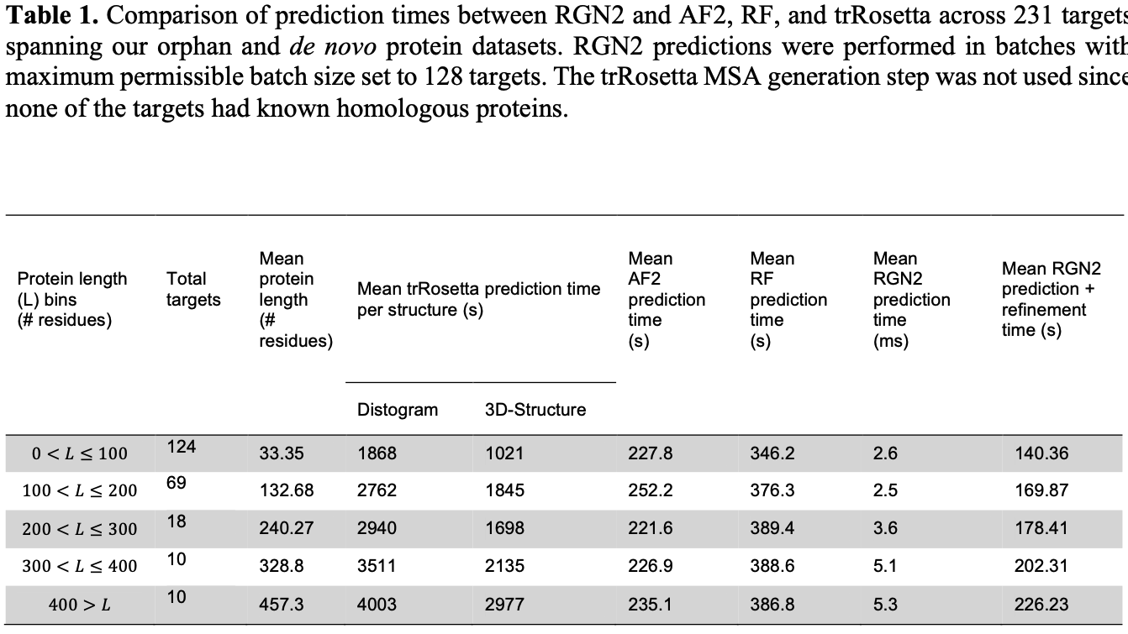
Results
RGN2 prediction speed

Slide 19
Methods
AminoBERT
Geometry module
Structure refinement in RGN2

Slide 20
Methods
AminoBERT
Randomly select sequence for chunk permutation.
Randomly select some sentences for masked language modelling.
Loss function:
$$Loss(seq)=I[seqischunkpermuted]×chunk_permutation_loss(seq)+(1-I[seqisgloballyperturbed])×masked_lm_loss(seq)$$
I[x] is the indicator of the event x
Chunk_permutation_loss(seq) is a standard cross entropy loss reflecting the classification accuracy of predicting whether seq has been chunk permuted.
masked_lm_loss(seq) is the standard masked language modelling loss as described in BERT.

Slide 21

Methods
Geometry module
The trace of $C_{α}$ can be thought of as a one-dimensional discrete open curve, characterised by a bond and torsion angle at each residue.
$r_{i}$ denotes the vector characterising the position of a $C_{α}$ atom at the i-th vertex (a triplet orthonormal vectors base)
Then define a unit tangent vector along an edge connecting two consecutive $C_{α}$ atoms

Slide 22
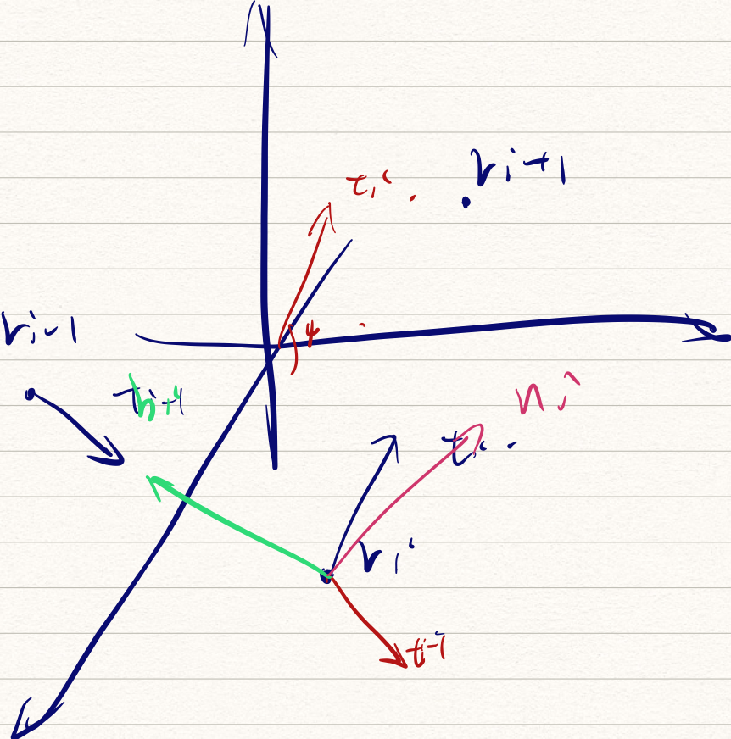
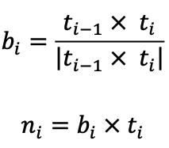
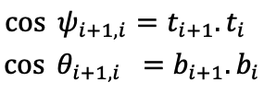
Methods
Geometry module
Two extra vectors of binormal and normal vectors for assigning frames to each i-th $C_{α}$ atom
We define bond angles $ψ$ by $t_{i}$ and torsion angles $θ$ by $b_{i}$

Slide 23
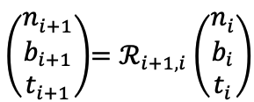
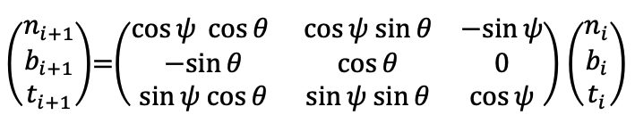
Methods
Geometry module
The Frenet-Serret formulas describe the geometry of continuous and differentiable one-dimensional curves. For the discrete case, we use a rotation matrices to relate two consecutive frames ($C_{α}$ atoms) along the protein backbone.
The equivalent of the Frenet-Serret formulas for the discrete case

Slide 24
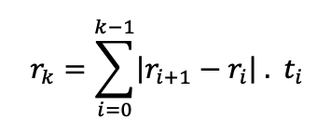

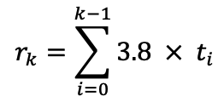
Methods
Geometry module
We could reconstruct the protein backbone through bond and torsion angles
Using tangent vectors $t_{i}$ we could reconstruct all $C_{α}$ positions. $|r_{i+1}-r_{i}|$is the length between atoms, and we take . Thus

Slide 25
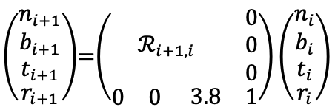
Methods
Geometry module
The model outputs bond and torsion angles. By entering the first $C_{α}$ atom, we could sequentially construct the coordinates for all the $C_{α}$ atoms.

Slide 26
Discussion
RGN2 fuses a protein language model (AminoBERT) with a approach to describe $C_{α}$ backbone geometry based on the Frenet-Serret formulation.
Speculation: The latent space of the language model also captures recurrent evolutionary relationships.
The use of the Frenet-Serret formulas addresses the requirement that proteins exhibit translational and rotational invariance.
“It Is possible that language models will replace MSAs in general use but more likely are new architectures that merge the two”

Slide 27
Discussion
Limitations
The immediate output of the recurrent geometric network only constrains local dependencies between $C_{α}$ atoms. The model may further improve if using a better inductive prior than learning immediate contacts.
The refinement of RGN2 is yet in the end-to-end implementation.

