Slide 1

ANOMALY DETECTION
Name:
Hirakjyoti Medhi

Slide 2
OBJECTIVE
1. CCTV Surveillance is used to a greater extent but still it lacks the feature of automatic violence detection
2. Manual monitoring is not a feasible task and the time taken to respond to the situation is also crucial
3. A Real-Time violence alert is proposed

Slide 3
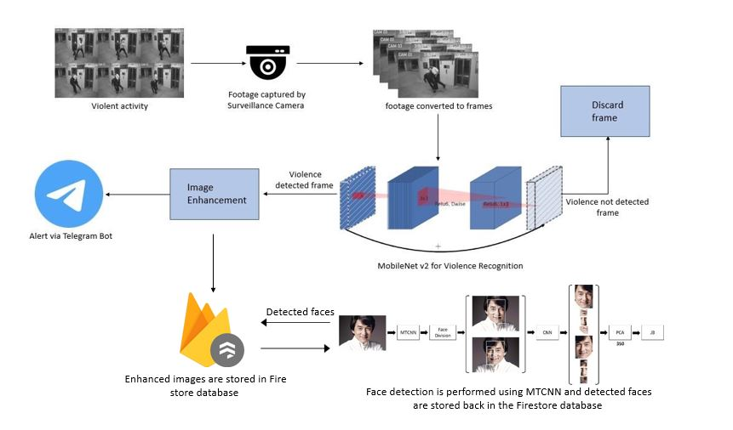
Architecture Diagram
Footage from the surveillance camera is broken down into frames. The frames are
given as input to MobileNet v2 classifier for detecting violent activities in the given
sequence of input frames. If no violent activity is recognized the respective frames are
discarded. The violence detected frame is obtained and it is enhanced for better clarity.

Slide 4
About the Dataset:
The dataset contains 1000 video clips which belongs to two classes,
violence and non-violence respectively. The average duration of the video clips is
5 seconds and majority of those videos are from CCTV footages.

Slide 5
Methodology
A dataset having 1000 videos each of violence category and nonviolence category was chosen
A model was trained using MobileNetV2 using the dataset
Real-time video footage is given as input
Output is obtained as image frames

Slide 6
MobileNet V2
Convolutional neural network that is 53 layers deep
Provides real-time classification capabilities under computing constraints in devices like smartphones.
Utilizes an inverted residual structure where the input and output of the residual blocks are thin bottleneck layers.
Uses lightweight convolutions to filter features in the expansion layer

Slide 7
Results
In this section testing and training accuracy are displayed in the below given graphical
representation. For each epoch 350 videos from the violence class and 350
videos from the non-violence are trained. 92.5% accuracy was obtained on training and a
respective accuracy of 92.5% was obtained when a CCTV footage that was not included
in the dataset was given for testing.
In the graph the accuracy and loss comes to a constant level of increment
and decrement after approximately 5 epochs. The obtained confusion matrix and
other evaluation parameters are also shown.
A video with violence is given as input to the system. The Figure shows one frame
in the video that was labeled to have violent activity. Another video clip without violent
activity was given as input.

Slide 9
Summary
Violence scene detection in real-time is a challenging problem due to the diverse content
and large variations quality. In this research, we use the MobileNet v2 model to
offer an innovative and efficient technique for identifying violent events in real-time
surveillance footage. The proposed network has a good recognition accuracy in typical
benchmark datasets, indicating that it can learn discriminative motion saliency maps
successfully. It’s also computationally efficient, making it ideal for use in time-critical
applications and low-end devices. Here, we had also shown the working of an Alert
system that is integrated with the pretrained model. In comparison to other state-ofthe-
art approaches, this methodology will give a far superior option.

