Slide 1
DISEASE - PREDICTION
PYTHON MINI PROJECT
Hiral Patel – 16010421071
Adwait Patankar - 16010421070

Slide 2
Problem Statement and Objective
Create a Graphical User Interface (GUI) using Tkinter - Standard Python Interface, to make the algorithm of Disease Prediction much more easier and accessible for the users.
The system should be functional as to accept the user input as their Name and the Symptoms (any 3) the user has been facing.
The system then runs the program which uses Pandas and NumPy libraries from python and accesses a database/dataset in the form of an excel sheet containing Prototype - the symptoms and their possible consequences (diseases). The symptoms given by the user are trained and as per the accuracy score, a disease is predicted.

Slide 3




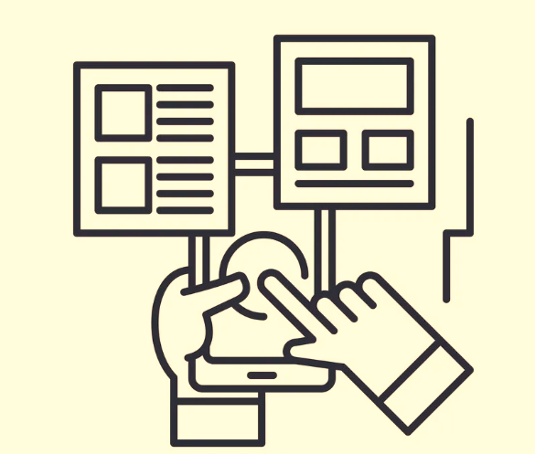
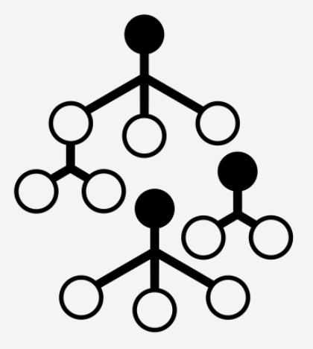
System Architecture
DATA-VALIDATION
PREDICTED-VALUE
OUTPUT-PROGNOSIS
USER WINDOW
USER-INPUT
RANDOM FOREST CLASSIFICATION

Slide 4
Working of the System
When we access and run the code, an output window pops up, which is a graphical user interface made with the help of a python library – Tkinter. The page asks the user to input it’s Name and the user gets to choose any 3 symptoms out of the given drop down menu.
Once user has selected the symptoms, the user presses on the “CHECK” button, also made with the help of Tkinter.
The program stores the prototype file of excel and reads it with the help of Data-Frames, which helps us access the data in the form of tables. We have allotted every disease with a serial number which makes it easier when used for prediction.
The user input then goes through the random forest classifier where it goes through multiple decision trees and gives an output as the disease-prognosis after data validation.

Slide 5
Importing Libraries
We use NumPy to ravel through the sheet, Pandas – we use Data-Frames to read and replace values and Tkinter to build a basic GUI.
NumPy:
NumPy is a Python library used for working with arrays. It also has functions for working in domain of linear algebra, Fourier transform, and matrices. NumPy stands for Numerical Python.
Pandas:
Pandas is an open source Python package that is most widely used for data science/data analysis and machine learning tasks.
Tkinter:
Tkinter is the de facto way in Python to create Graphical User Interface and is included in all standard Python Distributions. In fact, it’s the only framework built into the Python standard library.

Slide 6
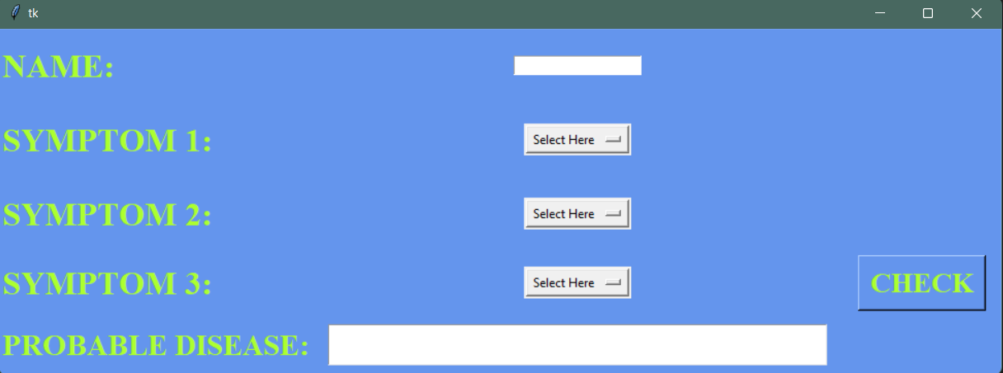
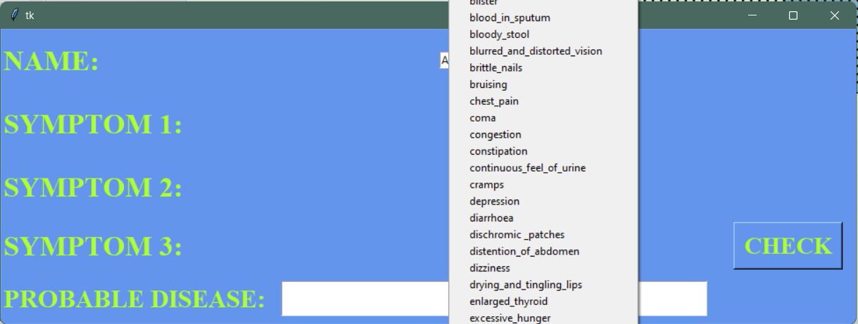
Results and Outputs
The interface which pops up as the Output Window. Where user can enter their Name and Symptoms.
The Symptoms can be selected from the Drop Down Menu.

Slide 7
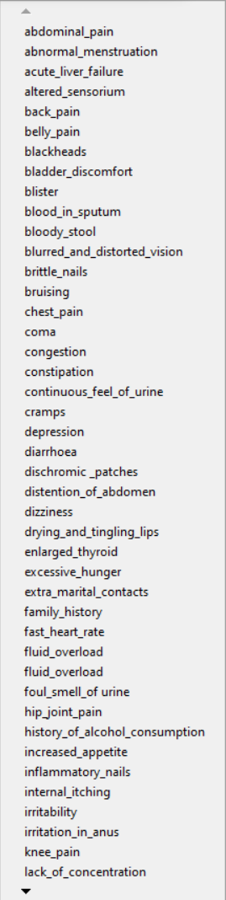
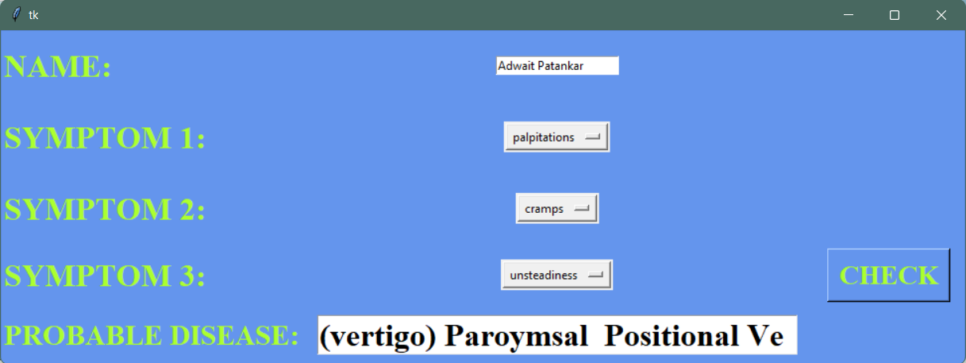
Results and Outputs
The Drop Down Menu.
Once the information is entered, we can see the “PROBABLE DISEASE”.

Slide 8
CONCLUSION
We learned how to use Tkinter – Standard Python Interface as a GUI for the front-end of the mini-project and how to apply our in class developed knowledge about python as a language in a real life helping mechanism that is our project of Disease Prediction.
The project also helped us learn and explore basics of Machine Learning, using Random Forest Classification. We strengthened our grasps on Pandas and NumPy.
The algorithm and our logic application works optimally and in favor of the user for predicting the disease one might have.

Slide 9
REFERENCES
https://www.youtube.com/watch?v=v6VJ2RO66Ag&ab_channel=NormalizedNerd
https://scholar.google.co.in/scholar?q=disease+prediction+using+machine+learning&hl=en&as_sdt=0&as_vis=1&oi=scholart
https://www.geeksforgeeks.org/disease-prediction-using-machine-learning/
https://www.kaggle.com/datasets/kaushil268/disease-prediction-using-machine-learning

Slide 10

THANK-YOU!
PS: Feel free to try out the Disease-Prediction for your own self, hopefully you’ll find it helpful in self prognosis at time of need.
GitHub - https://github.com/Hiral25p/Disease-Prediction:))

