Slide 1
Aavishkar
Inter- Collegiate/Institute/Department Research Convention
Category:5 Level:UG
DRIVE_ALERT
Slot No:5129

Slide 2

PROBLEM :
  leading cause of road accidents globally, around 40% of accidents happen due to this in India itself.
  major problem in India, causing about 100,000 crashes, 71,000 injuries, and 1,550 casualties each year.

Slide 3


OUR
OBJECTIVE:
1
To evade the accident due to drowsiness
2
To Protect the Driver Community from Fatal Consequences
3
Prioritizing Affordability and Accessibility for Widespread Adoption

Slide 4
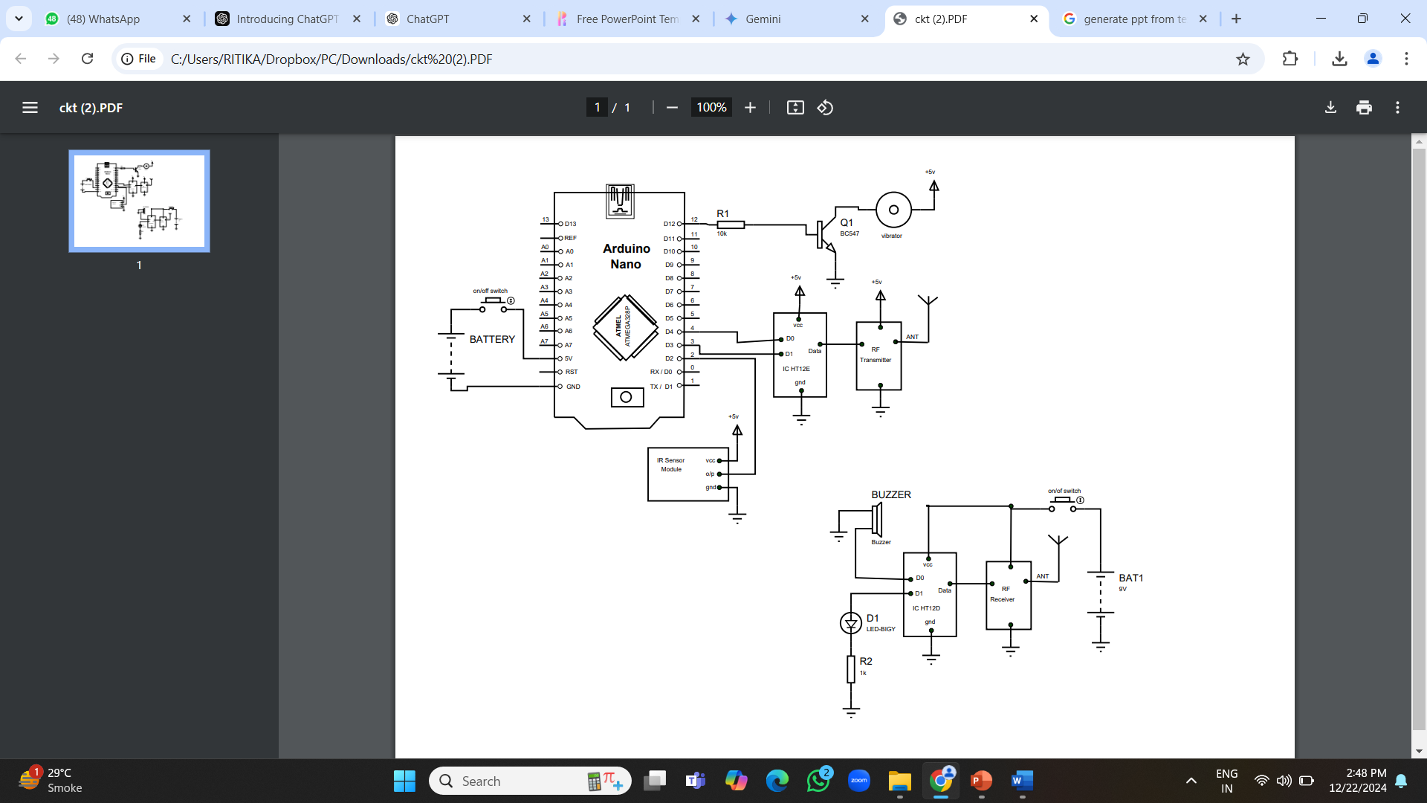
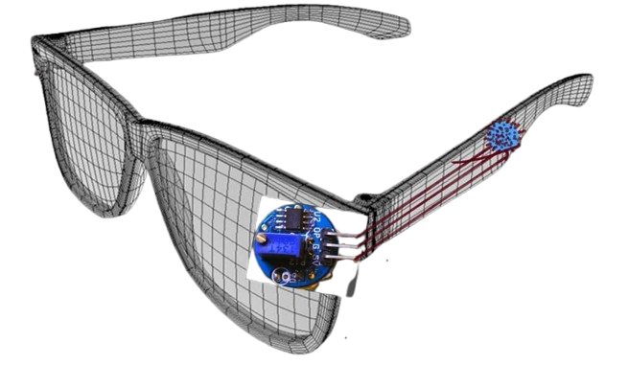
prototype

Slide 5


  Insufficient knowledge among the driver's community , In general as well.
  Unaffordability.
  lack of availability
GAP
ANALYSIS:

Slide 6

Q1: Obstructing the Vision due to the models structure
Queries
+
sol’n
Q2: How long is it Durable?
Q3: How is it Unique?

Slide 7

  Component Optimization - Placing the module slightly adjacent in order to avoid vision blockage.
  Cost effective - Using required compact size components with low power consumption .
  Compact in size- Attemp to SMD
  Understanding Requirement - providing SOS System and required functions.
UP-
GRADE
(LEVELING UP THE ACCURACY )

Slide 8

Components used:
  ATtiny402 Microcontroller at the center.
  IR Sensor (STHS34PF80) connected to the input pins of the ATtiny402.
  CR2032 Battery providing power to the ATtiny402 and other components.
  Vibrating Motor (V26DH2B1501852) connected via a Transistor System for control.
  nRF24L01 Module connected for communication output.
  ADXL335 Accelerometer connected to the ATtiny402 for motion sensing.
STRUCTURE
STUDY

Slide 9
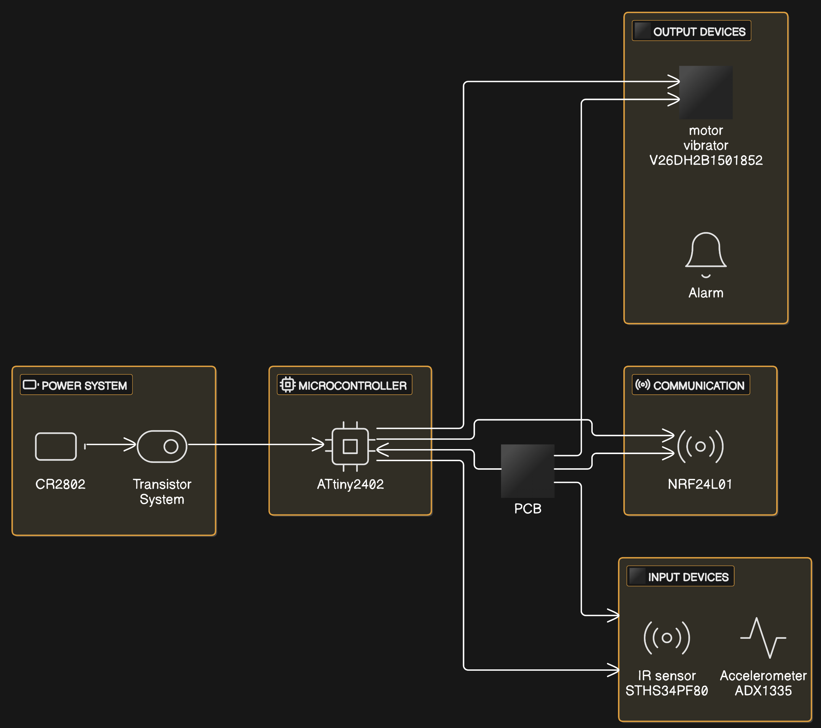
Schematic Updated Structure

Slide 10
costing
Initial Porototype
Updated Prototype
Arduino nano – 265
RF Module – 220
ICHT12e – 40
ICHT12d-40
3.7v battery – 130
IR sensor Module- 60
Wire- 30
Button-10
Frame- 100
Led- 4
Total:954inr
  ATtiny 402 Microcontroller ₹35 per unit
  STHS34PF80 IR Sensor ₹270 per unit
  CR2302 Battery ₹8 per unit
  V26DH2B1501852 Motor Vibrator₹120 per unit
  Transistor System ₹4 per unit
  NRF24L01 Radio Communication M₹120 per unit
  ADXL335 Accelerometer ₹350 per unit
Total: ₹907

Slide 11
Conclusion
In conclusion, Drive Alert is more than just a device—it’s a movement to transform road safety. With its cutting-edge features and driver-centric design, it offers a lifeline to those who need it most.
Every life is precious. Every accident is preventable. And every journey deserves to end safely.
“Be safe, stay alert—with Drive Alert.”

