Slide 1

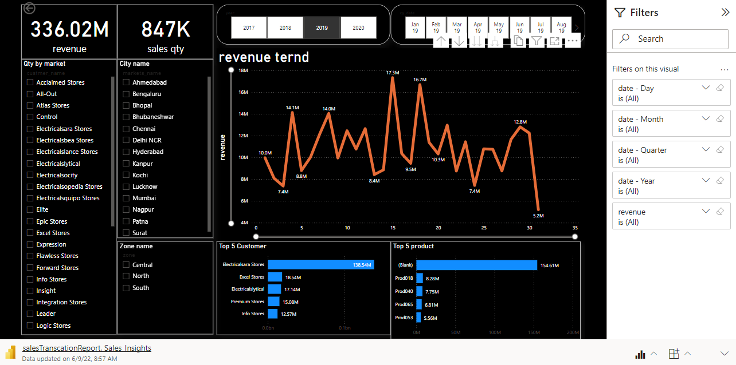
Sales Transaction Report

