Slide 1
STDIN | STDOUT | STDERR
May read | May write | May write
↑ | ↓ | ←
↑ | ↓ | NULL
… | … | …
Ruby.exe guest.rb
CGI4Ruby
CGI Extension
IIS 6.0

Slide 2
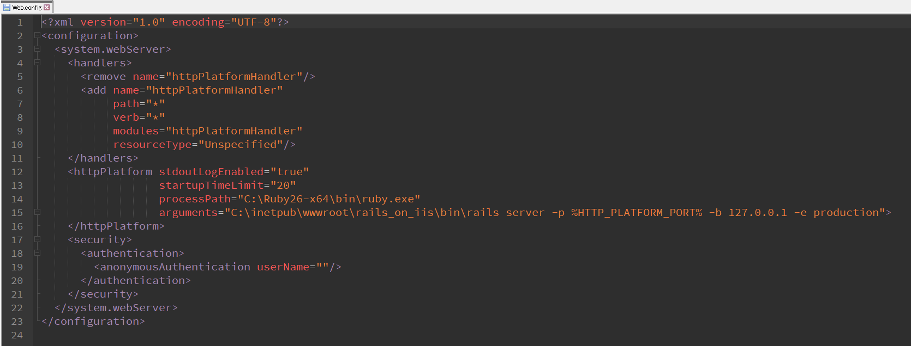
rails_on_iis
(rack-compliant)
Ruby …/rails
(via WEBrick)
TCP
HTTP
httpPlatformHandler
IIS 10.0

Slide 3
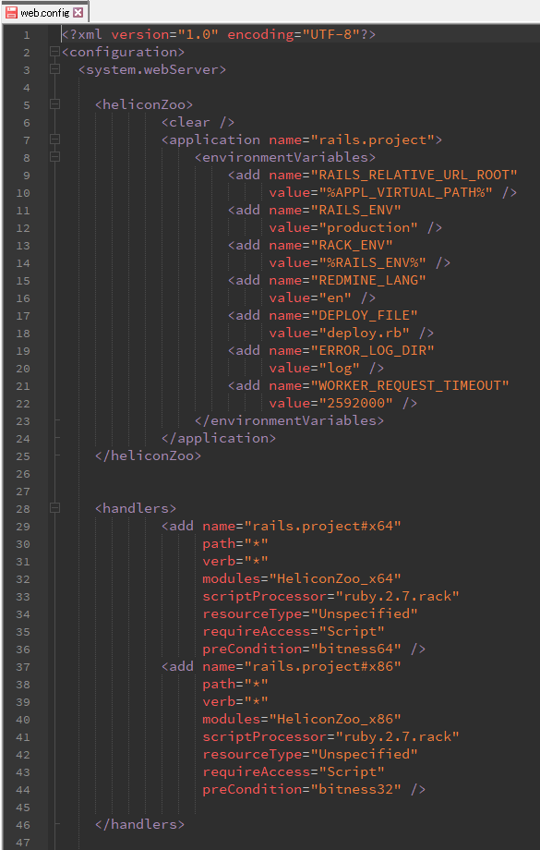
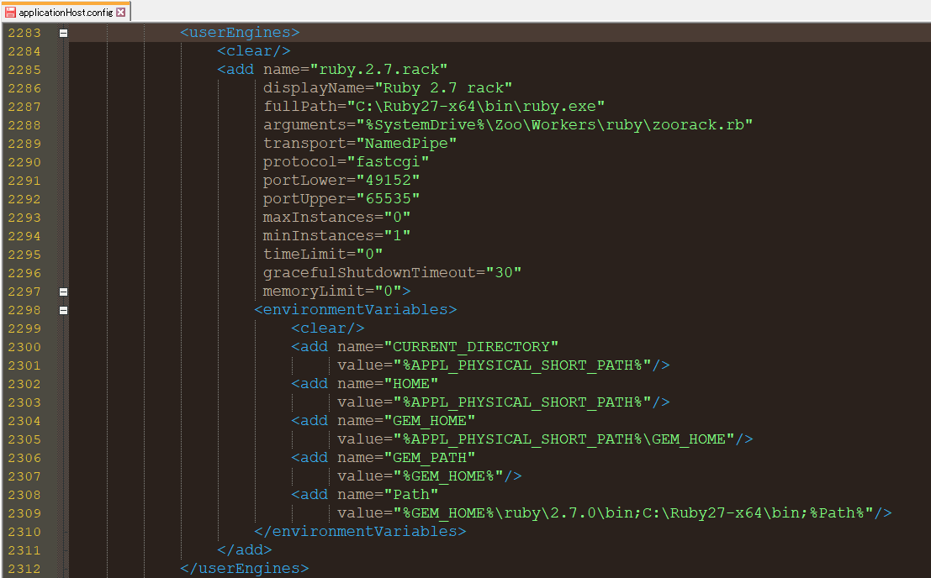
rails_on_iis
(rack-compliant)
Ruby …/zoorack.rb
NamedPipe
FastCGI
Helicon Zoo
IIS 10.0

