Slide 1
Statistical Data Analysis
Math3015
HITSZ, 2023

Slide 2
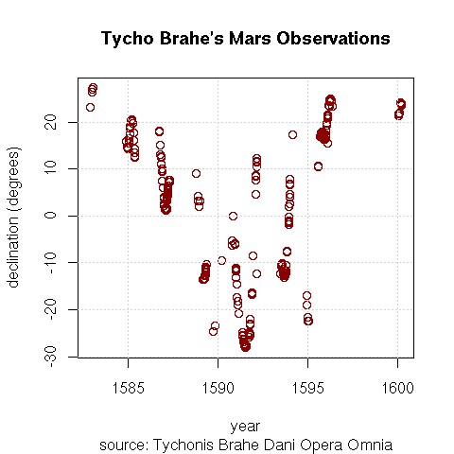
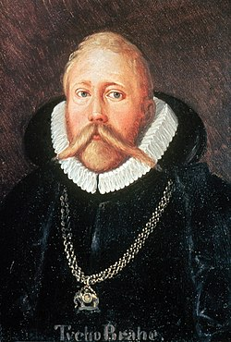
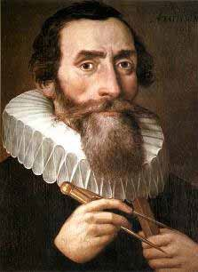
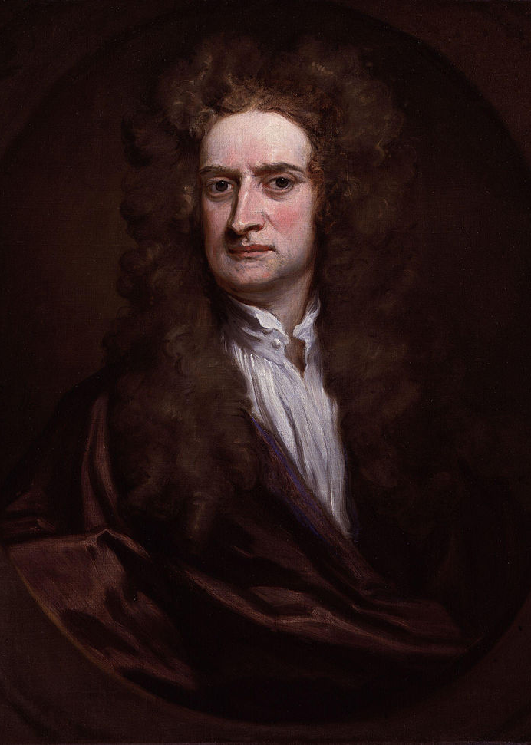

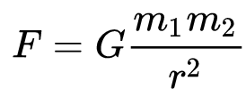
Data Analysis in Science
Scientific method
“systematic techniques used to acquire, modify, and integrate knowledge concerning observable and measurable phenomena”
Tycho Brahe
(1546–1601)
Johannes Kepler
(1571–1630)
Issac Newton
(1643–1727)
Natural science: empirical science
Statistics plays a vital role in making scientific discovery
Notes:
Classical paradigm in history: data -> phenomenological model -> fundamental theory

Slide 3

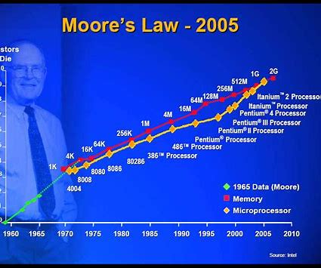
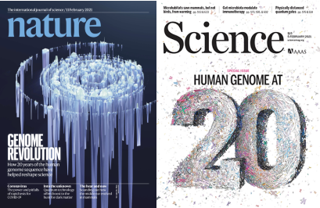
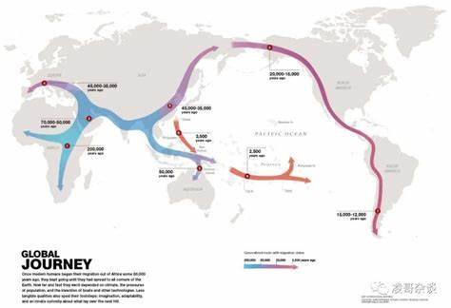
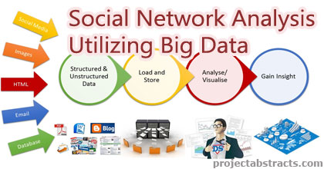
Data Science
With a massive amount data, gaining knowledge directly from data becomes possible
A new paradigm for research
Data + statistics > physical models ?
Notes:
Traditional scientific paradigm: Modeling, prediction, testing.
Data-driven science represents a new paradigm: emphasizes gaining knowledge directly from the data.
Example 1: bioinformatics (e.g. the Human Genome Project), which can answer many important scientific questions by analyzing information about living organisms’ genomes, such as: where do we come from.
In genome studies and protein folding prediction (big data and machine learning based approaches are now superior to physical model-based approaches).
Example 2: Social network analysis, which can drawing patterns of behavior from user data (not hard to imagine that there are many commercial applications)

Slide 4
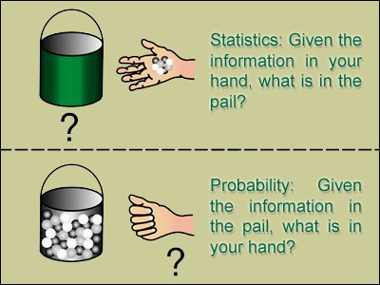
Probability and Statistics
Why bother with randomness?

Slide 5
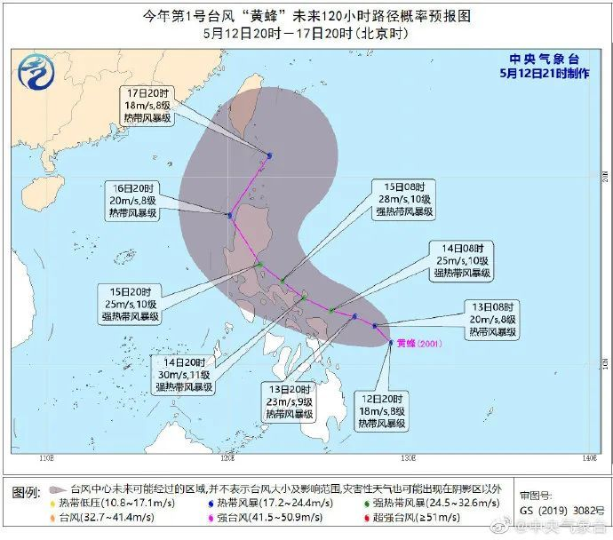
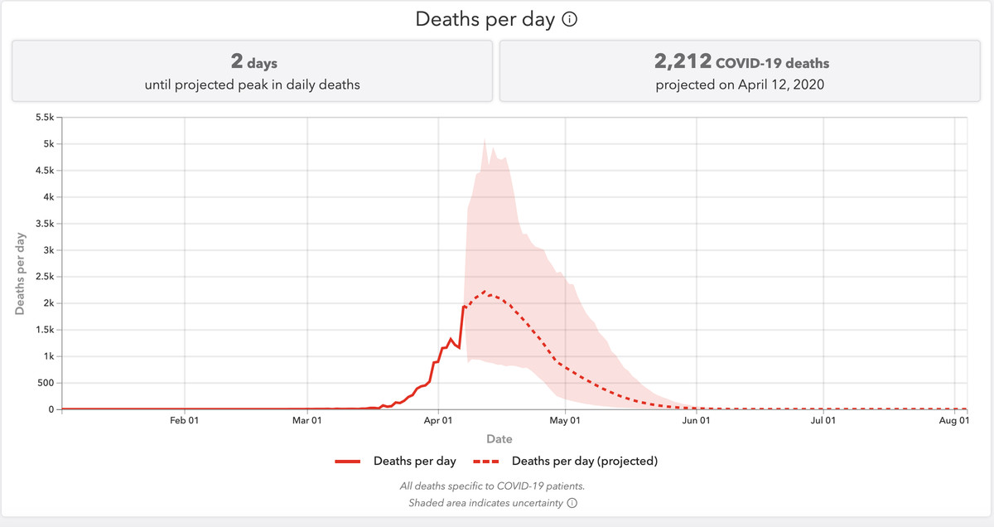
Complex Phenomena in Nature and Society
Many complex phenomena in nature and society possess randomness, due to
Quantum effect
The complexity of the system
Limitation of measurement and observation
…
Role of probability and statistics
Theory foundation for describing the natural law
Tools for testing of hypotheses
Meaningful and concise expression of the findings
…

Slide 6
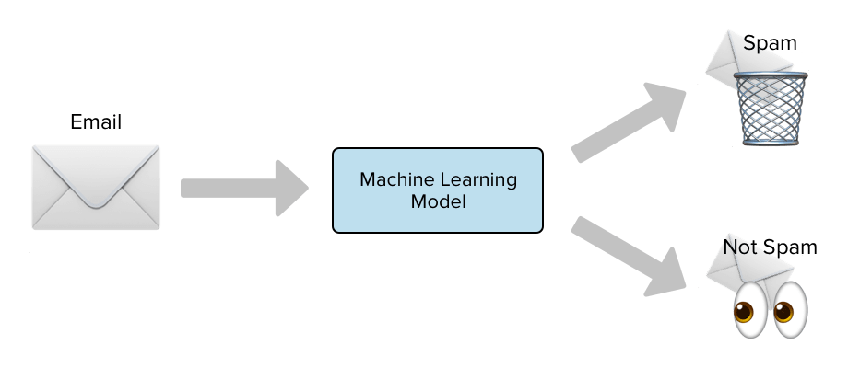
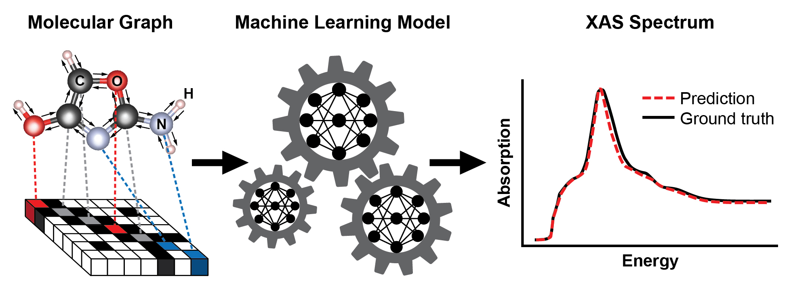
Statistical (Machine) Learning
For many tasks in data science, one needs to perform inference and decision-making under uncertainty.
Statistical/machine learning provide valuable toolbox for this business.

Slide 7
Statistical Inference
Observed data
Statistical inference
Statistical models
Assumptions
Probability principles
Knowledge discovery, prediction, control

Slide 8
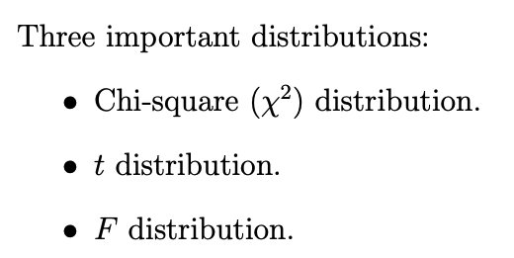
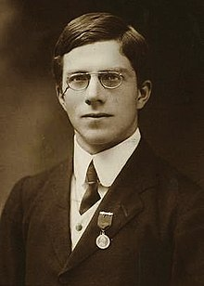
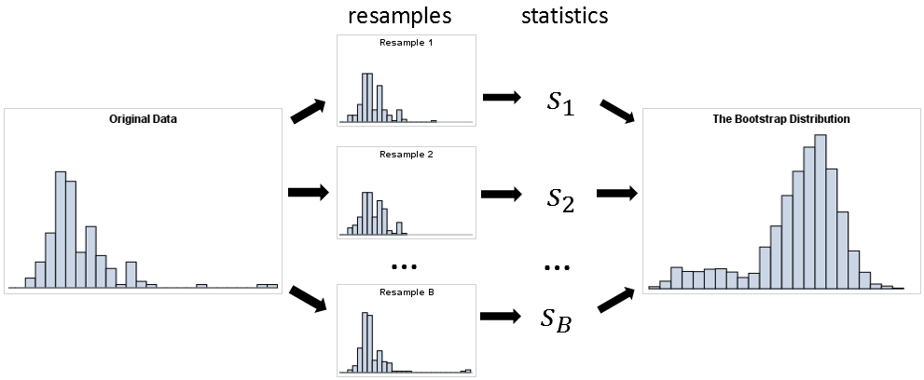

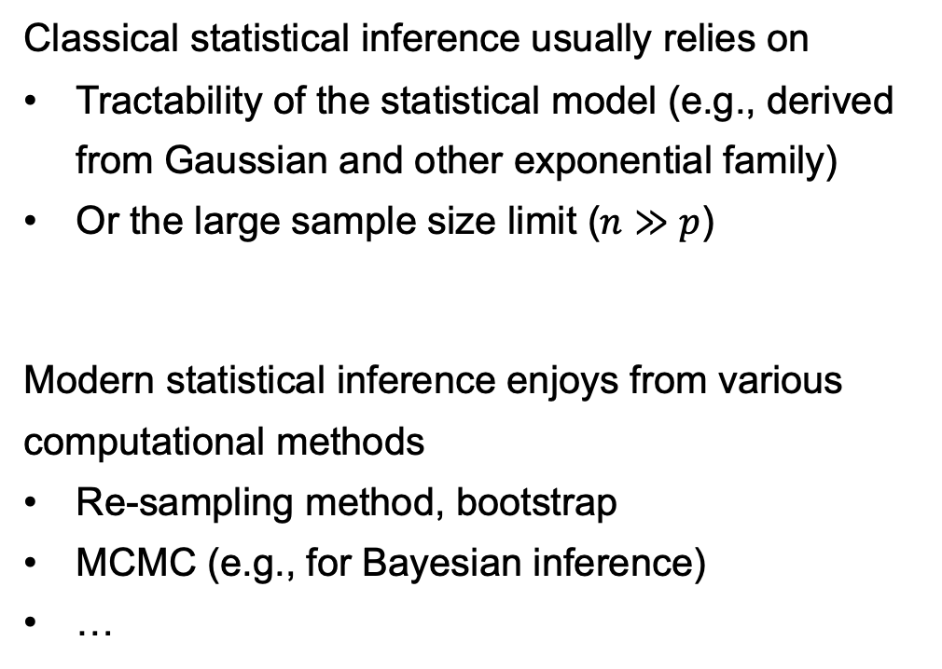
Computer Age Statistical Inference
Classical statistical inference usually relies on
Tractability of the statistical model (e.g., derived from Gaussian and other exponential family)
Or the large sample size limit ($n≫p$)
Modern statistical inference enjoys from various computational methods
Re-sampling method, bootstrap
MCMC (e.g., for Bayesian inference)
…
Ronald Fisher
(1890 – 1962)
Bradley Efron (1938 – )
Many complex statistical models and applications can be considered.
Notes:
Relevance of the course “computational statistics”.

Slide 9
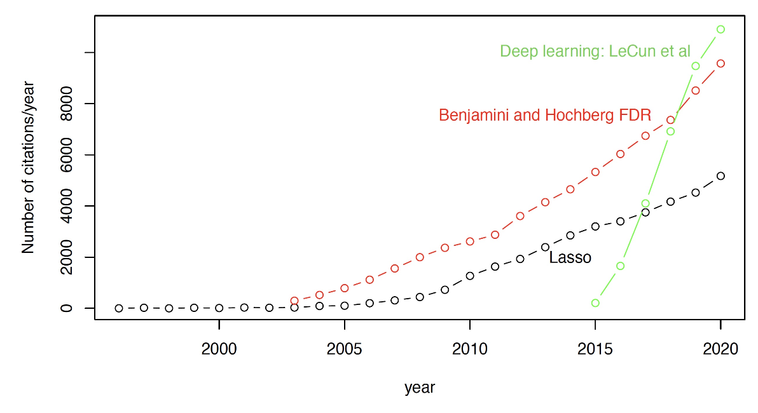
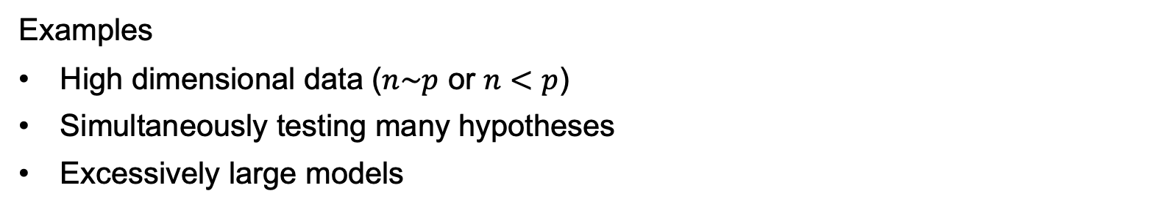
Computer Age Statistical Inference
Examples
High dimensional data ($n\sim p$ or $n<p$)
Simultaneously testing many hypotheses
Excessively large models
Notes:
The three examples correspond to (i) Lasso (ii) FDR (iii) deep learning, respectively.

Slide 10




Scope of The Course
Density/Distribution estimation: $p(x)$
(Generative model)
Parameter estimation
Gaussian mixture
Transport distance *
Normalizing flow *
Regression: $p(y|x)$
(supervised learning,
Discriminative model)
Generalized linear model (Poisson, logistic, Cox)
Regularization (ridge, Lasso)
Maximum likelihood
...
(A bit) theory + practice
Hypothesis testing
p-value, goodness-of-fit
Multiple testing, false discovery rate
Analysis of contingency table
Notes:
Blue: big data related
*: interesting but optional topics

Slide 11
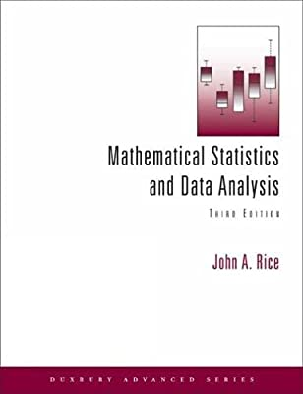
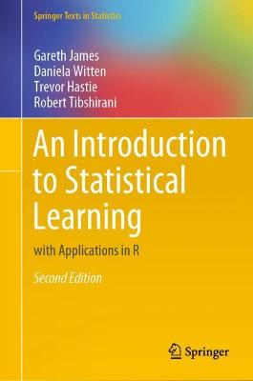
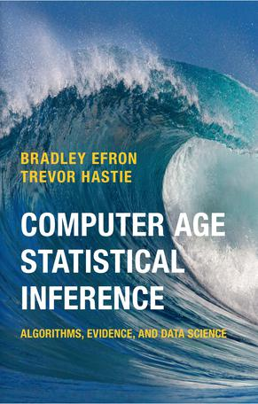
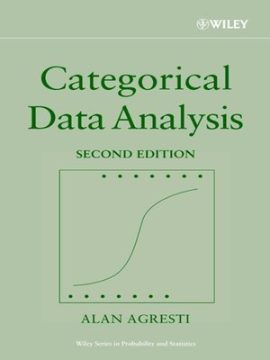
Main References
J. A. Rice,
Mathematical statistics and data analysis 3rd Ed,
MSDA3 (2006)
G. James, D. Witten, T. Hastie, R. Tibshirani,
ISLR2 (2021)
B. Efron, T. Hastie,
Computer age statistical inference,
CASI (2017)
A. Agresti,
Categorical Data Analysis,
CDA2 (2002)

Slide 12

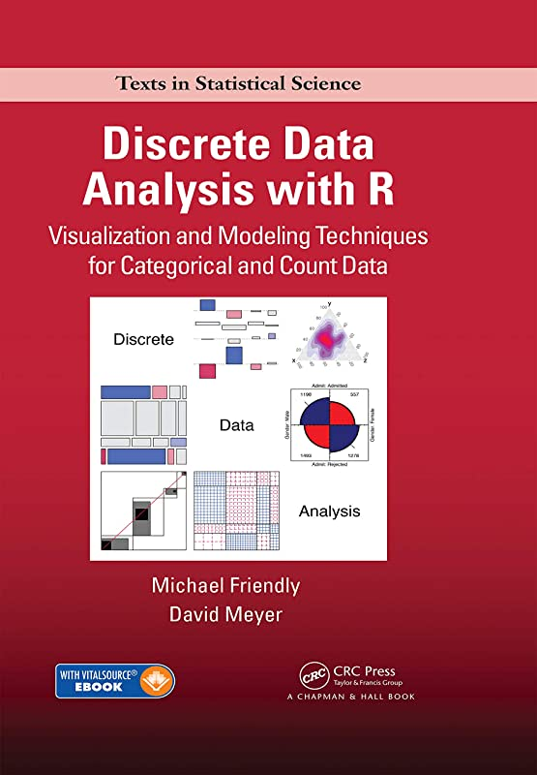
Main References on Software
R. I. Kabacoff
R语言实战 第2版,
(R in Action 2nd Ed) (2016)
M. Friendly and D. Meyer
Discrete Data Analysis with R,
(2015)
Documentations of the R and Python packages that will be used.

Slide 13
Logistic
3 homework (30%)
To be submitted individually
Lab 1 + Project 1(10%)
Topics and data will be given
Submit a written report, including core parts of your derivation/code
Submission in group (max size = 4) is allowed
Lab 2 + Project 2 (10%)
You are free to choose your favourate topic and data
Submit a written report, including core parts of your derivation/code
Submission in group (max size = 4) is allowed
Final exam (50%)
Closed-book

