Slide 1
PDF Utils
Hirbod

Slide 2
Purpose of the tools
Utility
Enhancing user experience compared to online tools
Availibilty

Slide 3
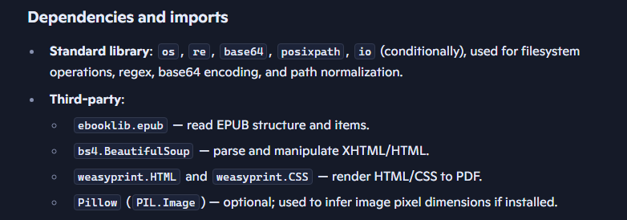
EpUb to PDF
This script converts EPUB files to PDF while trying to preserve the original EPUB styling and embed all referenced resources (images, fonts, CSS).
Notes:
It reads an EPUB with ebooklib, parses XHTML with BeautifulSoup, inlines CSS and resources as data: URIs, applies a final cascade of CSS (including page size and margins), and renders the result to PDF using WeasyPrint. The script also includes a bulk-conversion helper that converts every .epub file in a directory.

Slide 4
EpUb to PDF helper functions
_resolve_href(base_path, href)
Purpose: Normalize and resolve a relative href found in an EPUB document relative to the document that references it.
_embed_resources_in_css(css_text, css_item_path, items_by_path)
Purpose: Find url(...) and @import references inside CSS and inline referenced resources (images, fonts, other CSS) as data: URIs when the resource exists inside the EPUB.
_get_image_dimensions(resource)
Purpose: Try to determine pixel width and height of an image resource using Pillow.

Slide 5
EpUb to PDF helper functions
_process_and_embed_resources_in_soup(soup, base_path, items_by_path, debug_log=None)
Purpose: Walk the parsed XHTML soup and inline or fix resources and links so the final HTML is self-contained and linkable inside the single output HTML used for PDF rendering.

Slide 6
EpUb to PDF main function
Read EPUB
Build items_by_path
Collect global CSS:
Determine reading order (spin e): Build spine_items as the list of XHTML items in reading order.
Process each spine document:
Compose final HTML:
Render to PDF:

Slide 7

PDF‑compression utility

Slide 8
Dependencies and parameters
Pillow (PIL) → image processing
pikepdf → PDF editing, stream replacement, object compression
PyPDF2 → text extraction for scanned detection
Ghostscript (optional) → heavy compression
tempfile, shutil, subprocess → temporary files and external commands
Image compression presets (IMAGE_SETTINGS)
Each level defines:
max_size: maximum width/height after downsampling
quality: JPEG quality
progressive: progressive JPEG
grayscale: convert to grayscale
Level 4 is the most aggressive.
Notes:
Recompress embedded images using Pillow
Optimize PDF structure using PikePDF
Optionally run Ghostscript for aggressive compression

Slide 9
PDF darkmode
This script is a PDF “dark mode” converter. Its goal is to transform light-background PDFs into dark-themed versions without breaking fonts, text layout, or vector graphics.
Adds a dark background to each page
Recolors dark text to light text
Preserves fonts, bold/italic styles, symbols, and vector precision
Provides multiple visual themes
Supports both vector PDFs and scanned/image-heavy PDFs
Notes:
Predefined themes:
AMOLED: pure black background, near-white text
Sepia: warm, paper-like dark mode
Navy: blue-tinted dark mode

Slide 10
Architectural overview
Vector mode (default, preferred)
Uses PikePDF
Directly edits PDF content streams
Keeps everything vector-based
Ideal for digitally generated PDFs (books, papers, slides)
Image mode (fallback)
Uses PyMuPDF + Pillow
Rasterizes each page
Applies image-based dark mode conversion
Suitable for scanned documents or very complex layouts

Slide 11

PDF lightmode

