Slide 1

ICBP 2.0
The Smartest AI Nutrition Assistant
Your Name : Hiren J. Modha
Project GitHub Link: https://github.com/Hiren-Modha/Smart_AI_Nutrition_Assistant_Hiren.git

Slide 2
Content
Problem Statement
Objectives
Key Technologies
Core Features
Architecture
Agents and Modules
Gemini
Results
Conclusion & Future Work
References
Notes:
Here we are going to learn,
Text classification involves assigning categories to text, commonly applied in spam detection. It requires preprocessing (tokenization, stopword removal) and vectorization (e.g., TF-IDF). Models like Naive Bayes or Logistic Regression are trained and evaluated using metrics like accuracy and F1-score.

Slide 3
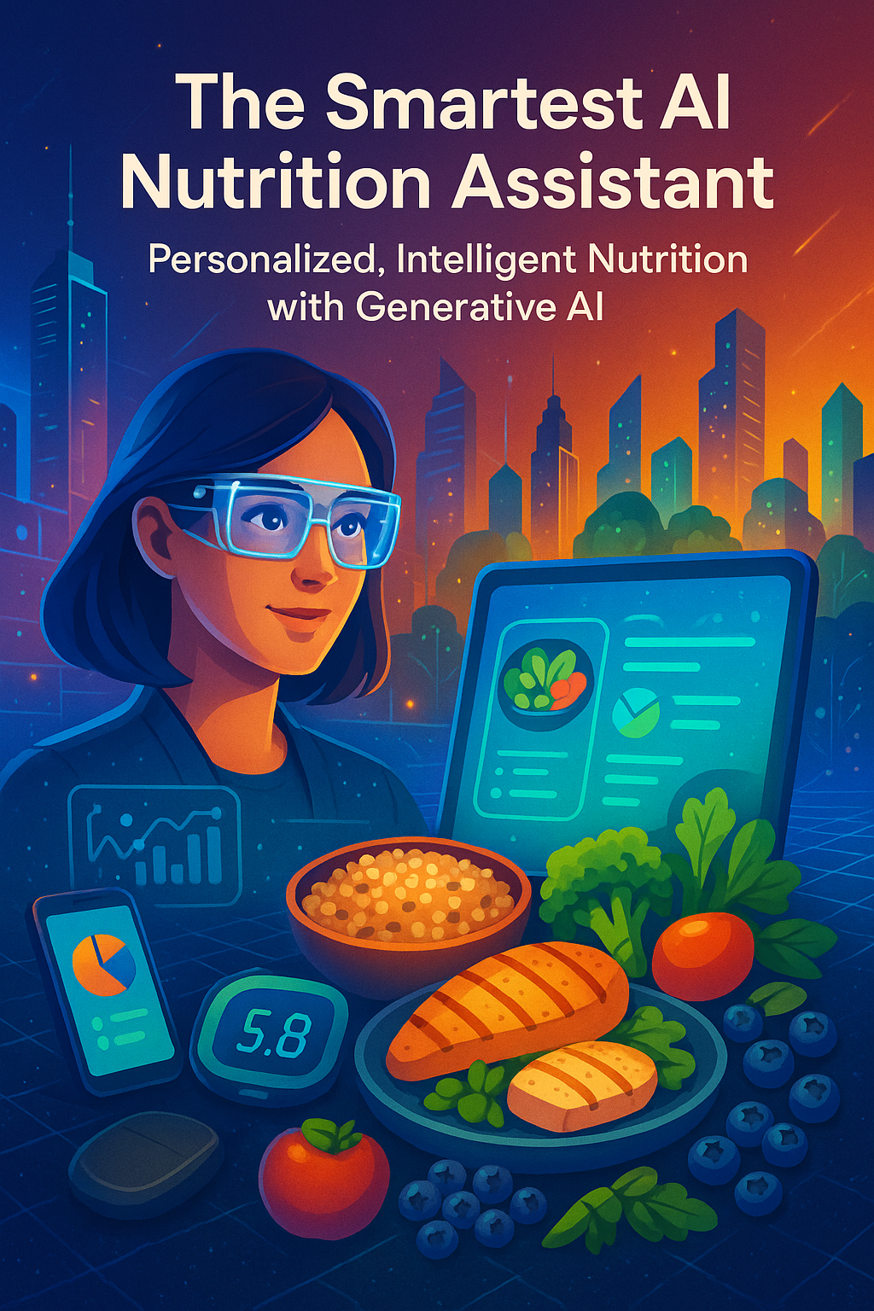
Problem Statement
Notes:
Need to discuss about :
What problem are you solving?
Why is it important?

Slide 4
Objective
Objectives
To build an intelligent, interactive nutrition assistant using generative AI that provides:
Personalized meal planning
Nutrition and calorie analysis
Smart suggestions based on goals/preferences
Dynamic feedback and contextual explanations
Support for both text and image input
Clean, interactive Streamlit GUI
Notes:
Need to discuss about :
Clear goals of the project
What you aim to achieve with AI/ML/DL

Slide 5
Objective
Key Technologies
Python + Streamlit
Google Gemini (LLM)
Agent-Based Architecture
Image & Text Processing
Notes:
Need to discuss about :
Clear goals of the project
What you aim to achieve with AI/ML/DL

Slide 6
Objective
Core Features
✅ Personalized Meal Planning
🍎 Nutrition & Calorie Analysis
🤖 Smart Suggestions (via Gemini)
🧠 Contextual Feedback Engine
📷 Image & Text Input Support
🖥️ Clean, Interactive Streamlit UI
Notes:
Need to discuss about :
Clear goals of the project
What you aim to achieve with AI/ML/DL

Slide 7
Objective
Architecture
smart_ai_nutrition_assistant/
├── agents/
│ ├── calorie_calculator.py
│ ├── feedback_agent.py
│ └── meal_planner.py
├── models/
│ └── gemini_api.py
├── ui/
│ └── app.py
├── .env
├── requirements.txt
└── run_app.py
Notes:
Need to discuss about :
Clear goals of the project
What you aim to achieve with AI/ML/DL

Slide 8
Objective
Architecture
SMART AI Nutrition Assistant
.env
requirements.txt
Agents
Run_app.py
Models
User Interface
calorie_ calculator.py
feedback_ agent.py
meal_planner.py
gemini_api.py
app.py
Notes:
Need to discuss about :
Clear goals of the project
What you aim to achieve with AI/ML/DL

Slide 9
Objective
Agents and Modules
User Input Handler – Accepts image/text + preferences
Meal Planning Agent – Builds diet plans
Nutrition Analyzer – Calculates macros & calories
Feedback Agent – Adapts based on user behavior
Smart Suggestion Agent – Offers alternatives (Gemini)
Notes:
Need to discuss about :
Clear goals of the project
What you aim to achieve with AI/ML/DL

Slide 10
Objective
Agents and Modules
User Input Handler – Accepts image/text + preferences
Meal Planning Agent – Builds diet plans
Nutrition Analyzer – Calculates macros & calories
Feedback Agent – Adapts based on user behavior
Smart Suggestion Agent – Offers alternatives (Gemini)
Notes:
Need to discuss about :
Clear goals of the project
What you aim to achieve with AI/ML/DL

Slide 11
Objective
Smart Suggestions with Gemini
LLM-based personalized advice
Recommends healthier swaps
Explains meal quality and decisions
Learns and adapts to user feedback over time
Notes:
Need to discuss about :
Clear goals of the project
What you aim to achieve with AI/ML/DL

Slide 12
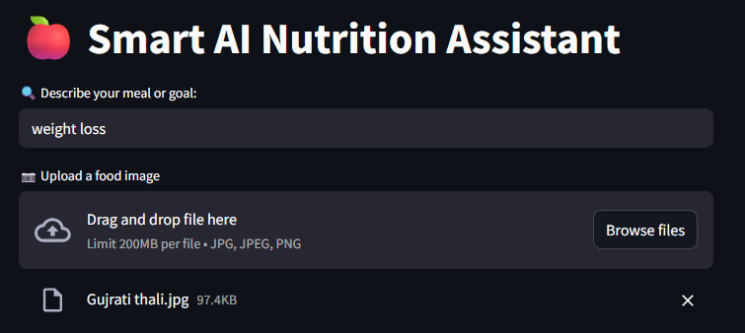
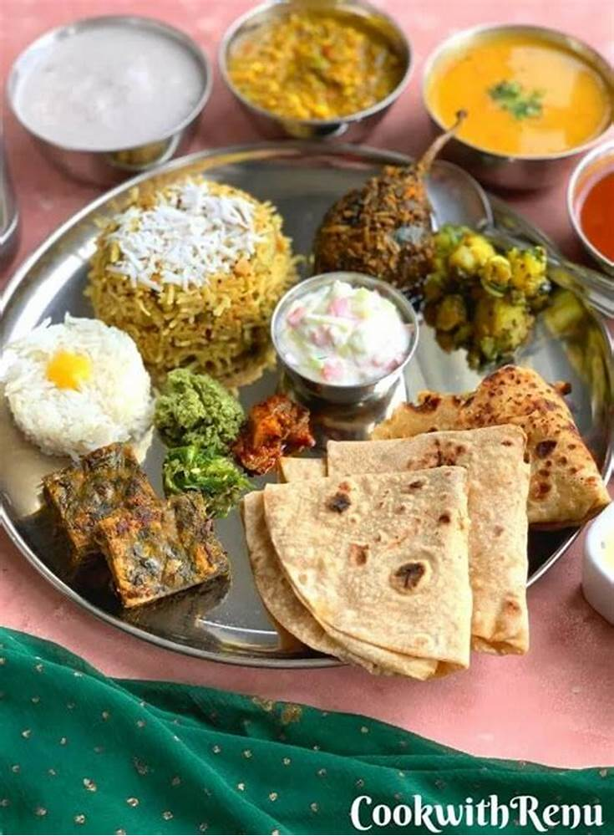
Objective
Results
Notes:
Need to discuss about :
Clear goals of the project
What you aim to achieve with AI/ML/DL

Slide 13
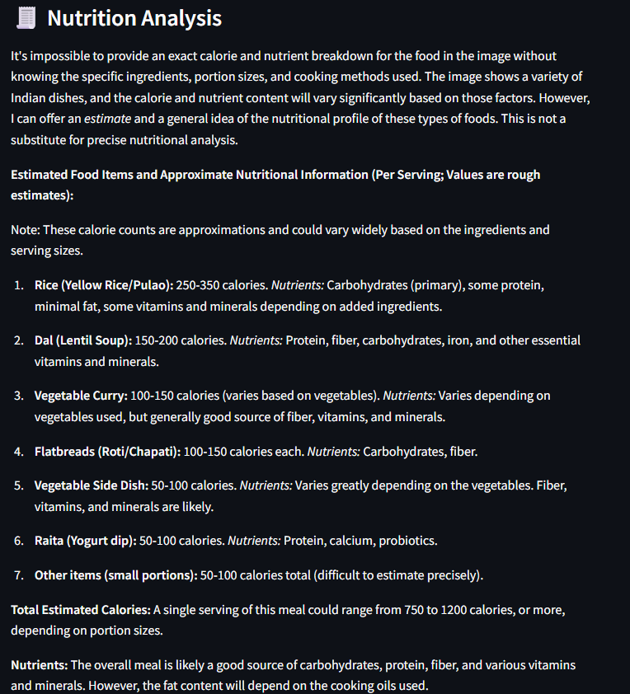
Objective
Results
Notes:
Need to discuss about :
Clear goals of the project
What you aim to achieve with AI/ML/DL

Slide 14
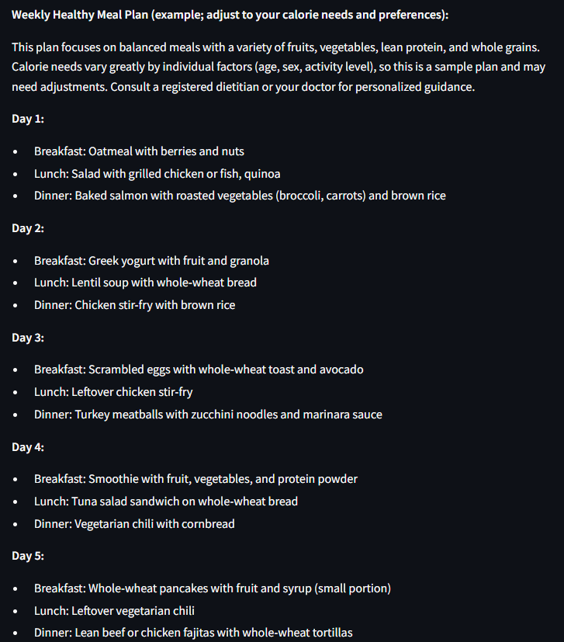
Objective
Results
Notes:
Need to discuss about :
Clear goals of the project
What you aim to achieve with AI/ML/DL

Slide 15
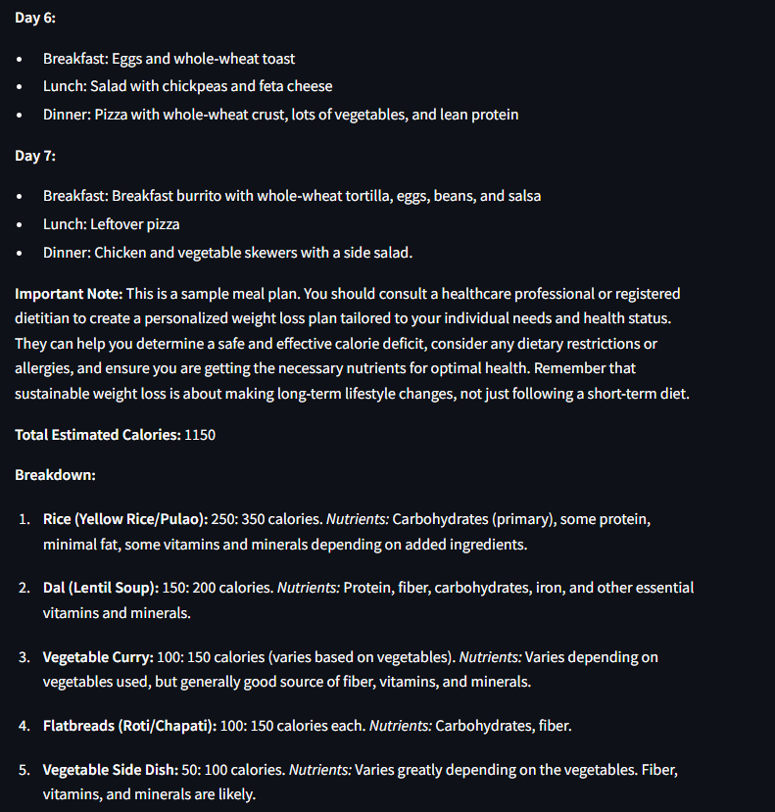
Objective
Results
Notes:
Need to discuss about :
Clear goals of the project
What you aim to achieve with AI/ML/DL

Slide 16
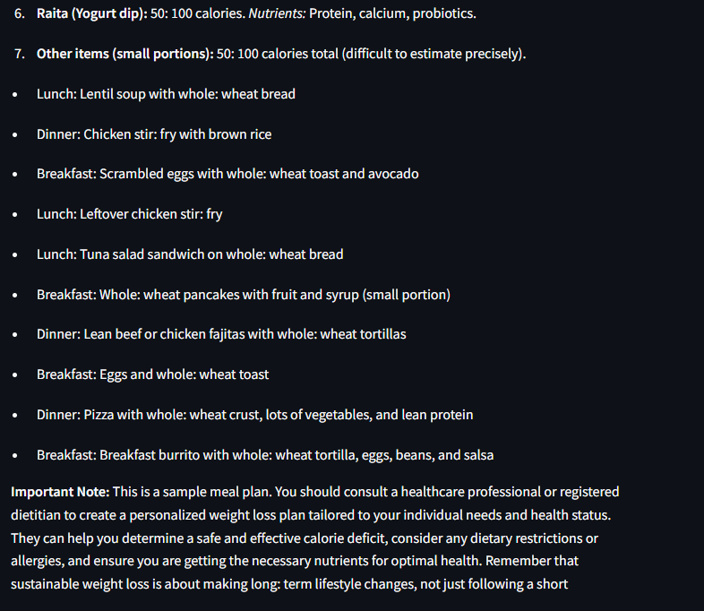
Objective
Results
Notes:
Need to discuss about :
Clear goals of the project
What you aim to achieve with AI/ML/DL

Slide 17
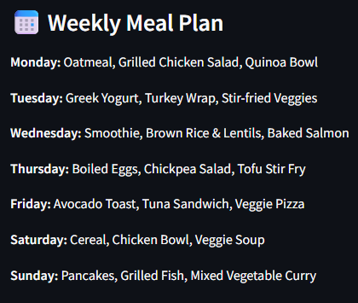
Objective
Results
Notes:
Need to discuss about :
Clear goals of the project
What you aim to achieve with AI/ML/DL

Slide 18
Objective
Conclusion
The Smart AI Nutrition Assistant integrates cutting-edge generative AI to offer a personalized nutrition management solution.
It uses Google Gemini to process:
Text inputs (e.g., health goals, preferences)
Image inputs (e.g., food photos, grocery labels)
Key functionalities include:
Identifying food items from images
Calculating calorie content and Providing nutritional breakdown
Generating weekly meal plans based on user goals and medical conditions
Notes:
Need to discuss about :
Clear goals of the project
What you aim to achieve with AI/ML/DL

Slide 19
Objective
Conclusion
The system uses a modular, agent-based architecture for scalability and maintainability.
Includes specialized agents like: meal_planner , calorie_calculator , feedback_agent
The Streamlit-based user interface ensures a simple, interactive experience for all users.
The assistant supports adaptive learning, allowing it to refine its recommendations continuously based on user feedback.
Overall, it serves as a dynamic and intelligent health companion, combining AI-powered analysis with real-time personalization.
Notes:
Need to discuss about :
Clear goals of the project
What you aim to achieve with AI/ML/DL

Slide 20
Objective
Future work
Integration with Wearables & Fitness Trackers:
Sync with devices like Fitbit, Apple Health, or Google Fit for real-time activity and calorie tracking.
Voice Input and Conversational AI:
Allow users to interact via voice using a chatbot interface with real-time feedback and Q&A.
Real-time Food Recognition:
Improve image processing by incorporating deep learning-based object detection (e.g., using YOLO or MobileNet) for more accurate food identification.
Dietary Restriction Filters:
Add advanced filters (e.g., vegan, keto, gluten-free, allergies) to personalize meal plans more precisely.
Notes:
Need to discuss about :
Clear goals of the project
What you aim to achieve with AI/ML/DL

Slide 21
Objective
Future work
5.Database and Cloud Integration:
Store user preferences and history securely using Firebase or Supabase for a seamless experience across devices.
6.Multilingual Support:
Expand the assistant’s accessibility by supporting multiple languages.
7.Gamification and Habit Tracking:
Incorporate progress tracking, rewards, and goal setting to enhance long-term engagement.
Notes:
Need to discuss about :
Clear goals of the project
What you aim to achieve with AI/ML/DL

Slide 22
Thank You

