Slide 1
PROJECT TITLE
CAPSTONE PROJECT
Presented By:
1. Student Name-College Name-Department

Slide 2
OUTLINE
Problem Statement (Should not include solution)
System Development Approach (Technology Used)
Algorithm & Deployment (Step by Step Procedure)
Result
Conclusion
Future Scope(Optonal)
References

Slide 3
Problem Statement
Mention what your project is all about min 5 line

Slide 4
System Approach
The "System Approach" section outlines the overall strategy and methodology for developing and implementing. Here's a suggested structure for this section:
System requirements
Library required to build the model

Slide 5
Algorithm & Deployment
Describe step by step procedure to complete your project

Slide 6
Result
Attach screen snaps of the code and output min 5
Attach your Github link
https://github.com/

Slide 7
Conclusion
Summarize the findings and discuss the effectiveness of the proposed solution. Highlight any challenges encountered during the implementation and potential improvements.

Slide 8
Future scope(Optional)
Discuss potential enhancements and expansions for the system.

Slide 9
References
List and cite relevant sources, research papers, and articles that were instrumental in developing the proposed solution.

Slide 10
THANK YOU

Slide 11
Employee Salary Prediction
Hiren Chauhan
Hinesh13@gmail.com
[AICTE B2_AI - (2025-26)]
IGNOU

Slide 12
Project Overview
This project aims to predict whether an employee's income is more than $50K a year based on census data. We'll walk you through the process of building a machine learning model, from data cleaning to deployment.

Slide 13
The Data: Adult Census Dataset
We're using the 'Adult' dataset from the UCI Machine Learning Repository. It contains 15 features, including:
- Age
- Workclass
- Education
- Marital Status
- Occupation
-...and more!

Slide 14
The Challenge: Messy Data
Real-world data is rarely perfect. Our dataset had missing values, represented by '?'. We'll show you how we handled these to ensure our model is accurate.

Slide 15
Data Cleaning: Replacing '?'
We replaced the '?' values with a more descriptive placeholder: 'Other-[column_name]'. This helps the model understand that these are unique cases.

Slide 16
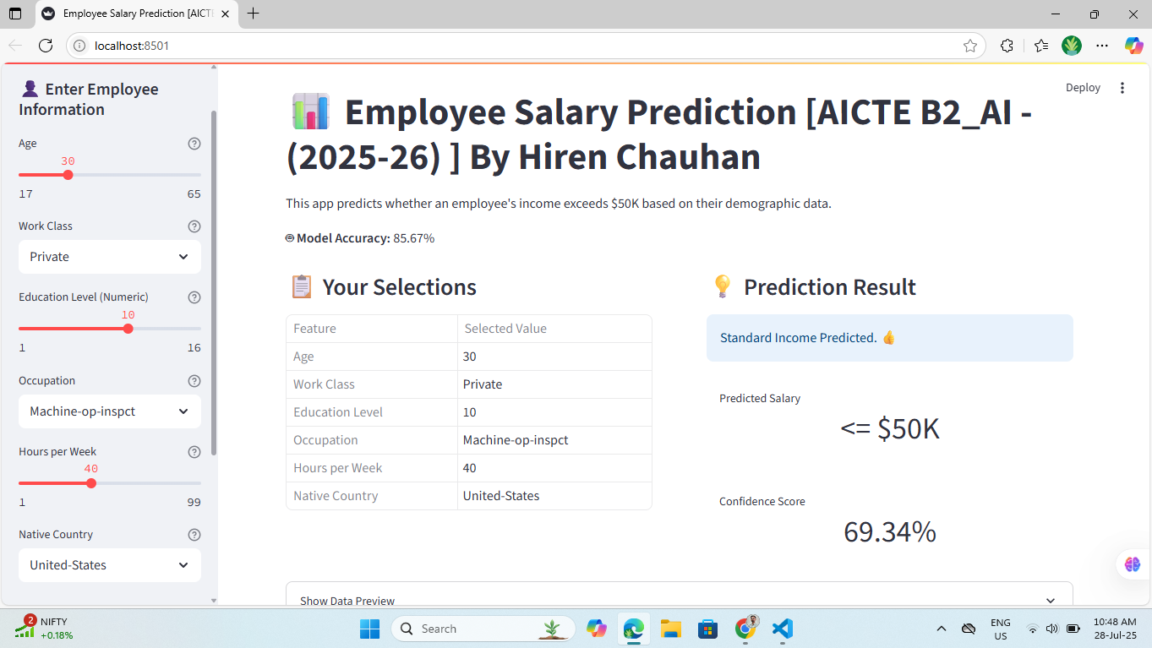
Our Machine Learning Workflow

Slide 17
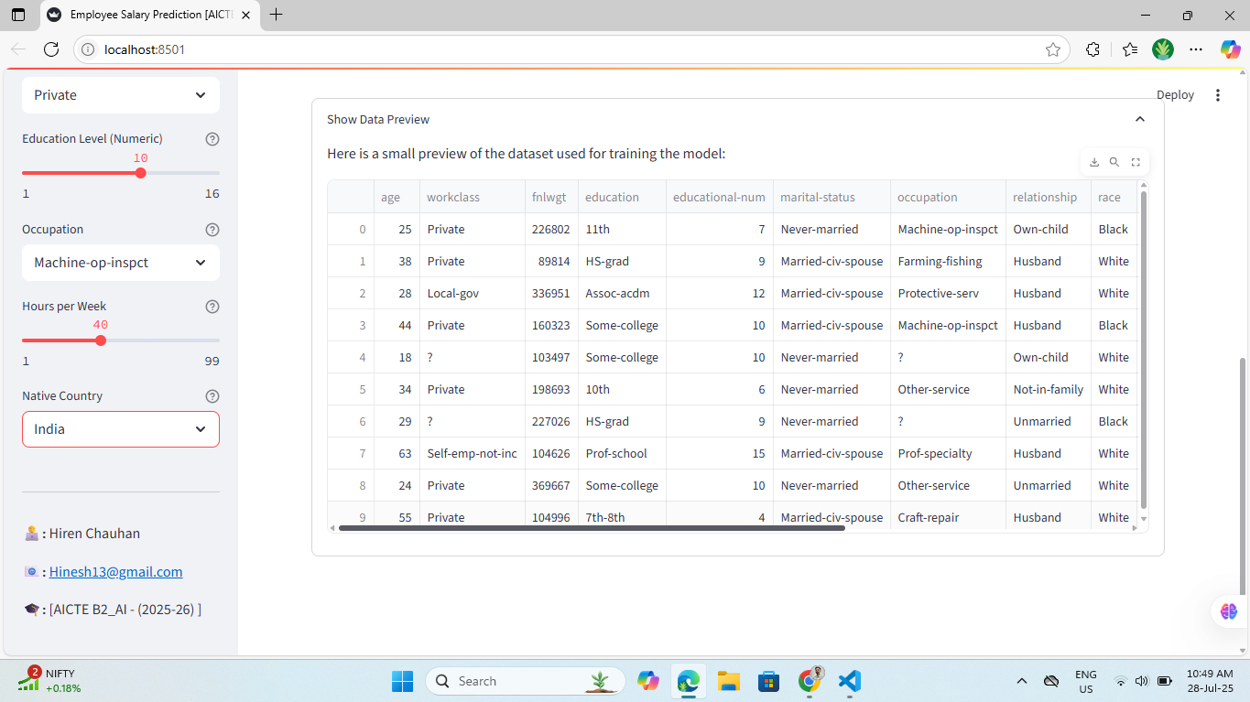
The Algorithm: Random Forest
We chose the Random Forest algorithm for this task. It's a powerful and versatile algorithm that's great for classification problems. It works by building multiple decision trees and merging them together to get a more accurate and stable prediction.

Slide 18
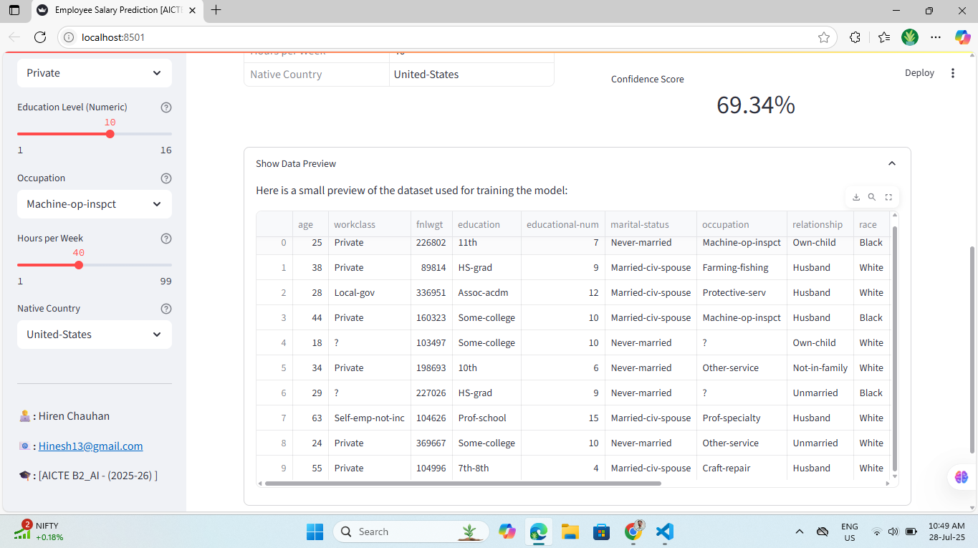
The App: A User-Friendly Interface

Slide 19
How it Works: Behind the Scenes
When you enter an employee's details, the app sends them to our trained model. The model then predicts the income level and sends the result back to the app.

Slide 20
The Results: High Accuracy
Our model achieves an accuracy of over 85%, which is a great result for this type of problem. This means that our predictions are highly reliable.

Slide 21
Future Improvements
We're always looking for ways to improve. In the future, we could:
- Try different algorithms to see if we can get even higher accuracy.
- Add more features to the model.
- Deploy the app to the cloud so that anyone can use it.

Slide 22
Thank You!
Any questions?

