Slide 1
कलाकृति
Curating Culture, Crafting Stories

Slide 2
Executive Summary
Business Name and Concept: A marketplace for handcrafted regional artifacts, connecting artisans with buyers seeking unique home decor and collectibles.
Mission Statement: Empowering artisans by providing a global platform to showcase and sell their creations.
Vision Statement: To be the leading marketplace for authentic handcrafted artifacts, empowering artisans
while offering customers exclusive, high-quality decor pieces.
Service Offering: Verified regional artifacts, exclusive bidding, personalized gifts, and a premium subscription model.
Target Market: Home decor enthusiasts, collectors, gift shoppers, and interior designers.
Competitive Advantage: Authentic handcrafted artifacts, AI-driven shopping, and influencer collaborations.
Financial Overview: Revenue from sales commissions, subscriptions, bidding fees, and seller promotions.

Slide 3
Problem Statement
Purpose: Lack of a dedicated platform for authentic handcrafted artifacts, limiting artisans’ reach and buyers’ access to unique pieces. | Market Gaps/Customer Pain Points: Difficult to find verified, high-quality handcrafted artifacts. Artisans struggle with digital presence and fair pricing. Lack of personalization and exclusive shopping experiences.
Current Solutions: Generic e-commerce platforms with limited artisan representation. Local markets with restricted reach and inconsistent quality. | Why is Solving This Important? Provides artisans with fair trade opportunities and global exposure. Gives customers access to unique, verified, and personalized handcrafted decor.

Slide 4
Business Idea and Solution
Our Solution:
A curated online marketplace connecting artisans with buyers, ensuring authenticity, fair pricing, and a premium shopping experience.
Product/Service Description:
  Verified handcrafted regional artifacts.
  Bidding feature for exclusive collectibles.
  Personalized gift packaging and customization.
  Subscription model for early access and discounts.
Unique Selling Proposition:
  Exclusive, authenticated artifacts directly from artisans.
  AI-powered personalized shopping recommendations.
  Strong influencer and interior designer collaborations.

Slide 5
Business Idea and Solution
Feature And Benefits:
  Bidding System → Access to rare, limited-edition artifacts.
  Subscription Model → Early access, discounts, and free shipping.
  Personalized Packaging → Enhances gifting experience.
  AI Recommendations → Simplifies shopping with curated suggestions.
Innovative Aspects:
  Tech-enabled artisan verification and fair trade pricing.
  Gamified bidding experience for rare collectibles.
  AI-driven shopping personalization and engagement.

Slide 6
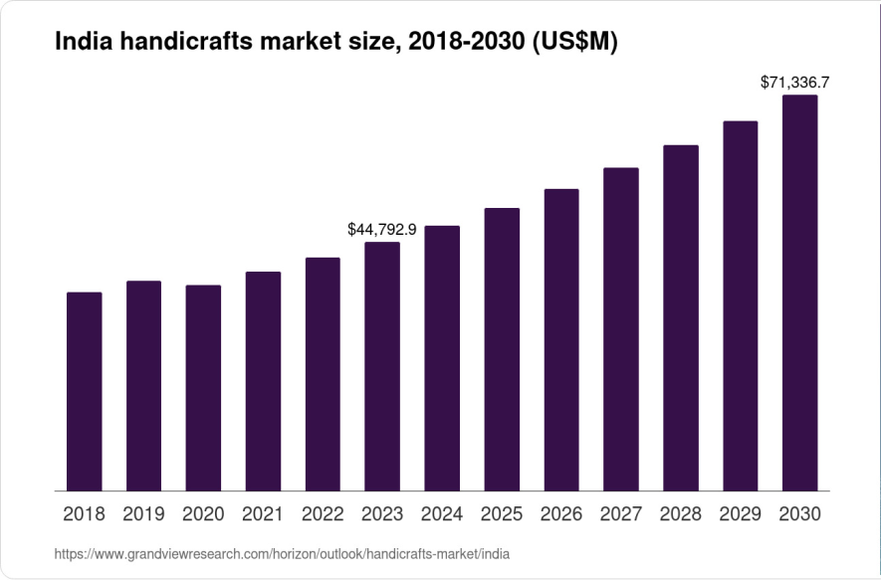
Market Research and Analysis
We operate in the artisan and handcrafted goods market, which is a niche within the broader e- commerce and home decor industries.
Market Size and Growth:
Competitive Landscape:
Direct Competitors
Indirect Competitors
Positioning through Differentiation:
We focus on exclusive, authenticated, and
personalized artifacts.
Our bidding feature and gift packaging services provide added value.
Partnerships with interior designers and influencers amplify our reach and strengthen our brand image.

Slide 7
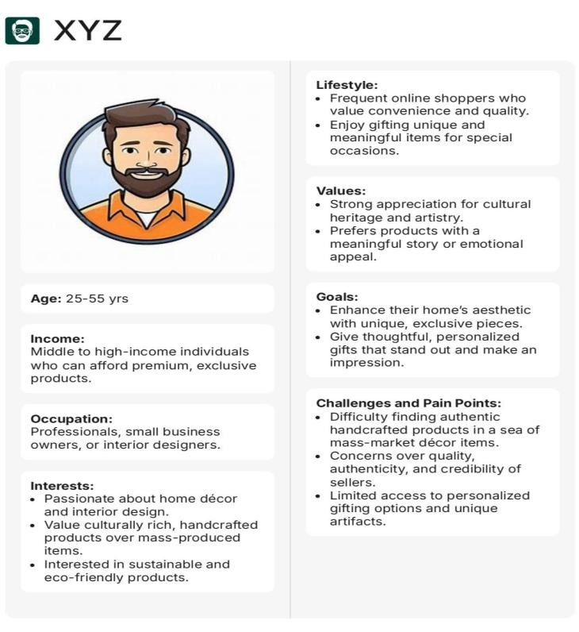
Market Research and Analysis
Customer’s Need:
Authenticity and Quality, Convenience, Sustainability, Trust, Uniqueness.
Target Customer:
Collaborator’s Current Needs:
Artisans (Sellers): Visibility, Fair Pricing, Logistics Support
Delivery and Logistics Providers: Volume Consistency, Cost Efficiency, Service Reliability
Influencers and Interior Designers: Commission- Based Partnerships, Exclusive Access, Collaborative Branding Opportunities
Current Competitors:
Fabindia, Asha Handicraft Association, Craft Maestros, Dastkar, etc

Slide 8
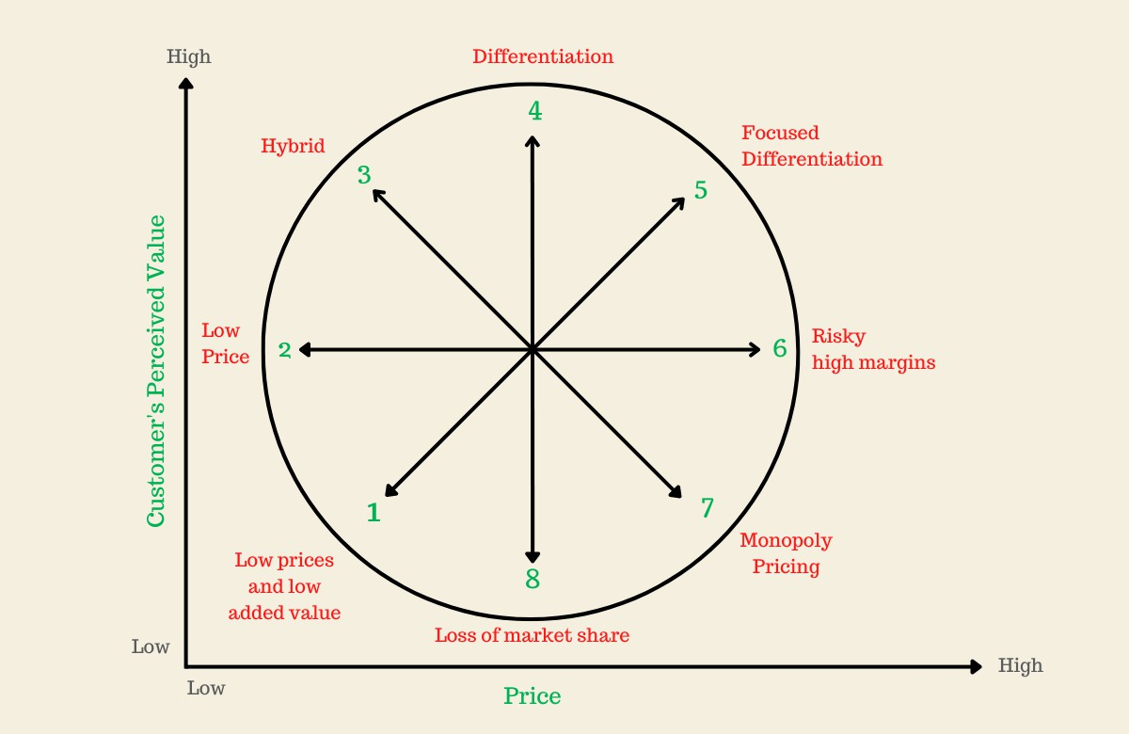




Market Research and Analysis

Slide 9
Business Model
Position: Focused differentiation, premium pricing for unique artifacts Targets niche market of home decor enthusiasts and collectors seeking exclusivity. Leverages perceived value theory to justify premium pricing in a specialized segment. | Revenue Streams: Commissions, subscriptions, bidding fees, promotions Diversified income ensures financial stability and supports platform growth. Aligns with multi-sided platform economics, capturing value from multiple user groups.
Pricing Strategy: Commission-based, tiered subs, dynamic bidding Balances profitability with artisan fairness and customer value. Draws on price discrimination theory to optimize revenue across customer segments. | Sales Channels: Online marketplace, collaborations, art fairs Combines digital convenience with targeted offline outreach for maximum reach. Utilizes channel synergy theory to enhance accessibility and customer touchpoints

Slide 10
Business Model
Watering Holes: Social media, art fairs, online decor communities Engages customers where they naturally gather online and offline. Applies community engagement theory to build trust and brand loyalty. | Partnerships: Artisans, logistics, designers/influencers, payment gateways Strengthens operations, trust, and market reach through key collaborations. Grounded in resource dependency theory, securing critical external capabilities.
Suppliers: Vetted regional artisans for quality Ensures authenticity and quality through a rigorous vetting process. Reflects supply chain curation theory to maintain competitive differentiation. | Customer Acquisition: Digital marketing, influencer ties, loyalty programs Multi-channel approach for broad reach, high engagement, and retention. Based on customer lifetime value theory to maximize long-term profitability.

Slide 11
Marketing and Sales Strategy
Brand: Position KalaKriti as a premium brand celebrating cultural artistry and authenticity. Emphasize trust—81% of consumers prioritize authentic brands. | Sales Tactics: E-Commerce & Direct Selling: Leverage a robust website (global conversion ~2.86%) and art/craft fairs, with personalized outreach reaching up to 20% conversion. Subscriptions: Offer exclusive memberships to boost recurring revenue by 3–10%.
Marketing Channels: Social Media: Utilize Instagram (1.5B monthly users), Facebook (2.91B monthly users), and Pinterest for visual storytelling. Influencers: Generate about $6.50 for every $1 invested. Email: Achieve an average ROI of $42 per $1 spent. SEO: Benefit from a 14.6% conversion rate versus 1.7% for outbound tactics. | Customer Retention: Enhance retention—a 5% increase can boost profits by 25–95% . Use loyalty programs to potentially lift repeat purchases by 30% . Deliver exceptional service to improve retention rates by up to 40% .

Slide 12
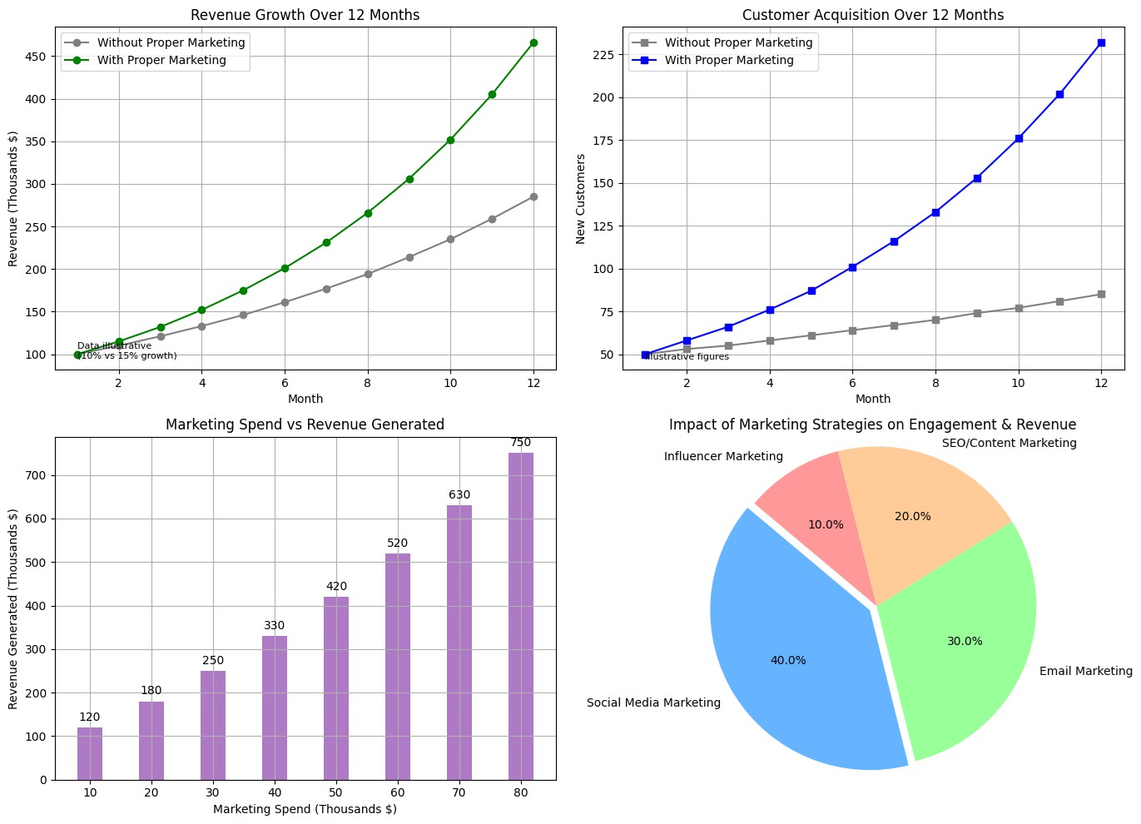
Marketing and Sales Strategy
Sources:
blog.hubspot.com – Provides data on marketing budget as a percentage of revenue and industry benchmarks.
Inbeat.agency – Offers statistics on customer acquisition and
conversion rates.
180ops.com – Provides insights on ROI from digital and email marketing.
blog.revpartners.io – Offers data on influencer marketing effectiveness.
Additional research from Statista and industry reports on social media reach and digital marketing benchmarks.

Slide 13
Operation Plan
Product Development:
  Build a user-friendly platform (website + app) for artists and buyers.
  Features: Artist profiles, physical art listings, secure payments, and messaging.
  Agile development with iterative testing and updates.
Logistic and Supply Chain:
  Artists manage listings, packaging, and shipping; platform provides guidelines.
  Partner with third-party logistics for reliable, affordable shipping.
  Implement order tracking for buyers.
Physical Assets
  Office space (or remote setup) for core team operations.
  Servers/cloud hosting for platform infrastructure.
  Basic office equipment (computers, software).

Slide 14
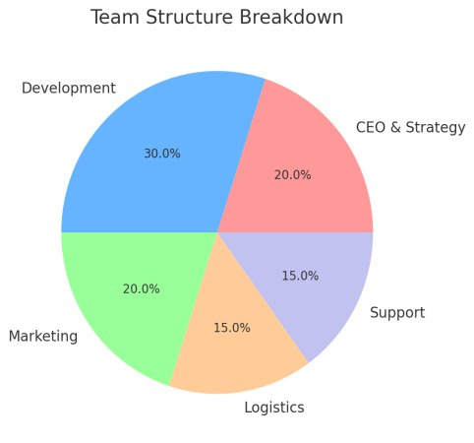
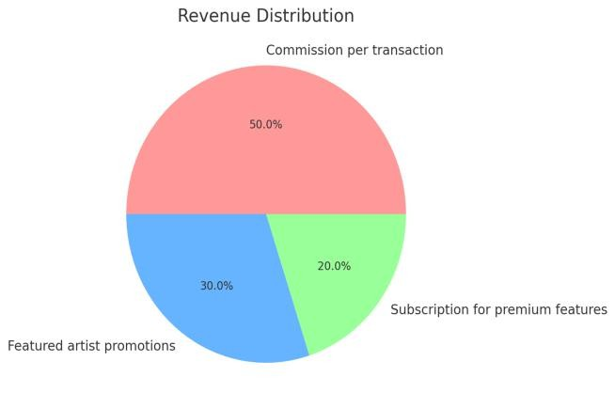
Operation Plan
Teams and Roles:
  CEO/Founder: Strategy and vision.
  CTO: Platform development.
  Marketing Manager: Customer acquisition.
  Operations Manager: Logistics and partnerships.
  Support Team: Query resolution.
Milestones and Timeline:
  Month fi-3: Platform design and MVP
development.
  Month 4: Beta launch with select artists/buyers.
  Month 5-6: Full launch + marketing campaign.
  Month 7-9: Onboard 500+ artists, acquire 1,000+ buyers.
  Month fi2: Breakeven with 5,000+ transactions.

Slide 15
Key Business, Financial & Market Risks
Business Risks
Artisan reliability & product authenticity → Risk of inconsistent quality and counterfeit products.
Supply chain & logistics delays → Late deliveries can lead to customer dissatisfaction.
Legal & compliance challenges → Changing government regulations may impact operations.
Financial Risks
High initial investment & slow revenue growth → Requires significant capital before profitability.
Unpredictable cash flow & payment delays → Artisans may expect upfront payments, while customers prefer post-delivery payments.
High customer acquisition cost vs. low retention → Expensive marketing may not convert into repeat customers.
Market Risks
Competition from e- commerce giants → Amazon & Flipkart may introduce similar handcrafted product categories.
Shifting consumer preferences → Mass-produced alternatives may appeal to price-sensitive buyers.
1
2
3
- Seasonal demand fluctuations → Sales may decline during off-seasons, impacting revenue.

Slide 16
Financial Plan
Component | Amount (INR)
Startup Costs (Total) | ₹100,000
Platform Development | ₹40,000
Marketing & Branding | ₹25,000
Legal, Licensing & Admin | ₹15,000
Operations & Contingency | ₹20,000

Slide 17
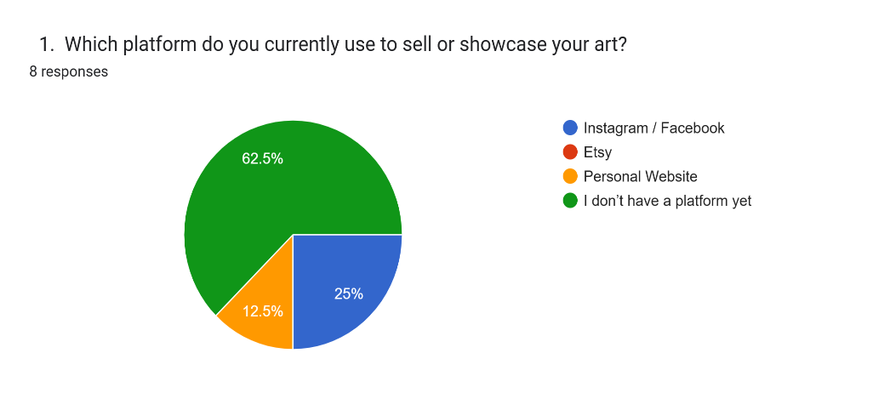
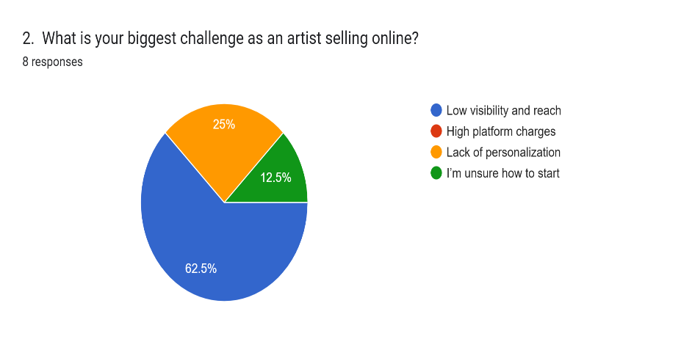
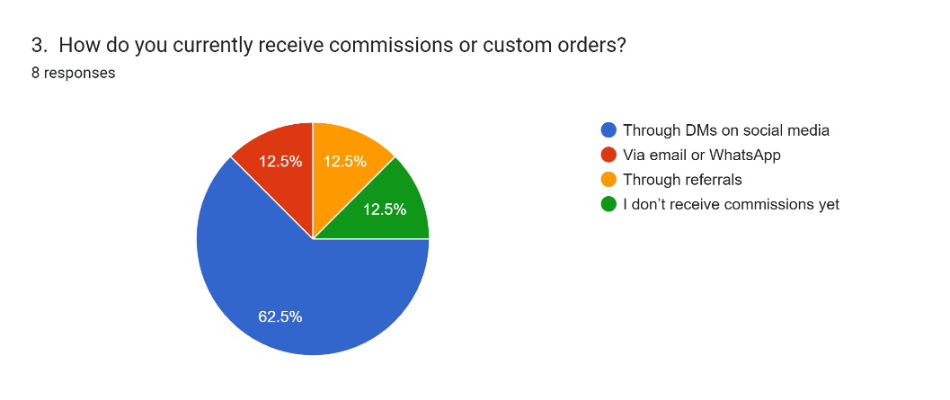
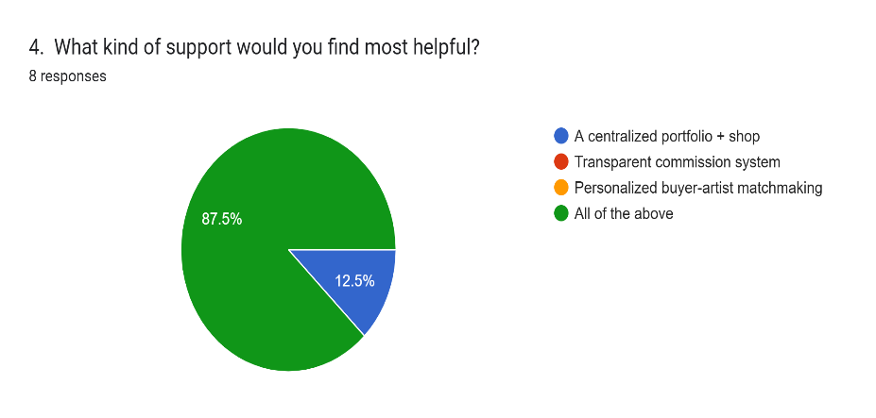
Survey tailored to gather insights

Slide 18
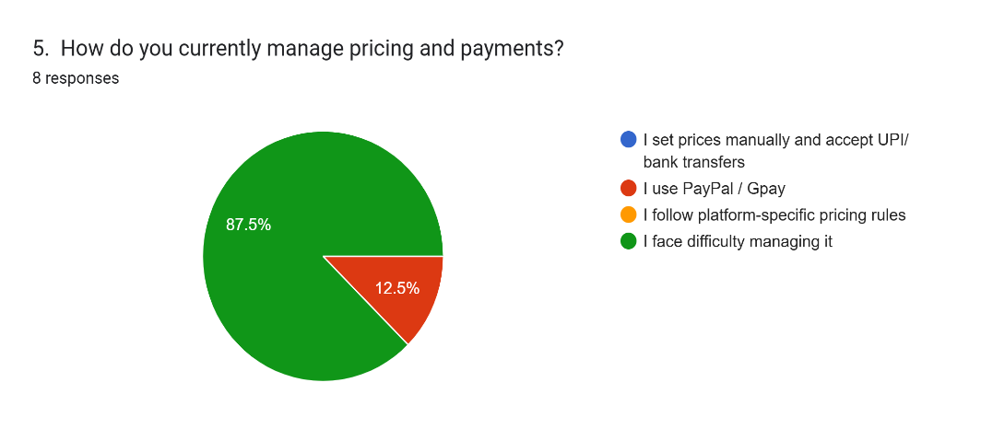
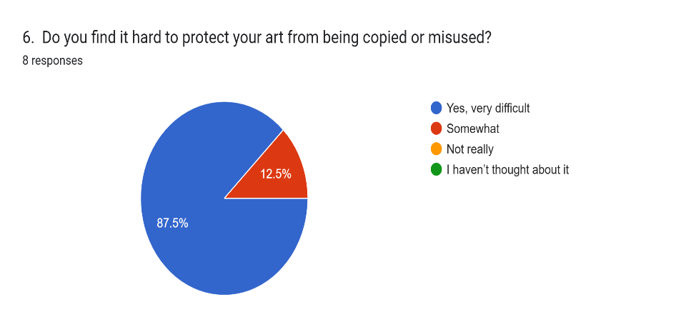
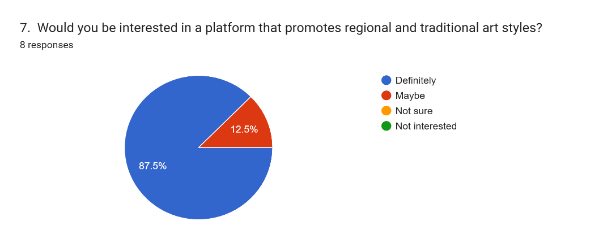

Survey tailored to gather insights

Slide 19
Conclusion
Unique Marketplace: Connects artisans with global buyers for authentic, handcrafted artifacts.
Empowering Artisans: Enhances digital presence and ensures fair pricing.
Innovative Features: Offers verified listings, exclusive bidding, and personalized gifting.
Target Audience: Caters to home décor enthusiasts, collectors, and interior designers.
Diverse Revenue Streams: Generates income via commissions, subscriptions, and bidding fees.
Strategic Roadmap: Combines robust marketing, agile operations, and risk mitigation for
scalable growth.

Slide 20
धन्यवाद

