Slide 1

Flipkart Sales Performance Analysis
Power BI Business Intelligence Dashboard Review
EXECUTIVE BRIEFING · 2024

Slide 2

EXECUTIVE SUMMARY
Business Health at a Glance
₹2.4Cr
₹42L
18K
Total Sales
Total Profit
Total Orders
Year-to-date revenue
Net profitability
Orders processed
12K
17.5%
Total Customers
Profit Margin
Active customer base
Net margin achieved
Executive Insight: Performance can be monitored through sales, profitability, customer growth, and operational efficiency — all unified in a single Power BI dashboard.

Slide 3
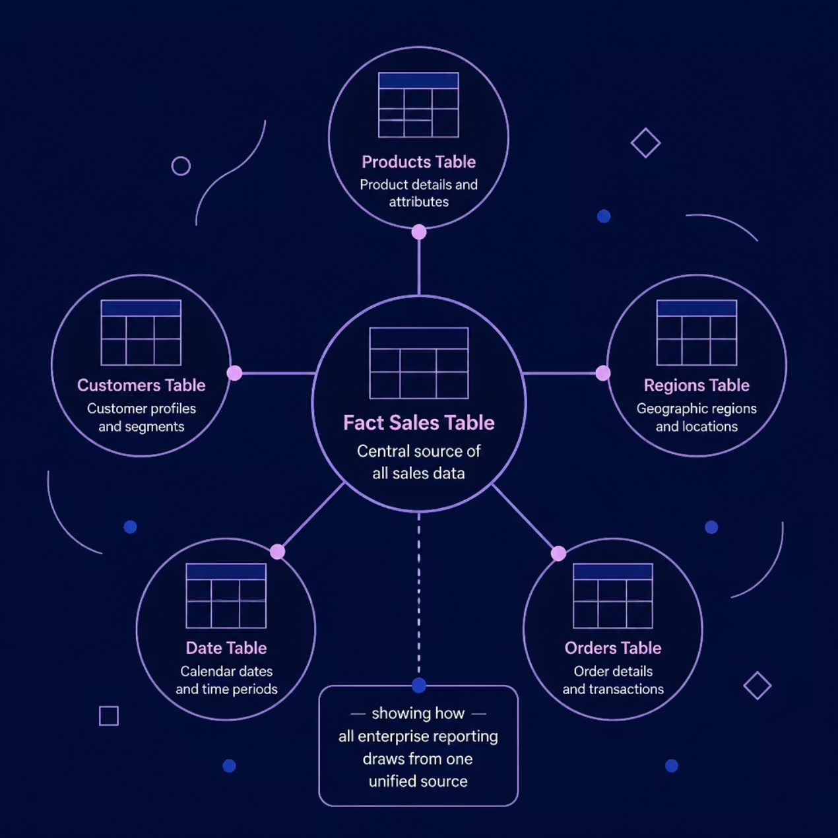
DATA ARCHITECTURE
Single Source of Truth: Dashboard Architecture
Enterprise Data Model
A star schema architecture ensures consistent, reliable reporting across all business units — eliminating data silos and enabling real-time decision-making.
Fact Table
Dimension Tables
Sales transactions
Products, Customers, Regions, Date

Slide 4
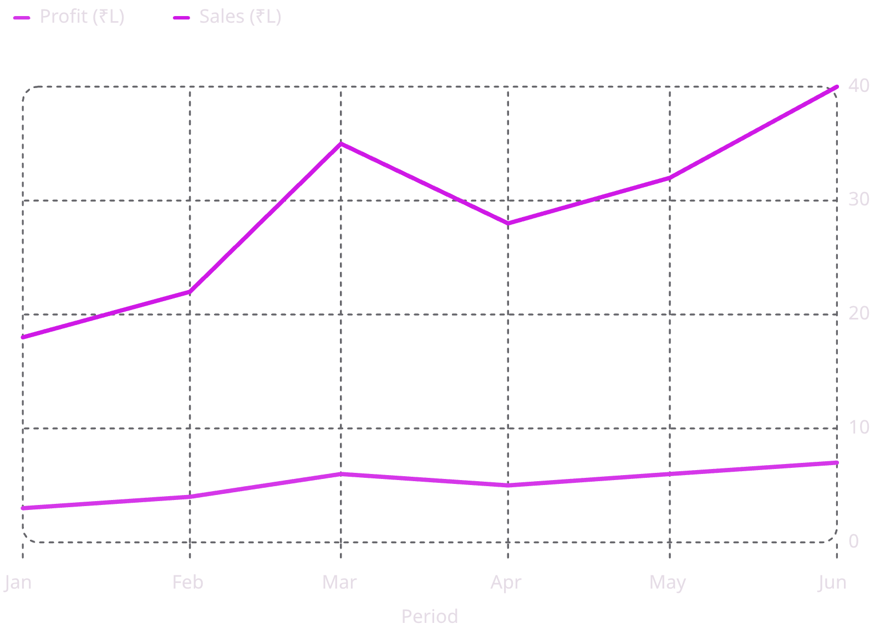

SALES PERFORMANCE
Revenue Trends: YTD, QTD & MTD
Time Intelligence Insights
YTD, QTD, and MTD views reveal revenue momentum and flag months requiring intervention.
Peak Period: March and June show the strongest revenue — align marketing spend accordingly.
YTD Sales
QTD Sales
MTD Sales
₹2.4 Cr total
₹72 L current
₹28 L running

Slide 5
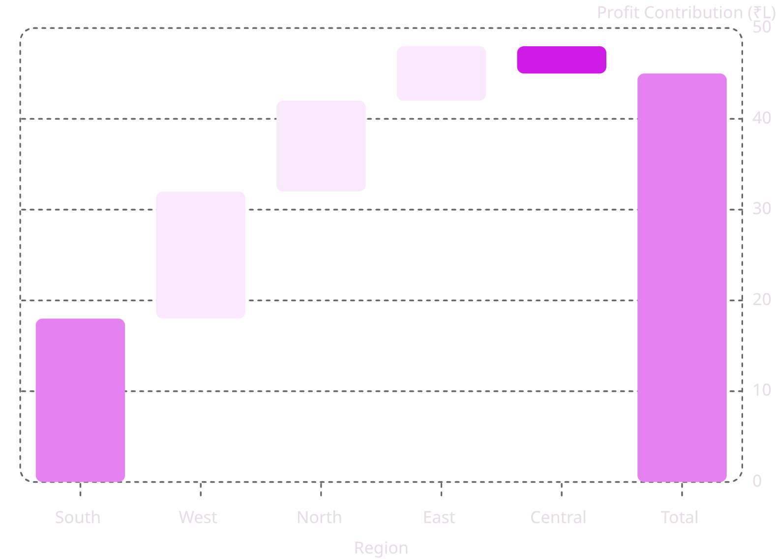

REGIONAL ANALYSIS
Regional Profitability: Where Value Is Created
Executive Regional Insight
The South and West regions drive the majority of profitability, while Central requires strategic intervention to reverse negative contribution.
🏆 South & West
⚠️ Central Region
📈 North & East
Highest profit contributors — protect and scale.
Negative contribution — review logistics and pricing.
Growth potential — targeted investment warranted.

Slide 6
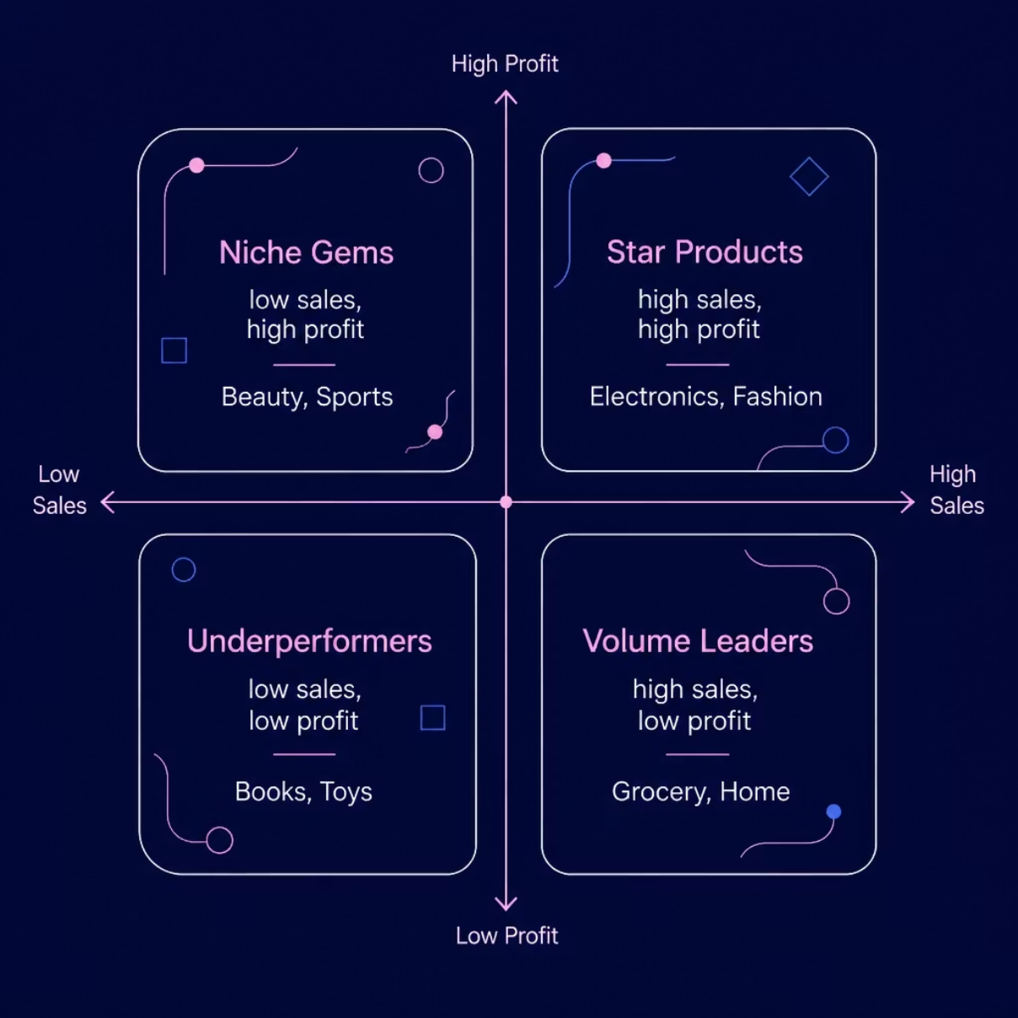

PRODUCT INTELLIGENCE
Product Portfolio: Revenue & Profit Drivers
Category Strategy Framework
Classifying products by sales and profit reveals where to invest, protect, and optimize.
⭐ Star Products
📦 Volume Leaders
💎 Niche Gems
🔍 Underperformers
Electronics & Fashion — defend margins.
Grocery & Home — optimize fulfillment costs.
Beauty & Sports — scale with targeted marketing.
Books & Toys — evaluate discontinuation or repositioning.

Slide 7
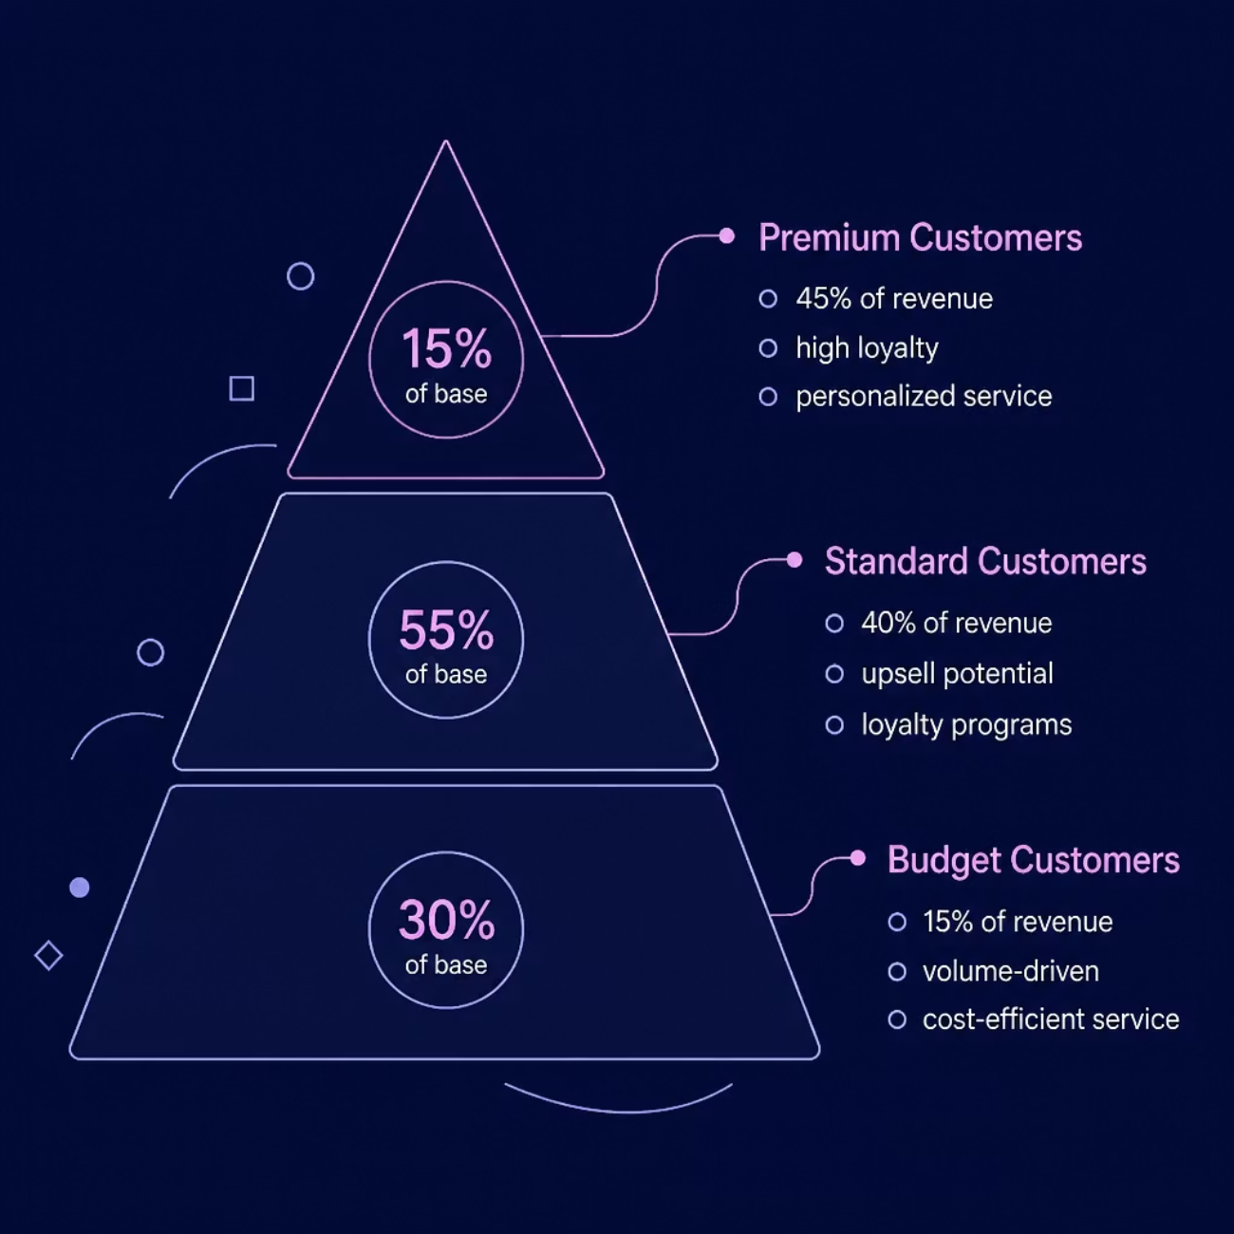

CUSTOMER INTELLIGENCE
Customer Segmentation & Retention Strategy
Three-Tier Customer Model
Segmenting customers by value enables differentiated retention strategies and maximizes lifetime revenue.
Retention Priority: Repeat customers represent 62% of orders — loyalty programs are a high-ROI investment.
Premium (15%)
Standard (55%)
Budget (30%)
45% of revenue — VIP treatment
40% of revenue — upsell focus
15% of revenue — efficiency play

Slide 8





STRATEGIC INSIGHTS
Key Business Insights: Executive Dashboard
🟢 Top Opportunity
🔴 Top Risk
🏆 Best Category
South & West regions show untapped growth — increase marketing investment.
Central region profitability is negative — immediate cost review required.
Electronics leads in both revenue and profit — protect supply chain.
📍 Best Region
💙 Retention Status
South region delivers highest profit margin — replicate success model.
62% repeat customer rate — strong, but premium segment needs dedicated programs.

Slide 9




STRATEGIC PRIORITIES
Three Strategic Priorities for 2024–25
Protect High-Margin Products
Invest in High-Growth Regions
Improve Customer Retention
Defend Electronics & Fashion margins through pricing discipline and supply chain optimization.
Scale South & West operations; deploy targeted campaigns in North & East.
Launch tiered loyalty programs for Premium and Standard segments to boost lifetime value.
Phase 1
Phase 3
Protect margins: pricing review & supply audit
Retention programs: loyalty launch & CLV tracking
Phase 2
Regional investment: South & West expansion
Phased execution ensures focused resource allocation with measurable milestones each quarter.

Slide 10
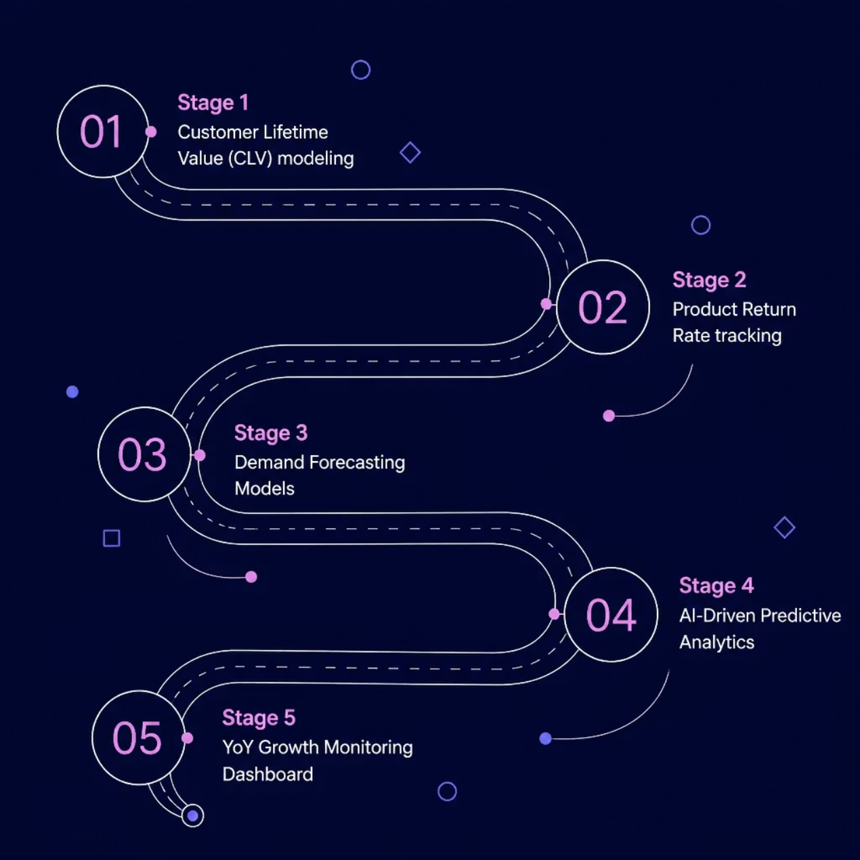
ROADMAP & CLOSING
Future Enhancements & Next Steps
Building Toward Predictive Intelligence
Each enhancement layer adds analytical depth — from descriptive reporting to AI-driven forecasting.
Thank You
Questions & Discussion
FLIPKART · POWER BI DASHBOARD REVIEW · 2024
01
02
03
CLV Modeling
Return Rate Tracking
Forecasting & AI
Quantify customer lifetime value
Monitor product returns by category
Predict demand and automate insights

