Slide 1

Personalized Allergic Environment Notifications and Smart Pharmacist Medication with digitized Prescription
By Saviours:
Jigar Dedhia (001837711)
Madhuja Gosavi (001860074)
Hiren Shah (001828539)

Slide 2
Problem Statement
Over 40% of the immediately treatable medical issues causes major consequences(treatment, money etc.) due to the lack of immediate relief remedies.
One of the main reasons for this is due to the unavailability of medicines without the prescription from the doctor.
Also, Allergies are the 6th leading cause of chronic illness in the U.S. They affect as many as 30 percent of adults and 40 percent of the children.
Lack of knowledge of the current exposable allergic conditions.

Slide 3
Proposed Solution
Make real-time interaction between patient and any doctor in the network possible.
Digitize the prescription and send it directly to the pharmacist.
Display the nearby pharmacists to the users
Sense the environmental conditions.
Alert the users regarding the allergies/epidemics
Aware the users about the on-going camps in the network.

Slide 4
Object Model

Slide 5
Use Cases
Users can signup to the application.
Users can view Alerts.
Users can raise issue requests and converse with Doctor.
Doctor can view the history of a issue request.
Doctors can prescribe medicines.
New Camps can be organized.
Users can rate doctors
Doctors can consult other doctors
Lab organization added
Email notification sent
Doctors can request Lab Tests to Lab Organizations

Slide 6
Demo - Screenshots

Slide 7
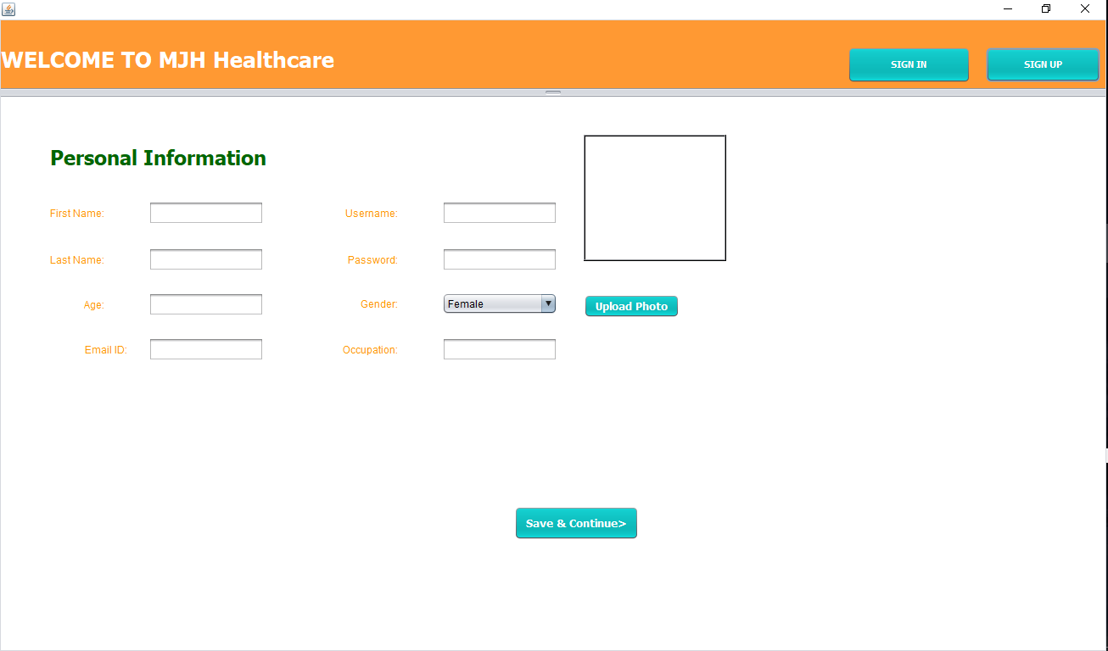

Slide 8
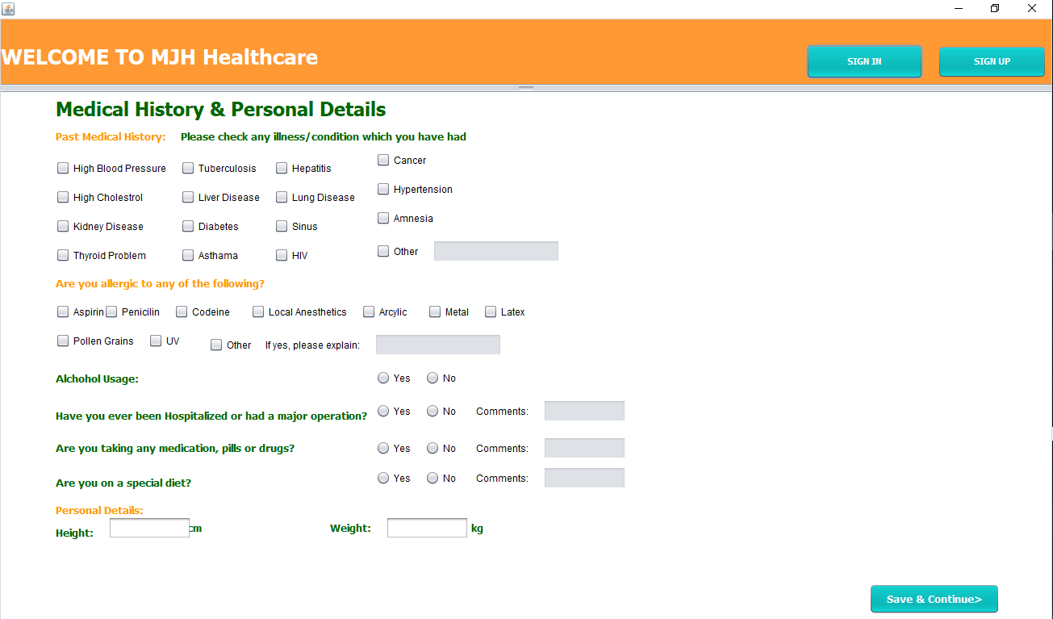

Slide 9
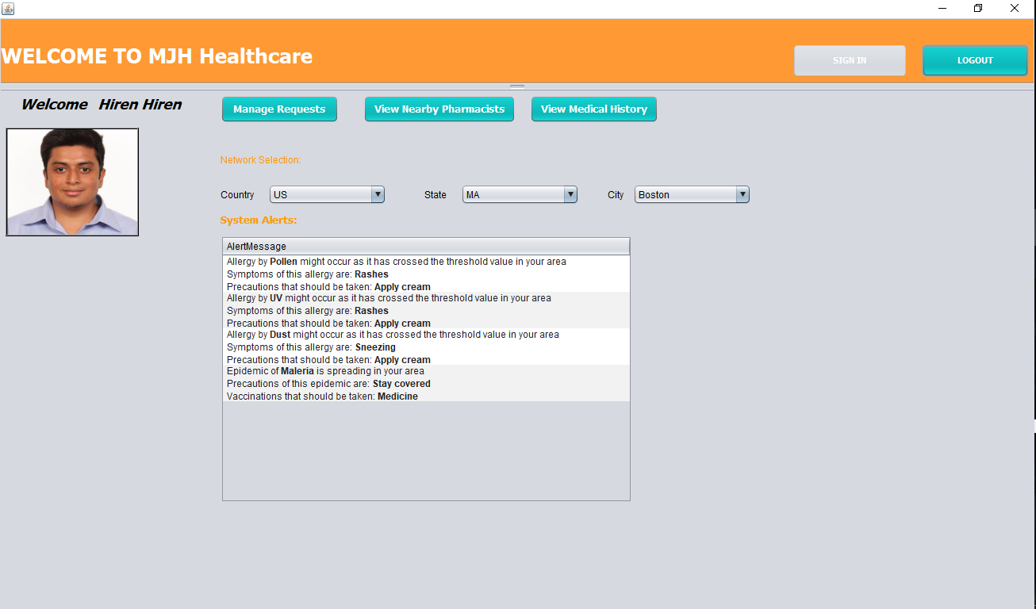

Slide 10
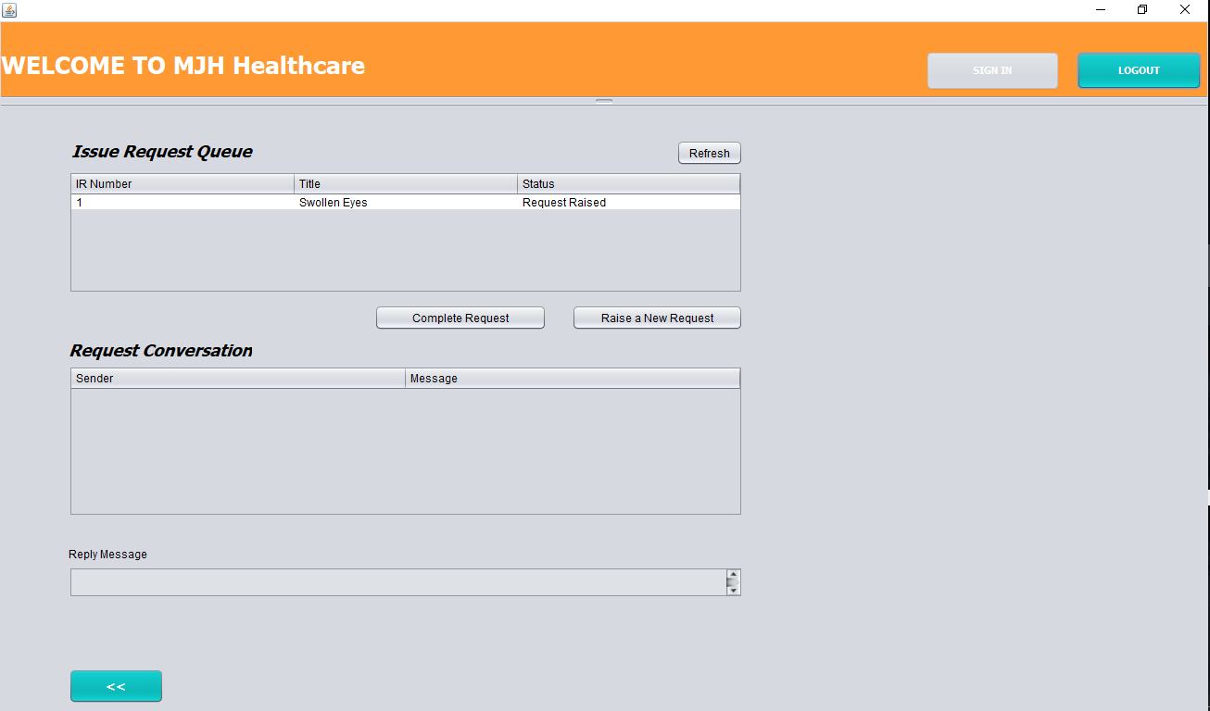

Slide 11
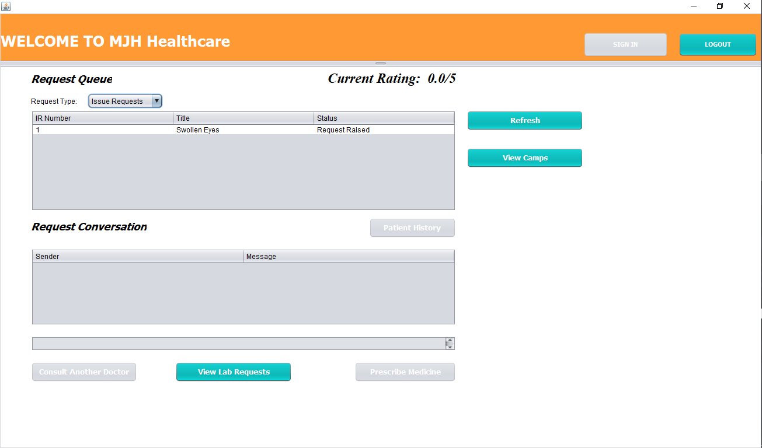

Slide 12
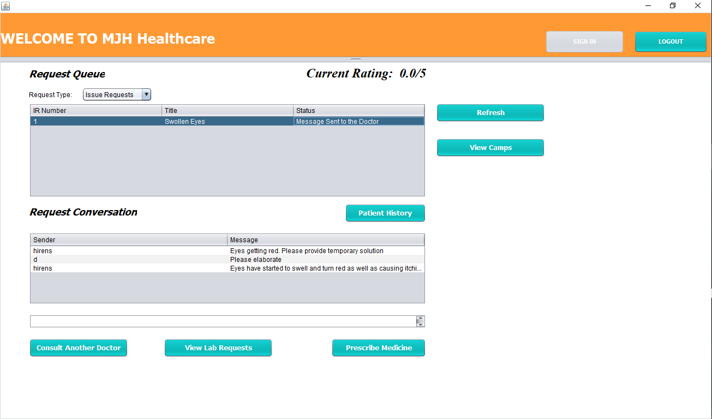

Slide 13
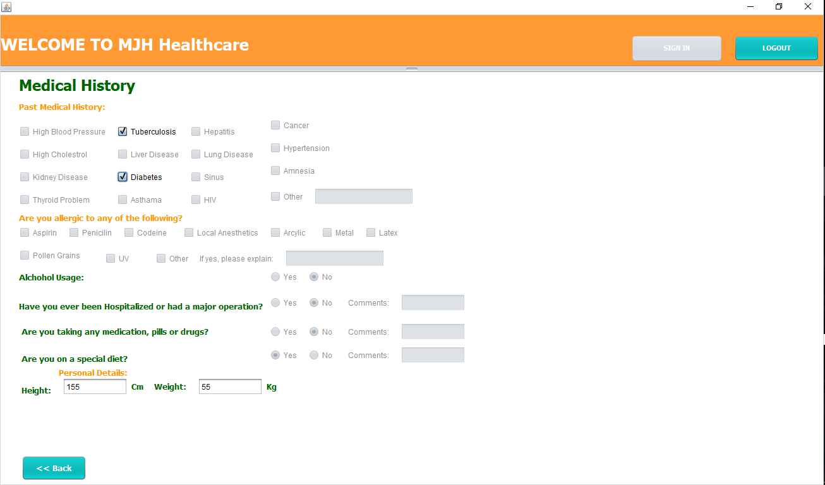

Slide 14
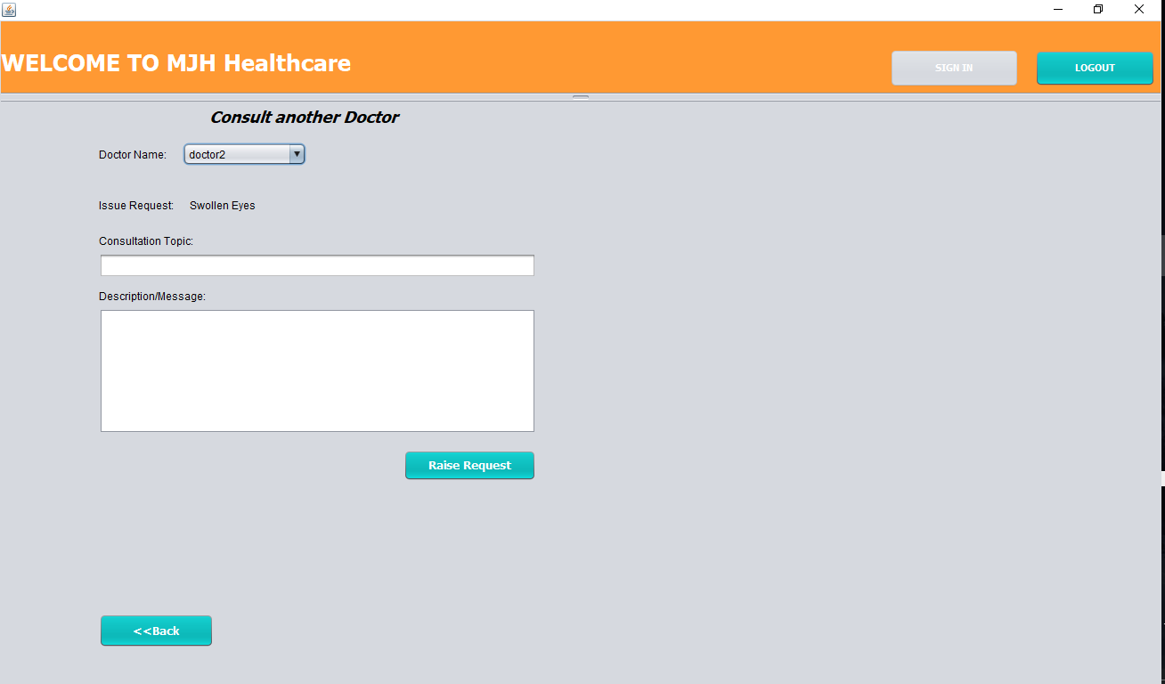

Slide 15
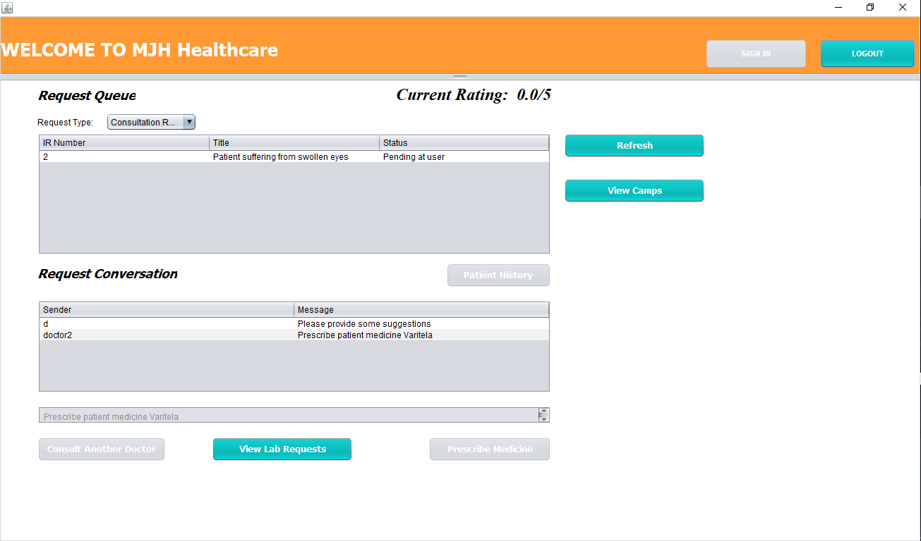

Slide 16
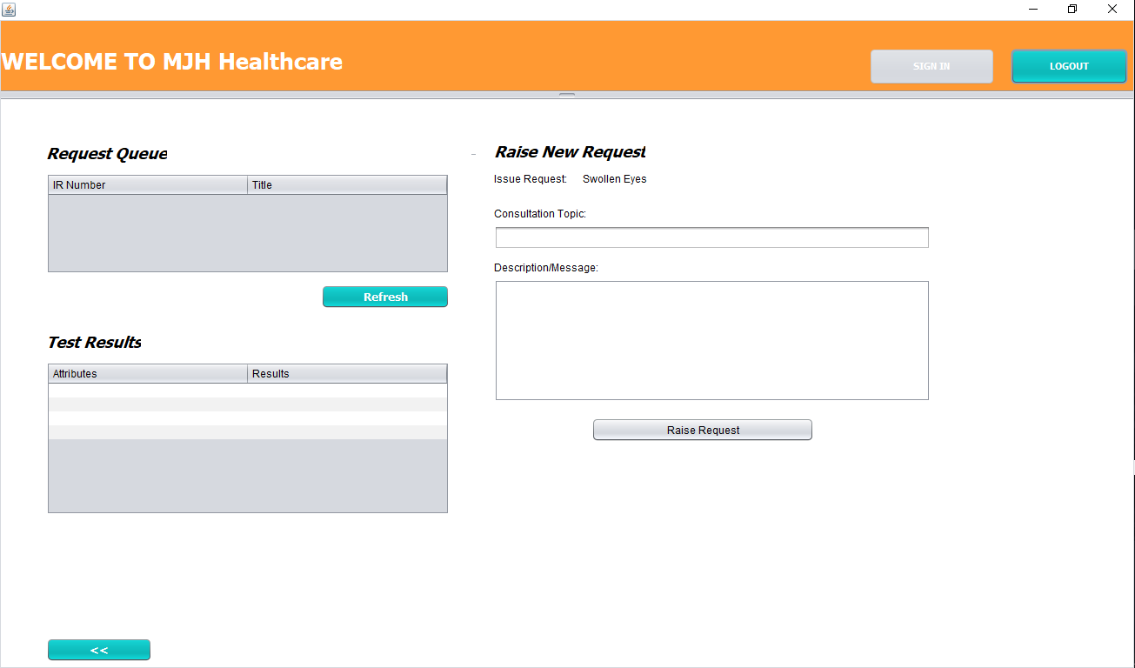

Slide 17
