Slide 1


MULTI-MODAL (V+A+T) EMOTION CAUSE PAIR EXTRACTION
Created By:
Achhada Hiren Rajkumar (2101CS03)
Ali Haider (2101CS07)
Vansh Singh (2101CS79)

Slide 2
TABLE OF CONTENT
Introduction
Task 1 - Dataset Collection
Task 2 - Annotation
Task 3 - Model
Results

Slide 3
OBJECTIVE
To extract emotion-cause pairs related to the “disgust” emotion from multi-modal data — video (V), audio (A), and text (T).
Disgust is a complex emotion with diverse causes (e.g., moral, physical, social), making it a good candidate for emotion-cause research.

Slide 4
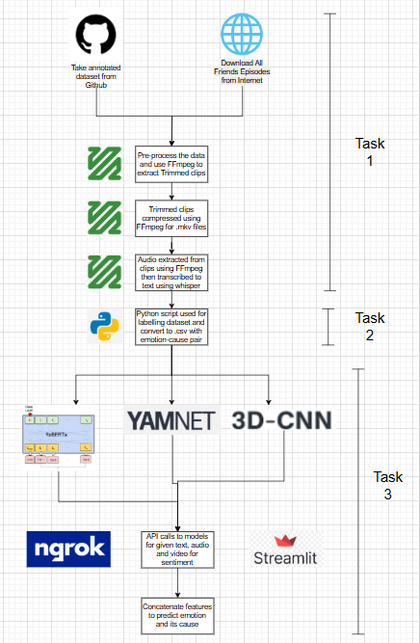
Full Architecture Pipeline

Slide 5

01
Downloaded clips of F.R.I.E.N.D.S from YouTube
02
Used annotated Dataset from Github for extracting Clips from different season episodes
TASK 1
(AUTOMATED COLLECTION)
03
Used FFmpeg for extracting those specific clip portions and then extracting the respective text, audio and video from there.

Slide 6
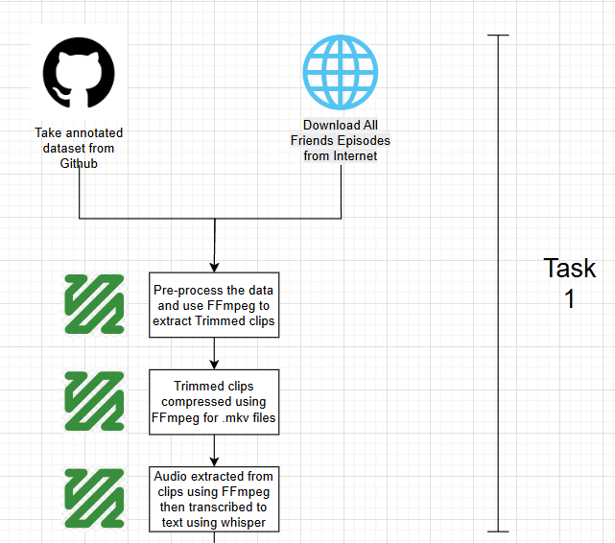

Slide 7
01
Pre-process the data and use FFmpeg to extract Trimmed clips
02
Trimmed clips compressed using FFmpeg for .mkv files. Audio extracted from clips using FFmpeg then transcribed to text using whisper
TASK 2
03
Python script used for labelling dataset and convert to .csv with emotion-cause pair

Slide 8
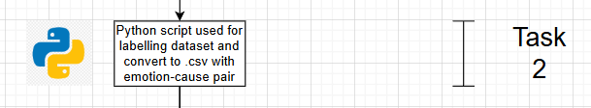

Slide 9
01
Use RoBERTa, YAMNet, 3DCNN for deriving textual, audio and video features.
02
Use ngrok and streamlit for API calling and frontend purposes respectively to extract features for given snippets.
TASK 3
03
Finally combine the features extracted using transformer to predict the final emotion and its cause

Slide 10
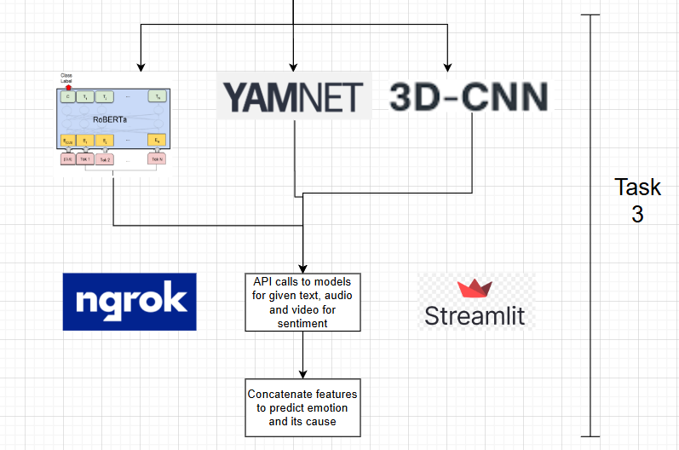

Slide 11

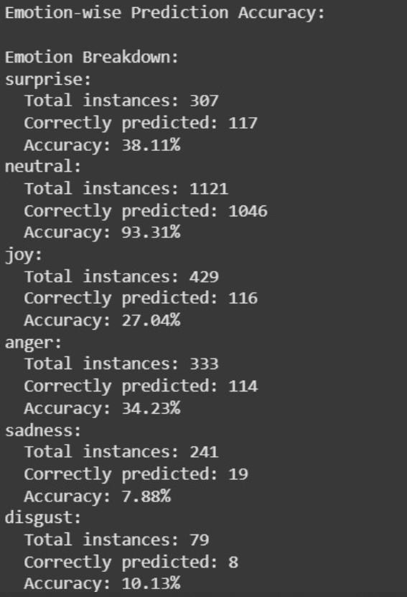
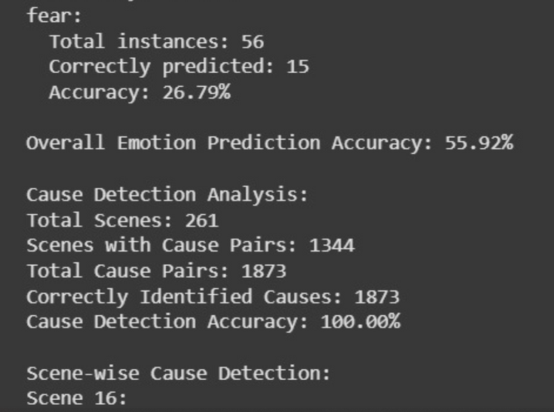
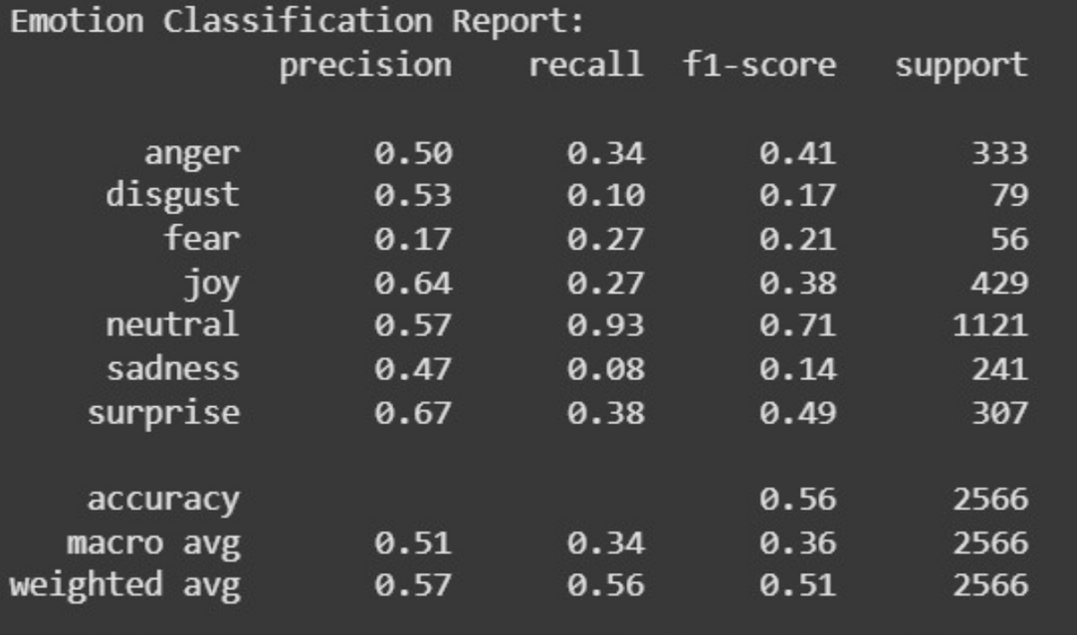
RESULTS

Slide 12
THANK YOU

