Slide 1
FORMAL LANGUAGE AND AUTOMATA REMOVAL OF EPLISON AND UNIT USELESS SYMBOLS
OMKAR SONAR(RA2112701010025)
N.HIRIDHARAN(RA2112701010010)

Slide 2
OBJECTIVE OF THE PROBLEM
Removal of Epsilon Productions:
Identify Epsilon Productions:
Look for productions of the form A → ε, where A is a non-terminal symbol.
Also, identify nullable non-terminals (non-terminals that can derive ε).
Remove Epsilon Productions:
For each production A → ε, remove it.
For each production B → αAβ, add new productions without A, considering all possible combinations of A being present or absent in the derivation of α and β.

Slide 3
OBJECTIVE OF THE PROBLEM CTND.
Removal of Useless Symbols:
Identify Non-Terminals and Terminals:
Non-terminals that derive at least one string are called reachable non-terminals.
Terminals are always considered reachable.
Find Reachable Non-Terminals:
Start with the start symbol and mark it as reachable.
Mark any non-terminal as reachable if it appears on the right-hand side of a production where all symbols are reachable.
Remove Unreachable Non-Terminals:
Remove any non-terminals and their productions that are not marked as reachable.
Find Useful Terminals:
Terminals that appear on the right-hand side of any production are useful.
Remove Useless Productions:
Remove any production that involves non-terminals or terminals that are not useful.

Slide 4
APPLICATIONS
Compiler Design
Code Optimization
Natural Language Processing (NLP)
Automated Code Generation
Error Detection and Reporting
Educational Purposes
Automated Testing

Slide 5

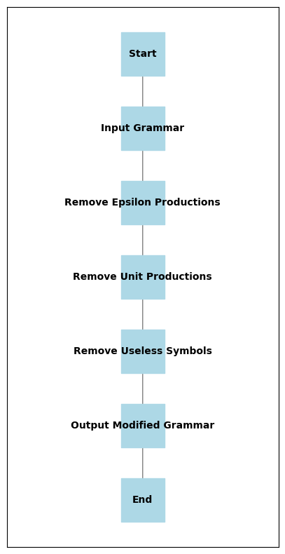
FLOWCHART:

Slide 6
CONCLUSION:
In conclusion, undertaking a project focused on the removal of epsilon unit productions and useless symbols in a context-free grammar serves as a valuable exploration into the optimization of language representations. By systematically eliminating these elements, the grammar becomes more concise and meaningful, facilitating efficient parsing, code generation, and error detection in various computational applications. This project not only provides practical insights into formal language theory but also underscores the importance of refining grammars for improved language processing and software development. Through this endeavor, one gains a deeper understanding of the intricate balance between grammar complexity and computational efficiency, contributing to foundational knowledge in fields such as compiler design, natural language processing, and automated code generation.

Slide 7
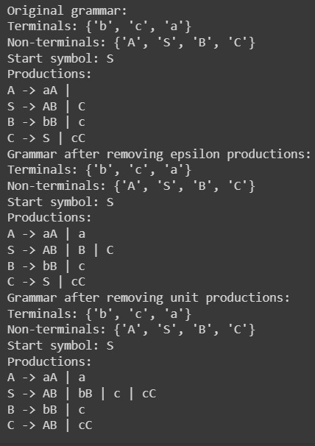
OUTPUT:

