Slide 1
Diabetes Prediction using Machine Learning
Shivani Kalewar
Shreya Nambiar
Hiril Raval
Robert Walsh

Slide 2
Proposed Workflow
Background Research Analysis
Data Exploration
Descriptive Analysis
Approach
Analysis
Business Questions
Comments & Questions

Slide 3
Background Research Analysis
Diabetes is among the most prevalent chronic diseases in the United States.
The CDC estimates that 1 in 5 diabetics, and roughly 8 in 10 prediabetics are unaware of their risk.
Diabetes also places a massive burden on the economy, with diagnosed diabetes costs of roughly $327 billion dollars and total costs with undiagnosed diabetes and prediabetes approaching $400 billion dollars annually.
In a diabetic person, the body not is unable to make enough insulin or unable to use it effectively.
The individual loses the ability to effectively regulate levels of glucose in the blood, and can lead to reduced quality of life and life expectancy.
While there is no cure for diabetes, strategies like losing weight, eating healthily, being active, and receiving medical treatments can mitigate the harms of this disease in many patients.
Early diagnosis can lead to lifestyle changes and more effective treatment, making predictive models for diabetes risk important tools for public and public health officials.

Slide 4
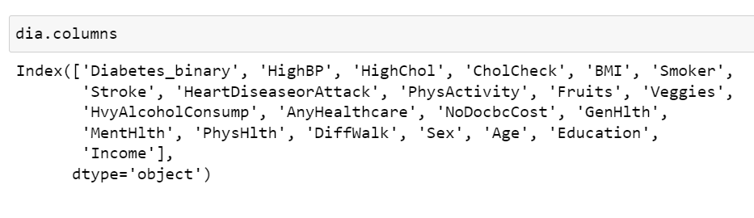
Data
Responses from the Behavior Risk Factor Surveillance System (BRFSS) patient survey with questions about a person's lifestyle, socioeconomic status, and medical history.
Entire data set consists of 253,690 observations with 22 variables based on questions from the survey.
Subset 1: A data set consisting of 70,692 observations (from the original data).
Subset 2: A data set consisting of 40,000 observations.
Subset 1 is used in Python Analysis and Subset 2 is used in the Orange3 Analysis.

Slide 5

Feature Statistics
Name | Mean | Median
BMI | 29.86 | 29
GenHlth (scale 1-5 1 = excellent 2 = very good 3 = good 4 = fair 5 = poor) | 2.84 | 3
MentlHlth (no. of days during the past 30 days when mental health was not good? scale 1-30 days) | 3.75 | 0
PhysHlth (no. of days during the past 30 days when physical health was not good? scale 1-30 days) | 5.81 | 0
Age ((1 = 18-24, 9 = 60-64, 13 = 80 or older) | 8.58 | 9
Education 1 = Never attended school or only kindergarten 2 = Grades 1 through 8 (Elementary) 3 = Grades 9 through 11 (Some high school) 4 = Grade 12 or GED (High school graduate) 5 = College 1 year to 3 years (Some college or technical school) 6 = College 4 years or more (College graduate) ) | 4.92 | 5
Income 1 = less than 10,000 5 = less than 35,000 8 = 75,000 or more | 5.7 | 6

Slide 6
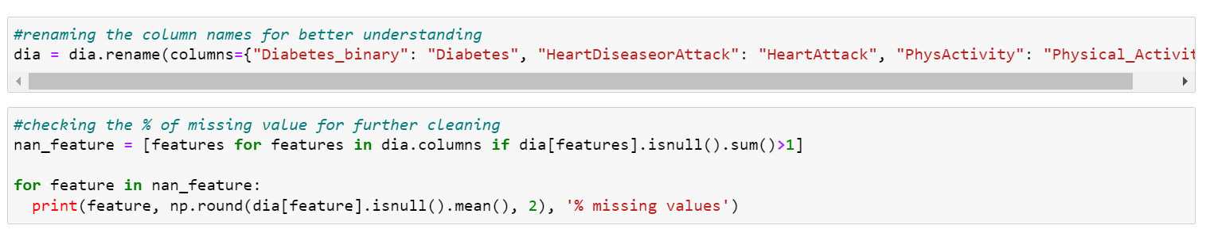
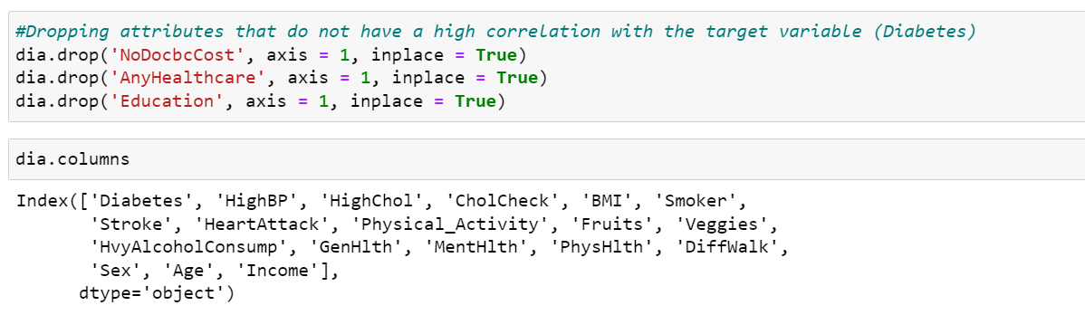
Data Cleaning:

Slide 7
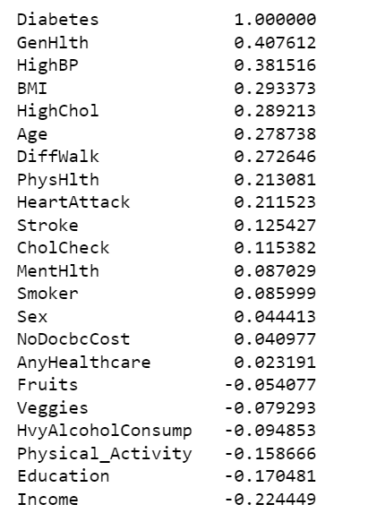
Data Exploration:
Correlation between the Outcome Variable (Diabetes) and all the predictors from the original data set.
We see 'GenHlth' is the most positively correlated predictor
On the other hand, 'Income' is the most negatively correlated predictor

Slide 8
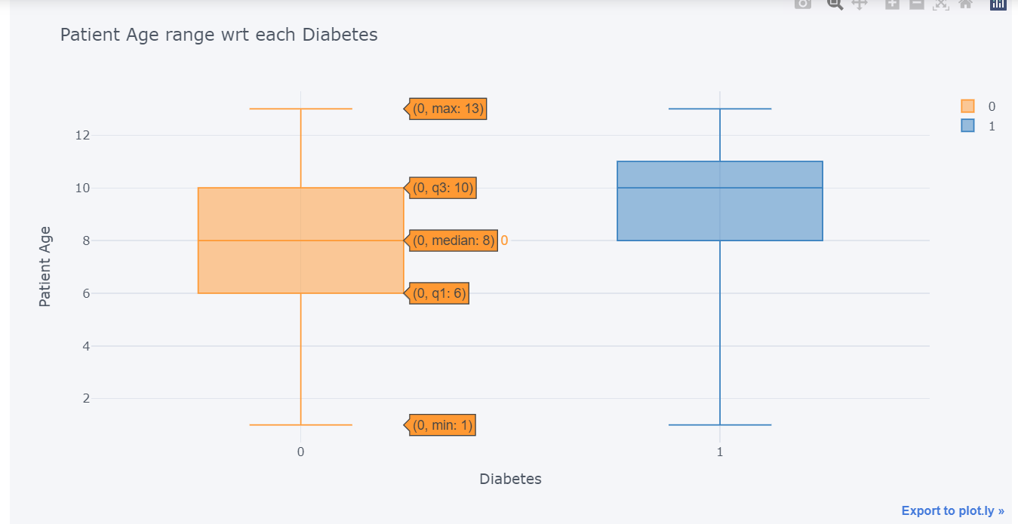
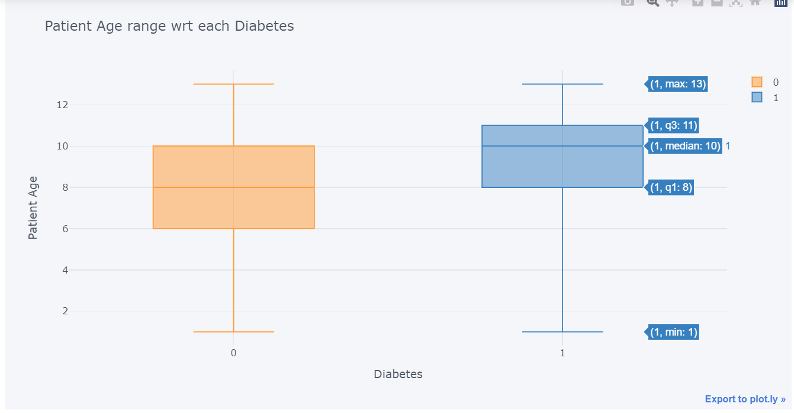
Data Exploration:
Boxplot : Age vs Diabetes

Slide 9
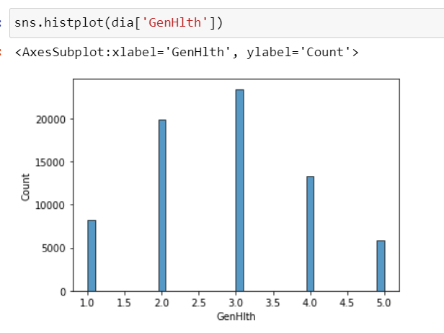
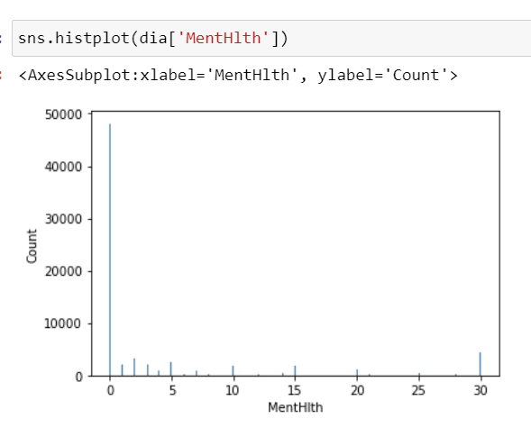
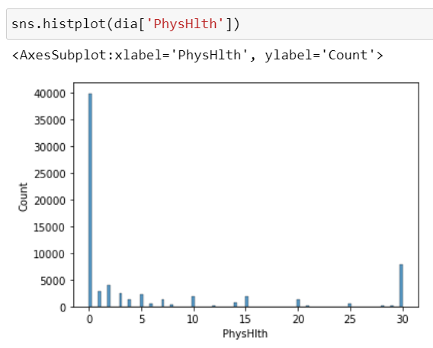
Data Exploration:
Histograms : Health Attributes

Slide 10
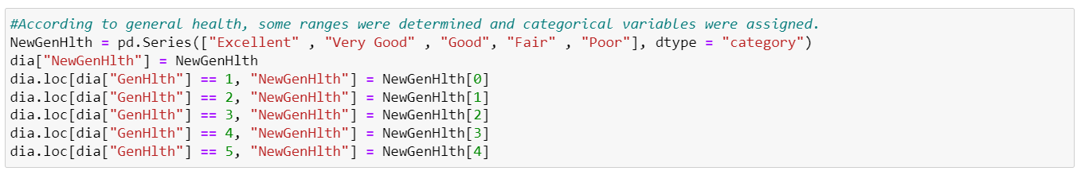
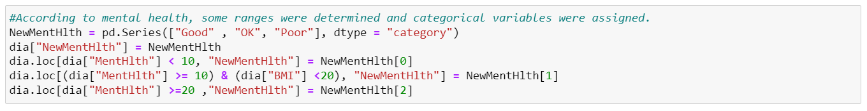
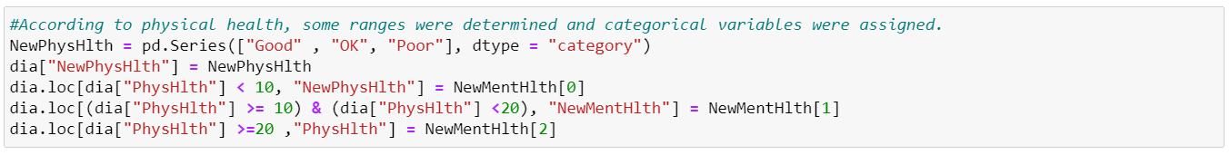
Feature Engineering:

Slide 11
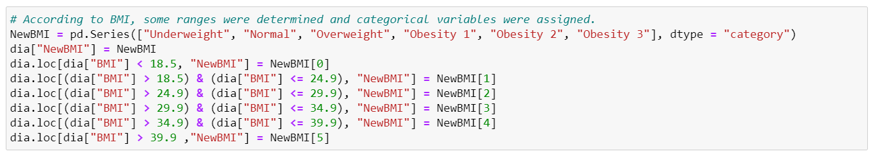
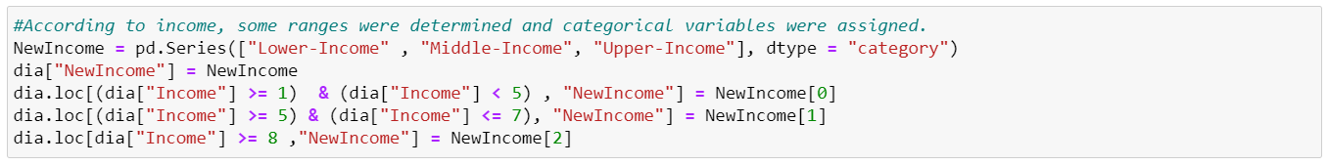
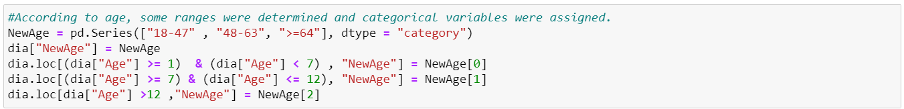
Feature Engineering:

Slide 12
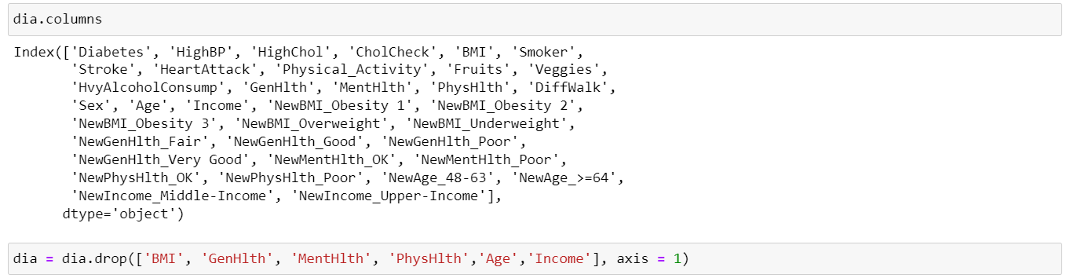
One Hot Encoding:

Slide 13
Analysis Approach (Python)
After splitting the data set into train and test sets, we transformed the two using StandardScaler function.
We develop the following Classification Models:
Logistic Classifier
KNN Classifier
SVM Classifier
Kernel SVM Classifier
Naïve Bayes Classifier
Decision Tree Classifier
Random Forest Classifier

Slide 14
Python Results on Subset 1 Data Set :
The table compares Model performance based on accuracy metric:
Model | Accuracy
Naïve Bayes | 53.80%
Logistic | 74.74%
SVM | 74.78%
Kernel RBF SVM | 76.01%
KNN | 78.70%
Random Forest | 86.28%
Decision Tree | 86.90%
The model that performed best was Decision Tree, whereas Naïve Bayes Classifier could not do well with the given data set (subset 1).

Slide 15
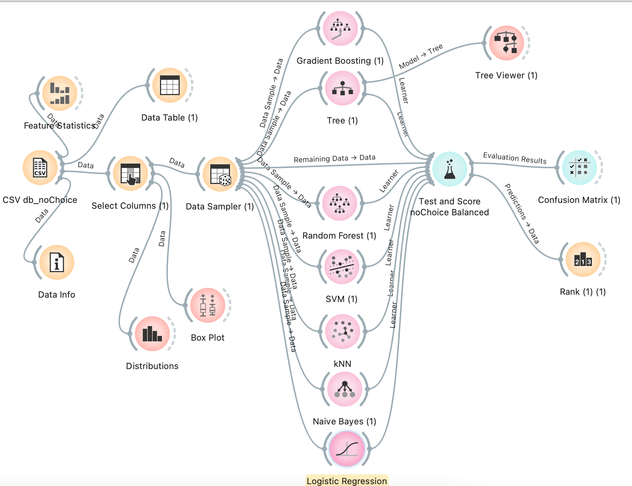
Analysis Approach (Orange3)

Slide 16
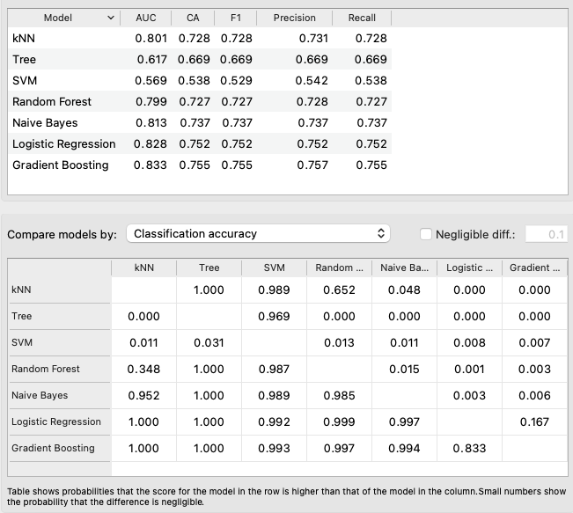
Orange3 Results on Subset 2 Data Set :
The table compares Model performance based on accuracy metric:
The model that performed best was Gradient Boosting Classifier, whereas SVM Classifier could not do well with the given data set (subset 2).

Slide 17
Research Questions Answers
Can the attributes listed in the survey be used to accurately predict a patient having diabetes? What are the main factors that influence a patient being diagnosed with diabetes.
Ans: The complete set of variables proved effective in predicting whether a person had diabetes or not.
2. Using this analysis, can we reduce the size of a survey by using fewer attributes in order to accurately predict, or screen, a patient for diabetes.
Ans: Accuracy decreased when we used a subset of variables . While there is potential to use a reduced survey for screening, it would not be as accurate at prediction as the model based on all variables.
3. Can a reduced set of attributes that are preventable and/or medically treatable be used to predict and therefore reduce the likelihood of diabetes better than attributes a person has no choice in?
Ans: When we reduced the size of the data set with just selective attributes, like choice/no choice the accuracy of the models decreased significantly.
Hence, we concluded that considering all the health factors are important in predicting the diabetes level in a patient.
4. Which model out of all has performed the best, would be worth deploying in real world?
Ans: From our analysis in Orange3 and Python, we observed that the Tree-based models performed well compared to other classification models.

Slide 18

Comments & Questions

