Slide 1
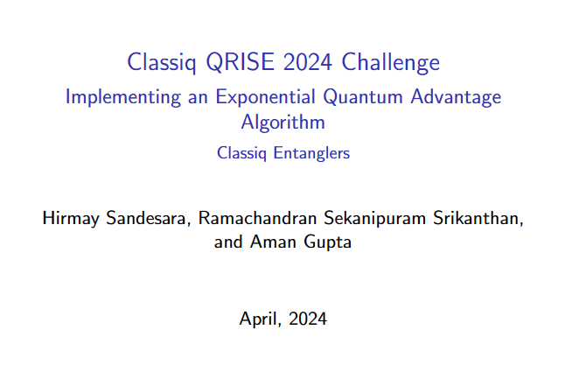

Slide 2
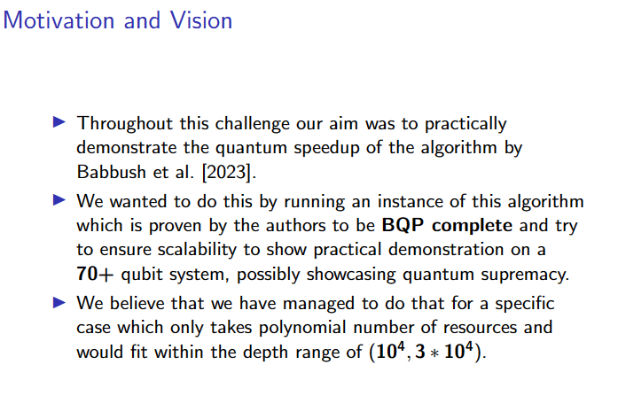

Slide 3
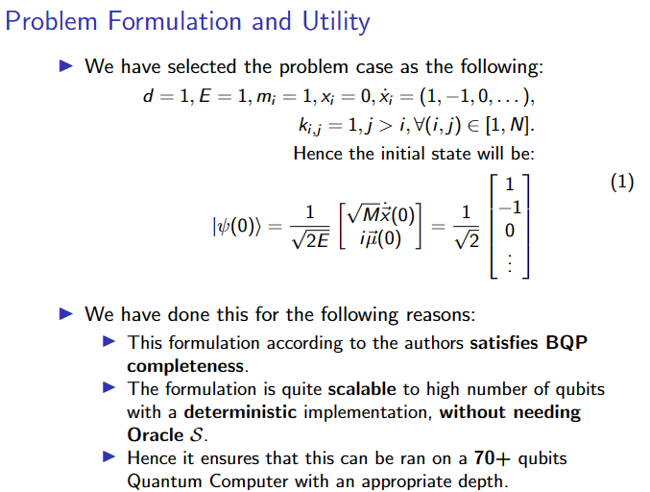

Slide 4
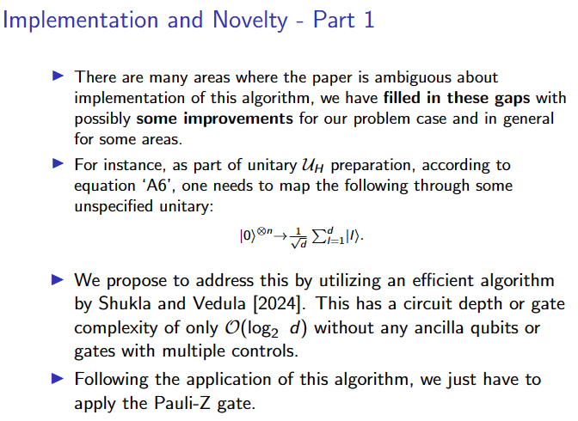

Slide 5
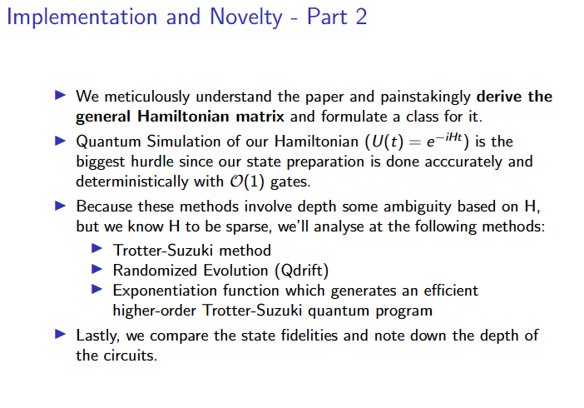

Slide 6

We use an iterative approach to perform Hamiltonian simulation using the classiq framework.
The first step is to understand classically the dynamics of the coupled spring mass system. We computed the lagrangian of the system and solved it for various time to get position and velocity.
Next, we manually performed the approach in the paper for a simple 2 mass system by computing the hamiltonian using the equations given in paper.
After that, we focusses our approach primarily in classiq due to the advantages of the synthesis framework in solving our problem.
We first start with the computation of initial state vector using the masses and spring constants provided.
This state vector is normalized and converted to quantum state using the classiq.

Slide 7
Next we compute the Hamiltonian using the deterministic approach instead of the oracle approach stated in the paper. The novelty in our approach is that we classically compute the hamiltonian matrix making it a deterministic circuit instead of an oracle based one.
This Hamiltonian matrix is converted to Sparse Pauli Ops to get the Pauli representation of the matrix.
Once we have the initial state and Hamiltonian circuit, the next step is to perform time evolution. We use Suzuki Trotterization approach to find out the state after 1 time unit.
Finally, we converted the state vector obtained from the simulation in position and velocity values for various masses.

Slide 8

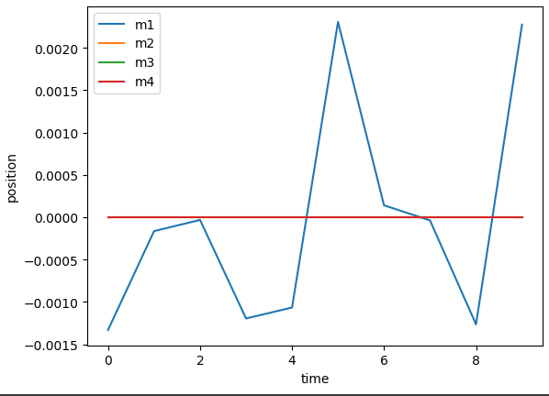
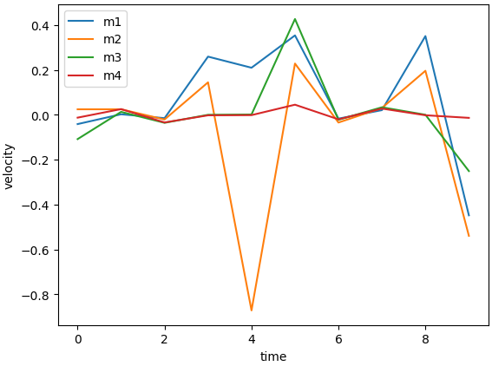
Considering a spring mass system as shown below
M1
M2
M3
M4

Slide 9
Classical Simulation of similar system is done in this tool
Coupled Oscillation Simulation (falstad.com)

Slide 10
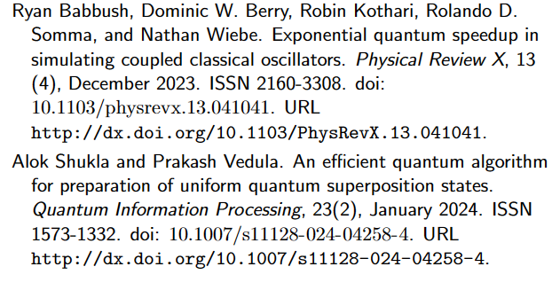
References

Slide 11
Thank you!

