Slide 1
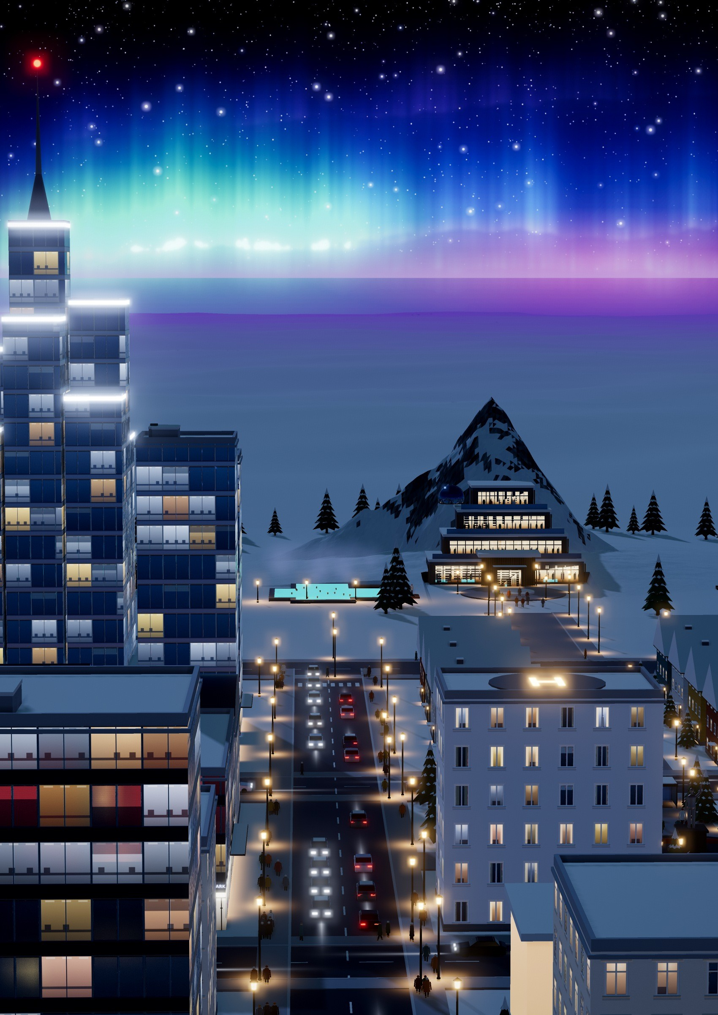

ISSUE 01 · POLAR / ICE CITY · A CITY BUILT IN 3D
AURORA HAVEN
A polar city that thrives
The city's own sun
A compact fusion station keeps 45,000 people warm through the polar night
PAGE 12
A snow mountain
you can walk inside
A whole leisure world inside a 35-metre snow peak
PAGE 17
Bread and water from snow and air
Inside the plant that feeds a city with no farmland
PAGE 15
−45 °C. 120 km/h. No sun.
The polar challenge, and the five ideas that answer it
PAGE 6

Slide 3
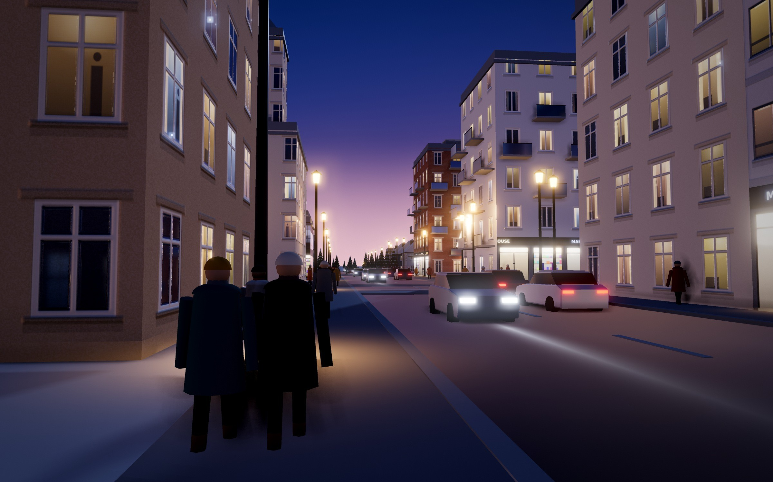
INSIDE THIS ISSUE
Contents
Shops and cafés on a downtown street at dusk. The streets are warmed from below, so they stay clear of ice without salt.
2
Letter from the Founders
25
Energy for the Polar Night
4
Who we are, our team and why we built Aurora Haven
26
Fusion, wind, sun, geothermal and storage
Welcome to Aurora Haven
Nothing Is Wasted
6
A compact city of 45,000 under a snow peak
27
Water and waste in closed loops
The Polar Challenge
Wild Neighbours
7
Cold, darkness, wind and thawing ground
28
Our urban eco-system: plants and animals
Our Vision & Mission
Getting Around Fossil-Free
8
Who is affected, and the five ideas that answer it
29
Routes, users, capacity, safety and energy
Nine Blocks, One Short Walk
Salad Under the Northern Lights
10
Downtown around the Aurora Roundabout
30
Inside the Evergreen Greenhouse Dome
The Whole City Plan
Safe and Ready for Any Storm
12
From the wind farm to Mount Aurora
31
Rescue, shelters and blizzard forecasts
The City's Own Sun
Pros & Cons
15
Breakthrough 1 · Fusion Power Station
32
Advantages, risks, costs and trade-offs
Bread and Water from Snow and Air
Invest in Aurora Haven
17
Breakthrough 2 · Snow-to-Food & Water Plant
33
Three ways to fund the city, stage by stage
A Snow Mountain You Can Walk Inside
Take the Tour
21
Breakthrough 3 · Mount Aurora
34
Eight stops around the city
Built by Us
Places to Visit
22
Our Eco-Polis model, and how to explore it
35
35 key places and what they do
Three Districts, One Loop
Through a Resident’s Eyes
23
How heat, water, oxygen and waste go round
36
An imagined day in the polar night
A Livable City Every Day
Sources & Assumptions
24
Schools, health, shops and culture
Where our facts come from
Homes for the Polar Night
Housing for every age, built for −45 °C
1

Slide 4
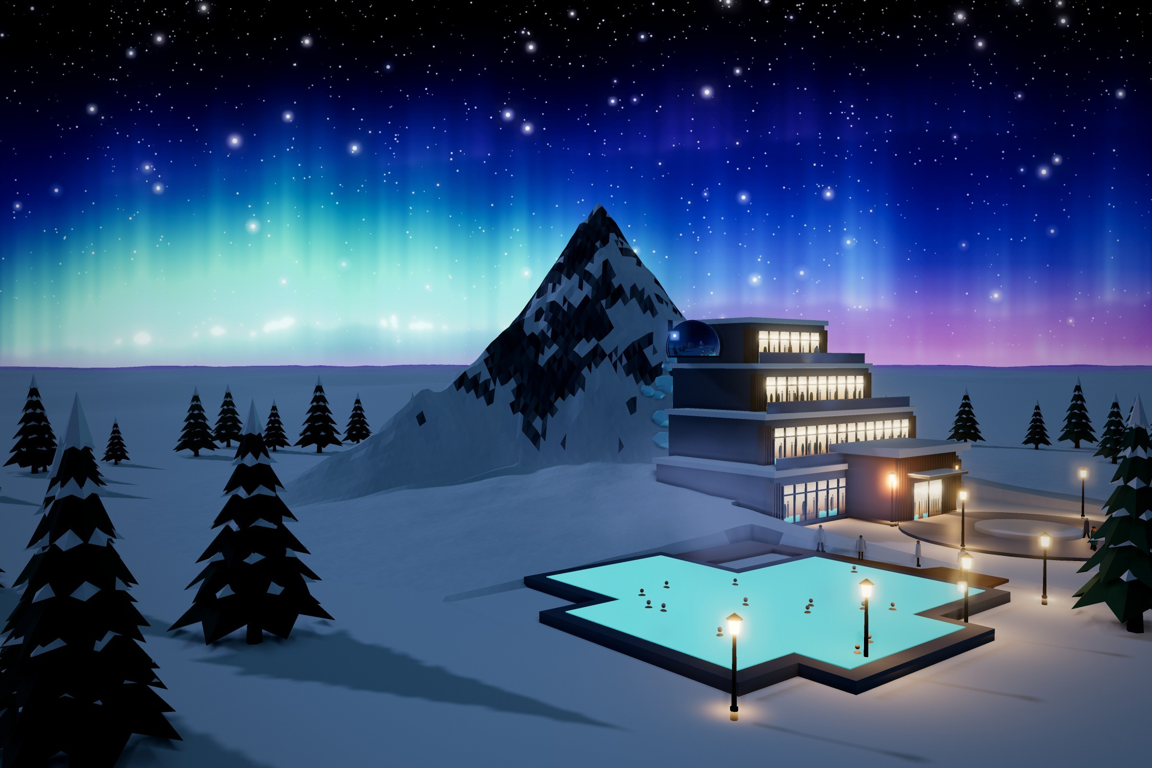
LETTER FROM THE FOUNDERS
“Our goal was not only to survive the cold but to build a city where people really want to live.”
The Aurora Lagoon, a 38 °C open-air mineral pool at the foot of Mount Aurora, under the northern lights.
WELCOME TO THIS SPECIAL FEATURE on a polar city named Aurora Haven – a bold architectural marvel where human ingenuity meets the call of the wild. In an era shaped by global climate shifts, this project is more than just an urban concept; it represents a strategic vision for survival and sustainable development in the earth’s most extreme polar environments.
From its sleek structural design to intelligent renewable energy integration, Aurora Haven redefines how humanity can adapt and thrive under pressure. We invite you to turn the page and step into a world where extreme natural challenges are transformed into a vibrant, resilient, and forward-thinking community.
The Polar City team
Class 11A4 · Lê Quý Đôn High School
ON THE COVER
Aurora 81 – Polar Landmark Tower, named in honour of Landmark 81 in Ho Chi Minh City, beside the street that leads to the glowing terraces of the Mount Aurora spa, under the northern lights. Its nine bundled glass tubes step back like bamboo stalks and cut blizzard wind load by about 25%.
2

Slide 5
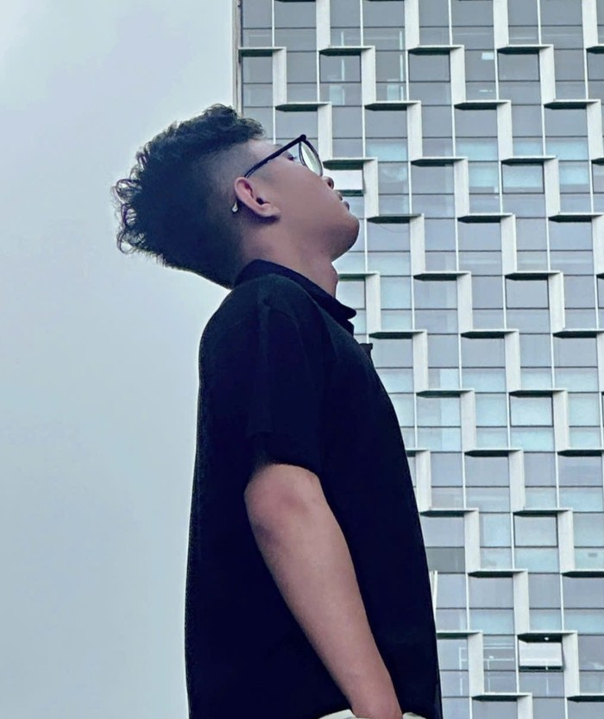
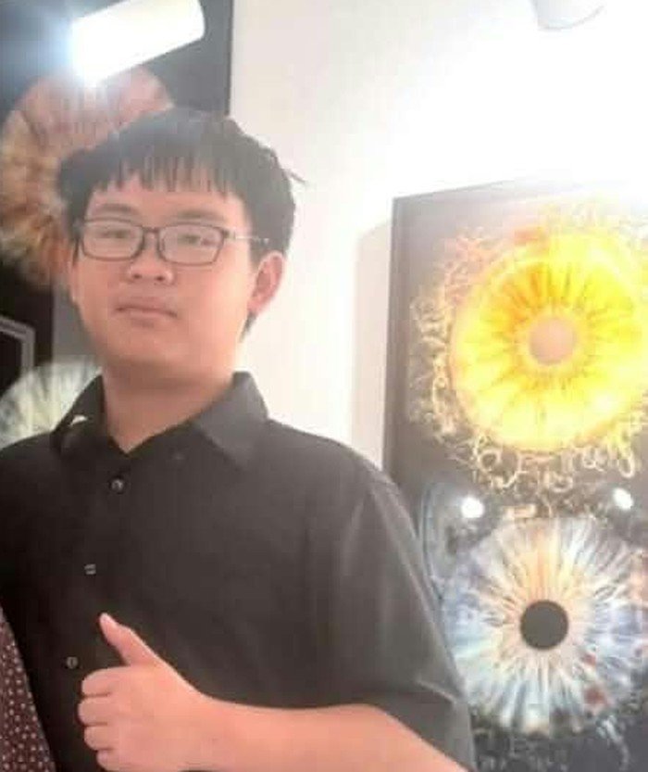


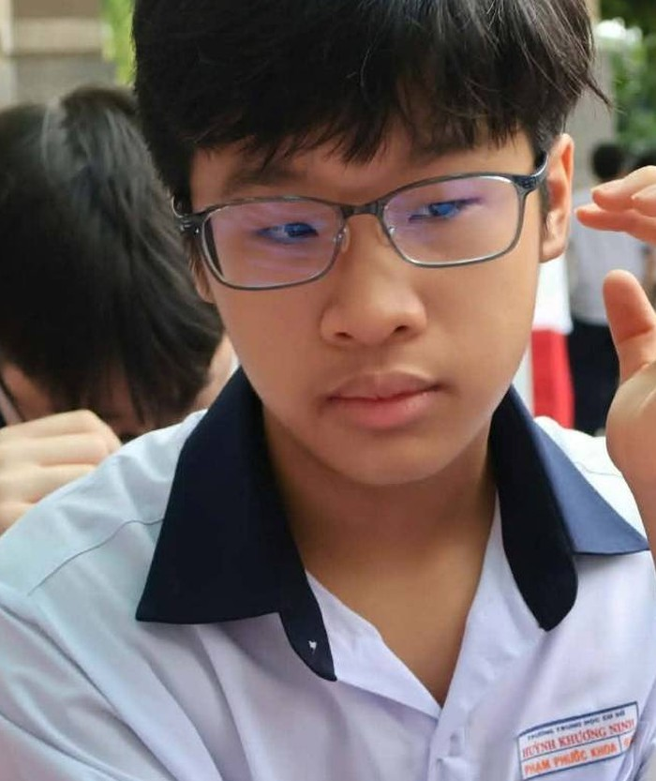


THE TEAM BEHIND AURORA HAVEN
Meet the Founders
The people who planned, built and wrote Aurora Haven, and what each of us did.
Nguyễn Đông Bảo
Nguyễn Bá Hiếu Thiện
Phan Minh Khôi
Magazine design · 3D city design
Team leader · Research · 3D city design
Research · Fact-checking
Dương Hàng Nguyên
Phạm Phước Khoa
Nguyễn Minh Triết
Video filming & editing · 3D city design
Video editing · Magazine design
Magazine design · Report
SCAN TO WATCH
Our real-world interview
Video on YouTube
youtu.be/QwcP_2Q3Esc
INTERVIEW CONCLUSION
Looking back on the interview session, our team not only gathered valuable architectural insights but also learned a great deal about creative thinking and teamwork. Preparing the questions, listening closely, and engaging in direct discussions helped us deeply understand how green technologies can be practically applied to extreme environmental challenges. Overall, this was a truly rewarding experience that broadened our perspectives and allowed us to bring the most inspiring stories to our magazine readers.
3

Slide 6
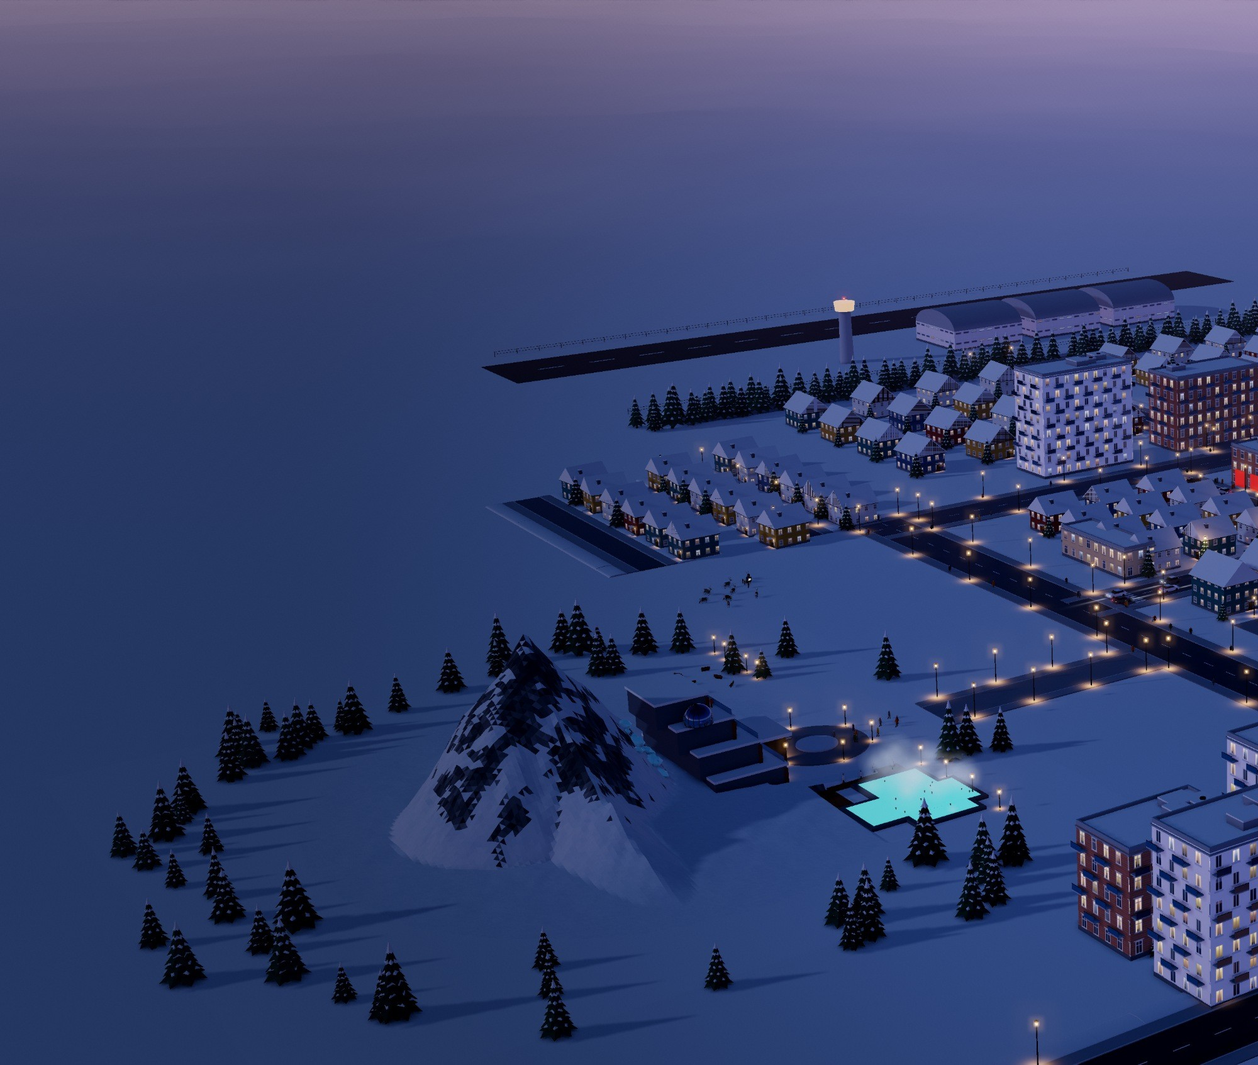
CITY OVERVIEW
Welcome to
Aurora Haven
Designed not just to survive the polar night, but to make life here warm, healthy and sustainable.
AURORA HAVEN IS a compact polar city of around 45,000 people, built on a frozen tundra plateau beneath the snow peak of Mount Aurora. Winters fall to −45 °C, the sun disappears for two months of polar night, and almost nothing can grow.
The whole city is shaped around one idea: heat, energy, water and food should never be wasted. Every building shares a single heating network, the city runs on zero-carbon energy, and nearly all of its water and waste is recycled.
Homes, schools, healthcare, shops and parks sit within a short walk of each other, connected by a downtown metro, electric trams and heated streets.
4

Slide 7
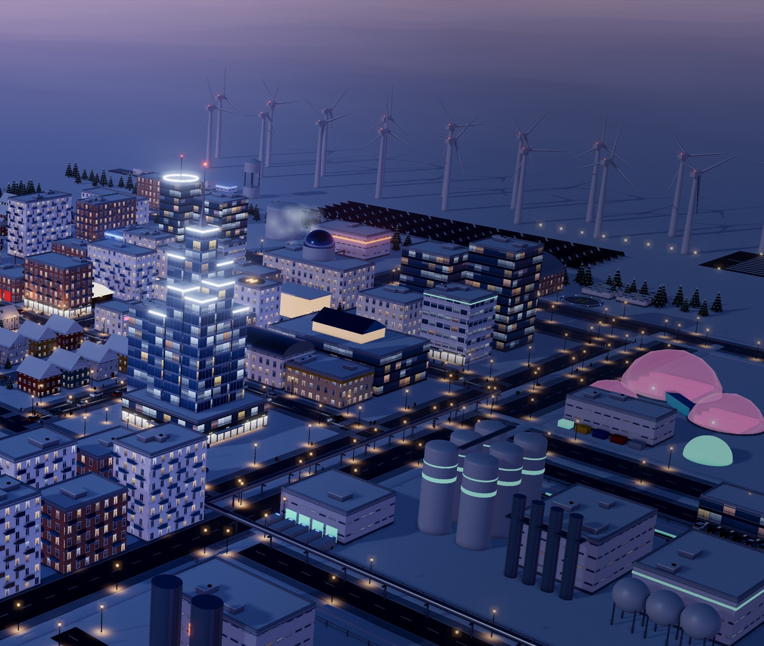
Aurora Haven at dusk, seen from the south-east: the fusion station in front, downtown and Aurora 81 in the middle, the wind farm on the windy northern edge.
What makes Aurora Haven special is its three signature districts. A fusion power station acts as the city’s own sun, giving steady power and heat even through the polar night. A Snow-to-Food & Water Plant turns snow and air into clean drinking water and food, so the city can feed itself without farmland.
And inside Mount Aurora, a geothermal spa resort offers warmth, rest and a view of the northern lights. Together they form one closed loop that keeps the city powered, fed and happy in one of the harshest places on Earth.
45,000
residents
−45 °C
winter lows
35 m
Mount Aurora, the snow peak
10 min
walk to daily needs
5

Slide 8
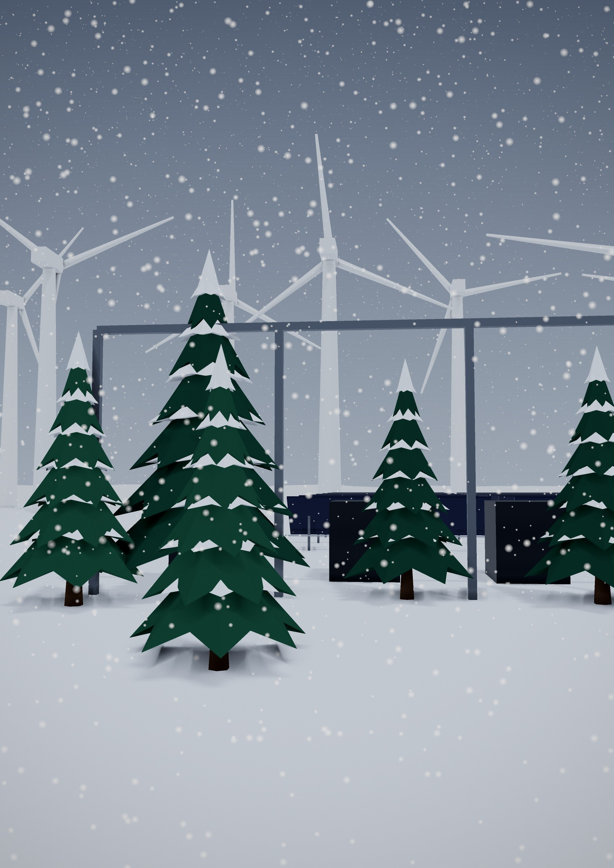
THE PLACE
The Polar Challenge
One of the hardest places on Earth to build a city, so every building had to answer one question.
Aurora Haven sits in one of the hardest environments on Earth. In winter the temperature falls to minus 45 degrees. For about two months the sun never rises, as in Tromsø, Norway, which sees no sunrise from late November to mid-January [19]. Blizzards can reach 120 kilometres per hour.
The ground is permafrost, so a warm building can thaw it and crack its own foundations. Across the Arctic, about 70% of today’s buildings, roads and pipelines on permafrost stand where the ground could thaw by 2050 [2]. There is almost no farmland, and in deep winter supplies can only arrive by air.
So we asked one question about every building in the city:
−45 °C
winter temperatures
2 months
of polar night, and two of midnight sun
120 km/h
blizzards
“How does it help people stay warm, fed, safe and happy here?”
≈4×
faster warming in the Arctic than the world since 1979 [1]
A blizzard sweeps past the snowbreak pines towards the Ice-Proof Wind Farm on the windy northern edge.
6

Slide 9
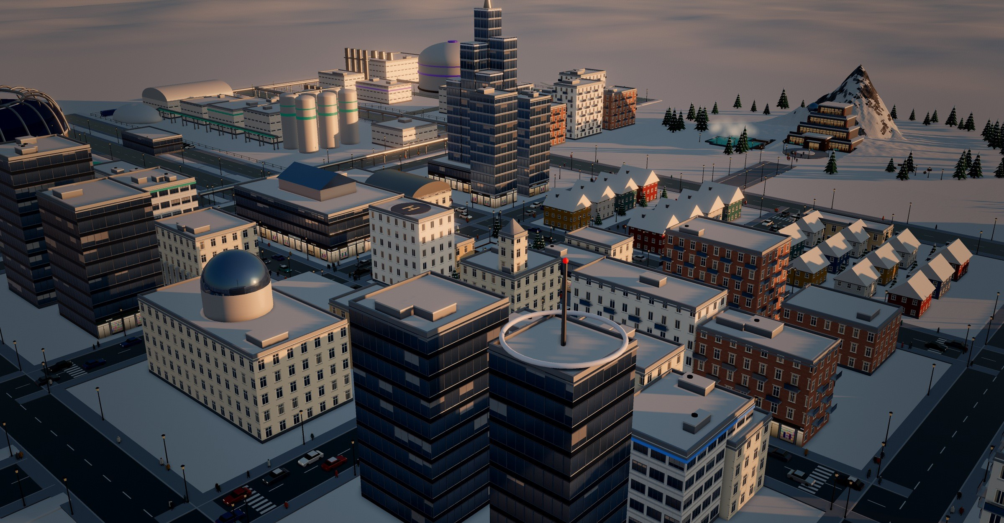
Downtown in the low sun, with Aurora 81, the food plant silos and Mount Aurora behind.
THE VISION
Our Vision & Mission
Our mission: a zero-carbon city where 45,000 people stay warm, fed, safe and happy through the polar night, without harming the tundra.
THE PEOPLE AND PLACES AT RISK
45,000 residents
4 million Arctic people
Families, children, older people and shift workers face −45 °C, two months without sun and 120 km/h blizzards every winter.
About 4 million people live in the Arctic today [3]. By 2050, nearly 4 million people may live where thawing ground can crack homes, roads and pipes [2].
Supply chains
The tundra and its wildlife
In deep winter, food, medicine and spare parts can only arrive by air, so one long storm can cut a city off.
Arctic foxes, hares, ptarmigans and reindeer depend on fragile, frozen land that a careless city would pollute, light up or melt.
FIVE DESIGN PRINCIPLES
01
Heat is life: one heating loop, fed by fusion and geothermal heat, warms every building; insulated piles keep the permafrost frozen.
02
Zero carbon: no fossil fuel burns anywhere; power comes from fusion, wind, sun and geothermal heat.
03
Closed loops: about 95% of water is recycled and rubbish is reused instead of thrown away.
04
Compact and car-light: daily needs within a 10-minute walk; the few cars are electric.
05
Resilient and healthy: shelters for 30 days, and light, parks, culture and a spa for the polar night.
7

Slide 10
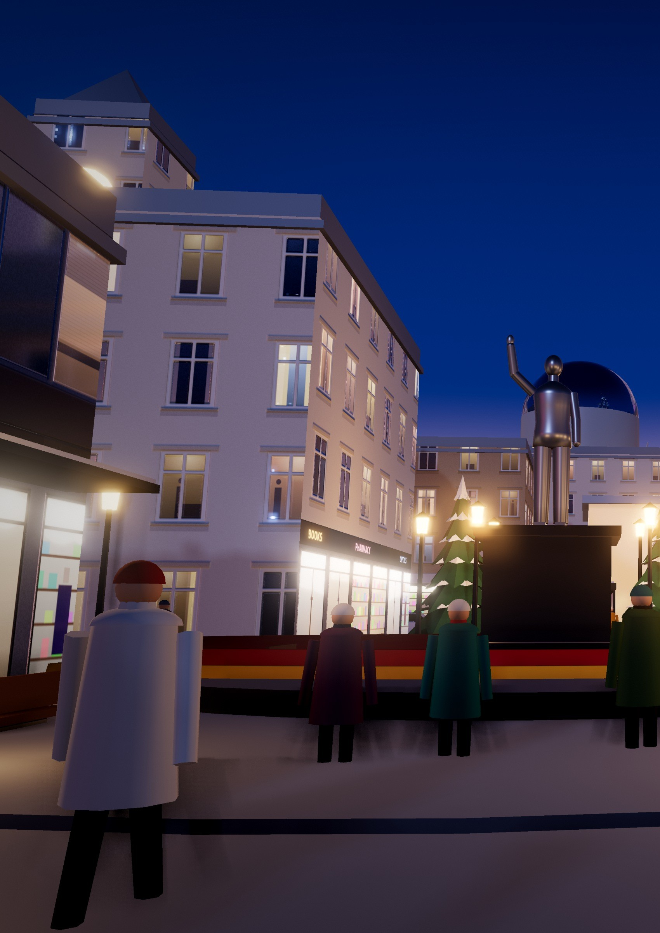
DOWNTOWN
Nine Blocks,
One Short Walk
Shops, schools, healthcare and homes within a short walk of each other, around the Aurora Roundabout.
Downtown is laid out in nine blocks around the Aurora Roundabout and the Founding Mayor Monument. The metro interchange lies under Liberty Mall, the tree-lined promenade through the four central blocks, which hosts festivals, markets and parades.
8

Slide 11
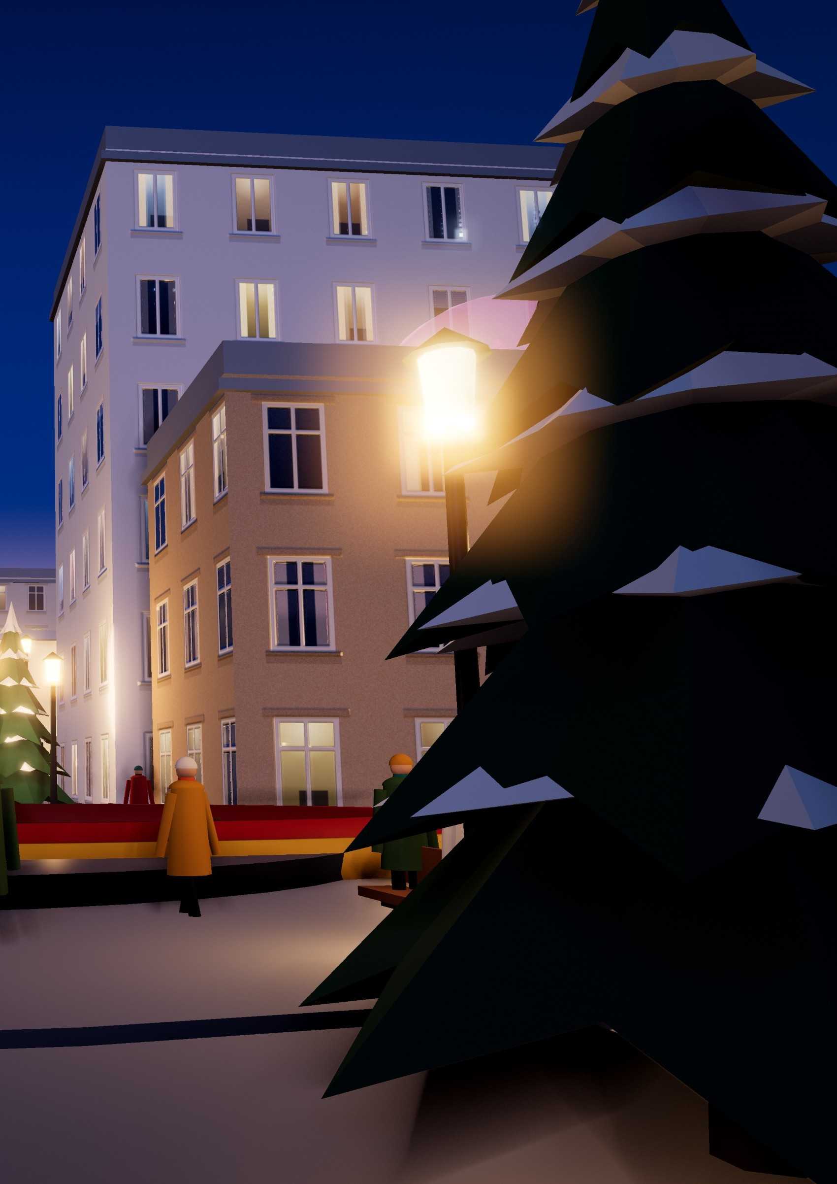
Liberty Mall at dusk, looking north to the Founding Mayor Monument. Its granite plaza is warmed from below by the heating loop and never ices, and twin lanterns line the way.
9

Slide 12
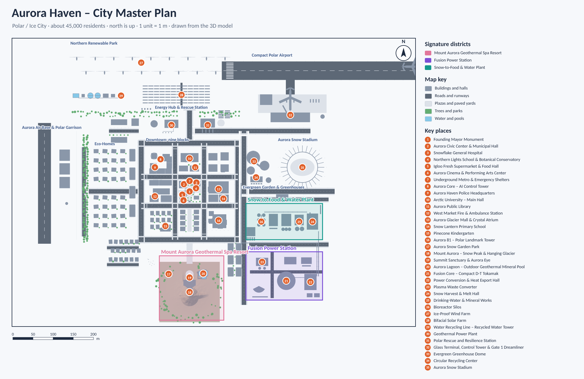
THE MAP
The Whole City Plan
Aurora Haven – City Master Plan. North is up; one unit is one metre. Drawn from the 3D model; the numbers are the 35 places listed on page 34.
DOWNTOWN
NORTH
Nine blocks around the Aurora Roundabout and the Founding Mayor Monument, with the hospital, schools, shops and the metro interchange.
The windy north holds the Northern Renewable Park, the energy hub, the Polar Rescue and Resilience Station and the airport.
WEST
EAST
The air base and garrison, behind a belt of trees that screens the eco-homes.
Greenhouses, the snow stadium, the fusion station and the Snow-to-Food plant, linked by pipe bridges and heat mains.
SOUTH
Framed by Liberty Mall, Mount Aurora rises with its geothermal spa resort inside.
10

Slide 13
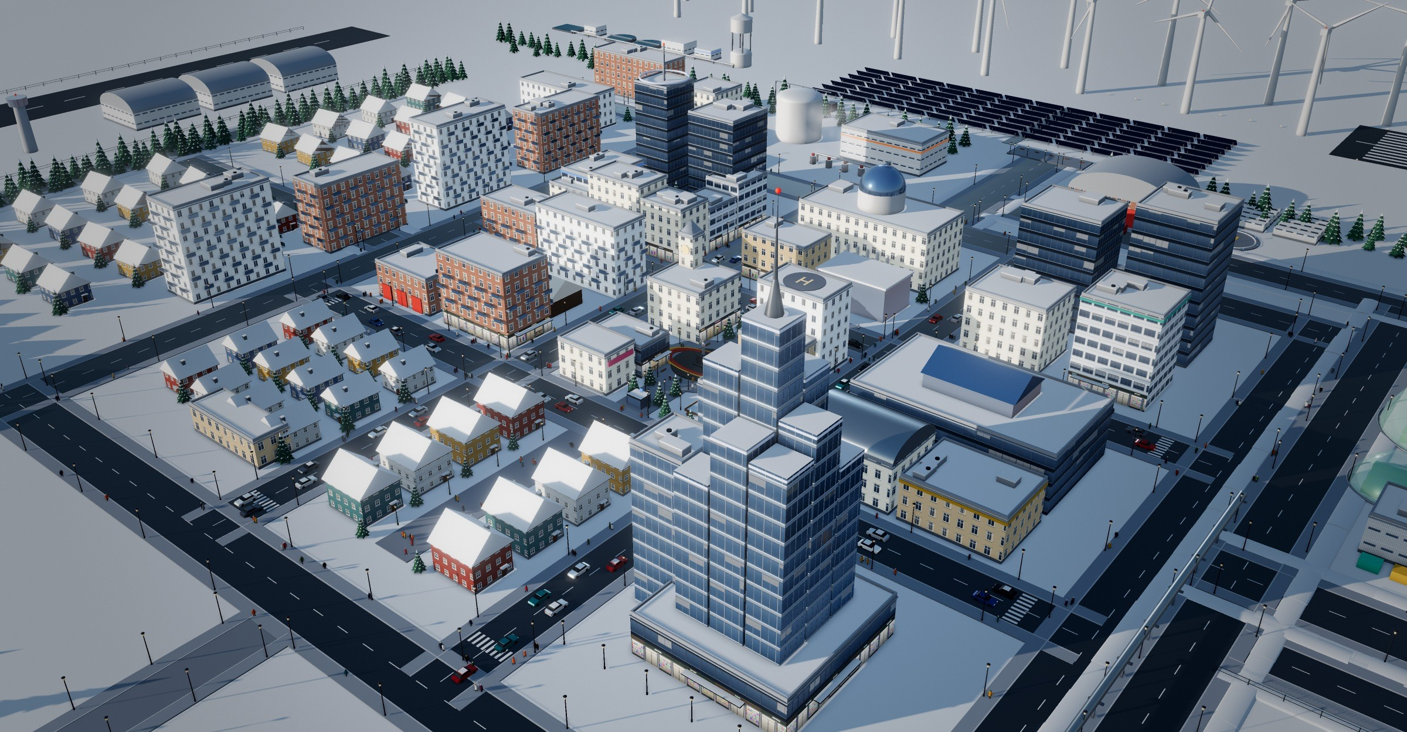
DOWNTOWN
The Nine Blocks
Downtown from the south-east. The map below follows the city plan, with north at the top.
Polaris Quarter
Knowledge Quarter
Financial District
Aurora Core – AI Control Tower · Aurora Haven Police Headquarters · Polaris Green Office Tower
Arctic University – Main Hall · Aurora Public Library
Arctic Stock Exchange · Aurora Green Finance Hall · Snowline Courthouse · Aurora Business Hotel
West Market Street
Civic Core & Liberty Mall
East Gallery Avenue
West Market Fire & Ambulance Station · Aurora Night Market Hall · Polar Pharmacy
Founding Mayor Monument · Civic Center · Snowflake General Hospital · Northern Lights School · Igloo Fresh · Aurora Cinema · Metro
Aurora Glacier Mall & Crystal Atrium · Snow Lantern Primary School · Northern Lights Music Hall
Snowpine Residences
Mount Aurora Approach
Aurora 81 District
Family homes · Pinecone Kindergarten · Snowpine Senior Care Home
Mount Aurora Guesthouse · Southside Police & Mountain Rescue Post · spa shuttle street
Aurora 81 – Polar Landmark Tower · Aurora 81 Residences (Twin Towers)
11

Slide 14
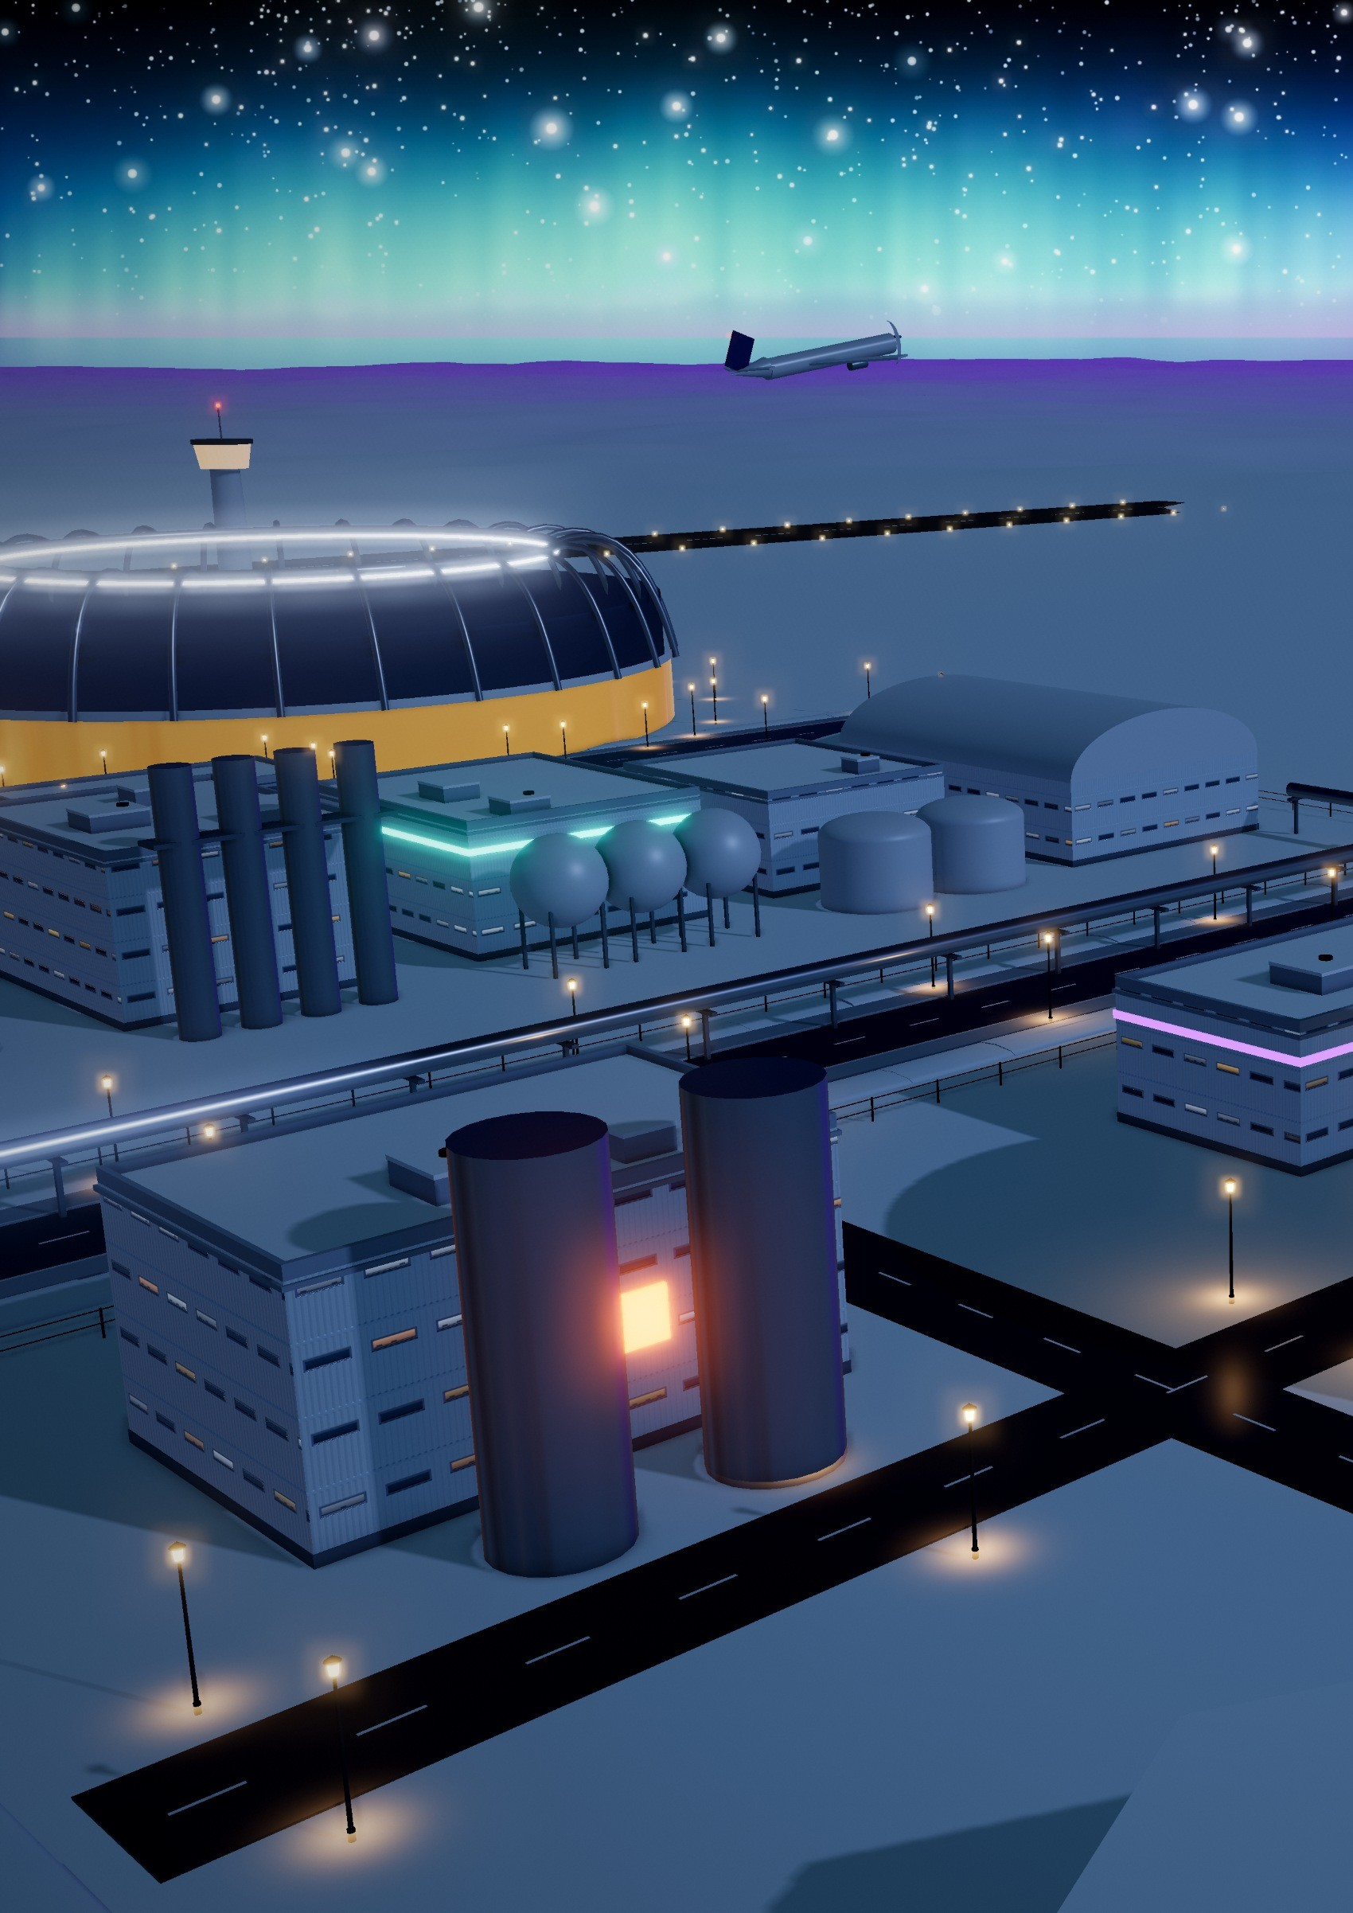
1
SIGNATURE DISTRICT 1 · FUSION POWER STATION
The City's Own Sun
Our big idea: put a fusion reactor inside the city itself, so one machine lights every home, heats every street and melts the snow we drink.
Our first signature district is the city’s own sun. Stage 1 takes deuterium from snowmelt water, so the fuel literally falls from the sky as snow. Stage 2 breeds tritium in a lithium blanket, so none is imported.
Stage 3 is the tokamak, where superconducting magnets hold a 150-million-degree plasma that makes about 800 megawatts of heat. Stage 4 turns that heat into about 300 megawatts of electricity and sends 450 megawatts into the district-heating loop.
The reactor runs on about 170 grams of fuel a day. If anything fails, the plasma simply goes out in a split second, so it cannot melt down or run away.
12

Slide 15
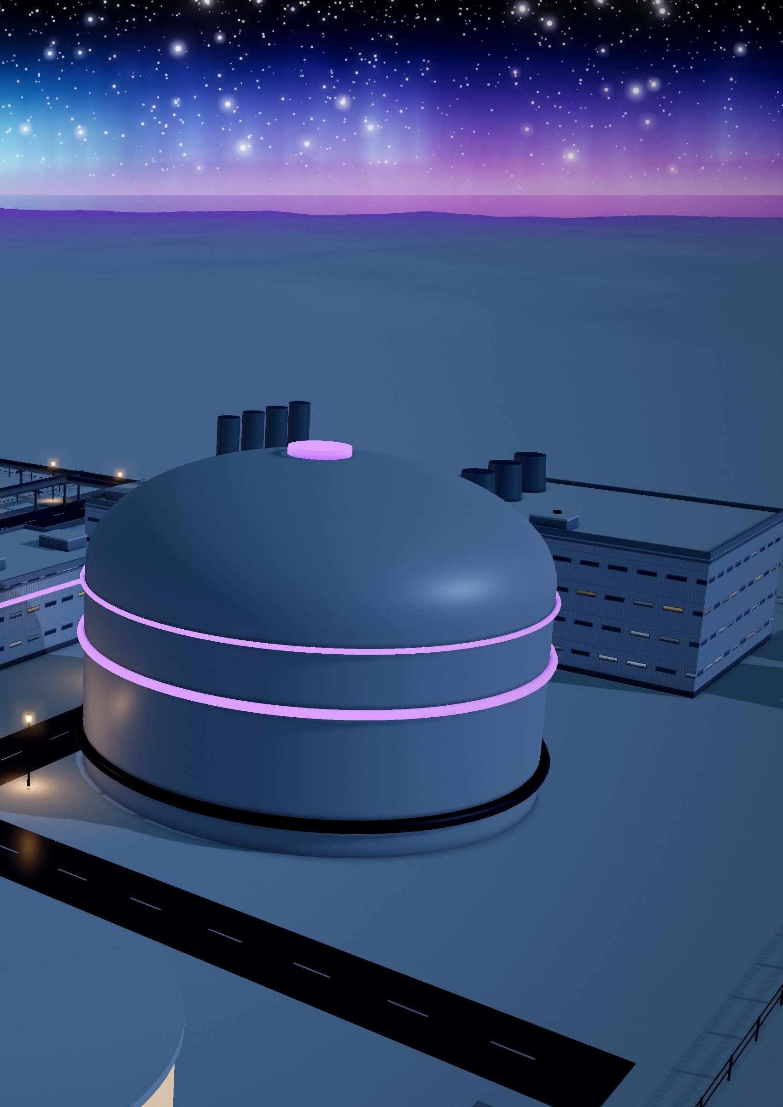
WHERE THE WORLD IS TODAY
REALITY CHECK
Fusion is still being tested. The compact SPARC tokamak aims for its first plasma around 2027 [5], and ITER in France plans to burn deuterium–tritium fuel in 2039 [4]. No fusion plant sells power yet: Aurora Haven is designed for the day one does.
≈ 0.2 kg a day
A day at 800 MW needs about 0.2 kg of fuel, close to our 170 g design. Breeding tritium at scale is unproven [11] and ITER costs €18–22 billion [12], so the city starts on wind, sun and geothermal power (page 25).
The Fusion Core, a compact D-T tokamak, glowing violet under the northern lights.
13

Slide 16
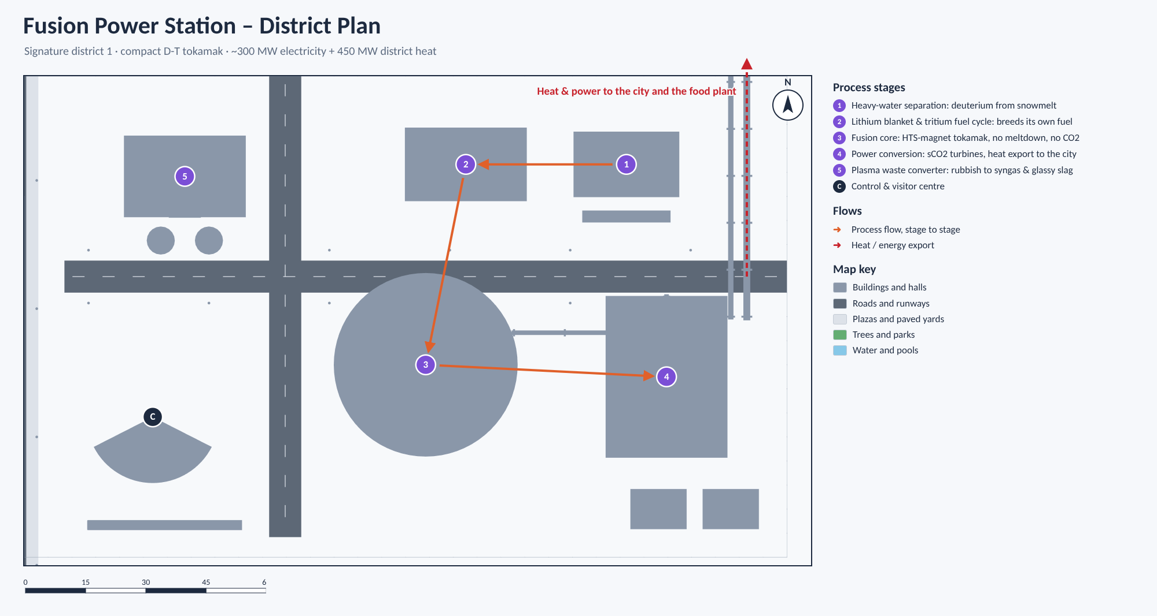
FUSION POWER STATION · HOW IT WORKS
Five Stages, One Sun
Fusion Power Station – District Plan. Signature district 1: a compact D-T tokamak.
1
Heavy-water separation
WHY IT’S GREEN
Takes deuterium from the deuterium-rich water left by the food plant’s electrolysers and purifies it to 99.8% heavy water.
94% used. Of 800 MW of heat, 300 MW becomes power and 450 MW warms the city.
No CO₂. Nothing burns, and the turbines’ CO₂ never leaves its loop.
Fuel from snow. Deuterium comes from meltwater: no mines, no tankers.
Rubbish reused. The converter’s hydrogen and CO₂ feed the food plant.
Little waste. Its radioactive waste is mostly short-lived, under 100 years, unlike spent fission fuel [20].
2
Lithium blanket & tritium fuel cycle
Breeds the tritium the reactor burns inside sealed, leak-monitored loops, so none is imported. Recovered helium cools MRI scanners.
3
Fusion core: compact D-T tokamak
Superconducting magnets hold a 150-million-degree plasma. If anything fails, the plasma simply goes out: it cannot melt down.
4
Power conversion & heat export
Turbines driven by CO₂ sealed in a closed loop make about 300 MW of electricity and send about 450 MW of heat to the city.
5
Plasma waste converter
Torches hotter than 5,000 °C turn about 20 tonnes of rubbish a day into hydrogen and CO₂ for the food plant, metals and paving blocks.
C
Control & visitor centre
Operators and an AI digital twin can stop the plasma in milliseconds; a public gallery faces the reactor.
14

Slide 17
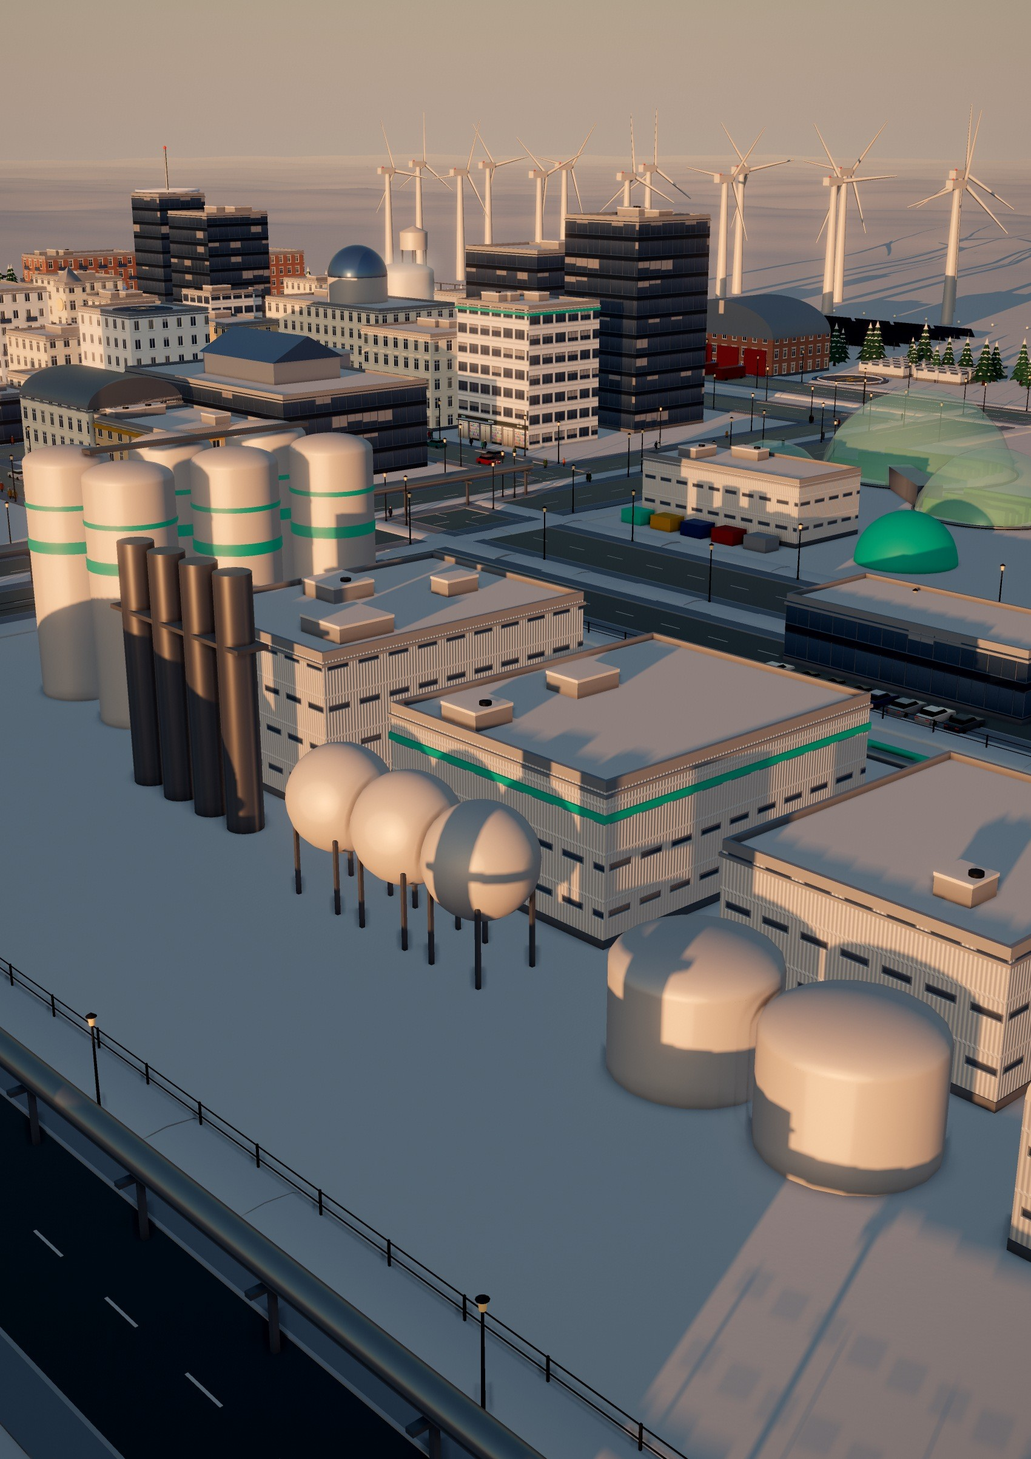
2
SIGNATURE DISTRICT 2 · SNOW-TO-FOOD & WATER PLANT
Bread and Water from Snow and Air
Our big idea: a factory that bakes bread and pours drinking water out of snow and air, so a city with no farmland can feed itself.
The six Bioreactor Silos in the low sun.
What do you eat where nothing grows? Stage 1 melts about 3,000 tonnes of clean tundra snow a day with spare heat from the fusion station, so the snow does the job of a cooling tower. Stage 2 turns the meltwater into all the city’s drinking water.
Stage 3 splits water into hydrogen and oxygen and captures CO₂ from the air; Stage 4 turns them into starch and fats. In Stage 5, microbes in six silos make about 2.5 tonnes of protein flour a day. Stage 6 cooks bread, noodles and drinks for the city.
15

Slide 18
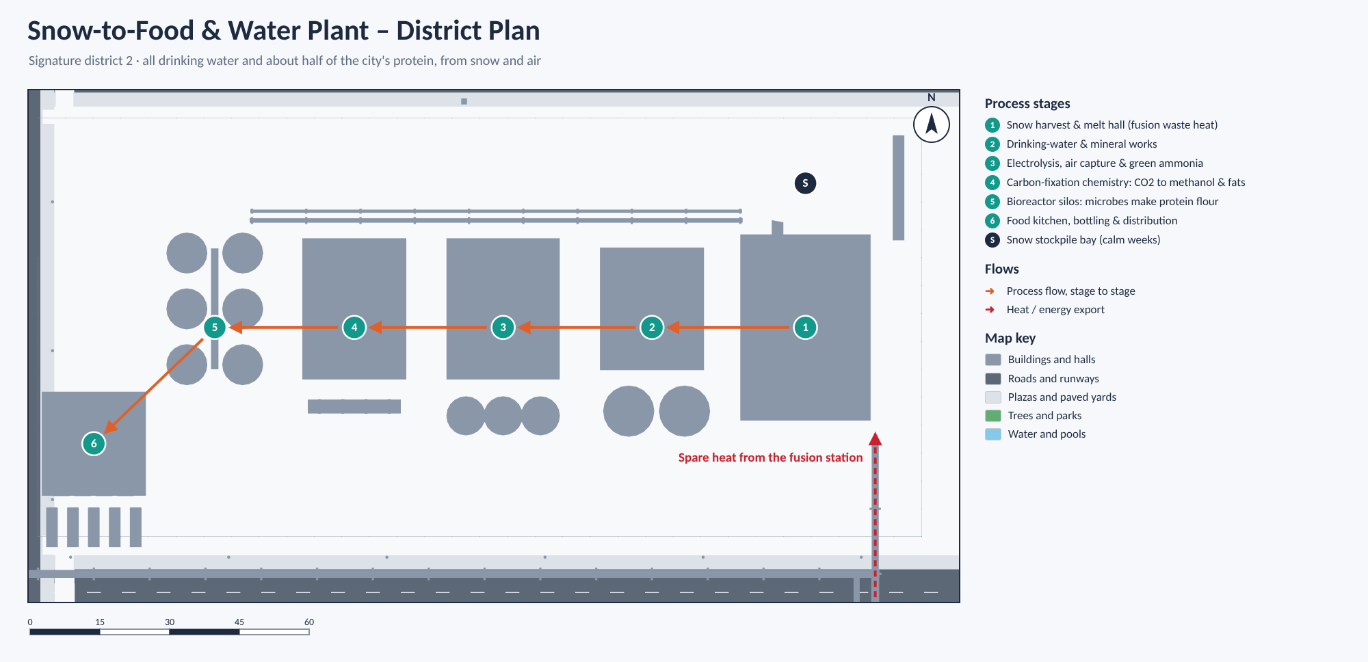
SNOW-TO-FOOD & WATER PLANT · HOW IT WORKS
Six Stages from Snow to Supper
Snow-to-Food & Water Plant – District Plan. All drinking water and about half of the city’s protein, from snow and air.
1
Snow harvest & melt hall
WHERE THE WORLD IS TODAY
Electric harvesters gather wind-packed snow upwind of the city; about 14 MW of spare fusion heat melts it.
Each step exists, but apart: Solein protein from Finland [6], starch made from CO₂ in a lab [7] and air capture in Iceland [8]. We link them in one plant.
2
Drinking-water & mineral works
Membranes and UV light remove every germ, calcite adds calcium and magnesium, and sensors test the water every five minutes.
3
Electrolysis, air capture & green ammonia
About 5 tonnes of hydrogen a day; the oxygen goes to the hospital and the waste converter.
4
Carbon-fixation chemistry
REALITY CHECK
A copper catalyst makes methanol, and enzymes build it into starch about eight times faster than a maize field.
≈ 13 MW
5
Bioreactor silos
Melting 3,000 tonnes of snow a day takes about 13 MW, inside the 14 MW of spare fusion heat. Starch from CO₂ is still lab-scale [7].
Hydrogen-eating bacteria make protein flour; yeasts and algae make oils and vitamins, 24 hours a day.
6
Food kitchen, bottling & distribution
Bread, noodles, protein mince and dairy-style drinks, delivered overnight in heated electric vans.
16

Slide 19
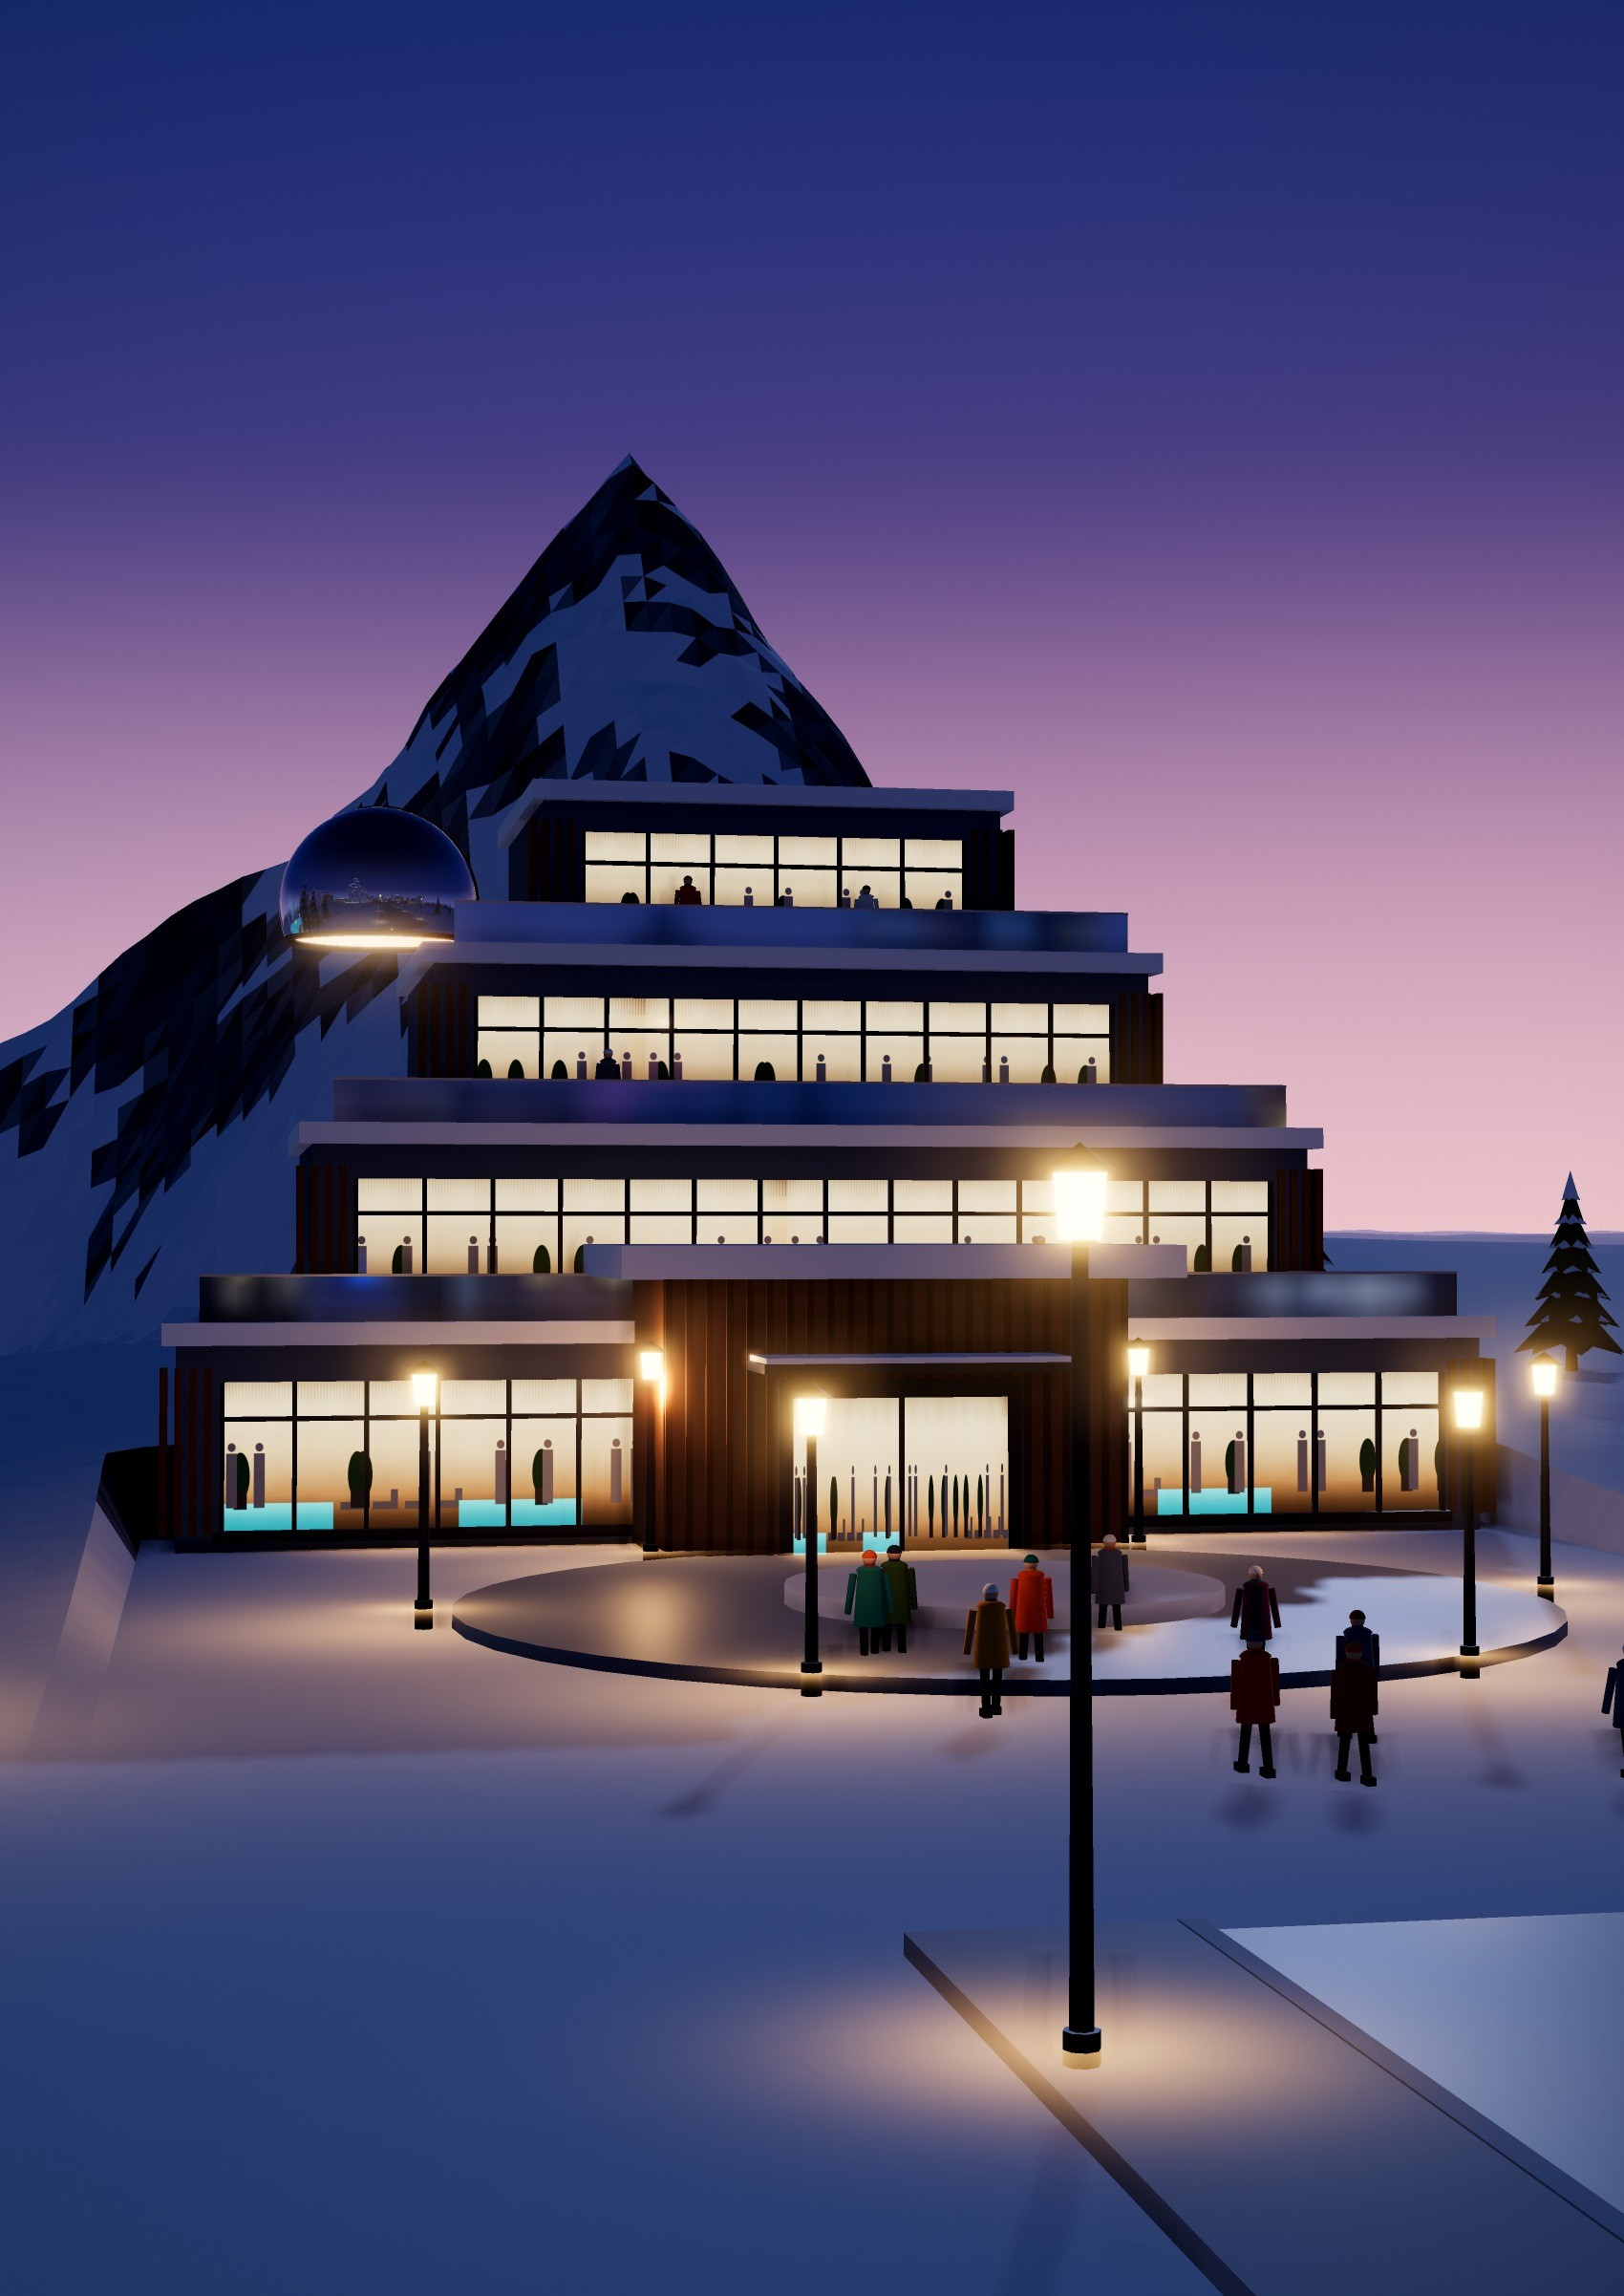
3
SIGNATURE DISTRICT 3 · MOUNT AURORA
A Snow Mountain
You Can Walk Inside
Our big idea: the mountain is the building. Inside a 35-metre snow peak shaped like Nepal’s Ama Dablam, a whole leisure world stays at 28 °C all winter.
The four spa levels step out of the north face; the forecourt is warmed by the spa’s used hot water, so guests walk ice-free from the shuttle to the door.
Guests enter through the North Portal, where a thermal revolving door and an air curtain keep the −45 °C air out. The peak’s deep snow works as a blanket that holds in the geothermal heat, and sensors release the snow load safely before an avalanche can build.
Outside is the Aurora Lagoon, a 38-degree mineral pool for bathing under the northern lights. The spa fights the winter blues, brings tourists and income, and in an emergency can shelter up to 1,000 people.
17

Slide 20
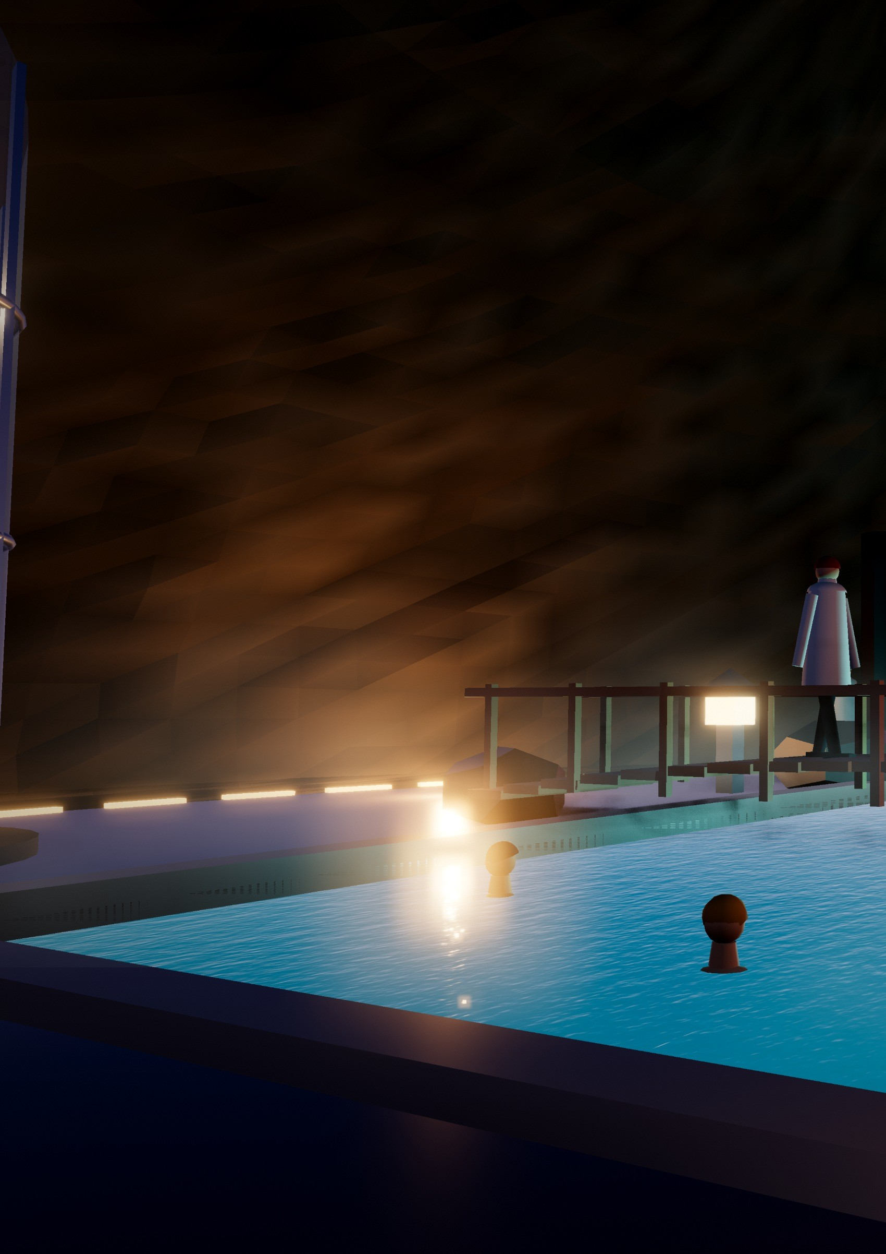
MOUNT AURORA · LEVEL 1
Inside the Mountain
The ground level and arrival floor of the spa: a welcome hall, two changing suites, a 7 × 13 m geothermal Mineral Lake grotto and an onsen garden with hot, warm and glacier-cold pools.
A 40 °C silica- and bicarbonate-rich spring rises from the geothermal field into the lake, spills over a basalt wall and flows on to the outdoor Aurora Lagoon.
18

Slide 21
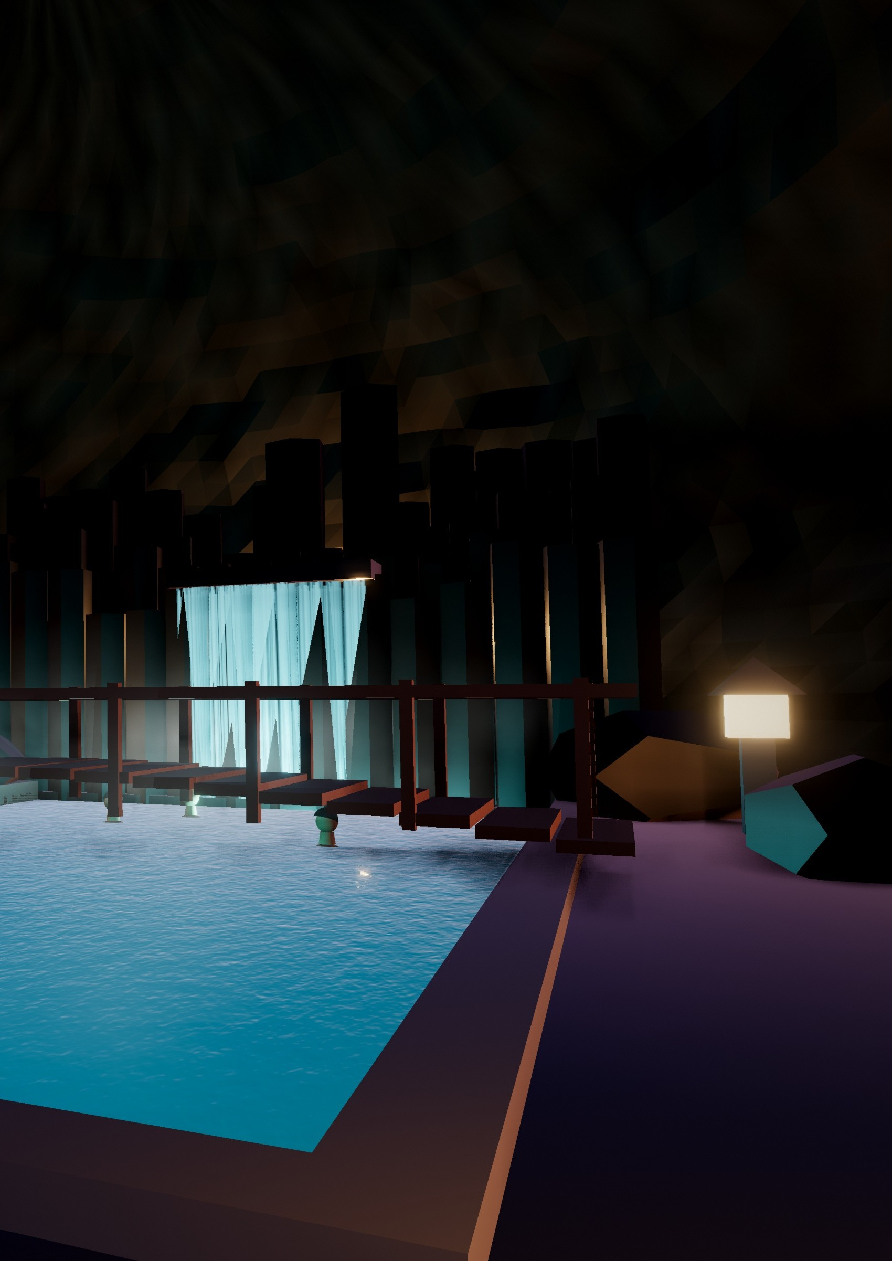
WHERE THE WORLD IS TODAY
REALITY CHECK
Iceland’s Blue Lagoon bathes visitors in 37–39 °C water from a geothermal power plant [9], and Switzerland’s Therme Vals is cut into a hillside [10]. Mount Aurora goes further: the whole snow peak becomes the building.
73 °C apart
An insulated rock shell holds 28 °C inside at −45 °C outside. It needs a hot spring below, to be confirmed by drilling, and thermosyphons like the Trans-Alaska Pipeline’s [14] keep the ground frozen.
The Mineral Lake Grotto: a larch footbridge crosses the 7 × 13 m lake, and stone lanterns light the shore below the basalt wall.
19

Slide 22
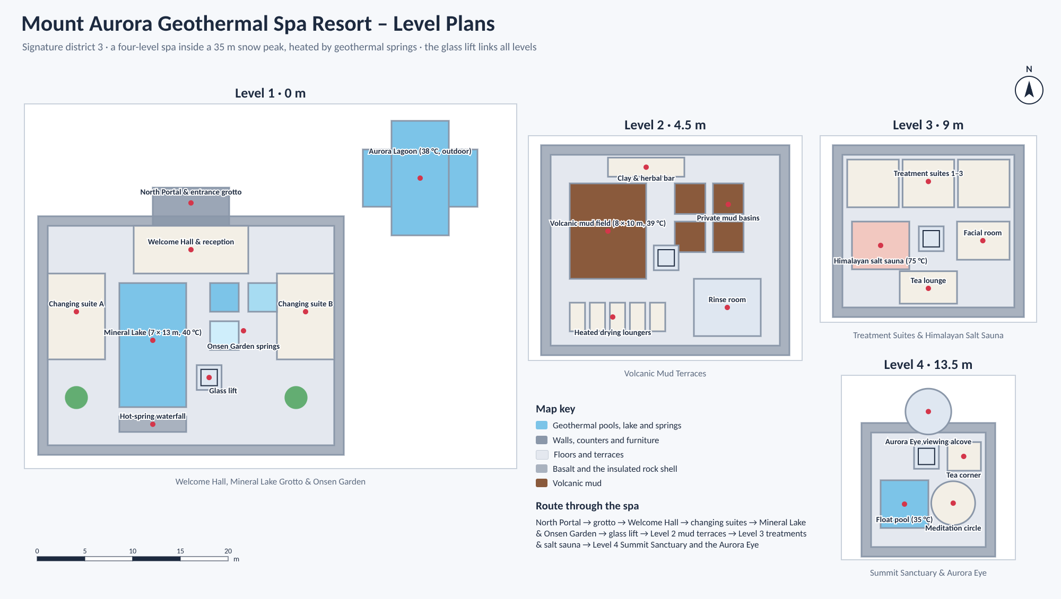
MOUNT AURORA · LEVEL BY LEVEL
Four Floors of Warmth
Mount Aurora Geothermal Spa Resort – Level Plans. The glass lift links all four levels.
LEVEL 1 · 0 M
LEVEL 2 · 4.5 M
Welcome Hall, Mineral Lake Grotto & Onsen Garden
A 40 °C silica-rich spring rises into a 7 × 13 m Mineral Lake; hot, warm and glacier-cold pools boost circulation.
Volcanic Mud Terraces
An 8 × 10 m mud field held at 39 °C. The mud is filtered and UV-sterilised every night and reused for months.
LEVEL 3 · 9 M
LEVEL 4 · 13.5 M
Treatment Suites & Himalayan Salt Sauna
Hot-stone massage, arctic kelp wraps and a 75 °C pink salt sauna heated by the geothermal loop.
Summit Sanctuary & Aurora Eye
A 35 °C float pool, a meditation circle and a heated glass bubble for watching the northern lights.
ALSO A SHELTER In a disaster, the mountain becomes a warm refuge for up to 1,000 people: geothermal heat, mineral water and the food reserve keep it running even if the city’s power fails.
Route through the spa: North Portal → grotto → Welcome Hall → changing suites → Mineral Lake & Onsen Garden → glass lift → mud terraces → treatments & salt sauna → Summit Sanctuary and the Aurora Eye.
20

Slide 23
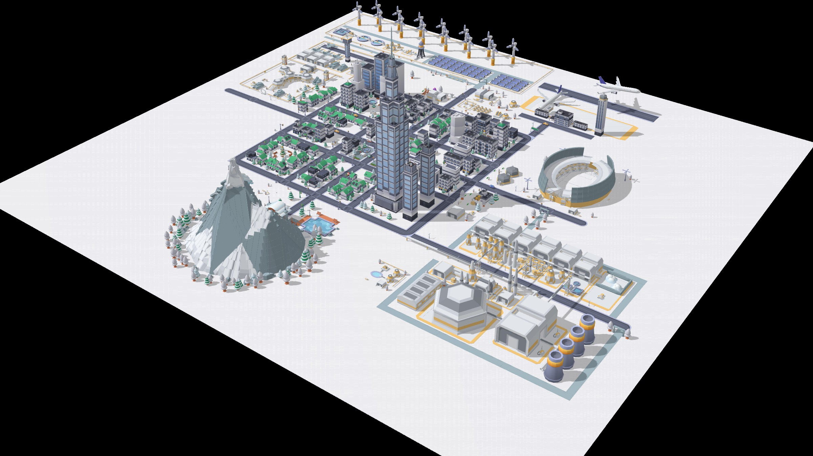
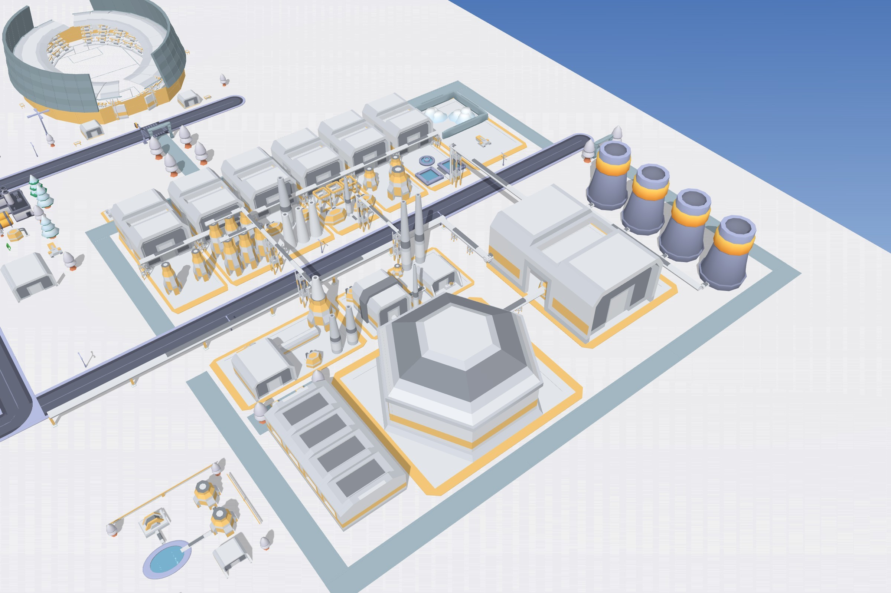
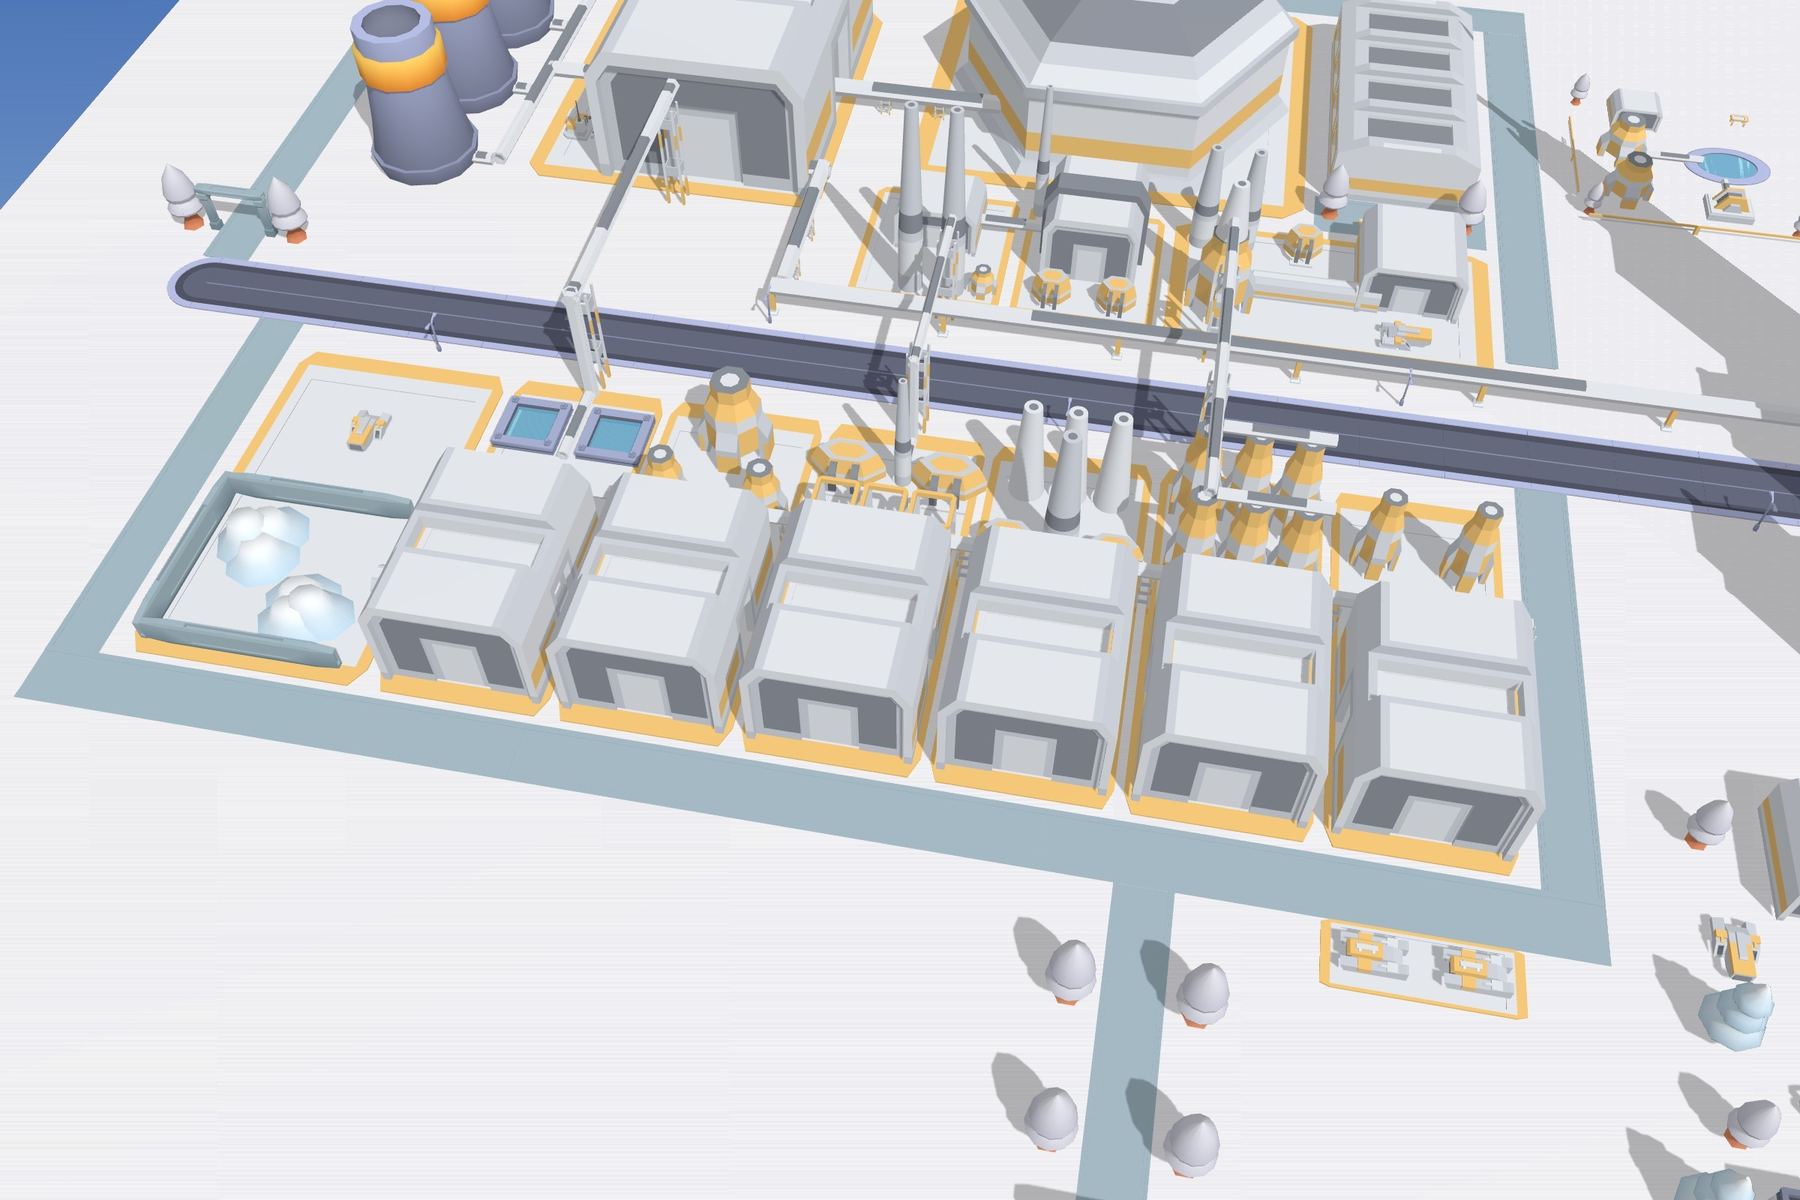
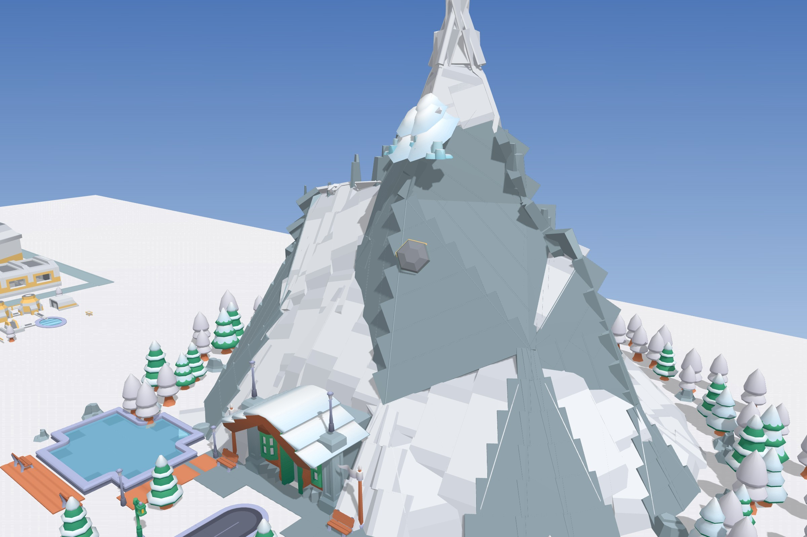
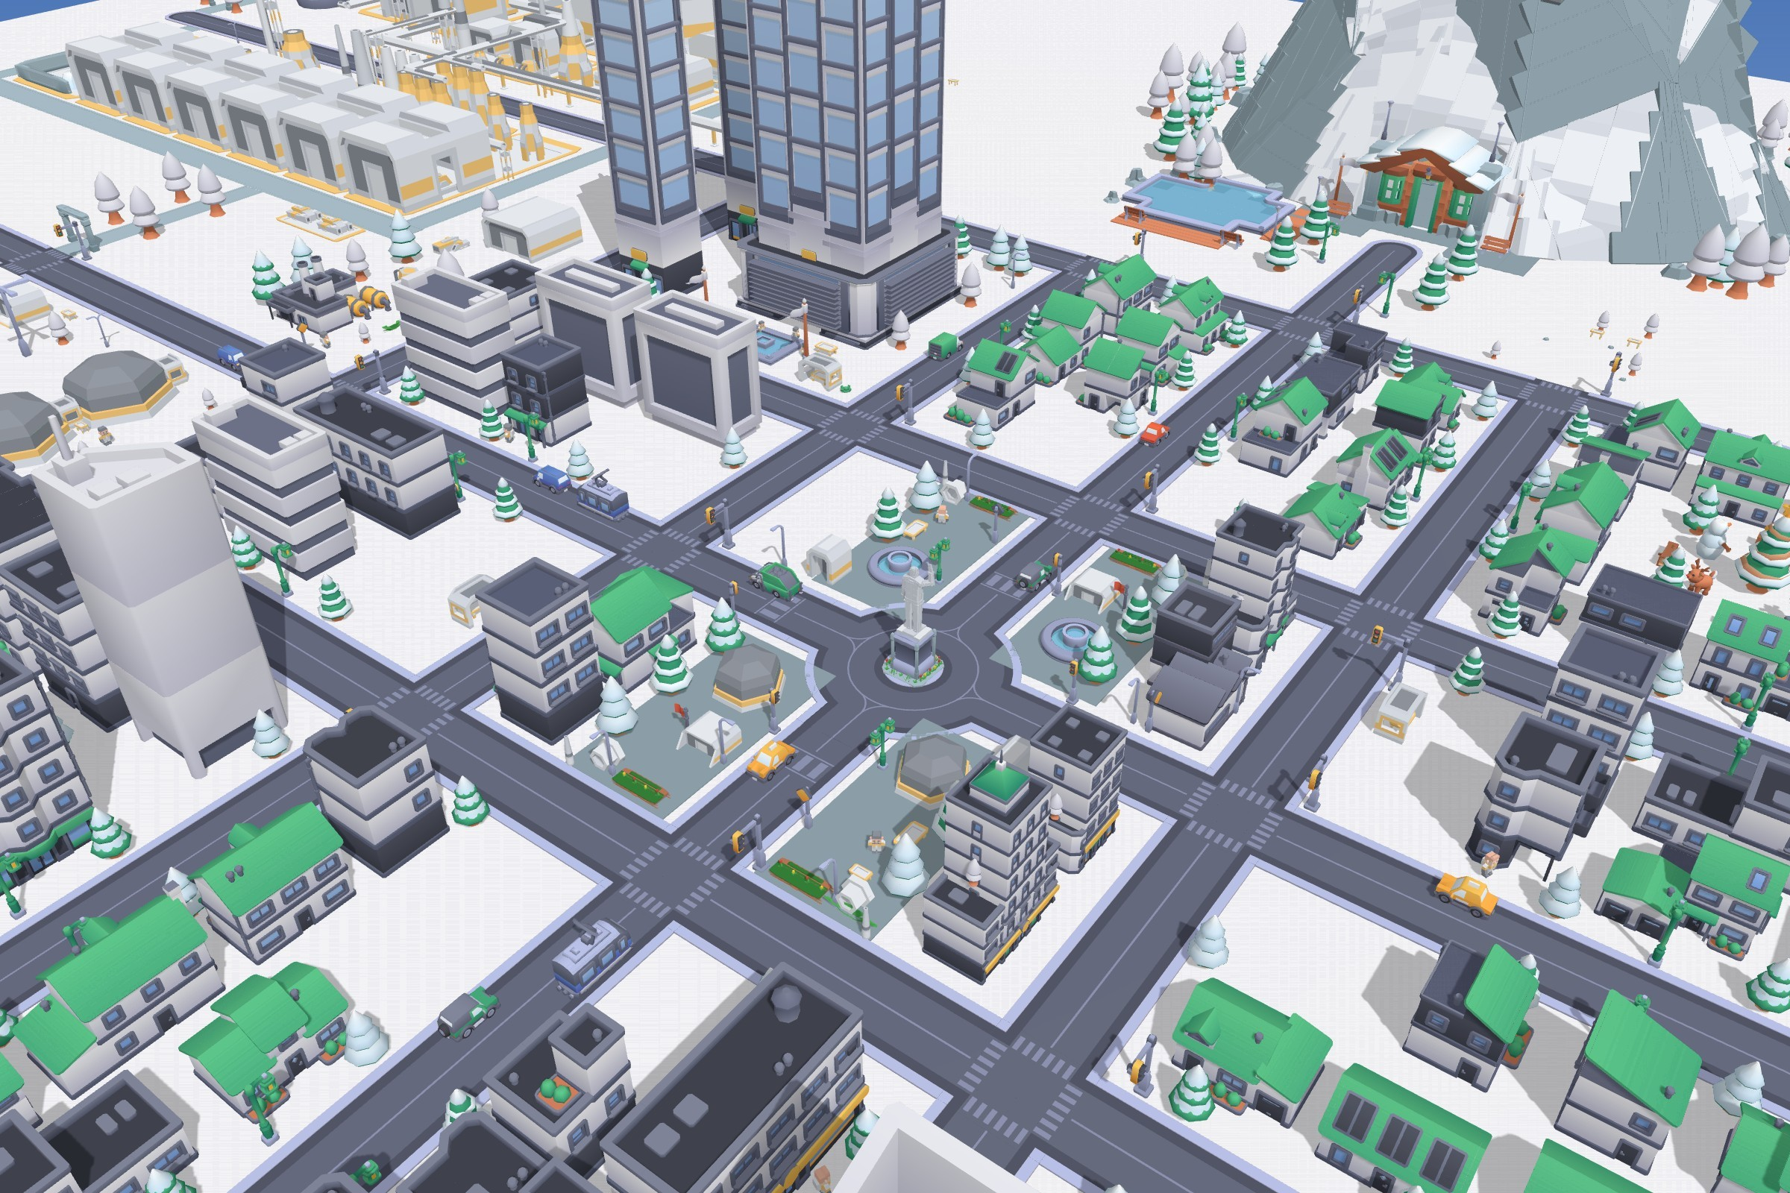


OUR ECO-POLIS MODEL
Built by Us
Before any picture in this magazine, we built Aurora Haven ourselves in the Eco-Polis Builder: 241 named places, each with its own purpose and special features.
The whole city in our Eco-Polis model.
Fusion Power Station
Snow-to-Food & Water Plant
Mount Aurora
Downtown
EXPLORE OUR 3D CITY
1. Scan the first code to download our map file.
2. Scan the second code to open the Eco-Polis Builder.
3. Click the Load button (folder icon) and choose Aurora_Haven.json.
4. Click Lock (View), then Full Screen.
5. Drag to turn, scroll to zoom, and click a building to read about it.
1 · Download our map
2 · Open Eco-Polis
Aurora_Haven.json
ecopolis3d.netlify.app
21

Slide 24
THE BIG IDEA
Three Districts, One Loop
The three signature districts do not work alone. Heat, water, oxygen and waste go round from one to the next instead of being thrown away.
Spare heat melts the snow
Fusion Power Station
Hydrogen & CO₂ made from rubbish
Snow-to-Food Plant
heat · power · waste converter
Deuterium-rich water returns as fuel
water · food · oxygen
Oxygen for the waste converter
↓ Heat, power and MRI helium
↑ Rubbish for the waste converter
Food for the spa cafés
Drinking water, food and medical oxygen
The City
Mount Aurora Spa
45,000 people, every building and the hospital
geothermal wellbeing
Geothermal springs
Heat
Water
Spare heat from the fusion station melts the snow at the food plant, so the snow does the job of a cooling tower.
The food plant’s electrolysers leave slightly deuterium-rich water, which goes back to the fusion station as fuel.
Oxygen
Waste
The same electrolysers supply oxygen to the plasma waste converter and the hospital.
The converter turns rubbish into hydrogen and CO₂ for the food lines, and its slag becomes paving.
Wellbeing
The spa turns geothermal heat into rest and health, and its restaurants serve food from the plant.
22

Slide 25
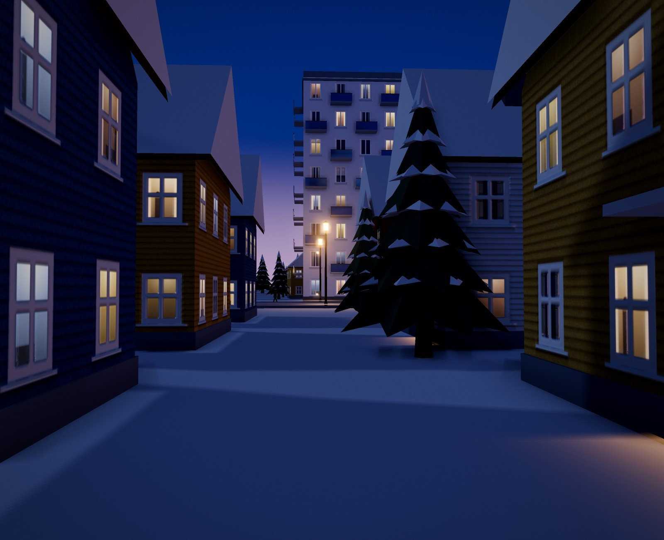
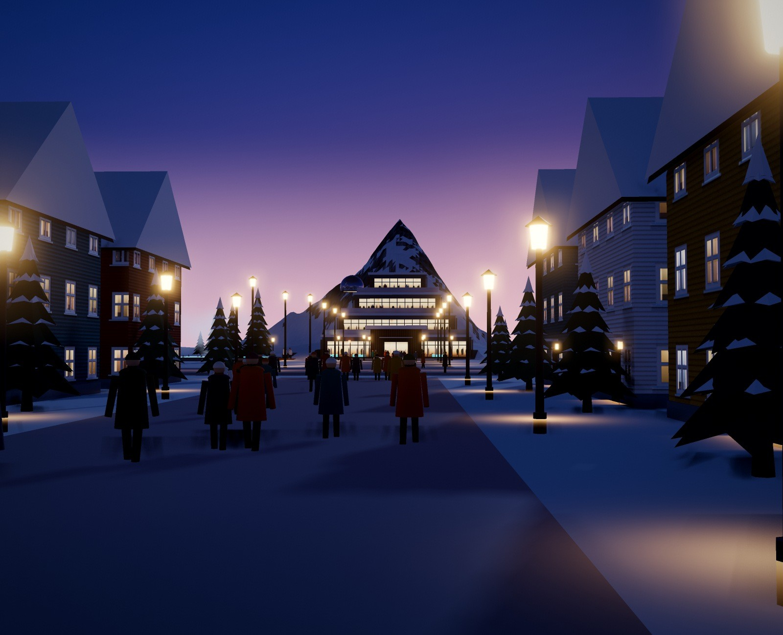
EVERYDAY LIFE
A Livable City Every Day
Snowpine Residences at dusk. Sidewalks warmed by district-heating return water stay snow-free, and spruces shelter the courtyards from the wind.
HOMES
Family houses in Snowpine Residences, the western eco-homes, towers such as the Aurora 81 Residences and Ice Crystal Apartments, co-living, student and senior housing.
LEARNING
Three kindergartens, Snow Lantern Primary School, the Northern Lights School for ages 6 to 18, and Arctic University.
HEALTH
Snowflake General Hospital with about 250 beds and a 24-hour emergency department, a campus clinic and a 24-hour pharmacy.
The Mount Aurora Approach: low buildings keep the summit in view, and warm, low-glare lanterns do not hide the aurora.
SHOPPING
250
5,000
Igloo Fresh Supermarket, Tundra Grocery, the night and fish markets and the Aurora Glacier Mall with its indoor atrium park.
hospital beds
students at Arctic University
CULTURE AND PARKS
Aurora Cinema, a music hall, a library open 24 hours in the polar night, the Snow Stadium and parks with heated benches.
23

Slide 26
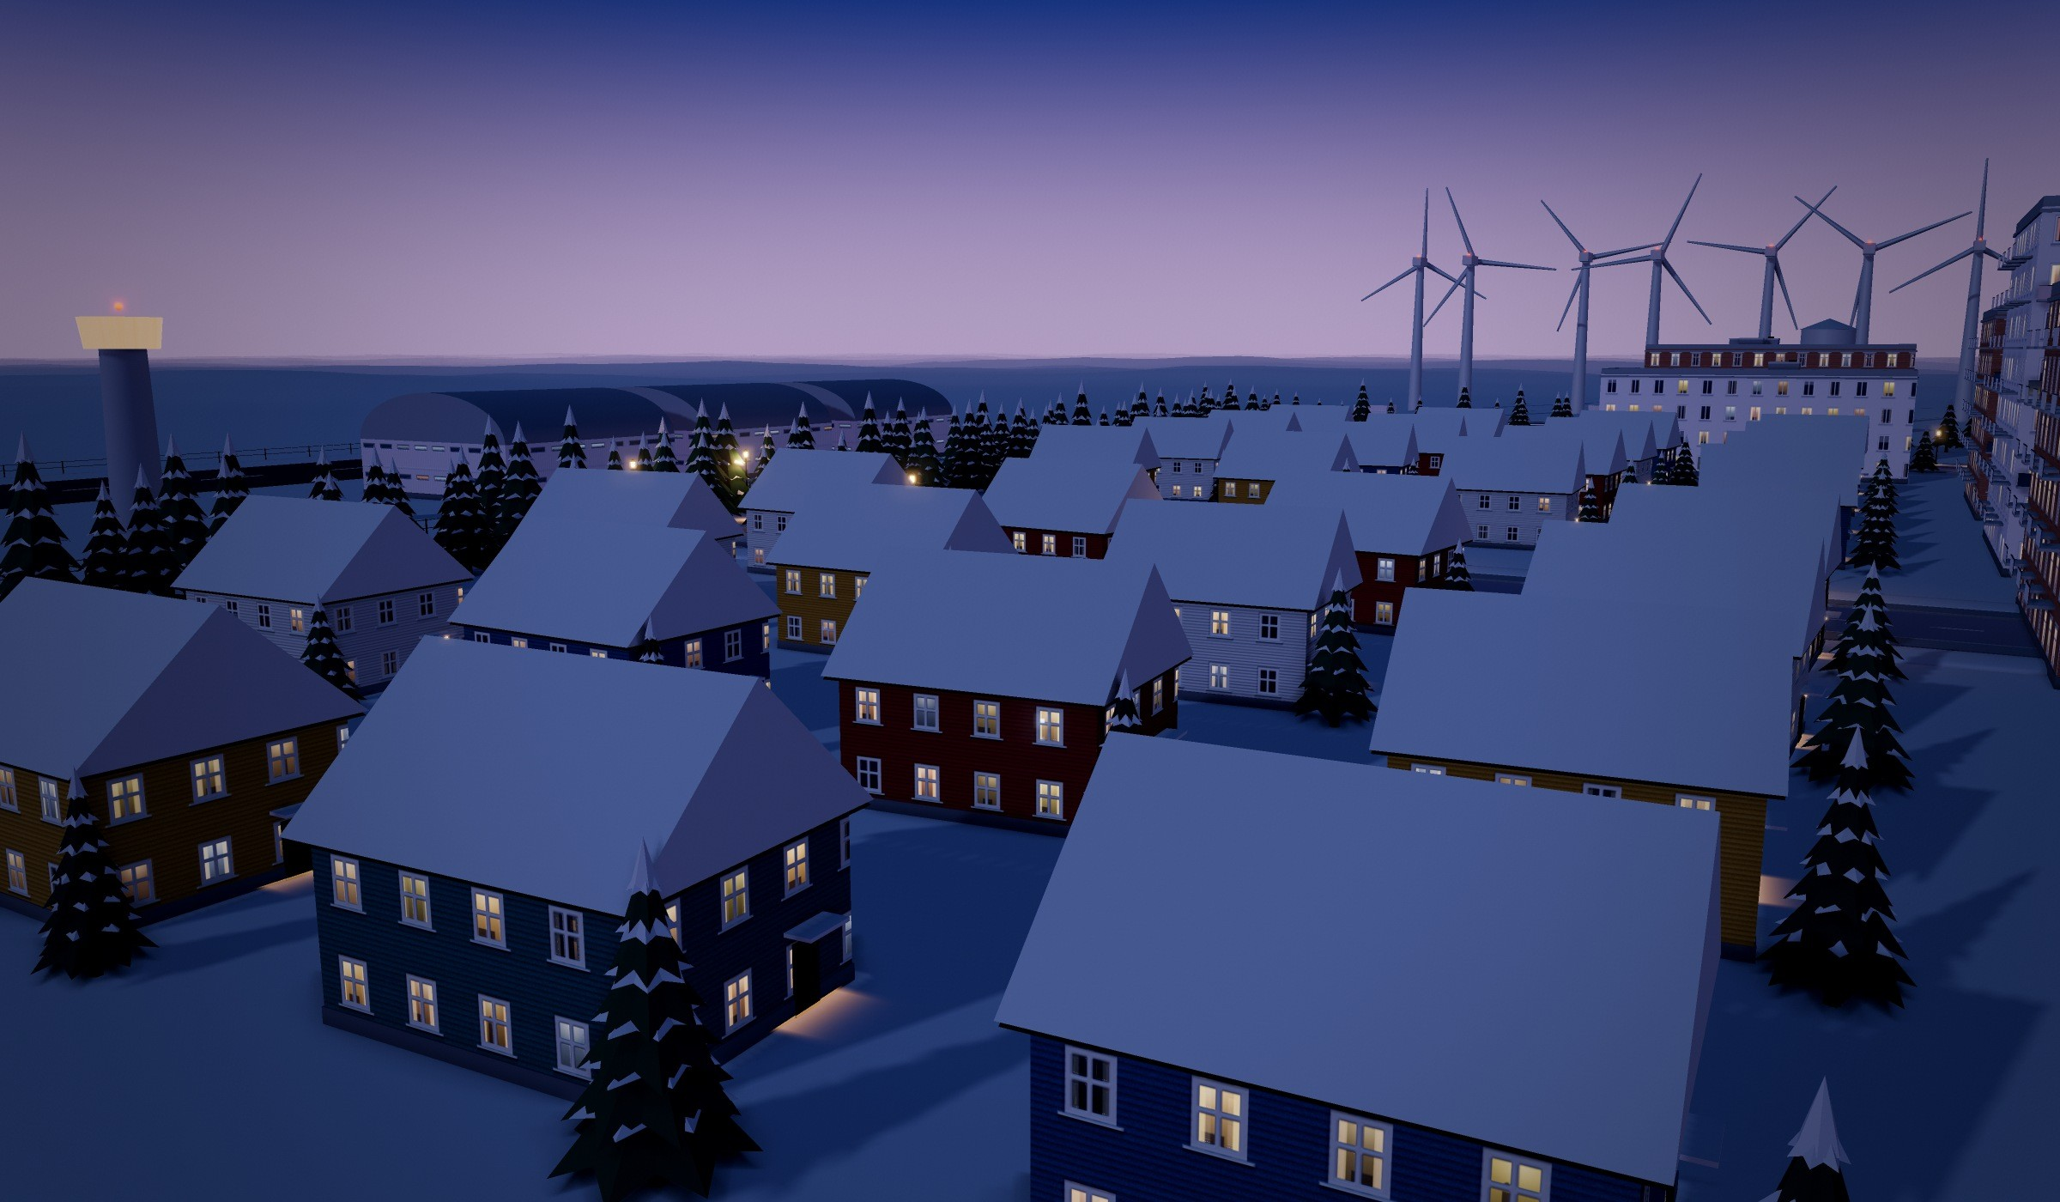
The western eco-homes at dusk, with the Ice-Proof Wind Farm and the air base behind.
HOUSING
Homes for the Polar Night
From passive eco-homes to towers with sky gardens, every home is built to stay warm, bright and safe at −45 °C, without thawing the ground beneath it.
HOW A HOME BEATS THE COLD
Insulated piles
Passive-house shell
Heat-recovery air
Homes stand on insulated piles above a ventilated air gap, so their warmth never thaws the permafrost.
Thick walls, triple glazing and an airtight shell: an eco-home needs about 80% less heat than an ordinary house.
Fresh air is warmed by the stale air going out, saving about 80% of the heat that would escape.
Winter-garden balconies
Snow-shedding roofs
Light in the dark
Glass-enclosed balconies stay usable at −45 °C and act as a warm buffer for the wall behind.
Steep, smooth roofs shed heavy snow by themselves, so they never overload or need shovelling.
Light tubes bring daylight deep inside, and dawn-simulating lamps wake families in the polar night.
A HOME FOR EVERYONE
600
350
150
120
12
apartments in the Aurora 81 Residences
apartments in Ice Crystal Apartments
older residents in Golden Aurora Senior Residences
rooms in the Student Residence Hall
residents in the Snowpine Senior Care Home
Plus family houses in Snowpine Residences and the Frostline Co-Living Tower for newcomers, young workers and visiting researchers.
24

Slide 27
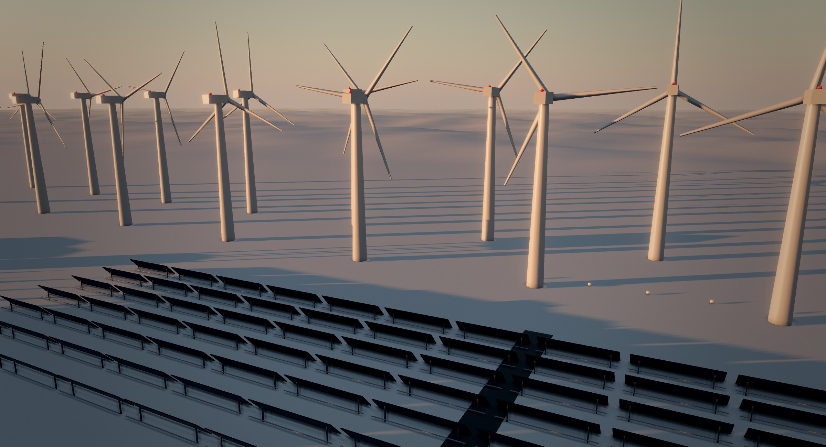
CLEAN ENERGY, DAY AND POLAR NIGHT
Energy for the Polar Night
Northern Renewable Park in the low sun: the Ice-Proof Wind Farm behind the Bifacial Solar Farm.
Wind and sun start the city’s own sun. Once fusion is running, they step back and stand guard.
1 · START-UP
2 · RUNNING
3 · BACKUP
200 MWh
300 + 450 MW
12 h
The Ice-Proof Wind Farm (60 MW) and the Bifacial Solar Farm fill the battery bank, which gives the big burst of power that starts the reactor’s magnets and heaters. The panels also catch light off the snow: tests in snowy Canada found about +19% [17].
Once the plasma burns, the fusion station keeps itself going and gives the whole city electricity and heat, day and polar night.
If the reactor stops for repair, wind, sun, the batteries, the 24-hour geothermal plant and the 12-hour heat tank take over, so no home goes cold.
25

Slide 28
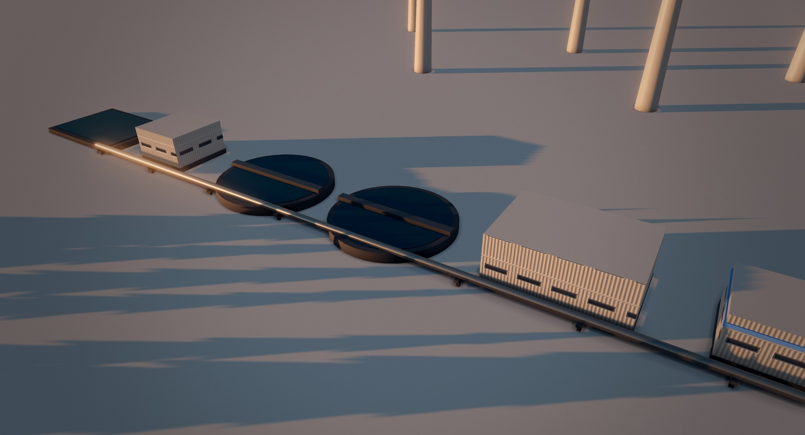
WATER AND WASTE
Nothing Is Wasted
The six-stage Water Recycling Line in the Northern Renewable Park, with the wind farm behind.
THE SIX-STAGE WATER RECYCLING LINE
1
2
3
4
5
6
Snowmelt & greywater intake
Intake pumps & bar screen
Settling basins
Sand & membrane filters
UV disinfection
Recycled water tower
In Aurora Haven, water goes round and round. Clean snow becomes drinking water at the Snow-to-Food plant. Used greywater from homes flows to the Water Recycling Line: screens, settling basins, sand and membrane filters, UV light, and finally a tower that feeds toilets, laundries, greenhouses and fire hydrants.
Dirty street snow is melted separately and never reaches the taps.
The Circular Recycling Center sorts about 30 tonnes of materials a day with AI optical sorters and robot arms. Food scraps become biogas, and the Plasma Waste Converter handles what is left, turning it into clean gas and building blocks.
Nothing goes to landfill in the permafrost.
95%
30 tonnes
0
of water is used again
of materials sorted every day
rubbish sent to landfill
26

Slide 29
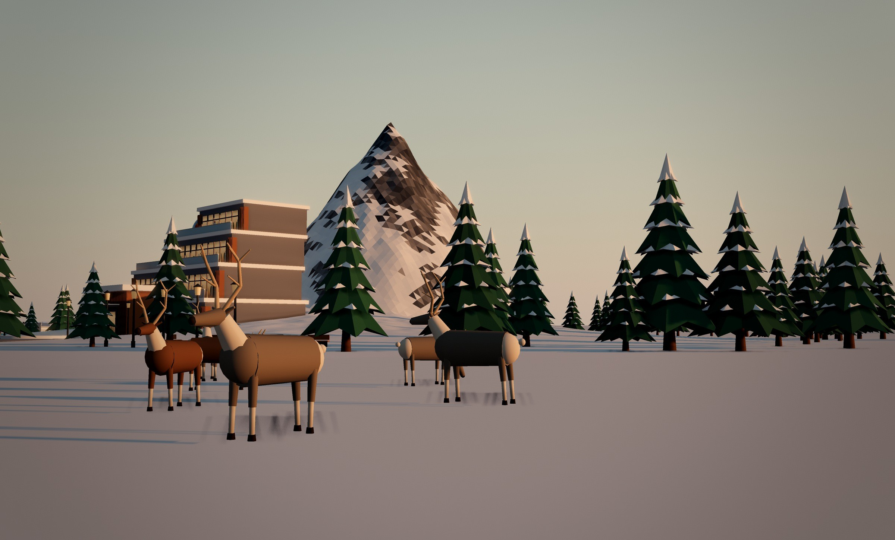
The eco-tour reindeer herd grazing on the tundra by the Snow Garden Park, with the foothill pines and Mount Aurora behind.
URBAN ECO-SYSTEM
Wild Neighbours
Aurora Haven is built to share the tundra: animals can move through the city, plants work as snow fences, and farmed life closes the food loop.
ANIMALS
PLANTS AND FARMED LIFE
Wildlife corridors. Snow-laden trees on the eastern and western edges give snow buntings, ptarmigans, arctic foxes and hares cover between the open tundra and the parks. Roads beside them have dimmed lights and wildlife underpasses.
Fences with gaps. Park fences have open rails, so drifting snow blows through, and gaps at ground level, so foxes and hares pass freely.
Reindeer. The eco-tour herd is cared for by herders who follow Sámi traditions. Rides last only a few hours a day, and GPS collars help find animals grazing on the tundra.
Polar bears. Fibre-optic sensors in the air base fence alert a wildlife team when a bear comes close, so people and bears stay apart safely.
Living snow fences. Belts of snow spruces and arctic pines trap drifting snow before it reaches the streets; the clean snow is collected for the food plant.
Green stepping stones. Snow lindens line Liberty Mall, and dwarf pines in heated planters on the Aurora 81 Sky Garden give birds a stepping stone across the city.
Aquaponics. In the Evergreen Aquaponics Dome, Arctic char and rainbow trout feed beds of lettuce, herbs and strawberries; the loop loses under 2% of its water a day.
Shelter and science. Rock gardens and boulders shelter ptarmigans and hares; nest boxes and a camera let schoolchildren count visitors with the Polar Climate & Ice Research Institute.
HOW THEY SURVIVE Arctic foxes grow a deep, pale winter coat that blends into the snow and keeps them warm down to about −50 °C [15]. The city helps them with cover, safe crossings and dark nights: outdoor lights switch on only when something moves.
27

Slide 30
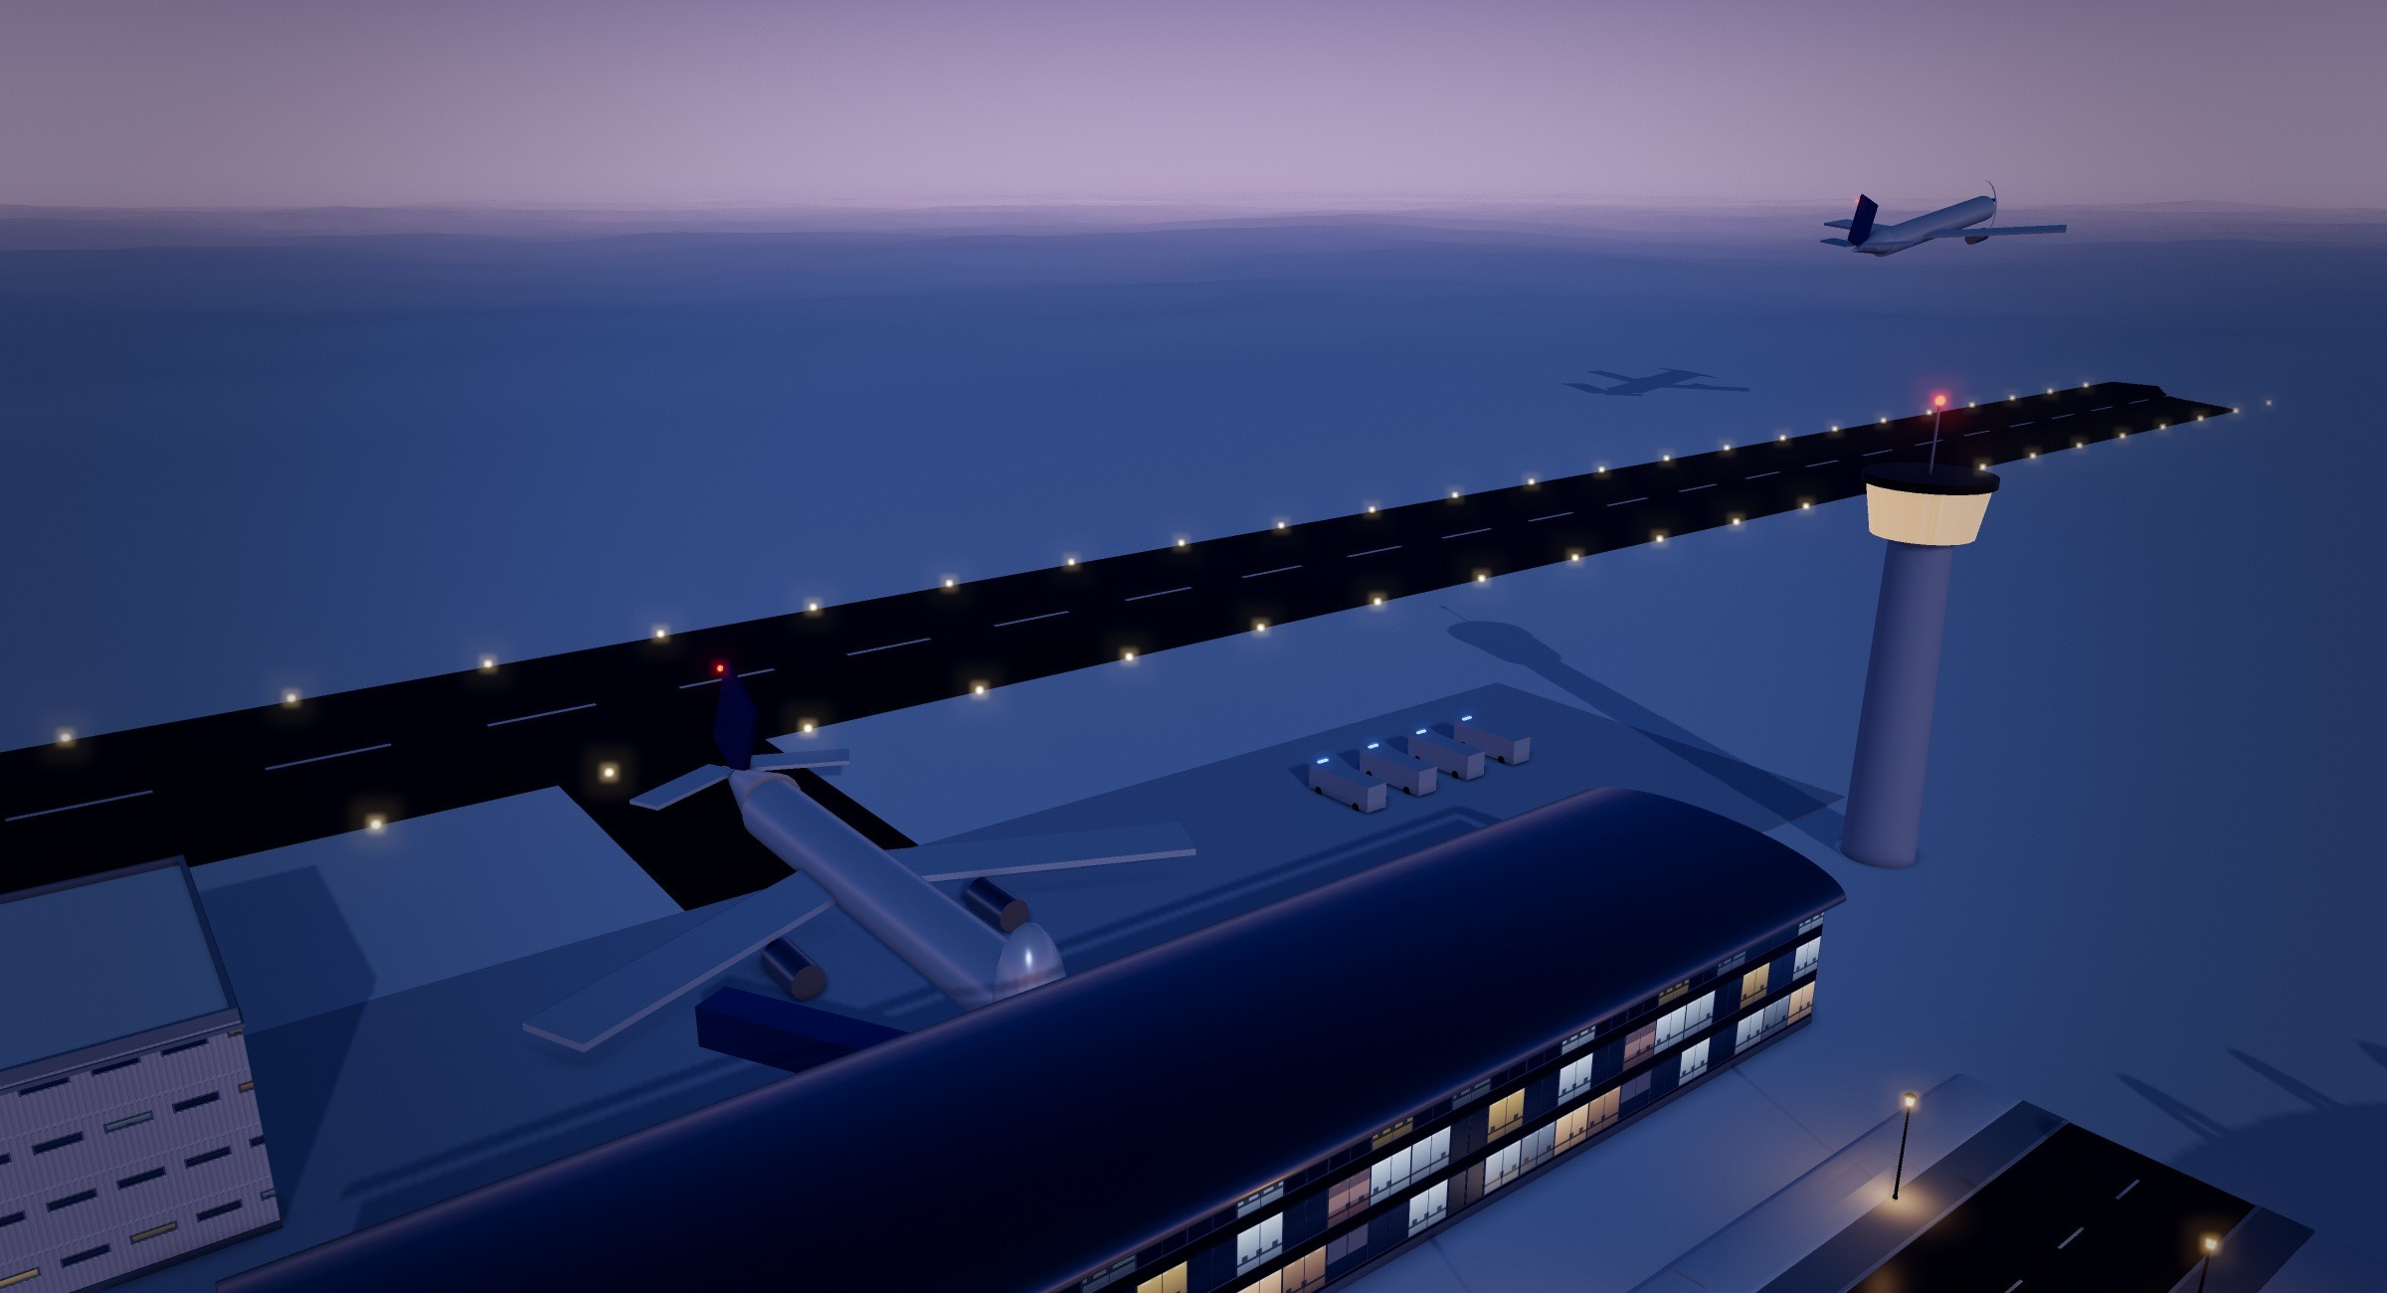
TRANSPORT
Getting Around Fossil-Free
Compact Polar Airport at dusk: the glass terminal, the control tower and Flight VN-81 climbing out.
Transport in Aurora Haven is electric and built for the cold. The heart of it is the metro: the north–south Aurora Line and the deep east–west Glacier Line meet at the Central Interchange Station under Liberty Mall. The driverless four-car trains run underground, so blizzards never stop them.
On the streets there are electric trams, buses and shared robotaxis, and people wait in heated bus shelters. The roads are warmed from below, so no salt is needed, as in Reykjavík, where water returning from home heating melts the snow under streets [18].
The airport, with its heated runway and e-fuel planes, keeps the city supplied through deep winter.
Aurora Line
north–south
Central Interchange Station, under Liberty Mall
Glacier Line
east–west
Who rides
How many
Safe in a storm
Powered by
Commuters, students, shoppers and stadium fans. Heated cars have space for wheelchairs, prams and skis.
Our estimate: if a four-car train carries about 400 people, a train every 3 min moves about 8,000 people an hour each way. After stadium events, trains every 90 s could clear the 8,000 seats in about 30 minutes.
Deep, insulated tunnels kept at about +5 °C, emergency walkways with glow strips, and doors straight into the four shelters.
All-electric and driverless. Braking returns about 30% of the energy, and insulation, not heaters, keeps the tunnels above freezing.
3 min
30%
2,800 m
between trains at rush hour
of train energy returned by braking
heated airport runway
28

Slide 31
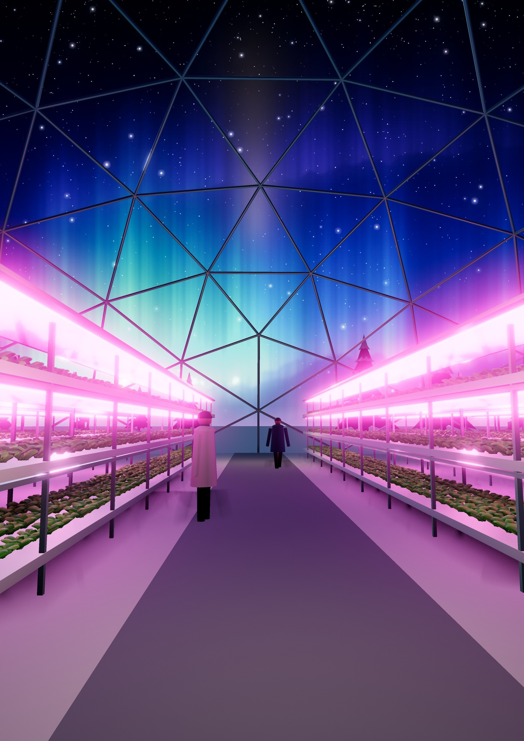
EVERGREEN GREENHOUSE DOME
Salad Under the Northern Lights
Fresh salad, tomatoes, peppers, herbs and berries all year, even in the polar night and in winters when supplies can only arrive by air.
Inside the Evergreen Greenhouse Dome, where the flowers for the monument’s red and yellow beds are raised too.
18 h
The dome is heated by the district-heating loop and wrapped in thermal curtains at night. LED grow lights give the plants 18-hour “days” on stacked hydroponic racks, and CO₂ from the biogas plant and the waste converter boosts growth.
LED “days” for the plants
90%
less water than fields [16]
29

Slide 32
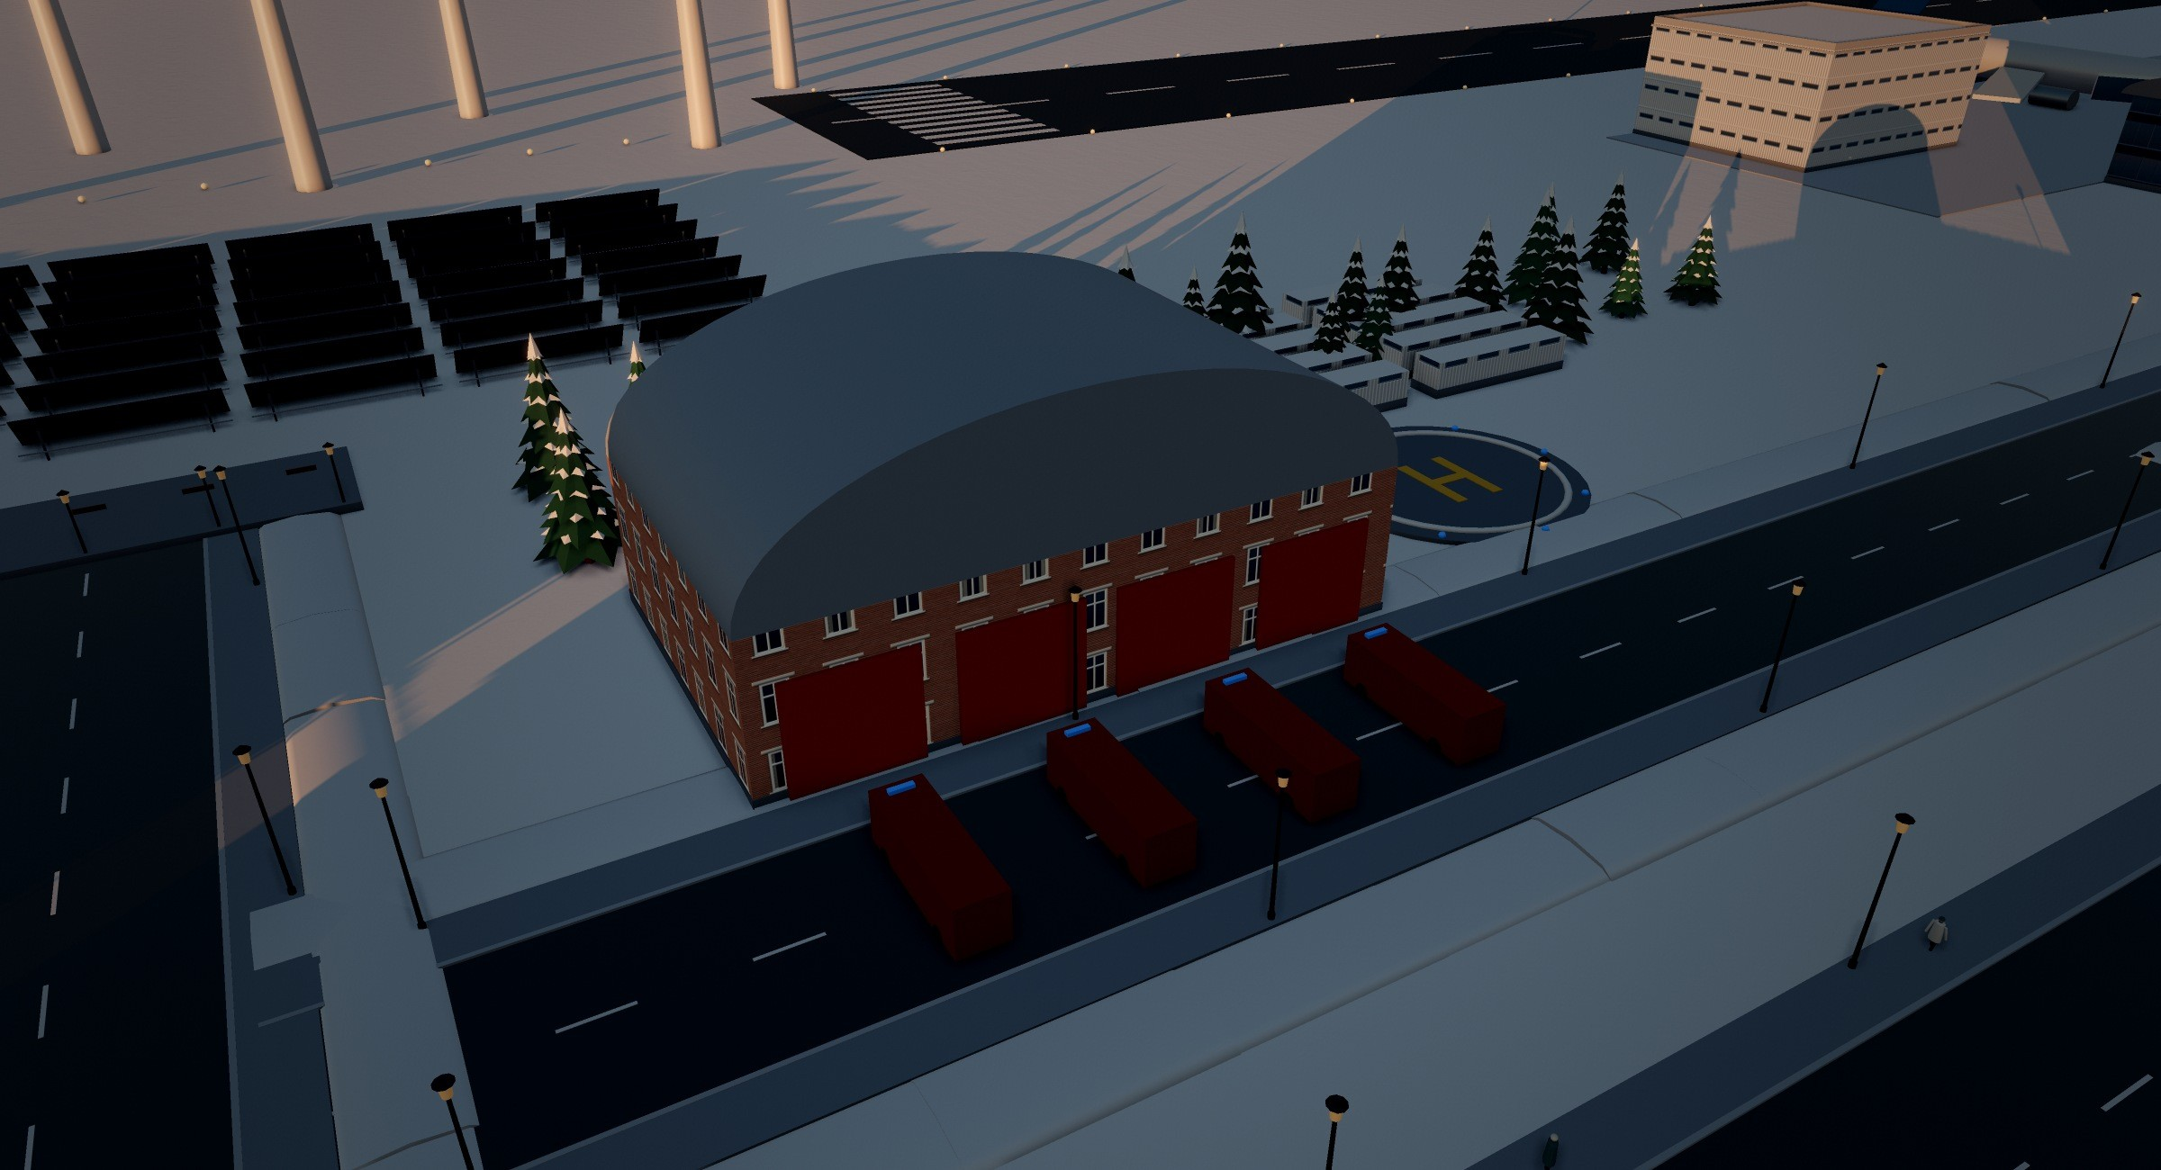
SAFETY
Safe and Ready for Any Storm
The Polar Rescue and Resilience Station in the Energy Hub, north of downtown, with its helipad.
In the polar night, safety comes first. The Polar Rescue and Resilience Station is home to the fire brigade, ambulances, ice rescue and the 112 emergency centre, and its vehicles leave within 60 seconds.
The West Market Fire & Ambulance Station reaches any downtown address in about four minutes, and a rescue helicopter is ready day and night.
Under Liberty Mall, four underground shelters can keep every resident safe for 30 days. Aurora Core, the AI control tower, forecasts blizzards up to 48 hours ahead and alerts every phone.
Cafés and lobbies act as warm points, and the air base runway is a backup for supply flights.
60 s
30 days
48 h
for rescue vehicles to leave
of supplies for every resident
blizzard forecasts
30

Slide 33
WEIGHING IT UP · AN HONEST BALANCE SHEET
Pros & Cons
No city is perfect. Here is what Aurora Haven does well, where it could fail, what it costs and what we gave up to make it work.
ADVANTAGES
LIMITATIONS AND RISKS
Zero carbon. No fossil fuel burns anywhere; four clean energy sources cover for each other.
Water and waste. About 95% of water is recycled, and nothing goes to landfill in the permafrost.
Food security. All tap water and about half of the protein are made in the city.
Safety. Shelters for every resident for 30 days, 48-hour blizzard warnings and a metro that storms cannot stop.
Wellbeing. Daily needs within a 10-minute walk, plus a spa, a 24-hour library and parks for the polar night.
Fusion is not ready. ITER plans deuterium-tritium operation only in 2039 [4]; until fusion works, the city depends on geothermal, wind, sun and storage.
One heating loop. If it fails at −45 °C, homes cool fast; the 12-hour heat tank and the geothermal plant are the safety net.
Thawing ground. Any heat leak could crack foundations, as thaw already threatens Arctic infrastructure [2]; sensors must watch it constantly.
Cut off by storms. In deep winter all supplies come by air.
High-tech risks. AI control systems need cyber-security and skilled staff, and new foods need people’s trust.
COSTS
Building: a fusion plant is one of the most expensive machines ever made: ITER alone is estimated at €18–22 billion to first plasma [12]. Solar Foods’ first protein factory cost about €42 million for up to 160 tonnes a year [6]. Heated streets, insulated tunnels and triple glazing all cost more than ordinary ones.
Running: direct air capture uses a lot of energy and still costs hundreds of dollars per tonne of CO₂ [13]. Hydroponic lettuce needs about 82 times more energy than field lettuce, but about 92% less water and 11 times less land [16].
TRADE-OFFS: WHAT WE CHOSE, AND WHAT WE GAVE UP
Compact blocks that save heat
→
smaller homes and less private space
Metro, trams and shared robotaxis
→
fewer private cars and less freedom to drive
Lights that switch on only when needed
→
darker streets, for the aurora and the wildlife
Limited reindeer rides, protected corridors
→
less tourist income, healthier animals
Factory-made food
→
no farmland needed, but more electricity and new tastes
OUR PLAN B Build in stages: first the geothermal plant, the wind and solar farms, the battery bank and the heat tank; add the fusion station when the technology is proven. Until then, the city grows more slowly.
31

Slide 34
INVESTMENT OPPORTUNITY
Invest in Aurora Haven
The Mount Aurora Approach at dusk: the street from downtown to the spa.
Aurora Haven needs partners to build it. We are looking for investors who want a share in a zero-carbon city, built step by step, starting with technology that already works today.
THREE WAYS TO INVEST
1
Green city bonds
2
Community shares
3
Research partnerships
Fund Stage 1: the geothermal plant, the wind and solar farms, the battery bank and the heat tank, paid back from selling heat and power to the city.
Residents and visitors buy shares in the wind and solar farms through the Aurora Green Finance Hall and share in the income they make.
Companies and universities test new food, energy and building ideas with Arctic University and the Polar Climate & Ice Research Institute.
WHAT YOUR MONEY BUILDS, STAGE BY STAGE
1
Stage 1 · A clean base. Technology that works today: the geothermal plant, the wind and solar farms, the battery bank, the heat tank, heated streets and the metro.
2
Stage 2 · Food and water. The Snow-to-Food & Water Plant, starting small. For scale, Solar Foods’ first protein factory in Finland cost about €42 million for up to 160 tonnes a year [6].
3
Stage 3 · Fusion. Built only when fusion power is proven. It is the most expensive part: ITER alone is estimated at €18–22 billion to first plasma [12], which is why it comes last.
WHAT INVESTORS GET BACK
Steady income from heat, power, water and food sold to 45,000 residents
Visitors to the Mount Aurora spa and the Snow Stadium all year
Know-how other Arctic towns can use: about 4 million people live in the Arctic [3]
A city with no fuel to import and no carbon to pay for
Please note: these are future concepts, not tested projects. Costs and returns still have to be worked out in a full business plan, and no return is guaranteed. The risks are on page 31.
READY TO BUILD THE FUTURE? Visit the Aurora Green Finance Hall in the Financial District, or meet our team on page 3.
32

Slide 35
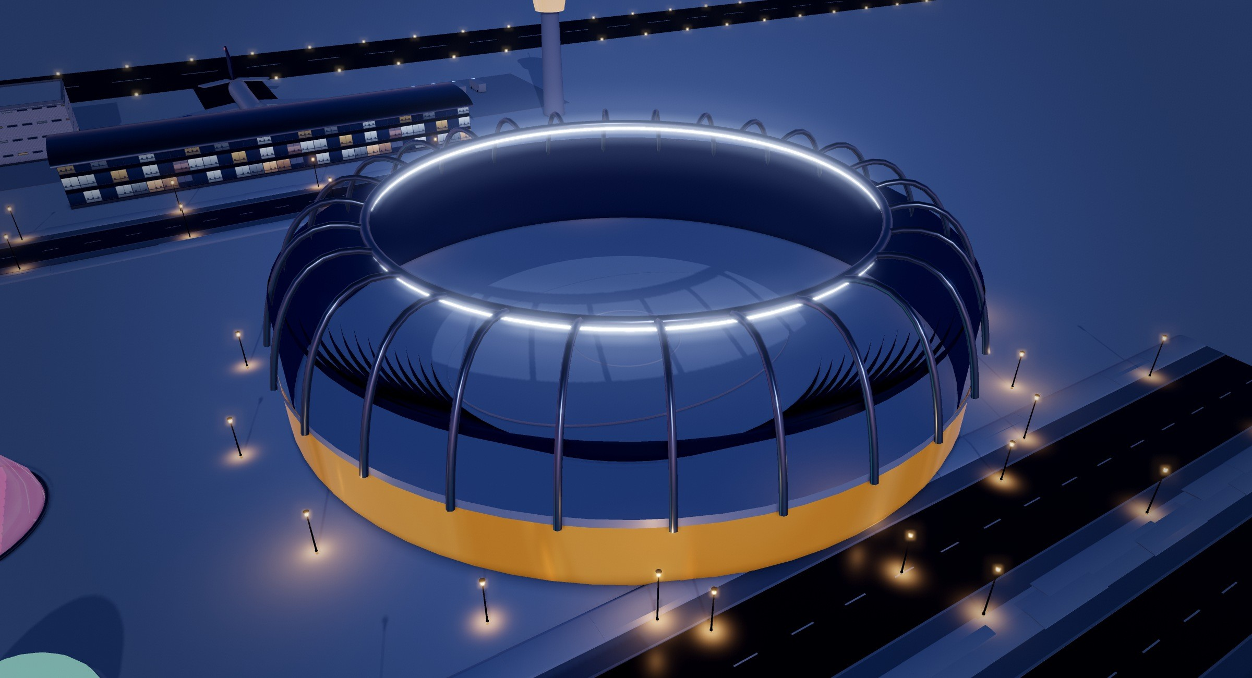
EXPLORE
Take the Tour: Eight Stops
A walk around Aurora Haven in eight stops, from the civic heart of downtown out to the plants, the snow peak and the windy northern edge.
1
Founding Mayor Monument
The civic heart of the city on the Aurora Roundabout.
2
Metro Entrance – Central Interchange Station
Escalators down to the metro and the shelters.
3
Snowflake General Hospital
About 250 beds and a 24-hour emergency department.
4
Fusion Core – Compact D-T Tokamak
The city’s own sun.
5
Snow Harvest & Melt Hall
Melts about 3,000 tonnes of snow a day with spare fusion heat.
6
Aurora Snow Stadium at dusk.
Mount Aurora – Snow Peak & Hanging Glacier
The 35 m peak with the spa inside.
BEHIND THE BUILD
7
Ice-Proof Wind Farm
Two rows of turbines making about 60 MW.
35
key places, numbered on the master plan
8
Polar Rescue and Resilience Station
Home of the 112 emergency centre.
9
If there is time: the Aurora Lagoon, the Bifacial Solar Farm and the Recycled Water Tower.
downtown blocks around the Aurora Roundabout
33

Slide 36
GUIDE · 35 KEY PLACES
Places to Visit
The numbers match the markers on the city master plan on page 10.
1
Founding Mayor Monument
19
Summit Sanctuary & Aurora Eye
The city’s civic heart on Aurora Roundabout: ceremonies, national holidays and walking tours.
Float pool, meditation circle and the Aurora Eye viewing bubble for the northern lights.
2
Aurora Civic Center & Municipal Hall
20
Aurora Lagoon – Outdoor Geothermal Mineral Pool
Town hall for the city council, ID cards, permits, housing and family services.
38 °C open-air silica pool for bathing under the northern lights.
3
Snowflake General Hospital
21
Fusion Core – Compact D-T Tokamak
Main hospital with about 250 beds and a 24-hour emergency department.
150-million-degree plasma giving about 800 MW of heat; it cannot melt down.
4
Northern Lights School & Botanical Conservatory
22
Power Conversion & Heat Export Hall
Primary and secondary school for about 900 pupils aged 6–18.
Makes about 300 MW of electricity and sends about 450 MW of heat to the city.
5
Igloo Fresh Supermarket & Food Hall
23
Plasma Waste Converter
Downtown’s main supermarket and food court; about half its food is made in the city.
Turns about 20 tonnes of rubbish a day into clean gas, recovered metals and building blocks.
6
Aurora Cinema & Performing Arts Center
24
Snow Harvest & Melt Hall
Cinema and theatre for films, concerts, ballet and school shows.
Melts about 3,000 tonnes of clean snow a day with spare fusion heat.
7
Underground Metro & Emergency Shelters
25
Drinking-Water & Mineral Works
Metro interchange linked to four shelters that last 30 days.
Makes about 2,500 m³ of drinking water a day, all of the city’s tap water.
8
Aurora Core – AI Control Tower
26
Bioreactor Silos
Operations centre where an AI digital twin runs traffic, heat, power and alerts.
Six silos where microbes make about 2.5 tonnes of protein flour a day.
9
Aurora Haven Police Headquarters
27
Ice-Proof Wind Farm
Central police station with a 24-hour police control room.
Two rows of ice-proof turbines making about 60 MW.
10
Arctic University – Main Hall
28
Bifacial Solar Farm
Lecture halls for about 5,000 students of polar engineering, fusion, food science, medicine and climate.
Double-sided panels that make power 24 hours a day in the midnight-sun months.
11
Aurora Public Library
29
Water Recycling Line – Recycled Water Tower
Free library, open 24 hours in the polar night; lends skis, telescopes and light-therapy lamps.
Stores recycled water for toilets, laundries, street cleaning, irrigation and hydrants.
12
West Market Fire & Ambulance Station
30
Geothermal Power Plant
Downtown fire and ambulance branch that reaches any downtown address in about 4 minutes.
Clean electricity and hot water around the clock; the second heat source.
13
Aurora Glacier Mall & Crystal Atrium
31
Polar Rescue and Resilience Station
Largest downtown mall, with an indoor atrium park of real trees.
Fire, ambulance and ice-rescue headquarters, home of the 112 emergency centre.
14
Snow Lantern Primary School
32
Glass Terminal, Control Tower & Gate 1 Dreamliner
Primary school for about 450 children aged 6–11 from the southern districts.
Passenger and cargo airport; the city’s supply link in deep winter.
15
Pinecone Kindergarten
33
Evergreen Greenhouse Dome
Kindergarten and day nursery for about 40 children aged 1–6.
Grows fresh vegetables and berries all year under LED light.
16
Aurora 81 – Polar Landmark Tower
34
Circular Recycling Center
Tallest tower and skyline symbol: offices, hotel and sky apartments, net-zero energy.
Sorts, repairs and recycles about 30 tonnes of materials a day.
17
Aurora Snow Garden Park
35
Aurora Snow Stadium
Public park with heated benches, a sledging slope and a snow-sculpture trail.
About 8,000 seats for snow sports, school sports days and the Midwinter Aurora Festival.
18
Mount Aurora – Snow Peak & Hanging Glacier
35 m landmark peak with the four-level spa inside.
34

Slide 37
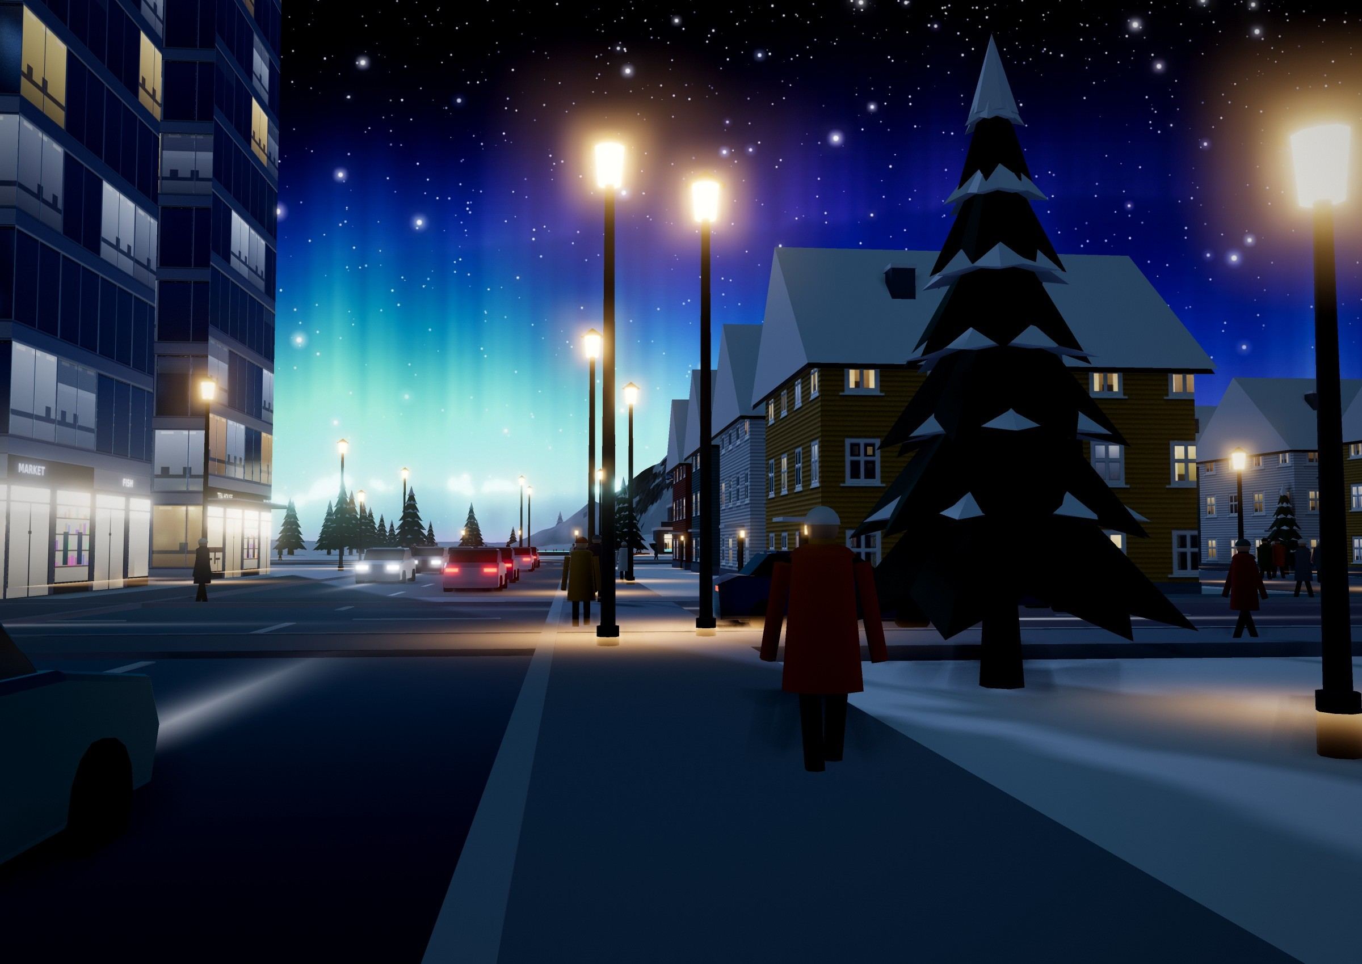
A DAY IN AURORA HAVEN · AN IMAGINED STORY
Through a Resident’s Eyes
It is January, and the sun has not risen for six weeks. This is how a winter day could feel for Mai, sixteen, a student at the Northern Lights School.
07:30 Mai’s flat in the Aurora 81 Residences is warm without a single heater: the district-heating loop brings the fusion station’s heat to every room. Breakfast is bread baked with starch made from snow and air.
08:10 The heated sidewalk outside is dry. She rides the driverless Aurora Line under Liberty Mall, every three minutes, blizzard or not.
12:30 Lunch is a salad grown under LED light in the Evergreen Greenhouse Dome. After school she borrows a light-therapy lamp from the 24-hour library.
17:00 Every phone pings a blizzard warning, two days ahead. The football match moves indoors; nobody panics.
20:00 The spa shuttle takes her to Mount Aurora. She floats in the 38 °C Aurora Lagoon as green curtains of light ripple over the snow peak.
“In the polar night, my city is the warmest place I know.”
Walking home on a heated sidewalk under the northern lights.
35

Slide 38
RESEARCH INTEGRITY
Sources & Assumptions
HOW TO READ OUR NUMBERS
Design values
Our estimates
Future concepts
Figures for our own city plan, such as 300 MW of electricity or 3,000 tonnes of snow a day. They come from our design, not from a real city.
Calculations we made ourselves and marked “our estimate”, such as the metro capacity, or worked out in the Reality check boxes. They show an idea is reasonable, not exact.
The fusion station and the snow-to-food plant do not exist at this size today. They are our team’s ideas for the future; no prototype has been tested.
REFERENCES
[1] Rantanen, M. et al. (2022). The Arctic has warmed nearly four times faster than the globe since 1979. Communications Earth & Environment, 3, 168. doi.org/10.1038/s43247-022-00498-3
[2] Hjort, J. et al. (2018). Degrading permafrost puts Arctic infrastructure at risk by mid-century. Nature Communications, 9, 5147. doi.org/10.1038/s41467-018-07557-4
[3] Arctic Human Development Report (2004). Stefansson Arctic Institute for the Arctic Council: about 4 million people live in the Arctic.
[4] ITER Organization (2024). Baseline 2024: press conference summary, July 2024. iter.org
[5] SPARC (tokamak). Wikipedia, accessed October 2026. en.wikipedia.org/wiki/SPARC_(tokamak)
[6] Solar Foods (2024). Factory 01 starts production of Solein in Vantaa, Finland (press release, 15 April 2024) and Factory 01 press kit. solarfoods.com
[7] Cai, T. et al. (2021). Cell-free chemoenzymatic starch synthesis from carbon dioxide. Science, 373, 1523–1527. doi.org/10.1126/science.abh4049
[8] Dezeen (9 September 2021). Climeworks opens Orca, a direct air capture plant in Iceland. dezeen.com
[9] Blue Lagoon (geothermal spa). Wikipedia, accessed October 2026. en.wikipedia.org/wiki/Blue_Lagoon_(geothermal_spa)
[10] Swissinfo. Stone and water temple delights the senses (the Therme Vals by Peter Zumthor). swissinfo.ch
[11] ITER Organization. Tritium breeding. iter.org
[12] Kramer, D. (29 April 2016). ITER costs are pinned down, with caveats. Physics Today. physicstoday.aip.org
[13] Sendi, M., Bui, M., Mac Dowell, N. & Fennell, P. (2024). Geospatial techno-economic and environmental assessment of different energy options for solid sorbent direct air capture. Cell Reports Sustainability, 1(8), 100151.
[14] Hasemyer, D. (17 July 2021). Thawing permafrost is artificially chilled to stabilize Alaska oil pipeline. Scientific American / Inside Climate News.
[15] AECO. Arctic fox: wildlife guidelines. aeco.no/guideline/wildlife/arctic-fox
[16] Barbosa, G. L. et al. (2015). Comparison of land, water, and energy requirements of lettuce grown using hydroponic vs. conventional agricultural methods. Int. J. Environ. Res. Public Health, 12(6), 6879–6891.
[17] pv magazine (23 May 2022). Bifacial solar modules shine in snowy environments. pv-magazine.com
[18] Iceland Review. Does Reykjavík have heated sidewalks? icelandreview.com
[19] Visit Tromsø. Winter in Tromsø: the polar night. visittromso.no
[20] Packer, L. W. et al. (2023). Neutron activation of ITER materials at JET. UKAEA-CCFE-CP(23)34. scientific-publications.ukaea.uk
PICTURES Every picture, plan and diagram in this magazine was made from our own 3D model of Aurora Haven (built with three.js). Text facts about the city come from our city plan and its place cards.
AI USE We used AI tools to help us build the 3D model of the city and make the pictures, plans and diagrams in this magazine, and to check our spelling and fix logic errors in the text.
36

Slide 40
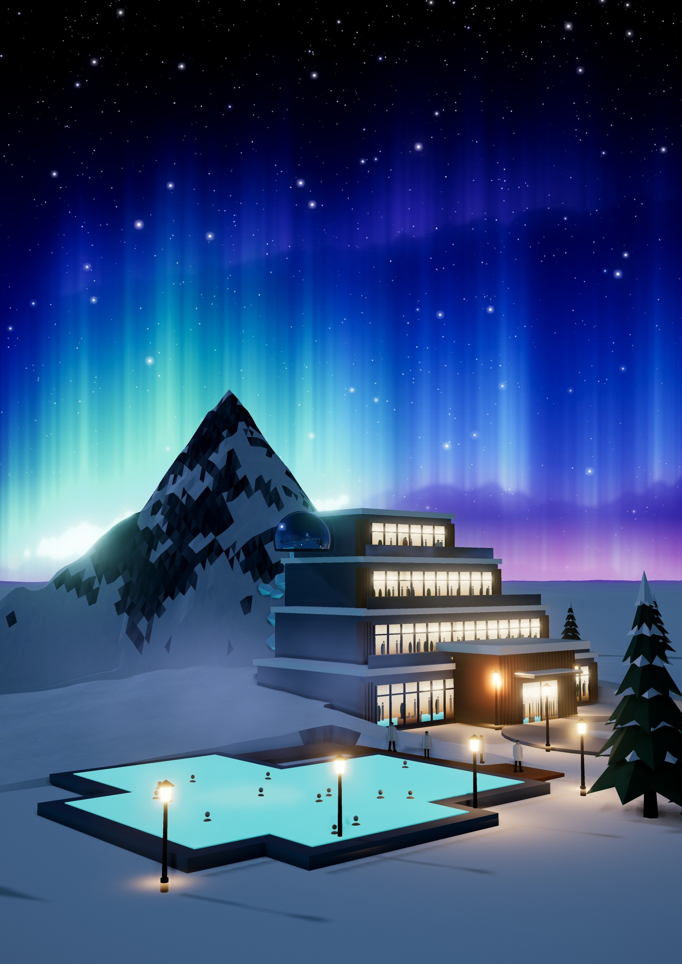



JOIN US
Warm, Green and Ready
AURORA HAVEN
A polar city that thrives
CONTACT THE TEAM
Polar City
Nguyễn Đông Bảo
Nguyễn Bá Hiếu Thiện
Phan Minh Khôi
Dương Hàng Nguyên
Phạm Phước Khoa
Nguyễn Minh Triết
Class 11A4 · Lê Quý Đôn High School
As we conclude this feature on Aurora Haven, we are left with more than just an impression of futuristic design – we are reminded of our shared responsibility toward the planet. The project clearly demonstrates that advanced technology and nature can coexist in harmony when guided by vision and innovation. Aurora Haven not only sets a precedent for resilient urban planning in extreme climates, but also serves as a powerful inspiration for a sustainable future where human communities are built to endure. May the concepts presented here spark further dialog and inspire bold solutions for generations to come.
SCAN TO READ
The interactive edition
Flip through this magazine online on FlipHTML5
Open the flipbook
Be one of the first polar citizens. Buy a community share in our wind and solar farms through the Aurora Green Finance Hall, study polar science at Arctic University, or come for a night at the Mount Aurora spa.

