Slide 1
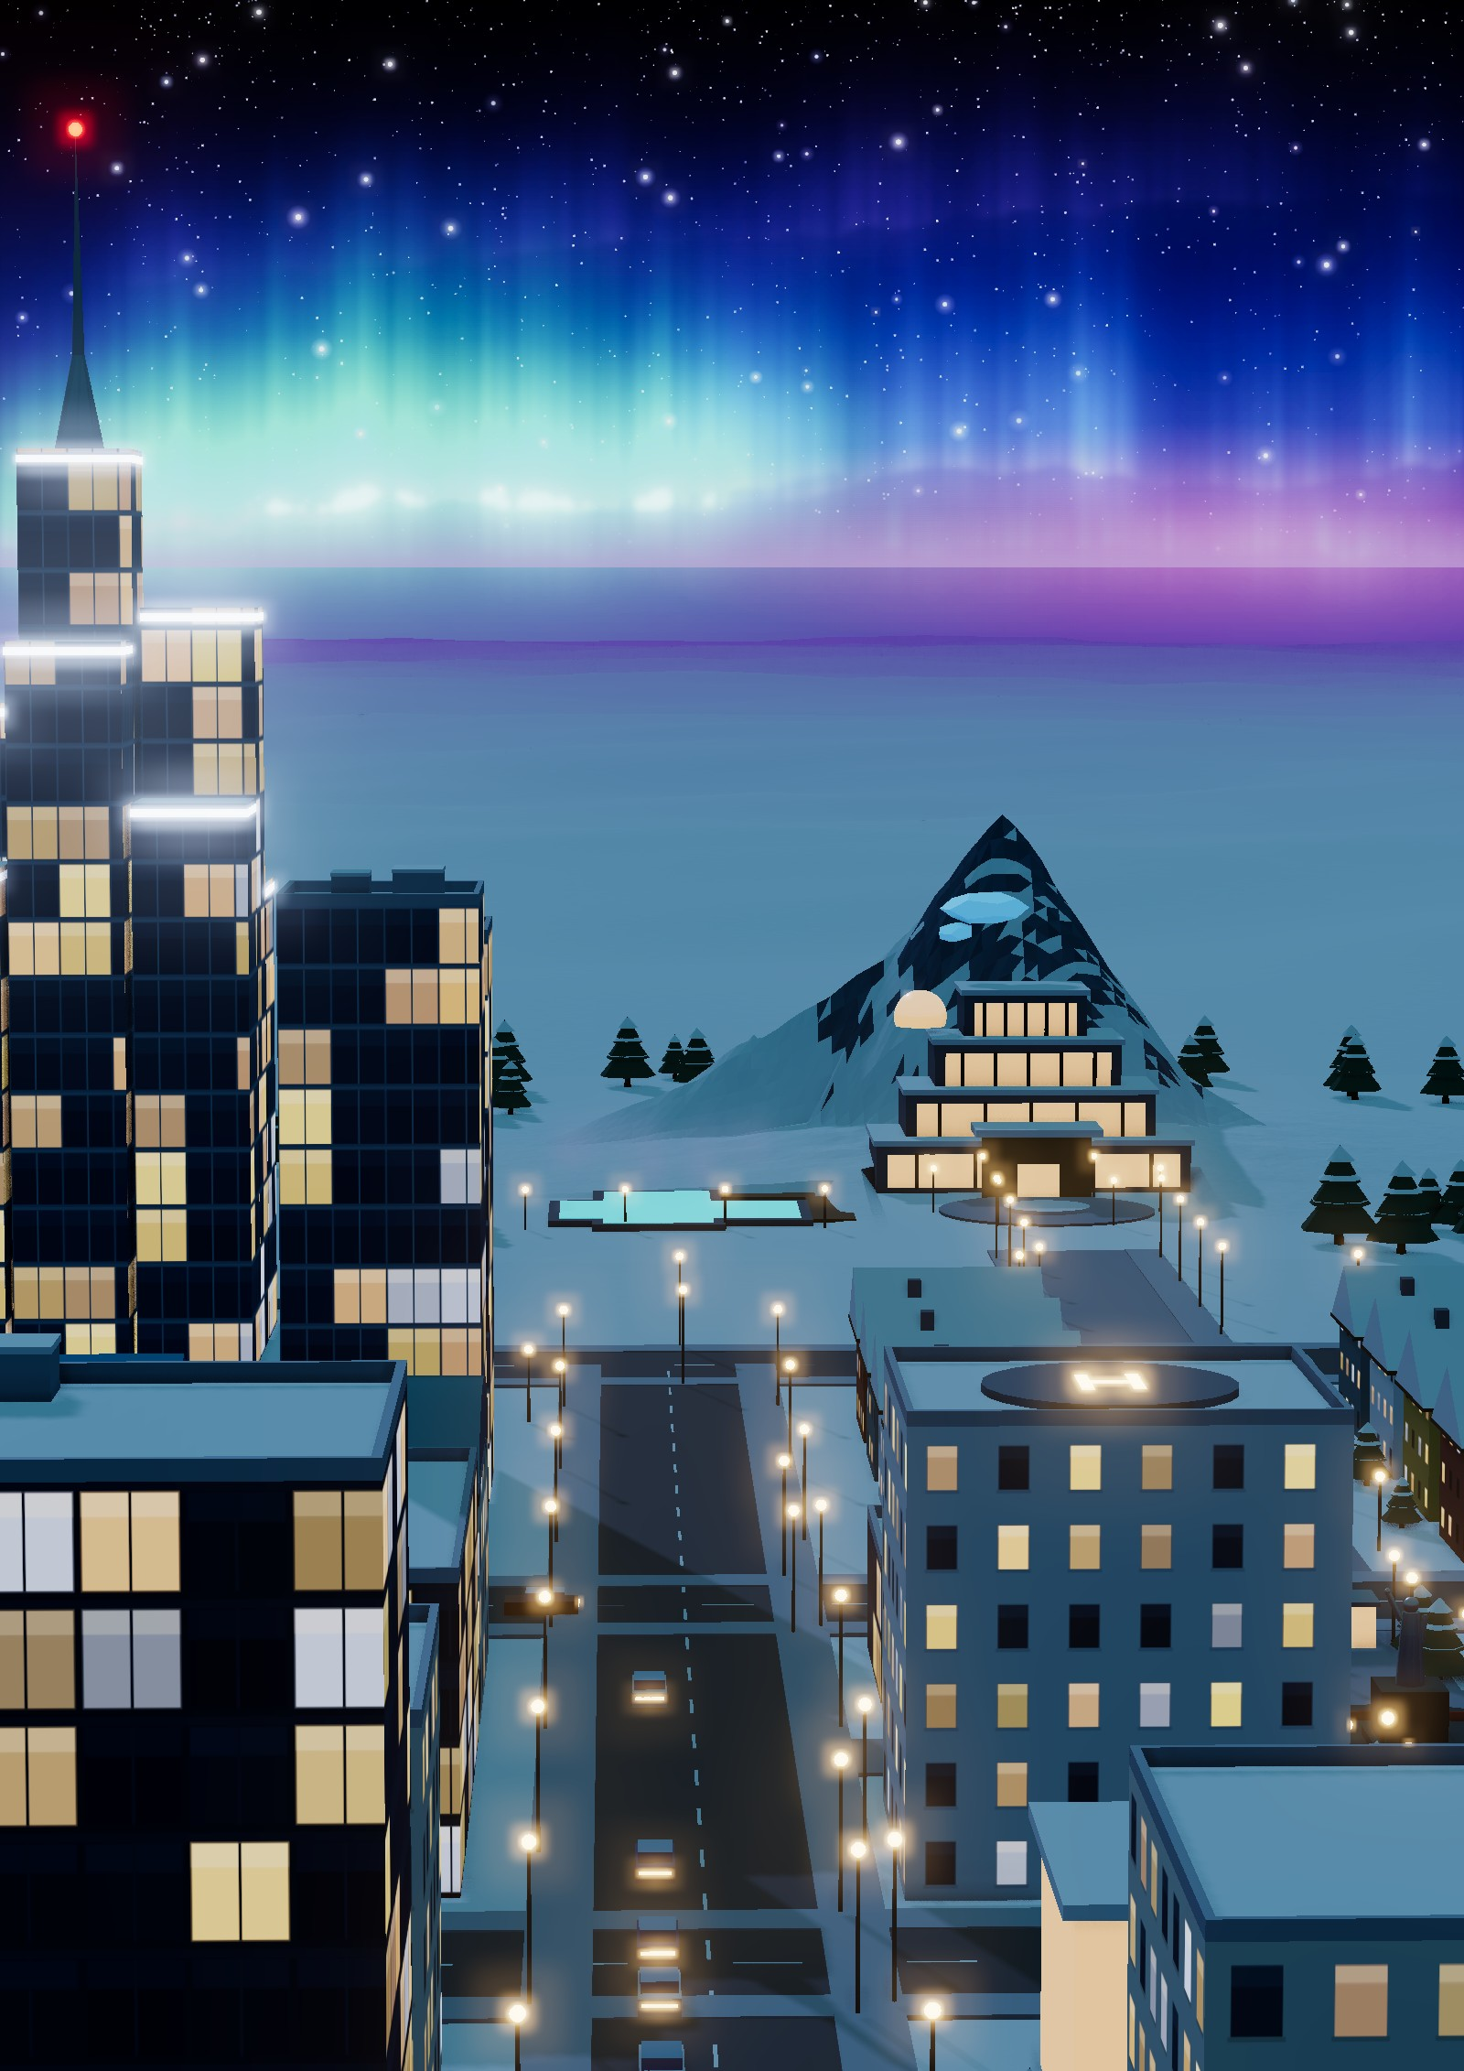

ISSUE 01 · POLAR / ICE CITY · SPECIAL 3D EDITION
AURORA HAVEN
A polar city that thrives
The city's own sun
A compact fusion station keeps 45,000 people warm through the polar night
PAGE 8
A warm heart
inside the ice
Four geothermal spa levels hidden in a 35-metre snow peak
PAGE 12
Bread and water
from snow and air
Inside the plant that feeds a city with no farmland
PAGE 10
−45 °C. 120 km/h.
No sun.
The polar challenge, and the five ideas that answer it
PAGE 4

Slide 2
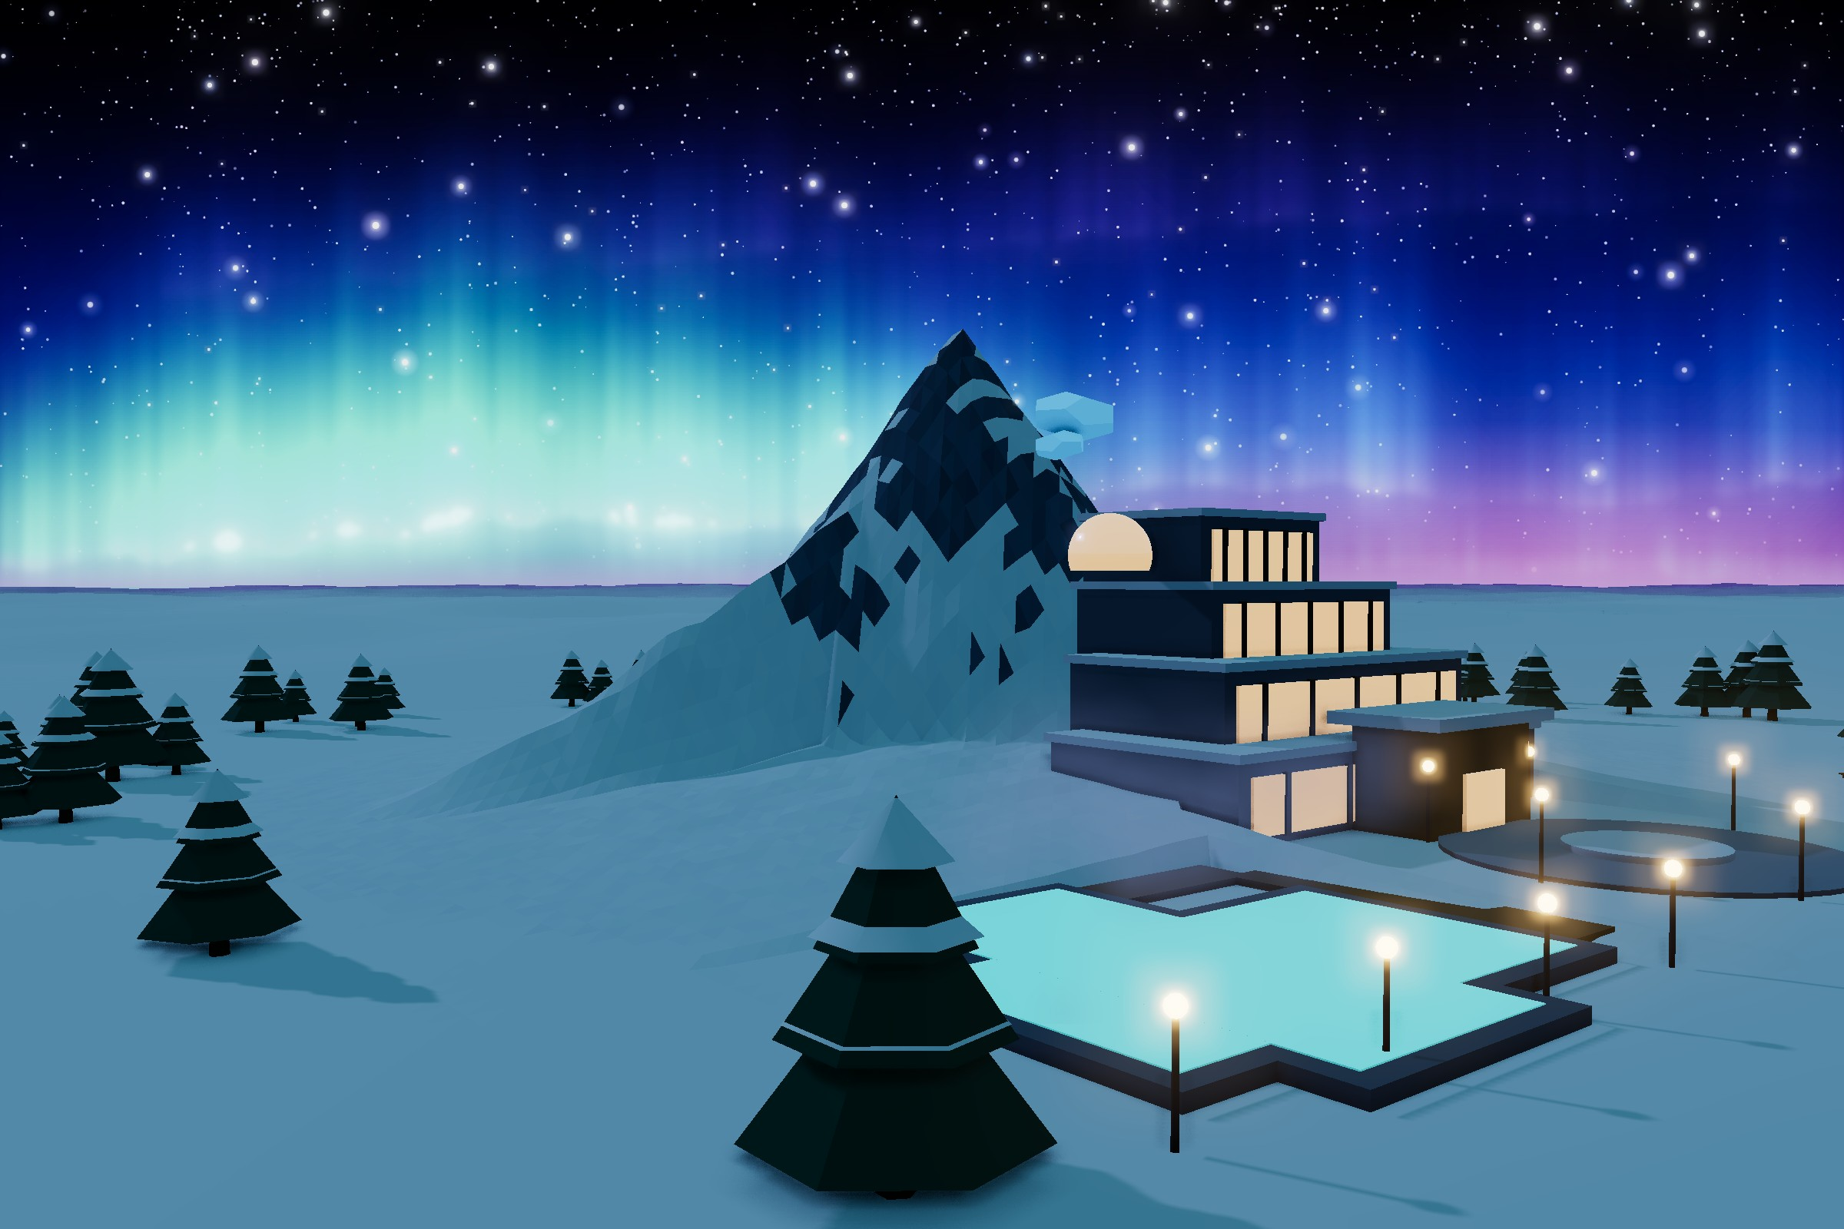
Contents
INSIDE THIS ISSUE
3
Welcome to Aurora Haven
A compact city of 45,000 under a snow peak
4
The Polar Challenge
Cold, darkness, wind and permafrost
5
Five Design Principles
The ideas behind every building
6
The Whole City Plan
From the wind farm to Mount Aurora
The Aurora Lagoon and the North Portal of Mount Aurora under the northern lights.
7
Nine Blocks, One Short Walk
Downtown around the Aurora Roundabout
8
The City's Own Sun
FROM THE EDITORS
Fusion Power Station
Welcome to the first issue of Aurora Haven, a magazine about our city for the Polar / Ice environment.
Aurora Haven is a compact city of about 45,000 people on a frozen tundra plateau, below a 35-metre snow peak called Mount Aurora. Our goal was not only to survive the cold but to build a city where people really want to live.
In these pages you will find the challenge we faced, our design ideas, our three signature districts and everyday life in the city. At the back, a self-guided tour takes you around the city, from the monument to the rescue station.
10
Bread and Water from Snow and Air
Snow-to-Food & Water Plant
12
A Warm Heart Inside the Ice
Mount Aurora Geothermal Spa Resort
14
Three Districts, One Loop
How heat, water, oxygen and waste go round
15
Energy for the Polar Night
Fusion, wind, sun, geothermal and storage
16
Nothing Is Wasted
Water and waste in closed loops
17
Getting Around Fossil-Free
Metro, trams, heated roads and the airport
[Group name]
18
A Livable City Every Day
[Member names] · [Class] · [Date]
Homes, schools, health, shops and culture
19
Safe and Ready for Any Storm
Rescue, shelters and blizzard forecasts
20
Take the Tour
Eight stops around the city
21
Places to Visit
ON THE COVER
35 key places and what they do
Aurora 81 – Polar Landmark Tower, named in honour of Landmark 81 in Ho Chi Minh City, beside the boulevard that leads to the glowing terraces of the Mount Aurora spa, under the northern lights.
23
Aurora Haven by the Numbers
The key figures in one place
24
Warm, Green and Ready
Until next time

Slide 3
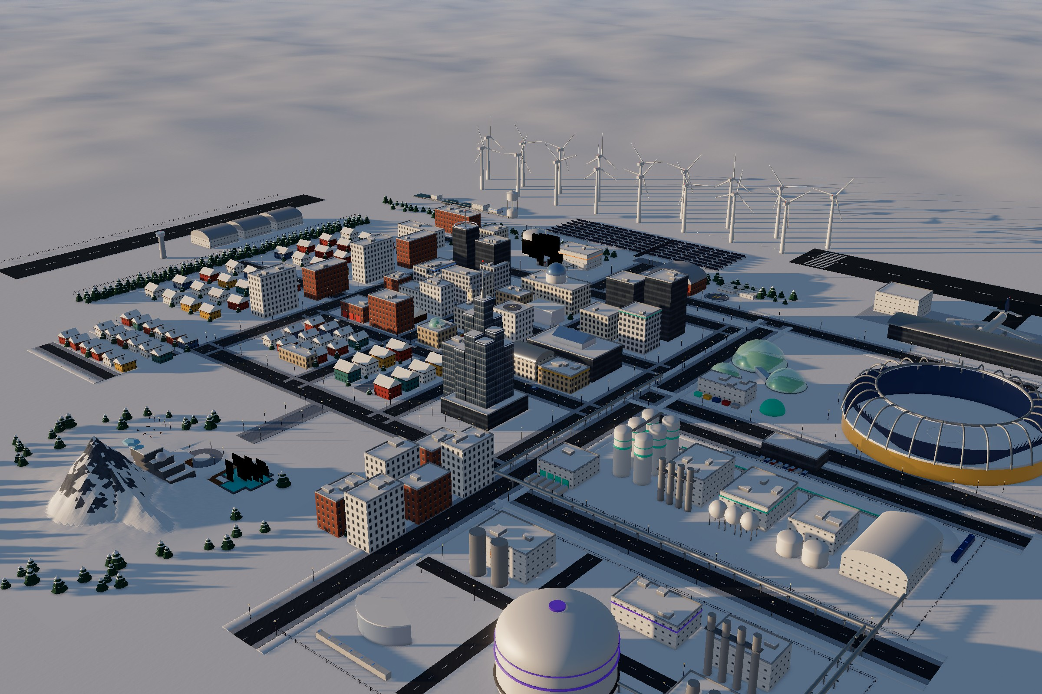
Welcome to Aurora Haven
CITY OVERVIEW
Aurora Haven from the south-east in the low midnight sun, rendered from the 3D model.
Aurora Haven is a compact polar city of around 45,000 people, built on a frozen tundra plateau beneath the snow peak of Mount Aurora. Winters fall to −45 °C, the sun disappears for two months of polar night, and almost nothing can grow. Aurora Haven is designed not just to survive these conditions but to make life here warm, healthy and sustainable.
The whole city is shaped around one idea: heat, energy, water and food should never be wasted. Every building shares a single heating network, the city runs on zero-carbon energy, and nearly all of its water and waste is recycled.
Homes, schools, healthcare, shops and parks sit within a short walk of each other, connected by a downtown metro, electric trams and heated streets.
What makes Aurora Haven unique is its three signature districts. A fusion power station acts as the city’s own sun, giving steady power and heat even through the polar night. A Snow-to-Food & Water Plant turns snow and air into clean drinking water and food, so the city can feed itself without farmland. And inside Mount Aurora, a geothermal spa resort offers warmth, rest and a view of the northern lights. Together they form one closed loop that keeps the city powered, fed and happy in one of the harshest places on Earth.
45,000
−45 °C
35 m
10 min
residents
winter lows
Mount Aurora, the snow peak
walk to daily needs

Slide 4
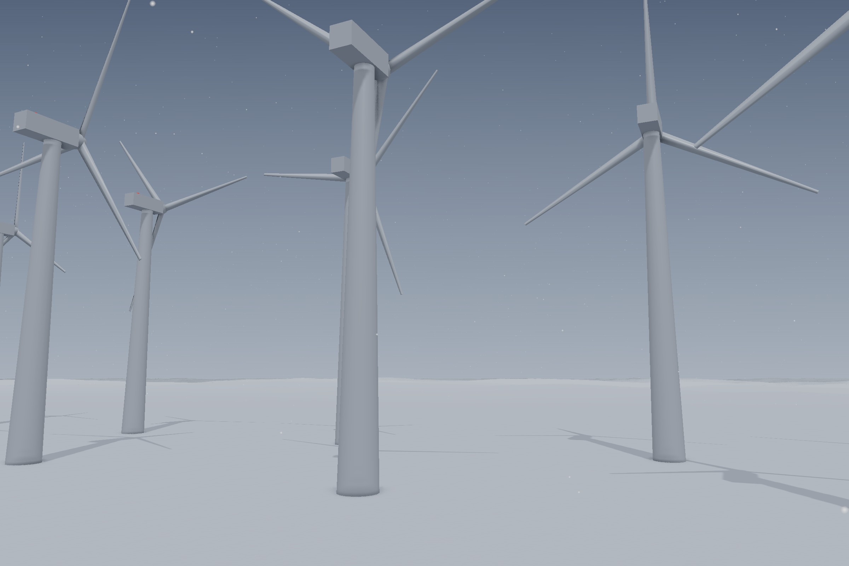
A blizzard sweeps over the Ice-Proof Wind Farm on the windy northern edge.
THE PLACE
The Polar Challenge
One of the hardest places on Earth to build a city, so every building had to answer one question.
Aurora Haven sits in one of the hardest environments on Earth. In winter the temperature falls to minus 45 degrees. For about two months the sun never rises, and for two months in summer it never sets. Blizzards can reach 120 kilometres per hour.
The ground is permafrost, so a warm building can thaw it and crack its own foundations. There is almost no farmland, and in deep winter supplies can only arrive by air.
So the designers asked one question about every building in the city:
−45 °C
winter temperatures
2 months
of polar night, and two of midnight sun
120 km/h
“How does it help people stay warm, fed, safe and happy here?”
blizzards
Permafrost
frozen ground that heaves under heat

Slide 5
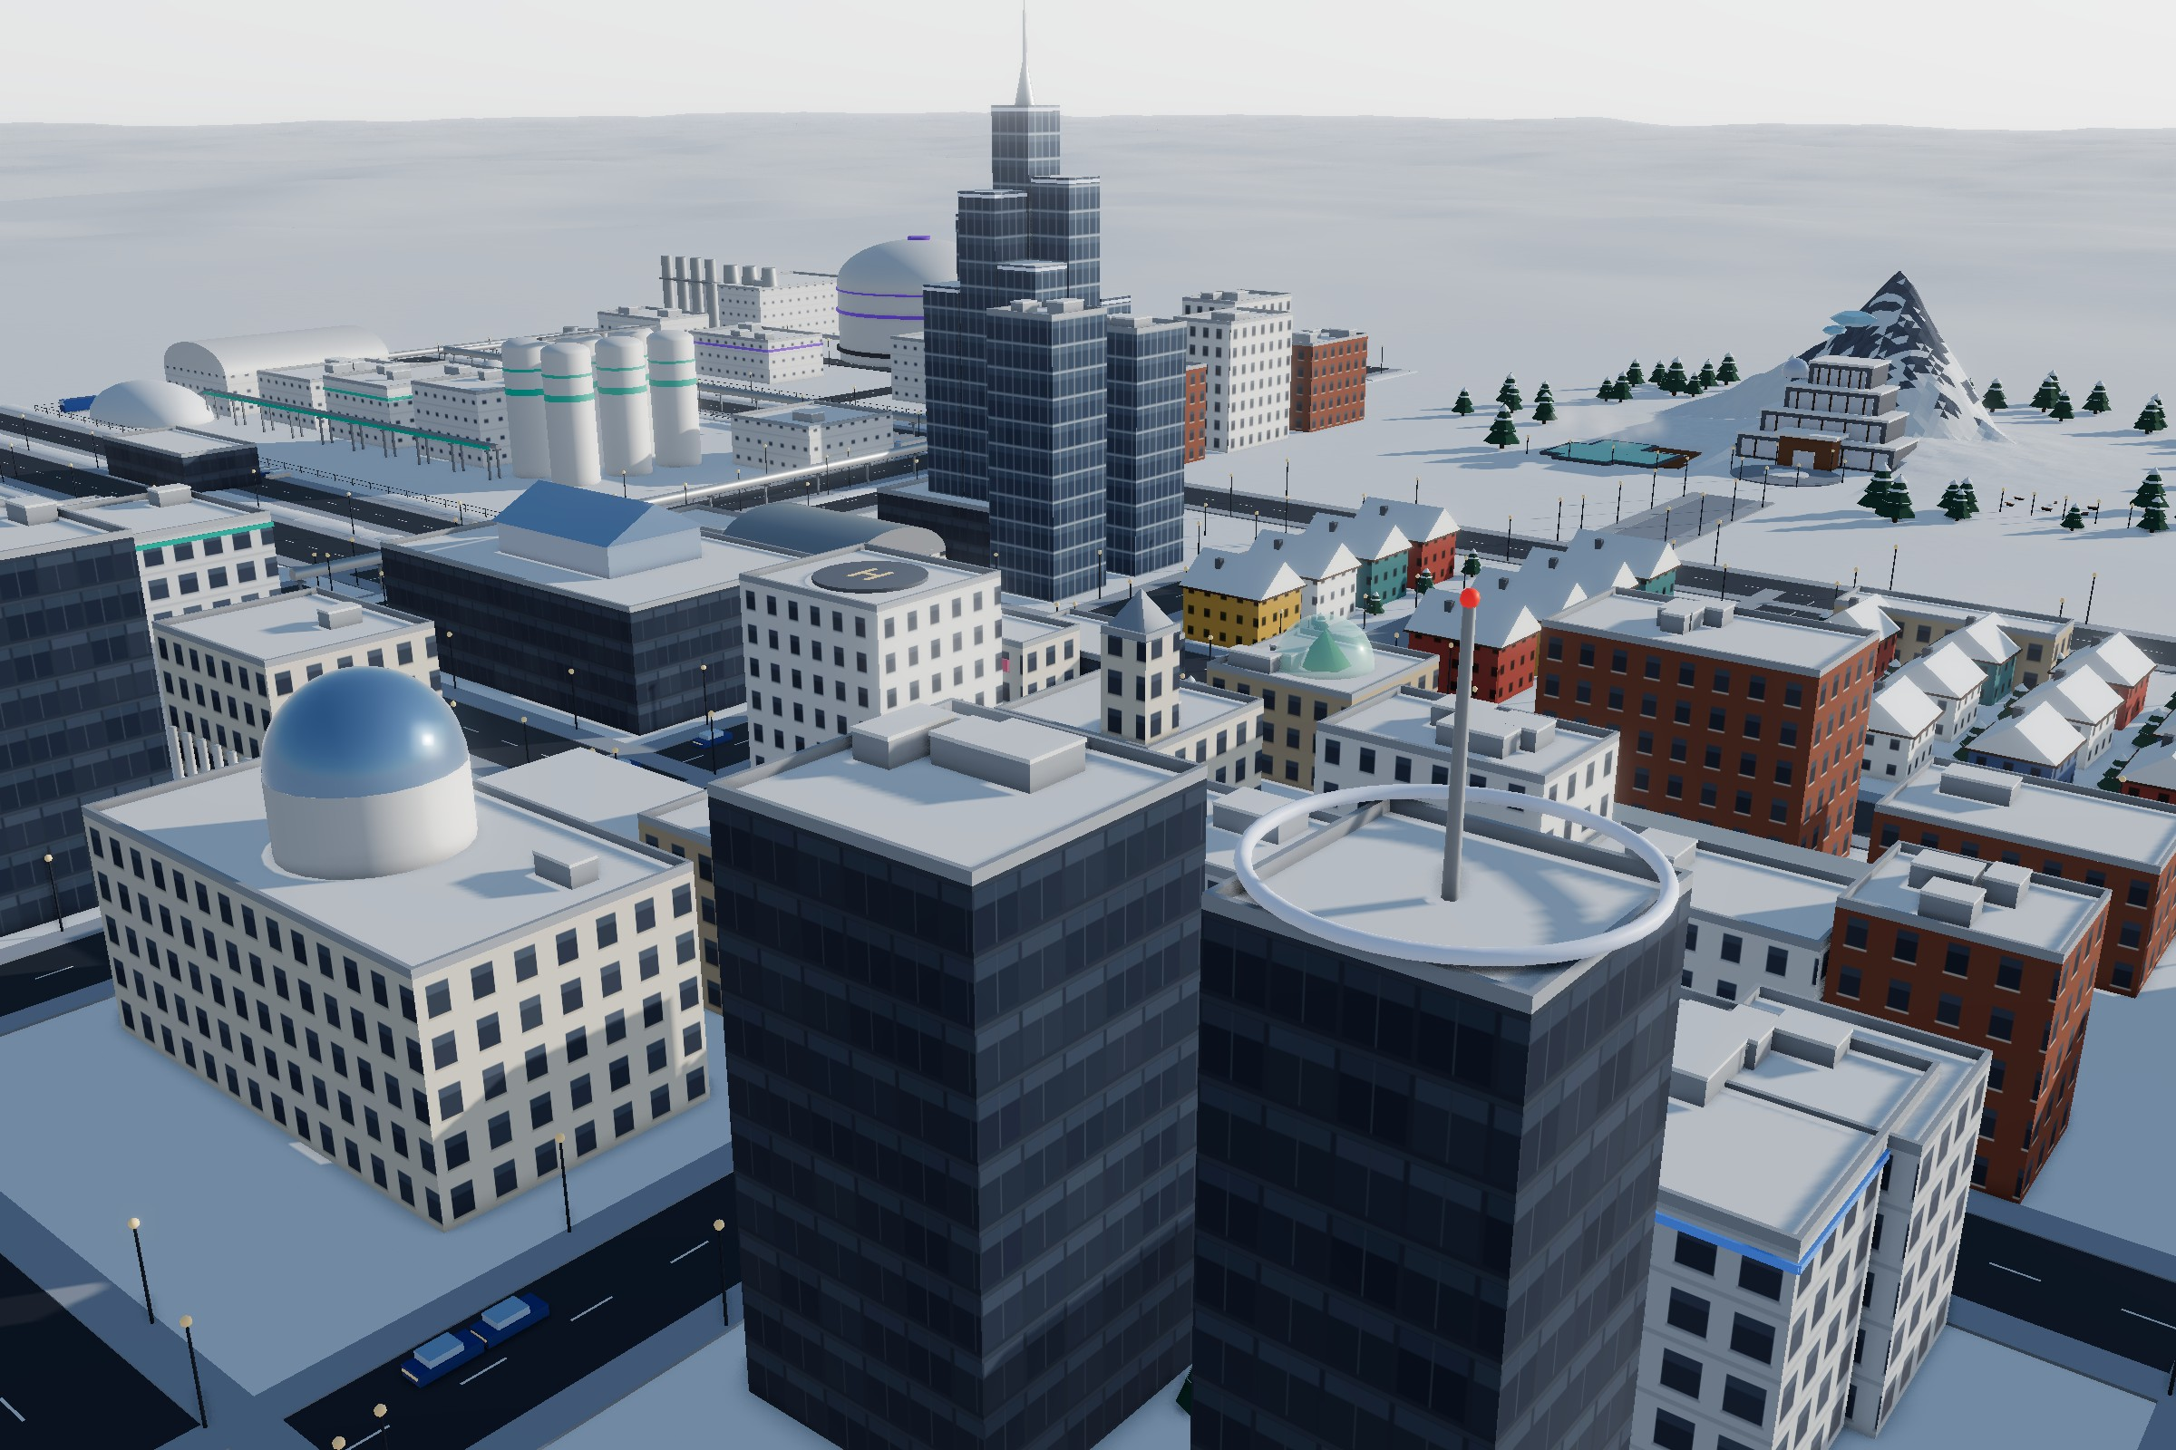
Five Design Principles
THE IDEAS
Heat, energy, water and food should never be wasted.
Downtown from the north-west, with Aurora 81, the food plant silos and Mount Aurora behind.
1
Heat is life
One district-heating loop, fed by the fusion station and the geothermal plant, warms every building. Triple-glazed buildings on insulated piles do not thaw the permafrost.
2
Zero carbon
No fossil fuel burns anywhere in the city. Power comes from fusion, wind, sun and geothermal heat.
3
Closed loops
About 95% of water is recycled and rubbish is reused, so water, food and waste go round instead of being thrown away.
4
Compact and car-light
Daily needs are within a 10-minute walk, and the few cars are electric.
5
Resilient and healthy
Shelters keep every resident safe for 30 days, while light, parks, culture and a spa carry people through the polar night.

Slide 6
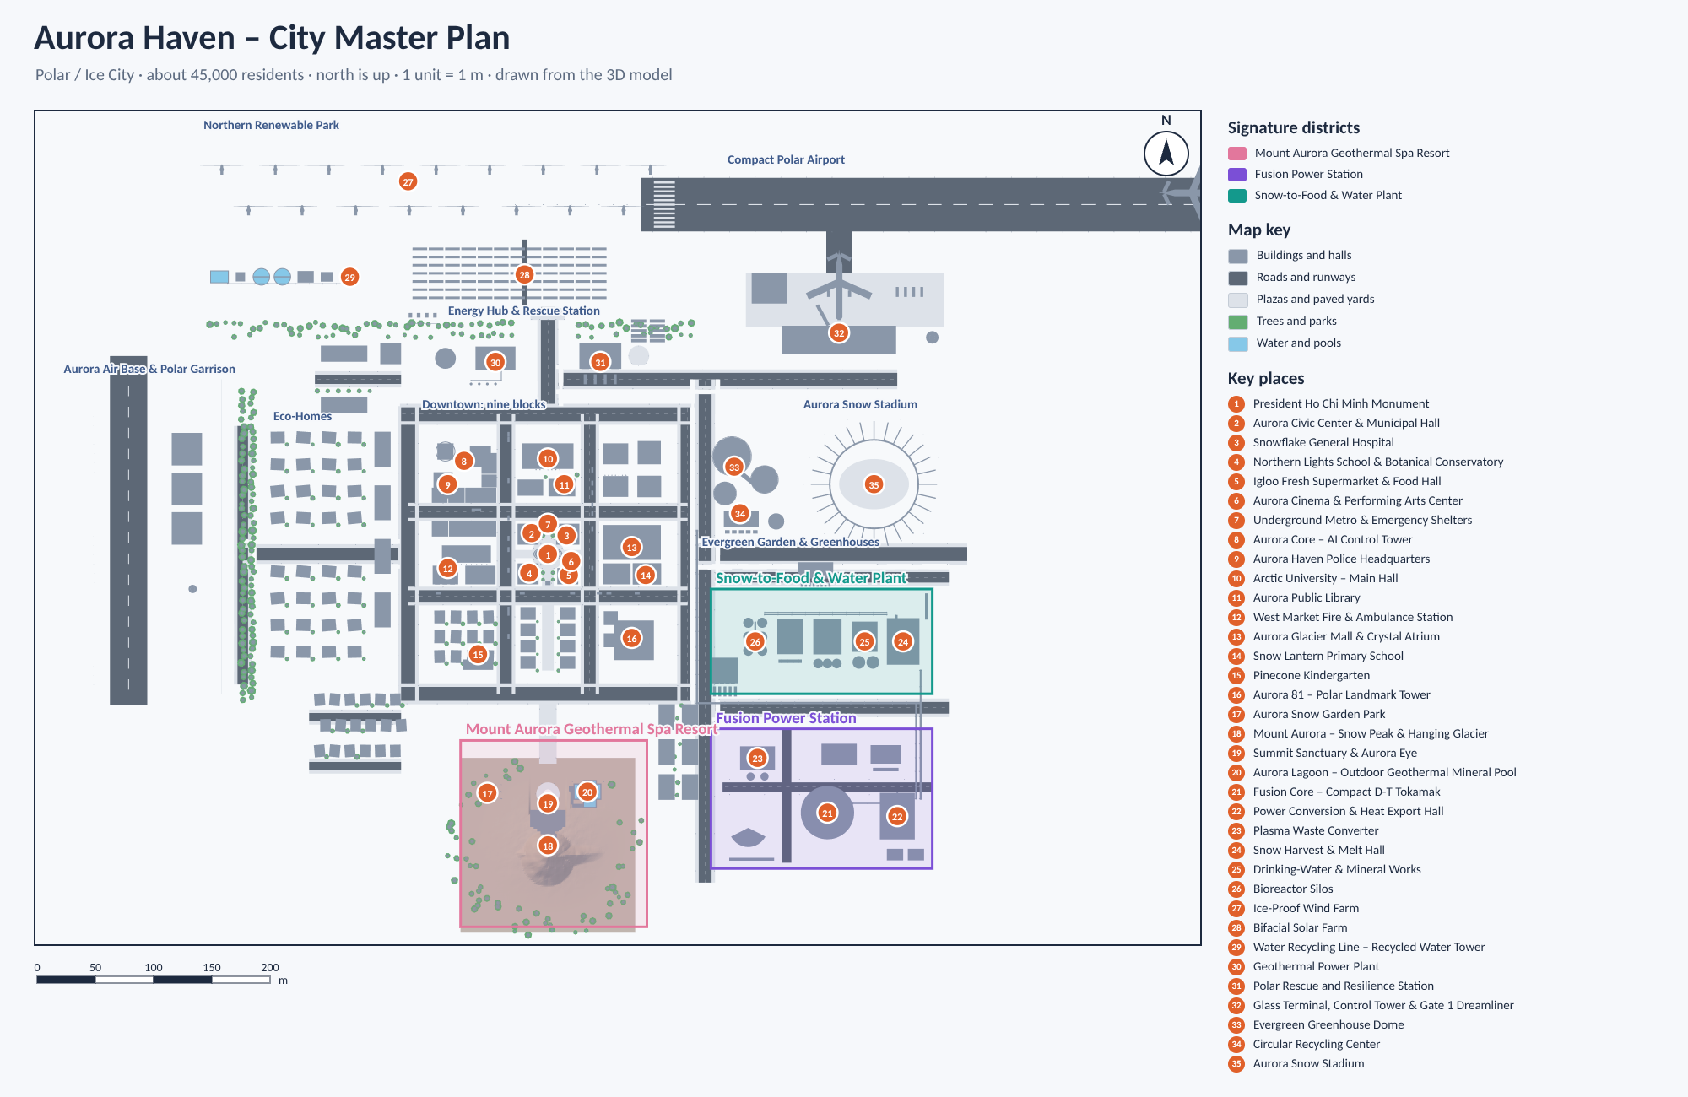
The Whole City Plan
THE MAP
Aurora Haven – City Master Plan. North is up; one unit is one metre. Drawn from the 3D model.
DOWNTOWN
NORTH
WEST
Nine blocks around the Aurora Roundabout and the President Ho Chi Minh Monument, with the hospital, schools, shops and the metro interchange.
The windy north holds the Northern Renewable Park, the energy hub, the Polar Rescue and Resilience Station and the airport.
The air base and garrison, behind a belt of trees that screens the eco-homes.
EAST
SOUTH
SIGNATURE DISTRICTS
Greenhouses, the snow stadium, the fusion station and the Snow-to-Food plant, away from homes but linked by pipe bridges and heat mains.
Framed by Liberty Mall, Mount Aurora rises with its geothermal spa resort inside.
Fusion Power Station
Snow-to-Food & Water Plant
Mount Aurora Geothermal Spa Resort

Slide 7
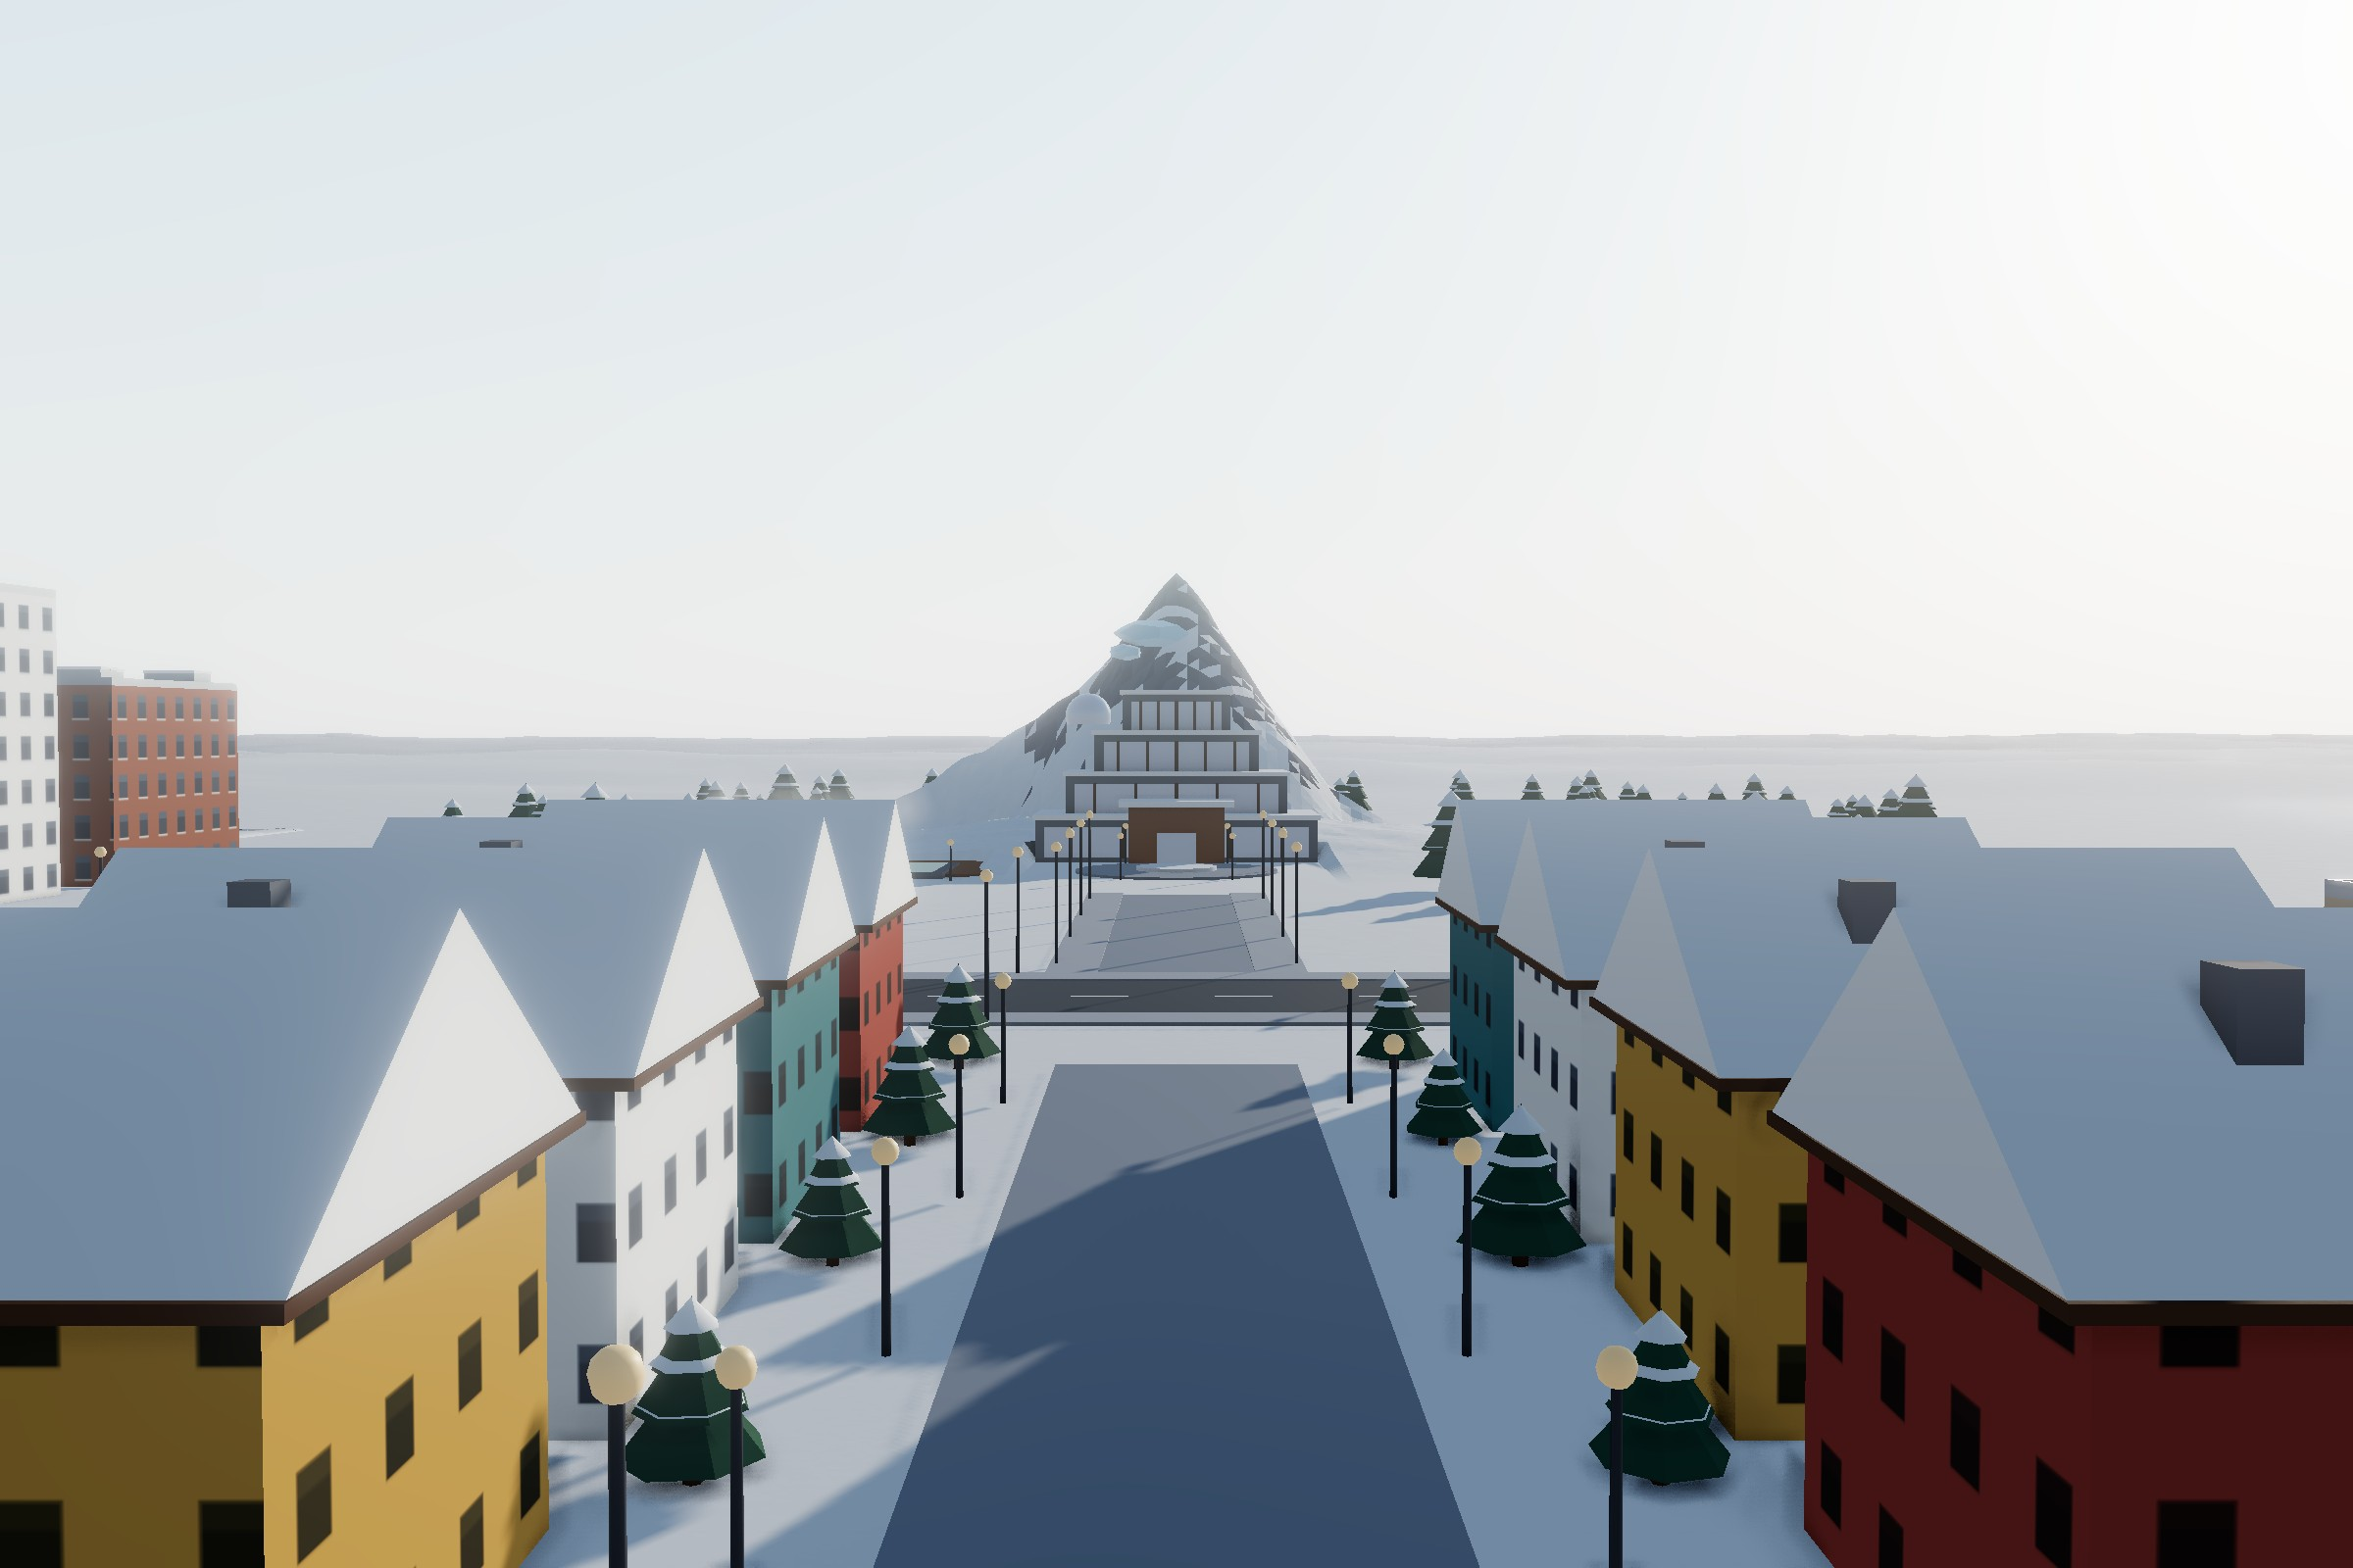
Nine Blocks, One Short Walk
DOWNTOWN
Looking south along the boulevard of the Mount Aurora Approach to the spa’s North Portal.
Downtown is laid out in nine blocks around the Aurora Roundabout. Shops, schools, healthcare and homes are within a short walk of each other, and the metro interchange lies under Liberty Mall. The map below follows the city plan, with north at the top.
Polaris Quarter
Knowledge Quarter
Financial District
Aurora Core – AI Control Tower · Aurora Haven Police Headquarters · Polaris Green Office Tower
Arctic University – Main Hall · Aurora Public Library
Arctic Stock Exchange · Aurora Green Finance Hall · Snowline Courthouse · Aurora Business Hotel
West Market Street
Civic Core & Liberty Mall
East Gallery Avenue
West Market Fire & Ambulance Station · Aurora Night Market Hall · Polar Pharmacy
President Ho Chi Minh Monument · Civic Center · Snowflake General Hospital · Northern Lights School · Igloo Fresh · Aurora Cinema · Metro
Aurora Glacier Mall & Crystal Atrium · Snow Lantern Primary School · Northern Lights Music Hall
Snowpine Residences
Mount Aurora Approach
Aurora 81 District
Family homes · Pinecone Kindergarten · Snowpine Senior Care Home
Mount Aurora Guesthouse · Southside Police & Mountain Rescue Post · spa shuttle street
Aurora 81 – Polar Landmark Tower · Aurora 81 Residences (Twin Towers)

Slide 8
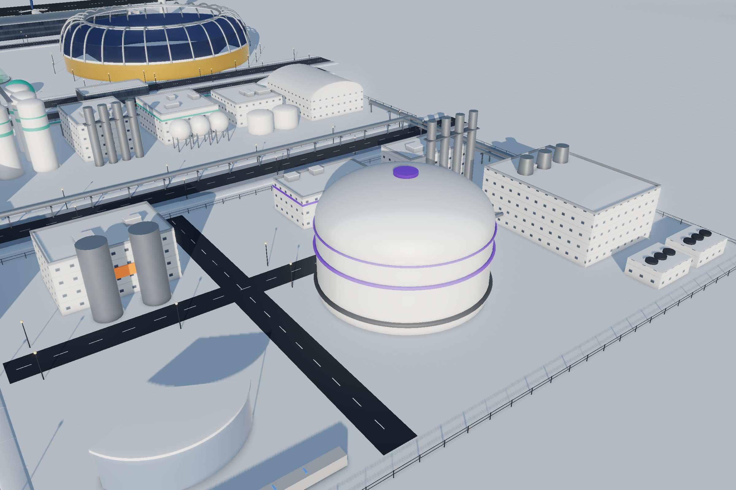
The City's Own Sun
1
SIGNATURE DISTRICT 1 · FUSION POWER STATION
A compact tokamak gives Aurora Haven about 300 MW of electricity and 450 MW of district heat, steady through the polar night, with no CO₂ and no meltdown.
Our first signature district is the city’s own sun. Stage 1 takes deuterium from snowmelt water, so the fuel literally falls from the sky as snow. Stage 2 breeds tritium in a lithium blanket, so none is imported.
Stage 3 is the tokamak, where superconducting magnets hold a 150-million-degree plasma that makes about 800 megawatts of heat.
Stage 4 turns that heat into about 300 megawatts of electricity and sends 450 megawatts into the district-heating loop. Stage 5 turns rubbish into clean gas and building blocks.
The reactor runs on about 170 grams of fuel a day. If anything fails, the plasma simply goes out in a split second, so it cannot melt down or run away.

Slide 9
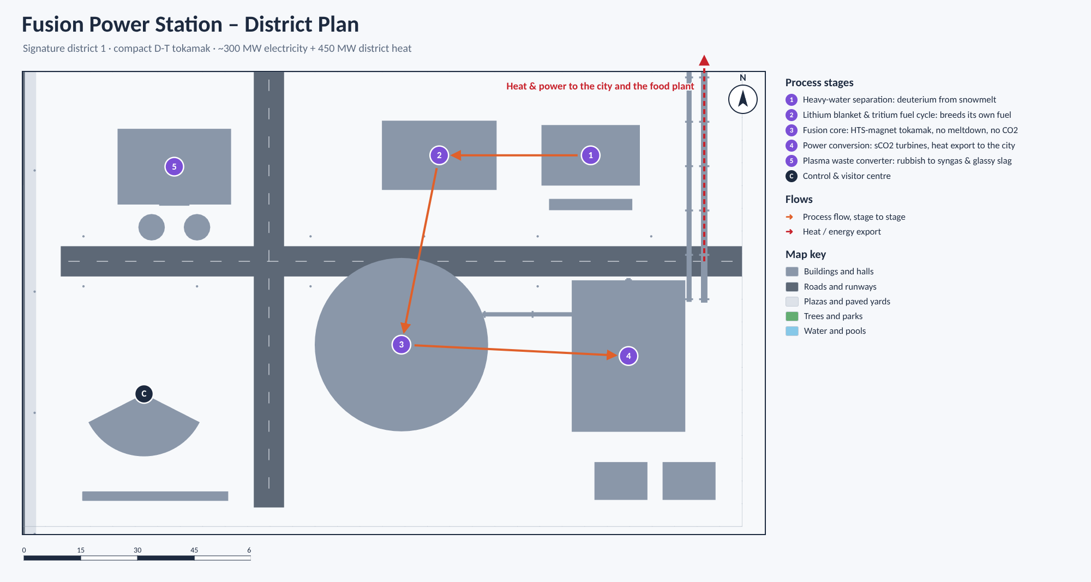
Five Stages, One Sun
FUSION POWER STATION · HOW IT WORKS
Fusion Power Station – District Plan. Signature district 1: a compact D-T tokamak.
1
Heavy-water separation
800 MW
Takes deuterium from the deuterium-rich water left by the food plant’s electrolysers and purifies it to 99.8% heavy water.
of heat from the plasma
2
Lithium blanket & tritium fuel cycle
300 MW
Breeds slightly more tritium than the reactor burns, so none is imported. Recovered helium cools the hospital’s MRI scanners.
of electricity
3
Fusion core: compact D-T tokamak
Superconducting magnets hold a 150-million-degree plasma. No CO₂, no long-lived waste, no meltdown.
450 MW
4
Power conversion & heat export
of district heat for the city
Supercritical-CO₂ turbines make about 300 MW of electricity and send about 450 MW of heat to the city.
170 g
5
Plasma waste converter
of fuel a day, about 70 g of it deuterium
Torches hotter than 5,000 °C turn about 20 t of rubbish a day into clean gas, metals and paving blocks.
1 litre
C
Control & visitor centre
of liquid helium a day for MRI scanners
Operators and an AI digital twin can stop the plasma in milliseconds; a public gallery faces the reactor.

Slide 10
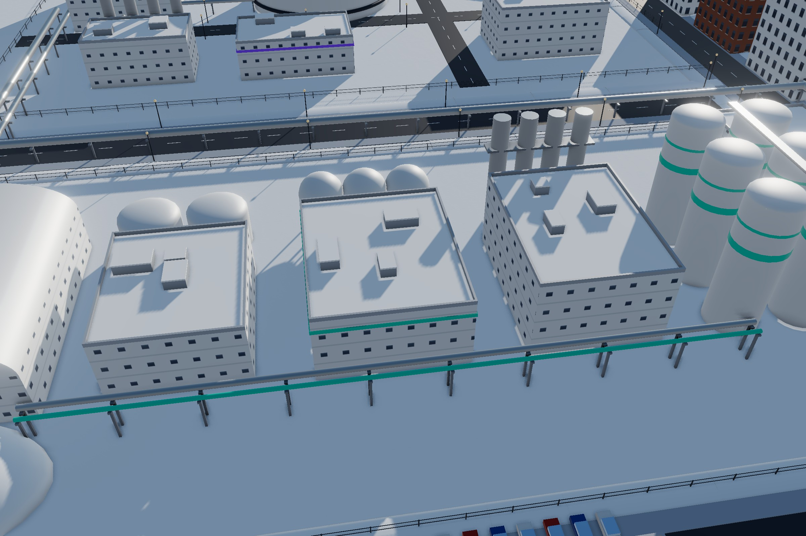
Bread and Water from Snow and Air
2
SIGNATURE DISTRICT 2 · SNOW-TO-FOOD & WATER PLANT
Six stages turn tundra snow and air into all of the city’s drinking water and about half of its protein, with no farmland at all.
What do you eat where nothing grows? Stage 1 melts about 3,000 tonnes of clean tundra snow a day with spare heat from the fusion station, so the snow does the job of a cooling tower. Stage 2 turns the meltwater into all the city’s drinking water.
Stage 3 splits water into hydrogen and oxygen and captures CO₂ from the air; Stage 4 turns them into starch and fats. In Stage 5, microbes in six silos make about 2.5 tonnes of protein flour a day. Stage 6 cooks bread, noodles and drinks for the city.

Slide 11
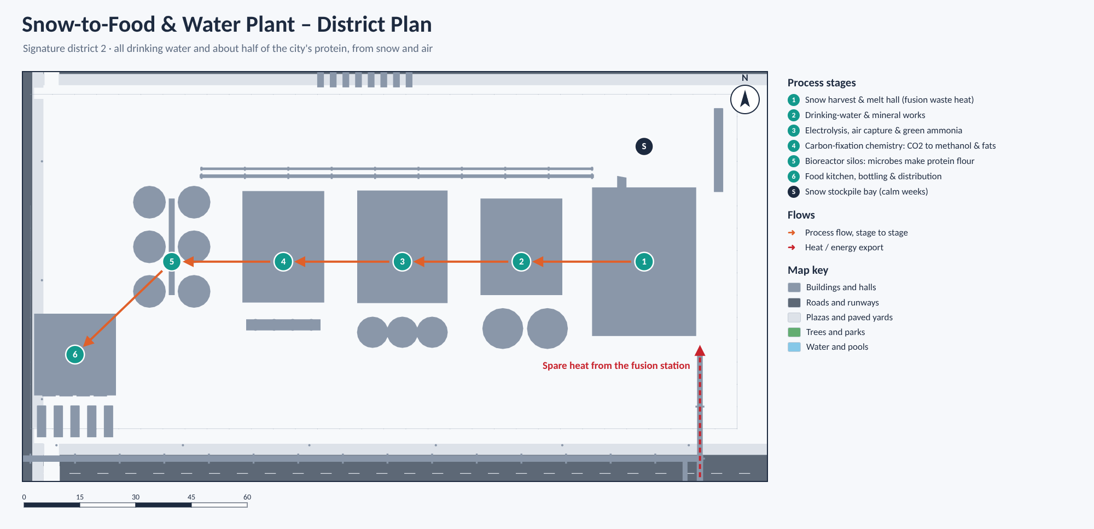
Six Stages from Snow to Supper
SNOW-TO-FOOD & WATER PLANT · HOW IT WORKS
Snow-to-Food & Water Plant – District Plan. All drinking water and about half of the city’s protein, from snow and air.
1
Snow harvest & melt hall
3,000 t
Electric harvesters gather wind-packed snow upwind of the city; about 14 MW of spare fusion heat melts it.
of snow melted a day
2
Drinking-water & mineral works
2,500 m³
Membranes and UV light remove every germ, calcite adds calcium and magnesium, and sensors test the water every five minutes.
of drinking water a day, all of the city’s tap water
3
Electrolysis, air capture & green ammonia
About 5 t of hydrogen a day; the oxygen goes to the hospital and the waste converter.
20 t
4
Carbon-fixation chemistry
of CO₂ captured from the air a day
A copper catalyst makes methanol, and enzymes build it into starch about eight times faster than a maize field.
2.5 t
5
Bioreactor silos
of protein flour a day, as much as 600 hectares of soybeans
Hydrogen-eating bacteria make protein flour; yeasts and algae make oils and vitamins, 24 hours a day.
30 days
6
Food kitchen, bottling & distribution
of meals and water for everyone in the Food Reserve Bunker
Bread, noodles, protein mince and dairy-style drinks, delivered overnight in heated electric vans.

Slide 12
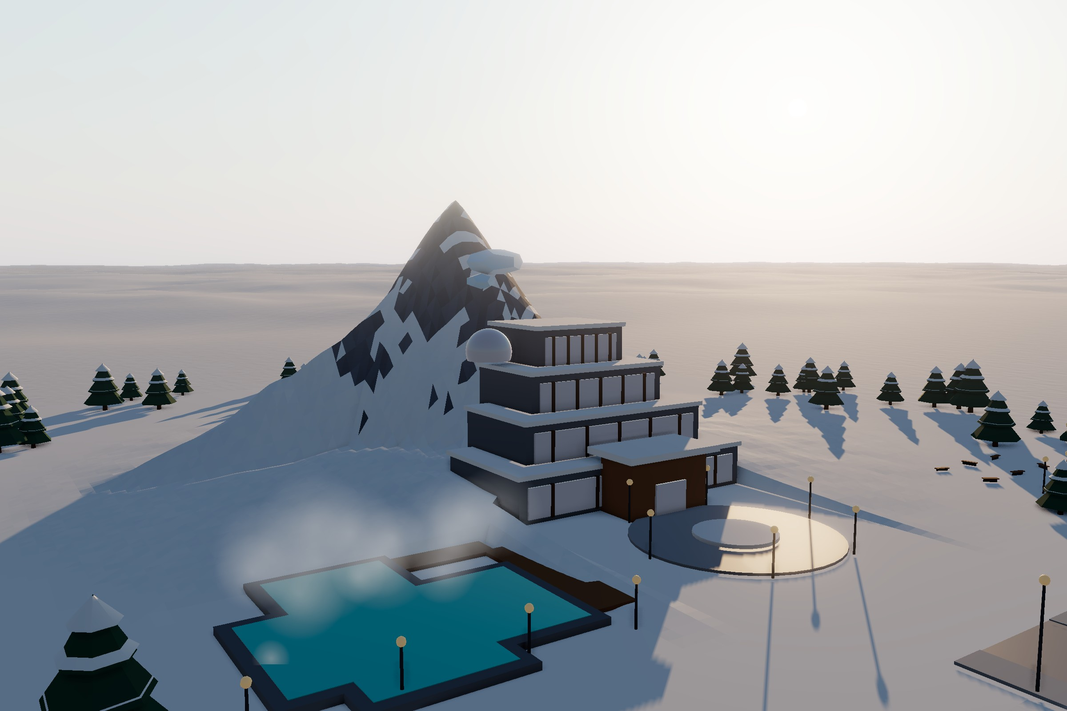
A Warm Heart Inside the Ice
3
SIGNATURE DISTRICT 3 · MOUNT AURORA GEOTHERMAL SPA RESORT
Inside a 35-metre snow peak shaped like Nepal’s Ama Dablam, four geothermal spa levels stay at 28 °C all winter.
Guests enter through the North Portal, where a thermal revolving door and an air curtain keep the −45 °C air out. The peak’s deep snow works as a blanket that holds in the geothermal heat, and sensors release the snow load safely before an avalanche can build.
Outside is the Aurora Lagoon, a 38-degree mineral pool for bathing under the northern lights. The spa fights the winter blues, brings tourists and income, and in an emergency can shelter up to 1,000 people.

Slide 13
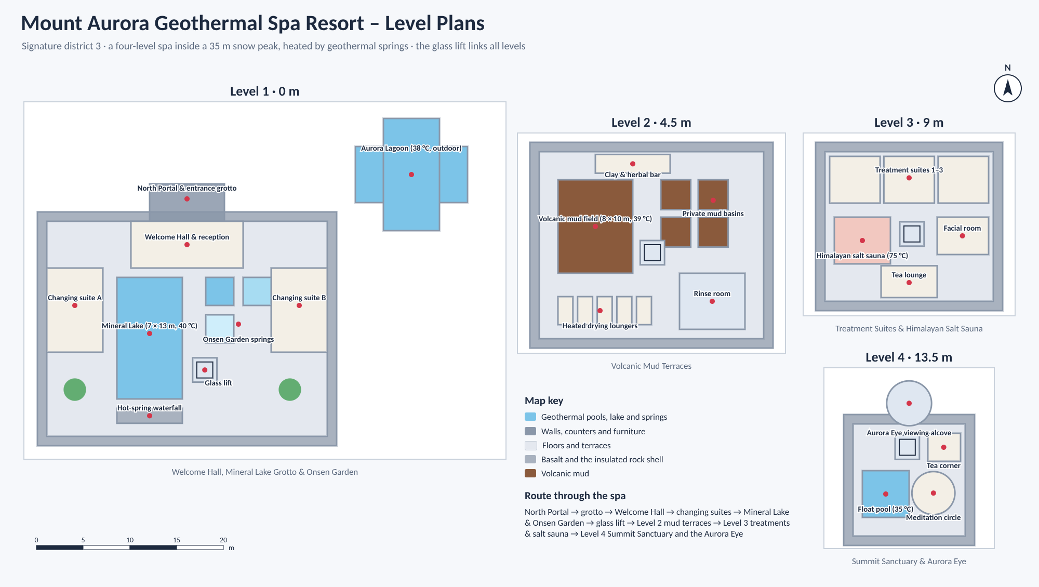
Four Floors of Warmth
MOUNT AURORA · LEVEL BY LEVEL
Mount Aurora Geothermal Spa Resort – Level Plans. The glass lift links all four levels.
LEVEL 1 · 0 M
LEVEL 2 · 4.5 M
Welcome Hall, Mineral Lake Grotto & Onsen Garden
A 40 °C silica-rich spring rises into a 7 × 13 m Mineral Lake; hot, warm and glacier-cold pools boost circulation.
Volcanic Mud Terraces
An 8 × 10 m mud field held at 39 °C. The mud is filtered and UV-sterilised every night and reused for months.
LEVEL 3 · 9 M
LEVEL 4 · 13.5 M
Treatment Suites & Himalayan Salt Sauna
Hot-stone massage, arctic kelp wraps and a 75 °C pink salt sauna heated by the geothermal loop.
Summit Sanctuary & Aurora Eye
A 35 °C float pool, a meditation circle and a heated glass bubble for watching the northern lights.
28 °C
40 °C
39 °C
75 °C
35 °C
38 °C
inside the spa
Mineral Lake spring
volcanic mud
salt sauna
float pool
Aurora Lagoon
Route through the spa: North Portal → grotto → Welcome Hall → changing suites → Mineral Lake & Onsen Garden → glass lift → mud terraces → treatments & salt sauna → Summit Sanctuary and the Aurora Eye.

Slide 14
Three Districts, One Loop
THE BIG IDEA
The three signature districts do not work alone. Heat, water, oxygen and waste go round from one to the next instead of being thrown away.
Spare heat melts the snow
Fusion Power Station
Hydrogen & CO₂ made from rubbish
Snow-to-Food Plant
heat · power · waste converter
Deuterium-rich water returns as fuel
water · food · oxygen
Oxygen for the waste converter
↓ Heat, power and MRI helium
↑ Rubbish for the waste converter
Food for the spa cafés
Drinking water, food and medical oxygen
The City
Mount Aurora Spa
45,000 people, every building and the hospital
geothermal wellbeing
Geothermal springs
Heat
Water
Spare heat from the fusion station melts the snow at the food plant, so the snow does the job of a cooling tower.
The food plant’s electrolysers leave slightly deuterium-rich water, which goes back to the fusion station as fuel.
Oxygen
Waste
The same electrolysers supply oxygen to the plasma waste converter and the hospital.
The converter turns rubbish into hydrogen and CO₂ for the food lines, and its slag becomes paving.
Wellbeing
The spa turns geothermal heat into rest and health, and its restaurants serve food from the plant.

Slide 15
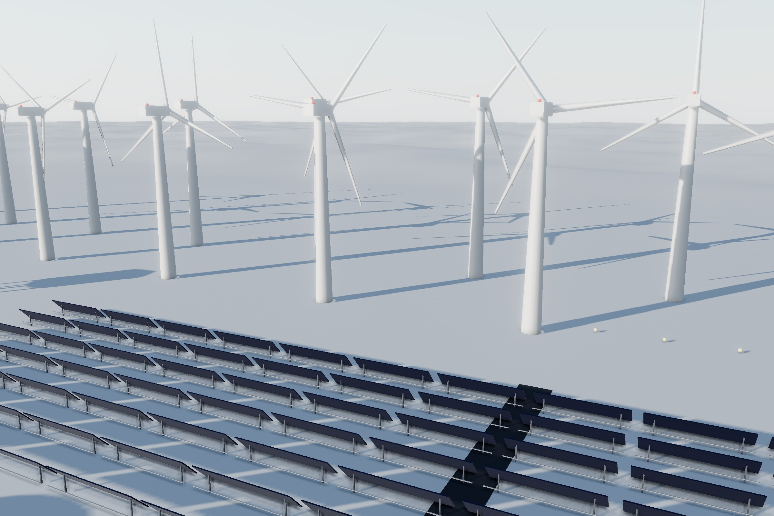
Energy for the Polar Night
CLEAN ENERGY, DAY AND POLAR NIGHT
Northern Renewable Park: the Ice-Proof Wind Farm behind the Bifacial Solar Farm.
The sun disappears for two months, so the city uses sources that cover for each other.
Steady
Fusion
60 MW
Ice-proof wind farm
Steady power and heat all year, even in total darkness.
Heated blades keep turning in freezing fog; most power comes in stormy winter.
+25%
Bifacial solar farm
24/7
Geothermal plant
Snow reflects light onto the panel backs; 24-hour power in the midnight-sun months.
Clean electricity and hot water around the clock, and the second heat source.
200 MWh
Battery bank
12 h
Heat storage tank
Recycled car batteries store spare wind and solar power for calm, dark days.
Keeps homes warm if a heat source stops, losing less than 1% of its heat a day.

Slide 16
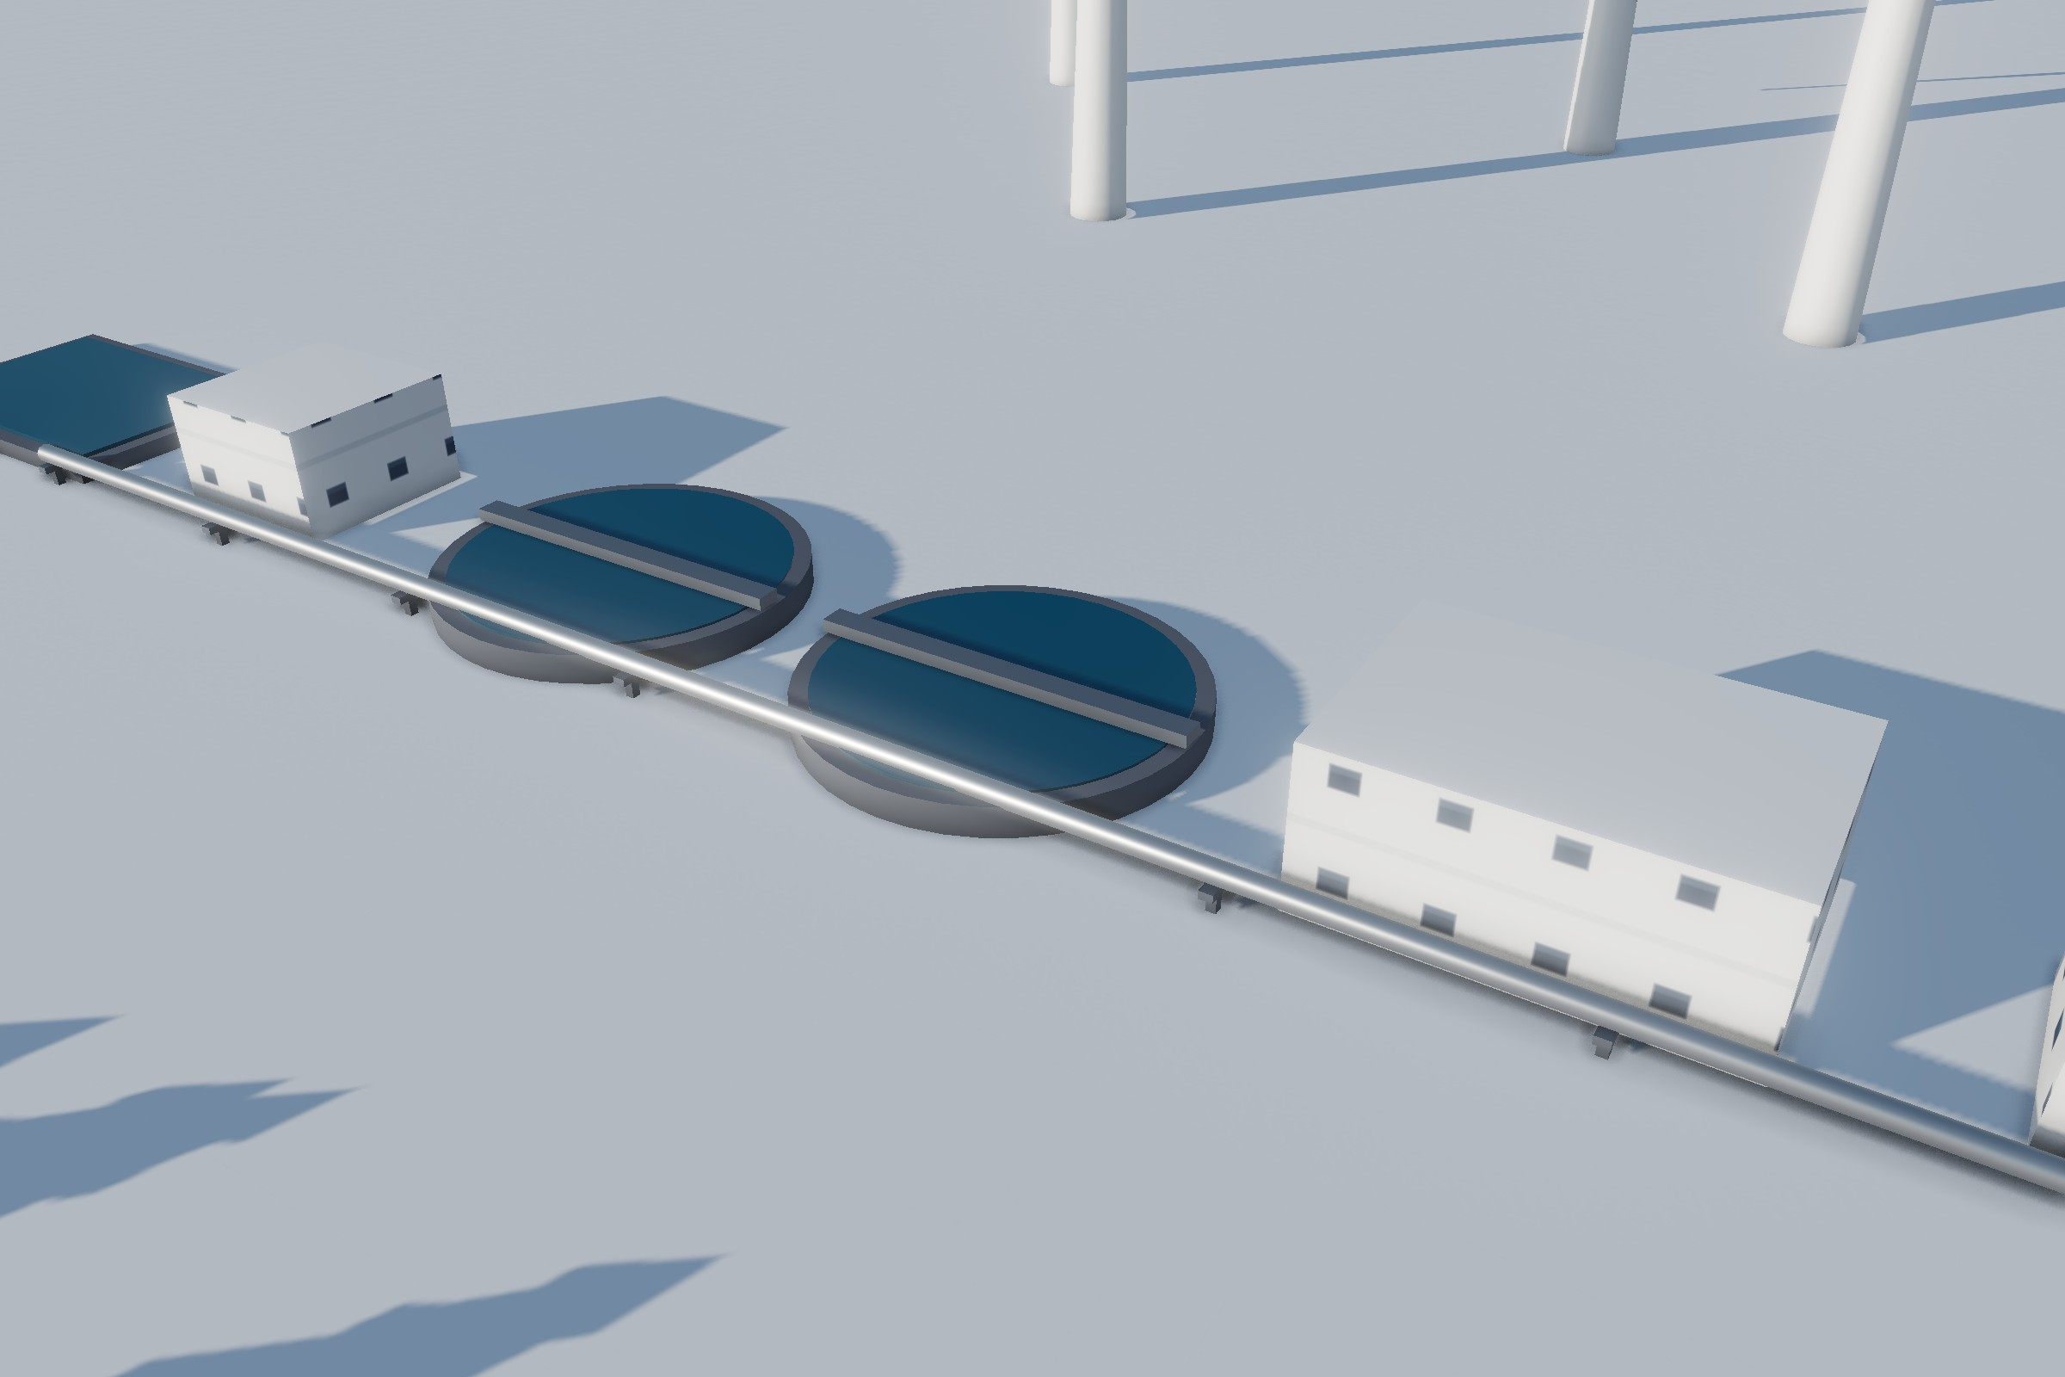
Nothing Is Wasted
WATER AND WASTE
The six-stage Water Recycling Line in the Northern Renewable Park, with the wind farm behind.
THE SIX-STAGE WATER RECYCLING LINE
1
2
3
4
5
6
Snowmelt & greywater intake
Intake pumps & bar screen
Settling basins
Sand & membrane filters
UV disinfection
Recycled water tower
In Aurora Haven, water goes round and round. Clean snow becomes drinking water at the Snow-to-Food plant. Used greywater from homes flows to the Water Recycling Line: screens, settling basins, sand and membrane filters, UV light, and finally a tower that feeds toilets, laundries, greenhouses and fire hydrants.
Dirty street snow is melted separately and never reaches the taps.
The Circular Recycling Center sorts about 30 tonnes of materials a day with AI optical sorters and robot arms. Food scraps become biogas, and the Plasma Waste Converter handles what is left, turning it into clean gas and building blocks.
Nothing goes to landfill in the permafrost.
95%
30 t
20 t
0
of water recycled
of materials sorted a day
of rubbish a day turned into gas and blocks
landfill in the permafrost

Slide 17
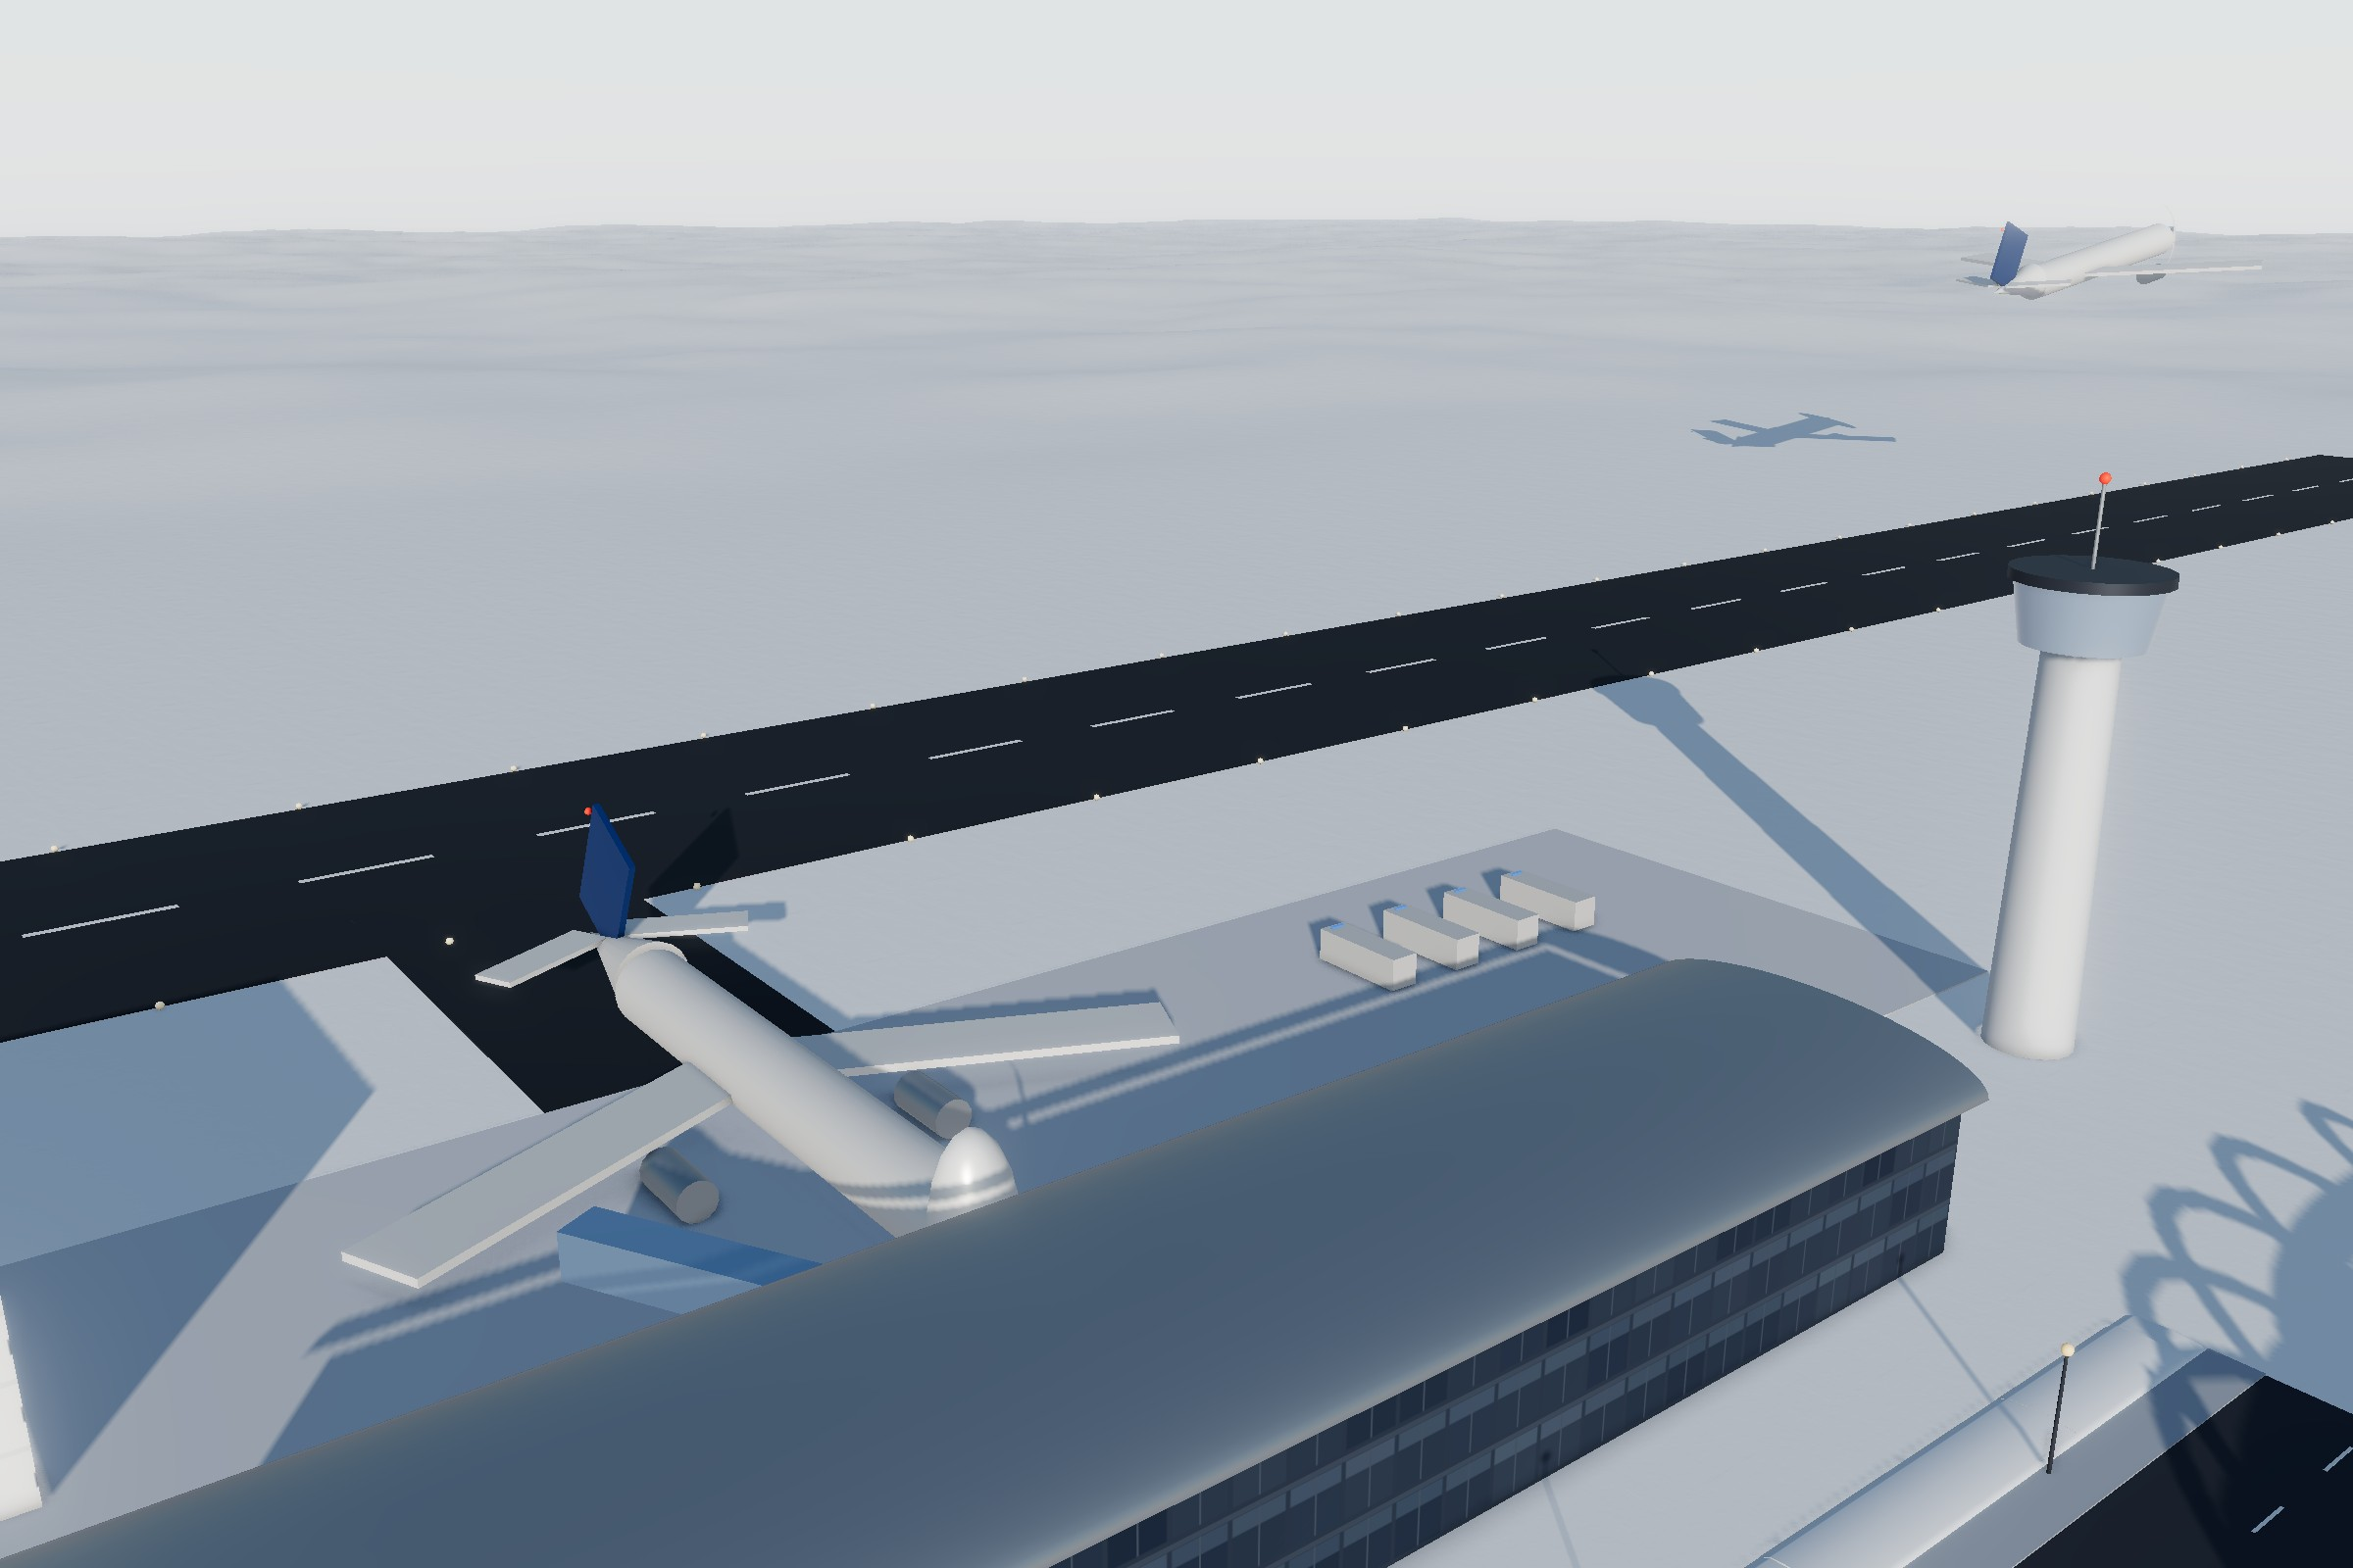
Getting Around Fossil-Free
TRANSPORT
Compact Polar Airport: the glass terminal, the control tower and Flight VN-81 climbing out.
Transport in Aurora Haven is electric and built for the cold. The heart of it is the metro: the north–south Aurora Line and the deep east–west Glacier Line meet at the Central Interchange Station under Liberty Mall. The driverless trains run underground, so blizzards never stop them.
On the streets there are electric trams, buses and shared robotaxis, and people wait in heated bus shelters. The roads are warmed from below, so no salt is needed, and an outer ring keeps trucks out of downtown.
Electric cars charge in the heated bays of the EV & Hover-Car Charging Hub, and the airport, with its heated runway and e-fuel planes, keeps the city supplied through deep winter.
Aurora Line
north–south
Central Interchange Station, under Liberty Mall
Glacier Line
east–west
3 min
4 min
30%
2,800 m
20 km/h
Aurora Line trains at rush hour
Glacier Line; every 90 s after big stadium events
of train energy returned by braking
heated airport runway
downtown speed limit

Slide 18
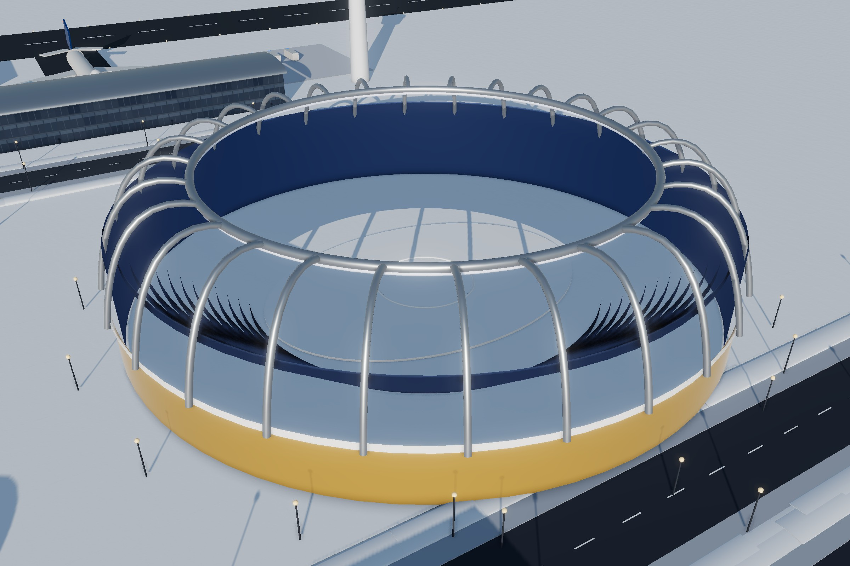
A Livable City Every Day
EVERYDAY LIFE
Aurora Snow Stadium, home of school sports days and the Midwinter Aurora Festival.
HOMES
LEARNING
Family houses in Snowpine Residences, the western eco-homes, towers such as the Aurora 81 Residences and Ice Crystal Apartments, co-living, student and senior housing.
Three kindergartens, Snow Lantern Primary School, the Northern Lights School for ages 6 to 18, and Arctic University.
HEALTH
SHOPPING
Snowflake General Hospital with about 250 beds and a 24-hour emergency department, a campus clinic and a 24-hour pharmacy.
Igloo Fresh Supermarket, Tundra Grocery, the night and fish markets and the Aurora Glacier Mall with its indoor atrium park.
CULTURE AND PARKS
250
900
Aurora Cinema, a music hall, a library open 24 hours in the polar night, the Snow Stadium and parks with heated benches.
hospital beds
pupils at Northern Lights School
5,000
8,000
students at Arctic University
seats in the Snow Stadium

Slide 19
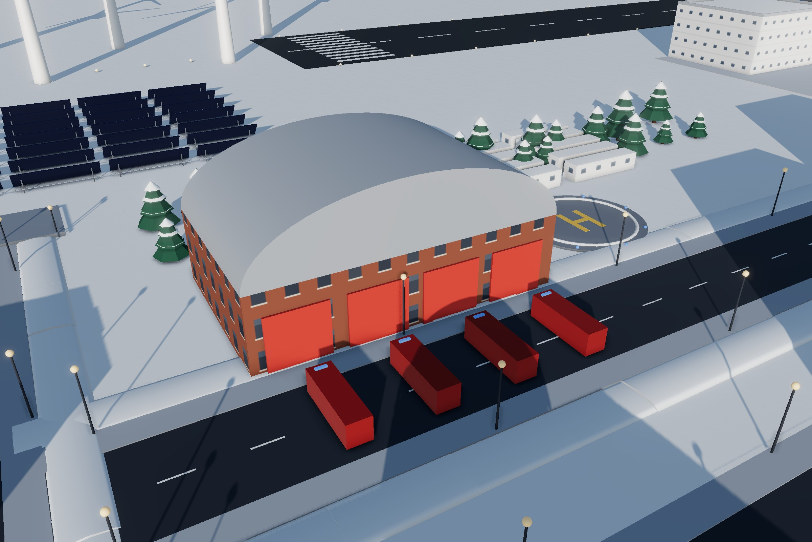
Safe and Ready for Any Storm
SAFETY
The Polar Rescue and Resilience Station in the Energy Hub, north of downtown.
In the polar night, safety comes first. The Polar Rescue and Resilience Station is home to the fire brigade, ambulances, ice rescue and the 112 emergency centre, and its vehicles leave within 60 seconds.
The West Market Fire & Ambulance Station reaches any downtown address in about four minutes, and a rescue helicopter is ready day and night.
Under Liberty Mall, four underground shelters can keep every resident safe for 30 days. Aurora Core, the AI control tower, forecasts blizzards up to 48 hours ahead and alerts every phone.
Cafés and lobbies act as warm points, and the air base runway is a backup for supply flights.
60 s
4 min
10 min
for rescue vehicles to leave
to any downtown address
for the rescue helicopter to be airborne
4
30 days
48 h
underground shelters
of supplies for every resident
blizzard forecasts

Slide 20
Take the Tour: Eight Stops
EXPLORE
A walk around Aurora Haven in eight stops, from the civic heart of downtown out to the plants, the snow peak and the windy northern edge.
1
President Ho Chi Minh Monument
The civic heart of the city on the Aurora Roundabout.
BEHIND THE BUILD
35
2
Metro Entrance – Central Interchange Station
Escalators down to the metro and the shelters.
key places, numbered on the master plan
3
Snowflake General Hospital
About 250 beds and a 24-hour emergency department.
9
downtown blocks around the Aurora Roundabout
4
Fusion Core – Compact D-T Tokamak
The city’s own sun.
1 m
per unit on every plan, drawn from the 3D model
5
Snow Harvest & Melt Hall
Melts about 3,000 t of snow a day with spare fusion heat.
MEETING THE BRIEF
6
Mount Aurora – Snow Peak & Hanging Glacier
The 35 m peak with the spa inside.
1
Smart design
polar answers to cold, darkness, wind and permafrost
2
Sustainability
7
Ice-Proof Wind Farm
Two rows of turbines making about 60 MW.
clean energy, closed loops, green spaces, electric transport
3
Livability
8
Polar Rescue and Resilience Station
Home of the 112 emergency centre.
homes, schools, hospital, shops, parks, cinema, roads
4
Detail
If there is time: the Aurora Lagoon, the Bifacial Solar Farm and the Recycled Water Tower.
one master plan, two district plans and four spa level plans

Slide 21
Places to Visit
GUIDE · 35 KEY PLACES
# | Name of the place | District | Purpose
1 | President Ho Chi Minh Monument | Civic Core & Liberty Mall | The city’s civic heart on Aurora Roundabout: ceremonies, national holidays and walking tours.
2 | Aurora Civic Center & Municipal Hall | Civic Core & Liberty Mall | Town hall for the city council, ID cards, permits, housing and family services.
3 | Snowflake General Hospital | Civic Core & Liberty Mall | Main hospital with about 250 beds and a 24-hour emergency department.
4 | Northern Lights School & Botanical Conservatory | Civic Core & Liberty Mall | Primary and secondary school for about 900 pupils aged 6–18.
5 | Igloo Fresh Supermarket & Food Hall | Civic Core & Liberty Mall | Downtown’s main supermarket and food court; about half its food is made in the city.
6 | Aurora Cinema & Performing Arts Center | Civic Core & Liberty Mall | Cinema and theatre for films, concerts, ballet and school shows.
7 | Underground Metro & Emergency Shelters | Civic Core & Liberty Mall (underground) | Metro interchange linked to four shelters that last 30 days.
8 | Aurora Core – AI Control Tower | Polaris Quarter | Operations centre where an AI digital twin runs traffic, heat, power and alerts.
9 | Aurora Haven Police Headquarters | Polaris Quarter | Central police station with a 24-hour police control room.
10 | Arctic University – Main Hall | Knowledge Quarter | Lecture halls for about 5,000 students of polar engineering, fusion, food science, medicine and climate.
11 | Aurora Public Library | Knowledge Quarter | Free library, open 24 hours in the polar night; lends skis, telescopes and light-therapy lamps.
12 | West Market Fire & Ambulance Station | West Market Street | Downtown fire and ambulance branch that reaches any downtown address in about 4 minutes.
13 | Aurora Glacier Mall & Crystal Atrium | East Gallery Avenue | Largest downtown mall, with an indoor atrium park of real trees.
14 | Snow Lantern Primary School | East Gallery Avenue | Primary school for about 450 children aged 6–11 from the southern districts.
15 | Pinecone Kindergarten | Snowpine Residences | Kindergarten and day nursery for about 40 children aged 1–6.
16 | Aurora 81 – Polar Landmark Tower | Aurora 81 District | Tallest tower and skyline symbol: offices, hotel and sky apartments, net-zero energy.
17 | Aurora Snow Garden Park | Foot of Mount Aurora | Public park with heated benches, a sledging slope and a snow-sculpture trail.
18 | Mount Aurora – Snow Peak & Hanging Glacier | Mount Aurora Geothermal Spa Resort | 35 m landmark peak with the four-level spa inside.

Slide 22
Places to Visit, Continued
GUIDE · 35 KEY PLACES
# | Name of the place | District | Purpose
19 | Summit Sanctuary & Aurora Eye | Mount Aurora Geothermal Spa Resort | Float pool, meditation circle and the Aurora Eye viewing bubble for the northern lights.
20 | Aurora Lagoon – Outdoor Geothermal Mineral Pool | Mount Aurora Geothermal Spa Resort | 38 °C open-air silica pool for bathing under the northern lights.
21 | Fusion Core – Compact D-T Tokamak | Fusion Power Station | 150-million-degree plasma giving about 800 MW of heat; it cannot melt down.
22 | Power Conversion & Heat Export Hall | Fusion Power Station | Makes about 300 MW of electricity and sends about 450 MW of heat to the city.
23 | Plasma Waste Converter | Fusion Power Station | Turns about 20 t of rubbish a day into clean gas, recovered metals and building blocks.
24 | Snow Harvest & Melt Hall | Snow-to-Food & Water Plant | Melts about 3,000 t of clean snow a day with spare fusion heat.
25 | Drinking-Water & Mineral Works | Snow-to-Food & Water Plant | Makes about 2,500 m³ of drinking water a day, all of the city’s tap water.
26 | Bioreactor Silos | Snow-to-Food & Water Plant | Six silos where microbes make about 2.5 t of protein flour a day.
27 | Ice-Proof Wind Farm | Northern Renewable Park | Two rows of ice-proof turbines making about 60 MW.
28 | Bifacial Solar Farm | Northern Renewable Park | Double-sided panels that make power 24 hours a day in the midnight-sun months.
29 | Water Recycling Line – Recycled Water Tower | Northern Renewable Park | Stores recycled water for toilets, laundries, street cleaning, irrigation and hydrants.
30 | Geothermal Power Plant | Energy Hub & Rescue Station | Clean electricity and hot water around the clock; the second heat source.
31 | Polar Rescue and Resilience Station | Energy Hub & Rescue Station | Fire, ambulance and ice-rescue headquarters, home of the 112 emergency centre.
32 | Glass Terminal, Control Tower & Gate 1 Dreamliner | Compact Polar Airport | Passenger and cargo airport; the city’s supply link in deep winter.
33 | Evergreen Greenhouse Dome | Evergreen Garden & Greenhouses | Grows fresh vegetables and berries all year under LED light.
34 | Circular Recycling Center | Evergreen Garden & Greenhouses | Sorts, repairs and recycles about 30 t of materials a day.
35 | Aurora Snow Stadium | Aurora Snow Stadium | About 8,000 seats for snow sports, school sports days and the Midwinter Aurora Festival.

Slide 23
Aurora Haven by the Numbers
KEY FIGURES
THE CITY
45,000
9
35
residents
downtown blocks
key places
CLIMATE
−45 °C
2 months
120 km/h
winter lows
of polar night
blizzards
FUSION POWER STATION
300 MW
450 MW
99.8%
electricity
district heat
heavy-water purity
SNOW-TO-FOOD & WATER PLANT
5 t
4 t
1 t
hydrogen a day
starch a day
fat a day
ENERGY AND STORAGE
60 MW
200 MWh
<1%
wind farm
battery bank
heat lost a day by the heat tank
MOUNT AURORA SPA
4
28 °C
1,000
levels, 0 to 13.5 m
all winter
people sheltered in an emergency
LIVABILITY
600
450
3
Aurora 81 apartments
pupils at Snow Lantern Primary
kindergartens
TRANSPORT
2
5 min
20 min
metro lines
spa shuttle
airport shuttle
All figures are design values for the Aurora Haven city project.

Slide 24
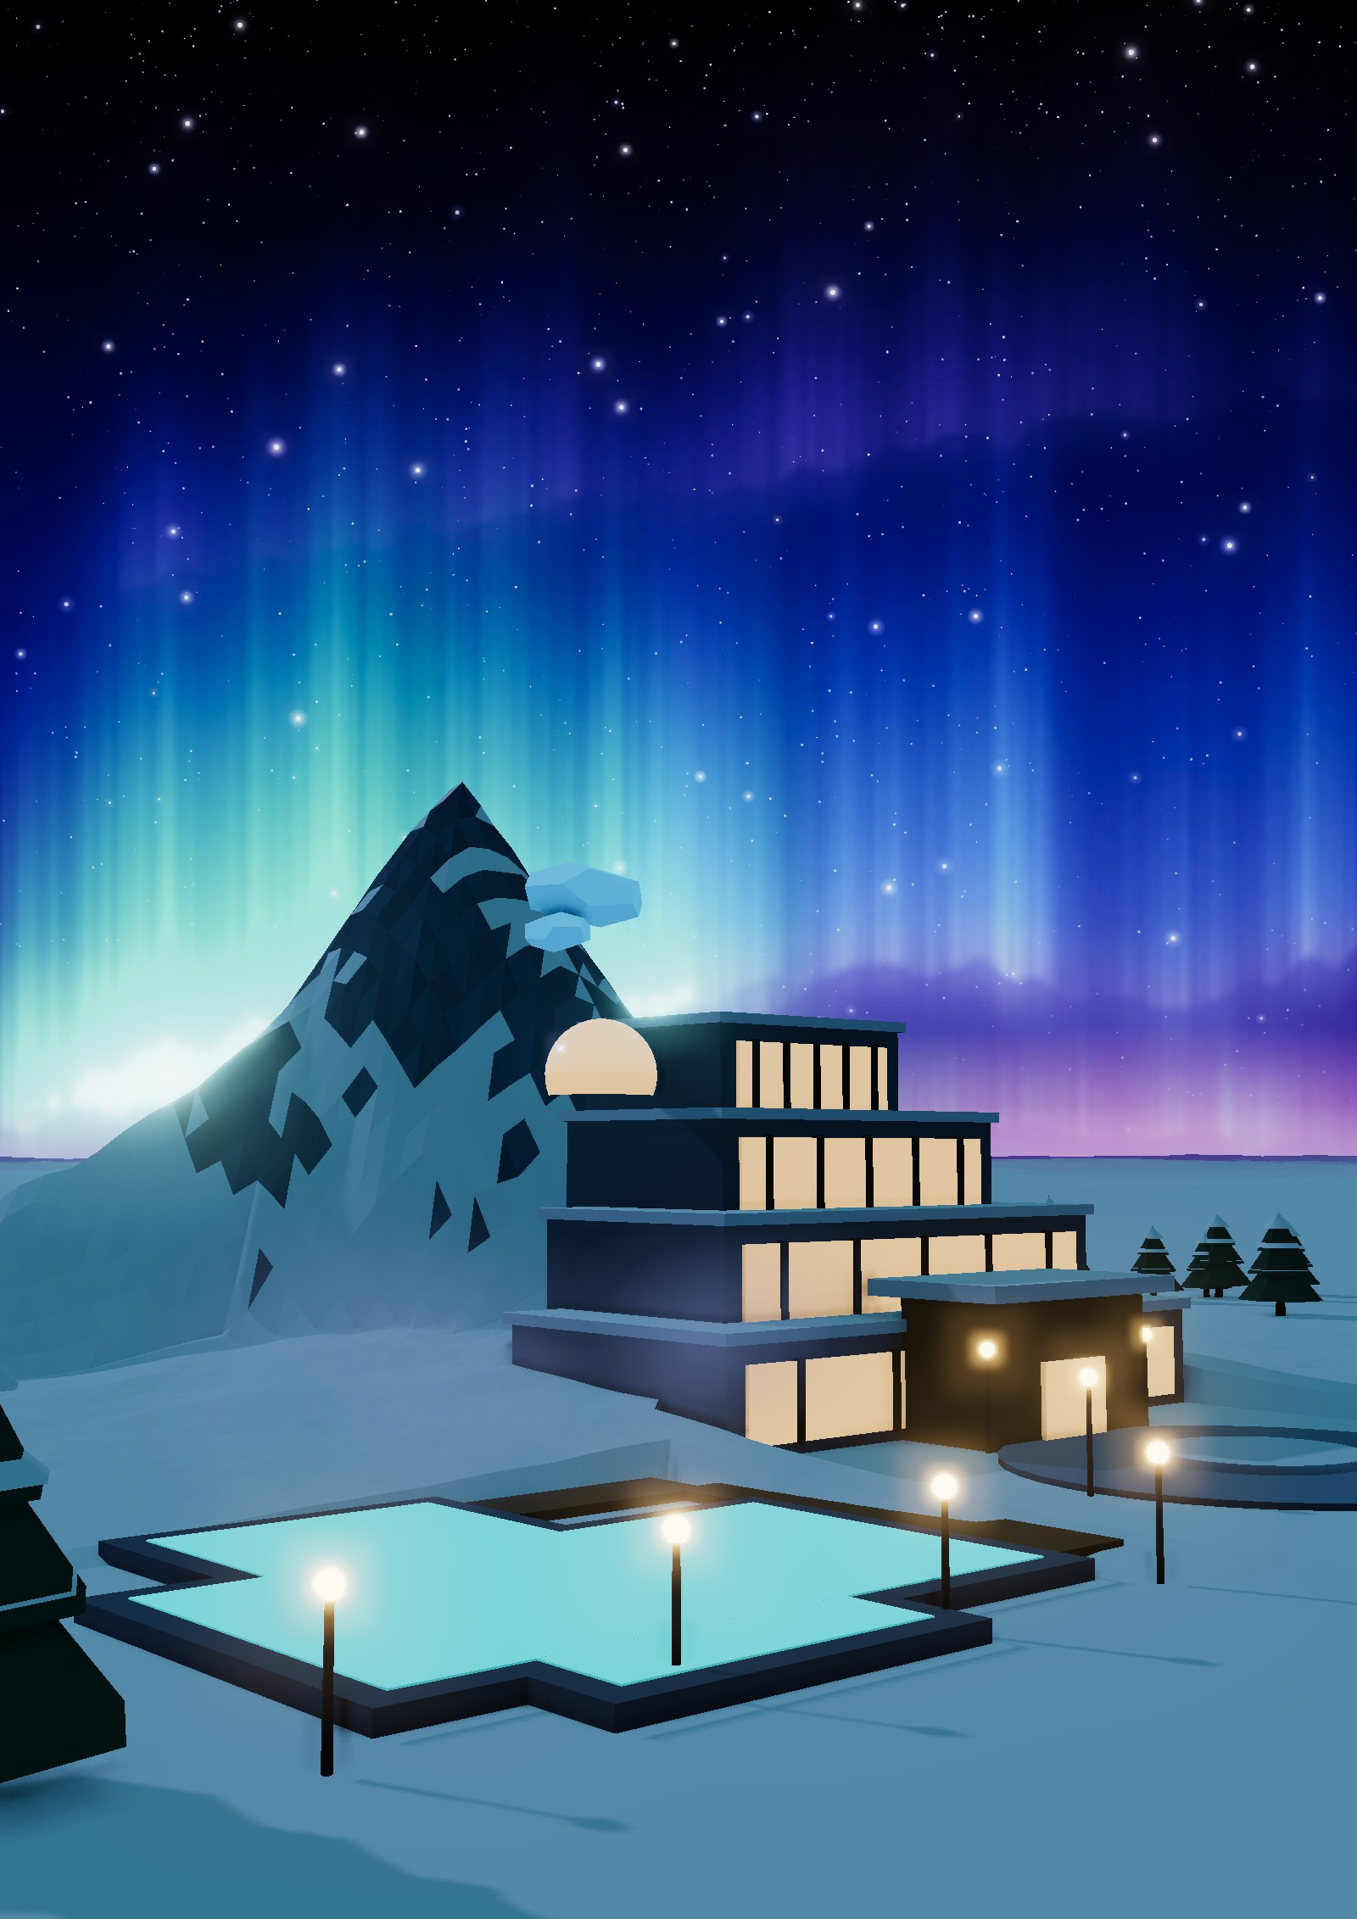
UNTIL NEXT TIME
Warm, Green and Ready
Aurora Haven does not just survive the polar environment; it thrives in it. Heat from fusion and geothermal energy keeps every building warm, and clean energy and closed loops mean no fossil fuel and almost no waste. Most importantly, it is a place where 45,000 people can live, learn, work and watch the northern lights together.
AURORA HAVEN
[Group name] · [Member names]
[Class] · [Date]
Modelled in 3D with three.js
Polar / Ice City

