Slide 1


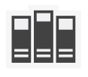


download
compile
link
C++
C++
SODL
source code
SODL
.lib file
Your App
link
depending
other
depended
libraries

